Slide 1


APUNet: Revitalizing GPU as Packet Processing Accelerator
Younghwan Go, Muhammad Asim Jamshed, YoungGyoun Moon, Changho Hwang, and KyoungSoo Park
School of Electrical Engineering, KAIST
Notes:
Good morning everyone. My name is Younghwan Go and I will be presenting our work on accelerating packet processing with GPU, named APUNet.
This is a work done with my colleagues Asim, YoungGyoun, Changho, and my advisor KyoungSoo Park.

Slide 2

GPU-accelerated Networked Systems
Execute same/similar operations on each packet in parallel
High parallelization power
Large memory bandwidth
Improvements shown in number of research works
PacketShader [SIGCOMM’10], SSLShader [NSDI’11], Kargus [CCS’12], NBA [EuroSys’15], MIDeA [CCS’11], DoubleClick [APSys’12], …
CPU
GPU
Packet
Packet
Packet
Packet
Packet
Packet
Notes:
Modern GPUs have been widely used to accelerate many compute- and memory-intensive applications. Applications benefit from GPU’s hundreds to thousands of parallel processing cores and large memory bandwidth. Fortunately, many network applications nicely fit the execution model of GPU.
While CPU processes one packet at a time, GPU would batch large number of packets, and process them in parallel to accelerate the throughput.
As a result, there have been many research works that show performance improvement of network applications using GPU over CPU.

Slide 3
Source of GPU Benefits
GPU acceleration mainly comes from memory access latency hiding
Memory I/O → switch to other thread for continuous execution
GPU
GPU
Quick
Context
Switch
Thread 1
Thread 2
Thread 1
Thread 2
…
a = b + c;
…
v = mem[a].val;
…
d = e * f;
…
…
…
a = b + c;
…
v = mem[a].val;
…
d = e * f;
…
…
Inactive
Inactive
Memory I/O
Prefetch in background
Notes:
More recently though, researchers identified that the source of GPU benefits comes mainly from its fast hardware thread switching to hide memory access latency rather than its high computation power.
What this means is: whenever a particular thread meets a memory I/O instruction,
the hardware scheduler inside GPU would quickly switch context to another thread to continue execution, thus avoid memory I/O blocking with background prefetch.

Slide 4
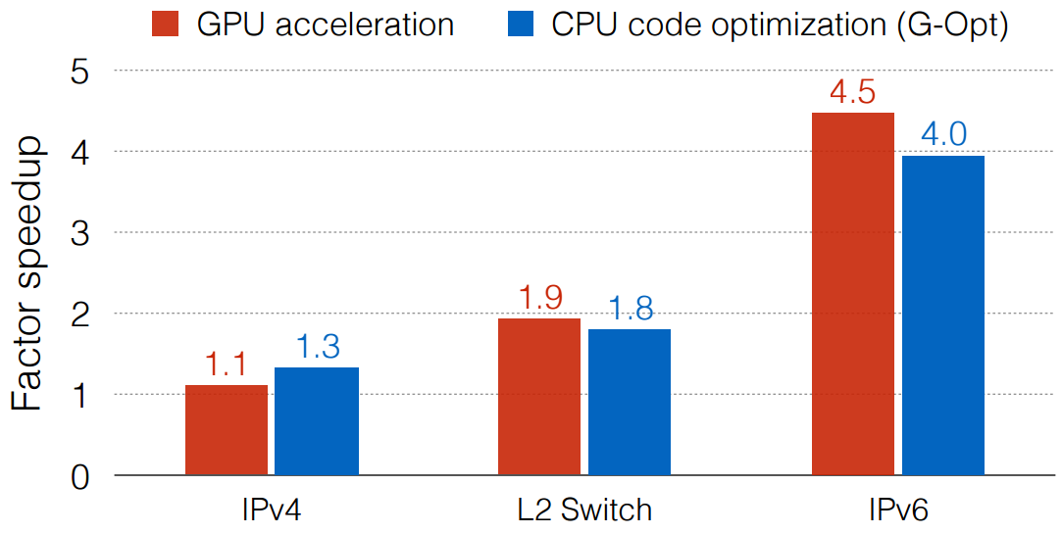
Memory Access Hiding in CPU vs. GPU
Re-order CPU code to mask memory access (G-Opt)*
Group prefetching, software pipelining
Questions:
Can CPU code optimization be generalized to all network applications?
Which processor is more beneficial in packet processing?
*Borrowed from G-Opt slides
*Raising the Bar for Using GPUs in Software Packet Processing [NSDI’15]
Anuj Kalia, Dong Zhu, Michael Kaminsky, and David G. Anderson
Notes:
With this, they presented a framework named G-Opt that simulates GPU’s memory access hiding into CPU code. They showed that by re-ordering CPU code with optimizations such as group prefetching and software pipelining,
they can achieve comparable or even better performance over GPU for number of network applications.
In light of these results, we ask ourselves the following questions: Can CPU code optimization be generalized to all network applications? And ultimately, which processor is more beneficial in packet processing?

Slide 5

Contributions
Demystify processor-level effectiveness on packet processing algorithms
CPU optimization benefits light-weight memory-bound workloads
CPU optimization often does not help large memory workloads
GPU is more beneficial for compute-bound workloads
GPU’s data transfer overhead is the main bottleneck, not its capacity
Packet processing system with integrated GPU w/o DMA overhead
Addresses GPU kernel setup / data sync overhead, and memory contention
Up to 4x performance over CPU-only approaches!
Notes:
In this work, we demystify each processor’s effectiveness on packet processing algorithms.
Our findings show that: CPU optimization does benefit light-weight memory-bound workloads, but
May not improve the performance if the workloads have large working sets.
In contrast, we find that GPU is beneficial to both memory and compute-bound workloads,
And the relative performance advantage of optimized CPU over GPU is mainly due to DMA transfer overhead over PCIe lane rather than the lack of capacity of GPU itself.
With these findings, we build a packet processing system with integrated GPU that avoids DMA transfer overhead.
We address the challenges in integrated GPU such as GPU kernel setup and data synchronization overhead, and memory contention.
And finally, we build a number of real-world network applications that outperform CPU-only approaches by up to 4 times.
In this talk, I will go through them one bye one, but let me first give you a little background on GPU.

Slide 6
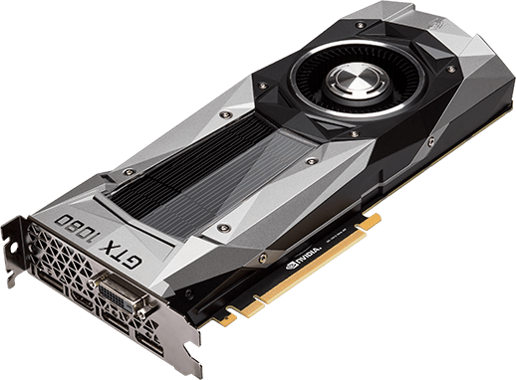

Discrete GPU
Peripheral device communicating with CPU via a PCIe lane
PCIe Lanes
Host
DRAM
GPU
PCIe Lanes
CPU
Host
DRAM
L2 Cache
Streaming Multiprocessor (SM)
High computation power
High memory bandwidth
Fast inst./data access
Fast context switch
Graphics
Processing
Cluster
x N
Scheduler
Registers
Instruction Cache
GDDR Device Memory
GDDR Device Memory
Require CPU-GPU
DMA transfer!
L1 Cache
Shared Memory
Notes:
There are mainly two types of GPU: discrete and integrated GPU. Here is a picture of a discrete GPU, which is a peripheral device that communicates with CPU via PCIe lanes.
Let me now change this into a simpler diagram. Discrete GPU has a number of supports for high-performance packet processing.
First, it has a high computation power with thousands of cores.
Also, it has an independent high bandwidth GDDR memory,
shared cache for fast instruction and data access,
and a hardware scheduler with many registers to support quick context switches.
Unfortunately though, as CPU and discrete GPU maintain separate memory devices, data sharing requires a DMA transfer between DRAM and GDDR memory, which we later show as a potential bottleneck point.

Slide 7
Integrated GPU
Place GPU into same die as CPU → share DRAM
AMD Accelerated Processing Unit (APU), Intel HD Graphics
CPU
Host
DRAM
Unified Northbridge
Host
DRAM
Unified Northbridge
No DMA transfer!
GPU
High computation power
Fast inst./data access
Fast context switch
Low power & cost
Graphics Northbridge
Graphics Northbridge
L2 Cache
Compute
Unit
x N
Compute Unit
Scheduler
Registers
L1
Cache
APU
Notes:
In contrast to discrete GPU, integrated GPU is placed into the same die as CPU, and shares the DRAM together. In this work, we look at integrated GPU platform from AMD named APU. Here is a simple diagram of APU. Overall, integrated GPU inherits the benefits seen by discrete GPU.
BUT the key advantage over discrete GPU is that integrated GPU can now directly access DRAM and eliminate DMA transfer overhead altogether.
In addition, integrated GPU significantly lowers power and cost, only consuming 35W with the price tag of 100 to 150 dollars.

Slide 8
CPU vs. GPU: Cost Efficiency Analysis
Performance-per-dollar on 8 popular packet processing algorithms
Memory- or compute-intensive
IPv4, IPv6, Aho-Corasick pattern match, ChaCha20, Poly1305, SHA-1, SHA-2, RSA
Test platform
CPU-baseline, G-Opt (optimized CPU), dGPU w/ copy, dGPU w/o copy, iGPU
CPU / Discrete GPU
CPU | Intel Xeon E5-2650 v2 (8 @ 2.6 GHz)
GPU | NVIDIA GTX980 (2048 @ 1.2 GHz)
RAM | 64 GB (DIMM DDR3 @ 1333 MHz)
Cost | CPU: $1143.9 | dGPU: $840
APU / Integrated GPU
CPU | AMD RX-421BD (4 @ 3.4 GHz)
GPU | AMD R7 Graphics (512 @ 800 MHz)
RAM | 16 GB (DIMM DDR3 @ 2133 MHz)
Cost | iGPU: $67.5
Notes:
So we explained the properties of discrete and integrated GPUs. Let’s now look at how these differences can be reflected in real-world network applications. For a fair comparison, we look at the “processor-level” cost-effectiveness of packet processing algorithms in terms of “performance-per-dollar” value. We choose this metric since it is difficult to compare only the performance when each platform has different hardware specifications and cost.
We carry out the cost efficiency analysis on 8 popular memory- or compute-intensive packet processing algorithms as listed here.
We tested on 5 different platforms: CPU baseline, G-Opt as optimized CPU, discrete GPU with and without DMA transfer, and integrated GPU. Below is the machine setup and price used for each platform.

Slide 9
Cost Effectiveness of CPU-based Optimization
G-Opt helps memory-intensive, but not compute-intensive algorithms
Computation capacity as bottleneck with more computations
Detailed analysis on CPU-based optimization in the paper ☺
Notes:
We first look at the cost effectiveness of optimizing CPU code with G-Opt. We first confirm that G-Opt improves the performance of memory-intensive algorithms that consist mostly of memory I/O instructions such as IPv6 table lookup and Aho-Corasick pattern matching.
However, we find that applying optimization on computation-heavy algorithms such as SHA-2 has negligible effect on performance, as now, the computation capacity becomes the main bottleneck.
On the other hand, we see discrete GPU with DMA transfer successfully improves the performance thanks to its high computation power. We find similar results for other algorithms such as ChaCha20, Poly1305, SHA-1, and RSA. This demonstrates that there exist many network applications that exploit large computation power of GPU.
We have more detailed analysis of CPU-based optimization in the paper, so please check it out if you are interested.

Slide 10
Cost Effectiveness of Discrete/Integrated GPUs
Discrete GPU suffers from DMA transfer overhead
Integrated GPU is most cost efficient!
Our approach:
Use integrated GPU to accelerate packet processing!
Notes:
Next, we look at the cost effectiveness of discrete and integrated GPUs. First, we find that for memory-intensive algorithm such as IPv4 table lookup, discrete GPU shows almost the same performance per dollar value as G-Opt. This is surprising since it means implementing memory access hiding in software is enough to match the performance of GPU using a hardware thread scheduler! BUT, additional analysis shows that it is not because of the lack of capacity in GPU device, but the data transfer overhead over PCIe lane that causes GPU to not achieve its maximum performance.
Here we see that discrete GPU without data transfer can outperform G-Opt by 3 times. Alright. Then can we hide this DMA transfer time? Unfortunately, masking this DMA delay is challenging as it is difficult to completely overlap data transfer with GPU kernel execution. As a result, this turns our attention to integrated GPU, which completely removes DMA transfer.
Thanks to shared memory and low price tag, we find that integrated GPU is the most cost efficient processor out of all, outperforming both CPU-based optimization and discrete GPU without data transfer.
With these findings, we select integrated GPU to build a high-performance packet processor.

Slide 11
Contents
Introduction and motivation
Background on GPU
CPU vs. GPU: cost efficiency analysis
Research Challenges
APUNet design
Evaluation
Conclusion
Notes:
Alright. Then are there any challenges in building an integrated GPU based high-speed packet processor? Let’s look at them one-by-one.

Slide 12
Research Challenges
Set input
Frequent GPU kernel setup overhead
Overhead exposed w/o DMA transfer
High data synchronization overhead
CPU-GPU cache coherency
More contention on shared DRAM
Reduced effective memory bandwidth
Redundant
overhead!
Launch kernel
Launch kernel
Teardown kernel
Teardown kernel
Retrieve result
APU
CPU
Bottleneck!
DRAM
Explicit
Sync!
GPU
BW: 10x↓
Cache
APUNet: a high-performance APU-accelerated network packet processor
Notes:
First, we find that there exists an overhead of frequent GPU kernel setup.
More specifically, as there is no longer a DMA transfer to overlap with GPU kernel execution time, frequent GPU kernel launch and teardown time becomes a dominant overhead.
Second, guaranteeing cache coherency between CPU and GPU results in high data synchronization overhead. To reflect the change in data to shared DRAM, CPU and GPU need to carry out explicit synchronization, which turns out to be very expensive.
Lastly, APU’s sharing of DRAM incurs more contention on the memory controller and bus, which can potentially reduce effective memory bandwidth for each processor. What is worse, bandwidth of DRAM is typically an order of magnitude lower than discrete GPU’s GDDR memory.
To address these challenges, we now present APUNet, a high-performance APU-accelerated network packet processor.

Slide 13
Persistent Thread Execution Architecture
Persistently run GPU threads without kernel teardown
Master passes packet pointer addresses to GPU threads
CPU
Shared Virtual Memory (SVM)
GPU
Master
Thread 0
Thread 1
Workers
Packet
Thread 2
Packet I/O
Packet
Thread 3
Packet
NIC
Packet Pool
Pointer Array
Persistent Threads
Packet
Notes:
Here is the overall architecture of APUNet. We have CPU and GPU sharing DRAM via a shared virtual memory or SVM.
As our solution to eliminating the redundant GPU kernel launch and teardown overhead, we have APUNet persistently run GPU threads without teardown. Then the question is, “if threads do not teardown, how do they receive new packets and process them?”. Let me explain how it’s done.
First, workers at CPU carry out a packet I/O to receive network packets and store them into a shared packet memory pool that can be accessed by both CPU and GPU.
Then, a master, which is responsible for communicating with GPU updates a shared pointer array that will contain the memory address of each packet payload, and alerts GPU of newly arrived packets.
Each persistently running GPU thread then accesses the packet payloads by using the memory addresses set in shared pointer array and finally process the packet.
Ok then. Once the packets are processed, how are the results synchronized back to CPU?

Slide 14
Data Synchronization Overhead
Synchronization point for GPU threads: L2 cache
Require explicit synchronization to main memory
Shared Virtual Memory
P
P
P
P
P
Master
CPU
GPU
Thread 0
Thread 1
Graphics
Northbridge
L2
Cache
Thread 2
Thread 3
Update result?
Need explicit sync!
Thread 4
Thread 5
Can process one request at a time!
Thread 6
Thread 7
Notes:
Here is a more simplified diagram of APUNet. One may think that once the GPU threads finish processing packets, the updated results will be written straight back to the shared virtual memory inside DRAM.
BUT, this is not true.
Actually, GPU has a separate cache where L2 cache is the global synchronization point for all running threads. GPU threads use memory barriers to synchronize updates with other threads, then only write back the result to DRAM when explicit synchronization happens such as kernel teardown or atomics operation. Unfortunately, we no longer teardown the kernel, and atomics is expensive since it requires additional operations such as memory fencing.
Then one can argue let’s just use atomics operations on parallel running threads to hide this overhead! This still doesn’t work since atomics request is processed one at a time inside graphics northbridge, which would serialize GPU threads, beating the purpose of GPU parallelization altogether.

Slide 15
Solution: Group Synchronization
Implicitly synchronize group of packet memory GPU threads processed
Exploit LRU cache replacement policy
Shared Virtual Memory
Master
P
P
P
P
P
Group 1
Group 2
32
0
For more details and tuning/optimizations, please refer to our paper ☺
Verify correctness!
CPU
GPU
GPU Thread Group 1
GPU Thread Group 2
GPU
L2 Cache
Thread 0
Thread 31
Thread 0
Poll
Poll
Poll
D
D
P
P
D
P
Process
Process
Dummy Mem I/O
D
D
P
P
D
P
Barrier
Barrier
Barrier
Notes:
So instead, we propose a group synchronization method, which implicitly synchronizes group of packet memory region that GPU threads finished processing. The key idea of implicit synchronization is to exploit APU’s LRU cache replacement policy. Let me explain how this works. First, GPU threads are divided into multiple “GPU thread groups” with a size of let’s say 32. In the beginning, GPU threads stay idle.
When packets arrive, master updates the “state” value of any idle “GPU thread group” with number of packets to process. If there are no more packets, other groups’ “state” values are set to 0.
Since here, master updated the “state” value for group 1, threads in group 1 begin processing packets.
Now, when all threads are done, it is possible that the results still remain in GPU’s L2 cache.
We then exploit other idle “GPU thread groups” to carry out a dummy memory operation on a separate memory block.
This operation then causes previously cached packet processing results to be evicted from L2 cache and written back to main memory. Finally, master at CPU verifies that update is visible and passes the results back to workers.
For more details, as well as tuning and optimizations, please refer to our paper.

Slide 16
Zero-copy Based Packet Processing
Integrate memory allocation for NIC, CPU, GPU
Option 1. Traditional method with discrete GPU
Option 2. Zero-copy between CPU-GPU
NIC
CPU
COPY
GPU
NIC
COPY
CPU
GPU
Standard (e.g., mmap)
GDDR (e.g., cudaMalloc)
Standard (e.g., mmap)
Shared (e.g., clSVMAlloc)
High overhead!
High overhead!
NIC
CPU
GPU
No copy overhead!
Shared (e.g., clSVMAlloc)
Notes:
Lastly, as our design shows, we rely heavily on the shared memory between CPU and GPU, which can suffer from memory contention. We address this challenge by minimizing the contention with extensive zero-copy packet processing throughout NIC, CPU and GPU.
Here is a traditional way of GPU-accelerated packet processor. We would normally have NIC and CPU share memory space via a standard memory allocator, then copy the packet payload to discrete GPU’s GDDR memory via PCIe lane.
As we have shown with cost efficiency analysis, this data transfer causes high overhead.
Now, if we use APU’s support for shared virtual memory, we can share the memory space between CPU and GPU. However, it is difficult to extend it to NIC such as Intel DPDK since its code depends on a contiguous physical memory space, which is not supported by APU’s shared memory allocator.
As a result, naïve usage of SVM would still require copying.
As a solution, we updated DPDK code to integrate memory allocation by avoiding physical mapping and registering page-locked shared virtual memory-allocated buffer to packet memory pool. This enabled us to completely remove copying throughout NIC, CPU and GPU, which improved the performance by 5 times as we will next show in the evaluation.

Slide 17
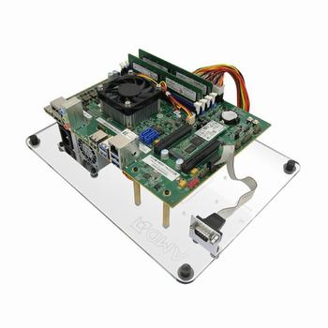
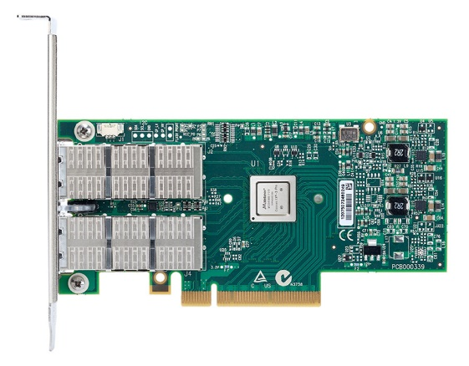
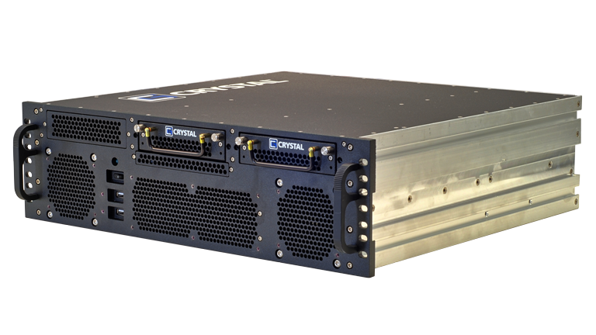
Evaluation
How well does APUNet reduce latency and improve throughputs?
How practical is APUNet in real-world network applications?
APUNet (AMD Carrizo APU)
RX-421BD (4 cores @ 3.4 GHz)
R7 Graphics (512 cores @ 800 MHz)
16GB DRAM
40 Gbps NIC
Mellanox ConnectX-4
Client (packet/flow generator)
Xeon E3-1285 v4 (8 cores @ 3.5 GHz)
32GB DRAM
Notes:
To evaluate APUNet, we use a AMD Carrizo APU machine as shown here.
We use a separate client machine to generate packets or flows depending on the experiments.
And we have these machines directly connected via a dual-port 40 Gbps Mellanox card.
For the evaluation, we answer the following questions. How well does APUNet reduce latency and improve throughputs? And how practical is APUNet in real-world network applications?

Slide 18
Benefits of APUNet Design
Workload: IPsec (128-bit AES-CBC + HMAC-SHA1)
Packet Processing Latency
Synchronization Throughput
(64B Packet)
5.7x
5.4x
1.5x
Notes:
In evaluating APUNet design, we use IPsec as our workload as it updates the entire packet payload.
We first measure the improvement in packet processing latency when we apply zero-copy packet processing and persistent GPU threads. We show that for all packets sizes, zero-copy significantly reduces the latency by 5.4 times. Moreover, removing GPU kernel launch and teardown with persistent threads further reduces latency by 1.5 times.
Next, we look at how group synchronization improves performance against atomics operation. For 64B packet, we clearly see that implicit synchronization is advantageous over serialized atomics, improving the throughput by 5.7 times.

Slide 19
Real-world Network Applications
5 real-world network applications
IPv4/IPv6 packet forwarding, IPsec gateway, SSL proxy, network IDS
IPsec Gateway
SSL Proxy
2x
2.75x
Notes:
We next determine the practicality of APUNet in real-world network applications by comparing with the throughputs of CPU baseline and G-Opt in 5 applications. In this talk, I will show just three of them but you can check our paper for more details.
Here are the results for IPsec gateway’s throughput for varying packet sizes and SSL proxy’s HTTP transactions per second for varying number of concurrent connections.
We see that as demonstrated with cost efficiency analysis, CPU-based optimization fails to improve CPU baseline performance. On the other hand, APUNet exploits GPU’s computation power to outperform CPU-approaches by 2 and 2.75 times.

Slide 20
Real-world Network Applications
Snort-based Network IDS
Aho-Corasick pattern matching
No benefit from CPU optimization!
Access many data structures
Eviction of already cached data
DFC* outperforms AC-APUNet
CPU-based algorithm
Cache-friendly & reduces memory access
Network IDS
4x
*DFC: Accelerating String Pattern Matching for Network Applications [NSDI’16]
Byungkwon Choi, Jongwook Chae, Muhammad Jamshed, KyoungSoo Park, and Dongsu Han
Notes:
Next, we ported Snort-based network IDS to APUNet that uses Aho-Corasick pattern matching.
One interesting finding is that unlike previous claims, memory-intensive NIDS does not benefit from G-Opt. The main cause of this is that when we implement a full NIDS, each packet processing has to go through a lot more number of data structures. This means more memory accesses to hide via prefetches, which ultimately causes eviction of not yet used cached data.
On the other hand, APUNet’s high parallel operation improves the NIDS throughput by up to 4 times.
One notable thing is DFC-based NIDS outperforms AC-based APUNet NIDS. DFC is a work from NSDI last year that designs a new CPU-based pattern matching algorithm, which uses cache-friendly data structures to significantly reduce memory accesses. As we can see, using a different algorithm can have a large impact on the performance. We leave our GPU-based DFC implementation as a future work but we hope it will further improve the performance of APUNet.

Slide 21
Conclusion
Re-examine the efficacy of GPU-based packet processor
GPU is bottlenecked by PCIe data transfer overhead
Integrated GPU is the most cost effective processor
APUNet: APU-accelerated networked system
Persistent thread execution: eliminate kernel setup overhead
Group synchronization: minimize data synchronization overhead
Zero-copy packet processing: reduce memory contention
Up to 4x performance improvement over CPU baseline & G-Opt
APUNet
High-performance, cost-effective platform for real-world network applications
Notes:
In conclusion, we have re-examined the efficacy of GPU-based packet processor. Through the cost efficiency analysis, we showed that discrete GPU’s capacity is bottlenecked by PCIe data transfer overhead, and removing it makes integrated GPU the most cost effective processor.
With this, we presented APUNet, an APU-accelerated networked system that addresses challenges in integrated GPU with persistent thread execution, group synchronization, and zero-copy packet processing. Through the evaluation, we saw that APUNet outperforms CPU approaches by up to 4 times.
With these results, we believe that APUNet will serve as a high-performance, cost-effective platform for real-world network applications.

Slide 22
Thank you.
Q & A
Notes:
Thank you for listening, and I would like to take any questions.

