Slide 1
A Disruption-tolerant Transmission Protocol for Practical Mobile Data Offloading
Younghwan Go, YoungGyoun Moon, Giyoung Nam, and KyoungSoo Park
Department of Electrical Engineering
KAIST

Slide 2







Mobile Devices as Post-PCs
Mobile devices are becoming similar to desktops in most areas of network communications
VoIP, Gaming, File Sharing, M2M, Web, Video, etc.

Slide 3
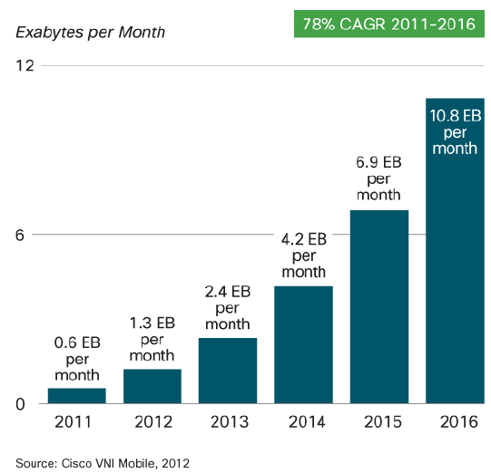
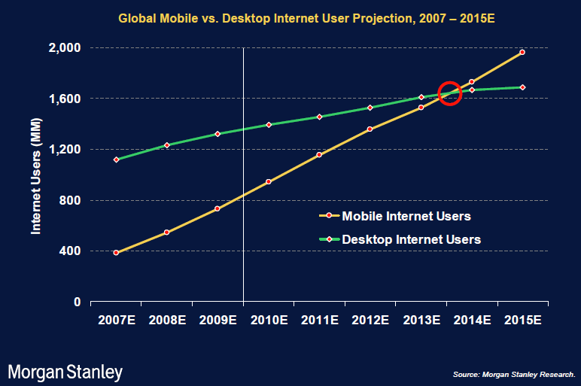
Mobile Data Explosion
Massive growth in mobile data communication
Expected to surpass # of wired Internet users soon
18X

Slide 4
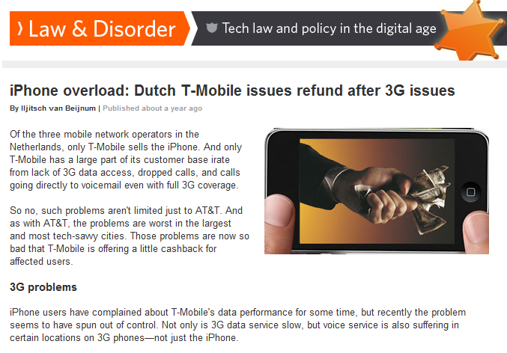
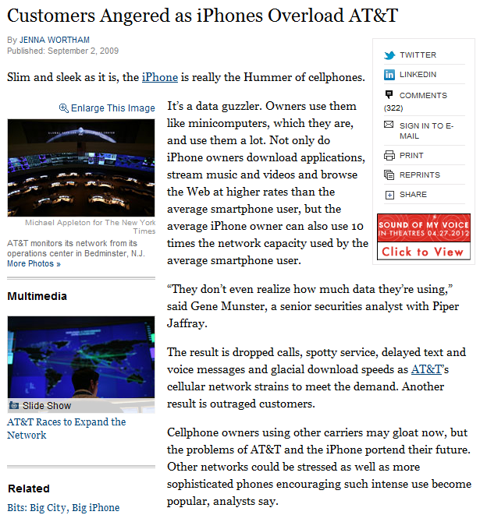
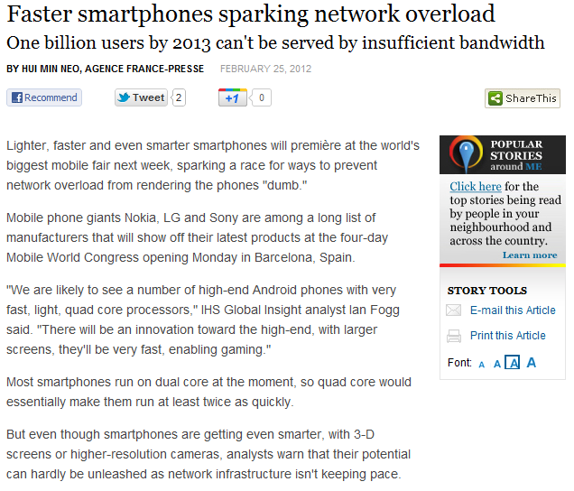
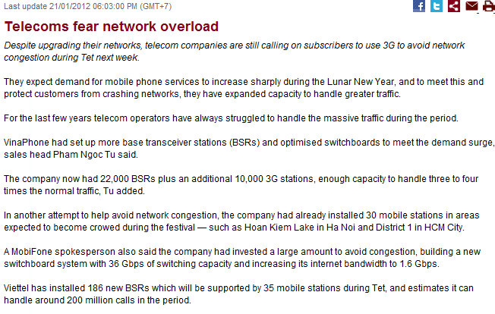
Mobile Network Capacity Overload
3G, LTE unlikely to provide much bandwidth as the wired Internet → Capacity overload

Slide 5
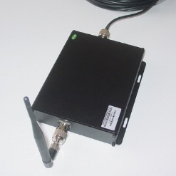
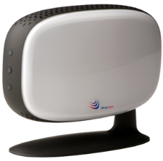
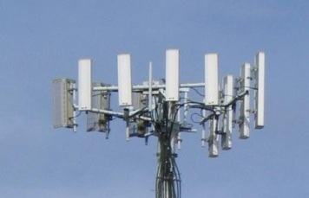
Existing Approaches
Increase physical capacity
Reduce cell size
Build more base stations (e.g., picocell, femtocell, cell tower)
Costly
Physical limitations due to signal interferences
Multiplex the shared radio medium
Cognitive radio
Unable to cope with aggregate network demands

Slide 6




Wi-Fi Offloading with DTN
Offload 3G traffic to cheap, high-bandwidth wired Internet through Wi-Fi before deadline expires
Haggle [WONS’06], Wiffler [MobiSys’10], DTap [CoNEXT’10]
Server
3G Cell Tower
Internet
Time until Deadline
≤
3G Transfer Time
Wi-Fi AP
Downloaded: 0%
Remaining: 6h
50%
4h
80%
2h
Downloaded: 80%
Remaining: 1.5h
Downloaded: 50%
Remaining: 3h
100%
0h
Client

Slide 7
Problem
Lack of system support for Wi-Fi offloading
TCP binds host to physical network location (IP/port)
Connection failure at IP/port changes → Restart
Application-level resumption method
Ad-hoc implementation for application separately
Difficult to handle dynamically-generated content
Our Approach:
Transparently handle network disruptions in the transport layer regardless of host’s physical network location

Slide 8
Our Solution
Disruption-tolerant Transmission Protocol (DTP)
New transport layer protocol in mobile environments
Reliable data transfer
Transparently mask network failures to applications
Provide illusion of continued connection regardless of physical network availability
Goal:
Transport layer support for practical mobile data offloading

Slide 9
Related Works
Mobility for IP networks
Mobile IP [JACS’95], i3 [SIGCOMM’02], HIP [RFC4423]
Separate host identity with location by relaying to ID
Require additional infrastructure support
Migrate TCP option [MobiCom’00]
Reuse connection after IP address change
Cannot handle large disruption delays
Existing DTN protocols
Bundle Protocol [RFC5050], LTP [RFC5325-5327]
For challenged networks with high delays & packet losses
Do not guarantee packet-level reliable data transfer
Require pre-defined values for communication

Slide 10
Contributions
No additional infrastructure support required
Reliable data transfer on existing infrastructure
Application developers do not need to handle disruption
TCP-mapped user-level UDP library
Easy porting to existing applications
Efficient data transfer performance
No retransmission from beginning after disruptions
128.9% more throughput than TCP
77.3% less power than always-connected 3G

Slide 11



Wi-Fi Availability Measurements
Measurement in Seoul
Visit 4 busy places
Outdoor: Gangnam, Myongdong, Insadong
Indoor: Coex
4-day visit → 27 hours of data
Measurement method
Client-to-server: 200 km
Latency: ping at connection
Bandwidth: Transmit large file

Slide 12
Wi-Fi Availability Measurements
Category | 3G | Wi-Fi
Availability | 100% | 45% (Bus/Subway) / 53% (Walk)
Latency | 130ms | 80ms
Bandwidth | 1 – 2 Mbps | 2.6 – 5 Mbps
Finding:
Wi-Fi has larger bandwidth & smaller latency than 3G even in the busy places of a large city

Slide 13
Wi-Fi Availability Analysis
Daily Trace [Yi. CoNEXT’10]
97 iPhone users’ trace during 18 days
Check network status (connection/inter-arrival time)
90th Percentile:
1.1 h
90th Percentile:
5.7 h
50th Percentile:
6.6 min
50th Percentile:
7.8 min

Slide 14
Mobile Applications in Disruptions
7 popular applications
Within the top 10 of each category
100,000+ downloads
Data transmission at network disconnections
Application | Category | Resumption method
Dropbox | Online storage | Not Supported
MapDroyd | Offline map access | Not Supported
Winamp | Podcast manager | Not Supported
Android Market | App. downloading | HTTP Range Request
Beyondpod | Podcast manager | HTTP Range Request
Google Listen | Podcast manager | HTTP Range Request
TubeMate | YouTube video | CGI Parameter Passing

Slide 15
Contents
Introduction
Background
Design
Implementation
Evaluation
Conclusion

Slide 16
TCP Not Suitable for DTN
TCP binds connection to host’s location (IP/port)
Location change causes IP/port change
DTN causes frequent disruptions
Constant switching between Wi-Fi & 3G
TCP connection failure at every disruption
Must restart data transfer from the beginning
How to provide seamless switching between disruptions?

Slide 17
DTP: Delay-tolerant Transmission Protocol
Separate connection with host’s physical location
Bind to a unique connection identifier
At disruption
Maintain connection state in memory
Illusion of continued, delayed connection
At reconnection
Link to previous connection by connection identifier
Resume communication from last position

Slide 18
Flow ID
Unique ID bound to a connection
Identify connection flow between two hosts
Stay persistent even after location change
Advantages
Application developers assume always-on connection
Allow switching between Wi-Fi and 3G
Seamless offloading for interactive or real-time data

Slide 19
DTP Variables
Flow ID
Identify a unique connection flow
Host ID
Identify a unique host
Keep-Alive Duration
Lifetime of a connection flow
CHG / RSP / AUTH
Bit flags for authenticating ownership of flow ID

Slide 20
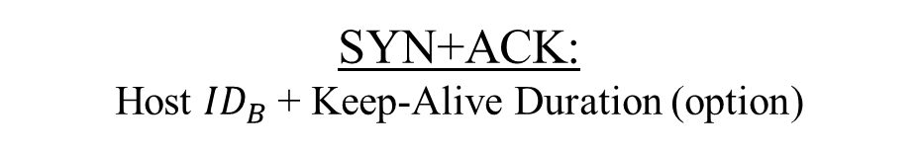
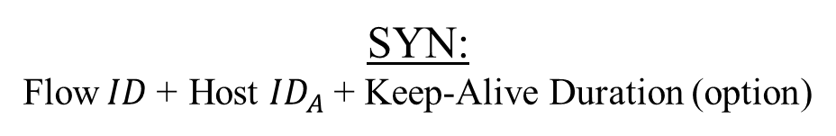
DTP Communication
Connection Establishment
Host A
Host B
SYN:
Flow$ID$+ Host ${ID}_{A}$ + Keep-Alive Duration (option)
SYN+ACK:
Host ${ID}_{B}$ + Keep-Alive Duration (option)
Verify Flow ID
ACK

Slide 21
DTP Communication
Data Transmission
Host A
Host B
Challenge:
Malicious user hijacks connection while “Host A” is in disruption
Connection Setup
Data Transfer
Disruption…
Solution:
Secret Key Exchange
&
Challenge-and-response
Resume Data Transfer
Connection Teardown

Slide 22


DTP Communication
Secret Key Exchange
Host A
Host B
Decryption:
SSL: By Server
DTP: By Client
SYN:
Public Key: ${(n, e)}_{A}$
Generate secret key and encrypt it with Host A’s public key
SYN+ACK:
$${ENC(secret key)}_{{PK}_{A}}$$
Decrypt and retrieve secret key
Advantage:
Distribute decryption overhead to ‘n’ clients
ACK

Slide 23
DTP Communication
Challenge-and-response
Host A
Host B
Disruption…
DATA or ACK:
Flow ID (new IP/port)
Detect address change
CHG + $nonce$
RSP + $HMAC$-${SHA1}_{key}(nonce)$
AUTH

Slide 24
DTP Communication
Connection Teardown
Explicit
Connection Close
Keep-Alive Duration
Expiration
Host A
Host B
Host A
Host B
Data Transfer Done
Data Transfer
FIN
Disruption…
FIN+ACK
Keep-Alive Duration Expired
ACK

Slide 25
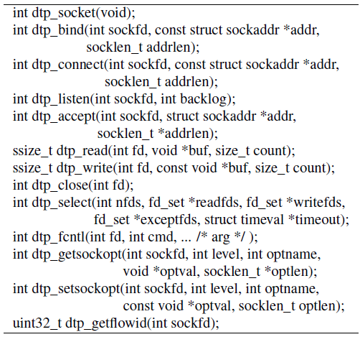
DTP API Library
UDP library to map TCP socket functions
5,283 LOC
Exporting DTP library
Wget (43,372 LOC)
19 lines changed

Slide 26
Implementation
Application thread
Provide TCP socket-like functions to applications
Transport core thread
Manage connection information
Process sending/receiving of packets
Transport Core Thread
dtp_read()
dtp_write()
sendto()
sendmsg()
recvfrom()
Application Thread
Connection Table
Flow ID,
Host ID
Keep-Alive Duration, Secret Key, …
Data
Connection
Socket
Network

Slide 27
Evaluation
Test
Microbenchmark
Throughput with no disruption (TCP vs. UDT vs. DTP)
Performance at network disruption
Throughput with disruption (TCP vs. BP vs. DTP)
Power consumption
Battery usage while transferring data with disruption
Device
Client
Laptop: i7-2620M CPU / 4GB RAM / Linux 2.6.40
Phone: Nexus S / Android 2.6.35.7
Server
Desktop: i7-2600 CPU / 8GB RAM / Linux 2.6.38-12

Slide 28
Microbenchmark
Laptop-to-server
DTP is comparable to TCP and UDT

Slide 29

Performance at Network Disruptions
Video transfer size (number of disruption)
77MB (0) / 154MB (1) / 308MB (2)
Connection/Disruption time = $6.6∗2^{n}$/7.8 minutes
128.9%
122.6%
47.9%
46.9%

Slide 30
Power Consumption
DTP-Wi-Fi (308MB file)
vs. TCP-Wi-Fi
1,655 sec less time
58.3% less power
vs. TCP-3G
2,021 sec less time
77.3% less power
Result:
Wi-Fi offloading with DTP requires less time and battery
to transmit data than always-connected 3G!

Slide 31
Conclusion
Explosive growth of mobile data communication causes network capacity overload
Disruption-tolerant Transmission Protocol
Identify connection with a unique flow ID
Illusion of delayed transfer during disruptions
Provide seamless switching between Wi-Fi & 3G
High throughput / Low power consumption
Potential solution to reduce 3G network usage as well as the battery consumption

Slide 32
Thank You! Any Questions?
http://www.ndsl.kaist.edu/

Slide 33
Discussion
State Explosion Attack
Create DTP connections with long keep-alive duration
Minimal connection state
Limit keep-alive duration value
Reset keep-alive duration at attack detection
ISP-driven Offloading Servers
Wi-Fi offloading for network resource utilization
DTP cloud storage service
Spread bandwidth consumption across time axis

