Slide 1
Towards Accurate Accounting of Cellular Data for TCP Retransmission
Younghwan Go, Denis Foo Kune*, Shinae Woo,
KyoungSoo Park, and Yongdae Kim
KAIST University of Massachusetts Amherst*
HotMobile’13, Jekyll Island, GA, USA
Notes:
Good morning. My name is Younghwan Go, I’m going to talk about whether we should account for TCP retransmissions in the cellular traffic or not.
This is a joint work with Denis, Shinae, KyoungSoo and Yongdae.

Slide 2




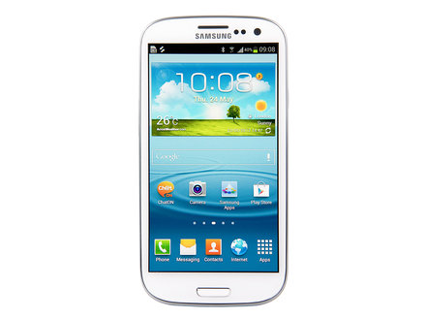








Mobile Devices as Post-PCs
Smartphones & tablet PCs for daily network communications
HotMobile’13, Jekyll Island, GA, USA
Notes:
We use mobile devices such as smartphones and tablet PCs for most of daily network communications now.
We use smartphones to watch videos, listen to music, play games, do facebook, send emails, and so on.

Slide 3
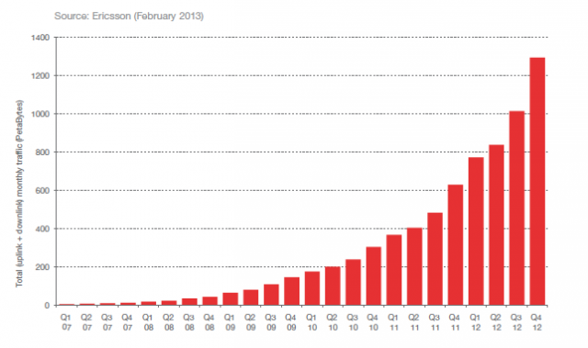
Mobile Devices as Post-PCs
Smartphones & table PCs for daily network communications
Massive growth in cellular data traffic
2x increase
in one year!
HotMobile’13, Jekyll Island, GA, USA
Notes:
As a result, we are seeing a massive growth in cellular data traffic in very short time.
Ericsson reported that just during last year, the usage of cellular data traffic has doubled in volume.
What is the side effect of this explosive growth?

Slide 4
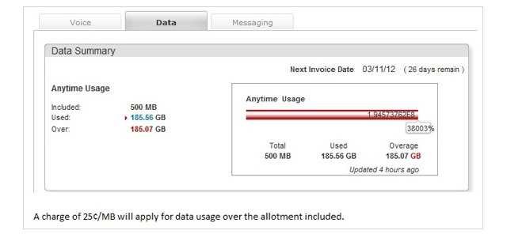

Cellular Traffic Accounting
Increase in cellular traffic bill
Average: $71 per month (2011) – J.D. Power & Associates
Overage fee
e.g., $15 per GB
AT&T | 1GB | 4GB | 6GB | 10GB | 15GB | 20GB
Mobile Share with Unlimited Talk & Text | $40 | $70 | $90 | $120 | $160 | $200
Verizon | 1GB | 2GB | 4GB | 6GB | 8GB | 10GB
Mobile Share with Unlimited Talk & Text | $50 | $60 | $70 | $80 | $90 | $100
= $43,377.92!
HotMobile’13, Jekyll Island, GA, USA
Notes:
As people use more and more traffic, obviously they have to pay more. As of 2011, the average cell bill was $71 per month.
As we see with AT&T and Verizon, as people ask for more data, the price increases.
But the problem gets worse when you have to pay for overage fee.
Here we have one user who is subscribed to monthly data plan for 500MB. Instead of using just the given 500MB limit, she overused by 185GB. What’s the total cost? Over $43,000!
Certainly you don’t want that happen to you.
Then how could have this happened?? Let’s look at how the ISP actually charges you.

Slide 5
3G/4G Accounting System Architecture
Charging Data Record (CDR)
Billing information (e.g., user identity, session elements, etc.)
Record traffic volume in IP packet-level
Question:
Should we account for TCP retransmissions?
$
NodeB
BS
3G UMTS
RNC
S-CDR
G-CDR
SGSN
GGSN
NodeB
CGF
UE
Internet
Target Server
eNodeB
S-GW
P-GW
4G LTE
MME
RAN
CN
HotMobile’13, Jekyll Island, GA, USA
Notes:
Here’s the architecture of the cellular ISP.
When the client UE communicates with the target server, the packets flow through the ISP core network’s SGSN & GGSN.
The information for billing, CDR, is stored in the two GSNs during communication, then is transferred to the billing system where the actual accounting takes place.
And the basic unit for accounting is byte-per-byte IP packets.
Alright. So we now know that all IP packets flowing through the ISP are accounted.
Then here’s an interesting question. Should we then account for all retransmitted packets?

Slide 6
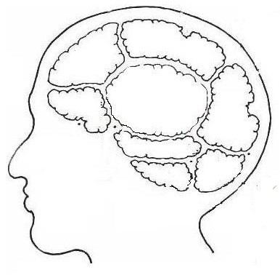

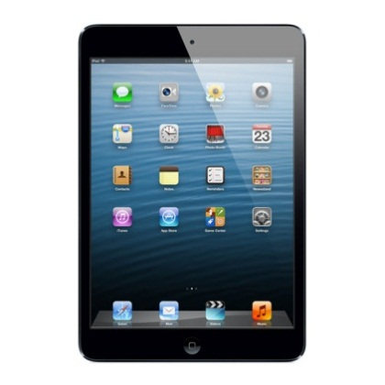
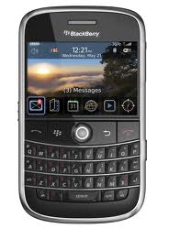
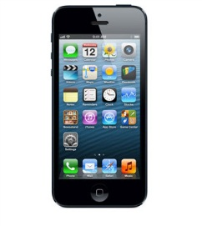
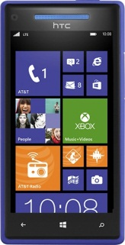
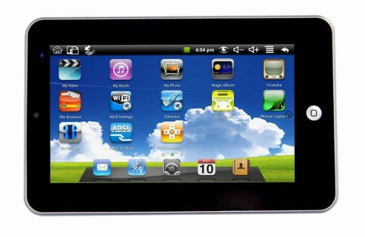
Cellular Provider’s Dilemma: Charging TCP Retransmissions
Subscriber’s point of view
Network condition
is not my concern
Volume = File size
Pay for
application layer
data only!
What’s
TCP
Retrans-mission?
ISP is evil
Equal pricing
Not fair
I don’t
care
Notes:
Let’s look at subscriber’s view on charging TCP retransmissions.
The main argument is that they should be charged for only the application layer data, which is the size of the content.
I don’t care what happens in the network. If this guy and I both watched the same movie content, we should be charged the same.

Slide 7

Cellular Provider’s Dilemma: Charging TCP Retransmissions
Cellular ISP’s point of view
Retransmission =
another IP packet
Require system update
TCP retransmissions
still consume
resources
Question:
How serious is TCP retransmission in the real-world?
Notes:
Then how about the cellular ISPs.
In their perspective, TCP retransmissions still consume their cellular network resources. To them, it’s just another IP packet.
Moreover, it would require a system that can accurately detect retransmission packets. They know that’s complex.
And… of course… not charging TCP retransmissions would mean losing money.
Then let’s see how much retransmission actually occurs in the real-world.

Slide 8
Real-World TCP Retransmission Ratio
3G traffic of Korean cellular ISP on 2012/09/29 (9PM ~ 0AM)
Mirror at one of 10 Gbps links below GGSN in Seoul
134,574,018 flows
6.64 TBs of IPv4 packets
1.89% of the flows show packet retransmissions
Finding:
Charging TCP retransmissions may cause
legitimate users to suffer from high cellular bills!
93%
CDF
HotMobile’13, Jekyll Island, GA, USA
Notes:
For this, we measured the 3G traffic in one of the ISPs in Korea on 2012/09/29 (9PM~0AM) by mirroring one of 10 Gbps links below GGSN in Seoul.
The measurement consists of over 134 million flows with 6.64 TBs of IPv4 packets.
First, we see that just 1.89% of the flows showed any packet retransmissions. So most of people do not have to care about retransmissions.
We then drew a retransmission ratio CDF graph for the 1.89% flows that showed retransmissions.
Interestingly, some flows showed very high retransmission ratio up to 93%
So blindly charging TCP retransmissions may cause legitimate users to suffer from high cellular bills!
So we see that there is a potential problem in cellular accounting of TCP retransmissions.

Slide 9
Previous Works
Peng et. al. [MobiCom’12 & CCS’12]
“Toll-free-data-access-attack”
Packets going through the DNS port are transferred free of charge
DNS lookups of 10,000 different domain names (Oct. 2012)
Easy fix by analyzing packet payloads on DNS port
Majority of ISPs prevent DNS tunneling attacks!
Cellular ISP | Result
2 US ISPs | Attack not possible
2 Korean ISPs | Attack not possible
1 Korean ISP | Attack possible via UDP-tunneling
HotMobile’13, Jekyll Island, GA, USA
Notes:
There have been some related works that looked at other problems in cellular accounting.
Peng and others introduced a “toll-free-data-access-attack” in MobiCom and CCS last year.
They claimed that packets going through the DNS port were free of charge, enabling free data transfer via DNS tunneling.
In order to verify this, we ran a DNS-lookup of 10,000 different domain names in 2 US ISPs and 3 Korean ISPs.
We saw that only 1 ISP was vulnerable to UDP-tunneling. The 2 US ISPs have changed their policy to account for all packets on DNS port.
We were also surprised to see that 2 Korean ISPs were detecting tunneled packets.
It makes sense since preventing this attack is easy, just analyzing packet payloads on DNS port.

Slide 10


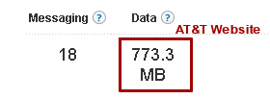
Are ISPs Accounting Correctly?
Content transfer without packet loss
All ISPs account for the proper amount
Retransmission test setup
Test Process
Client: download a file via wget
Server: retransmit packets via raw socket
Compare captured volume with charged volume provided by ISP
Cellular ISP | Test Client Device
AT&T (US) | iPhone 4 (iOS 5.1.1 – 9B206)
Verizon (US) | iPad 2 (iOS 5.1.1 – 9B206)
SKT (South Korea) | Galaxy S3 (Android 4.0.4)
KT (South Korea) | Galaxy S3 (Android 4.0.4)
LGU+ (South Korea) | Galaxy S3 (Android 4.0.4)
Cellular ISP
raw
socket
wget
HotMobile’13, Jekyll Island, GA, USA
Notes:
So the DNS attack is solved. Now let’s look at the general case. Are the ISPs accounting for normal data transmissions correctly?
We first check whether the ISPs account for base case where there is no packet loss, and confirm that they account for the proper amount.
Next, we experiment how ISPs are accounting for TCP retransmission packets.
For this test, we pick 2 ISPs from the US and 3 ISPs from South Korea and anonymize them by naming them with random numbers.
We have a client device which downloads a file from our modified HTTP server through the cellular network.
The server would then create retransmission packets by using a raw socket and sends them to the client.
For analysis, we capture the packets in the client and compare with charged volume provided by ISPs.

Slide 11
Controlled Retransmission
Server intentionally sends the same packet for ‘n’ times
(n = 10)
Data (Seq #: 1-1400)
ACK (Ack #: 1401)
Data (Seq #: 1-1400)
‘9’ Times
Dup. ACK (Ack #: 1401)
Data (Seq #: 1401-2801)
ACK (Ack #: 2802)
HotMobile’13, Jekyll Island, GA, USA
Notes:
For a simple test, we create controlled retransmissions where our server intentionally sends the same packet for ‘n’ times.

Slide 12
Controlled Retransmission
ISP-1, 2 do not account for retransmission packets
ISP-3, 4, 5 account for all retransmission packets!
ISP Accounting
Normal Data / ACK Packet
Duplicate ACK
Retransmitted Data Packet
11,122.6
107.84
1,524.1
14.97
14.97
1,092.8
1,092.5
10.77
HotMobile’13, Jekyll Island, GA, USA
Notes:
We see that ISPs 1 & 2 do not account for TCP retransmissions.
Let’s look at them in more detail by separating packets by each type.
Left graph shows the accounting volume of ISP-1 in KBs while the right graph shows the volume of ISP-2 in MBs.
The black bar shows the volume that the user actually has to pay.
We see that although both ISPs do not account for retransmission packets, their policy differs a little on what packets they do account for.
While ISP-1 does not account for duplicate ACKs, ISP-2 does.
What’s more interesting is that ISPs 3, 4 & 5 account for all retransmission packets, which means that in case of ISP-2’s test, ISPs 3, 4 & 5 will charge you for 108MB instead of 15MB.
This raises a vulnerability in cellular accounting.

Slide 13

Usage-Inflation Attack
$
$
$
$
$
$
$
$
Packet 1
Packet 1
Packet 1
Packet 1
Packet 1
Packet 1
Packet 1
Packet 1
$
$
$
$
$
$
$
$
Packet 1
Packet 1
Packet 1
Packet 1
Packet 1
Packet 1
Packet 1
Packet 1
$
$
$
$
$
$
$
$
Packet 1
Packet 1
Packet 1
Packet 1
Packet 1
Packet 1
Packet 1
Packet 1
$
$
$
$
$
$
$
$
Packet 1
Packet 1
Packet 1
Packet 1
Packet 1
Packet 1
Packet 1
Packet 1
$
$
$
$
$
$
$
$
Packet 1
Malicious server intentionally retransmits TCP packets
Inflation possible even after connection teardown
$
Packet 1
Packet 1
Packet 1
Packet 1
Packet 1
Packet 1
Packet 1
$
$
$
$
$
$
$
Packet 1
Packet 1
Packet 1
Packet 1
Packet 1
Packet 1
Packet 1
Packet 1
$
$
$
$
$
$
$
$
Packet 1
Packet 1
Packet 1
Packet 1
Packet 1
Packet 1
Packet 1
Packet 1
$
$
$
$
$
$
$
$
Packet 1
Packet 1
Packet 1
Packet 1
Packet 1
Packet 1
Packet 1
Packet 1
$
$
$
$
$
$
$
$
Packet 1
Packet 1
Packet 1
Packet 1
Packet 1
Packet 1
Packet 1
Packet 1
$
Overcharge Victim UE
$
$
$
$
$
$
$
Packet 1
Packet 1
Packet 1
Packet 1
Packet 1
Cellular Networks
Packet 1
Packet 1
$
Wired Internet
$
Packet 1
$
$
$
$
$
$
Packet 1
Packet 1
Packet 1
Packet 1
Packet 1
Packet 1
Packet 1
Packet 1
$
$
$
$
$
$
$
$
Packet 1
Packet 1
Packet 1
Packet 1
Packet 1
Packet 1
Packet 1
Packet 1
$
$
$
$
$
$
Request
$
$
Packet 1
Packet 1
Packet 1
Packet 1
Packet 1
Packet 1
Packet 1
Packet 1
Packet 1
Packet 1
Packet 1
$
$
$
$
$
$
$
$
Packet 1
Packet 1
Packet 1
Packet 1
Packet 1
Packet 1
Packet 1
Packet 1
$
$
$
$
$
$
$
$
Packet 1
Packet 1
Malicious Server
Core Network
Victim UE
Packet 1
Packet 1
Packet 1
Packet 1
Packet 1
Packet 1
$
$
$
$
$
$
$
$
Packet 1
Packet 1
Packet 1
Packet 1
Packet 1
Packet 1
Packet 1
Packet 1
$
$
$
$
$
$
$
$
Packet 1
Packet 1
Packet 1
Packet 1
Packet 1
Packet 1
Packet 1
Packet 1
$
$
$
$
$
$
$
$
Packet 1
Packet 1
Packet 1
Packet 1
Packet 1
Packet 1
Packet 1
Packet 1
$
$
$
$
$
$
$
$
Packet 1
Packet 1
Packet 1
Packet 1
Packet 1
Packet 1
Packet 1
Packet 1
HotMobile’13, Jekyll Island, GA, USA
Notes:
ISPs 3, 4 & 5 are vulnerable to usage inflation attack.
In this attack, a malicious server can overcharge the victim client by intentionally retransmitting TCP packets.
The client sends …(Explain the attack)
What’s more problematic is that this attack is possible even if the client closes the session.
As a result, you would get a huge bill.

Slide 14
Quasi Retransmission
Partial retransmission via incrementing window by one byte
No directly repeated sequence numbers
Data (Seq #: 1-1400)
ACK (Ack #: 1401)
Data (Seq #: 2-1401)
ACK (Ack #: 1402)
Data (Seq #: 3-1402)
ACK (Ack #: 1403)
HotMobile’13, Jekyll Island, GA, USA
Notes:
Now let’s turn our attention to ISPs 1 & 2. We want to verify whether they are really correctly detecting and not accounting for retransmission packets.
For this, we create packets that has partially-retransmitted payload by increasing the TCP send window only by one byte.
As a result, there will be no directly repeated sequence numbers nor duplicate ACKs.
However, the majority of the payload would be duplicates.

Slide 15
Quasi Retransmission
Results
ISP-1 does not charge TCP/IP header of partially retransmitted packets
ISP-2 charges TCP/IP header of partially retransmitted packets
ISP Accounting
Normal ACK + Normal Data Payload
TCP/IP Header for Data Packet
Partially Retransmitted Data Payload
Question:
What happens if we can tunnel the packet
inside retransmission packets?
12,704.3
104.67
911.8
7.56
7.56
560.9
561.3
4.62
HotMobile’13, Jekyll Island, GA, USA
Notes:
The results show that both ISPs correctly identify the partially-retransmitted payload and do not account for them.
But again, they have a slight different policy on accounting the TCP/IP header of partially-retransmitted packets.
…(Explain the result)
Great. So ISPs 1 & 2 correctly detect and do not account for retransmission packets.
But… let’s ask this question. What would happen if we can tunnel the retransmission packets without detection?

Slide 16
Free-riding Retransmission Attack
Hide real traffic inside payload of TCP retransmission packets
ISP inspects TCP header only, not the payload
Tunnel TCP Packet
Wired Internet
Cellular Networks
$
Fake TCP Hdr
Packet 1
Packet 2
Packet 1
Fake TCP Hdr
Packet 2
Packet 1
Packet 1
Packet 3
Packet 2
Fake TCP Hdr
Packet 3
Request
Fake TCP Hdr
Packet 2
Fake TCP Hdr
Packet 3
Packet 3
Fake TCP Hdr
Destination
Server
TCP Tunneling
Proxy
Core Network
Malicious UE
HotMobile’13, Jekyll Island, GA, USA
Notes:
If this is possible, we can carry out a free-riding retransmission attack.
In this attack, we can hide the real traffic inside the payload of TCP retransmission packets.
…(Explain the attack)
We checked whether this attack is possible with ISPs that do not account for retransmission packets.

Slide 17
Tunneling through Retransmission
Server sends the same header for ‘n’ times with different payload
(n = 2)
ISP Accounting
Normal Data Packet
Normal ACK
Duplicate ACK
TCP Tunneled Packet
Finding:
ISPs do not account for TCP-tunneled retransmission packets!
107.51
10,992.8
55.81
55.81
53.65
5,469.4
5,704.4
51.49
5,483.4
5,272.3
HotMobile’13, Jekyll Island, GA, USA
Notes:
In order to check for this, we create TCP-tunneled retransmission packets where the payload of retransmitted packets are different.
…(Explain the result)
We find that ISPs do not account for TCP-tunneled retransmission packets!
This is pretty intuitive since analyzing the payload of all packets would require lots of CPU cycles, a huge performance overhead.
In this paper, we suggest a number of solutions to mitigate this attack.

Slide 18
Mitigation Techniques
Detection of abnormal retransmission
Limit the number or ratio of retransmission packets per flow
☺ Small states per each flow
☹ False-positive alarm on legitimate flows
Deterministic DPI
Compare the payload of all retransmission packets
☺ No false-positive alarm
☹ High system overheads due to buffer management
HotMobile’13, Jekyll Island, GA, USA
Notes:
The simplistic way is to detect abnormal retransmissions by setting a threshold for number or ratio of retransmission packets per flow.
If a flow detects an abnormal retransmission, the ISP can then decide to either charge all retransmission packets or explicitly close the connection.
This method is advantageous in that it requires small states per each flow (such as number of retransmissions, etc.)
However, it could incur false-positive alarms on legitimate flows. We have already seen that even legitimate flows see retransmission ratio of up to 93%.
A more accurate solution is run deep packet inspection on all TCP flows by comparing the payload of all packets.
This method does not incur any false-positive alarm.
However, due to buffering of the entire payloads, it requires high memory overheads.

Slide 19
Lightweight Solution : Probabilistic DPI
Inspect a part of the payload of retransmission packets
☺ Small memory requirements
Minimal false-positives
Store n random locations per packet
Sequence number as the index
Random number generator to determine locations per each flow
Compute the difference between n-byte sequences
Future Work:
Build a high-speed cellular traffic monitoring middlebox system
HotMobile’13, Jekyll Island, GA, USA
Notes:
To reduce this overhead on memory requirements, we propose a lightweight solution called probabilistic DPI.
This stores and inspects only a part of the payload of retransmission packets.
It only requires small memory as well as minimal false-positives.
To extract the random bytes from the payload, we can use the sequence number as an index to the table that contains ‘n’ random locations.
We could determine these n-byte locations per each flow by using a random number generator with a secret number as a seed.
Once we have extracted some bytes from the same location, we can compute the difference between those n-byte sequences.

Slide 20
Conclusion
Massive growth in cellular data usage
Importance of accurate accounting of cellular traffic
Cellular ISP dilemma
Should we account for TCP retransmissions packets or not?
Accounting policies of ISPs differ even in the same country
Vulnerabilities in current accounting system
Usage-inflation attack
Free-riding retransmission attack
Suggest possible solutions on free-riding retransmission attack
HotMobile’13, Jekyll Island, GA, USA
Notes:
We have seen a massive growth in the cellular data usage.
However, the cellular ISPs are in a dilemma on whether to account for TCP retransmissions or not.
Through experiments, we see that no ISPs have perfect accounting policy for TCP retransmissions.
Some ISPs account for duplicate ACKs, some ISPs do not account for TCP headers of all partially-retransmitted payload packets.
Moreover, we have shown that whether we account for TCP retransmissions or not, ISPs are vulnerable to either usage-inflation attack or free-riding retransmission attack.
For future work, we suggest a probabilistic DPI system, which can accurately detect fake TCP retransmissions in high-speed.

Slide 21
Thank You! Any Questions?
http://www.ndsl.kaist.edu
Volunteers Needed !
yhwan@ndsl.kaist.edu
HotMobile’13, Jekyll Island, GA, USA
Notes:
We are looking for volunteer for measuring other ISPs on whether they account for TCP retransmissions.
If you are interested, please send an email to this address.

Slide 22
Cellular Accounting Unit
Record traffic volume in the form of T-PDU
Original IP packet
Move around GSNs via GTP-U tunnels
Attach GTP-U header in front of T-PDU
GTP-U
GTP-U Header
IP Header
TCP
Header
Data Payload
T-PDU
HotMobile’13, Jekyll Island, GA, USA

Slide 23
Unlimited LTE Data Plan
Cellular ISP | Price (per month) | Note | Throttling Volume
U.S. Cellular | $40 | No voice/text/tethering | -
T-Mobile | $70 / $90 | HSPA+ | -
Sprint | $79.99 | Small coverage | -
SKT | $101.34 | Data throttling | 18 GB
KT | $87.99 | Data throttling | 14 GB
 | $102.27 | Data throttling | 20 GB
 | $120.87 | Data throttling | 24 GB
LGU+ | $87.99 | Data throttling | 14 GB
 | $102.27 | Data throttling | 20 GB
 | $120.87 | Data throttling | 24 GB
HotMobile’13, Jekyll Island, GA, USA
Notes:
As people use more and more traffic, obviously they have to pay more. As of 2011, the average cell bill was $71 per month.
Not only that, if the users who are subscribed to monthly data plan use up all of provided monthly volume, they need to pay huge amount of bill for extra volume used.
Many users try to overcome this problem by subscribing to unlimited data plans where the users pay for a fixed price regardless of how much traffic they consume.
However, this is not so simple. Here is a table of American and Korean ISPs that provide unlimited LTE data plans.
…(Explain table)
As a result, accurate accounting of cellular traffic usage is vital for normal users.

