Slide 1
Reliable, Consistent, and Efficient Data Sync for Mobile Apps
Younghwan Go*, Nitin Agrawal,
Akshat Aranya, and Cristian Ungureanu
NEC Labs. America KAIST*
Notes:
Hi, I am Younghwan from KAIST.
In this talk, I’ll be introducing a sync service we built called Simba, which provides reliable, consistent, and efficient data sync service for mobile apps.
This is a joint work with Nitin, Akshat and Cristian from NEC Labs.

Slide 2
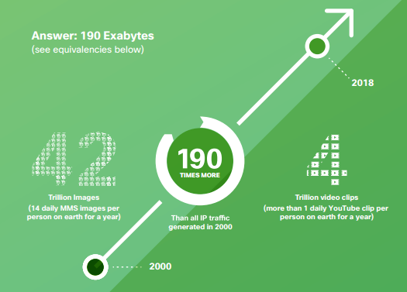

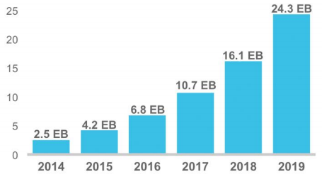
Increase in Data-centric Mobile Apps
Massive growth in mobile data traffic [Cisco VNI Mobile 2014]
24.3 Exabytes per month by 2019
190 Exabytes of mobile traffic generated globally by 2018
= 42 trillion images, 4 trillion video clips
Notes:
So, as you know, there has been a massive growth in mobile data traffic. According to Cisco, amount of mobile data traffic generated will reach 24.3 Exabytes per month by 2019 OR 190 Exabytes globally by 2018. How big is that? This is equivalent to 42 trillion images or 4 trillion video clips.
Inevitably, we are also seeing an increase of data-centric mobile apps. What do we mean by data-centric? Data-centric apps manage data locally in devices, remotely in cloud, and take care of synchronizing data between other devices. AND most apps nowadays fall into this category.

Slide 3
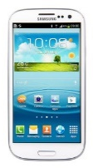



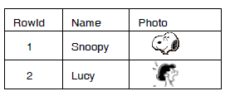


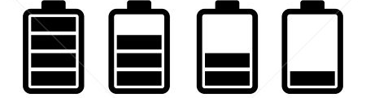
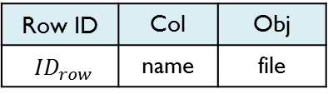
Difficulty in Building Data-centric Apps
Reliability: transparent failure handling
Consistency: concurrent updates, sync atomicity
Efficiency: minimize traffic/battery usage
Look!
My data is corrupted!
Structured data
Row ID | Col | Obj
${ID}_{row}$ | name | file
Unstructured data
010111001
110110111
Notes:
However, writing high quality data-centric apps is hard. Developers have to design and implement bunch of requirements, many of which are crucial for delivering a great mobile experience. Let me explain why this is so hard.
First, data-centric apps need to guarantee reliability at failures. For example, mobile users might experience network disruption in middle of sync. You might be updating a file and suddenly app dies or device turns off because you threw your phone on the ground or pulled off your battery. What you end up with is corrupted data then.
Second, apps need to guarantee consistency. For example, how do we maintain consistency of data when you were working on some file with your smartphone, and then move to a different place to work on your tablet? Moreover, let’s look at how recent apps like to manage data. A photo album app stores structured metadata in a table while unstructured photo data will be stored in an object store. Then how do we provide sync atomicity of these two inter-dependent data?
Lastly, mobile apps of course need to be resource efficient. It must minimize the cellular data usage for billing and reduce battery usage by eliminating any unnecessary network radio usage.
So how do we achieve these goals? We have two options. Option one, everyone can implement all of this own their own, building inside their apps. Or, we can just use sync services that do it for you. Dropbox, Google drive, iCloud are some examples of those sync services.

Slide 4


Mobile App Study on Reliability
Study mobile app recovery under failures
Network disruption, local app crash, device power loss
Analyze recovery when failed during write/update
Test 15 apps that use tables and objects
Independent or existing sync services (e.g., Dropbox, Parse, Kinvey)
Test process
Client 1
(RECOVER)
Activate airplane mode
Manually kill app
Pull the battery out
Client 2
(READ)
Client 1
(WRITE/UPDATE)
Notes:
Then let’s see how current mobile apps provide reliability at failures. We carried out a test to see how mobile apps recover after failures like network disruption, local app crash, and device power loss.
We tested 15 apps that use tables and objects. Some apps implemented their own sync mechanism while some used existing sync services like Dropbox, Parse, and Kinvey.
Here is how we ran the test, we have the first client do a write or update of tabular or object data. Then to simulate network disruption, we activated airplane mode. For crash simulation, we either manually killed the app or pulled the battery out. Then we observed the recovery result at client 1 as well as what the second client sees if client one synced after recovery.

Slide 5









Current Mobile Apps are not Reliable!
Disruption recovery
Loss of data if app/notification closed during disruption
No notification of sync failure
Manual re-sync creates multiple copies of same note
Crash recovery
Partial object created locally without sync
Corrupted object synced and spread to second client
Additional observations
No app correctly recovered from crash at object update
Many apps simply disable object update capability altogether
More details of the study can be found in our paper ☺
Notes:
In summary, we find that current mobile apps are not reliable!
In disruption failure test, we found that apps like Hiyu, Tumblr and Facebook lose data if app or notification is closed during disruption. Some apps like TomDroid, UPM and Keepass2Android didn’t event notify the user of sync failure. Interestingly, if we tried to manually sync during disruption, Evernote app created multiple copies of same note.
In crash failure test, we found that Instagram and Keepass2Android created partial object locally without sync. More serious problem was found in Dropbox and Evernote where they ended up corrupting the object, which was synced to the second client.
Some important observations we found were that no app in our study was able to recover correctly from crash during object update. Moreover, many apps that do provide object update feature in PC version simply disabled the object update capability altogether in mobile version.
If you are interested, more details of the study can be found in our paper.
Alright, so we see that there are so many problems in current apps no matter whether they implement their own data management mechanisms or use existing sync services. So what do we do? Let me first list the requirements or goals that a sync as a service should have.

Slide 6
Goals of Sync as a Service
Reliability
User can always sync to the latest data
User’s update is guaranteed to be synced to server
Consistency
Data can always return to a consistent state even after failures
Inter-dependent structured/unstructured data are synced atomically
Efficiency
Minimum mobile data traffic is generated for sync/recovery
Device’s overall network radio usage is reduced to save battery
Notes:
First, a sync service should be able to guarantee reliability where the user can always sync to the latest data in the server or cloud.
Second, it should guarantee consistency where user always sees data at a consistent state even after failures and it should provide atomic synchronizations on inter-dependent structured table and unstructured object data.
Third, it needs to guarantee efficiency where data traffic necessary for sync and recovery is generated at minimum and radio usage is reduced to save device battery.

Slide 7
Outline
Introduction
Mobile app study on reliability
Simba Client Design
Evaluation
Conclusion
Notes:
Ok. Now let me introduce design of our solution that achieves these goals.

Slide 8


Simba: Data-sync Service for Mobile Apps
High-level programming abstraction
CRUD-like interface for easy development
Unify tabular and object data
Transparent handling of data syncs and failures
Failure detection & recovery at network disruption and crash
Guarantee atomic sync of tabular and object data
Resource frugality with delay-tolerance and coalescing
Delay sync messages to be clustered
Reduce number of network messages & radio usage
Notes:
To achieve these goals, we introduce Simba, a reliable, consistent and efficient data sync service for mobile apps.
The key contribution of Simba is that first, it provides high-level programming abstraction for mobile apps. Basically, Simba provides a CRUD-like API, which is a create/read/update/delete operations, to mobile apps to support easy app developments. We selected this interface because this is what most of existing mobile apps use already. We also make it easy for apps to manage tabular and object data with a unified API as well.
Secondly, Simba provides data consistency to apps by transparently handling failure detection and data recovery under-the-hood. It also takes care of sync atomicity between inter-dependent tabular and object data. The take-away here is that app developers now do not have to worry anything about data managements for syncs and failures anymore.
Lastly, Simba is resource frugal by clustering delay-tolerant messages to reduce number of messages as well as radio usage.
Due to the limited time, I’ll mainly be talking about the first two designs in this talk.

Slide 9
Writing a Photo App with Simba
Create a photo album
Register read/write sync
Add a new photo
Retrieve stored photo
createTable(“album”, “name VARCHAR, photo OBJECT”, FULL_SYNC);
registerReadSync(“album”,600,0,3G); // period=10min, pref=3G
registerWriteSync(“album”,300,0,WIFI);// period=5min, pref=WiFi
objs = writeData(“album”, {“name=Snoopy”}, {“photo”});
objs[0].write(photoBuffer); // write object data
cursor = readData(“album”, {“photo”}, “name=?”, {“Snoopy”});
mis = cursor.getInputStream().get(0); // inputstream for object
mis.read(buffer); // read object data into buffer
Notes:
Let me first show you how simple it is to implement an app using Simba. Here is a sample code for photo app that utilizes Simba as a sync service.
First, a tabular, object unified table can be created by calling createTable function.
Now we register this table to use Simba as a sync service by registering read and write periods. What’s awesome here is that now the app is done taking care of all those complex sync and failure management. Simba takes care of all of that.
Next, write or adding a new photo is done first by calling writeData. In writeData function, we set tabular data while declaring the column name for object, which is “photo” in this case. Then writeData function returns a list of outputsream for given objects, where we write by calling write function.
To retrieve the stored photo, we call readData with the object’s column name, which returns an inputstream. We then call read to read object data into a buffer.

Slide 10
Writing a Photo App with Simba
Conflict resolution
beginCR(“album”);
rows = getConflictedRows(“album”);
for (row; rows; next row) {
// choice = MINE, THEIRS, OTHERS
resolveConflict(“album”, row, MINE);
}
endCR(“album”);

Slide 11
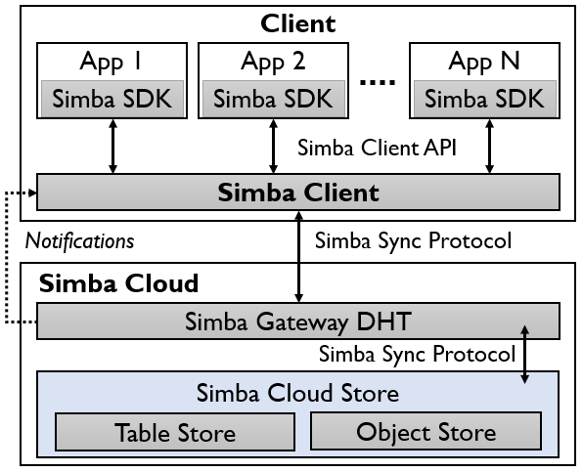

Overall Architecture
Reliable data sync between sClient ↔ sCloud
Simba Cloud (sCloud)
Manage data across multiple apps, tables, and clients
Respond to sClient’s sync request
Push notifications to sClient
Version-based Sync Protocol
Row-level consistency
Unique id per row, ${ID}_{row}$
One version per row, $V_{row}$
Simba Cloud paper to be presented at EuroSys 2015!
“Simba: Tunable End-to-End Data Consistency for Mobile Apps”
Notes:
Let me now explain how Simba sync service is actually run.
Here is an overall architecture of Simba. Sync service is done by transferring sync messages between Simba Client (sClient) and Simba Cloud (sCloud).
Simba Cloud takes care of managing data sync across multiple client apps and tables by responding to client’s sync requests and pushing notifications for new or updated data.
Simba’s sync protocol is based on versioning each row with a unique ID.
In this paper, we focus mainly on the workings of Simba client.
For those of you who are interested in Simba Cloud paper, please stay tuned! as it will be presented in EuroSys this year.

Slide 12
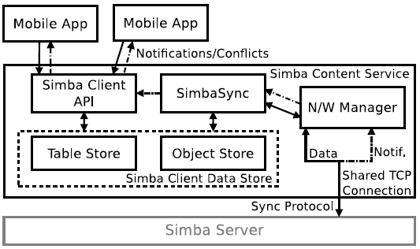
sClient: Simba Content Service
Simba Client API (sClientLib)
Interface to access table and object data for apps
Upcall alerts for events (new data, conflict) to apps
SimbaSync
Manage fault-tolerance, data consistency, row-level atomicity
N/W Manager
Send/receive sync messages, receive notifications
Simba Client Data Store
Simba Cloud
Notes:
Let’s now look at Simba Client.
Basically Simba Client is a service running inside a client device that takes care of managing the tabular and object data, and syncing updates with the Simba Cloud.
Here are some main components of Simba Client. Simba Client API provides interface for mobile apps to access table and object data, and is responsible for alerting events such as new data and conflict.
SimbaSync handles all sync-related operations and handles fault-tolerance, data consistency, row-level atomicity and etc.
Then all sync messages are sent and received via Network Manager, which also receives notifications from sCloud.
Lastly, Simba Data Store provides a unified store for inter-dependent tabular and object data.

Slide 13
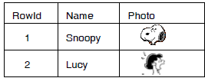
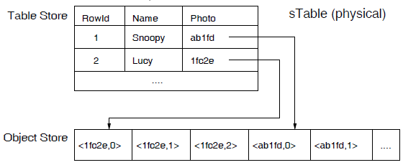
Simba Client Data Store
We don’t want half-formed data to appear on our phone!
Simba Table (sTable)
Unified table store for tabular and object data
Logical sTable
Physical sTable
Map by object_id
SQLite
Subdivide object into chunks
LevelDB
Notes:
So why do we want this unified store for mobile apps? It’s because you wouldn’t want half-formed data to appear on your phone. For example, you wouldn’t want an updated photo object appear on your phone while the metadata of that photo is from the previous version.
So Simba Data Store provides a logically unified table. This is done by having a physical table store with an object_id that links to an object store that stores actual object data. For fine-grained syncing, we further subdivide object into chunks and store them.
Our current implementation uses SQLite for table stare and LevelDB for object store, which is a LSM store. Since there existed no object store code for Android, we had to port LevelDB.

Slide 14
Simba Local States
Include additional local states to determine:
Health of data (latest vs. updated)
Sync readiness (object closed after update)
Failure state (sync in progress after network disruption)
Recovery actions (retry, reset, recover corrupted objects, etc.)
Simba local states
Dirty Chunk Table (DCT): updated chunk ids per object
Update in
tab | obj data
End of
obj update
Sync in progress
Row in
conflict
Row ID | Version | $${Flag}_{TD}$$ | $${Flag}_{OD}$$ | $${Count}_{OO}$$ | $${ Flag}_{SP}$$ | $${ Flag}_{CF}$$ | Name | Photo
${ID}_{row}$ | $V_{row}$ | 0/1 | 0/1 | 0/1/../n | 0/1 | 0/1 | “Snoopy” | object_id
Notes:
Ok great. Then how does Simba actually provide reliability and consistency? We do this by introducing number of local states into Simba.
These local states determine things like whether the data is synced to the latest version, or is updated and waiting for sync. It also determines whether an object update is completed and ready for sync. And lastly, it determines the status of data at failure, and what recovery actions to take with it.
Here are some of the local states Simba uses.
Flag_TD and Flag_OD are dirty flags that identify whether there was an update in tabular or object data.
Count_OO shows the number of opened object for update. We identify a row as ready for sync when the value of Count_OO is 0.
Flag_SP identifies whether a row is currently sync pending.
Lastly, Flag_CF identifies a row that resulted in conflict after sync.
In addition, we add persistent dirty chunk table (DCT), which contains the ids of the chunks per object that have been updated.

Slide 15
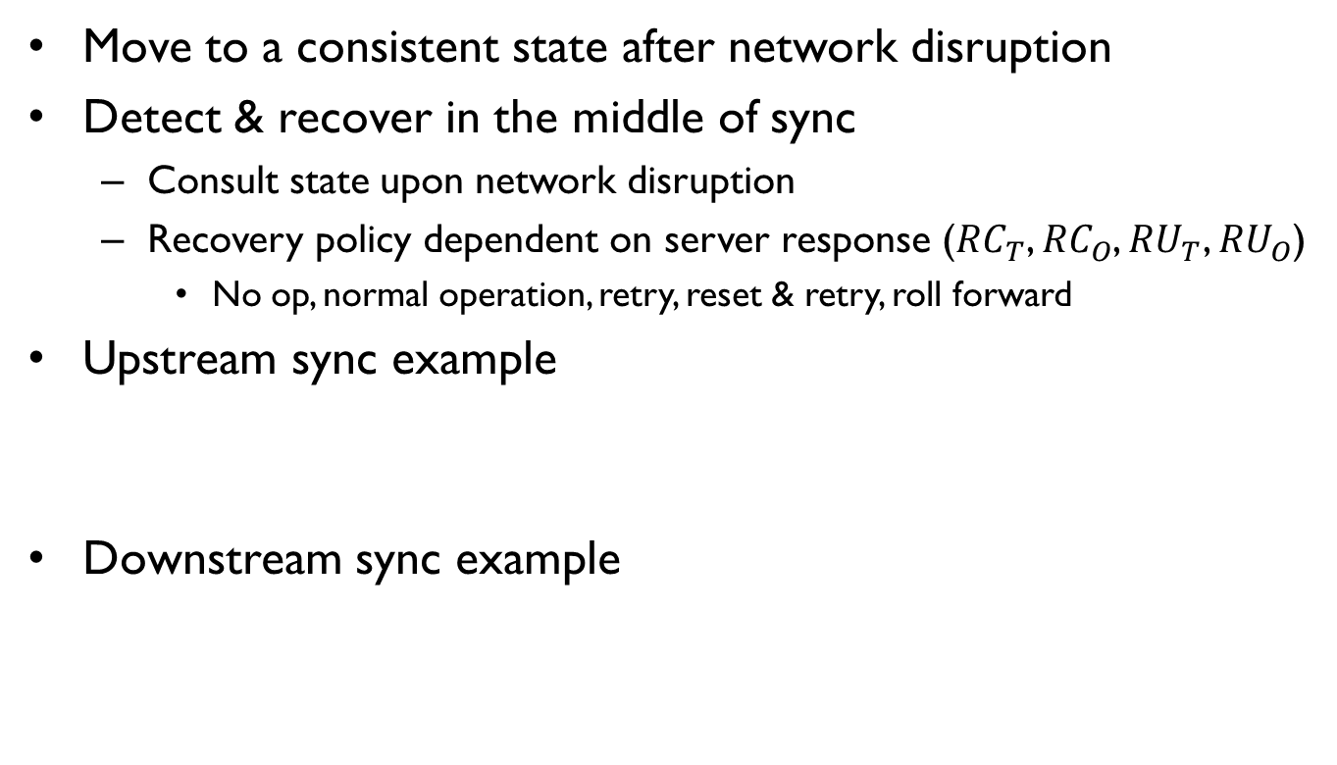
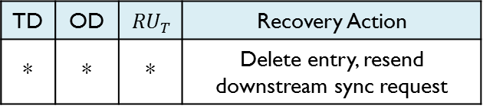
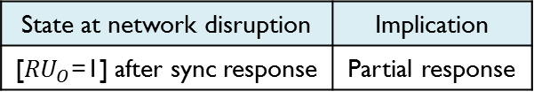
Handling Network Failures
Move to a consistent state after network disruption
Detect & recover in the middle of sync
Consult state upon network disruption
Recovery policy dependent on server response (${RC}_{T}$, ${RC}_{O}$, ${RU}_{T}$, ${RU}_{O}$)
No op, normal operation, retry, reset & retry, roll forward
Upstream sync example
Downstream sync example
State at network disruption | Implication | Recovery Policy | Action
[SP=1] before sync response | Missed response | Reset & retry | SP=0, TD=1, OD=1 if ∃DCT
State at network disruption | Implication
[${RU}_{O}$=1] after sync response | Partial response
TD | OD | $${RU}_{T}$$ | Recovery Action
* | * | * | Delete entry, resend downstream sync request
Notes:
Let me now explain how Simba recovers from failures. First goal of Simba is to return to a consistent state after network disruption.
Simba consults the current state and server responses such as conflict for table or object, and update for table or object to detect and recover from network disruption. The recovery can take any form of no operation, normal operation, retry, reset and retry, and roll forward.
Here are some of simple examples on how recovery is done. For an upstream sync case, let us consider that there was a network disruption after sync request message was sent but before the client received the response. This implies the client is in a missed response state, which takes the recovery policy of reset and retry. The recovery action is as follows. We first reset sync pending flag back to 0. We then set table dirty flag to 1, and set object dirty flag to 1 if any of the object id for corresponding row has been marked dirty in DCT.
Now for downstream sync case, let’s say that Simba Cloud sent a message that there is an update for object data, but before Simba Client could receive updated object data, we were disconnected. This is a partial response state. In this case, we delete the partial response entry, and resend the downstream sync request to sCloud.

Slide 16

Handling App/Device Failures
Roll back/forward to a consistent state after crash
Recovery policy dependent on local states
${Flag}_{TD}$, ${Flag}_{OD}$, ${Count}_{OO}$, ${Flag}_{SP}$, ${Flag}_{CF}$, $DCT$
Recover from a crash during sync
Recover from a crash at update
TD | OD | OO | SP | CF | Recovery Action
0 | 0 | =0 | 1 | - | Restart upstream sync (SP = 0, TD = 1, OD = 1 if ∃DCT)
TD | OD | OO | SP | CF | Recovery Action
1 | 0 | >0 | 0 | 0 | Start upstream sync (OO = 0)
* | 1 | >0 | 0 | 0 | Torn row! Retrieve consistent row version from sCloud (TD = 0, OD = 0, OO = 0)
Notes:
Now then how does Simba recover from app or device crash? The goal here is to roll back or even forward to a consistent state after crash.
Simba recovers from crash by consulting the 5 local states: TD, OD, OO, SP, CF and DCT.
Let me give some examples of how Simba recovers. First, let’s say that a device crashes in middle of sync process. At app restart, Simba detects that this row was in sync process by checking SP is set to 1. If it sees that OO is set to 0, we consider that object was not in middle write, so the row is in a consistent state but not synced. So Simba allows the app to restart sync process by first setting SP to 0, TD to 1, and OD to 1 if persistent DCT has object id corresponding to the row set.
Now let’s say that a crash occurred while the object was opened for update. This means that object was left open at crash and OO value will be greater than 0. Simba then identifies whether the object is corrupted or not by checking the OD flag. If the OD value is set to 0, it signifies that the object was opened for write but has not been written yet. So we simply start upstream sync for the first row case. However, in case the object was dirtied and set OD flag to 1, Simba identifies the row as torn and starts server-assisted recovery by requesting for consistent row version from sCloud. Once the recovery is done, it resets all flags back to 0.

Slide 17
Evaluation
Evaluation goals
Does Simba provide transparency to apps?
Does Simba perform well for sync and local I/O?
Evaluation setup
sClient
Galaxy Nexus (Android 4.2)
Nexus 7 (Android 4.2)
sCloud
2 Intel Xeon servers: 16-core (2.2GHz), 64GB DRAM, 8 7200RPM 2TB disk
4 VMs on each sCloud: 4 core, 8GB DRAM, one disk
WiFi: 802.11n (WPA)
Cellular: 4G LTE (KT, LGU+, AT&T)
Notes:
So now that I described about the design of Simba, let’s now evaluate how Simba performs in practice.
Here, we aim to evaluate two things: does Simba provide transparency to apps, and does Simba perform well for sync and local I/O.
For this, we used sClient as either Galaxy Nexus or Nexus 7 phones running Android 4.2, and sCloud running on 8 VMs across 2 Intel Xeon servers each with a dual 8-core 2.2 GHz CPU, 64GB DRAM, and 8 7200RPM 2TB disks.
The networks we used were WPA-secured WiFi and 4G LTE of KT and LGU+ in Korea, and AT&T in US.

Slide 18
App Development with Simba
Simple and easy app development with Simba
Building a photo app with existing sync service (Dropbox)
No inter-operation of table and object
No support for row-level atomicity (only column-level!)
No detection & recovery of torn rows
App | Description | Total LoC | Simba LoC
Simba-Notes | “Rich” note-taking with embedded images and media | 4,178 | 367
HbeatMonitor | Monitor and record a person’s heart rate, cadence and altitude using Zephyr heartbeat sensor | 2,472 | 384
CarSensor | Record car engine’s RPM, speed, engine load, and etc using Soliport OBD2 sensor | 3,063 | 384
Simba-Photo | Photo-sync app with write/update/read/delete operations on tabular and object data | 527 | 170
Notes:
We first looked at how easy it is to develop an app with Simba.
Here are some of the apps that we implemented using Simba. Simba-Notes is an Evernote-like app with “rich” note-taking features. Heartbeat Monitor app records person’s health condition like heart rate and syncs to the cloud. Similarly, CarSensor app records car’s conditions like speed, RPM and uploads data to the cloud. Lastly, we also implemented the photo app we’ve been talking about with operations like write/update/read and delete of tabular and object data. As you can see with the number of lines implemented, it only required few hundred lines of code to use Simba for data management and syncs. But actually, most of them were just wrap up functions. So real data management codes were usually implemented in tens of lines of code.
We also tried building a photo app with existing sync service to compare the development efforts. We picked Dropbox since it is a popular sync service that provides API for table stores as well as object stores. As we expected, this required a lot of more efforts due to number of limitations.
First, Dropbox had separate APIs for tables and files, resulting in no mechanism to handle atomic operation for table and object. What’s more problematic was that even within the table store, it did not provide row-level atomicity but only in column-level. In case of failure handling, Dropbox could not detect torn rows, resulting in syncing corrupted data.

Slide 19
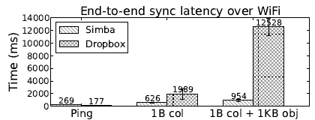
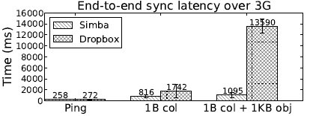
Sync Performance
End-to-end sync latency for “1B col” & “1B col + 1KB obj”
Test method
Client 1 updates for sync → client 2 receives update
Clients (Korea), sCloud (Princeton), Dropbox server (California)
Results
Network latency: small component of total sync latency
Simba performs well compared to Dropbox in all cases
Notes:
We also confirmed that Simba performs comparable to existing sync services.
We compared Simba’s end-to-end sync performance to Dropbox when syncing a 1B column data or 1B column and 1KB object.
For this experiment, we measured the time for 1 client to write a new data and have client 2 receive the update. The clients were in Korea while Simba Cloud was in Princeton and Dropbox server was in California.
Here are the results for syncing over WiFi or 3G. We include the ping time to show the base latency between client and server. The y-axis shows the time in milliseconds.
Overall, we see that network latency consists of a small component of sync latency. Moreover, Simba performs comparable to Dropbox in all cases.

Slide 20
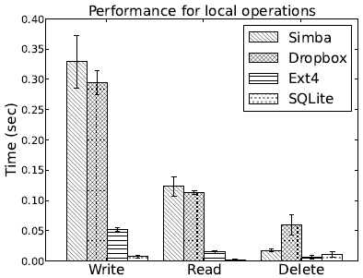
Local I/O Performance
Time to write/read/delete one row with 1MB object
~10% slower than Dropbox for write/read
IPC overhead between Simba-app and sClient
Better than Dropbox for delete
Lazy deletion: marked for delete → delete after sync completion
Notes:
Next, we measure how Simba performs in local I/O such as write, read and delete compared to Dropbox. For this, we measured the time to do local I/O for a single row that contains 1MB object data.
The result graph is shown as this. The y-axis shows time in seconds. We include base performance for Ext4 and SQLite as a reference.
We find that Simba performs about 10% worse than Dropbox for write and read, which is mainly due to the IPC overhead from communicating between Simba app and sClient.
Simba performs better in case of delete. This is due to Simba’s lazy deletion policy where the data is marked for delete, but only deleted after sync has been completed.

Slide 21
Conclusions
Building data-centric mobile app should be transparent
Mobile app developers should focus on implementing app core logic
Require service that handles complex network and data management
Simba: reliable, consistent, and efficient data-sync service
Unified sTable and API for managing tabular and object data
Transparent handling of data syncs and failures
Resource frugality with delay-tolerant coalescing of sync messages
Practical for real-world usage
Easy app development/porting with CRUD-like API
Sync performance comparable to existing services
Minimum local I/O overhead
Notes:
So in conclusion, we argue that building a data-centric mobile app should be transparent. App developer’s job is to focus on the app core logic while it is the lower layer sync service that should handle complex network and data management.
Therefore, in this paper, we presented Simba, a reliable, consistent and efficient data-sync service that provides unified sTable and API for managing tabular and object data. We showed that Simba handles atomic data syncs and failures transparently. Moreover, Simba is resource frugal with delay-tolerant coalescing of sync messages.
Lastly, through evaluation, we showed that Simba is practical for real-world usage. It is easy to develop a Simba app with CRUD-like API. Also, the sync and local I/O performance is comparable to existing state-of-art sync services.

Slide 22
Thank you!
Simba source: https://github.com/SimbaService/Simba
Project homepage: http://www.nec-labs.com/~nitin/Simba
Notes:
This is the end of my talk.
If you are interested in using our code, Simba source code is currently available at github. For updated news, please check our project homepage as well.
Thank you! And I would like to take any question.

Slide 23
Related Works
Data sync services
Parse, Kinvey, Bayou, Mobius [MobiSys’12]: support table sync
LBFS [SOSP’01]: support file sync
Do not provide sync service for both tables and objects
Failure tolerance
ViewBox [FAST’14]: guarantee consistency of local data at crash
Works for files in desktop FS
Storage unification
TableFS [ATC’13]: separate storage pools for metadata and files
KVFS [FAST’13]: store file and metadata in a single key-value store
Consider integration without network sync or a unified API
Notes:
We look at some of related works that tried to solve similar problems. Number of works presented new data sync services such Parse, Kinvey, Bayou and Mobius for table syncs, and LBFS for file syncs. However, none of them provide a sync service that unifies both tables and objects.
ViewBox is one of the latest work that tries to guarantee data consistency at crash. However, it only focuses on local files in desktop FS and does not handle other failures such as network disruption.
Several works also presented unified storage such as TableFS, which had separate storage pools for metadata and files, and KVFS, which stored file and metadata in a single key-value store. However, they did not consider how to handle unified storage for network sync and did not provide a unified API for app developments.

Slide 24
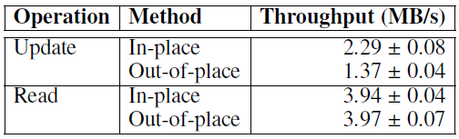
Balancing Sync Efficiency & Transparency
In-memory vs. persistent DCT
Sync only updated chunks for each object during sync
In-memory DCT lost after crash: send entire object → inefficient!
Persist DCT to prevent re-syncing entire, potentially large objects
In-place vs. out-of-place update
Recover a torn (corrupted) row with data from the consistent state
Out-of-place: local state + I/O overhead for common-case operation
In-place: retrieve consistent version of row from sCloud
69%
Notes:
Although a pretty straightforward sync process, there are several things we need to consider for sync efficiency and transparency.
First, let’s look at additional local state for DCT. DCT is used to identify the updated chunks so that the client doesn’t have to send the entire object during sync. However, there is a problem that if an app or device crashes before an updated object could be synced, it will result in loss of in-memory DCT, forcing us to send the entire object. This is definitely inefficient in terms of mobile data traffic usage. Instead, we decide to make DCT persistent at start of sync to prevent resync entire, potentially large object at crash recovery.
Second, let’s consider a tradeoff between in-place vs. out-of-place update. Considering the crash recovery, it makes more sense to write the update in a separate table and wait until the update has been synced to sCloud to update the local table. However, this results in an overhead of holding additional local state plus potentially large object data as well as I/O overhead for common-case operations. Instead, we take in-place update approach and borrow help from sCloud when recovering from crash. Through throughput measurement, we find that in-place update increases the write throughput by 69%.

