Slide 1


Enabling Performance Exploration and Analysis for Multi-parametric Systems
Younghwan Go, Juan A. Colmenares*
KAIST, Samsung Research America*

Slide 2

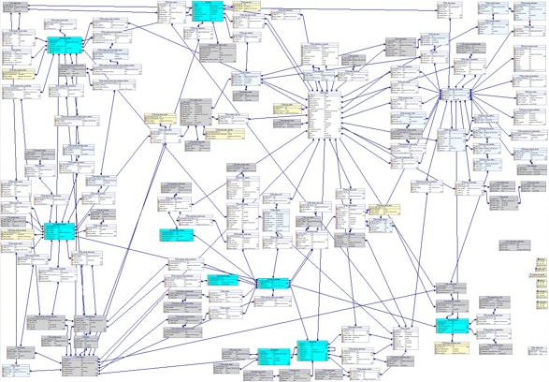

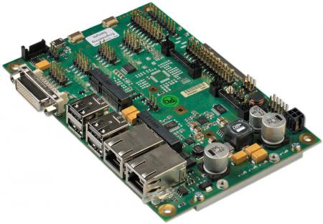
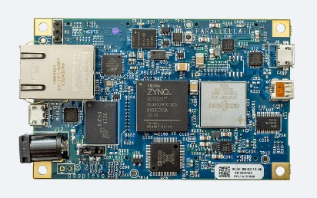
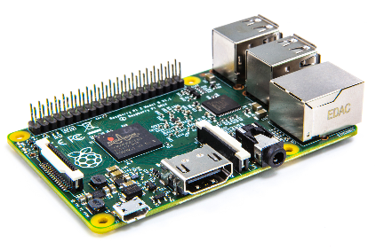
Difficulty in System Performance Tuning
Tuning 3rd party systems is challenging
No deep knowledge of system internals
Need “black-box” trial-and-error tuning
Multiple embedded platforms
Need to tune separately for each platform
How can I reproduce advertised performance?
Actual
Performance
Advertised
System resources

Slide 3




SPEX: System Performance Explorer
Framework for characterizing performance of unfamiliar systems
Easy to use, flexible, and applicable to various platforms
Ease of profiling enabled by developers
Developer instruments system code for profiling
User enables relevant instrumentation without code
Low profiling overhead
Collect traces of only enabled probes
Compact binary trace records of monitored system
Flexible performance exploration
Separate performance collection from policy
Automatically explore large configuration space
Observed System
System Code
{ … }
{ … }
$${Probe}_{0}$$
$${Probe}_{1}$$
Collector
Configuration
Agent
$$Q_{0}$$
$$Q_{1}$$
Tracer
Explorer
Policy
SPEX

Slide 4
Performance Data Collection
Collector: gather trace records from probe circular queues
Lock-free queues to prevent blocking
Tracer: process (calculate) trace records
Control which probe to enable profiling
Receive raw trace records (init_val, final_val)
Calculate performance metric (e.g., throughput)
Observed System
Probe
Trace
Collector
Trace
Control
Data
Collector
Free
SPEX Framework
Tracer

Slide 5




Performance Exploration
Explorer guides performance exploration with vary configurations
① Receive performance metrics from Tracer
② Teardown-configure-run process based on policy
Exploration policy
Interchangeable module to direct exploration
Configure parameters observed system runs on
Determine when to stop current run / exploration
Configuration agent
XML configuration file that contains parameters
E.g., number of threads, file paths, names of remote nodes, other inputs
Observed System
System Code
{ … }
{ … }
$${Probe}_{0}$$
$${Probe}_{1}$$
Collector
Configuration
Agent
$$Q_{0}$$
$$Q_{1}$$
①
Tracer
Explorer
②
Policy
SPEX

Slide 6
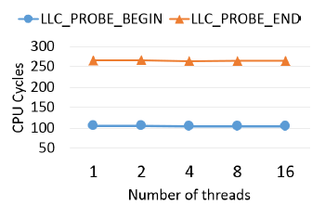
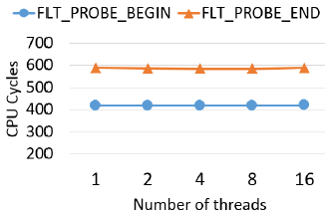
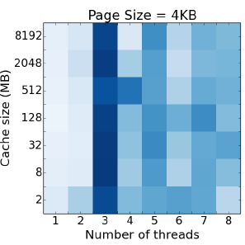
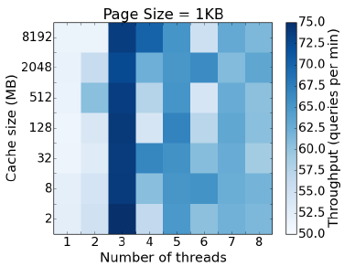
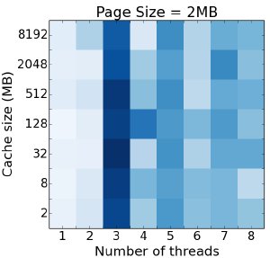
Evaluations
(a) LLC refs and misses
(b) Memory page faults
Experiment setup
Intel Xeon 3.2 GHz (hexa-core), 8 GB RAM, Ubuntu 14.04.4 LTS (kernel 3.13.0-79), 500 GB HDD
Probe overhead and scalability
Few hundred CPU cycles maintained throughout different number of threads
Exploring query throughput of SQLite3
Setup: NYC Taxi Trips dataset (169M records)*
Configuration: page size, cache size, thread number
Policy: brute-force on all configurations
Results
Max performance at 3 threads = scalability collapse!
Stable performance with vary page/cache size
*http://www.andresmh.com/nyctaxitrips/

Slide 7
Conclusions
Difficult to “trouble-shoot” unfamiliar 3rd party systems
Limited understanding of system internals
Redundant profiling between multiple platforms
SPEX: a framework for system performance exploration
Easy to use without the knowledge of system source code
Low profiling cost with design optimizations
Pluggable policy depending on interested performance metric
Successful in finding max performance of practical systems (e.g., SQLite3)
Correctly identify scalability collapse phenomenon
Identify core parameter that affects performance
Future Plan:
Design and implement sophisticated exploration policy,
support binary instrumentation, explore multi-node system

Slide 8
Thank you.
Q & A

