Slide 1

Tunneling Neural Perception and Logic Reasoning through Abductive Learning Wang-Zhou Dai, Qiu-Ling Xu, Yang Yu, Zhi-Hua Zhou
Presented by: Haoxuan Yang
Colorado School of Mines, Golden, CO
4/23/2018

Slide 2
Inspiration of this work
In the most learning process of human being, perception and reasoning are basic human abilities.
However, these two abilities are incompatible in the current Machine Learning systems.
Perception approach: Deep Neural Network
Reasoning approach: Prolog
Human-like trial-and-error abductive process: Mayan scripts were a complete mystery to modern humanity.

Slide 3
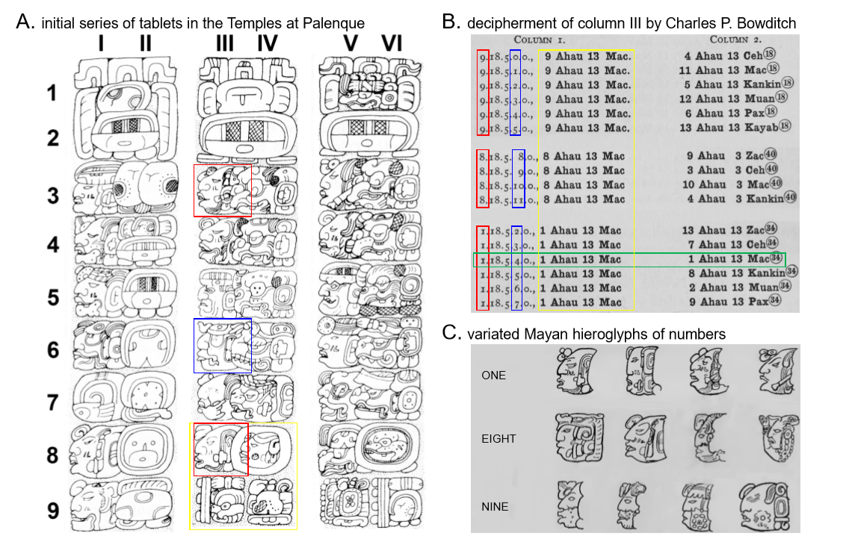
Mayan Hieroglyph Decipherment

Slide 4
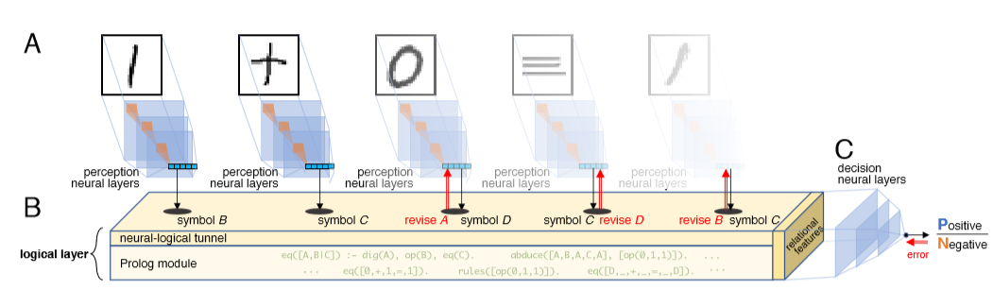
Neural Logical Machine (NLM)
Perception layers: 2-layer CNN, 2 fully connected layers, a softmax layer.
Reasoning layers: logical layer, 2 fully connected layers (decision layer)

Slide 5



Logical Programming (Prolog)

Slide 6




Logical Programming (Prolog)

Slide 7
Problem setting
A set of labeled training data X = {(x1,y1),...,(xn, yn)}
Label: yi ∈{0,1}
Background knowledge (domain knowledge):
just for parsing the equations and identify the structure of the input equation.
The goal: it is designed is to learn the mapping for perception layers (mapping from image to symbol, just a classification task) and the resoning layer (generate addition rules for calculating “+” operations) simultaneously from the data X

Slide 8
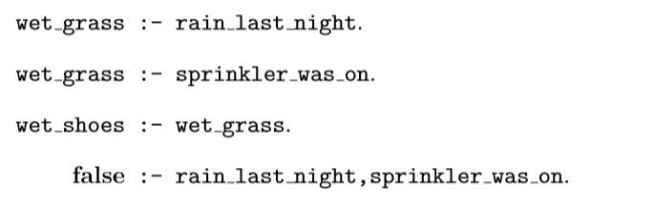
A typical reasoning process of forming a hypothesis that explains given observations.
When an observation of wet_shoes is true and observation of no rain occurred last night?

Slide 9
Reasoning layers
eq0=[0,1,1,1,1], logical layer cannot abduce a consistent hypothesis
The optimization part will begin substituting some of the values in eq0 with blank Prolog variables, eq1=[0,_,1,_,1].
Then, abduce a consistent hypothesis involving the additive rule and eq1_new=[0,+,1,=,1].
Finally, the abduced eq0 1 can be used as a supervised signal to train the perception model, helping it distinguish images of “+” and “=” from other symbols.

Slide 10
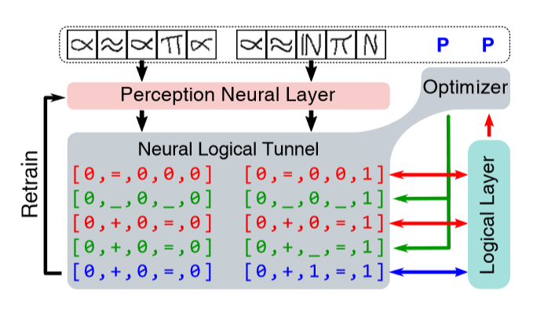
Neural Logical Machine (NLM) again

Slide 11
Subsampling
Problem: In ﬁrst-order logic, evaluating the consistency of a set of formulas on given facts is NP-hard.
Solution: subsampling data X over multiple iterations, where each subsample contains only 5—10 equation images.

Slide 12
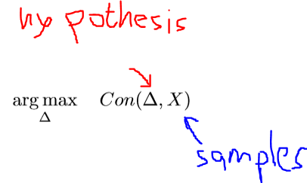
Objective
where the consistency Con(∆,X) is deﬁned by the size of the maximum consistent subset
X_c ⊆ X derived from ∆

Slide 13
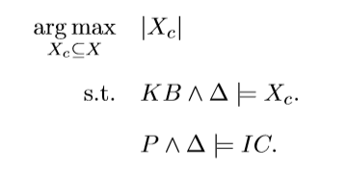
Objective
where KB and IC are the domain knowledge and integrity constraints, respectively, deﬁned in the abductive logic program of the logical layer.

Slide 14
Objective
When the perception model is under-trained, the perceived symbols eq0 from X might contain mistakes.
Logic model tries to solve this problem by substituting some possibly incorrectly perceived symbols in eq0 to blank variable “ _” .
Abduce a symbol list eq_new that ensures a maximally consistent ∆ on dataset X.
Then, it retrains the perception model (CNN)

Slide 15
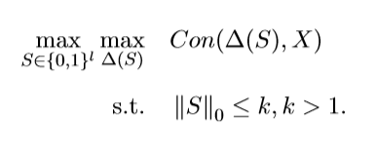

Objective
The substitution vector can be represented by
When Si = 1 then the i-th interpreted symbol in eq0 will be replaced with a blank variable “_”.
Hypotheses that are too far away from the perceived symbols and obtaining bad solutions, the number of substituted variables should be constrained.

Slide 16
Derivative-free Optimization
It’s a binary vector optimization problem in an extremely complex hypothesis space, popular gradient-based optimization techniques can hardly be applied to this scenario.
A derivative-free optimization technique, RACOS. RACOS is a randomized derivative-free optimization method implemented by a classiﬁcation model that discriminates good solutions from bad ones, and it achieves good performance on complex optimization problems.

Slide 17
Problem
In fact, some sets of examples (such as the arithmetic equations “1+10=11, 11+100=111”) can achieve maximum consistency using just one bitwise addition rule 1+0=1, which might not be true.
Moreover, when the perception model in the n-th iteration is under-trained, reasoning model might abduce incorrect bitwise addition rules.

Slide 18
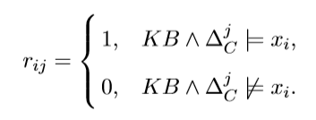
Solving the problem
To solve this problem, we retain the reasoning models abduced in each iteration as a relational feature.
When an equation xi is input into NLM, its symbolic interpretation (predicted equation) mapped by the perception model will be evaluated by all the relational features to produce a binary vector ri = [ri1,...,riR], where:
This vector of relational features transforms the original dataset X = {xi,yi} into a new dataset X ’ = {ri,yi}, from which a decision model is learned by the decision layer.

Slide 19
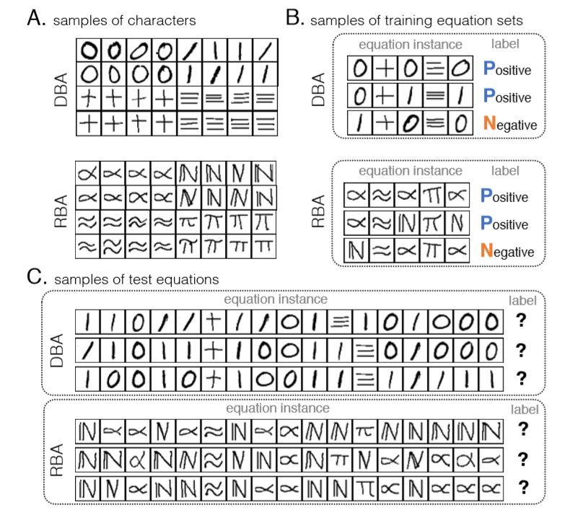
Experiments

Slide 20
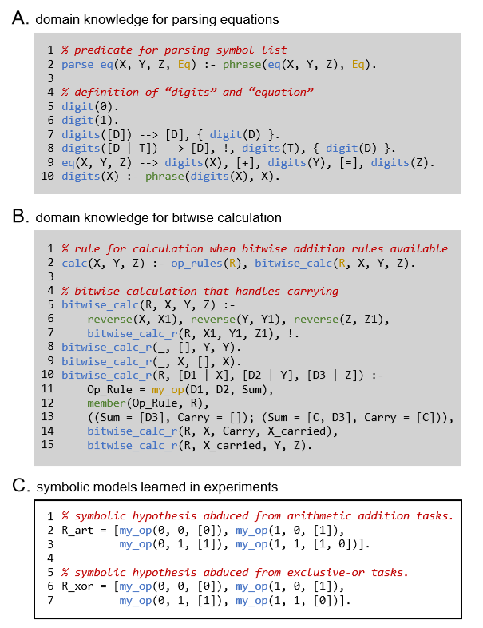

Slide 21
Experiments
Compare with Diﬀerentiable Neural Computer (DNC) and LSTM
Because both are state-of-the-art benchmark models capable of solving tasks from sequential input such as arithmetic equations.

Slide 22
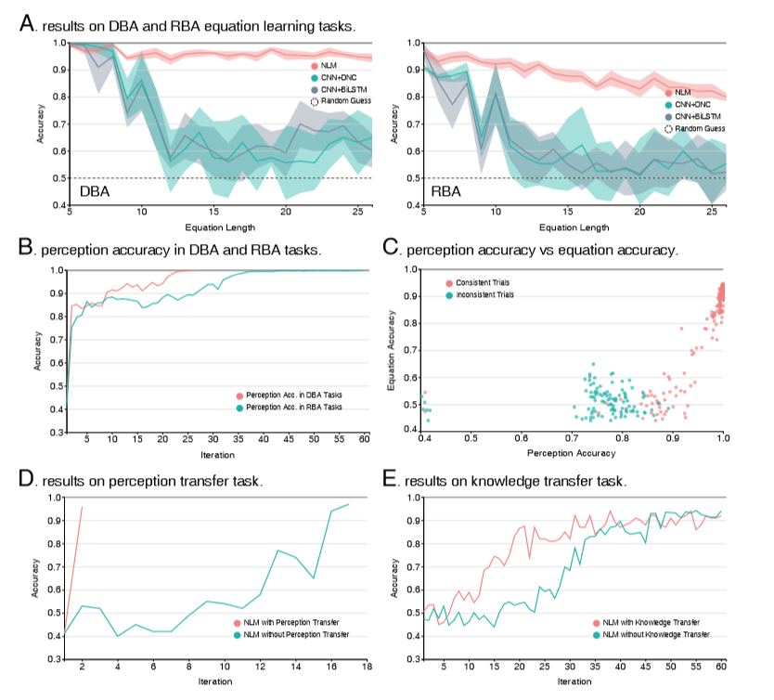

Slide 23
Comments
Abductive learning is the ﬁrst framework designed for simultaneously learning both reasoning and perception models.
From my understanding, this framework uses logic model to provide “supervised signal” for the perception layers and use perception layers to reduce the search space of the logical model.
It’s a unsupervised learning because the perception part and logical part supervise each other. Labels are just for computing the accuracy of the output.
Gradient descent needs equation to be derivable but this optimization gives another way. It can find the inconsistency of the equation and the logical rules but it doesn’t tell which symbol is wrong.

Slide 24
Comments
Subsampling can improve the efficiency but can only generate locally agreed hypothesis. To tackle this, they retain the latest R relational features (hypotheses generated by previous samples) in a buffer and generate a binary vector to evaluate the new samples, and then feed it into decision layer. Thus, some of the relational features will be abandoned during the training process of the decision neural layer.
The revision process of the logical layer (substituting incorrect symbols with blank variables and then replace some other symbols) is not a black box. It give the framework interpretable explanation and it is a heuristic trial-and-error search.

