Slide 1
Recurrent Neural Network-LSTM

Slide 2
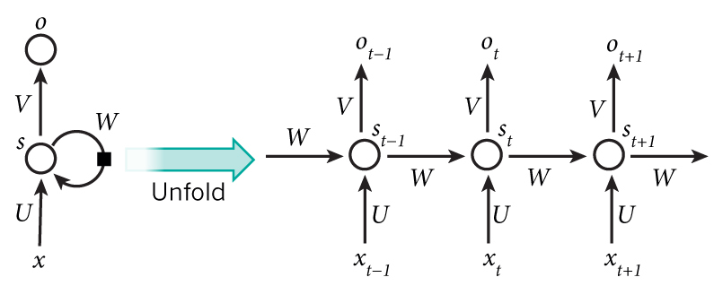
Unrolling
Notes:
http://www.wildml.com/2015/09/recurrent-neural-networks-tutorial-part-1-introduction-to-rnns/
http://colah.github.io/posts/2015-08-Understanding-LSTMs/

Slide 3
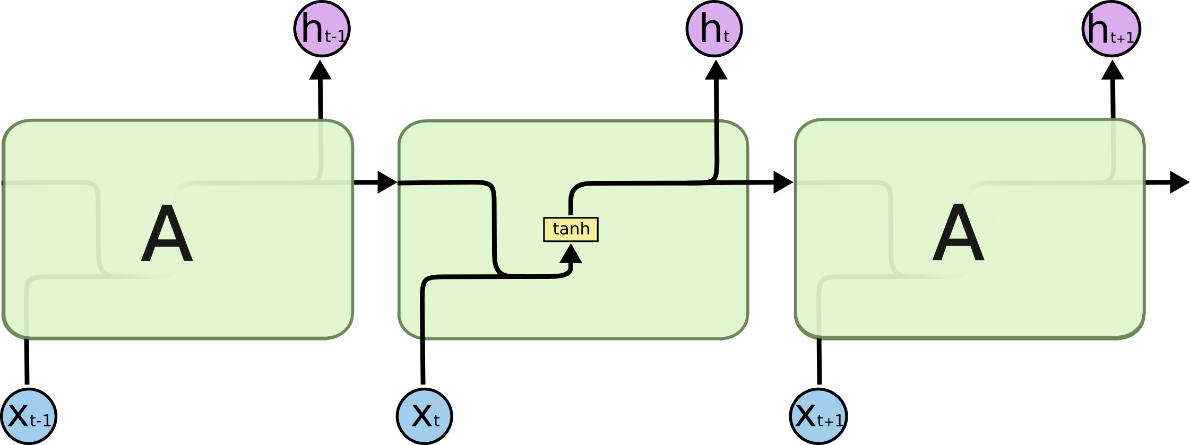
Vanilla RNN Unit
Notes:
Note: y(t) = W*h(t)

Slide 4
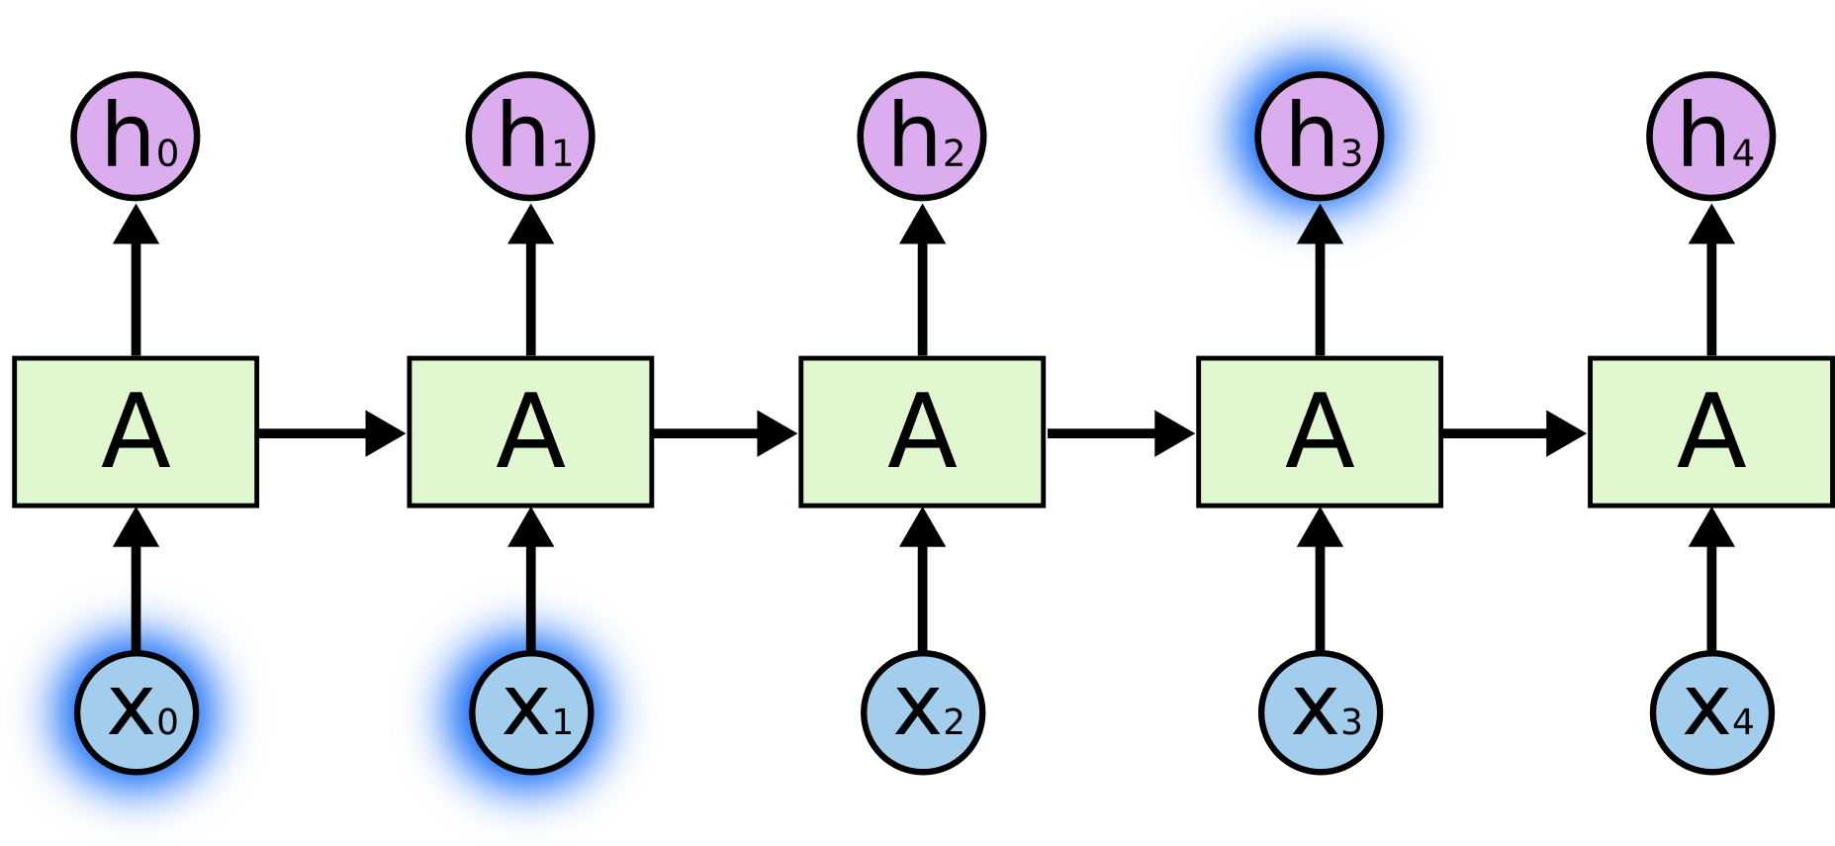
Short Term Dependency
“The clouds are in the sky”

Slide 5
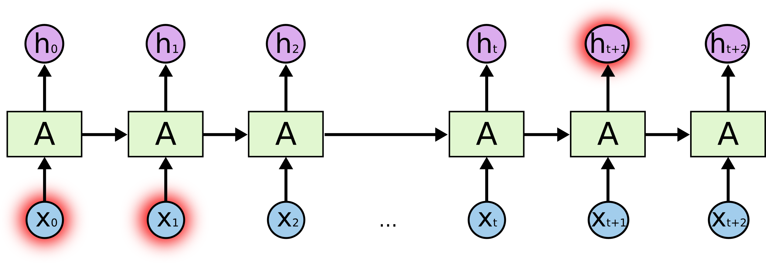
Long Term Dependency
“I grew up in France… I speak fluent French.”

Slide 6
Vanishing/Exploding Gradients
Exploding Gradients
Truncated BPTT
Clip gradients at threshold
RMSprop to adjust learning rate
Vanishing Gradients
Harder to detect
Weight initialization
ReLU activation functions
RMSprop
LSTM, GRUs

Slide 7

LSTM Unit
Notes:
Try to resolve the gradient vanish problem by gating mechanism
Pink circles are Pointwise operations, arrows are Vector transfer

Slide 8
LSTM
Manipulate memory
“Forget” – Flush the memory
“Input” – Add to memory
“Output” – Get from memory

Slide 9
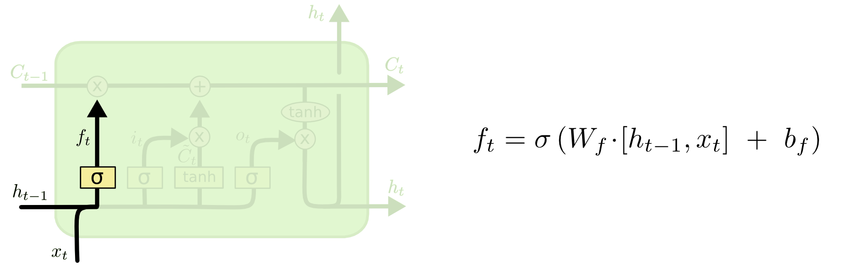
Forget Gate
Notes:
Sigmoid layer outputs from 0~1, → how much of each component should be let through
0: Let nothing through, 1: Let everything through

Slide 10
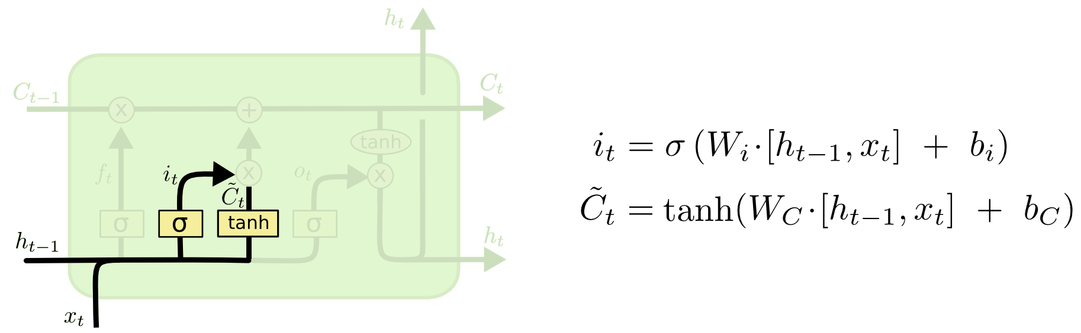
Input Gate
Notes:
Note: Actually, the real input gate should be only the sigmoid layer.
? 当前状态？
？tanh?

Slide 11
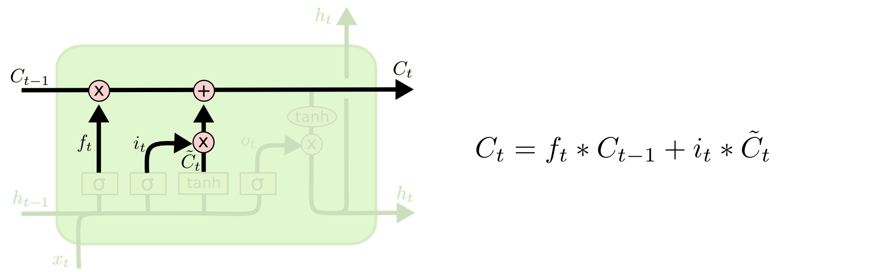
Update State

Slide 12
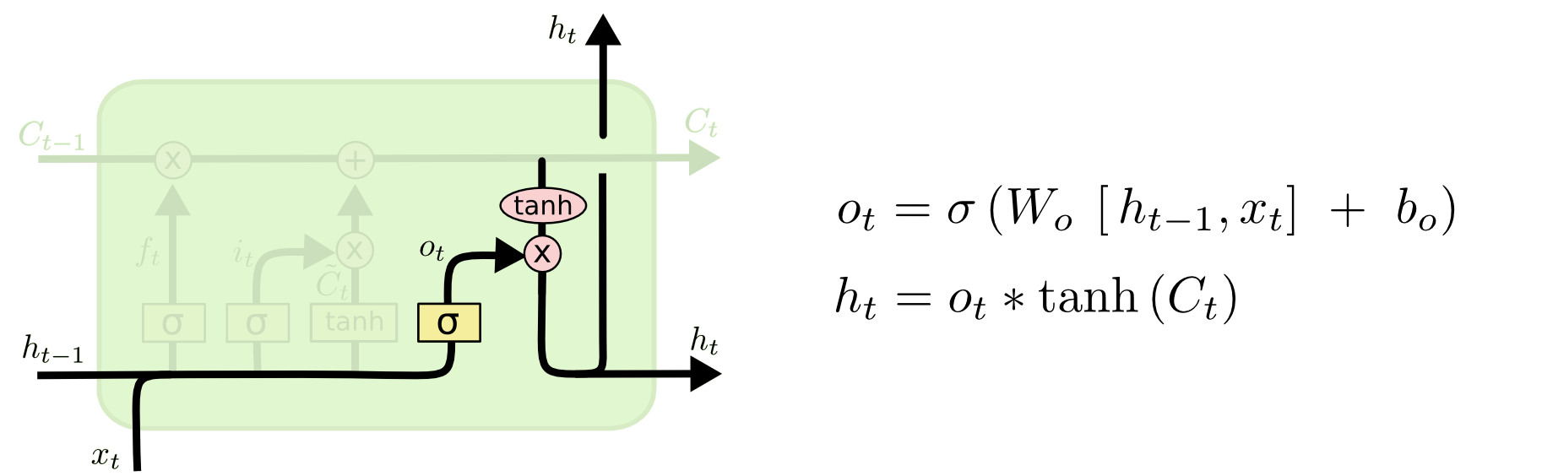
Output Gate
Notes:
? 这里的tanh作用？

Slide 13
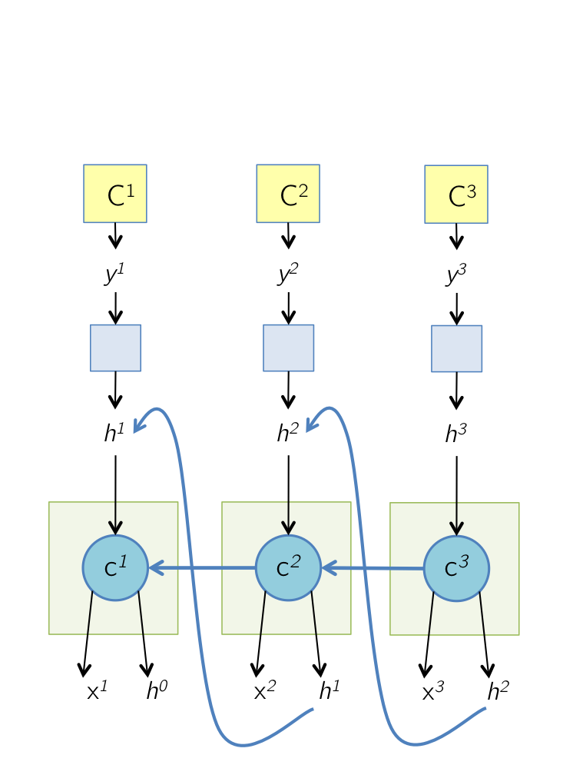
BP-Workflow

Slide 14
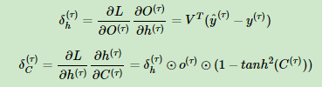
BP – Cont.
Notes:
L, O

Slide 15
BP – Cont.

Slide 16

BP – Cont.

Slide 17
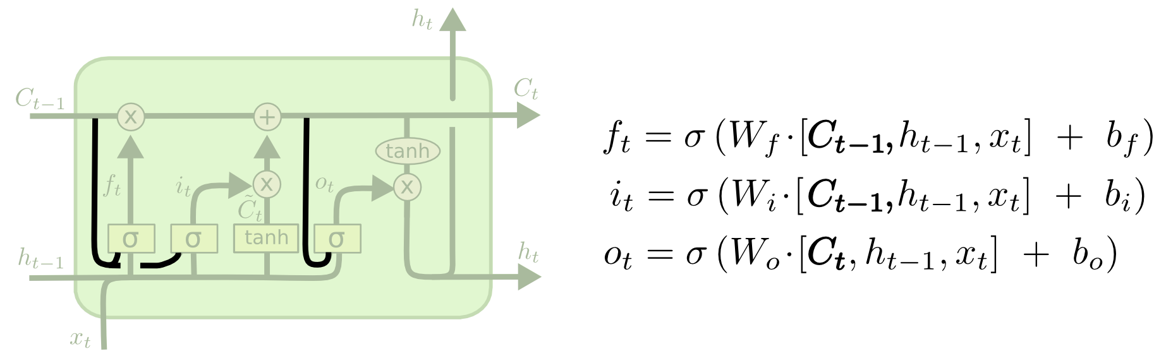
Variants on Long Short Term Memory --Peephole Connections
Notes:
Peephole: Let the gate layers look at the cell state.

Slide 18
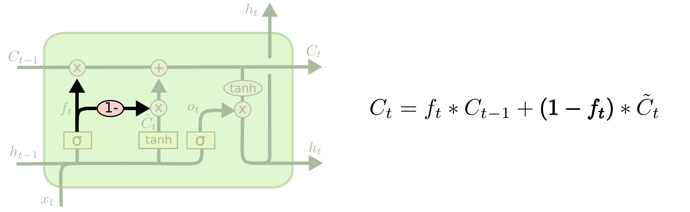
Variants on Long Short Term Memory --Tied

Slide 19
References – Stock Price Prediction with LSTM
https://lilianweng.github.io/lil-log/2017/07/08/predict-stock-prices-using-RNN-part-1.html

