Slide 1
Recurrent neural network
Jiayin Xie

Slide 2
Artificial neural network(ANN or NN)
An ANN is based on a collection of connected units or nodes called artificial neurons . Each connection or edge between artificial neurons can transmit a signal from one to another. The artificial neuron that receives the signal can process it and then signal artificial neurons connected to it.
In common ANN implementations:
1) The signal at a connection between artificial neurons is a real number.
2) The output of each artificial neuron is calculated by a non-linear function of the sum of its inputs.
3) Artificial neurons and edges typically have a weight that adjusts as learning proceeds. The weight increases or decreases the strength of the signal at a connection.
4) Typically, artificial neurons are organized in layers. Different layers may perform different kinds of transformations on their inputs.
5) The weights as well as the function that computes the activation can be modified by a process called learning which is governed by a learning rule.

Slide 3
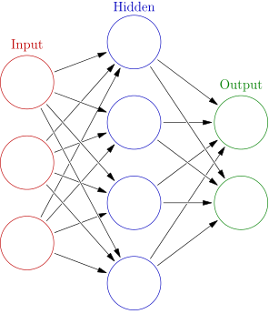
Basic idea of Neural network
Structure of the Neural network
Neurons
Activation function
Input which depends on Propagation function
Output which determined by activation function
Connections and weights
Propagation function
Learning rule (which modifies the parameters of the neural network)

Slide 4
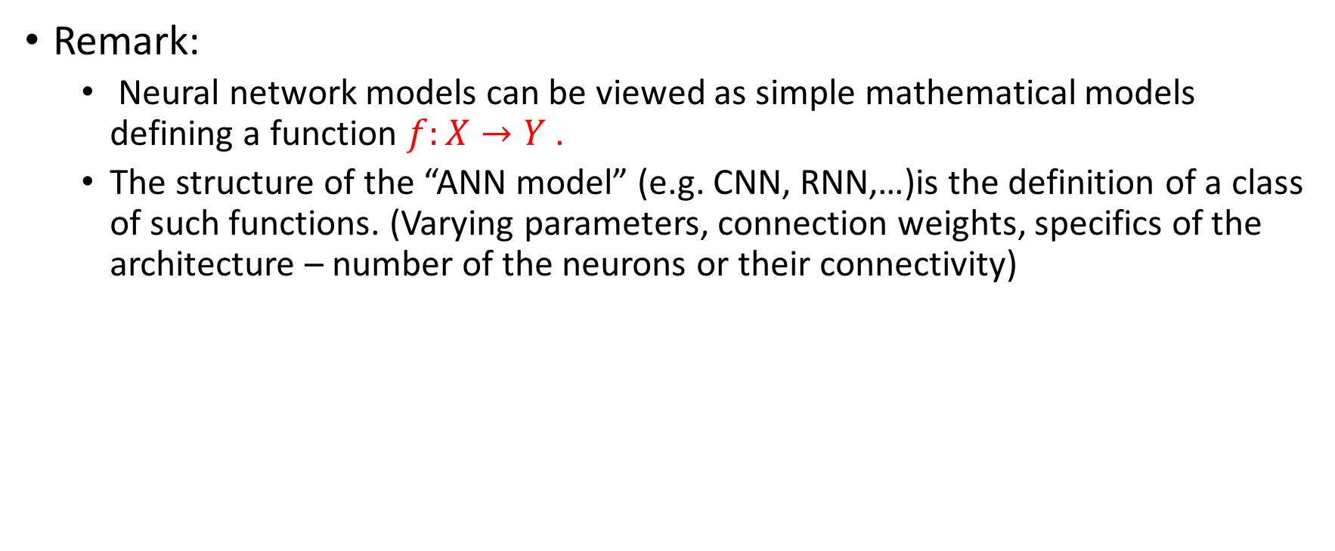
Classical Neural network
Remark:
Neural network models can be viewed as simple mathematical models defining a function $f:X→Y$ .
The structure of the “ANN model” (e.g. CNN, RNN,…)is the definition of a class of such functions. (Varying parameters, connection weights, specifics of the architecture – number of the neurons or their connectivity)

Slide 5
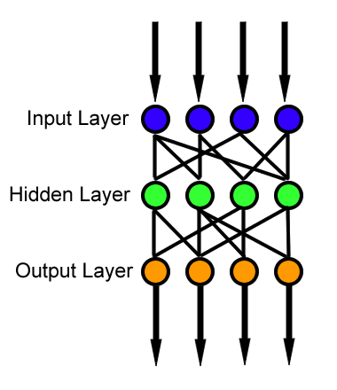
Feedforward neural network
A feedforward neural network is an artificial neural network wherein connections between the nodes do not form a cycle.
The information moves in only one direction, forward, from the input nodes, through the hidden modes and to the output nodes. There are no cycles or loops in the network.

Slide 6
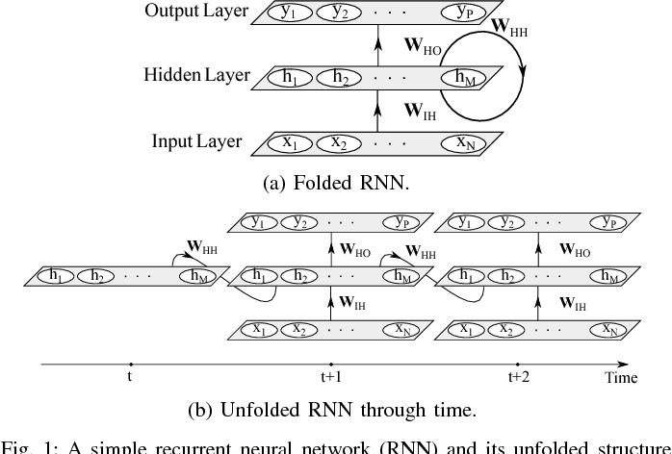
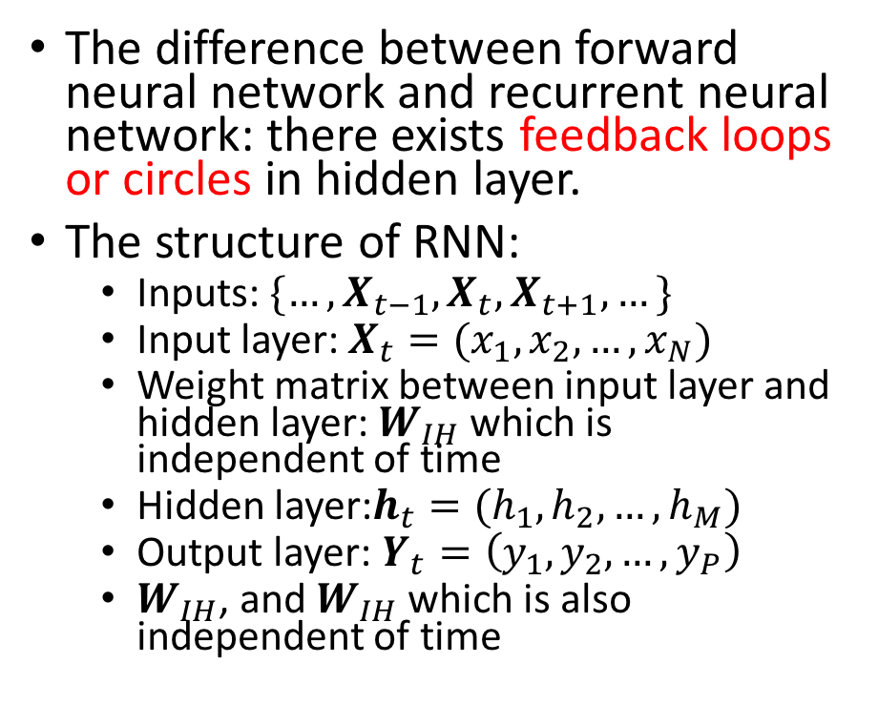
Recurrent neural network
The difference between forward neural network and recurrent neural network: there exists feedback loops or circles in hidden layer.
The structure of RNN:
Inputs: $\{…,X_{t−1},X_{t},X_{t+1},…\}$
Input layer: $X_{t}=(x_{1},x_{2},…,x_{N})$
Weight matrix between input layer and hidden layer: $W_{IH}$ which is independent of time
Hidden layer:$h_{t}=(h_{1},h_{2},…,h_{M})$
Output layer: $Y_{t}=\left(y_{1},y_{2},…,y_{P}\right)$
$W_{IH}$, and $W_{IH}$ which is also independent of time

Slide 7
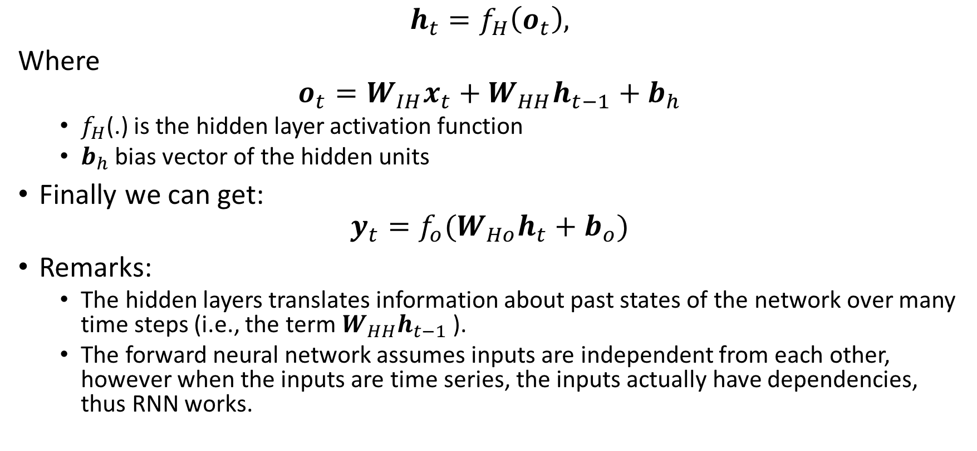
Model architecture
$$h_{t}=f_{H}\left(o_{t}\right),$$
Where
$$o_{t}=W_{IH}x_{t}+W_{HH}h_{t−1}+b_{h}$$
$f_{H}$(.) is the hidden layer activation function
$b_{h}$ bias vector of the hidden units
Finally we can get:
$$y_{t}=f_{o}(W_{Ho}h_{t}+b_{o})$$
Remarks:
The hidden layers translates information about past states of the network over many time steps (i.e., the term${ W}_{HH}h_{t−1}$ ).
The forward neural network assumes inputs are independent from each other, however when the inputs are time series, the inputs actually have dependencies, thus RNN works.

Slide 8
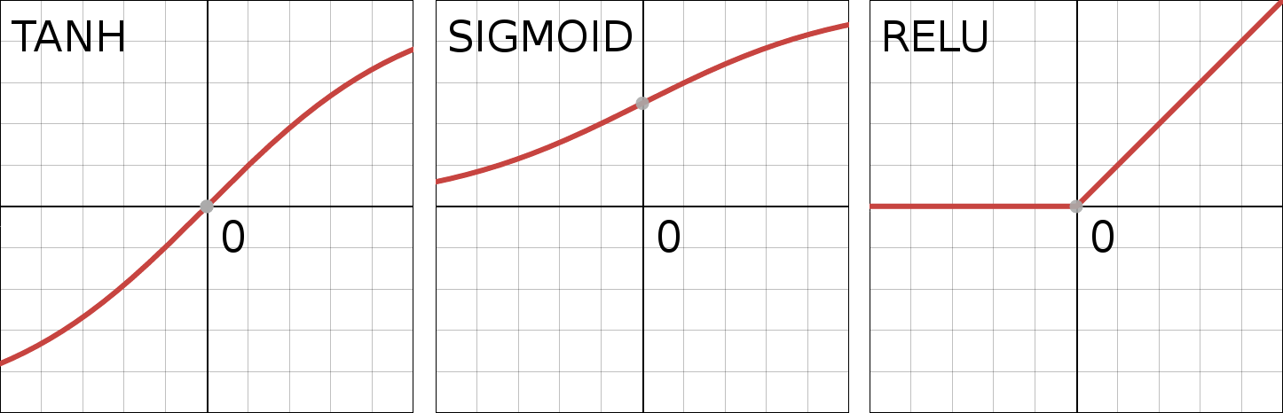

The choice of activation function
$1) tanh\left(x\right)= \frac{e^{2x}−1}{e^{2x}+1}$ - tanh
$2) σ\left(x\right)= \frac{1}{1+e^{−x}}=\frac{\tanh\left(\frac{x}{2}\right)+1}{2}$ - sigmoid
$3) y\left(x\right)=max⁡(x,0)$- RELU

Slide 9

Loss Function
Loss function evaluates performance of the network by comparing the output $y_{t}$ with the corresponding target $z_{t}$:
$$ℒ\left(y,z\right)= \sum_{t=1}^{T}{ℒ_{t}(y_{t},z_{t})}$$

Slide 10
Gradient-based Learning methods
Basic idea: As mentioned previously, to find the suitable function in the class or set of function, we need to modify the parameter of the model. The GD method adjust the weights of the model by finding the error function derivatives with respect to each member of the weight matrices in the model. To minimize the total loss, GD changes each weight in proportion to the derivative of the error with respect to that weight.

Slide 11
How to Update the weight matrix ?
1. We define the Loss function to measure the discrepancies between output and expected output. Eventually, we hope to find a suitable set of weights for each edge of the network, so that the total loss can be minimized.
2. We do a forward propagation for one training example to calculate the output.
3. Once the output is computed, we can compute the loss for each neuron of the output layer. Then, we can use backward propagation to measure how each output neuron’s loss is affected by each neuron backward.
4. Then we can update our weight based on this specified training.

Slide 12



Backward propagation through time
Gradient vanish may happen when T is very big.
The reason why we need a truncated back propagation

Slide 13
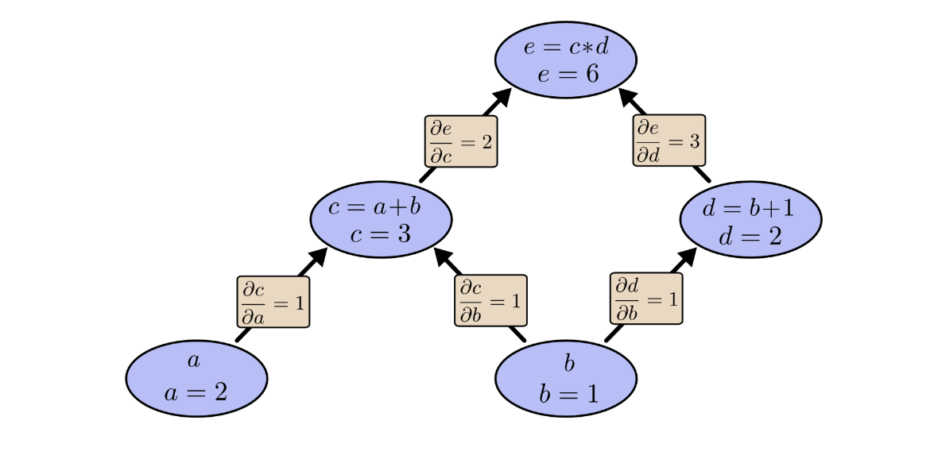
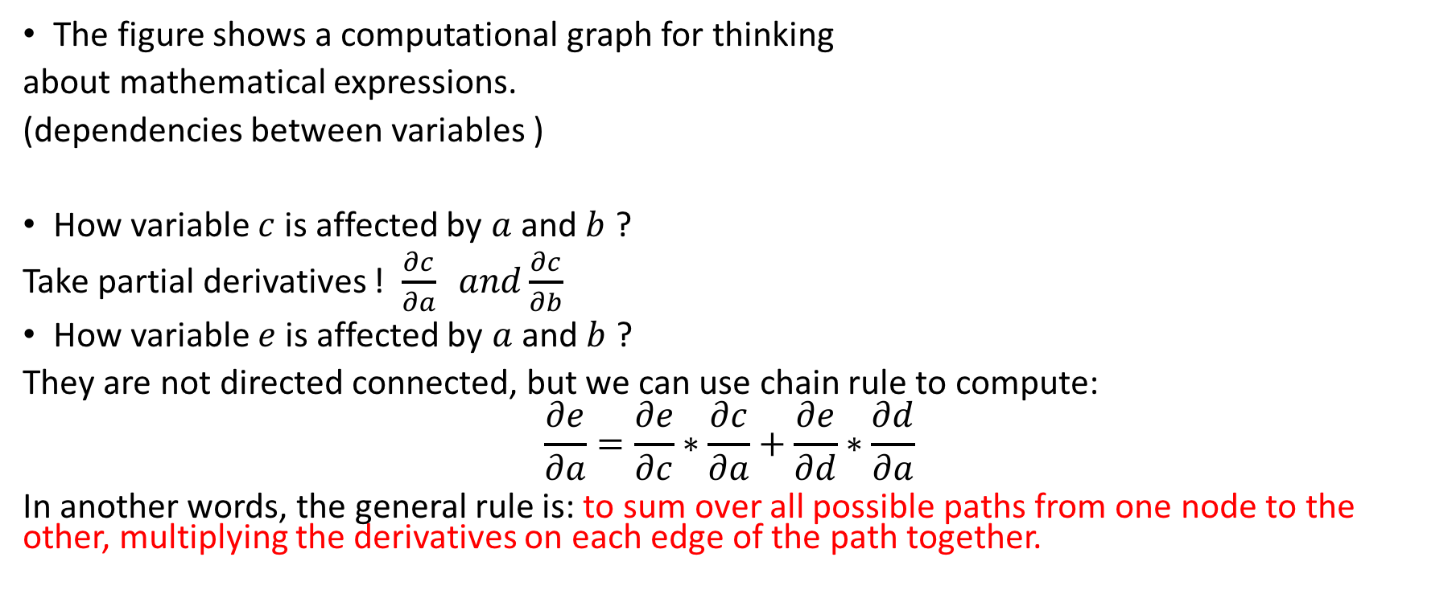
Computational Graphs - from Colah’s blog
The figure shows a computational graph for thinking
about mathematical expressions.
(dependencies between variables )
How variable $c$ is affected by $a$ and $b$ ?
Take partial derivatives ! $\frac{∂c}{∂a} and\frac{∂c}{∂b}$
How variable $e$ is affected by $a$ and $b$ ?
They are not directed connected, but we can use chain rule to compute:
$$\frac{∂e}{∂a}=\frac{∂e}{∂c}∗\frac{∂c}{∂a}+\frac{∂e}{∂d}∗\frac{∂d}{∂a}$$
In another words, the general rule is: to sum over all possible paths from one node to the other, multiplying the derivatives on each edge of the path together.

Slide 14
Application in NLP tasks
Language Model

