Slide 1
2048
Data Structure and Object Oriented Programming
Instructor: Sai Keung Wong
National Yang Ming Chiao Tung University, Taiwan

Slide 2
2048
It’s a 4x4 board game. We can change its dimension, of course.
There are numbers (usually 2 and 4) generated randomly.
Move step: use UP, DOWN, LEFT, RIGHT keys to move the numbers to the respective side to combine the numbers.
Press ‘a’ or ‘A’: To automatically play for one step.
Press the spacebar to toggle the autoplay mode. In the autoplay mode, the performance must be interactive. To obtain a full score of this part, the program should combine at least 512 or higher in a cell in a 4x4 board.
Rules for number combination:
(1) two adjacent numbers in the same movement direction.
(2) they must be the same.
A new number is produced by adding the two numbers together. The new number cannot be combined in the same step.

Slide 3
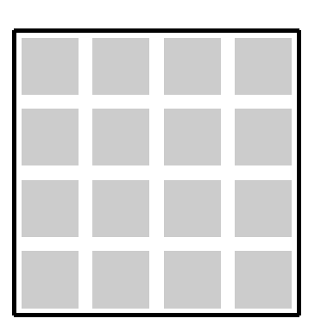
The new number is produced at the position opposite to the movement direction.
An example for DOWN. The preference position starts from the top row and from left to the right. You can use a method other than that to generate a new number.

Slide 4
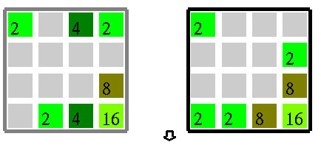
Example
Move down. The two numbers 4 are combined into 8. The other numbers are moved down. A new number 2 is produced at the upper left corner.
Previous step
Current step

Slide 5
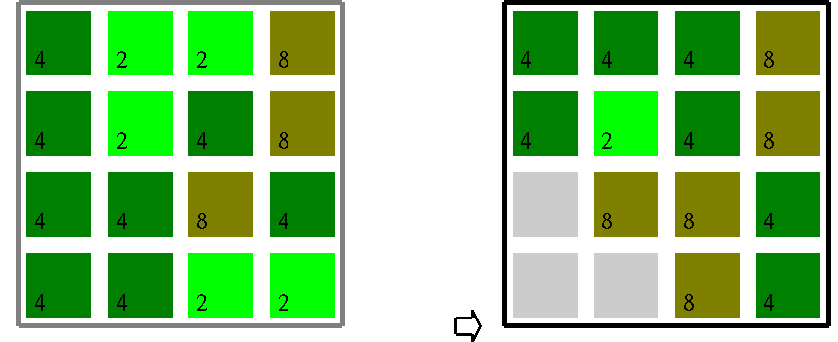
Example
Move to right.
The two numbers 4 are combined into 8 but the new number cannot be combined with the existing 8.

Slide 6
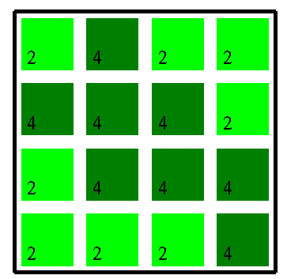
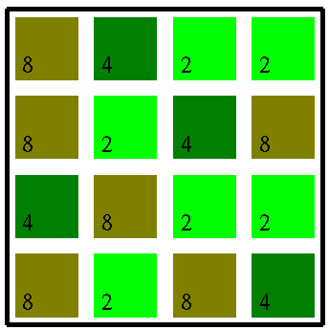
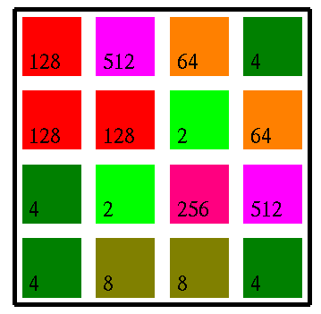
Boards
generateNumbers_All_2to4
generateNumbers_All_2to8
generateNumbers_All

Slide 7
Tasks
generateNumber( ) : generate a new number (2 or 4) after a move step is finished.
void MY_2048::handleSpecialKeyPressedEvent( unsigned char key )
You may also want to implement something inside this function after a move key is handled.

Slide 8
Tasks: The autoplay mode
Implement an algorithm to automatically play the game. The performance must be interactive.
Implement void MY_2048::update( )
Add extra data members and member functions if necessary.
Hint: Use recursive function(s) to evaluate a depth-first tree with at least height 7. So that we know all the possible outcomes at such level. Then we pick the best result and apply the best action at the first level.
four actions
at first level
subtrees

Slide 9
//Modify the message if necessary
void MY_2048::askForInput( )
{
cout << "MY_2048" << endl;
cout << "Key usage:" << endl;
cout << "1: generate randomly the numbers 2 and 4 for all the cells" << endl;
cout << "2: generate randomly the numbers 2, 4 and 8 for all the cells" << endl;
cout << "3: generate randomly the numbers for all the cells" << endl;
cout << "r: clear all the cells" << endl;
cout << " " << endl;
cout << "UP, DOWN, LEFT, RIGHT: move the numbers to the respective side" << endl;
}

Slide 10
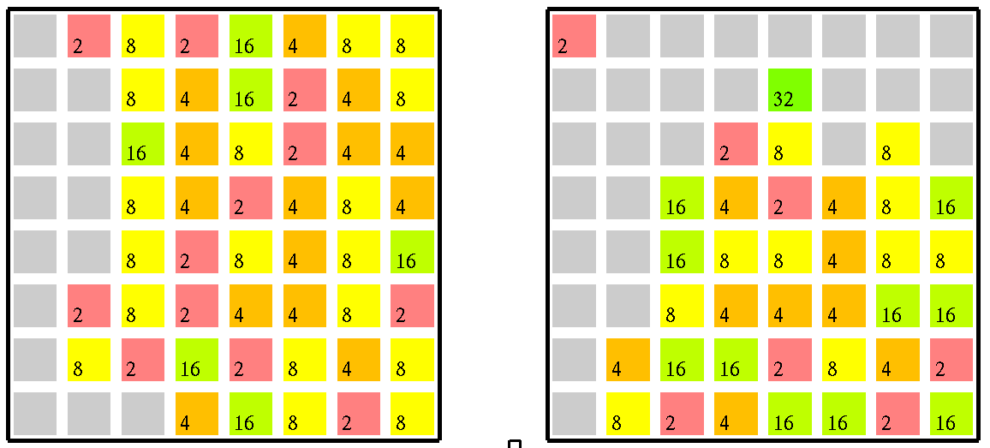
Game board with dimension 8x8

Slide 11
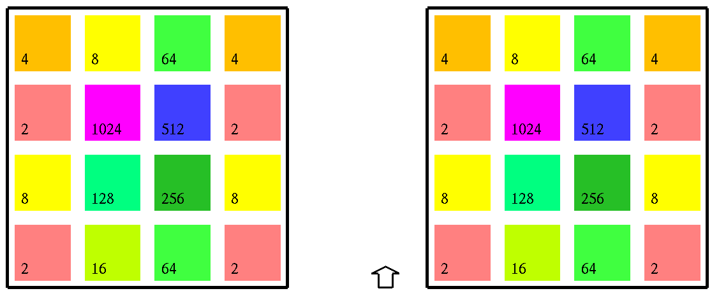
Auto play

Slide 12
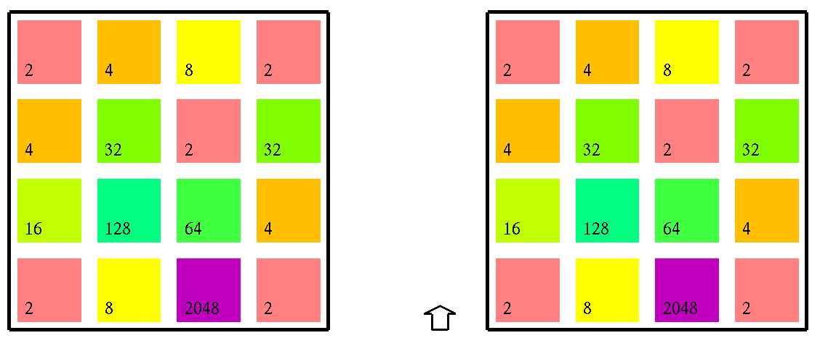
The best result (by luck)

Slide 13
There are some bugs in the demo program. Could you find them?

Slide 14
Enjoy programming

