Slide 1
Usability testing results

Slide 2
Conventions for user feedback:
Must fix
Should fix
Could fix
Grey italics: comments
Screenshot
Must fix:
xxx
Should fix:
xxx
Could fix:
xxx

Slide 3
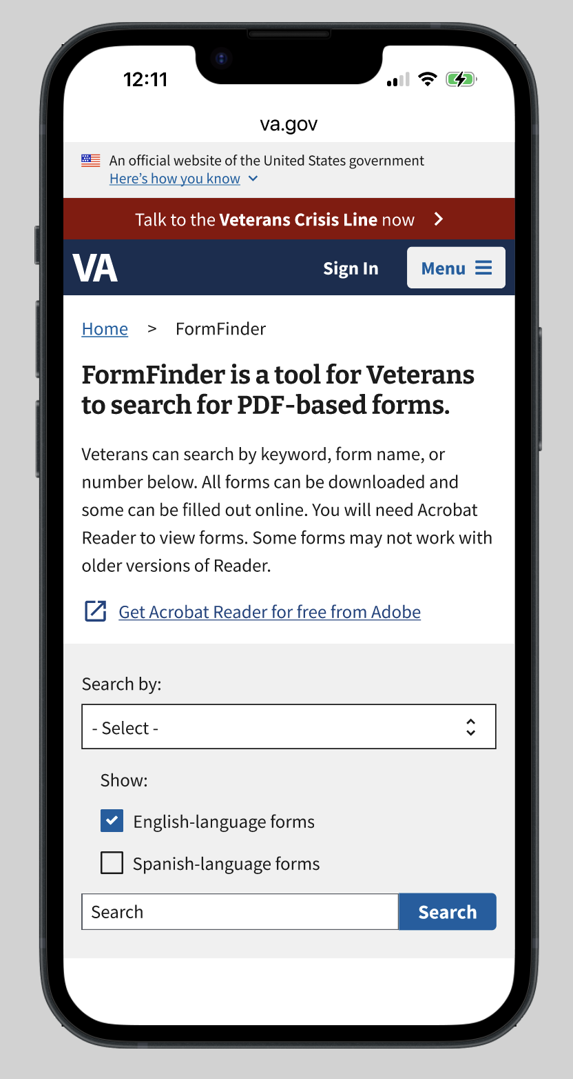
Italics: comments
Must fix
Should fix
Could fix
Could fix:
Change copy so user understands it refers to the form, not the website

Slide 4
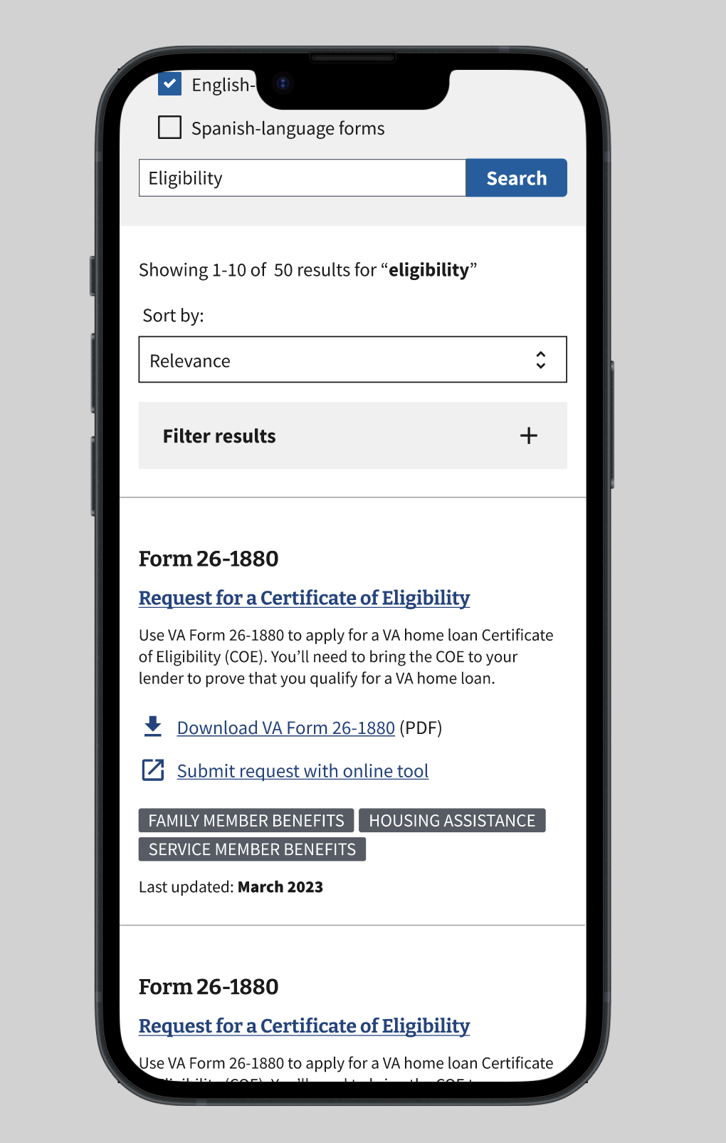
Italics: comments
Must fix
Should fix
Could fix
Would expect to learn more about the form when clicking
Could fix:
Include information about ‘how to use’
Include steps
Check w/ Tech if we can only have the most up-to-date forms showing up so we can delete this

