Slide 1
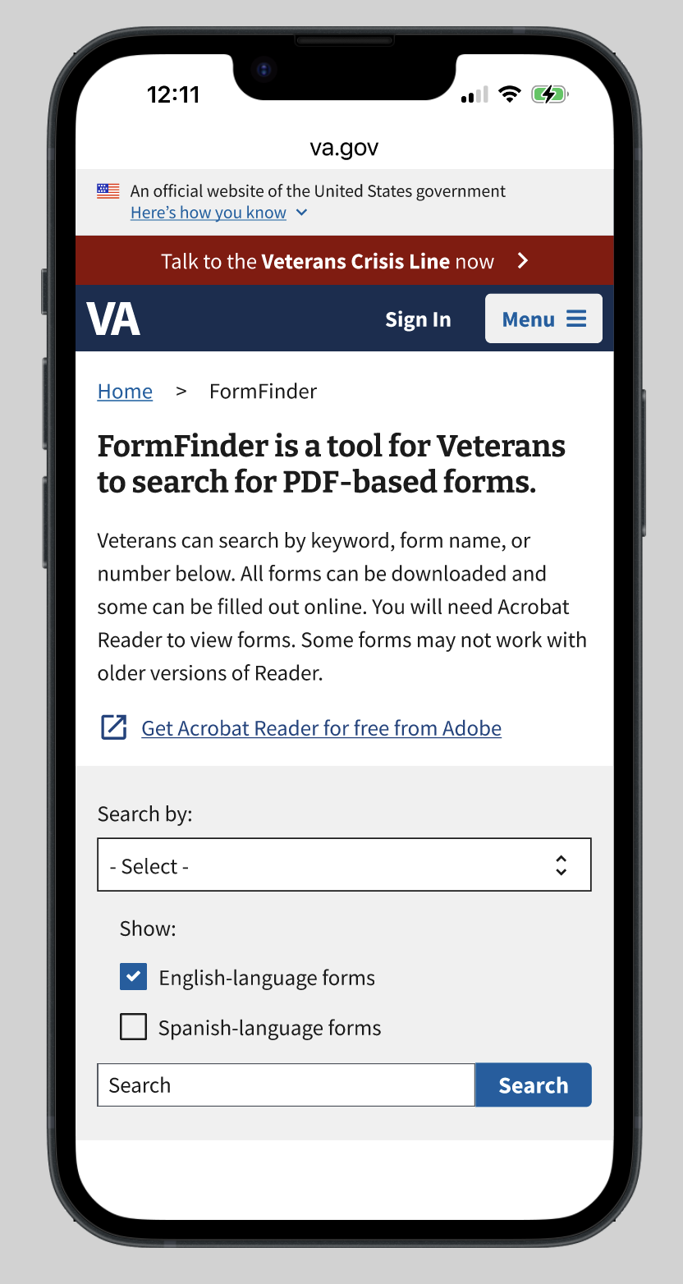
Italics: comments
Must fix
Should fix
Could fix
Could fix:
Change copy so user understands it refers to the form, not the website

Slide 2
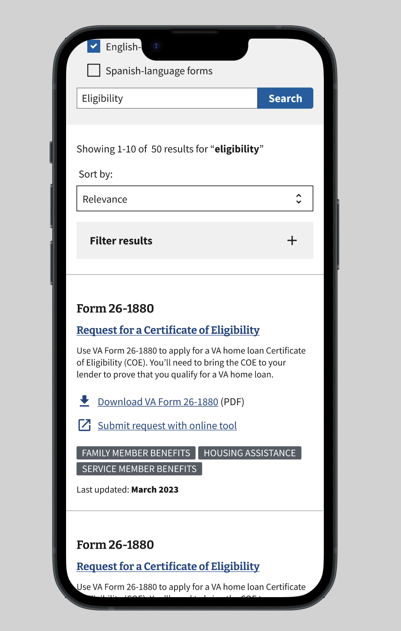
Italics: comments
Must fix
Should fix
Could fix
Would expect to learn more about the form when clicking
Could fix:
Include information about ‘how to use’
Include steps
Check w/ Tech if we can only have the most up-to-date forms showing up so we can delete this

