Slide 1
Methylation & Pubmed Search
Joerg Heintz

Slide 2
Learning Plan
Read
Books
Campbell Biology, 9th Edition
DNA can transform bacteria
Building a structure model of DNA, key feature of DNA structure
Base paring (rudimentary)
DNA replication (not methylated)
Chromosome (histones,
Wikipedia:
Methylated DNA immunoprecipitiation: → input framework, different techniques
DNA Methylation
Papers
Epigenetics alterations in aging, review, Appl Phisiol,
The DNA Methylome, review, FEBS Letters, 2010
Introducing String Matching, Modification, Using R Regular Expressions
Videos
Statistics for Genomics: DNA methylation, Rafael Irizarry, 1:10:03h
Next Steps
Biology: Transcription is the DNA directed synthesis of RNA (synthesis of an RNA transcript)
R: data mining k words -> reducing amount of papers
DNA Methylation & R: hidden markov models to understand the process of cancer detection based on sequencing data
DNA Alignment

Slide 3
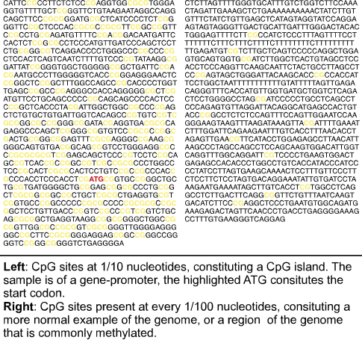
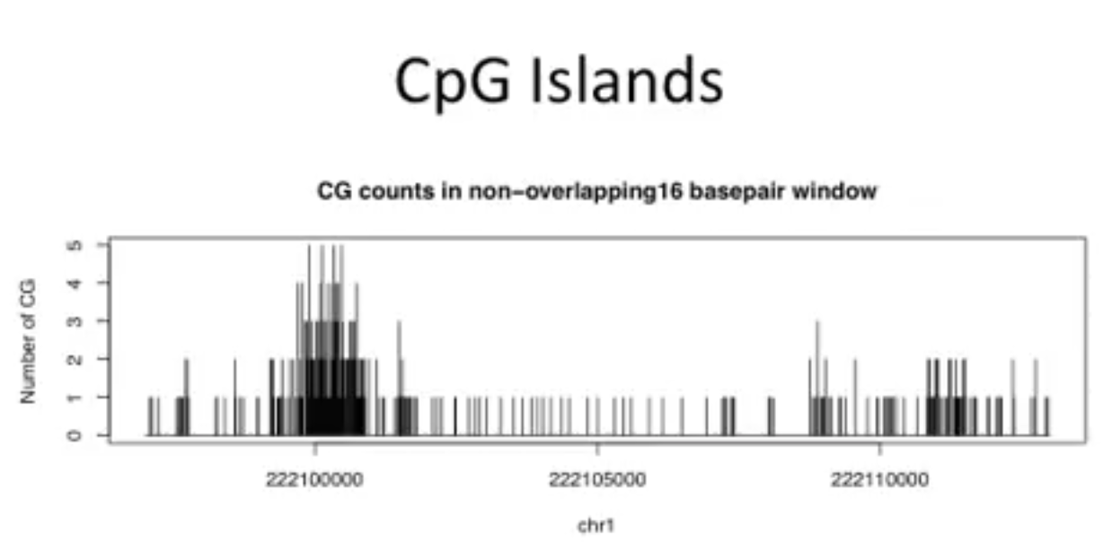
Summary I
DNA Methylation
Process by which methyl groups are added to DNA to modify (block, inactivate) the gene (loci, region of a DNA) expression without changing the sequence of the DNA base pairs (CG, TA). Methylation only occurs by C followed by G. If the DNA replicates the methylation status will be preserved. The same genome can have different methylation patters. The following sequence combinations exist after methylation:
C, 5mC, G,T,A,
Variations & Combinations & Occurrence
CG occurrence:
TA, TA, AT, AT, CG, CG, GC, GC, … = 16
CpG Island Definition:
N>200, GC-content > 50%
Obs/exp > 0.6 , expected is usually 1/20 ?
List contain 20,0000 CGI
Relevance:
Methylation controls the gene expression and subsequently DNA sequence responsible associated with genotype. DNA is heritable and that makes used by differentiated cells to pass tissue-specific transcription pattern to daugther cells in cell division.
Measuring Methylation in the entire genome
Convention
Hypermethylated CpG island silence tumor suppressor genes
Cancer cells are globally hypomethylated
Techniques:
Microarrays.
Separate the methylated part of the genome for the unmethylated part of the genome. A probe tells you if this part of the genome in your sample. Probe effect: 2 color array.
Total DNA vs. unmethylated DNA
Methylated DNA
(T) | (A)
(A) | (T)
(C) | (G)
(G) | (C)
(5mC) | (G)
(G) | (5mC)
(5mC) | (G)
(G) | (C)
(C) | (G)
(G) | (5mC)

Slide 4
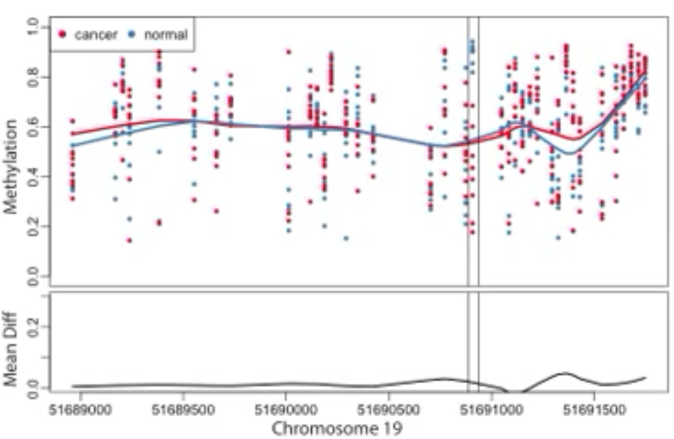
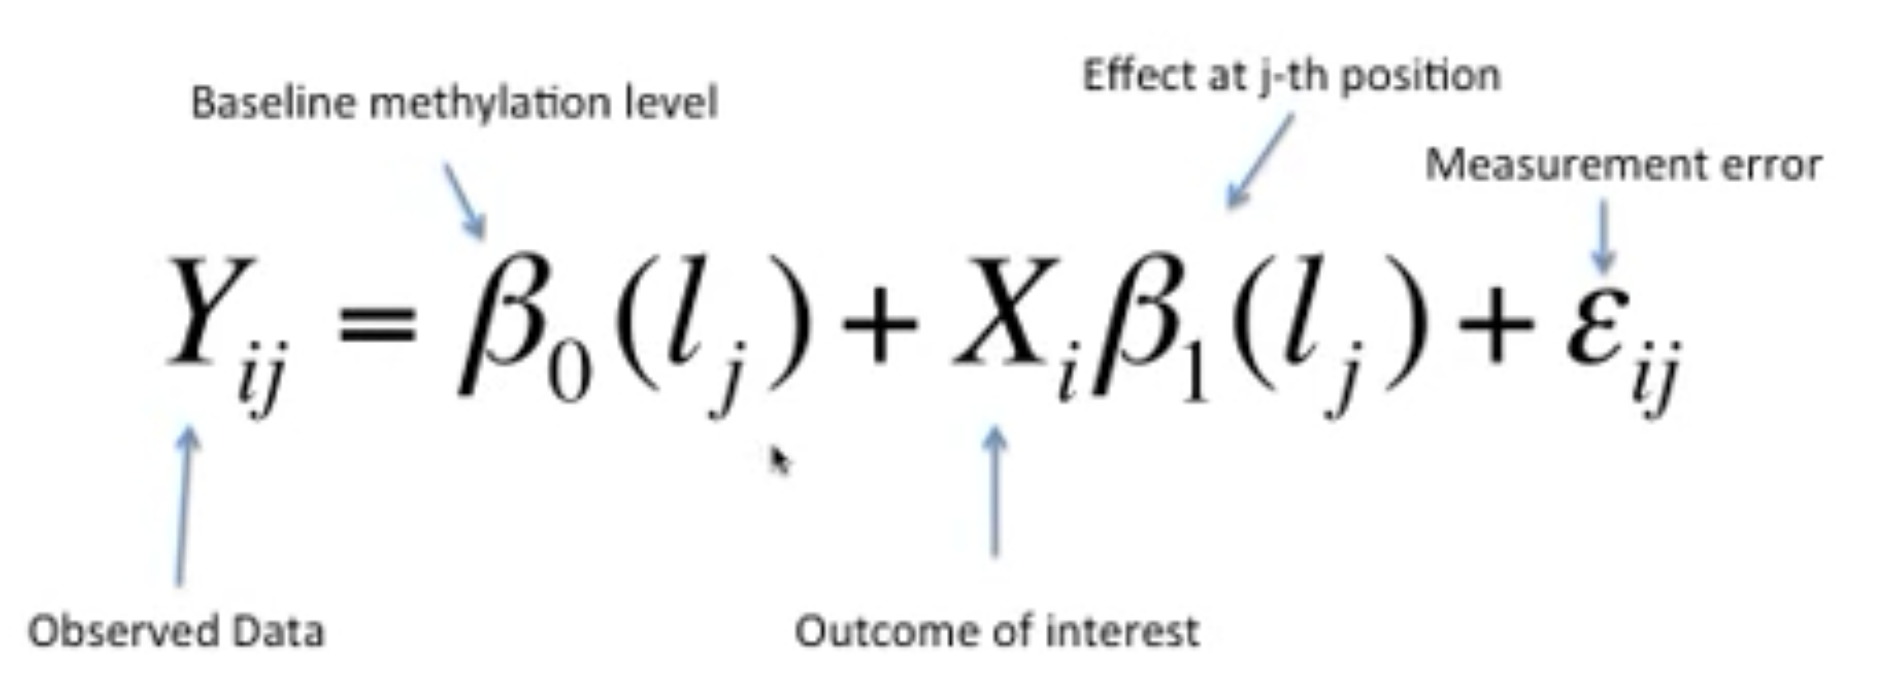
Summary II
Finding differentially methylated regions (DMRs)
Hypothesis:
Cancer and normal cells, island are higher in islands
Cancer has less methylation
Genomic traceplot
Methylation and Sequencing Principles
NGS provides a more complete picture of the methylome, whole genome methods are still quite expensive. To reduce costs and increase throughput, some researchers are using targeted methods, which only look at a portion of the methylome.
Microarrays provide for low cost and increases throughput. Because details of exactly how methylation impacts the genome and transcriptome are still being investigated, many researchers find a combination of both technologies best fits their needs—
Application Decision: NGS for discovery and microarrays for rapid profiling. [Source 2013, January Genengnews]

Slide 5
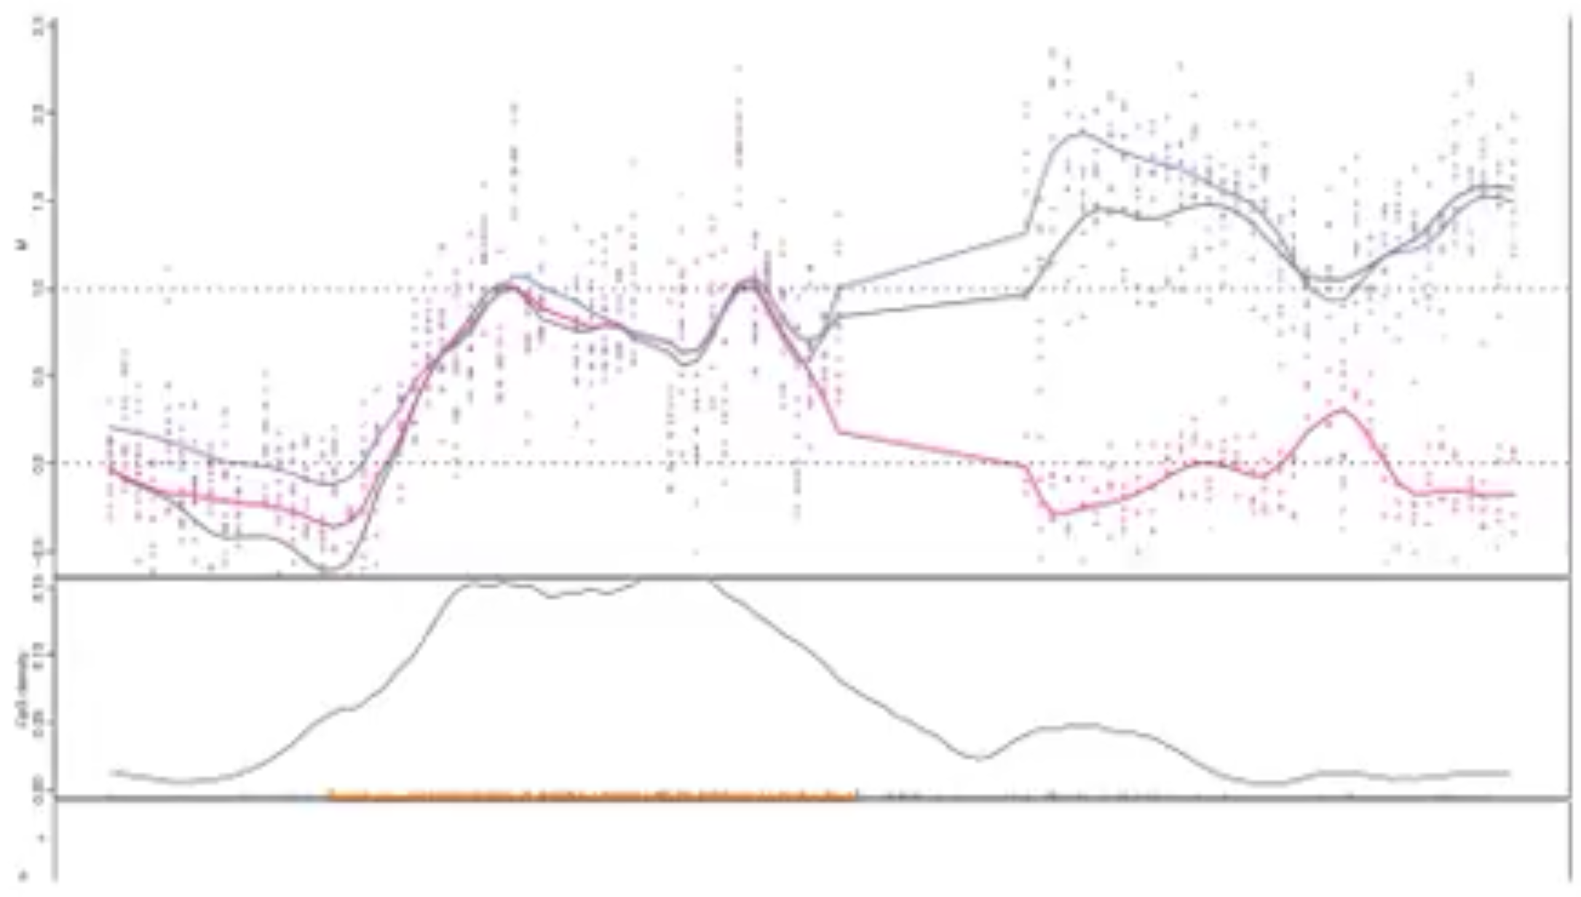
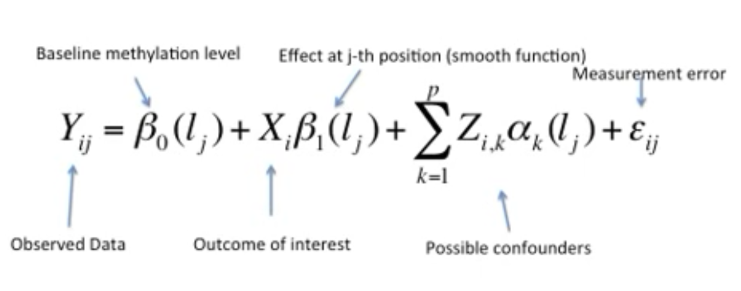
Summary III
Methylation Level (mean differences)
Hidden Markov Model (?)
Differences in tissues
CpG density
CpG densities ( peaks)
CpG Islands ( peaks)
CpG Island Shores
Chromosome 19

Slide 6
R Programming: Summary IV
Software Development
Github to KnowEnG Gitlab
Data Fetching
Data Base with papers available, 22.8 MB, 12.778 papers, 8 variables
Cleaned (ready for data mining)
Started applying data mining package (corpus, preparing, word statistics)
Next Steps
Finding the key words, and associations
In

Slide 7
Epigenetics Methylation Sequencing Framework
User Environment
User knowledge
Biological question
Methods ( statistical methods included, data processing)
Knowledge of CGI location
Sample characteristics (weight, length, number, …)
Sequencing technique: Microarrays, Next Generation Sequencing
time constraints
resolution requirements(Island, shores -> expected CPG density )
Costs
Sequencing Technologies
Typing
Application: small number of loci across many samples
Techniques: PCR, restriction enzymes, mass spectrometry
Profiling
MeDIP, MeDIP-seq (NGS)
RLGS (restrictive landmark genomic scanning
bisulfite conversion based methods
User Environment / Technical Characteristics
Arrays, traditional, bisulfite modification based
Next Generation Sequencing or Microarrays
In progress
Standard Investigations
Re-sequencing
SMP discovery and genotyping
Binding sites: Chip-Seq
Gene expression: RNA Seq
Measuring methylation changes
Associations between gene expression and methylation
Anticipated Decision derived from Expected Associations
Methylation Sequencing = F(resolution, antibody)
MeDIP = F(>16pb)
Knowledge of the cgi location excludes genome-wide sequencing methods
Methods | Pro / Con | Description
MeDIP | 0 | Limited by the number of restriction sites (4100 landmarks)
Bisulfite modification based sequencing | 0 | Conversion of unmethylated cytosine to uracil can be unstable Labor intensive, not suitable gor genome-wide studies (redefining CpG island using hidden Markov models, 2010)

Slide 8
Approach: Developing Decision Tree
Support Level
User
User
Environment
Criteria
Motivation
t
Selects Sequencing Method
Applies Sequencing Method
Assess Lab Results
Processes Raw Data

Slide 9
Next steps:

Slide 10
Sequencing Methods
WGBS | Whole-genome bisulfite sequencing
RRBS | Reduced representation bisulfite sequencing
Me-DIP
MDB
Method | Application
CHIP-Seq | TF binding sites
RNA-Seq | Gene expression

Slide 11
Learning Objectives
Methylation Basics
What is methylation
How does reproduction of an methylated DNA sequence work?
Where takes methylation place?
Methylation Sequencing Methods
Characteristics of methylation sequencing methods
Methods
Sample Preparation
Sequencing Protocol
Preprocessing of raw data (required to identify the methylated sequences
Devices and Equipment
User Capabilities
Which decision are involved before sequencing methylated sequence?

