Slide 1
Conformal Field Theories
and Tensor Categories
June 13, 2011 - June 17, 2011
Beijing International Center for Mathematical Research

Slide 2
I would like to welcome all the participants and guests!
Hope that you have a good visit to our center!

Slide 3
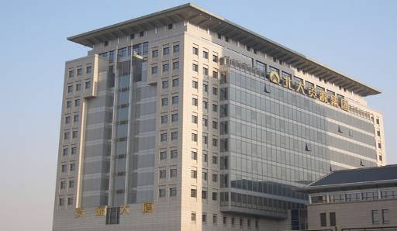
Beijing International Centre for Mathematical Research (BICMR) was created in 2005 by decree of national government. BICMR runs temporarily in Peking University Resources Building.

Slide 4
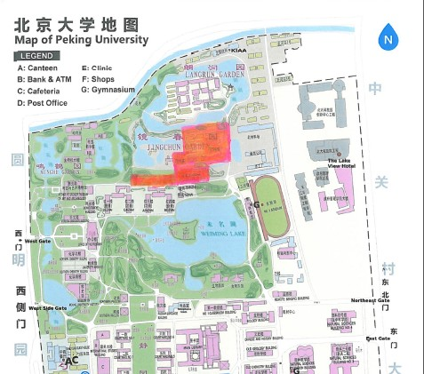
The main office buildings of BICMR will be spread in several Chinese classical houses with gardens on the north shore of the WeiMing Lake on campus. The BICMR’s construction is supported by the State government and Peking University.

Slide 5
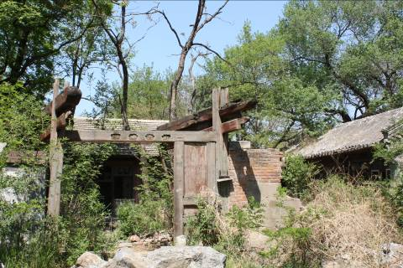
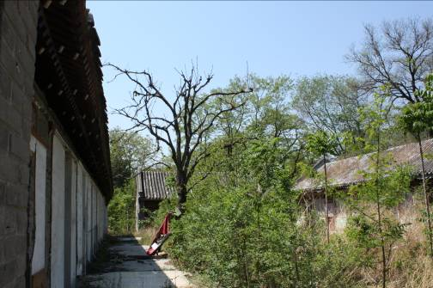
Before the construction, there are mostly teachers’ dormitories and old houses.
The overall environment is messy and chaotic.

Slide 6
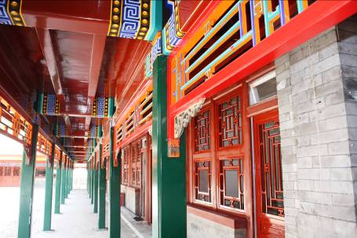
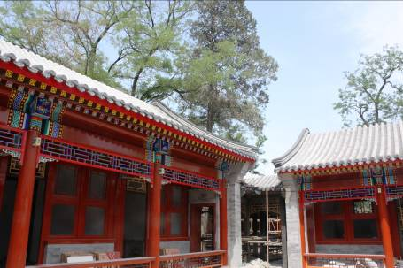
We expect to move in the main office buildings in August 2011. It will be one of the most beautiful parts of Peking University campus. The total construction area is about
7000 square meters.

Slide 7
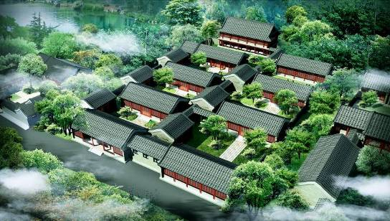

Slide 8
Thank you!

