Slide 1
Mid-Term Presentation
Distributed Database Query Engine Service (DDQES)
T.R.A.C.K Team
Frederic Colin, Henry Loharja, Ng Yi Ying

Slide 2
Presentation Outlines
Distributed System Environment
Database System Engines
High Availability (HA) Web Service
Project Timelines [Current]
Project Timelines [Next]
Project Values

Slide 3
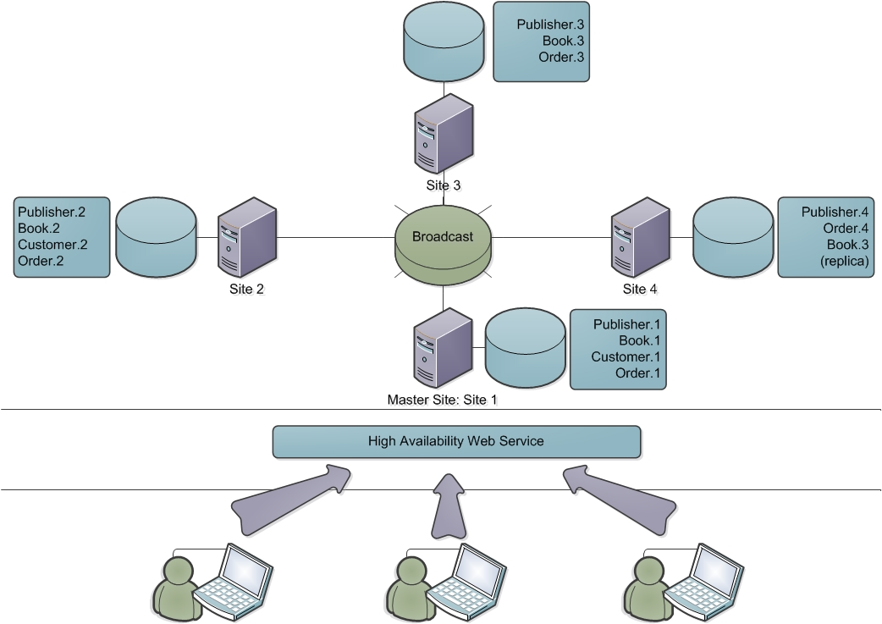
Distributed Systems Environment
Notes:
Four Tables: Publisher, Book, Customer, Orders
Table Fragmentation: Vertical and Horizontal
Communication Flow: User -> HA Web Service -> Distributed Query Processing Application (DQPA) -> Query Decomposition & Optimized Retrieval & Merging Result -> Return Result
Next section: Database Engine & Application

Slide 4
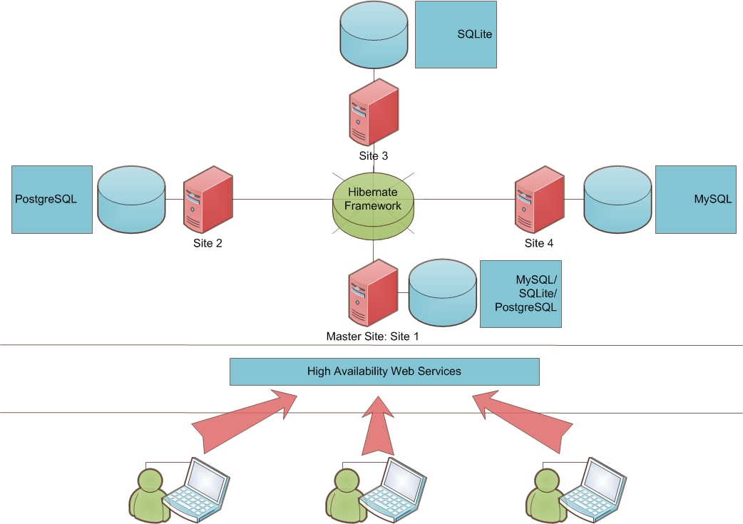
Database System Engines
Notes:
For better operating system compatibility, Programming language: Java
Three heterogeneous DB: MySQL, SQLite, PostgreSQL
Fred elaborate on query communication using Hibernate Framework
Next slide: Henry’s Web Service

Slide 5
High Availability (HA) Web Service
Notes:
Master Site Strategy & Dictionary Storage
Henry’s

Slide 6
Project Timelines [ Current ]
Initiation
Scope Identification
System Design
Proof of Concept
Mid-Term Presentation
26/04/13
11/03/13
18/03/13
25/03/13
19/04/13
Notes:
Weekly meeting
Success connection from Java Launcher Application to Database
Create Database based on XML file

Slide 7
Project Timelines [ Next ]
System Preparation
Optimization
Database Development
DQPA Development
Documentation
Hibernate Framework
Finalize Optimization Plan
Database Implementation
Hibernate Linkage
Integration
Testing
Report Template Creation
Wrap Up
Final Review
Presentation
Documentation
Launcher
[29/04/2013]
[06/05/13]
[13/05/13]
[20/05/13]
[03/06/13]
[10/06/13]
Fred
Ying
Fred
Henry
Ying
Henry
Notes:
Full participations throughout the process
Perform in-depth fragmentation calculation
Actual Implementation, Integration & Testing
Report & Documentation & Presentation

Slide 8

Project Values
Communication of 4 Physical Computers
Heterogeneous Database Engine
MySQL
SQLite
PostgreSQL
High Availability (HA) Recovery

Slide 9

Thank you
Question and Answer?

