Slide 1
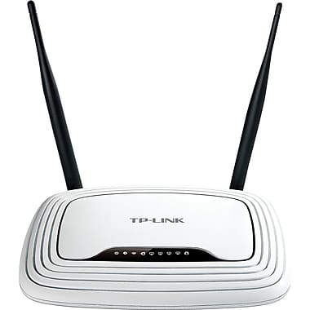

SKIP THE CART
MOBILE GROCERY ORDERING APPLICATION
trACEroute
COMP 3350
Summer 2018

Slide 2
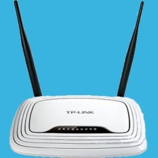

The Vision:
SKIP THE CART provides Winnipeg shoppers the opportunity to browse, order and have same-day delivery of fresh and packaged grocery items from the store to their homes or places of business.
SKIP THE CART
MOBILE GROCERY ORDERING APPLICATION
trACEroute
Notes:
*** 1 minute *** (1:00)
Users: Customers, employees/managers, delivery drivers
Initial vision a lot more ambitious than what was delivered.
Features / Stories not yet implemented:
Customer view products by department/category with drill-down listing
Customer track delivery progress in real-time
Customer rating system
Refund/Exchange
Help and support centre

Slide 3
The TEAM:
GOUTHAM “Dev” Dhannapuneni :
UX genius able to churn out entire features in a single day
YI “Ollie Login” PENG:
Account management workhorse and acceptance test afficionado
RONALD “Fixer” MALIXI:
Project Hound with the ability to sniff out and destroy bugs and smells
JUSTIN “Time” GOUGE:
Head priest of the Church of the Unit Test and LEAN master of JIT delivery
CHRIS “The Mouth” CHMELYK:
Prophet of Constant Integration, troubled by merge conflict nightmares
SKIP THE CART
MOBILE GROCERY ORDERING APPLICATION
trACEroute
Notes:
*** 1 minute *** (2:00)
Goutham and Ollie performed bulk of work on presentation layer and feature delivery.
- Goutham: storefront features
- Ollie: user account management features
Ronald and Chris handled bulk of persistence layer/database, integration and merge conflicts, and bug fixing
Justin handled majority of work on unit and integration tests, and didn’t complain too much when people broke them.
Documentation sort of fell by the wayside…

Slide 4

THE DEMONSTRATION:
SKIP THE CART
MOBILE GROCERY ORDERING APPLICATION
trACEroute
Notes:
*** 3-4 minutes *** (6:00)
Justin to deliver

Slide 5
The SUCCESSES:
A majority of features were implemented IAW vision statement
We had good team communication, rapport and participation
We all learned a lot about Android development and GIT
We got to experience first-hand several of the principles taught on the course
SKIP THE CART
MOBILE GROCERY ORDERING APPLICATION
trACEroute
Notes:
*** 1 minute *** (7:00)
While we didn’t accomplish everything we set out to, we nevertheless got most of it done
We all got along with each other, participated on Slack
Despite people’s busy schedules (courses, work), everyone contributed
Each of us brought different expertise we all learned from
e.g. Goutham - Android dev; Justin - GIT; etc
We learned with first-hand experience why this is a required course
More about this on the next slide.

Slide 6
LESSONS LEARNED:
AGILE is not a panacaea
Incurring technical debt can be costly
Stick to your flow plan, and employ constant integration
‘Freeze’ the branch before a release
Documentation is actually important
Development-driven testing is not optimal
SKIP THE CART
MOBILE GROCERY ORDERING APPLICATION
trACEroute
Notes:
*** 2 minutes *** (9:00)
AGILE development, might not be the optimum solution for all projects or parts of projects
It is ideally suited to producing UX features
Does not necessarily provide for a good data model
Caused difficulties WRT persistence layer in Iteration 2
Iteration 1 design decision caused bad smell that we decided not to fix for Iteration 2
Decided to use inheritance – should not have done that
Caused a tonne of work in iteration 3 to refactor
In iterations 1 and 2, we used GIT to defeat us
Did not adhere to GitHub flow we had decided upon
Everyone working on isolated and old branches
Every commit resulted in serious merge conflicts, regressions
We pushed several last-minute changes in Iteration 2
Scrambled to fix resulting bugs, and left no time for other work
Should have pushed features to a later date
Our lack of documentation hampered our ability to work efficiently
Team members were occasionally unsure of what they should be doing
Work was often duplicated
Testing…yeah.

Slide 7

QUESTIONS
SKIP THE CART
MOBILE GROCERY ORDERING APPLICATION
trACEroute

