Slide 1
Serverless Image Labeling & Retrieval Application
Prepared by: Team4
Highly Available, Multi-Region, Serverless AWS Architecture

Slide 2
Architecture Overview
Global entry point via Amazon CloudFront (HTTPS)
Static frontend hosted on Amazon S3
API Gateway exposes backend APIs
Amazon Cognito provides authentication & JWT tokens
AWS Lambda handles application logic
Amazon RDS (Multi-AZ) stores image metadata
Amazon Rekognition analyzes uploaded images

Slide 3
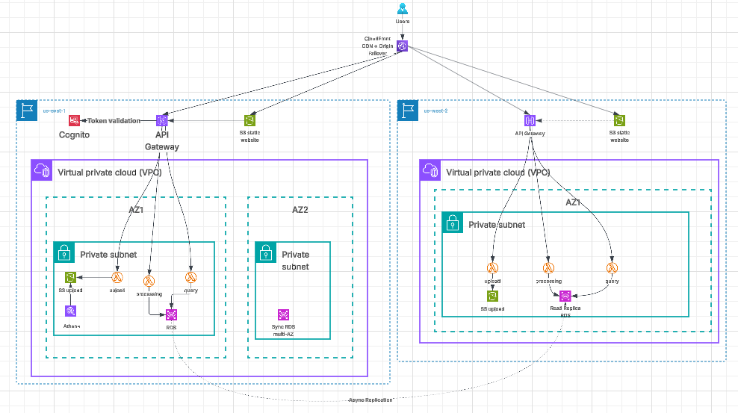
Architecture

Slide 4
End-to-End User Workflow
User accesses website via CloudFront
User authenticates with Cognito
Frontend requests pre-signed S3 upload URL
Image uploaded directly to S3
Lambda triggers Rekognition analysis
Metadata stored in Amazon RDS
User retrieves images & labels via API

Slide 5
HA & DR
Amazon RDS Multi-AZ for AZ-level fault tolerance
Cross-region RDS Read Replica for DR
CloudFront Origin Groups handle regional failover
Primary & DR regions host identical stacks
Automatic failover without DNS propagation delay

Slide 6
Why Serverless Architecture?
No server management
Built-in scalability
Pay-per-use cost model
High availability by design
Strong security boundaries

