Slide 1
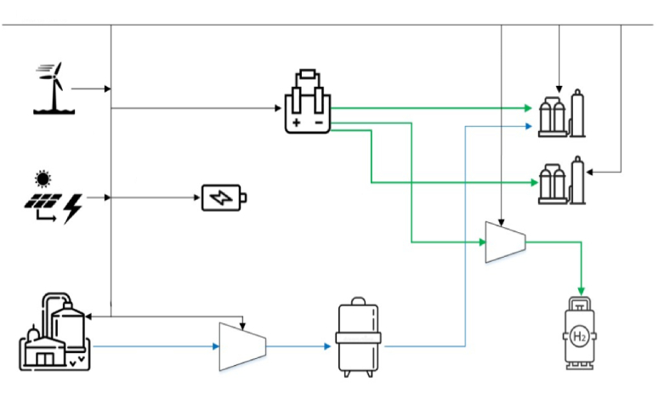
Wind turbine
battery
PV panels
Biogas plant
Compressor A

Slide 2

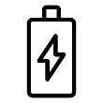

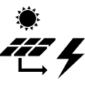

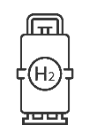
60kV
Battery
Plant 1
Wind trubine
10kV
PV panels
Plant 2
Electrolyser
Compressor
Hydrogen tank

