Slide 1
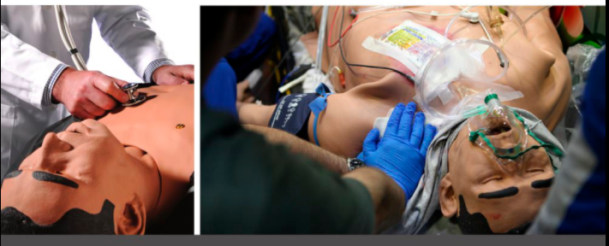
DREAD analysis and mitigation
for a medical mannequin as described by Glisson et al (2015)

Slide 2
 | Damage | Reproducibility | Exploitability | Affected users | Discoverability
week authentication / bruteforce | 1 | 2 | 2 | 1 | 3
denial of service | 1 | 2 | 2 | 1 | 1
man in the middle | 1 | 3 | 3 | 1 | 3
0 = no risk
1= some risk
2= elevated risk
3 = maximum risk.

Slide 3
Mitigations
Two factor authentication (2FA)
use state of the art wireless protocols (WPA-2, Bluetooth) instead of outdated and unsecure protocols (WPA)
Deploy VPN
Deploy firewall / limit logins to a specified IP address or range
Monitor the network for intrusion via Intrusion Detection System (IDS)
Deactivate vulnerable features (WPS) of the network
Use wired connection only (e.g., cross-link cable), if feasible
Add authentication and encryption in the application layer of the system software
Limit failed login attempt
Do not use default port, edit the port line in sshd_config file
Use Captcha
unique login URLs

