Slide 1
Reinforcement Learning via Diffusion
(final presentation)
Yibin Hu, Daniel Wang, Raymond Liu

Slide 2
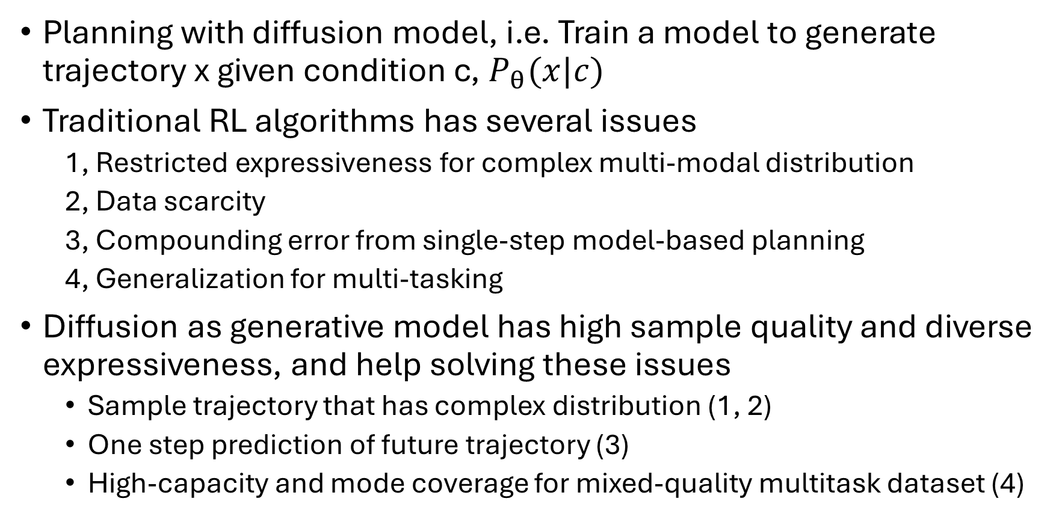
Problem Overview
Planning with diffusion model, i.e. Train a model to generate trajectory x given condition c, $P_{θ}(x|c)$
Traditional RL algorithms has several issues
1, Restricted expressiveness for complex multi-modal distribution
2, Data scarcity
3, Compounding error from single-step model-based planning
4, Generalization for multi-tasking
Diffusion as generative model has high sample quality and diverse expressiveness, and help solving these issues
Sample trajectory that has complex distribution (1, 2)
One step prediction of future trajectory (3)
High-capacity and mode coverage for mixed-quality multitask dataset (4)
Notes:
Restricted expressiveness: for example, policy with unimodal Gaussian parameterization is difficult to use when multiple actions are likely favored
Data scarcity: data augmentation is limited to simple environment
Compounding error: When predicting with a neural dynamic model, there could be single-step errors due to the limited data support and stochastic environment transitions. Cumulative single-step errors can make planned states deviate from the dataset distribution
Generalization for multi-tasking: Even in the same environment, changing the reward function requires retraining a policy from scratch. Existing online multitask works attempt to learn the same policy in different task environments, suffering from conflicting gradients across multiple tasks and low sample efficiency due to pure online learning.

Slide 3
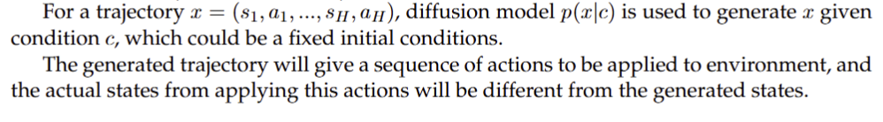
Planning Task: Walker2D
We replicate the diffusion planning on Walker2D by using trajectory dataset from D4RL walker2d expert and Gymnasium environments
The predicting diffuser is U-Net architecture with
Multiple residual blocks with temporal convolution
Temporal Embedding
The trajectory x is sequence of state action pair, for walker2d, state has 17 dimensions and action has 6 dimensions, the planning horizon is 7 (original paper use 32), so shape(x) = (23, 32)
Max diffusion step is 20
Adam optimizer, learning rate 4e-05, batch size 32, around 500k steps trained

Slide 4
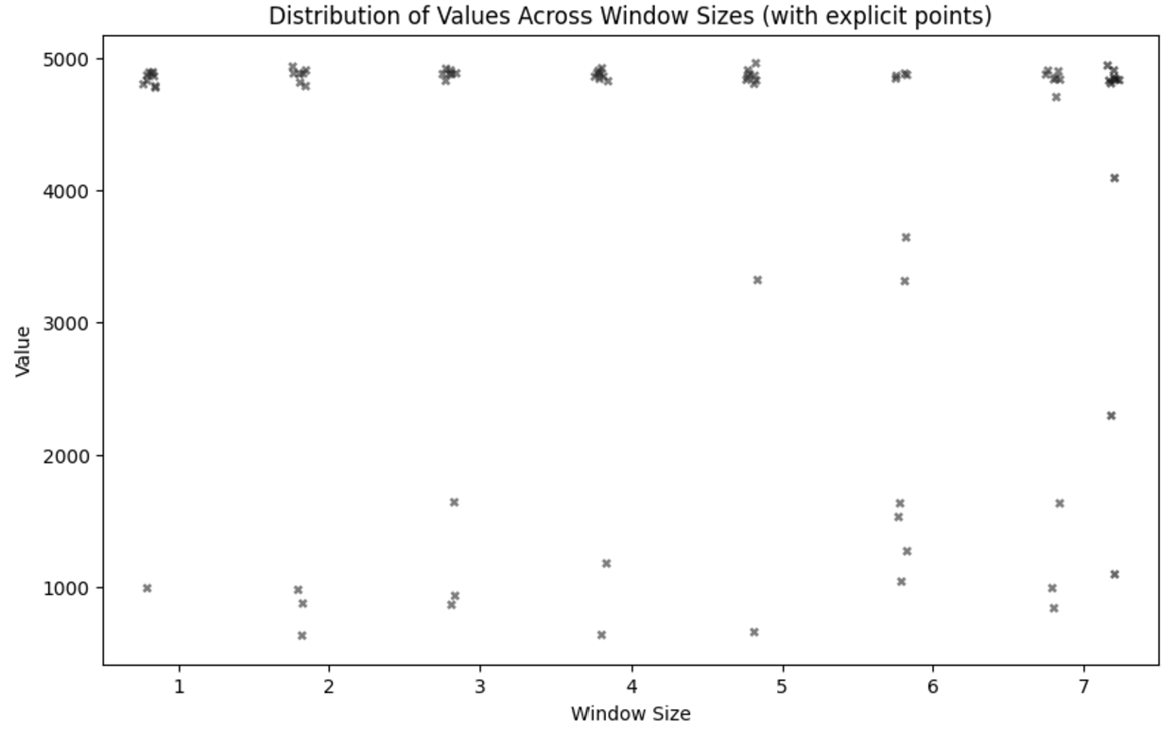
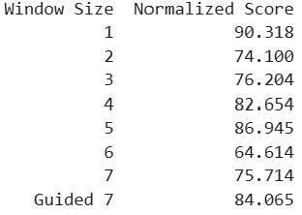
Results: Walker2D
We tested the performance with effective horizon from 1 to 7 (the model is trained with planning horizon being 7), when the window size is 0 this model just predicts the action given the state. The plot show as the effective planning horizon increases the agent will more frequently end an episode earlier, resulting in a lower average value
We also noted that the normalized score, which is defined to be (test value / average value of dataset)x100 (unit is %), is lower than 100, which is expected, as diffusion is learning to mimic the dataset trajectory, the learned trajectory can’t outperform the original trajectory.

Slide 5
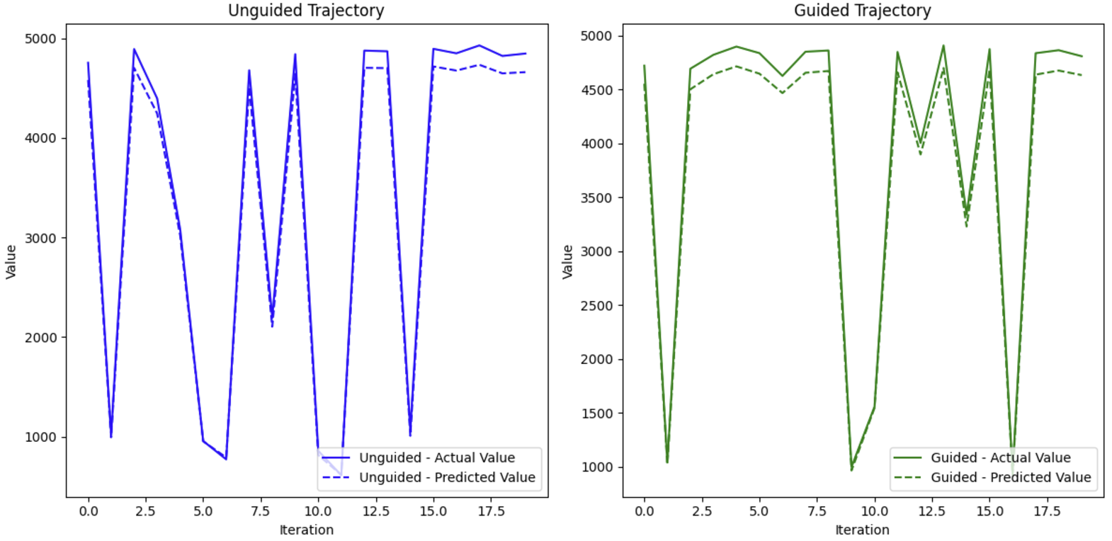
Results: Walker2D
For horizon = 7, 20 episodes are tested for guided and unguided diffusion, although the value model does correctly predict the value of trajectory, the result show that there is instability in our replication of the original paper’s result, where larger 32 planning horizon is used.

Slide 6
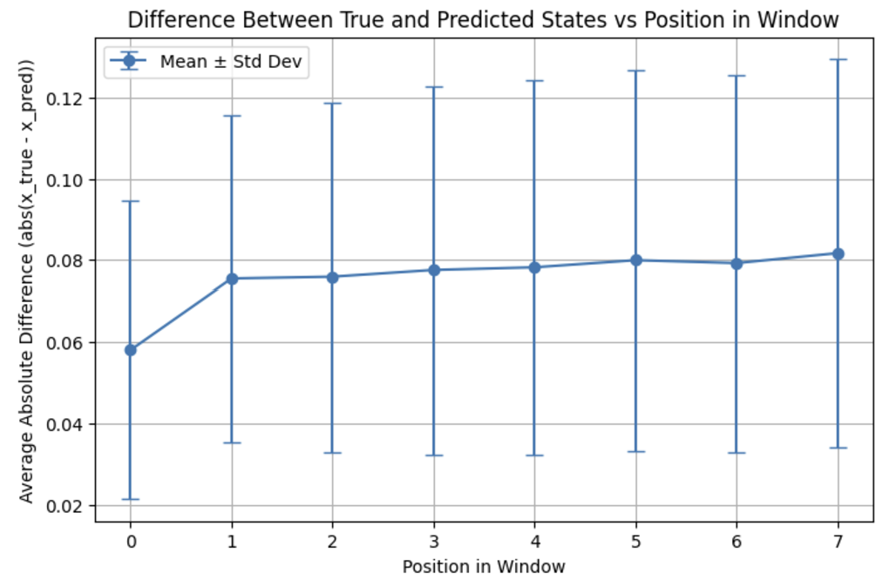

Out of Distribution Problem
The “early stop” of some episodes is caused by the use of generative diffusion, as it can produce deviated or novel trajectory in testing, which leads to inaccurate planning and instability.
The deviation increases for states that is far away and less correlated with initial state $s∈$ [-1, 1]. The initial state mismatch is unclear, likely due to rounding error or mistake in boundary case.

Slide 7
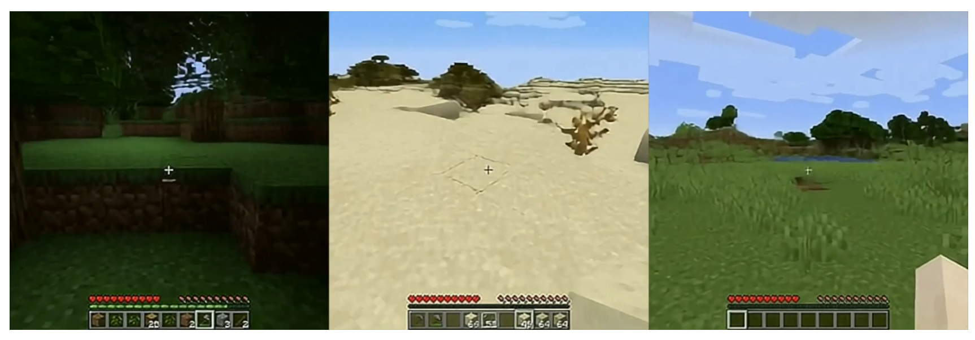
Application
Recently, diffusion transformer and RL are used to generate game by producing the next frames given the current frame and player actions.
Novel combination of states and actions can result in OOD problem, where generated frame could be unrealistic and doesn’t follow physics laws. For example, press forward when facing a wall could lead to generation of a new scene right on the wall.
How to make a generative RL model stay faithful to targeted distribution? How to enforce the model to not break the rules that are implicit in dataset?

Slide 8
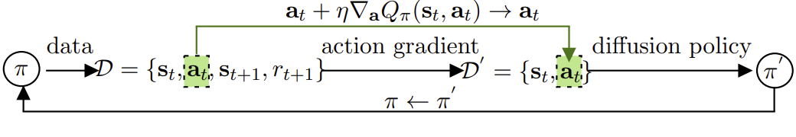
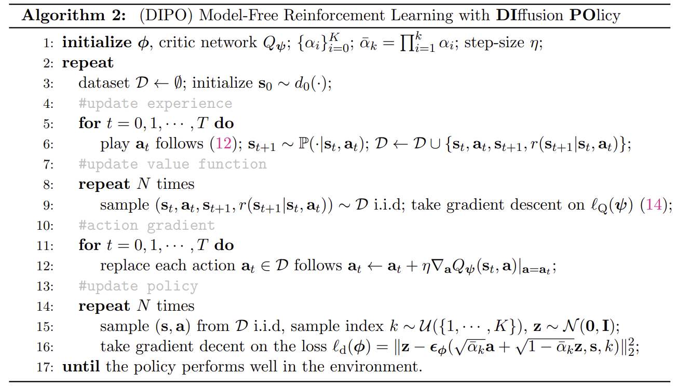
Online RL via Diffusion
We briefly looked at DIPO (Diffusion Policy for Online RL), which uses stochastic process to represent policies as multimodal distributions, enabling more expressive and diverse action generation.
Notes:
Diffusion is used in online learning. After initialization, it first collects some new experience by following the diffusion policy, and then the critic Q network is updated, then actions is updated using the action gradient and replaced by better actions to improve the dataset, and lastly the diffusion policy is updated.

Slide 9
Open Problems
Computation cost: Slow inference prohibit real time application
Credit assignment: In reinforcement learning, it's crucial to assign credit to actions that lead to long-term rewards. Diffusion models are not inherently structured to handle this temporal aspect, making effective credit assignment challenging.
Out of distribution: Use of reward guidance on trained diffusion may not guarantee the convergence, as it causes the diffusion to deviate from learned data distribution, potentially leading the out of distribution problem
Stability and Convergence: Training diffusion models with RL can be unstable, and the convergence to an optimal or near-optimal policy is not guaranteed, as diffusion models are generally designed for generative tasks, not goal-directed planning.
Adapting to Non-Stationary Environments: Diffusion models typically assume a stationary data distribution, which may not align with dynamic RL environments where the distribution of experiences changes as the agent learns.
Data Requirements for Effective Training: Diffusion models often require diverse and high-quality datasets for training. In RL environments, collecting such data can be impractical, especially in tasks that require real-world interactions.

Slide 10
Conclusion
Diffusion Models for RL Planning:
Demonstrated the capability of diffusion models to plan and generate realistic trajectories in reinforcement learning tasks.
Explored the application of both guided and unguided diffusion in solving sequential decision-making problems.
Challenges:
Stability issues and difficulty ensuring convergence when combining diffusion with reinforcement learning.
Handling out-of-distribution scenarios where generated trajectories deviate from realistic or physically valid states.

Slide 11
References
Luo, Calvin. "Understanding diffusion models: A unified perspective." arXiv preprint arXiv:2208.11970 (2022).
Janner, Michael, et al. "Planning with diffusion for flexible behavior synthesis." arXiv preprint arXiv:2205.09991 (2022).
Zhu, Zhengbang, et al. "Diffusion models for reinforcement learning: A survey." arXiv preprint arXiv:2311.01223 (2023).
Ho, Jonathan, Ajay Jain, and Pieter Abbeel. "Denoising diffusion probabilistic models." Advances in neural information processing systems 33 (2020): 6840-6851.
Yang, Long, et al. "Policy representation via diffusion probability model for reinforcement learning." arXiv preprint arXiv:2305.13122 (2023).

Slide 12
Workload
Yibin: Searching and reading papers, implementation (rewrite source codes), experimentation (model training), writing report
Daniel: Reading papers, making slides, implementation (setting up environment), experimentation (testing), writing report
Raymond: Reading papers, making slides, implementation (setting up environment), experimentation (testing), writing report

Slide 13
Rendered Demo
Predicted trajectory (left) and true trajectory (right synced with reality every 8 time steps)
The predicted trajectory is generated by autoregressively apply the model, which shows the states that the model thinks it is experiencing
The true trajectory use the true state observed in env to predict next 8 states every 8 steps.

Slide 14

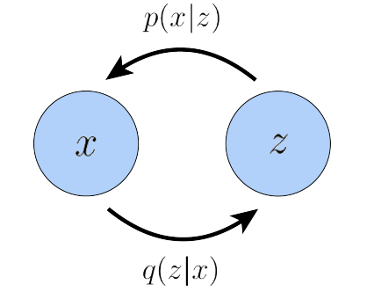
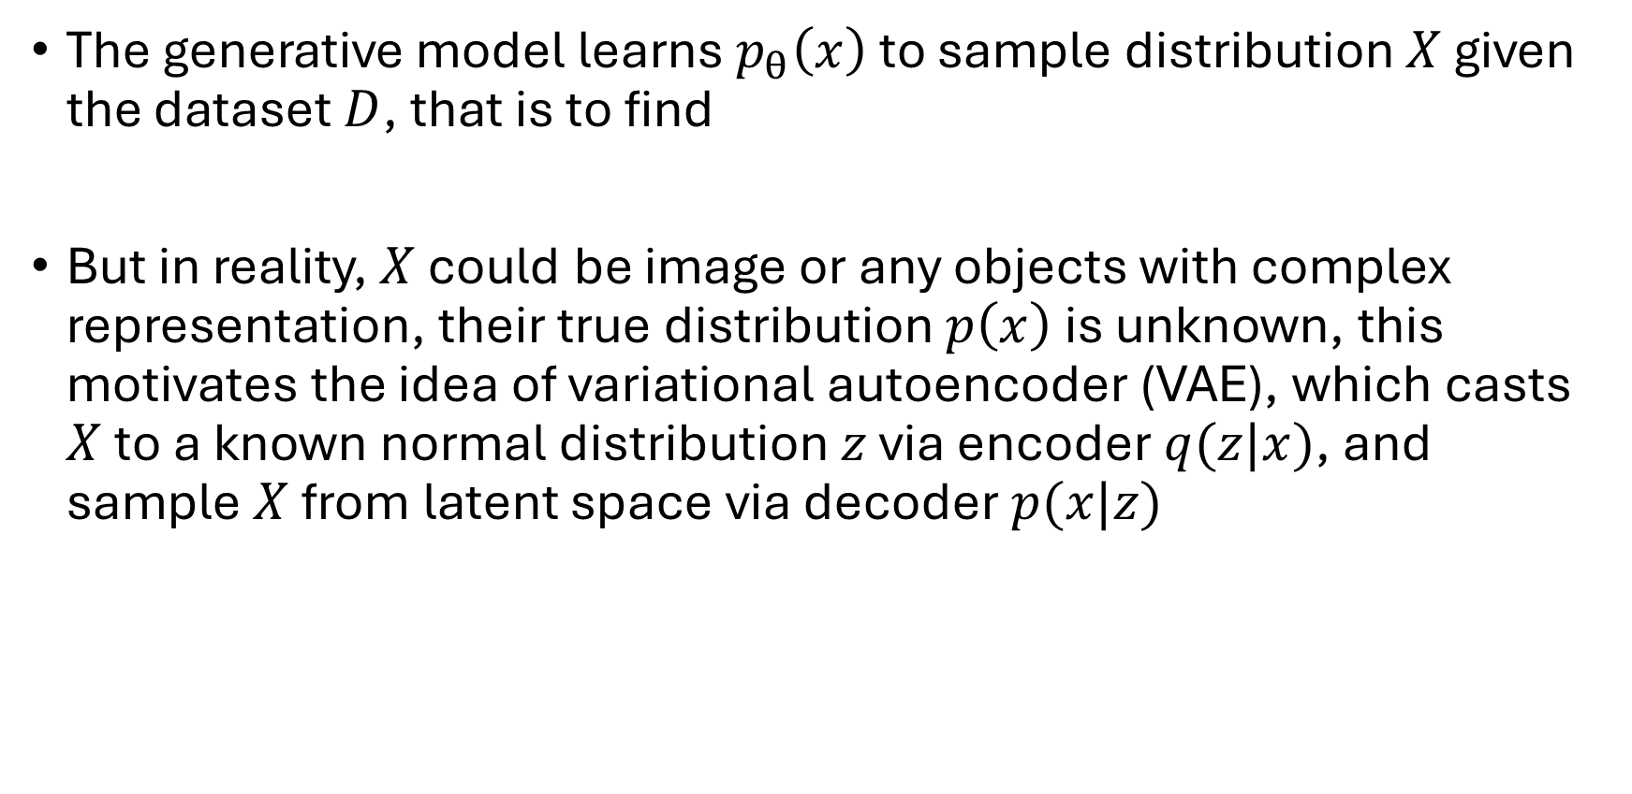
Background: maximum likelihood estimation, VAE
The generative model learns $p_{θ}\left(x\right)$ to sample distribution $X$ given the dataset $D$, that is to find
But in reality, $X$ could be image or any objects with complex representation, their true distribution $p\left(x\right)$is unknown, this motivates the idea of variational autoencoder (VAE), which casts $X$ to a known normal distribution $z$ via encoder $q(z|x)$, and sample $X$ from latent space via decoder $p(x|z)$

Slide 15
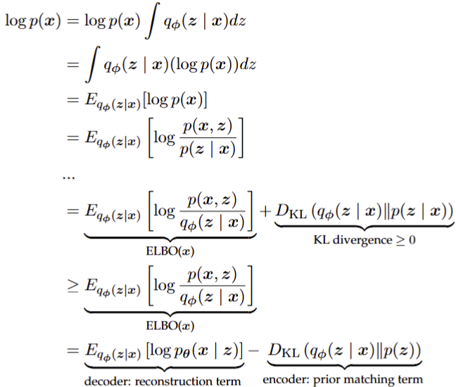
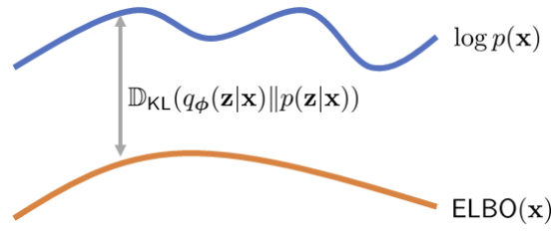
Background: Evidence Lower Bound (ELBO)
Under VAE formulation, it can be shown MLE is equivalently to maximize ELBO*
*: Calvin Luo, Understanding Diffusion Models: A Unified Perspective, p3-5
Notes:
So to maximize the log likelihood is equivalent to maximize likelihood of sample x given z, while minimizing the KL divergence of decoder, that is to make the latent z from x be close to targeted normal distribution.

Slide 16
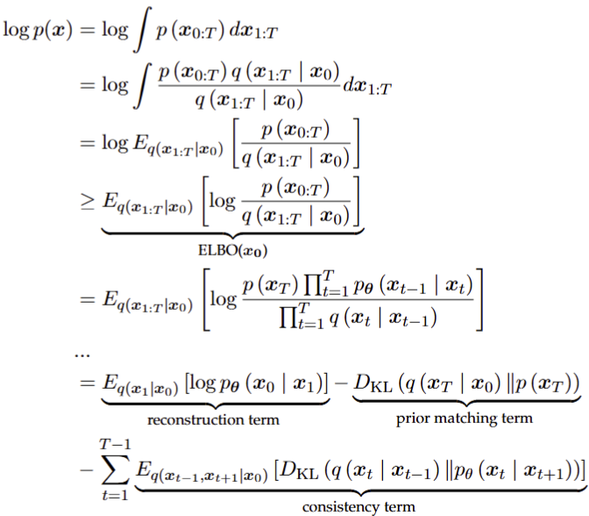
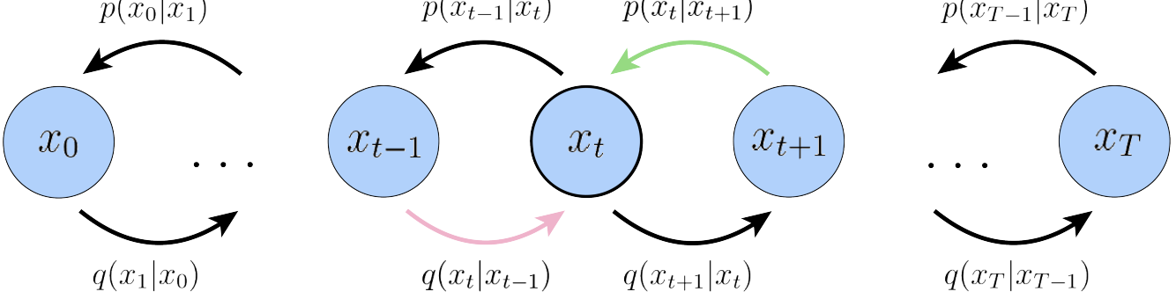
Background: Variational Diffusion Model
With VAE, Variational Diffusion Model generalizes to have multiple deep latent layers for richer representation of higher-level abstraction
Notes:
Following similar arithemetics done for VAE, it can be shown that the variational diffusion model are optimizing reconstruction term, prior matching term plus a series of denoising matching term, same as before, the reconstruction term ensure the reconstructed x0 to be close to data distribution, and prior matching term make sure that the highest latent x_T is pure gaussian noise. Here, the extra edition is the consistency term, which minimizes the KL divergence between xt from encoder and x_t from decoder, that is to ensure denoising step inverse what nosing step do.

Slide 17
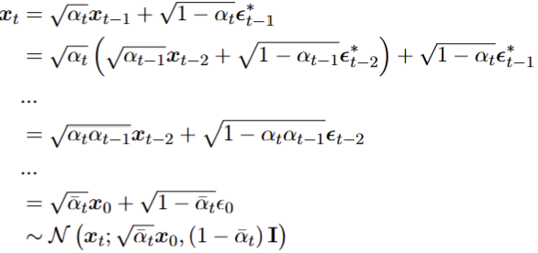
Background: Noising
The nosing step is a series of deterministic procedures that gradually remove information and turn x into Gaussian noise
Notes:
In each step t, x_t is converted from x_t-1 from Guassian diffusion kernel with diffusion schedule parameters alphas, this is equivalently seen as replace portion of x_t-1 with guassian noise. We can replug this recursive relation back into itself to get the one step nosing formula that output x_t given x_0. So with this any ground truth x_0 can be noised to arbitrary time step in one step calculation, and the encoder process of diffusion is pre-determined and doesn’t need to be learned.

Slide 18
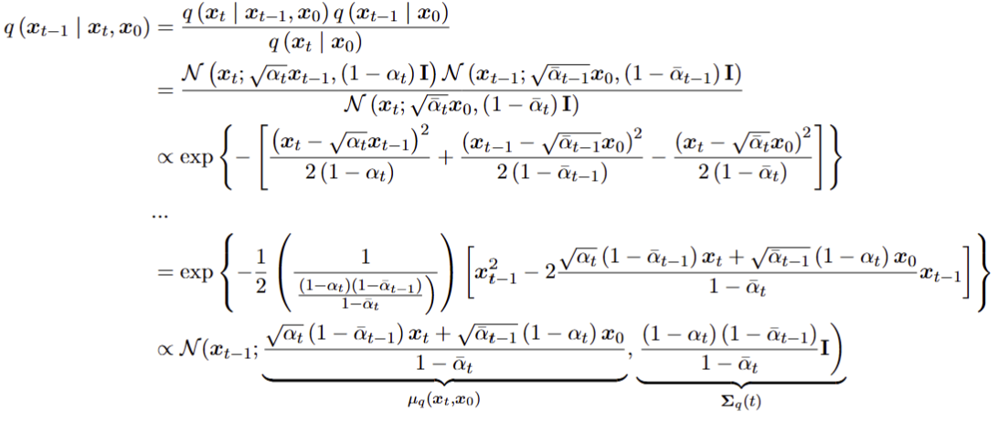

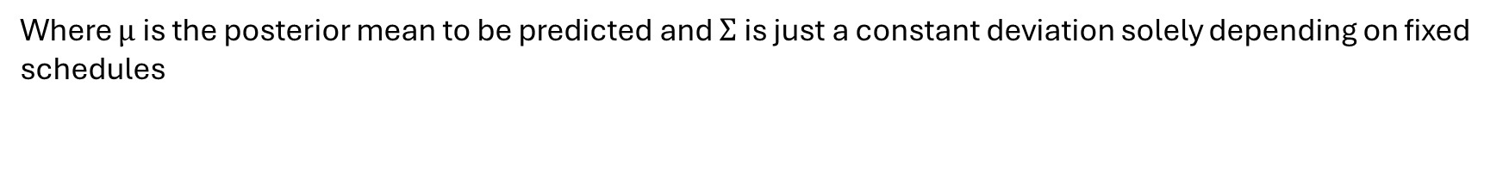
Background: Denoising
The denoising steps gradually recover the object from pure noise by reversing process. Using Bayes rule, the $q\left(x_{t−1} | x_{t}\right)$ is
Where $μ$ is the posterior mean to be predicted and $Σ$ is just a constant deviation solely depending on fixed schedules
Notes:
Using the Bayes rule, the reverse distribution for encoder can be derived by writing it in terms of known expression, which are just guassian kernel, writing them out explicitly and combine, and then doing some algebra to complete the square and rewrite the whole expression into a gaussian diffusion for x_t-1, we eventually arrived at a expressions for posterior mean mu_q and sigma_1

Slide 19

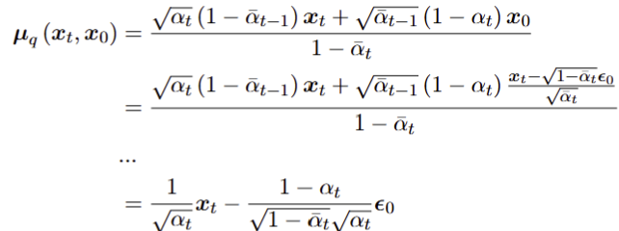

Background: Predictions
To reverse the diffusion is to learn the posterior mean that transition $x_{t−1}$ from $x_{t}$

Slide 20
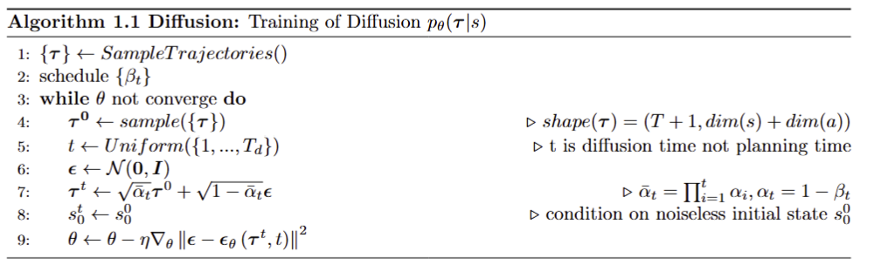
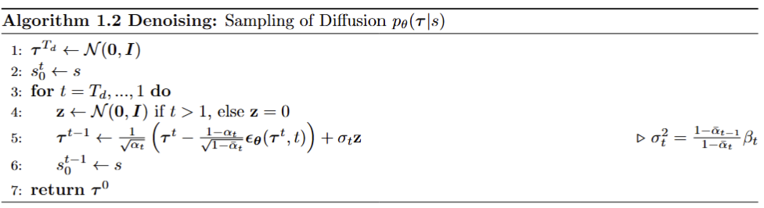
Diffusion Algorithm $P_{θ}(τ|c)$
The general algorithm for planning with diffusion for c being initial state s of a trajectory x
Notes:
To train the diffuser, first schedule constants like beta and alphas are previously calculated, then trajectory is sampled from the dataset and perturbed into a arbitrary timestep between 1 and capital T, the max diffusion step using the one step encoding derived earlier. Then a conditioning is applied, here that is to make the initial state to be s, then the diffuser predict the noise given the perturbed trajectory and the timestep it is at. To sample a trajectory given an initial state, first a pure noise is drawn from gaussian at max diffusion step and it is denoised repetitively by subtracting the predicted noise, and conditioning is also applied at each step, this eventually returns a generated trajectory that fulfill the conditions.

