Slide 1








CGMM: Non-Invasive Continuous Glucose Monitoring in Wearables Using Metasurfaces
© MobiCom 2025
Hong Kong, China
Hao Pan, Yezhou Wang, Jiting Liu, Ruichun Ma,
Lili Qiu, Yi-Chao Chen, Guangtao Xue, Ju Ren
Notes:
Hi everyone, this is hao pan from MSRA. This time, I’m here on behalf of all the authors to share our work. The title is:

Slide 2
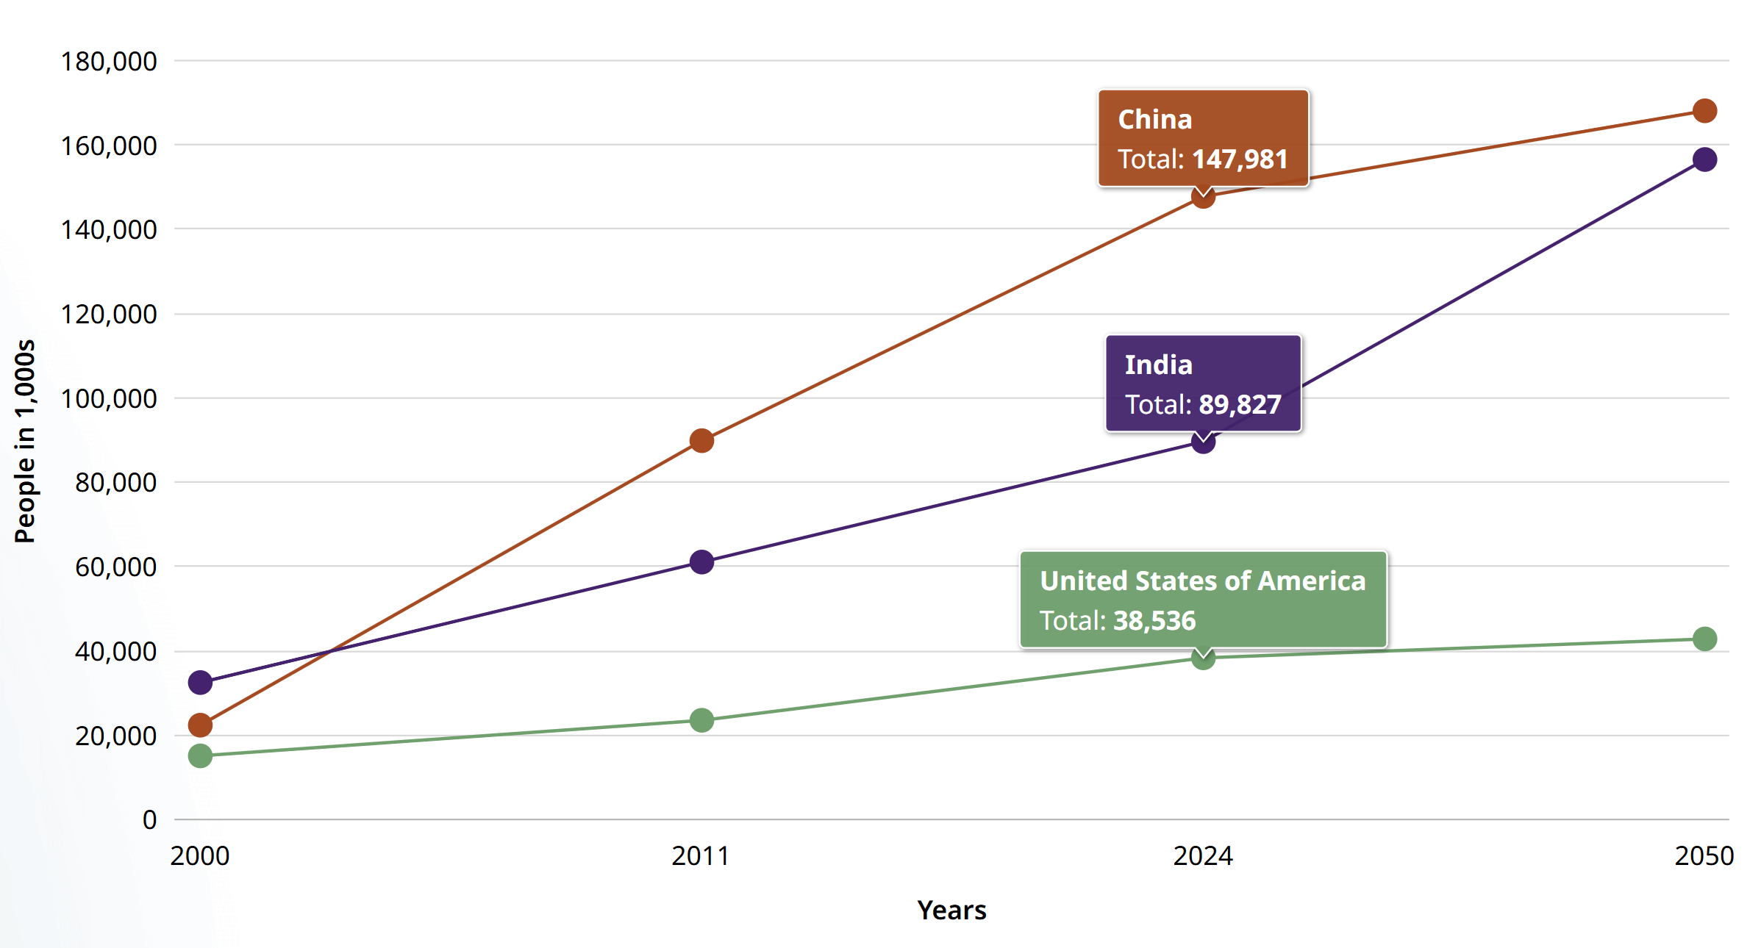
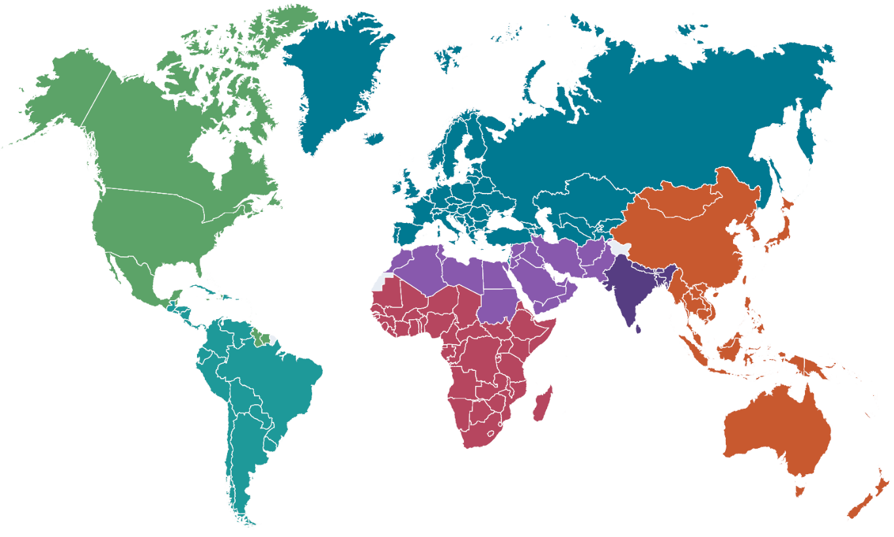
Diabetes is a Growing Global Health Threat
Diabetes has become a major global public health challenge in the 21st century.
By 2024, there will be a total of 589 million adults aged 20–79 with diabetes globally; this number is projected to reach 853 million by 2050.
As of 2024^{[1]}, the number of people with diabetes is:
China: 147.9 million
India: 89.8 million
USA: 38.5 million
By 2050^{[2]}, the projected number of people with diabetes worldwide:
Europe:
72.4 million
North America:
68.1 million
Western Pacific: 253.8 million
Middle East
and North Africa: 162.6 million
South America: 51.5 million
Africa: 59.5 million
[1] https://diabetesatlas.org/data-by-location/country/china/
[2] https://diabetesatlas.org/resources/idf-diabetes-atlas-2025/
Notes:
Diabetes has become a major global public health challenge in this century. And the number of people with diabetes is increasing rapidly every year.

Slide 3
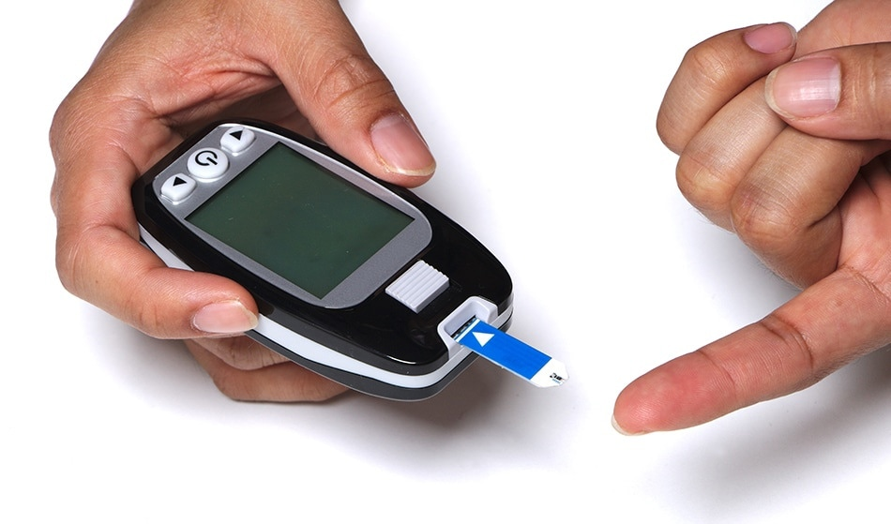
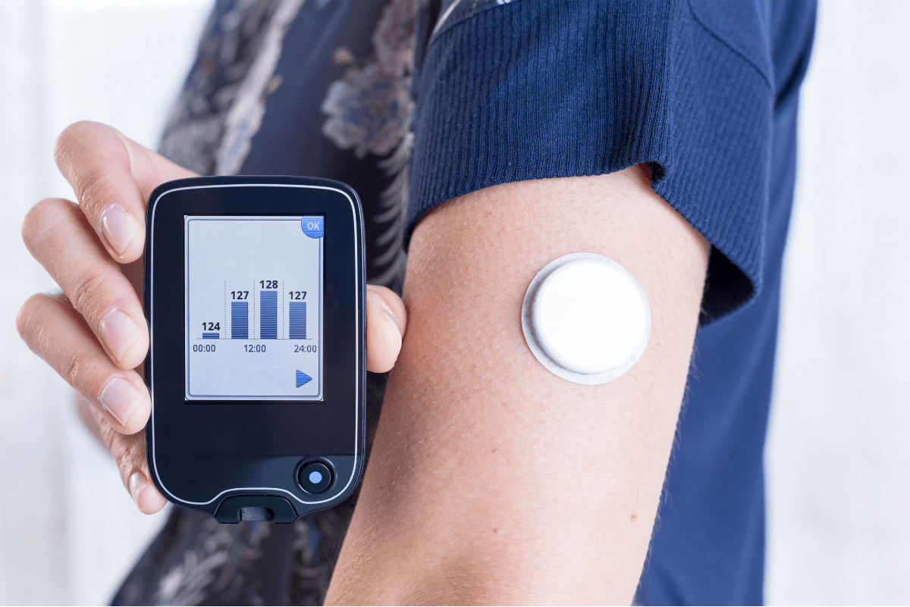
Existing Methods for Glucose Sensing
Glucometer (Fingertip Blood Sampling) :
• Lancet (for individual patient use only)
• Disposable test strips (consumables)
• Blood glucose meter
Continuous Glucose Monitor (CGM):
• CGM sensor (consumable, replaced every two weeks)
• CGM reader (data reading based on NFC/BLE technology)
Notes:
Currently, there are mainly two types of commercial glucose monitors.
One is the standard finger-prick meter—you use a lancet to get a drop of blood from your finger and test it.
The other is the continuous glucose monitor, or CGM, where you wear an invasive sensor that continuously tracks the glucose changes and sends data to a reader.

Slide 4
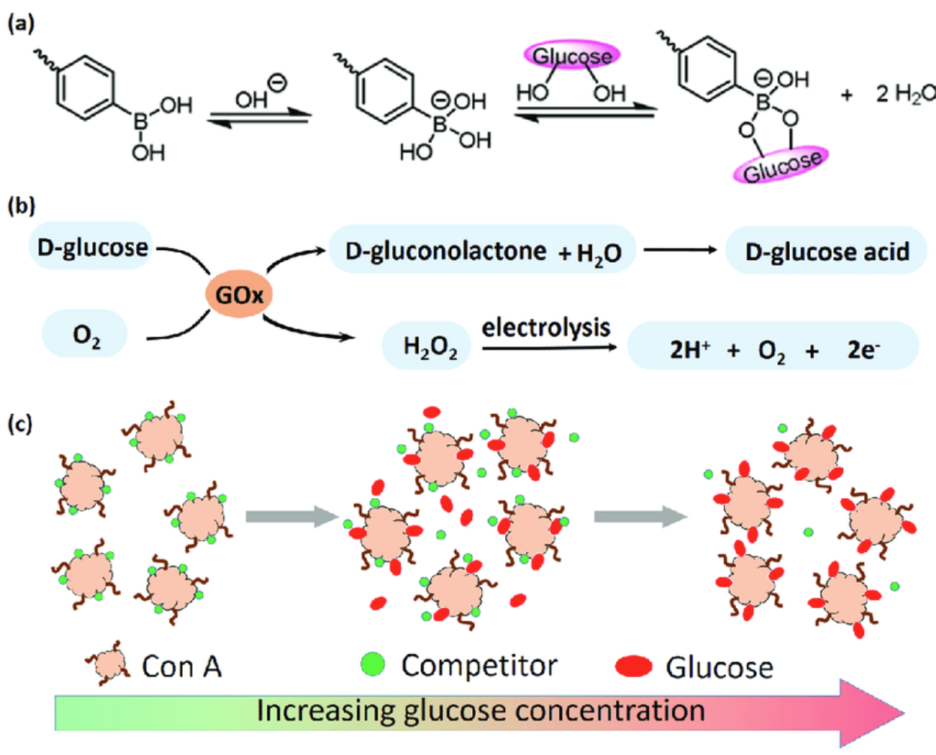
Existing Methods for Glucose Sensing
Electrochemical
Principle:
Glucose oxidase (GOx) oxidizes glucose molecules to produce hydrogen peroxide (H₂O₂), which is further converted into an electrical signal.
Advantages:
High accuracy
Provides absolute values
Disadvantages:
Invasive, causing pain and discomfort
Glucose oxidase (GOx) requires regular replacement
Notes:
All these methods are based on electrochemical principles. Basically, glucose oxidase reacts with glucose in the blood, producing H2O2, which gets turned into an electrical signal the device reads.
The advantage is they're very accurate and output the absolute glucose values. The drawback is, they're invasive—so they can be painful or uncomfortable. Another point is the CGM sensor needs to be replaced each two weeks.

Slide 5

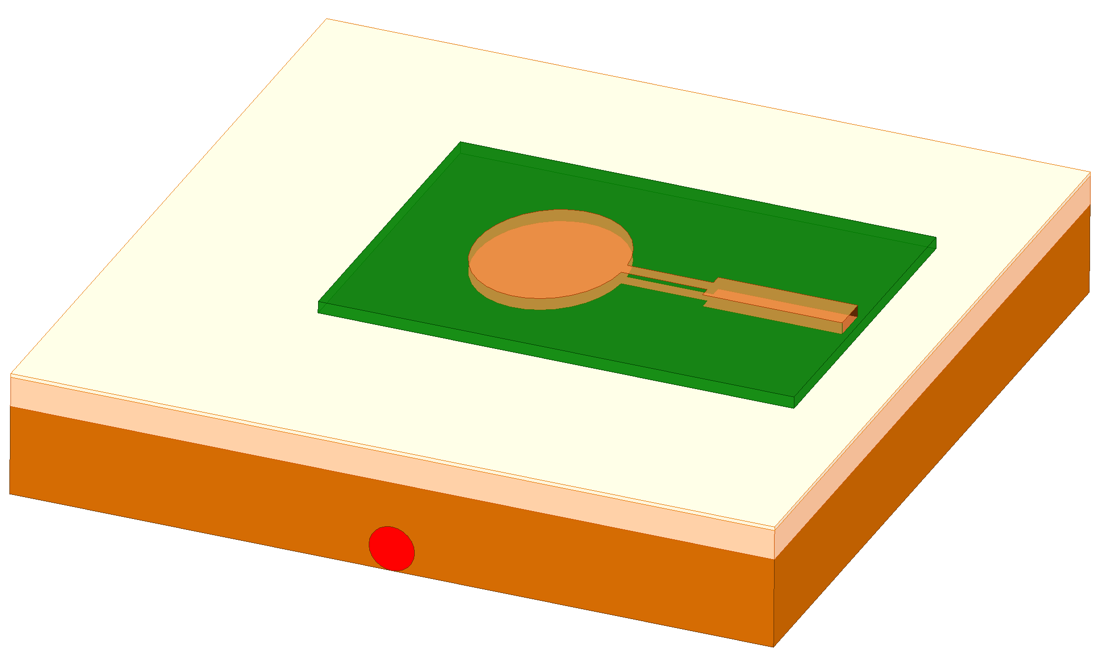
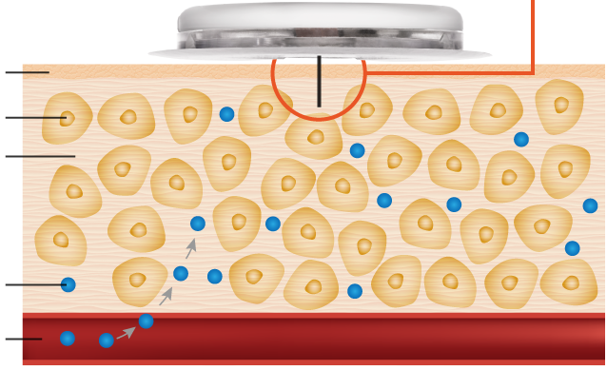

From Invasive to Non-invasive
CGM Sensor
Filament
Skin
Patch antenna
Skin
Cells
Interstitial
fluid
Interstitial
fluid
Fat
Glucose
Muscle
Blood vessel
Blood vessel
Electrochemical (invasive):
A probe is permanently implanted under the skin to extract interstitial fluid for blood glucose concentration measurement.
Electrophysical (non-invasive):
The PERMITTIVITY of interstitial fluid changes with glucose concentration.
The device is attached to the surface of the skin, and measures blood glucose concentration by detecting changes in electrophysical properties.
Notes:
Our goal is to shift from invasive continuous glucose monitoring to an non-invasive approach.
Traditional CGM sensors rely on a soft needle that sits under the skin to measure the glucose concentration in the tissue liquid. Instead, we’re exploring an electrophysical method to detect glucose changes.
The basic principle is, when glucose level in the tissue liquid changes, its overall permittivity also changes. By placing antennas or other RF devices on the skin, we have the opportunity to quantify these permittivity changes, and in turn, sense the blood glucose information in the noninvasive manner.

Slide 6

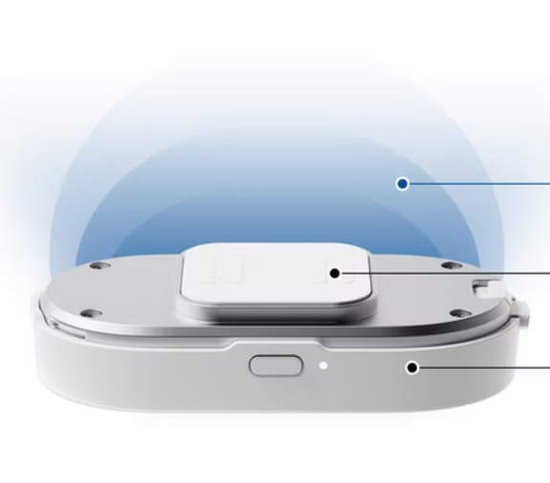
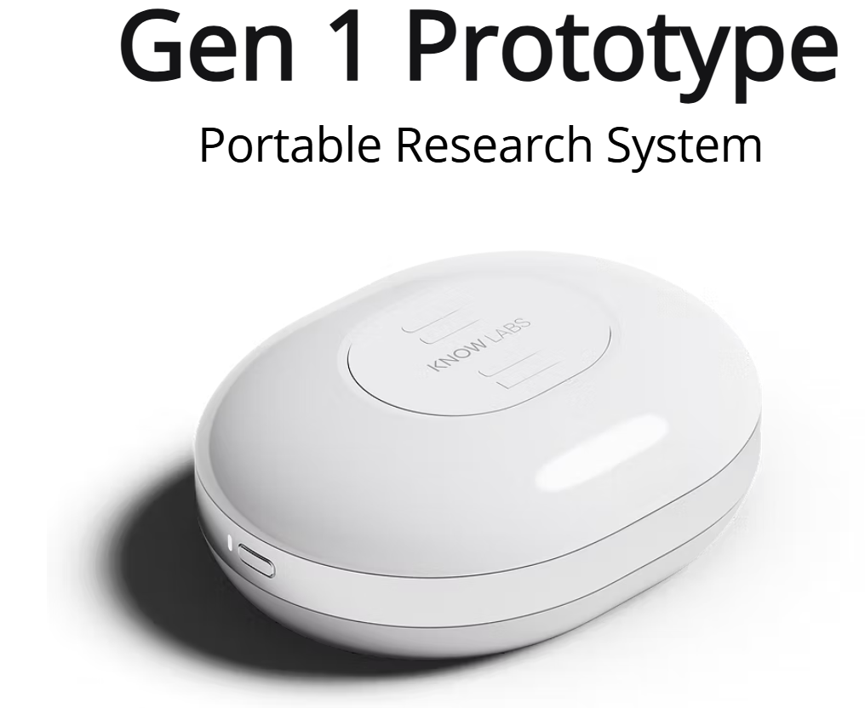
Existing Works on Non-invasive Glucose Sensing (RF-based)
Energy Field
Antenna
Array
RF
Generator
Hagar Technology (Israeli), has developed the Gwave, an non-invasive (watch-style) blood glucose device^{[1]}
It uses RF wave to continuously and in real time monitor glucose levels in the blood.
No commercial products have been released to date.
[1] https://www.hagartech.com/
Know Labs (U.S.) has developed a portable non-invasive blood glucose measurement device^{[2]}
An RF dielectric sensor scans the entire tissue (including interstitial fluid, capillary blood, venous blood, and cellular glucose).
An antenna array transmits and captures RF wave (reflected) signals, predicting the glucose concentration changes.
No commercial product is currently available.
[2] https://www.knowlabs.co/technology
Notes:
A few startups are trying non-invasive glucose monitoring using electrophysical methods. For instance, Hagar Technology has developed something called GWave for watch-style monitoring, but they haven’t shared technologies details. Know Labs is working on a portable device that uses RF antennas at different frequencies to spot small changes in reflectance and detect glucose. But so far, none of these options have a product on the market.

Slide 7
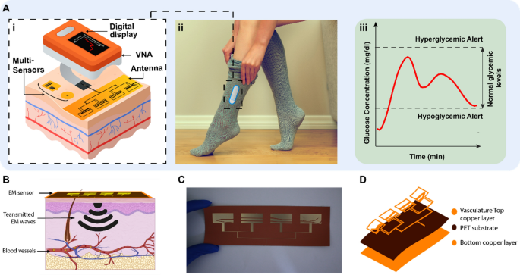
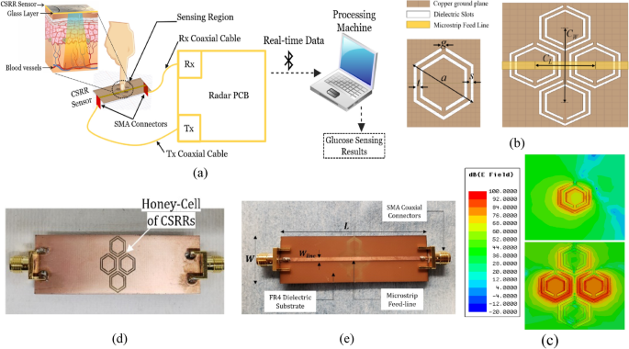
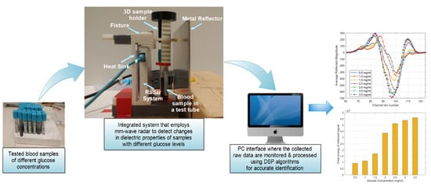
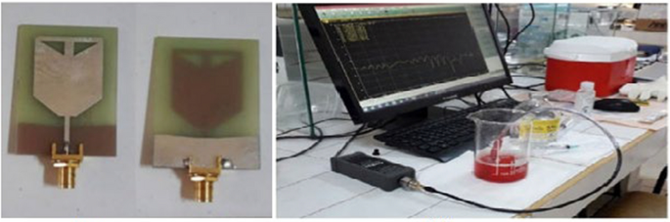
Existing Works on Non-invasive Glucose Sensing (RF-based)
[1]
[2]
[4]
[3]
[1] Wearable flexible body matched electromagnetic sensors for personalized non-invasive glucose monitoring. Nature Scientific Reports, 2022
[2] Low-cost portable microwave sensor for non-invasive monitoring of blood glucose level: novel design utilizing a four-cell CSRR hexagonal configuration. Nature Scientific Reports, 2020
[3] A microwave system based on a UWB microstrip antenna for non-invasive in vitro measurement of glycemia in human blood: an experimental study. Microwave and Optical Technology Letters, 2022.
[4] Blood glucose level monitoring using an FMCW millimeter-wave radar sensor. Remote Sensing, 2020
Notes:
Some researchers have tried designing antennas or RF resonators and measuring reflectance, known as the S11 parameter, to predict changes in glucose levels.
Note that, in these papers, they all assume that any changes in permittivity of tissue liquid are mostly due to changes in blood glucose, as long as temperature and humidity stay constant during the measurement.

Slide 8
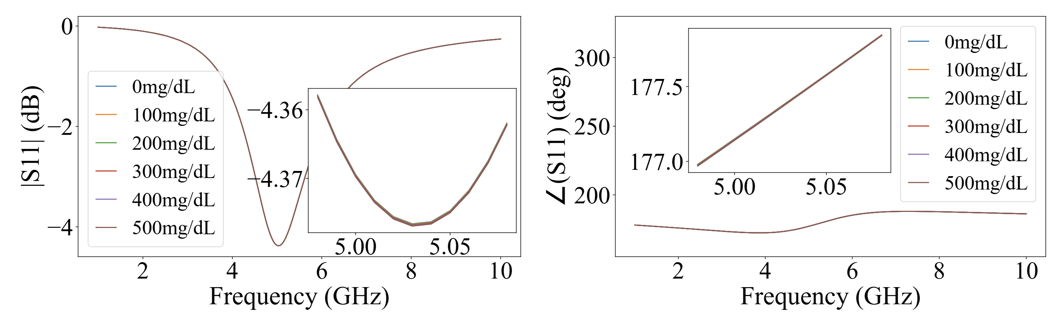










Preliminary Analysis: Directly Using Antenna/Resonator
skin-fat-muscle-bone
$$Z_{s}\text{,}{\text{γ}}_{s}$$
$$Z_{f}\text{,}{\text{γ}}_{f}$$
$$Z_{m}\text{,}{\text{γ}}_{m}$$
…
$$l_{s}$$
$$l_{f}$$
$$l_{m}$$
Changes in $S_{11}$ (antenna/resonator frequency response) is very small
Highly sensitive equipment is required for measurement.
antenna
$$Z_{antenna}$$
$$Z_{load}$$
$$Z_{source}$$
human tissues
TX / RX
$$S_{11}$$
antenna
skin
fat
muscle
Notes:
But in fact, it’s difficult to directly detect those primitivity changes caused by the glucose changes with an antenna or resonator.
To look into this, we built a circuit model combining the antenna and human tissue. Tissue liquid is mainly include skin, fat, and muscle, and any change in their permittivity affects the antenna’s S11 parameters. [click] Our simulations showed that even if you use a regular WiFi antenna and change glucose from 0 to 500 milligrams per deciliter, there’s no noticeable changes in S11 amplitude or phase. So, directly using antenna would require super sensitive RF equipment.

Slide 9
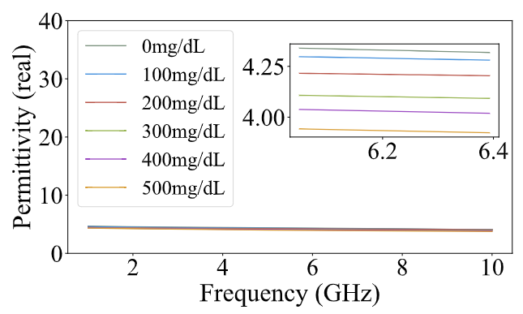
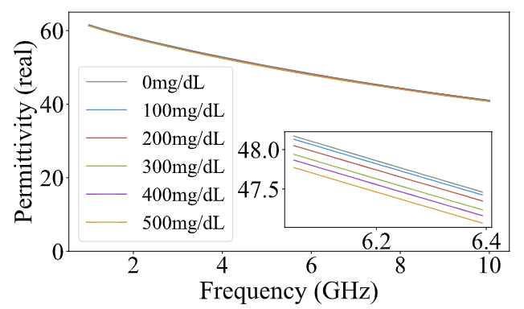







Permittivity Changes of ISF and Blood are SMALL!
Glucose
concentration:
0->500mg/dL
Permittivity of fat:
4.29 to 3.96
Change rate is only
7.7%.
Glucose
concentration:
0->500mg/dL
Permittivity of muscle:
48.23 to 47.77
Change rate is only 0.95%
skin-fat-muscle-bone
$$Z_{s}\text{,}{\text{γ}}_{s}$$
$$Z_{f}\text{,}{\text{γ}}_{f}$$
$$Z_{m}\text{,}{\text{γ}}_{m}$$
…
$$l_{s}$$
$$l_{f}$$
$$l_{m}$$
antenna
$$Z_{antenna}$$
$$Z_{load}$$
$$Z_{source}$$
human tissues
TX / RX
$$S_{11}$$
antenna
skin
fat
muscle
Notes:
We also build two models to describe the relationship between the tissues and glucose. According to our modeling, [click] when blood glucose levels go from 0 to 500 milligrams per deciliter, the permittivity of fat drops from 4.29 to 3.96, which is only about a 7.7% change. [click] For muscle, the permittivity goes from 48.23 down to 47.77—a change of less than 1%. So, as you can see, these changes are really quite small.

Slide 10


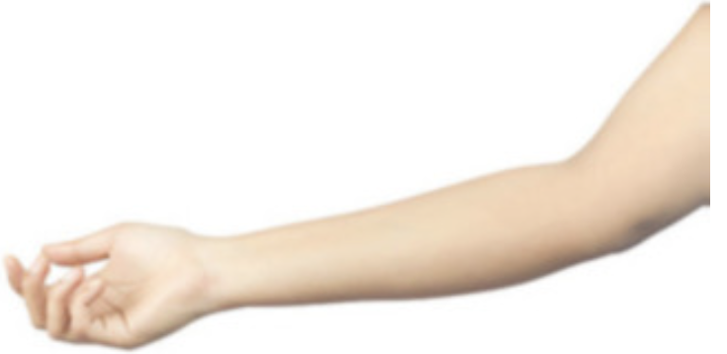
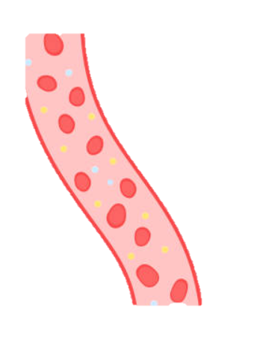
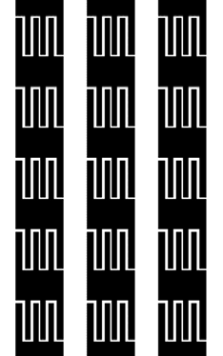
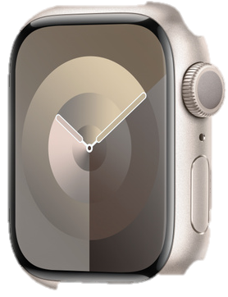


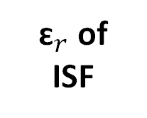
Our Solution: Design a Metasurface
to “Amplify” the Effect of Permittivity Changes in ISF on the S-parameters.
antenna in wearables
${\text{ɛ}}_{r}$of
ISF
glucose level:
our designed
metasurface
$$c (↑)$$
skin
freq.
interstitial
fluid (ISF)
antenna
freq. response
blood
vessel
$$f(↑)$$
freq.
glucose level (c)
passive
metasurface
wearables
resonant freq. point
Notes:
Our approach is to introduce an electromagnetic metasurface, [click] the idea is to make the metasurface boost the impact that small changes in the permittivity of tissue liquid have on the antenna’s S11 parameter. That means let metasurface act as an amplifier. This way, it becomes much easier to detect changes in the antenna’s S-parameters and, from there, infer any resonant point shifts in blood glucose levels.

Slide 11
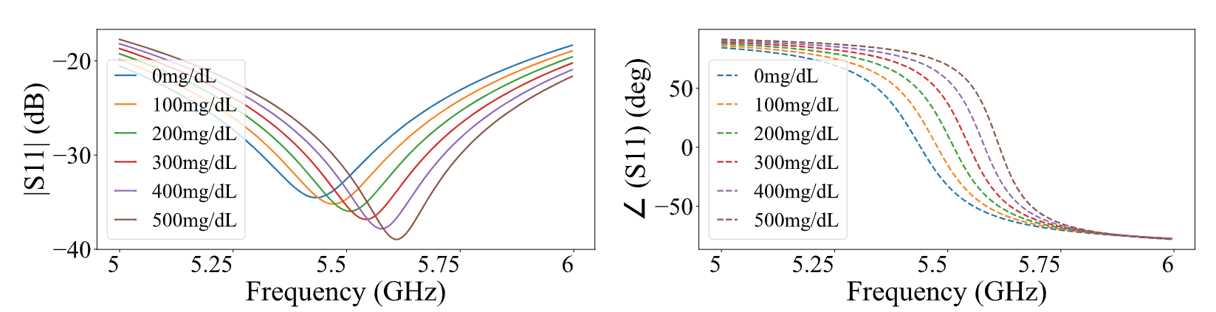













Metasurface Rule: Strong Resonant among Antenna-MTS-Body
antenna
metasurface
skin/fat/muscle
near-field coupling
$$Z_{d}\text{,}{\text{γ}}_{d}$$
$$Z_{s}\text{,}{\text{γ}}_{s}$$
$$Z_{f}\text{,}{\text{γ}}_{f}$$
$$Z_{m}\text{,}{\text{γ}}_{m}$$
metasurface
$$Z_{source}$$
$$Z_{antenna}$$
$$l_{f}$$
$$l_{s}$$
$$l_{m}$$
…
$$l_{d}$$
antenna
sensing target:
glucose levels in ISF
TX / RX
$$Z_{pattern}$$
$$Z_{load}$$
skin
fat
muscle
$$S_{11}$$
Strong Resonant
Optimization Target:
Maximize
the changes in S-parameters
caused by
the ISF’s permittivity changes.
Notes:
What we did was introduce a metasurface between the antenna and the body—so now it’s antenna, metasurface, then tissue. (click) This setup creates strong resonance between the three, [click] so even small changes in the tissue’s permittivity lead to big shifts in the antenna’s S-parameters. As shown in the figure, when glucose goes from 0 to 500 milligrams per deciliter in the tissue liquid, you can clearly see a shift in the resonance point and in the phase. [click] Now, the main challenge is figuring out how to design the metasurface to maximize sensitivity and make detection as simple as possible.

Slide 12
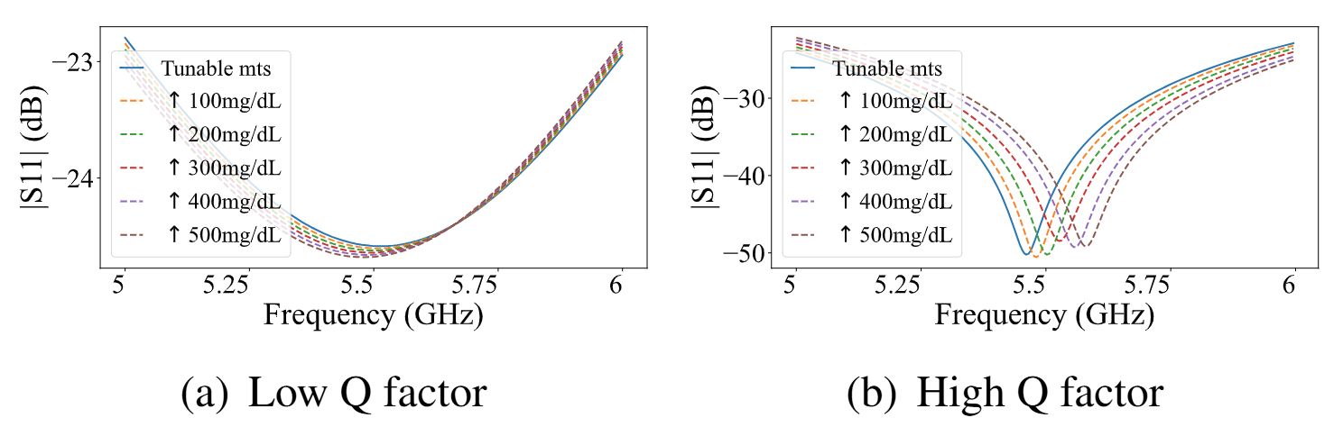



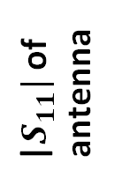


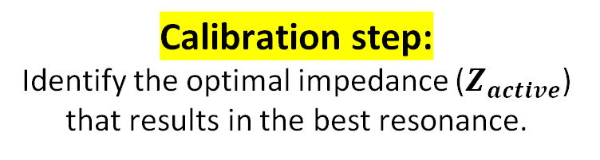







Design a Tunable MTS for Calibration
UNKNOWN params
non-optimal metasurface design
antenna
metasurface
skin/fat/muscle
$$Z_{s}\text{,}{\text{γ}}_{s}$$
$$Z_{f}\text{,}{\text{γ}}_{f}$$
$$Z_{m}\text{,}{\text{γ}}_{m}$$
$$Z_{source}$$
$$Z_{antenna}$$
$$l_{s}$$
$$l_{f}$$
$$l_{m}$$
sensing target:
glucose levels in ISF
$$Z_{pattern}$$
$$Z_{active}$$
$$Z_{load}$$
$$S_{11}$$
optimal metasurface design
Calibration step:
Identify the optimal impedance ($Z_{active}$) that results in the best resonance.
Programmable diodes
|$S_{11}|$of
antenna
Substrate
layer
Metal layer
freq.
Notes:
But when we try to solve this optimization problem, there’s a challenge—[click] we don’t know the exact tissue properties for our users, like the permittivity or thickness of skin, fat, and muscle. These details are really important for modeling. [click] Because uncertain parameters for the optimization problem will cause the non-optimal metasurface design. To handle this, we accounted for the diversity in human tissue and ran parameter sweeps and optimization to design a programable metasurface with a range of impedance, so it works for most people. [click] We came up with a tunable metasurface to help with calibration, [click] and use it to determine the optimal impedance that results the best resonance for the target user. [click] And when you compare the unoptimized metasurface to the optimized one, the difference in performance is clear.

Slide 13

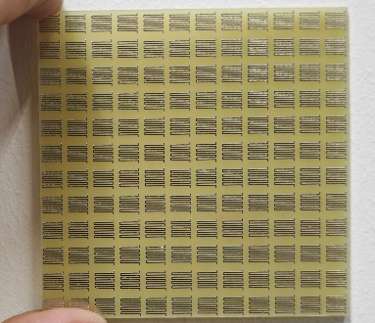
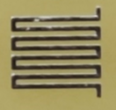

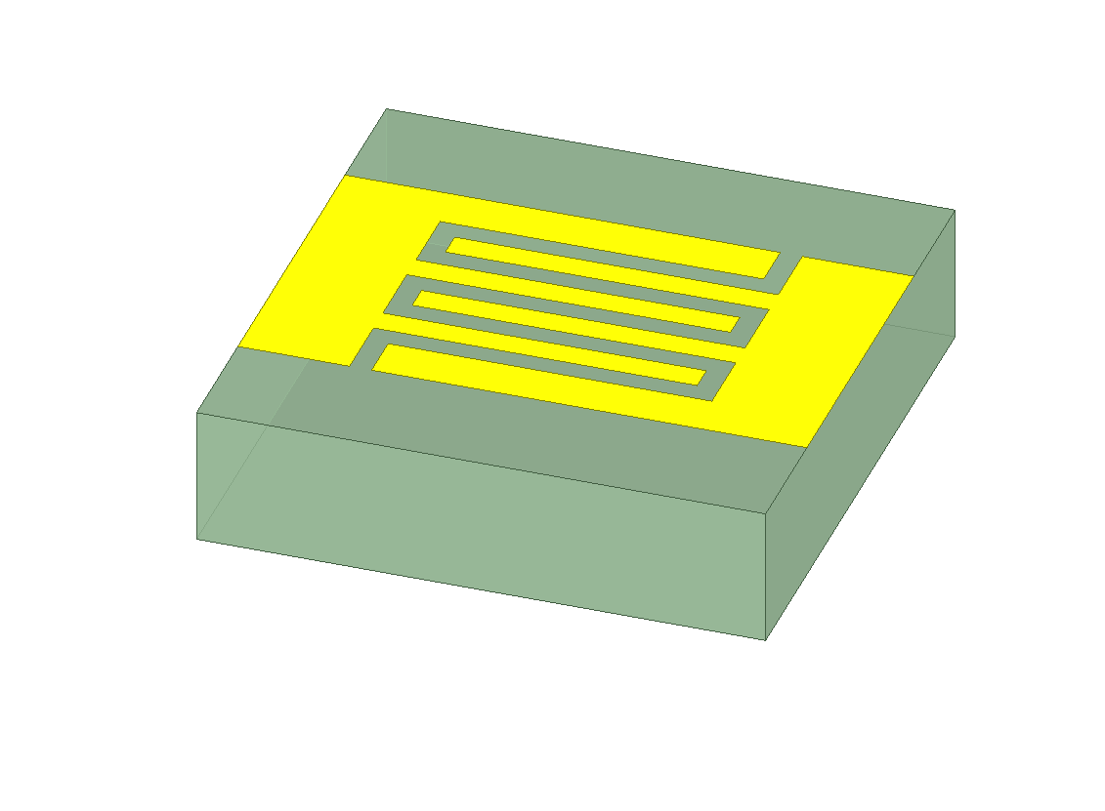
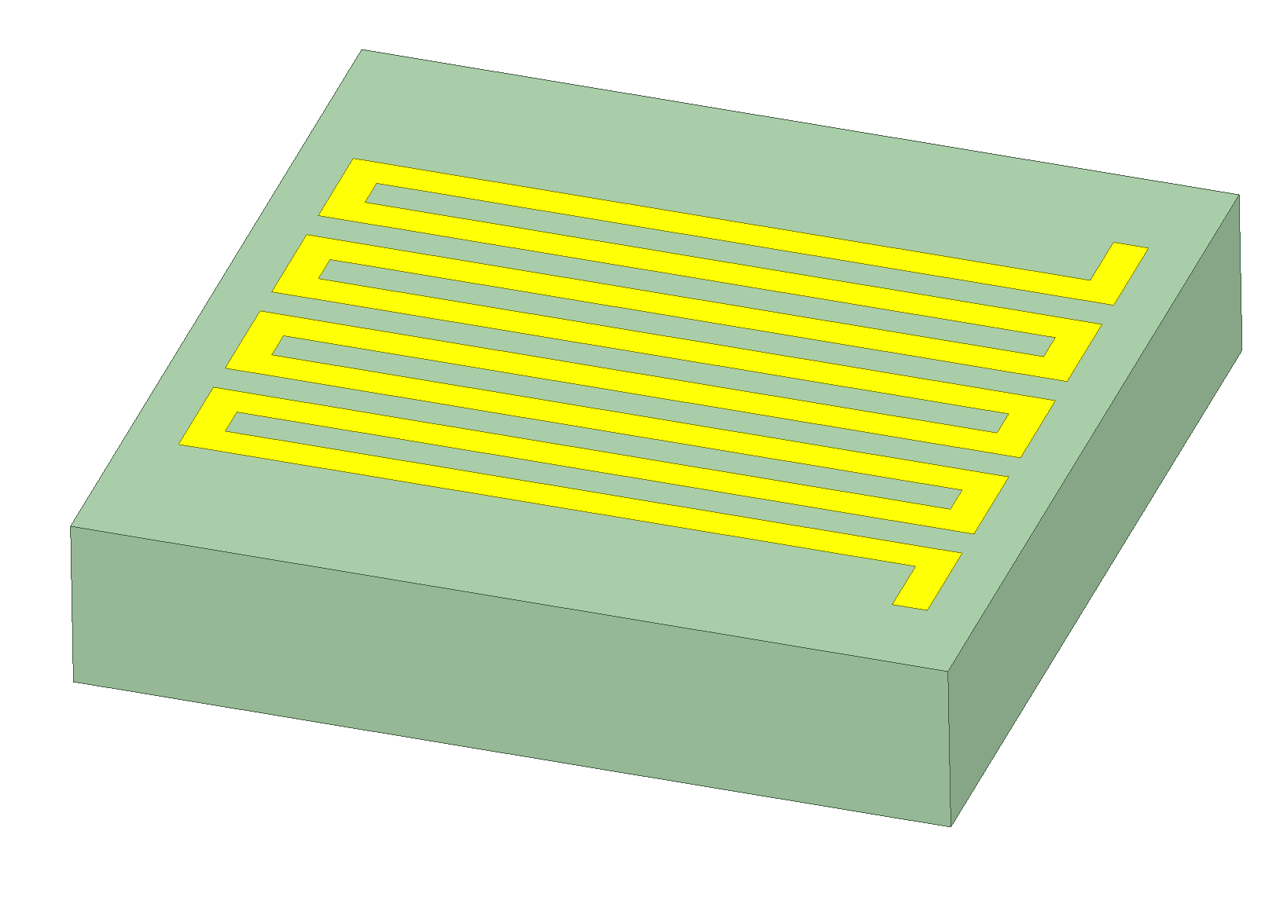
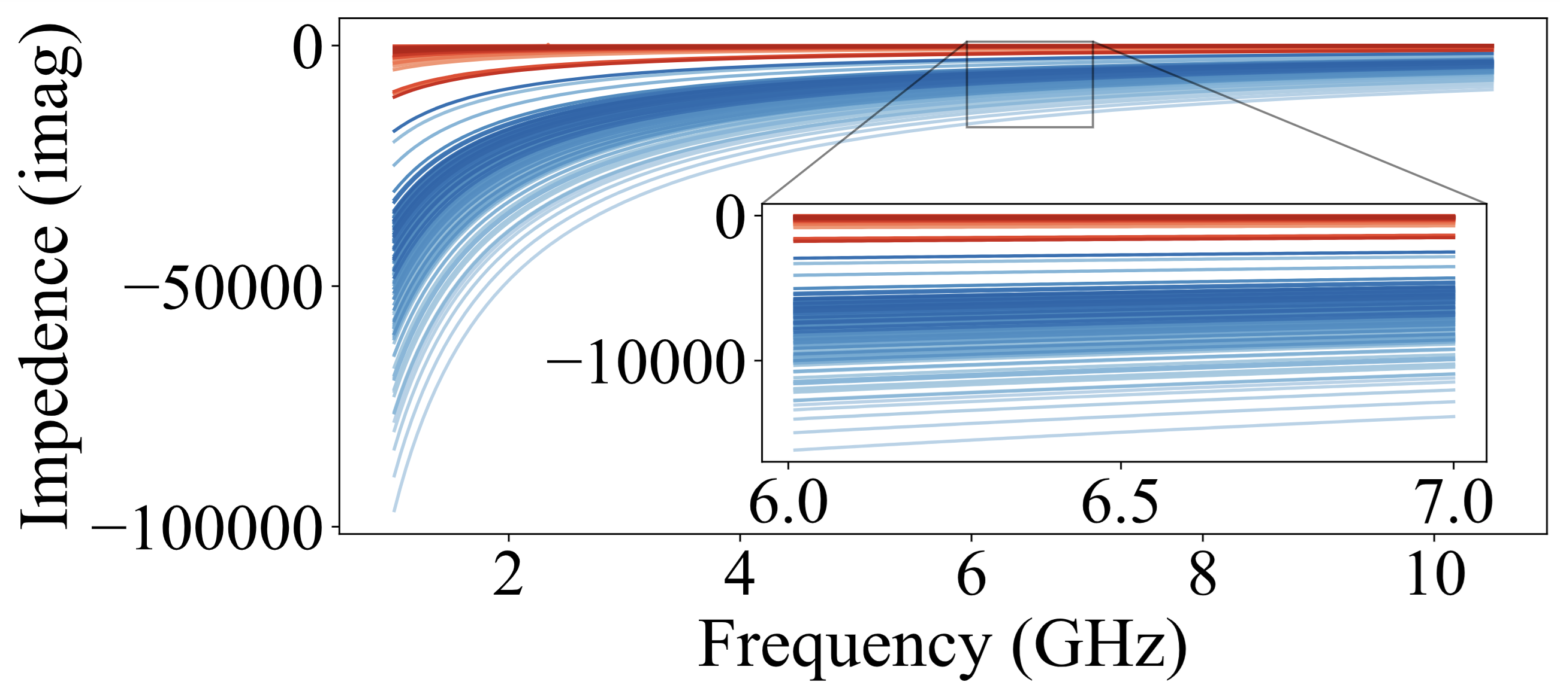
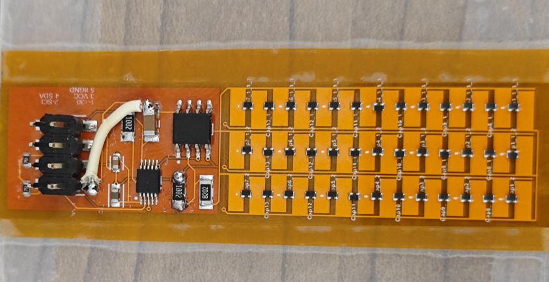

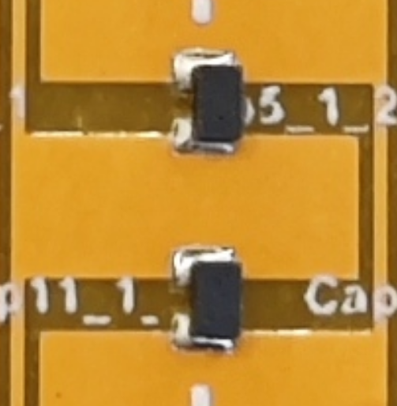


































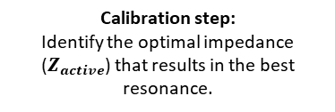

Metasurface Optimization Pipeline
$$(a)$$
tunable
metasurface
$$(d)$$
Metal layer
antenna
UNKNOWN params: skin/fat/muscle
Finger number:
Finger number:
near-field coupling
Optimization case of passive metasurfaces.
$$a$$
$$N$$
$$a$$
Inverse-design passive
metasurface:
According to the optimal $Z_{metal}$ , obtain the pattern params $L, N,a,b,w$
$$Z_{s}\text{,}{\text{γ}}_{s}$$
$$Z_{f}\text{,}{\text{γ}}_{f}$$
$$Z_{m}\text{,}{\text{γ}}_{m}$$
$$N$$
metasurface
Metal layer
$$b$$
$$b$$
antenna
$$Z_{source}$$
$$Z_{antenna}$$
$$l_{s}$$
$$l_{f}$$
$$l_{m}$$
$$l_{d}$$
$$w$$
$$w$$
…
$$Z_{active}$$
$$l_{d}$$
sensing target:
glucose levels in ISF
Substrate
layer
Substrate
layer
FR4
copper
TX / RX
skin
muscle
$$Z_{load}$$
$$L$$
$$L$$
fat
Passive Metasurface Template 1
Passive Metasurface Template 2
$$S_{11}$$
$$(b)$$
Calibration step:
Identify the optimal impedance ($Z_{active}$) that results in the best resonance.
$$(c)$$
$$Z_{d}\text{,}{\text{γ}}_{d}$$
Tunable
Metasurface
$$g$$
$$w_{1}$$
Given the substrate layer, optimize $Z_{metal}$for the equivalent ABCD matrix of the tunable mts
$$H$$
$$w_{2}$$
$$l_{d}$$
Programmable diodes
|$S_{11}|$of
antenna
$$Z_{active}$$
$$Z_{metal}$$
Substrate
layer
Metal layer
freq.
$$P$$
Calibration: A tunable metasurface is used for calibration to determine the parameters that produce optimal resonance for the target user's tissue.
controller module
varactor
diode
copper
PFC
Notes:
Here is our metasurface optimization pipeline: [click] During the calibration stage, we use a programmable metasurface to figure out the optimal impedance that creates strong resonance for the target user. [click] Once we have that information, we use it to design a passive metasurface that can replace the adjustable one. This passive metasurface helps us cut costs, avoid complicated circuit designs, and even eliminate the need for a power supply—making the system much simpler and more user-friendly.

Slide 14
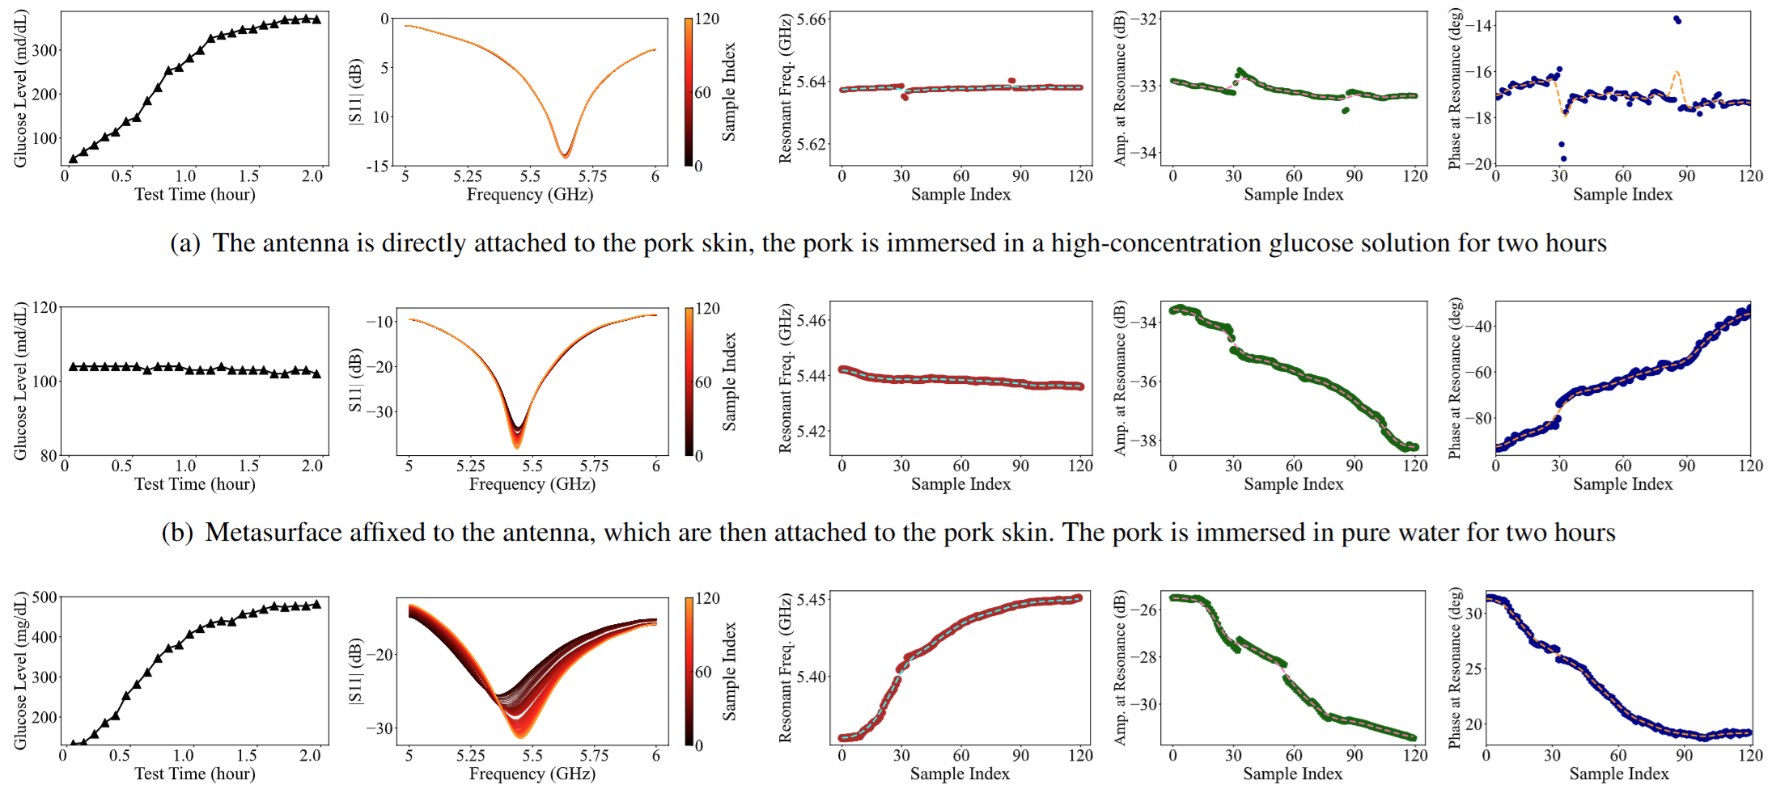
Without Metasurface vs. With Metasurface
Without glucose
Without metasurface
With glucose
Without metasurface
With glucose
With metasurface
Average 25MHz shifting maps to ~100mg/dL.
120mg/dL → 480mg/dL
5.36GHz →
5.45GHz
Notes:
We used a VNA to test on a volunteer in the real-world scene. Without any change in blood glucose, or without metasurface, we measured antenna reflectance and found hard-to-catch S11-parameter fluctuations, even when glucose levels stayed almost the same.
[click] Then, we asked volunteers to drink the sugar water to raise their glucose and measured again—still without a metasurface. The resonance point shifted just a little, and the amplitude and phase changes weren’t very reliable.
[click] Finally, we had volunteers increase their glucose and used our optimized metasurface. This time, we saw a clear and consistent resonance shift—the frequency always went up with higher glucose. Amplitude and phase also changed more steadily. All these results show our method can reliably detect blood glucose changes.

Slide 15
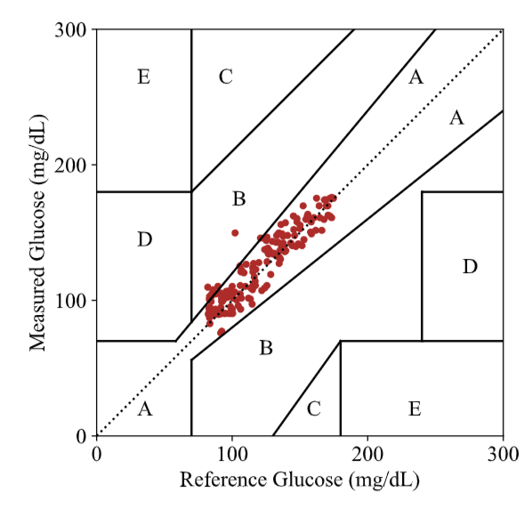
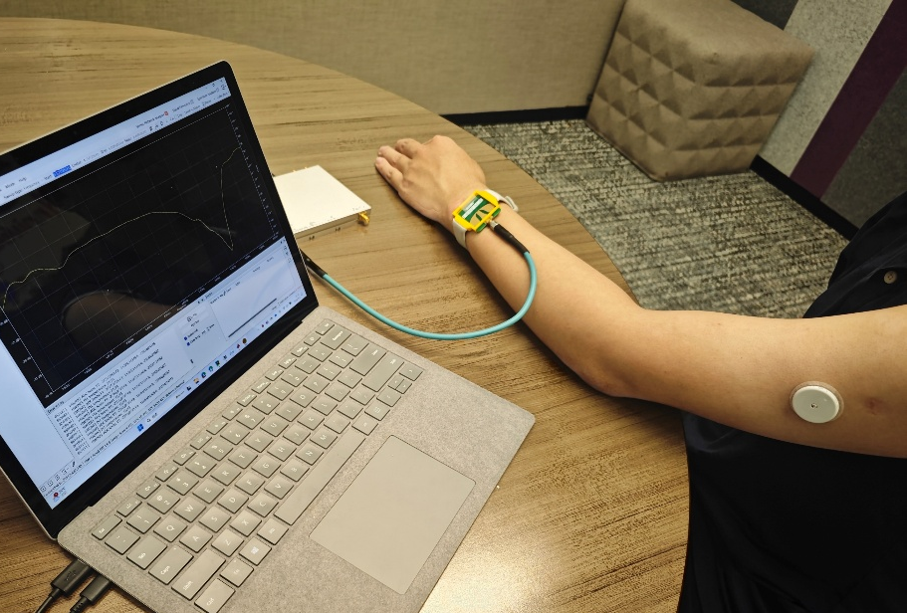
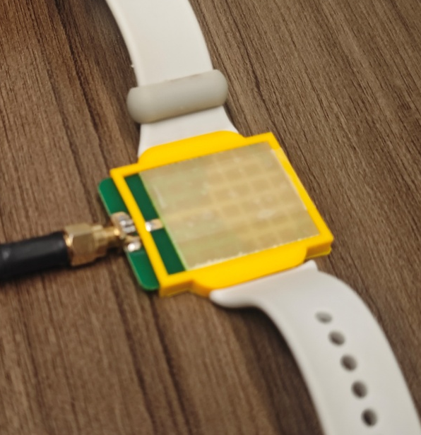
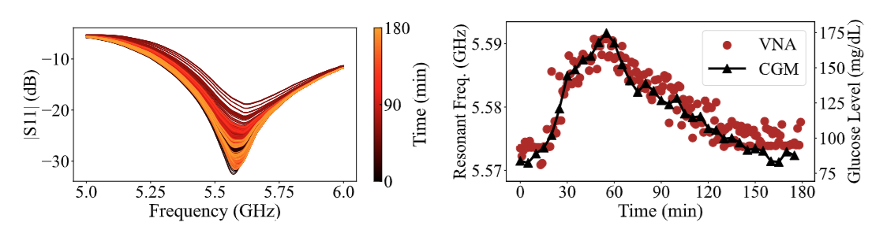
Human Experiment 1:
Vector Network Analyzer + Wi-Fi Antenna + Metasurface
LibreVNA
CGMM
Metasurface
CGM
Wi-Fi
Antenna
Clarke error grid analysis: - Zone A: 94.4%
- Zone B: 5.6%
- Zones C, D, and E: 0%
Notes:
We also built a wearable prototype and tested it out in real-world scenes. Our first version used the LibreVNA, which is a portable, low-cost vector network analyzer, together with a standard commercial WiFi antenna. The results showed that our method was able to track changes in blood glucose just as accurately as a traditional CGM.

Slide 16
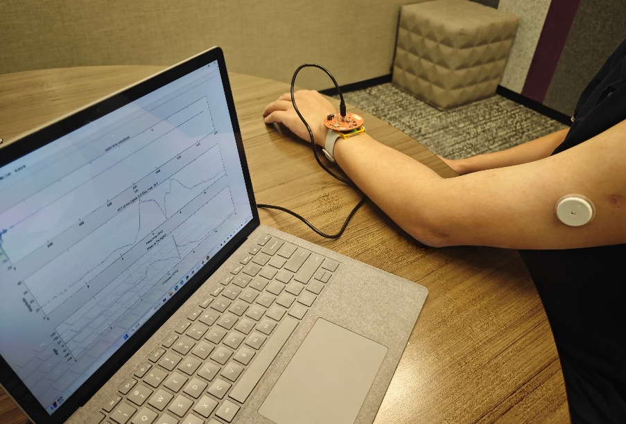
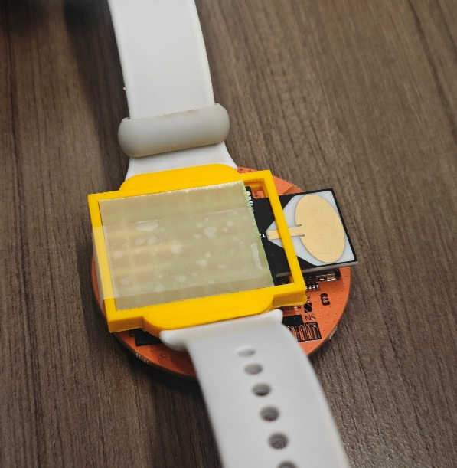
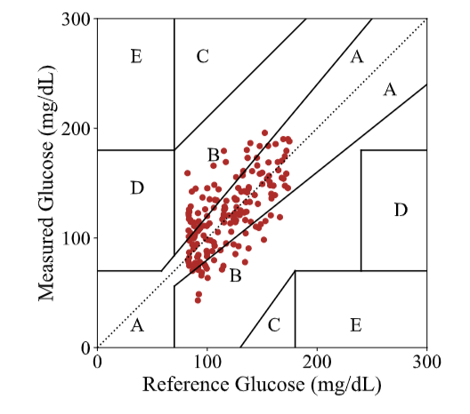
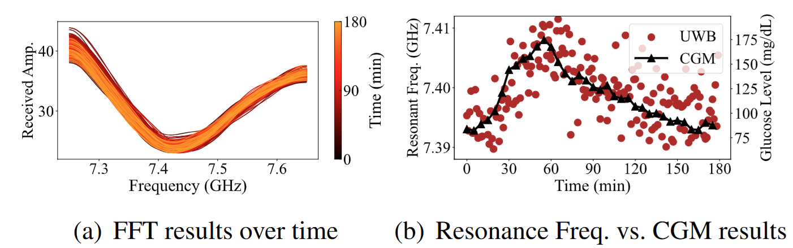
Human Experiment 2:
Commercial UWB Radar Device + Metasurface
CGMM
Metasurface
CGM
UWB
Radar Module
Clarke error grid analysis: - Zone A: 63.8%
- Zone B: 36.2%
- Zones C, D, and E: 0%
Notes:
We also teamed up a commercial UWB radar with our designed metasurface, which is optimized to match the UWB radar’s operating frequency. Using this setup, we created another prototype, and our experiments showed that when equipping with our optimized metasurface, existing devices can actually detect blood glucose changes non-invasively.

Slide 17
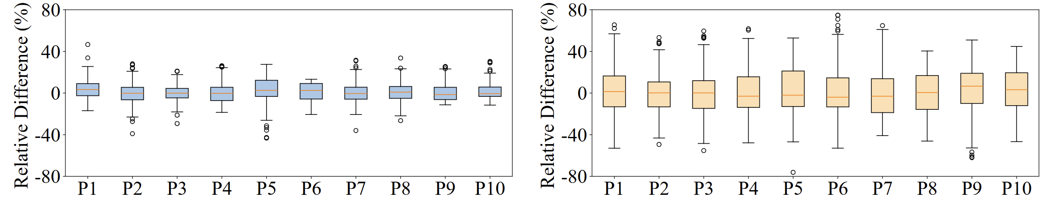
Performance in Human Experiments
Human experiment (Glucose change range: ~50 - ~150mg/dl)
(a) Prototype with LibreVNA
(b) Prototype with UWB (7.25~10.2GHz)
Experimental setup (incorporating our metasurface) | Relative error | Absolute error (RMSE)
V: LibreVNA | -5.02% ~ 6.93% | 9.65 mg/dL
U: UWB (6-8.5GHz) | -13.76% ~ 15.95% | 20.54 mg/dL
P1-10 refer to Participants 1-10
Notes:
We tested both of these prototypes with multiple volunteers, and the results are able to verify the robustness of our system and its accuracy in estimating glucose changes. For all the detailed results, please check out our paper.

Slide 18
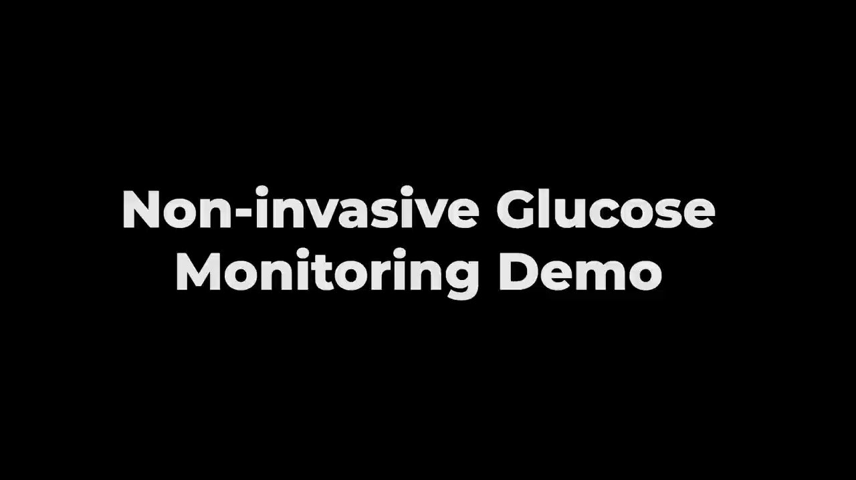
Demo Video
Notes:
This is our demo video.
Here, we showcase our latest highly integrated compact wearable prototype, which features an RF power detector and signal source that implements the function of antenna’s S11 parameter measurement.
Using this setup, we also successfully achieved non-invasive glucose sensing.

Slide 19
CGMM: Non-Invasive Continuous Glucose Monitoring in Wearables Using Metasurfaces
© MobiCom 2025
Hong Kong, China
Thanks for Listening !
Notes:
All the above is I want to share about our work. Thank you all for listening.
The main challenge with optical-related technologies is dealing with interference from all kinds of external light sources. Since changes in blood sugar levels only cause very subtle shifts in the Raman spectrum, you really need a highly controlled testing environment and a very sensitive image sensor to accurately measure light intensity and spectral features.
Right now, our method can only measure relative changes in blood glucose levels, because our metasurface is designed to amplify relative changes in the permittivity of the tissue liquid and map them onto the antenna’s S11 parameter. So, our work is very suitable for monitoring blood permittivity changes before and after meals. Of course, our approach can also be used for measuring absolute glucose levels. For example, on the first morning of one week period, you could use a finger-prick test to get an absolute blood glucose value, which can serve as a reference point to help our system provide absolute glucose measurements.
Our contribution is that we use the metasurface to verify the modality of RF channel can be used in the wearable glucose sensing, and this modality can be used with other modalities, such as optical, PPG, thermal, and any others, to enhance the overall performance of the noninvasive glucose sensing.

