Slide 1

SaDiF: Spoofing Attack on BLE Direction Finding Based Localization System
Runting Zhang, Yijie Li, Dian Ding, Hao Pan, Yongzhao Zhang, Xiaoyu Ji, Jiadi Yu, Guangtao Xue, Yi-Chao Chen
MobiHoc 2025
Notes:
Good afternoon, everyone. My name is Runting Zhang from Shanghai Jiaotong University. Today I’ll be presenting our work: “SaDiF: Spoofing Attack on BLE Direction Finding Based Localization System.”

Slide 2

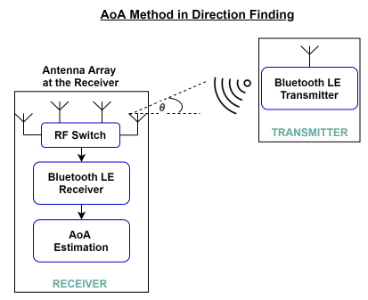



BLE Direction Finding Feature
AoA Method in Direction Finding
Asset Tracking
Official standard for BLE localization
Popular Angular-based method
High Accuracy: submeter-level
Indoor Navigation
Autonomous Guided Vehicles
Notes:
BLE Direction Finding was introduced in Bluetooth 5.1 and is now widely used in asset tracking, logistics, and smart factories for applications including indoor navigation, autonomous guided vehicles.
As an official standard, it enables a high-accuracy, sub-meter level localization performance.

Slide 3





Motivation: Security Issue
Attacker
Man-in-the-Middle Attack
Jamming Attack
Property Damage
Package Loss
BLE 5.1 Locator
Direction Finding Packet
Faked Location
AoA
Localization Result
BLE 5.1 Tag
Is BLE Direction Finding Safe Enough?
Localization systems are becoming the Prime Targets for malicious actors.
Notes:
However, as localization systems become more critical, they also become prime targets for attackers.
Considering a simple model of direction finding system,
an attacker may conduct a jamming attack to disable the localization function, causing serious logistics issues including package loss,
or manage to spoof the positioning result with a Man-in-the-Middle Attack, which may lead to significant property damage.
The question is now raised: is BLE Direction Finding really safe enough?

Slide 4
BLE Direction Finding Process
RF Signal Transmission
AoA/AoD Estimation
Channel Sync
CTE Info Alignment
CFO Elimination
Constant Tone Extension (CTE): Key Component
CTE Transmission
Angular Computation
CTE Signal Sampling
Antenna Switching
Post Filtering
IQ Sampling
Notes:
Let’s briefly look at how BLE Direction Finding works. There are mainly three parts: RF Signal Transmission, CTE Signal Sampling, and angular Estimation.
The key component is the Constant Tone Extension (CTE)—a segment of the signal used for phase sampling. By switching antennas and sampling the phase difference, the locator finally estimates the angle of arrival.

Slide 5


CTE Structure and Transmission
Locator
Advertising
Ext Adv
Periodic advertising
……
…
AUX_SYNC_IND
AUX_SYNC_IND
ADV_EXT_IND
AUX_ADV_IND
CTE Info
CTE
CTE Info
CTE
Target
Attacker may spoof the positioning result by Injecting the CTE period!
CTE Format: 1$μs$ switching and sampling slots
Guard Period
（4$μs$）
Reference Period
（8$μs$）
Switch
slot
Sample
Slot 1
Switch
slot
Sample
Slot 2
…
Switch
slot
Sample
Slot 74
Notes:
The CTE is transmitted between target and locator with a series of packets following the BLE periodic advertising.
Given the CTE Info segments, locator knows the exact CTE format and determine its corresponding antenna switching and sampling.
But since this process lacks authentication, Attacker may spoof the positioning result by Injecting the CTE period!

Slide 6

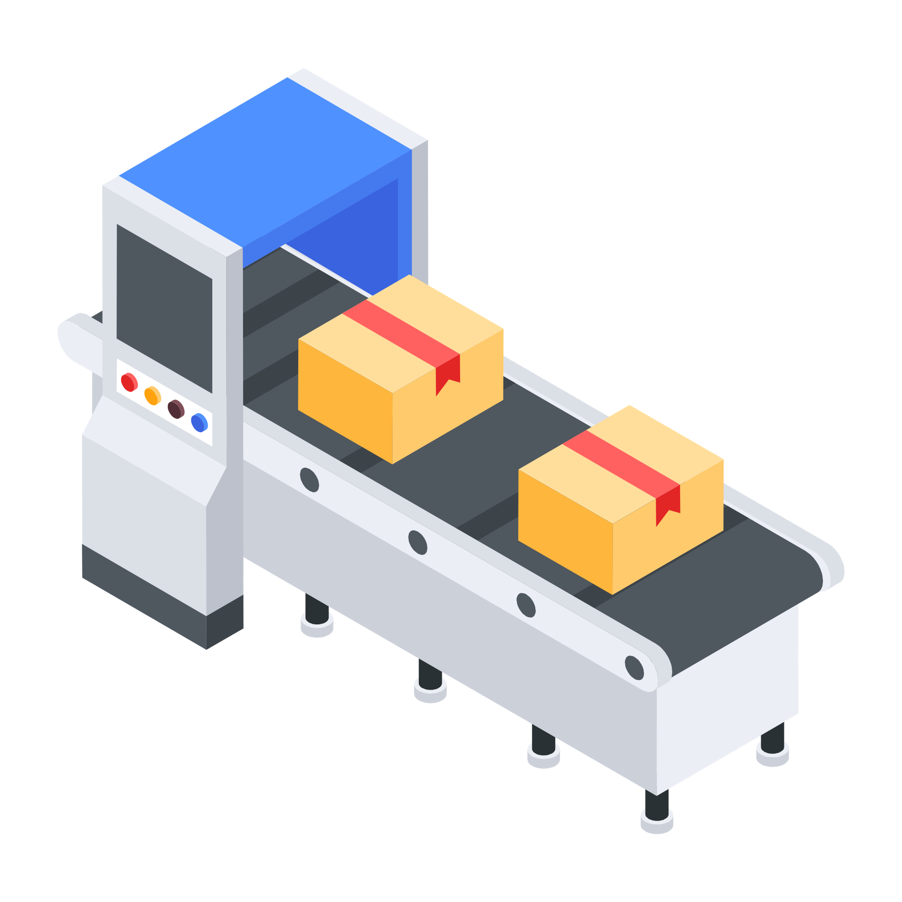


SaDiF Illustration
AoA Localization
Trajectory
BLE packet
CTE
BLE 5.1
Tag
CTE
CTE
BLE packet
BLE packet
Notes:
Now take a look at our SaDiF. In a logistics scenario relying on direction finding localization system,
Locators receiving the BLE packets with CTEs from tag, estimating the AoA and finally sending back the position of targets,
Autonomous Guided Vehicles or robots then plan its trajectory based on the given results.

Slide 7

SaDiF Illustration
CTE
BLE Injection
Wrong Trajectory
CTE
x
BLE 5.1
Tag
？
CTE
x
CTE
x
Injection Area
Notes:
Here, we propose SaDiF, in a certain injection area,
the attacker conducts the spoofing attack that injects malicious phase shifts during the CTE transmission,
misleading the locator into reporting a wrong trajectory of the victim device.

Slide 8
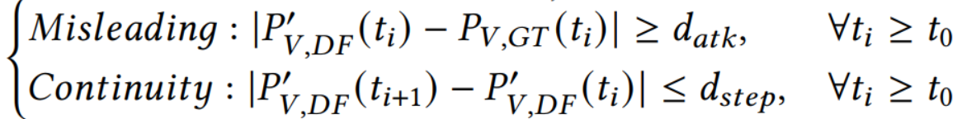
Threat Model
Objectives
Assumptions
Victim: Users or Administrators of the BLE Direction Finding Localization System.
Goal: Manipulate the localization result of victim and create a misleading and continuous trajectory.
Attacker’s Capabilities:
Access Locations of victim & locator
Higher TX power than victim
Antenna Array Structure
Attacker’s Restrictions:
No Physical Access to any device in localization system
Cannot Tamper with BLE Standard
Limited Attacker’s Location
Notes:
Our threat model defines the victim as Users or Administrators of Direction Finding System.
The attacker managed to Manipulate the localization result of victim and create a misleading and continuous trajectory.
The assumption of attacker includes the ability to: Access Locations of victim & locator; transmit RF signal with Higher power than victim; and acquire the Antenna Array Structure
The attacker is prohibited to: make any Physical Access to any device in localization system; Tamper with BLE Standard; and move its device to arbitrary places

Slide 9
Challenges
Improve the Concealment of Attack, hard to detect
Maintain a Continuous and Deterministic Spoofing Path
Enhance the Attack Robustness against Hardware Imperfections
Notes:
We faced three main challenges:
Bypassing existing defenses
Maintaining a continuous and deterministic spoofing path and
Ensuring robustness against hardware imperfections

Slide 10
SaDiF Design
RF Signal Transmission
AoA Estimation
Channel Sync
CTE Info Alignment
CFO Elimination
CFO Elimination
CTE Transmission
CTE Transmission
Wrong
CFO Est.
Angular Computation
Angular Computation
CTE Signal Sampling
Antenna Switching
Manipulated
AoA
Post Filtering
IQ Sampling
Notes:
Let’s go back to the direction finding process to reveal the design of Sadif.
We aim to spoof the original CTE transmission,
Resulting in a wrong CFO estimation,
And finally a manipulated AoA output.

Slide 11
SaDiF Design
RF Signal Transmission
AoA Estimation
C1
Channel Sync
CTE Info Alignment
CTE-based Signal
Injection
CFO Elimination
C2
CTE Transmission
Wrong
CFO Est.
Attack Signal Generation
Angular Computation
Phase Shift Filtering
CTE Signal Sampling
Antenna Switching
Manipulated
AoA
C3
Injection Timing Optimization
Post Filtering
IQ Sampling
Notes:
SaDiF works in three stages: First, we eavesdrop on BLE packets to sync with the victim.
Then, we generate an attack signal with a carefully filtered phase shift. Finally, we inject the signal during the CTE reference period, which leads to a wrong AoA estimation.
Following, I’ll show some design details of our system to deal with mentioned challenges.

Slide 12
Challenge 1: Guarantee Attack Concealment
Predict Time and Channel for following packets
Decode Parameters indicating the CTE Format
AUX_SYNC_IND
structure
AUXPtr
PDU
Preamble
Header
CTE Info
CRC
CTE
Preamble still comes from victim
No interference on the packet PDU
Signal Injection Attack on CTE
Undetectable by common physical-layer detection mechanisms!
Notes:
To firstly guarantee the concealment of our attack, we focus on the packet structure of AUX_SYNC_IND with CTE.
After decoding its PDU for segments AUXPtr and CTE Info, the attacker can Predict Time and Channel for following packets
Also acquiring Parameters indicating the CTE Format,
Which is essential for the Signal Injection Attack on CTE period
On the other hand, such injection ensures that Preamble still comes from victim,
And No interference on the packet PDU,
proving that it’s Undetectable by common physical-layer detection mechanisms, which rely on physical-layer features like packet preamble detection or RSSI deviation to detect spoofing.

Slide 13



Attacker
Locator
Target
. . .
Attack Starts
Signal Eavesdrop
AUX_SYNC_IND
$$t_{1}$$
CTE
AOA √
ADV_EXT_IND
AUX_ADV_IND
SYNC “Established”
$t_{1}+Δ$t
AUX_SYNC_IND
CTE
AOA √
Attack Works
CTE-based Signal Injection
AUX_SYNC_IND
$t_{1}+2Δ$t
Fake AOA ×
injected CTE
Notes:
In detail, attack starts with a signal eavesdropping. Attacker eavesdrops the prepended BLE packets to synchronize with the target’s periodic advertising.
The synchronization is considered “established” when attacker successfully receives an AUX_SYNC_IND packet with CTE.
Attack finally works when CTE-based Signal Injection is conducted on the next AUX_SYNC_IND packet.

Slide 14
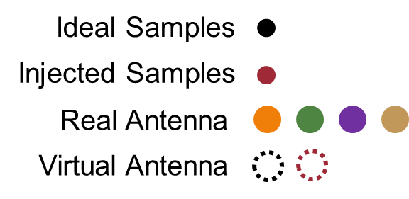




Challenge 2: Maintain Attack Continuity
Reference Period(8μs)
Switch Slot
Smpl Slot1
Switch Slot
Smpl Slot2
Switch Slot
Smpl Slot3
…
Switch Slot
Smpl Slot74
Standard CTE (All 1s)
Phase
$$φ_{1→3}$$
. . .
$$φ_{1→2}$$
$${2φ}_{CTE}+2φ_{CFO}$$
$$φ_{CTE}+φ_{CFO}$$
Time
Notes:
Next, the second challenge of attack continuity comes from the angle estimation process.
When sampling a standard CTE, the CFO is estimated by reference-period samples.
Virtual antenna is aligned to finally derive the phase difference $φ_{1→2}$ for following angular algorithm.
But considering the injected CTE,

Slide 15



Challenge 2: Maintain Attack Continuity
Reference Period(8μs)
Switch Slot
Smpl Slot1
Switch Slot
Smpl Slot2
Switch Slot
Smpl Slot3
…
Switch Slot
Smpl Slot74
Injected CTE
Phase
Linear Phase Difference
Susceptible to Interference
$${φ′}_{1→3}$$
$$φ_{1→3}$$
. . .
$${φ′}_{1→2}$$
$$φ_{1→2}$$
$$φ_{CTE}+{φ′}_{CFO}$$
$${2φ}_{CTE}+2φ_{CFO}$$
$$φ_{CTE}+φ_{CFO}$$
Time
Notes:
We inject malicious phase shifts to the CTE reference-period signal,
Leading to a wrong CFO estimation result ${φ′}_{CFO}$
And the corresponding manipulated phase difference ${φ′}_{1→2}$ (phi prime from 1 to 2)
However, the additional phase difference is linearly limited, which makes the output AoA Susceptible to Interference

Slide 16
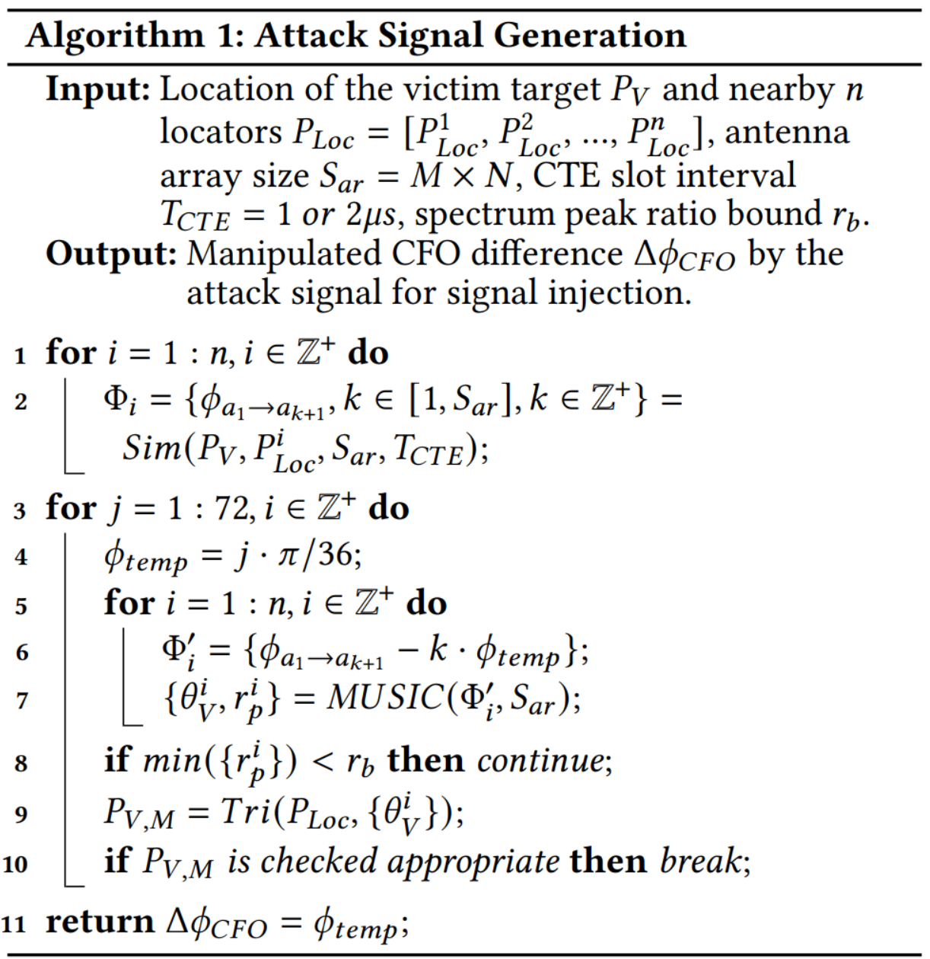
Attack Signal Generation
We introduce the Phase Shift Filtering algorithm to:
Verify whether the manipulated AoA result is vulnerable to interference
Filter the appropriate additional phase shift sets
Select the expected phase shift for attack signal generation
Phase Shift Filtering Iteration
Notes:
To maintain AoA continuity and avoid random jumps in positioning,
we designed our attack signal generation with a Phase Shift Filtering algorithm. It simulates the MUSIC spectrum, verifies the manipulated AoA result and filters out unstable phase shifts, ensuring the spoofed trajectory is smooth and believable.

Slide 17



Challenge 3: Avoid Jitter Effect
Guard Period(4μs)
Reference Period(8μs)
Switch Slot
Smpl Slot1
Switch Slot
Smpl Slot2
Switch Slot
Smpl Slot3
…
Switch Slot
Smpl Slot74
Ideal injection
$$t_{j}$$
Delayed injection
Jitter effect
Insufficient Covering
Unexpected Influence on Switching Samples
Time ($μs$)
$$T_{0}$$
Notes:
The last challenge of Hardware imperfection, or hardware jitter can cause timing errors, leading to unstable injection.
Considering an ideal injection that perfectly covers the CTE reference period,
Real-case injection may be delayed due to jitter effect,
Causing insufficient covering of reference-period samples,
And more seriously, unexpectedly influence the IQ samples among antenna switching, causing uncontrolled AoA outputs.

Slide 18
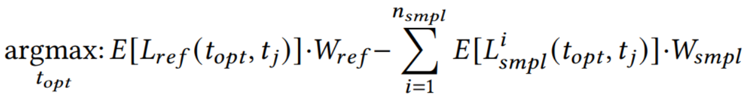





Injection Timing Optimization
Guard Period(4μs)
Reference Period(8μs)
Switch Slot
Smpl Slot1
Switch Slot
Smpl Slot2
Switch Slot
Smpl Slot3
…
Switch Slot
Smpl Slot74
Ideal injection
$$t_{j}$$
Delayed injection
Jitter effect
Timing optimization
$$t_{opt}$$
$$t_{j}$$
$$|t_{j}−t_{opt}|$$
Time ($μs$)
$$T_{0}^{′}$$
$$T_{0}$$
Notes:
So, we introduced an Injection Timing Optimization mechanism that shifts the transmission time slightly to maximize coverage of the reference period and minimize interference.
The optimized timing $t_{opt}$ can be derived by solving this optimization problem.

Slide 19
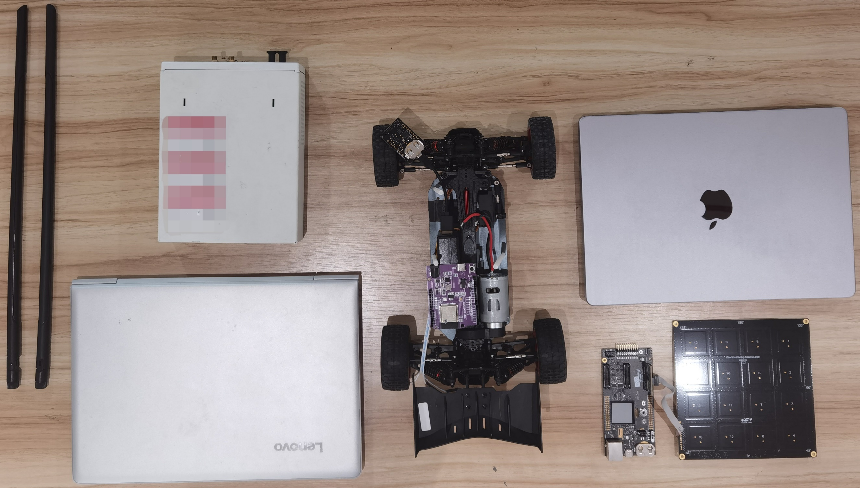

Experiment Setup
Attacker’s Devices
Direction Finding Target (Victim)
Direction Finding Locator and Server
USRP
Server
Tag
Laptop
Locator
COTS Tags
Notes:
We implemented SaDiF using a USRP N210 as the attacker,
and commercial BLE tags as victims
And we use a Silicon Labs Pro Kit with antenna array as the locator,

Slide 20
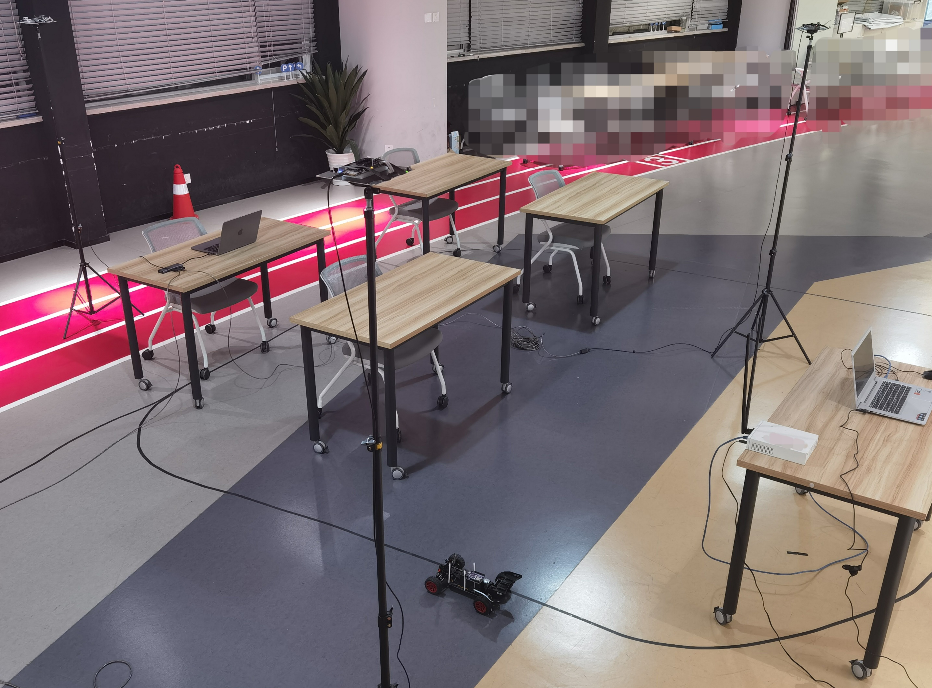
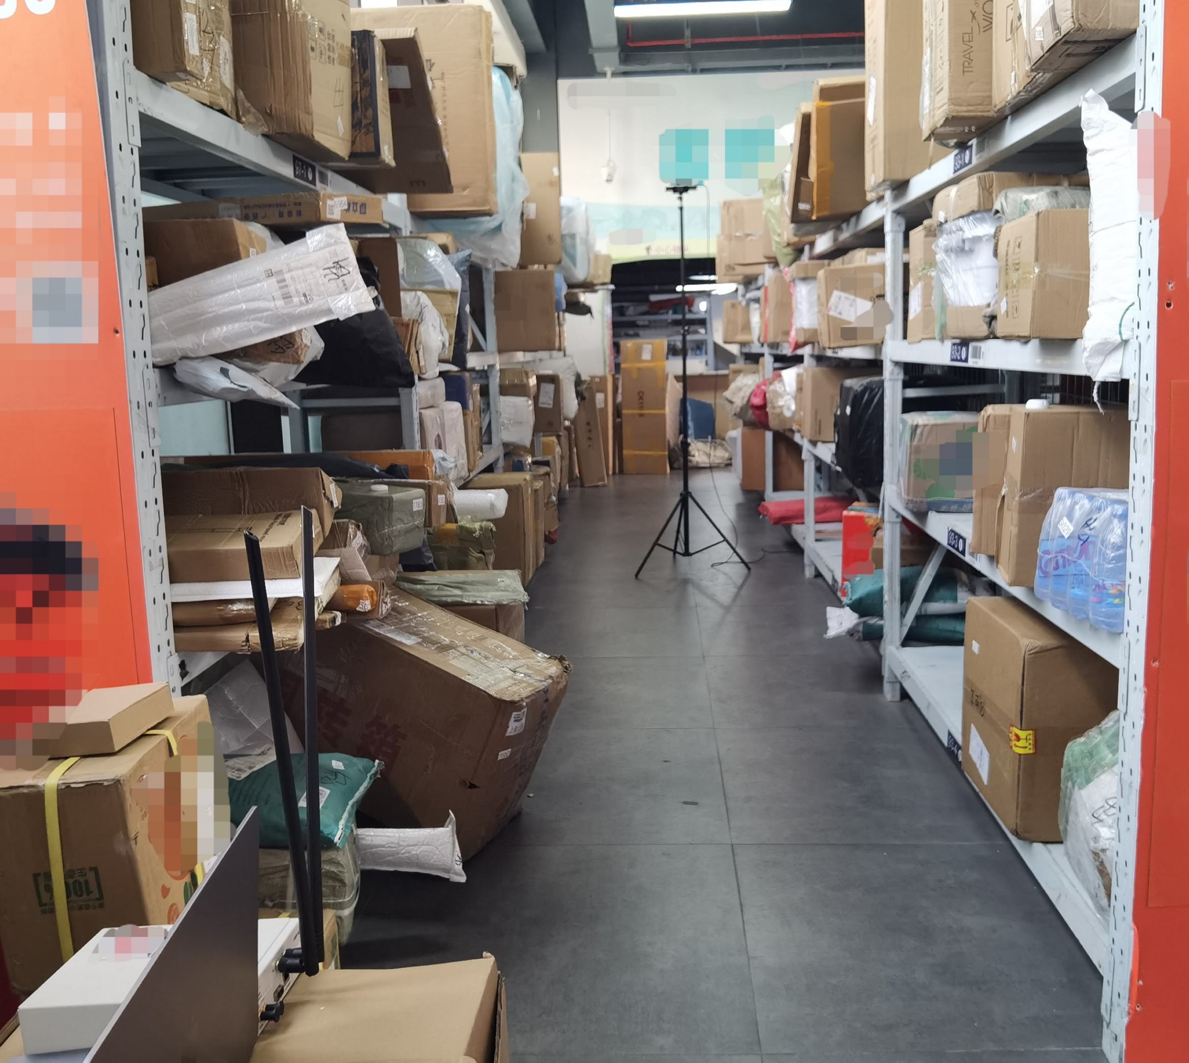
Experiment Setup
Locator
Locator
Server
Attacker
Attacker
Victim
Victim
Victim
In-Lab Scenario
Real Logistics Scenario
Notes:
Tests were conducted in both lab and real logistics environments.

Slide 21
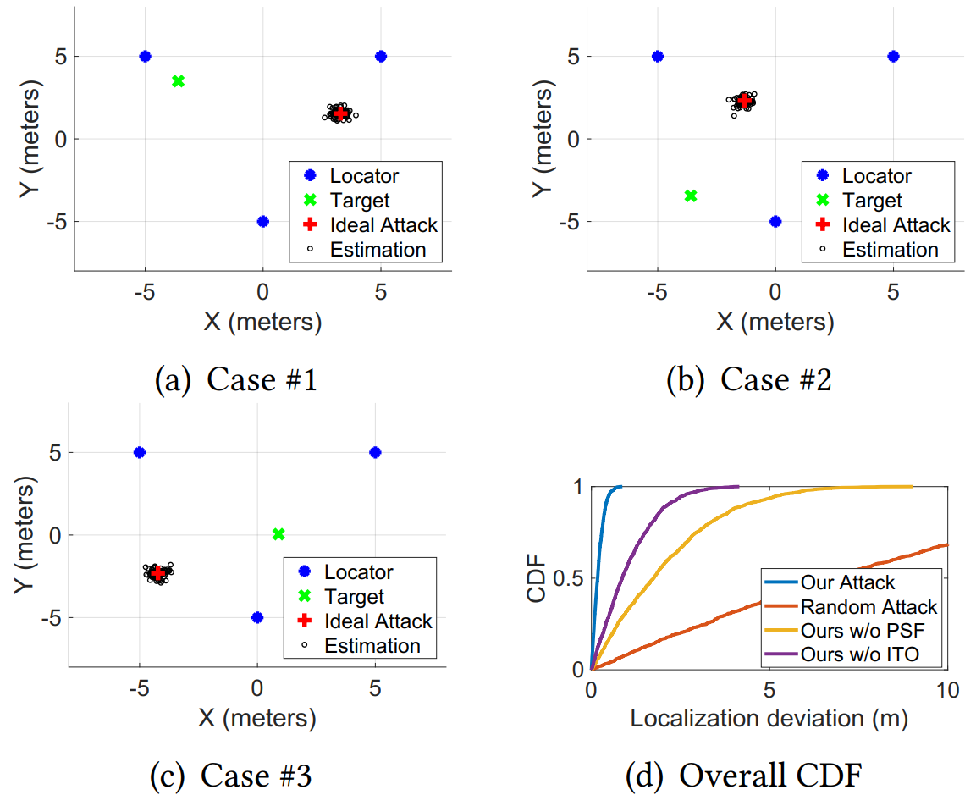
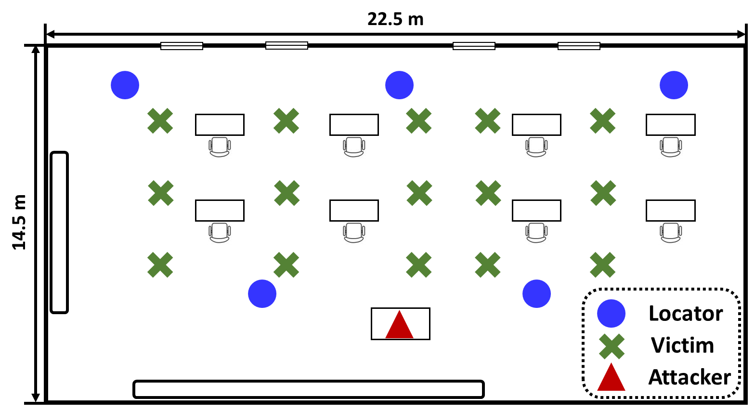
Performance
Attack on Still Point
Average Localization Deviation: 0.199m
Notes:
For stationary targets, SaDiF achieved an average localization deviation of only 0.199 meters, successfully spoofing the location to a controlled false point.

Slide 22
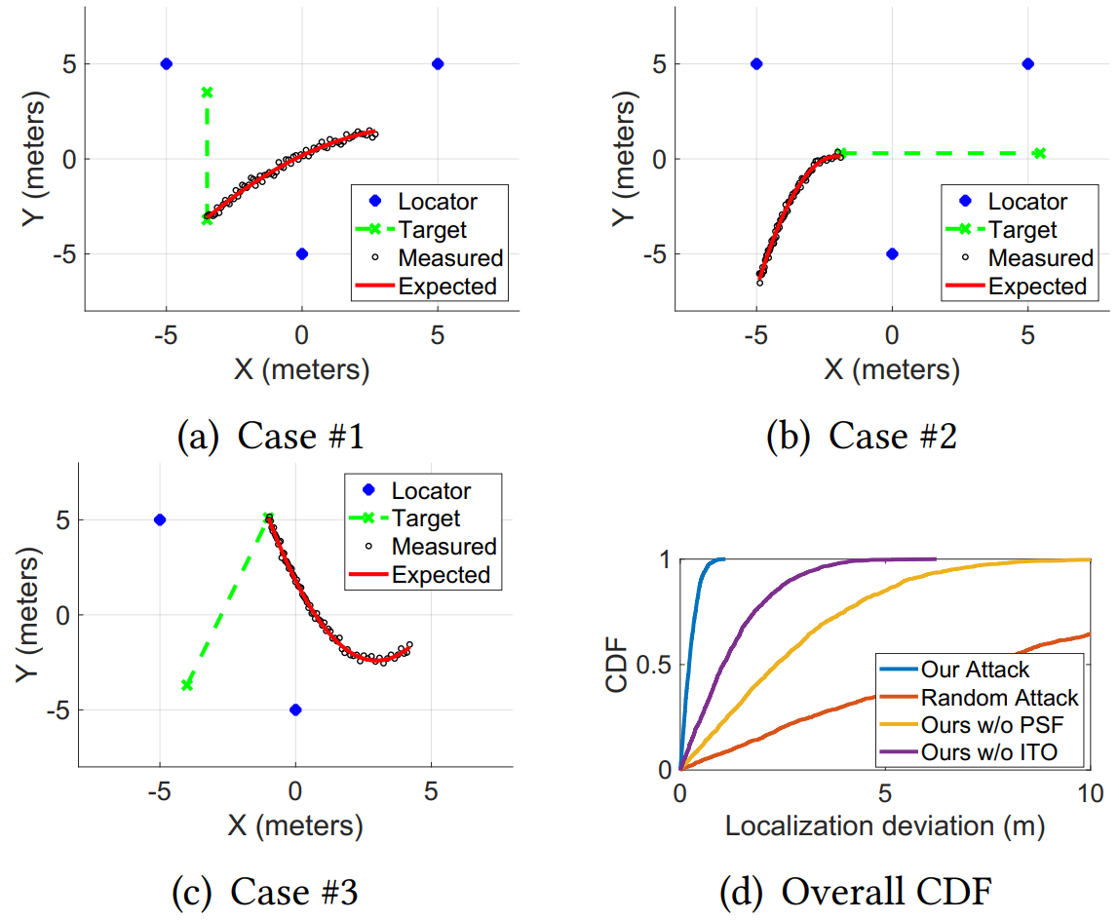
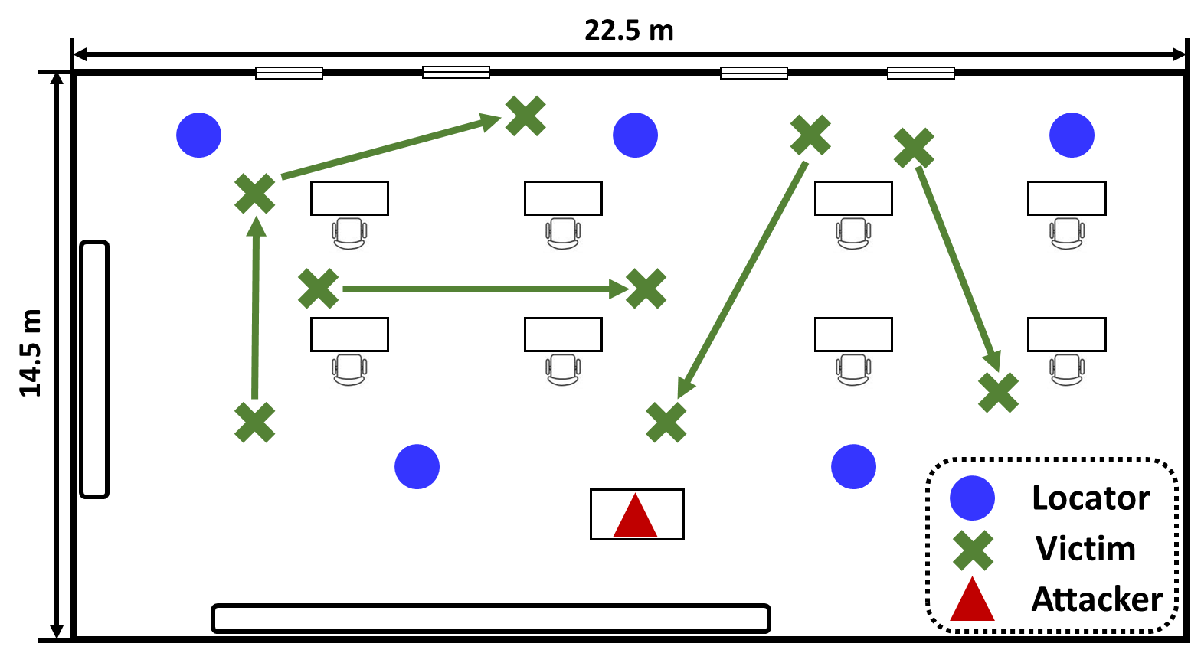
Performance
Attack on Trajectory
Average Localization Deviation: 0.250m
Notes:
For moving targets, SaDiF still performed well, with an average deviation of 0.250 meters, creating a smooth and misleading trajectory.

Slide 23
Conclusion
Proposed SaDiF that exploits the inherent vulnerabilities of CTE phase sampling process in BLE Direction Finding to mislead existing localization systems, reporting continuous and incorrect trajectories.
- For other system details, including Detailed Algorithms, Full Evaluation Results and Countermeasures, please check our paper for more information.
Notes:
In summary:
Our Proposed SaDiF exploits the inherent vulnerabilities of CTE phase sampling process in BLE Direction Finding to mislead existing localization systems, reporting continuous and incorrect trajectories.
For other system details, please check our paper for more information.

Slide 24
Thank You
Notes:
Thank you for your attention.

Slide 25
Following
are backups

Slide 26
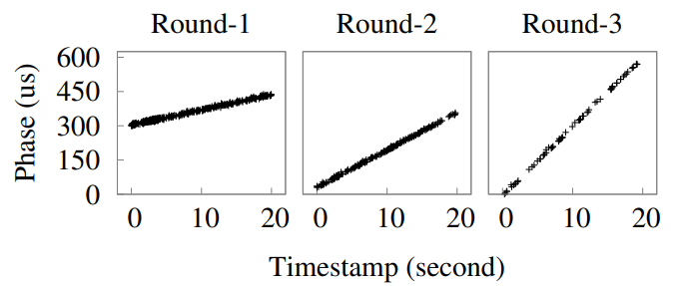
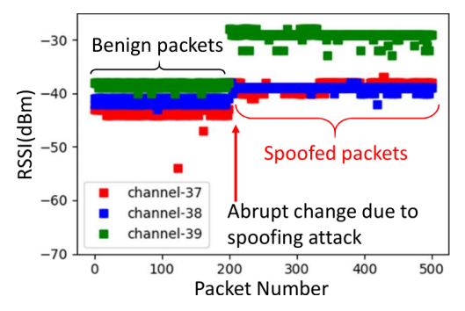
Existing Defenses
Physical-Layer Defense
Existing defenses (identifications) against BLE spoofing attack exploit the unique Physical-Layer Feature of the BLE devices (e.g. preamble detection, RSSI deviation).
BlueID (Clock Skew Estimate)
BlueShield (RSSI Monitor)
Is BLE Direction Finding Safe Enough?
Notes:
To counter these common attacks, existing defenses rely on physical-layer features like packet preamble detection or RSSI deviation to detect spoofing.
Among them, BlueID estimated the clock skew by comparing the phase pattern in received preamble. BlueShield monitored the RSSI and identify malicious user with abrupt RSSI change.
But is BLE Direction Finding really safe enough?
[Fig. 4. Preamble detections separated based on the GHT shown in Fig. 3.
Figure 4: Observed RSSI values under spoofing attacks (with typical channel interference). ]

Slide 27
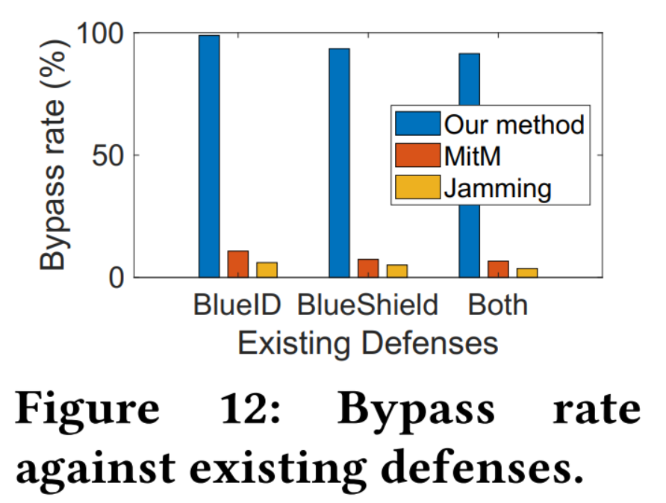
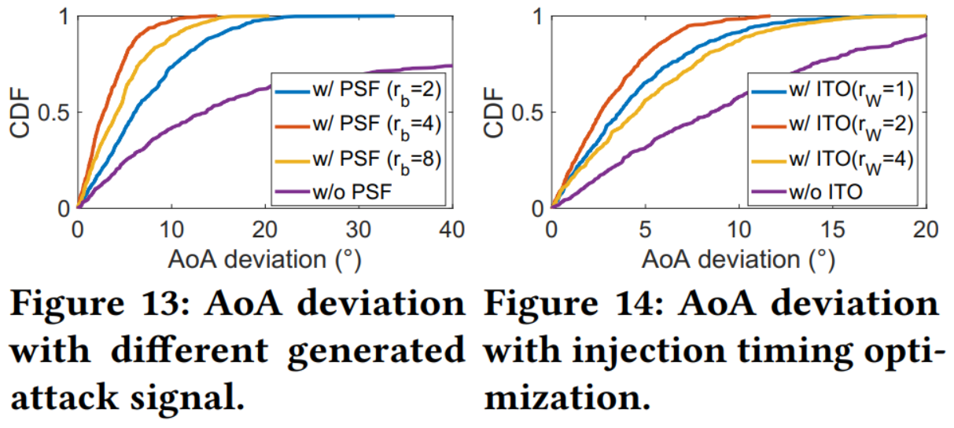
Micro-benchmarks
Notes:
备用

Slide 28
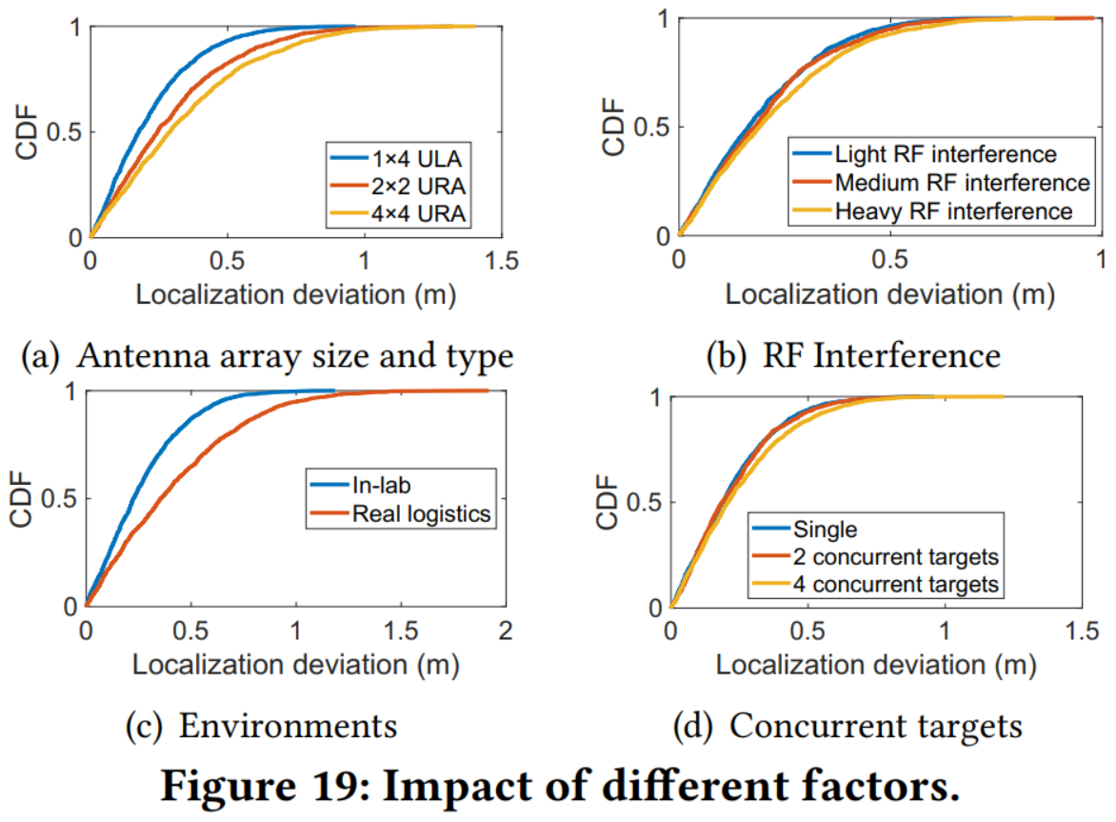
Impact of Factors
Notes:
备用

