Slide 1
OS Fingerprinting and Tethering Detection in Mobile Networks
Yi-Chao Chen
The University of Texas at Austin
Joint work:
Yong Liao‡, Mario Baldi‡, Sung-Ju Lee‡, Lili Qiu†
Narus Inc. ‡, The University of Texas at Austin†

Slide 2



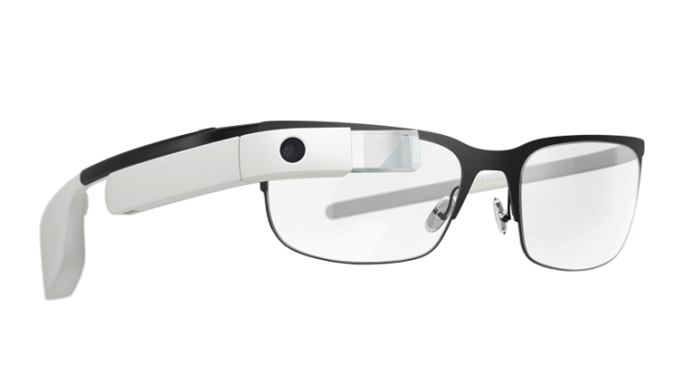


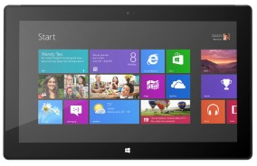




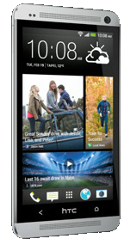





Mobile OS Fingerprinting
Problem statement
Infer what operating system a device is running by analyzing the packets it’s generating.
Tethering detection: identify mobile devices which are sharing the Internet access
?
?
?
Notes:
The number of mobile devices will exceed the world’s population by 2015.
mobile data traffic last year was nearly 18 times the size of the entire global Internet in 2000

Slide 3
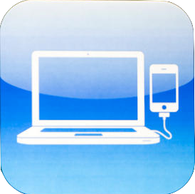
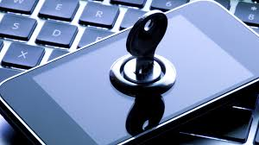
Importance
Tethering detection
Billing for shared access in mobile networks
Security
Policy enforcement in enterprise networks
Notes:
Tethering:
tethering allows sharing the Internet connection of the phone or tablet with other devices such as laptops.
At&t policy for tethering
Knowing OS can launch attack – known security hole in iOS SSH
Allow malicious to access your phone

Slide 4
Existing Works
Application
HTTP user agent [P0f], DHCP options [Satori]
Transport
Network
IP TTL, ID, dest address [P0f, PAM04]
Link
802.11 MAC fields, SSID, frame size [MOBICOM07]
TCP handshake, timeout, MTU, flags, init seq. number [P0f, NMap, VEYSET02, PAM04, RAID03], TCP Timestamp [INFOCOM99, IMW02]
Notes:
Well known tool P0f: dynamics in TCP handshake and IP flags usage
Some other finds maximal transmission unit in TCP syn packet are different across OSes

Slide 5
Limitation of Existing Works
Existing works focus on the Internet traffic
Mobile networks impose new challenges:
Dynamic frequency due to power saving
Clock skew, boot time estimation, …
Short connections
TCP flavors, initial sequence number, …
Features might have changed in mobile OSes
TCP MTU, IP flags, …
Notes:
Clock frequency has been successfully and widely adopted in identifying NAT hosts, routes, …
but not in mobile networks due to dynamic frequency
clock skew, one of the prominent metrics used for device finger printing identified in the previous works doesn't work well for mobile devices.

Slide 6
Approach
Identify features to fingerprint mobile device OSes
Detect tethering
Clock frequency stability, boot time estimation
IP Time-to-Live, ID Monotonicity
TCP timestamp option, window size scale option, timestamp monotonicity
Combine multiple features
Quantify the performance
Individual and combined features
OS fingerprinting and tethering detection
Notes:
All identify useful
Which are new
Which are changed (how)

Slide 7
Dataset
Lab trace
56 mobile user traces
14 Android phones and tablets traces
Samsung Galaxy S5, HTC Ones, HTC Inspire phones, Google Nexus 10 tablet
10 iOS traces
iPhone 4s, iPhone5s, iPad 2, iPod Touch
iOS 5.1.1, iOS 6.1
32 Windows laptops traces
running Windows XP or Windows 7
Each capture lasts 10~30 minutes

Slide 8
Other Datasets
Trace | Time | Duration | # IPs
Lab Trace | Oct. 2013 | 2 hours | 56
SIGCOMM08 Trace | Aug. 2008 | 1 day | 223
OSDI06 trace | Nov. 2006 | 1 day | 292

Slide 9
Features
Clock Frequency
The frequency is stable in Android and Windows,
but vary over time in iOS devices
High clock frequency std. suggests iOS
Notes:
See this figure, it’s reasonable to …

Slide 10
Features
IP ID Monotonicity
Android:
Some devices completely randomize the IP IDs
Some periodically reset to random values.
iOS: randomize the IP ID of each packet
Windows: IP ID consistently increase monotonically
High violation ratio suggests iOS;
low violation ratio suggests Windows.
Notes:
The identification field in the IP header is primarily used in IP de-fragmentation.

Slide 11
Features
TCP Timestamp Option
iOS and Android have TCP TS Option,
but Windows doesn’t
Low ratio of TCP TS option suggests Windows.
Notes:
The TCP timestamp option is used for measuring round trip time and protecting against wrapped sequence numbers.

Slide 12
Features
IP Time-To-Live
TCP Window Size Scale Option
Boot time estimation
Notes:
Refer to the paper for details

Slide 13
Combining Features
No single feature works in all scenarios
Naïve Bayes classifier
Probability of being OS_{x}
Probability of finding feature f_{i} in OS_{x}’s traffic
Probability of finding feature f_{i} in all traffic
Notes:
Why independent
it still works, we can remove the assumption if we have larger dataset

Slide 14
Tethering Detection
Apply the same technique for tethering detection.
Features which identify mobile devices
IP Time-To-Live
TCP timestamp monotonicity
Clock frequency
Boot time estimation
Multiple OSes

Slide 15
Evaluation – Single Feature
No single feature identifies all OSes accurately.
Notes:
Precision: the fraction of identified OS are correct
Recall: the fraction of the OS that are correctly identified

Slide 16
Evaluation – Combing Features
Combining all features yields the best result.

Slide 17
Evaluation – Tethering Detection
Combining all features also yields the best result in tethering detection.

Slide 18
Conclusion
Contributions
Identify new features for mobile OS fingerprinting and tethering detection
Develop a probabilistic scheme that combines multiple features
Evaluate the individual and combined features
Combing multiple features yields the best performance
OS fingerprinting: 100% precision, 80% recall
Tethering detection: 79%-89% recall when targeting 80% precision
Notes:
Through our preliminary result,
This is an initial study, we
There are still tasks remains ..

Slide 19
Thank You!
yichao@cs.utexas.edu

Slide 20
Backup Slides

Slide 21
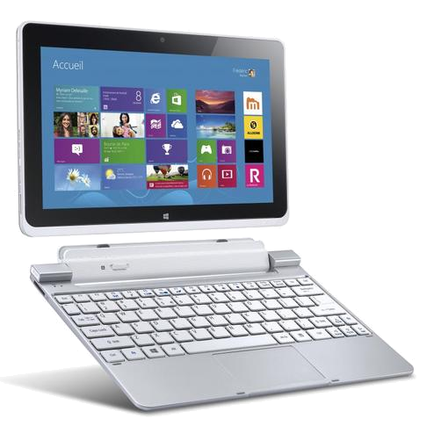
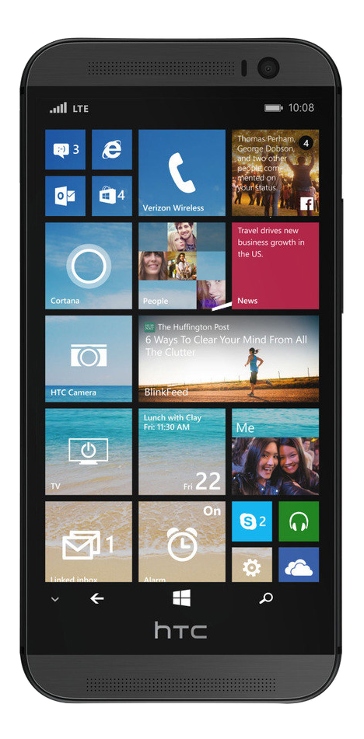
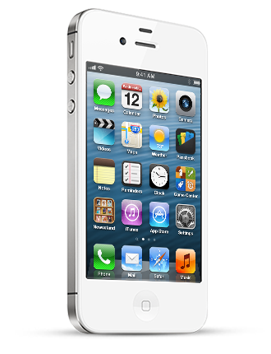
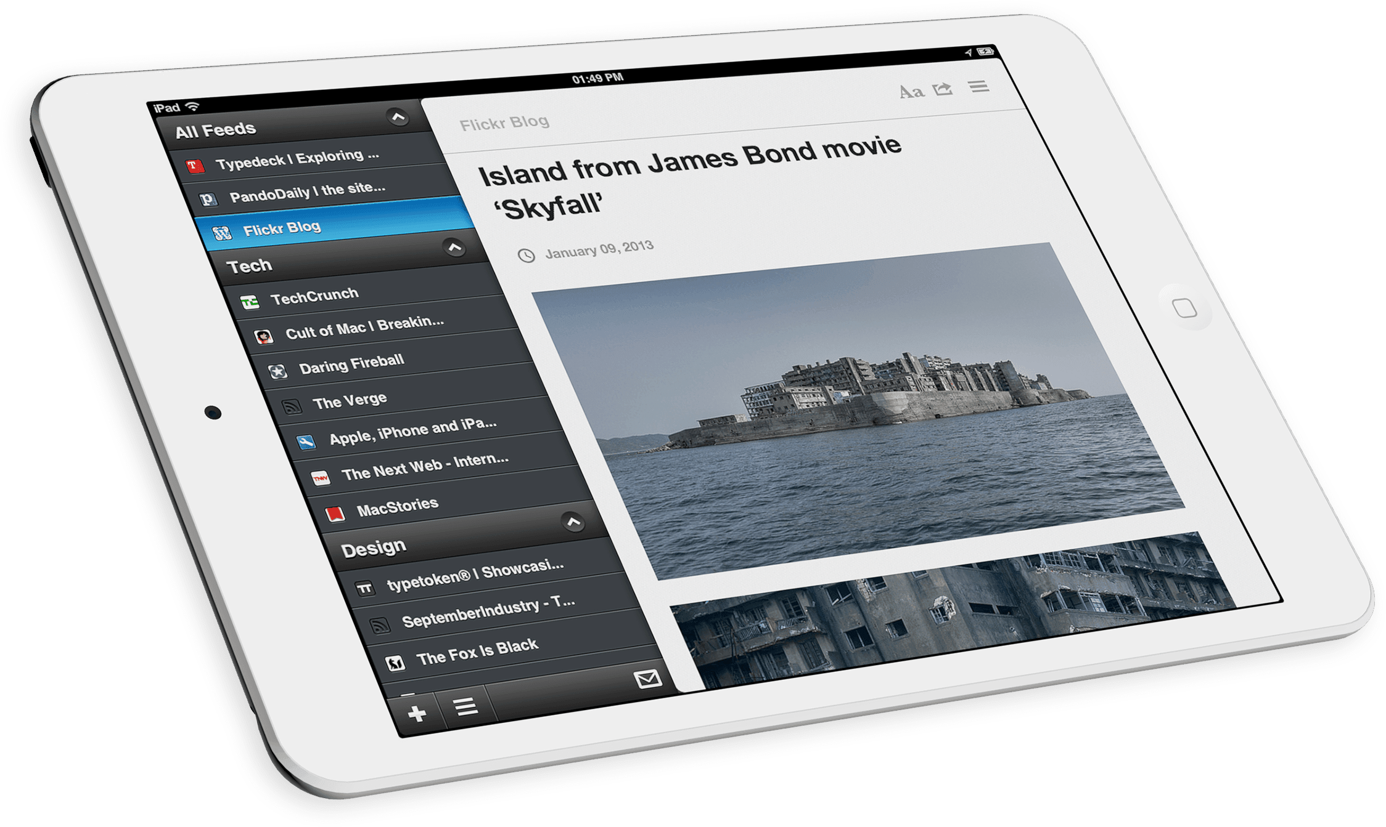
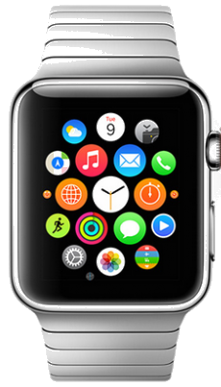
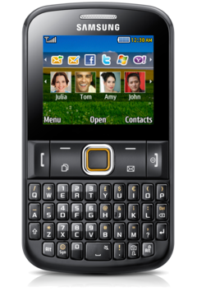
Mobile OS Fingerprinting
Notes:
The number of mobile devices will exceed the world’s population by 2014.
mobile data traffic last year was nearly 18 times the size of the entire global Internet in 2000

Slide 22
Features
IP Time-To-Live (TTL)
Windows: 64 or 128
iOS and Android: 64

Slide 23
Features
TCP Window Size Scale Option
iOS: 16
Windows and Android: 2, 4, 64, or 256
Notes:
This option allows TCP client and server to negotiate and use a larger window size

Slide 24
Evaluation – Comparing Classifiers
Probability based classifier outperforms other classifiers by 5~21% in F1-score measurement.

