Slide 1
Event Detection using Customer Care Calls
Yi-Chao Chen¹, Gene Moo Lee¹, Nick Duffield², Lili Qiu¹, Jia Wang²
The University of Texas at Austin¹, AT&T Labs – Research²

Slide 2



Motivation
Customer care call is a direct channel between service provider and customers
Reveal problems observed by customers
Understand impact of network events on customer perceived performance
Regions, group of users, services, …
Notes:
Customer care service is a direct channel between service provider and customers
Customer care calls can reveal problems observed by customers and details about the nature of events
Understand impact of network events on customer perceived performance
A complement to network performance metrics

Slide 3


Motivation
Service providers have strong motivation to understand customer care calls
Reduce cost: ~$10 per call
Prioritize and handle anomalies by the impact
Improve customers’ impression to the service provider
Notes:
Service providers have strong motivation to understand customer care calls
Operating call centers and handling calls cost $10 per call. If it’s important to identify problems asap and deflate the calls
Prioritize and handle anomalies by the impact
the way to deal with customer care calls directly impact customers’ experience and their impression of the company
So the goal of this paper is to identify events using customer care calls

Slide 4
Problem Formulation
Goal
Automatically detect anomalies using customer care calls.
Input
Customer care calls
Call agents label calls using predefined categories
~10,000 categroies
A call is labeled with multiple categories
Issue, customer need, call type, problem resolution
Notes:
This study uses data derived from calls to customer support centers of a major mobile service provider.
When a call reach a call agent, the call agent label calls with predefined categories.
A call can be labeled with multiple ccategories depends on the issue, customer need, call type, and problem resolution.

Slide 5
Problem Formulation
Output
Anomalies
Performance problems observed by customers
e.g. Service outage due to DOS attack, power outage, low bandwidth due to maintenance

Slide 6
Example: Categories of Customer Care Calls

Slide 7
Input: Customer Care Calls
T₁
T₂
T₃
…
T_{t}
# of calls of category n in time bin t

Slide 8
Example: Anomaly
Service outage due to DOS attack
Low bandwidth
due to maintenance
Power outage
Output: anomaly indicator = [ 0 0 0 1 0 0 0 0 0 1 1 1 0 0 0 0 0 0 1 0 0 0 0 0 0 0 0 0 0 0 ]
Notes:
Mention it’s binary and company can get more information from external sources like twitter/detailed notes

Slide 9

Challenges
Customers respond to an anomaly in different ways.
Events may not be detectable by a single category.
Notes:
Customers respond to an event in different ways. For example, for major events, like service outage, customers may call immediately. But for small events, customers may call after they become available or may not call at all. It depends on many factors including the event impact, customer availability, and time-of-day.
Many important events cannot be detected by looking at calls in one category.
Single categories is vulnerable to outliers
Scalability. There are thousands of possible categories by which calls may be labeled. Learning from such a large dimension of features is challenging.
Have ts of categories individually, and show they can not reveal the anomaly

Slide 10


Challenges
Customers respond to an anomaly in different ways.
Events may not be detectable by a single category.
Notes:
Customers respond to an event in different ways. For example, for major events, like service outage, customers may call immediately. But for small events, customers may call after they become available or may not call at all. It depends on many factors including the event impact, customer availability, and time-of-day.
Many important events cannot be detected by looking at calls in one category.
Single categories is vulnerable to outliers
Scalability. There are thousands of possible categories by which calls may be labeled. Learning from such a large dimension of features is challenging.
Have ts of categories individually, and show they can not reveal the anomaly

Slide 11

Challenges
Customers respond to an anomaly in different ways.
Events may not be detectable by a single category.
There are thousands of categories.
Notes:
Customers respond to an event in different ways. For example, for major events, like service outage, customers may call immediately. But for small events, customers may call after they become available or may not call at all. It depends on many factors including the event impact, customer availability, and time-of-day.
Many important events cannot be detected by looking at calls in one category.
Single categories is vulnerable to outliers
Scalability. There are thousands of possible categories by which calls may be labeled. Learning from such a large dimension of features is challenging.
Have ts of categories individually, and show they can not reveal the anomaly

Slide 12
Challenges
Inconsistent classification across agents and across call centers
Notes:
Customer care calls are labeled and input into system manually by call agents. And the call centers can change the usage of categories. Therefore, call categorization depends on the information supplied by the customer, which may lead to inconsistent classification across agents and across call centers

Slide 13

Our Approach
We use regression to approach the problem by casting it as an inference problem:
A(t,n): # calls of category n at time t
x(n): weight of the n-th category
b(t): anomaly indicator at time t

Slide 14
Our Approach
Training set: the history data
A: Input timeseries of customer care calls
b: Ground-truth of when anomalies take place
x: The weight to learn
Testing set:
A’: The latest customer care call timeseries
x: The weight learning from training set
b’: The anomaly to detect
A
x
=
b
A’
x
=
b’

Slide 15
Issues
Dynamic x
The relationship between customer care calls and anomalies may change.
Under-constraints
# categories can be larger than # training traces
Over-fitting
The weights begin to memorize training data rather than learning the generic trend
Scalability
There are thousands of categories and thousands of time intervals.
Varying customer response time
Notes:
As the categories and events evolve, the relationship between the inputs and the anomalies may also change. Therefore x can change over time.
number of categories can be much larger than the number of constraints derived from the training traces

Slide 16
System Overview
Reducing Categories
Clustering
Identifying important categories
Regression
Temporal stability
Low-rank structure
Combining multiple classifiers

Slide 17
Clustering
Agents usually classify calls based on the textual names of categories.
e.g. “Equipment”, “Equipment problem”, and “Troubleshooting- Equipment”
Cluster categories based on the similarity of their textual names
Dice’s coefficient
Reducing Categories
Clustering
Identifying important categories
Regression
Temporal stability
Low-rank structure
Combining multiple classifiers

Slide 18
Identify Important Categories
L₁-norm regularization
Penalize all factors in x equally and make x sparse
Select categories with corresponding value in x is not 0
Reducing Categories
Clustering
Identifying important categories
Regression
Temporal stability
Low-rank structure
Combining multiple classifiers
Notes:
L1-norm is also known as least absolute value method, which select x to minimize the difference between Ax and b and x.
The method penalizes all factors in x equally and makes x sparse.
We select categories with corresponding value in x is not 0

Slide 19
Regression
Impose additional structures for under-constraints and over-fitting
The weight values are stable
Small number of factors of dominate anomalies
Fitting Error
Reducing Categories
Clustering
Identifying important categories
Regression
Temporal stability
Low-rank structure
Combining multiple classifiers

Slide 20
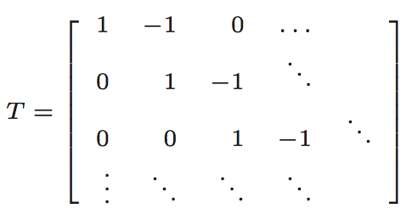
Regression
Temporal stability
The weight values are stable across consecutive days.
Reducing Categories
Clustering
Identifying important categories
Regression
Temporal stability
Low-rank structure
Combining multiple classifiers
Notes:
we use a simple temporal transformation matrix to minimize the change in x between two consecutive days
T denotes Toeplitz matrix with central diagonal given by 1, the first upper diagonal given by -1.

Slide 21
Regression
Low-rank structure
The weight values exhibit low-rank structure due to the temporal stability and the small number of dominant factors that cause the anomalies.
Reducing Categories
Clustering
Identifying important categories
Regression
Temporal stability
Low-rank structure
Combining multiple classifiers
Notes:
To capture the low-rank nature of weight matrix, we introduce a penalty term function
U is a N × r unknown factor matrix
and V is a d × r unknown factor matrix,
Minimizing the penalty term ensures X has a good rank-r approximation: M ≈ U ∗ V T .

Slide 22
Regression
Find the weight X that minimize:
Reducing Categories
Clustering
Identifying important categories
Regression
f(X): Fitting error
Temporal stability
Low-rank structure
g(X): Temporal stability
Combining multiple classifiers
h(X,U,V): Low-rank

Slide 23
Combining Multiple Classifiers
What time scale should be used?
Customers do not respond to an anomaly immediately
The response time may differ by hours
Include calls made in previous n (1~5) and next m (0~6) hours as additional features.
Reducing Categories
Clustering
Identifying important categories
Regression
Temporal stability
Low-rank structure
Combining multiple classifiers
Notes:
Animation for this

Slide 24
Evaluation
Dataset
Customer care calls: data from a large network service provider in the US during Aug. 2010~ July 2011
Ground-truth anomalies: all anomalies reported by Call Centers, Network Operation Centers, and etc.
Metrics
Precision: the fraction of claimed anomalies which are real anomalies
Recall: the fraction of real anomalies are claimed
F-score: the harmonic mean of precision and recall
Notes:
The higher the better

Slide 25
Evaluation – Identifying Important Features
Notes:
Recall: the fraction of real anomalies are claimed
Precision: the fraction of claimed anomalies that are real anomalies
PCA find the principle components that has the largest possible variance

Slide 26
Evaluation – Identifying Important Features
Notes:
Recall: the fraction of real anomalies are claimed
Precision: the fraction of claimed anomalies that are real anomalies
PCA find the principle components that has the largest possible variance

Slide 27
Evaluation – Identifying Important Features
Notes:
Recall: the fraction of real anomalies are claimed
Precision: the fraction of claimed anomalies that are real anomalies
PCA find the principle components that has the largest possible variance

Slide 28
Evaluation – Identifying Important Features
L1-norm out-performs rand 2000, PCA, and L2-norm by 454%, 32%, and 10%
Notes:
Recall: the fraction of real anomalies are claimed
Precision: the fraction of claimed anomalies that are real anomalies
PCA find the principle components that has the largest possible variance
L2-norm, also known as the least squares method. Weekness is the effect of gross measurements error on the solution and the disturbance and absorbance of gross error on the solution
L1–norm, also known as the least absolute values method, was affected by almost none or very little from gross error

Slide 29
Evaluation – Regression

Slide 30
Evaluation – Regression

Slide 31
Evaluation – Regression
Fit+Temp+LR out-performs Random and Fit by 823% and 64%

Slide 32
Evaluation – Number of Classifiers

Slide 33
Evaluation – Number of Classifiers

Slide 34
Evaluation – Number of Classifiers
use 30 classifiers to trade off the benefit and cost.

Slide 35
Contributions
Propose to use customer care calls as a complementary source to network metrics.
A direct measurement of QoE perceived by customers
Develop a systematic method to automatically detect events using customer care calls.
Scale to a large number of features
Robust to the noise

Slide 36
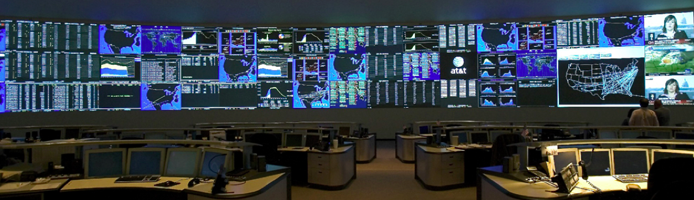
Thank You!
yichao@cs.utexas.edu

Slide 37
Backup Slides

Slide 38
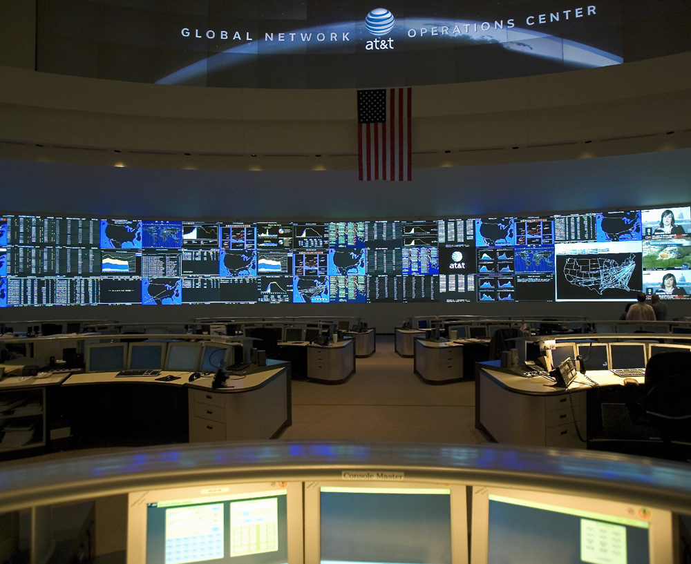
Notes:
Global Network Operations Center

Slide 39
Twitter
Leverage Twitter as external data
Additional features
Interpreting detected anomalies
Information from a tweet
Timestamp
Text
Term Frequency - Inverse Document Frequency (TF-IDF)
Hashtags: keyword of the topics
Used as features
e.g. #ATTFAIL
Location

Slide 40
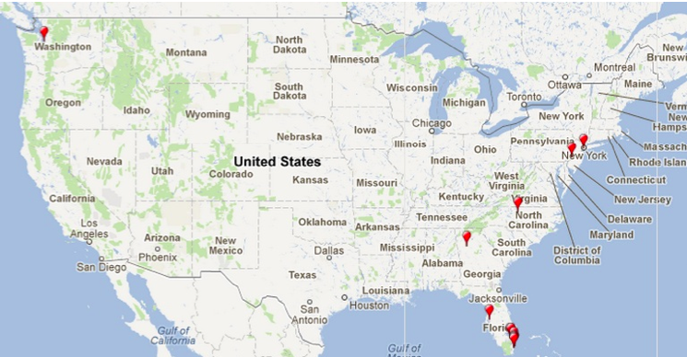
Interpreting Anomaly - Location

Slide 41
Describing the Anomaly
Examples
3G network outage
Location: New York, NY
Event Summary: service, outage, nyc, calls, ny, morning, service
Outage due to an earthquake
Location: East Coast
Event Summary: #earthquake, working, wireless, service, nyc, apparently, new, york
Internet service outage
Location: Bay Area
Event Summary: serviceU, bay, outage, service, Internet, area, support, #fail

Slide 42
How to Select Parameters
K-fold cross-validation
Partition the training data into K equal size parts.
In round i, use the partition i for training and the remaining k-1 partitions for testing.
The process is repeated k times.
Average k results as the evaluation of the selected value

