Slide 1
Turning a Mobile Device into a Mouse in the Air
Sangki Yun, Yi-Chao Chen and Lili Qiu
Department of Computer Science
The University of Texas at Austin
ACM MobiSys 2015, Florence, Italy

Slide 2
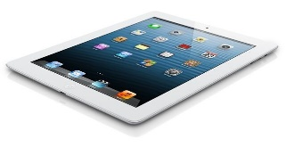
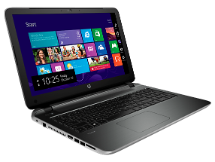
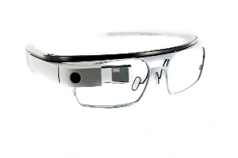
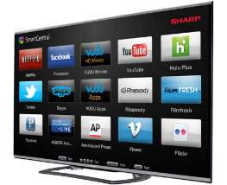
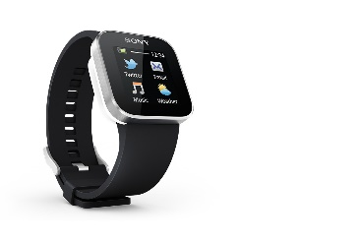
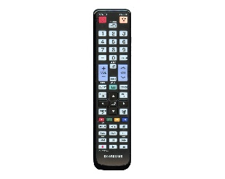
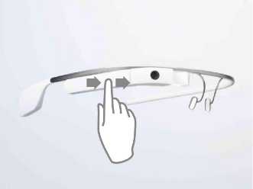
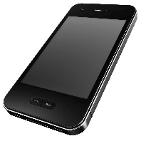
Era of Smart Devices
Smart Devices

Slide 3
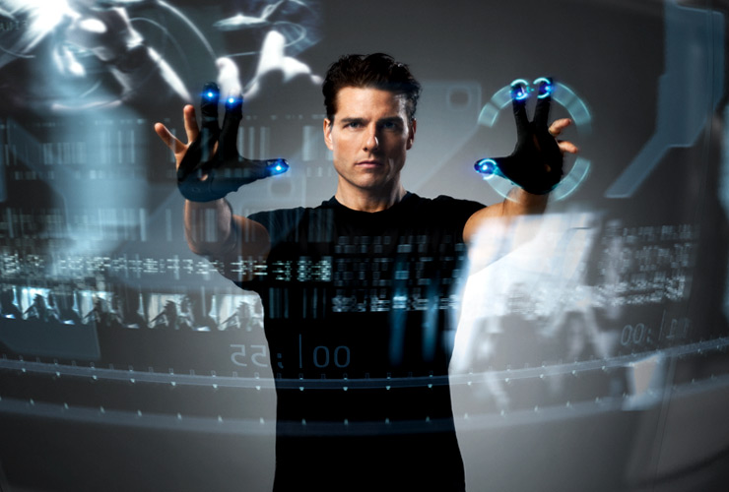
Ideally

Slide 4
Our goal
Controlling smart devices using existing mobile devices
How to enable precise mobile device position tracking?

Slide 5
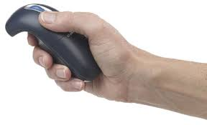
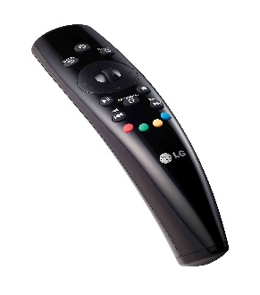
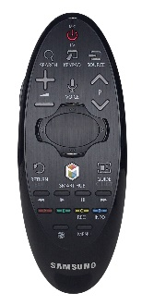
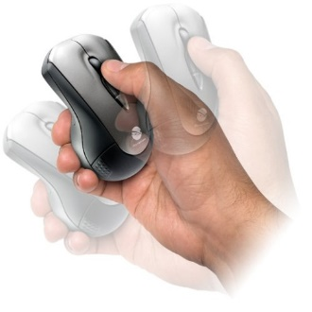
Possible solutions
RF signal based device localization – sub-meter level accuracy
Accelerometer based device tracking – not feasible due to huge noise
Gyroscope – track the rotational movement of the device

Slide 6
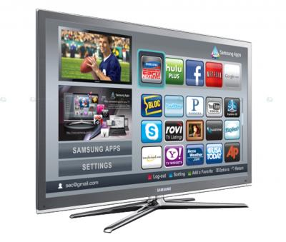
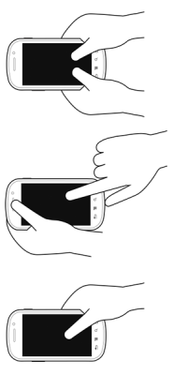
Our Approach
Audio based movement tracking using Doppler effect
Two speakers emit pure sinusoid tones in inaudible frequencies
The device position is tracked by the Doppler shift of the recorded audio signal

Slide 7
Outline
Background

Slide 8
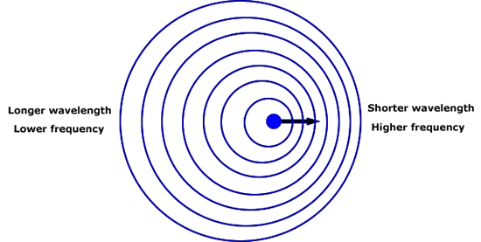
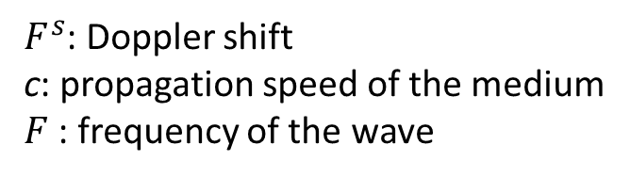
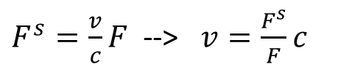
Doppler Effect
Doppler shift – change in the frequency due to the movement of the sender or the receiver
$F^{s}=\frac{v}{c}F$ --> $v=\frac{F^{s}}{F}c$
$F^{s}$: Doppler shift
c: propagation speed of the medium
$F$: frequency of the wave

Slide 9
Why Doppler? (Why not accelerometer?)
Compared to accelerometer, it is much more accurate to track the movement
Acceleration while device is moving
Measured Doppler shift
Movement estimated from the accelerometer
Movement estimated from Doppler shift

Slide 10
Doppler based device movement tracking
Accurately estimating the Doppler shift
Tracking the position from the distance change
Finding the distance between speakers
Finding the initial position of the device
Controlling a device with one speaker

Slide 11
Doppler shift estimation
Short-term Fourier Transform (STFT)
Observe the change of spectrum over time
Use Hamming window to mitigate aliasing
Detect the Doppler shift by finding the peak frequency with maximum magnitude

Slide 12
Improving the frequency shift estimation accuracy
Utilize larger spectrum (Send 5 audio tones in 200 Hz interval)
Outlier removal (Doppler shift change larger than 10 Hz)
Maximal Ratio Combining
MRC without outlier removal
Doppler shift from multiple channels
MRC with outlier removal

Slide 13
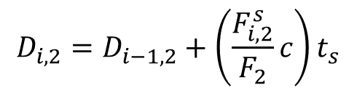
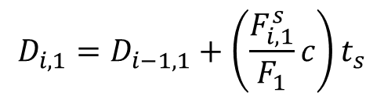
Tracking the device position - 1
Assumptions
The distance between speakers is known
The initial device position is known
Measure Doppler shift from two speakers
Using the previous position and Doppler, update new distance from speakers
$$D_{i,1}=D_{i−1,1}+\left(\frac{F_{i,1}^{s}}{F_{1}}c\right)t_{s}$$
$$D_{i,2}=D_{i−1,2}+\left(\frac{F_{i,2}^{s}}{F_{2}}c\right)t_{s}$$

Slide 14





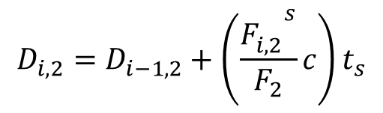







Tracking the device position - 2
Having the distance from two speakers, finding the position is finding the intersection of two circles
$$(0,0)$$
$$(D,0)$$
$$D_{3,1}$$
$$(x_{4},y_{4})$$
$$D_{3,2}$$
$$D_{2,2}$$
$$D_{2,1}$$
$$(x_{3},y_{3})$$
$$D_{1,1}$$
$$(x_{2},y_{2})$$
$$D_{1,2}$$
$$(x_{1},y_{1})$$
$$(x_{0},y_{0})$$

Slide 15
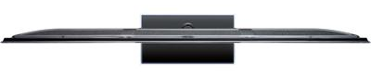



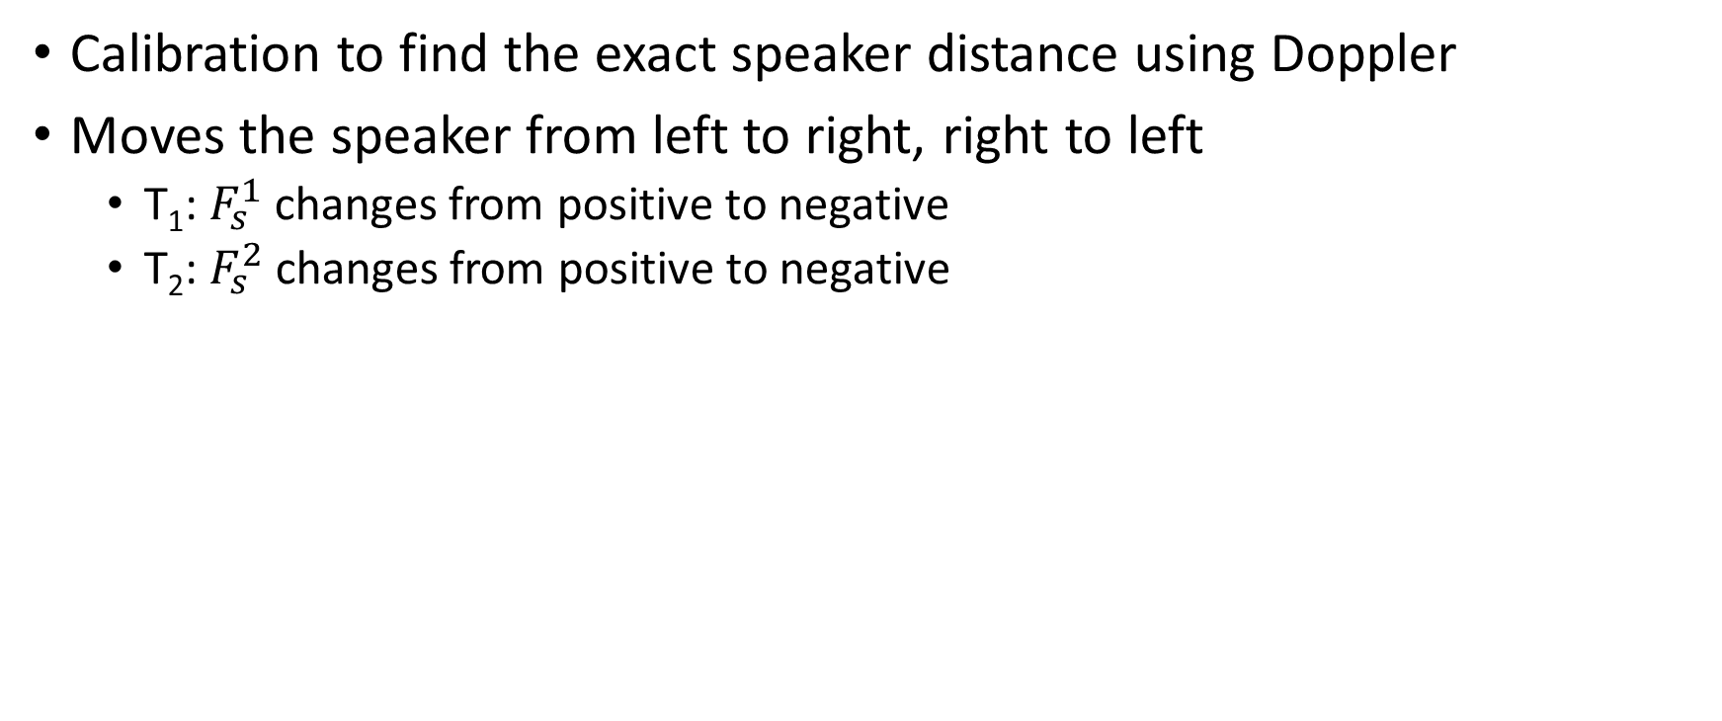


Finding the distance between speakers
Calibration to find the exact speaker distance using Doppler
Moves the speaker from left to right, right to left
T₁: $F_{s}^{1}$ changes from positive to negative
T₂: $F_{s}^{2}$ changes from positive to negative
$$T_{0}$$
$$T_{1}$$
$$T_{2}$$
$$T_{3}$$

Slide 16
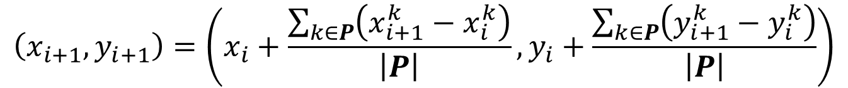

Finding the initial position (particle filtering)
Initially allocate many particles in a given space
In each movement update, remove particles that give infeasible movement (i.e., D < D₁ + D₂)
Update position by averaging the movement of all remaining particles
$$P=\left\{\left(x_{o}^{1},y_{o}^{1}\right),…,\left(x_{o}^{N},y_{o}^{N}\right)\right\}$$
$$\left(x_{i+1},y_{i+1}\right)=\left(x_{i}+\frac{\sum_{k∈P}{\left(x_{i+1}^{k}−x_{i}^{k}\right)}}{\left|P\right|},y_{i}+\frac{\sum_{k∈P}{\left(y_{i+1}^{k}−y_{i}^{k}\right)}}{\left|P\right|}\right)$$

Slide 17
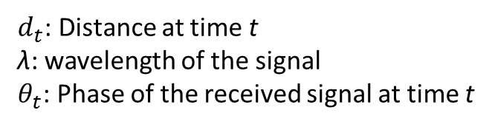

Controlling a device with one speaker
Leverage one speaker and one RF signal (WiFi or Bluetooth)
Measure the change of the distance from speaker using Doppler shift
Measure the change of the distance from RF source using phase change
Use the same mechanism to track the position
$$d_{t2}=\left(\frac{θ_{t2}−θ_{t1}}{2π}\right)λ+d_{t1}$$
$d_{t}$: Distance at time t
λ: wavelength of the signal
$θ_{t}$: Phase of the received signal at time t

Slide 18
Implementation
We implement AAMouse to enable real-time device tracking
Mobile application – collect audio signal from the microphone and deliver it to the tracking processor
Tracking processor - track the device, visualize the current position
For comparison, we also implement
Camera based tracking (ground-truth)
Accelerometer based tracking
Gyroscope
Moves the pointer by rotational movement of the device
Used in commercial air mouse devices

Slide 19
Performance evaluation
We performed user study with 8 students, and evaluated
Tracking accuracy
Target pointing
Show a point on the screen
Ask the user to point it
Drawing
Show a simple shape such as heart, circle, diamond, triangle
Ask the user to draw it

Slide 20
Tracking accuracy
AAMouse
Median error: 1.4 cm
90th percentile error: 3.4 cm
Not affected by background noise
Accelerometer
Median error: 17.9 cm
90th percentile error: 37.7 cm

Slide 21
Target Pointing evaluation
R=D_{a} / D_{s}
D_{a}: actual distance the pointer travels to reach the target
D_{s}: Distance between the target and the origin
AAMouse
Camera
Gyroscope
Samples from 80th percentile R

Slide 22
Drawing evaluation
Drawing error
The distance between original shape and the drawn image
AAMouse
Camera
Gyroscope
Samples from median drawing error

Slide 23
Conclusion
We develop an audio based device tracking and apply it to realize mouse
Future work
Improving the accuracy and robustness of the tracking
Realizing 3D tracking

Slide 24

Thank you!

Slide 27
Putting it all together
Speaker distance calibration
Initialize Particles
Mobile device records audio signal and feeds back to processor
Estimate the frequency shift and the velocity
Compute the distance from each particle
Compute new locations of particles and filter out particles with infeasible movement
Find new location of the device

Slide 28
Micro benchmark - 1
Impact of using multiple sounds and outlier removal
With outlier removal
Without outlier removal

Slide 29
Micro benchmark - 2
Impact of the speaker distance calibration
CDF of the speaker distance error
Trajectory error with various speaker distance errors

Slide 30
Motivation
Goal: precise device tracking technique to use a mobile device as Air mouse
Applications
Remote controller for Smart TV, Google Glass, laptop and PC
Motion controller for gaming applications (e.g., X-Box Kinect, Nintendo Wii)
Gesture recognition for Smart watch

Slide 31
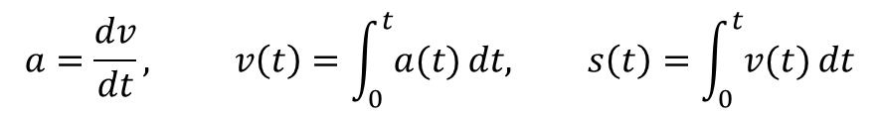
Accelerometer based device tracking
Accelerometers are equipped in most mobile devices
Ideally, we can track the device position by double integration of the acceleration
In practice, hand vibration significantly affects the acceleration, and small error accumulate quickly due to double integration
$$a=\frac{dv}{dt}, v\left(t\right)=\int_{0}^{t}{a(t)}dt, s\left(t\right)=\int_{0}^{t}{v(t)}dt$$

