Slide 1


KLEOS
“Build practical skills through real projects, then show what you can do on your own.”
Notes:
0:00–0:25 | Introduce Kleos. Start with a question, a project or a career goal. Kleos helps you build the understanding to take the next step yourself.

Slide 2

The Problem
Preparing for an AI future. Still learning for grades.
• Too little real-world practice
Few opportunities to tackle open-ended tasks, test ideas, and learn from failure.
• Too few opportunities to develop judgement
Learners need practice framing problems, evaluating AI outputs, and testing solutions.
• Grades take priority over genuine interests
GPA pressure crowds out meaningful projects and deep expertise in fields learners love.
The gap: turning knowledge and curiosity into independent capability.
Notes:
0:25–1:05 | Ask the audience to remember a time they read an answer and still could not use it. The hard part is finding the missing idea and seeing what to do next.

Slide 3


Slide 4
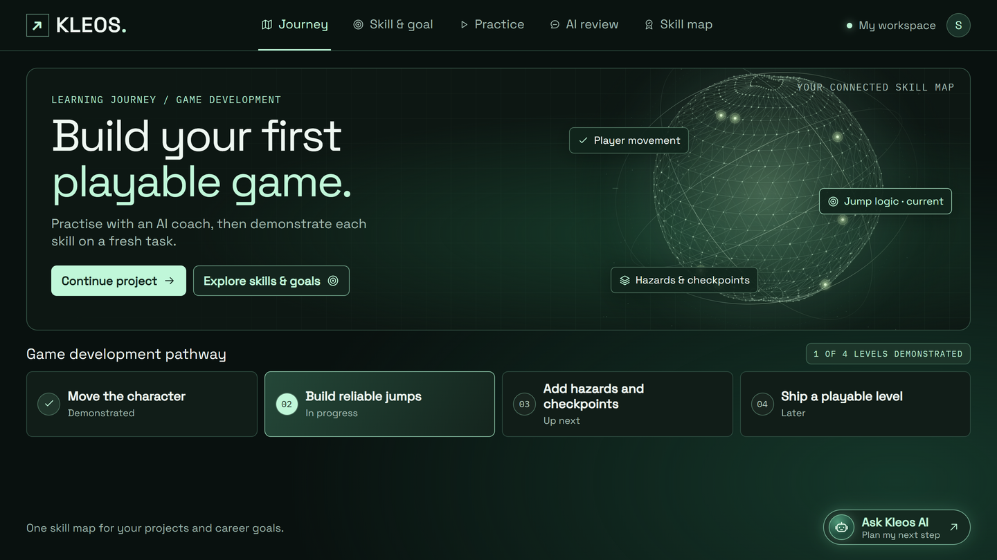
Our Solution
Learn the skill you choose through
progressive, practical tasks.
1. Choose your skill and goal.
2. Demonstrate your starting ability.
3. Practise at the right level.
4. Get personalised agent guidance.
5. Demonstrate the skill independently and progress.
KLEOS / SOLUTION 01 OF 05 Your goal sets the direction. Your ability determines the next level.

Slide 5
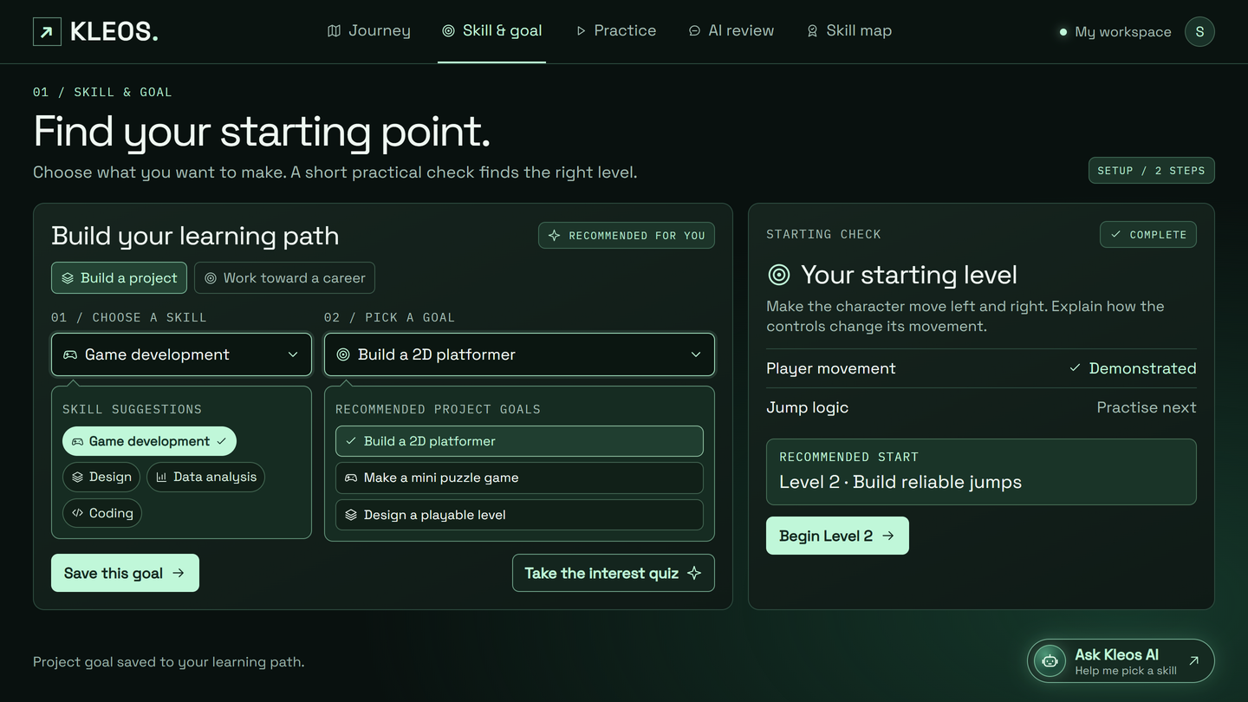
Your Skill. Your Starting Point.
Tell Kleos what you want to achieve.
• Choose a skill or explore your interests.
• Set a concrete learning goal.
• Complete a short practical check.
• Begin at your demonstrated level.
Example goal
“I want to build a 2D platformer.”
Player movement: demonstrated
Jump logic: next to practise
KLEOS / SOLUTION 02 OF 05 Build on what you already know.

Slide 6
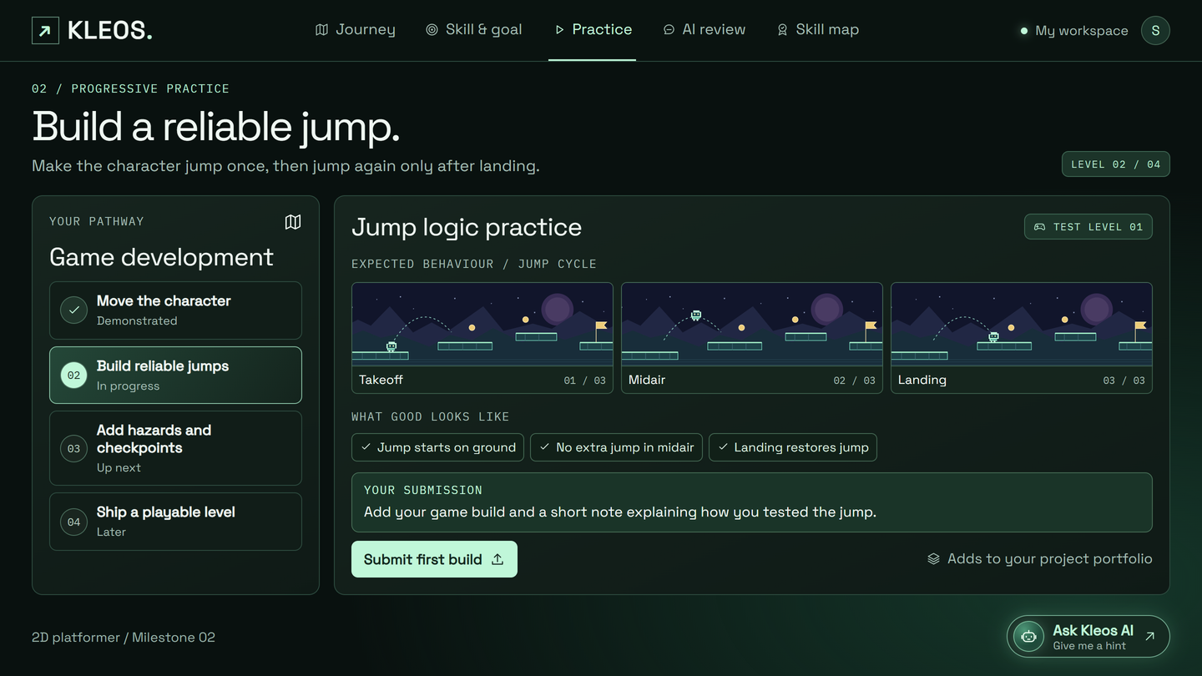
Learning Through Progressive Tasks
Every level has a practical task and
a clear standard for completion.
Game development pathway
Level 1 Move the character
Level 2 Build reliable jumps
Level 3 Add hazards and checkpoints
Level 4 Ship a playable level
Current task
Prevent extra jumps in midair.
Restore the jump after landing.
KLEOS / SOLUTION 03 OF 05 Increasing difficulty develops deeper skill and practical experience.

Slide 7
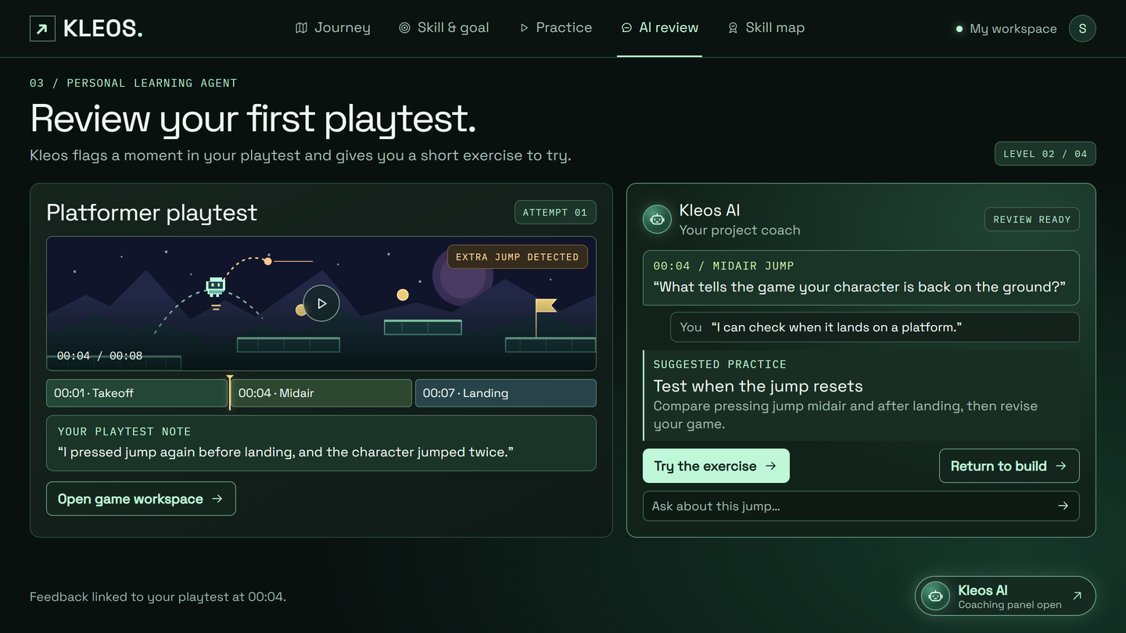
Your Personal Learning Agent
The agent reviews your playtest and
suggests what to practise next.
• Flags the extra jump in midair.
• Asks how the game detects landing.
• Gives a focused test to try.
• Guides you back to revise your game.
Example feedback
“What tells the game your character
is back on the ground?”
KLEOS / SOLUTION 04 OF 05 You make the decisions. Your agent helps you improve your judgement.

Slide 8
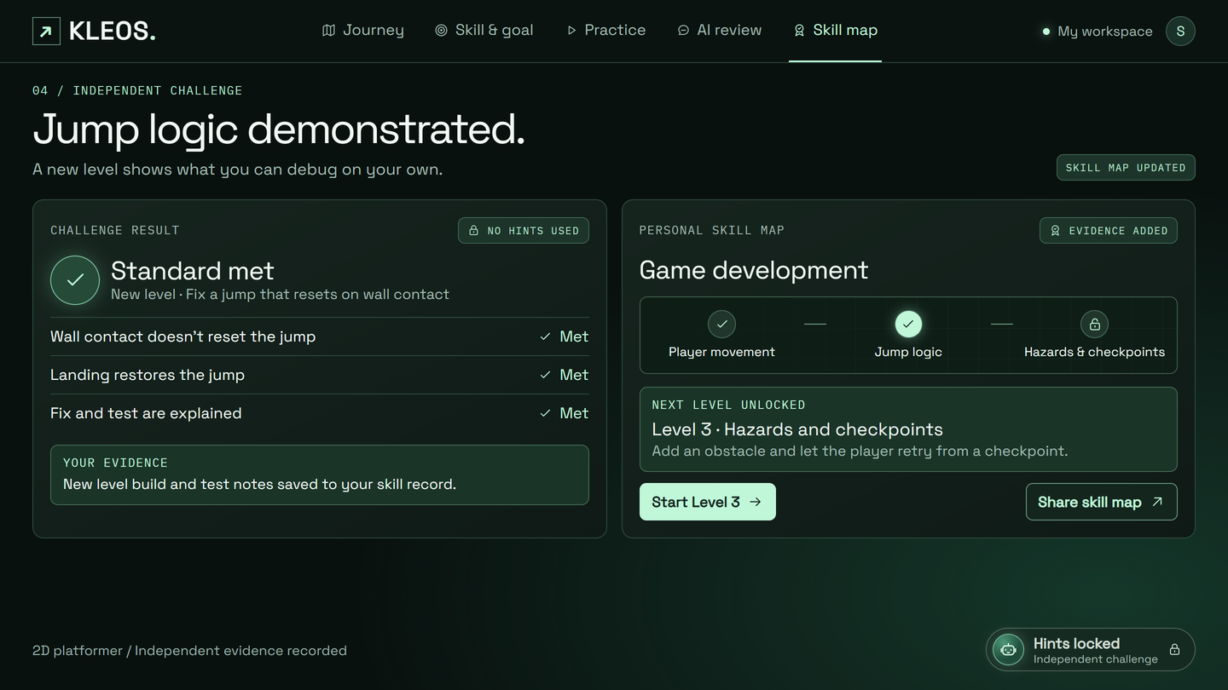
Demonstrate Ability. Progress Further.
Progress depends on what you can
do independently.
• Apply the skill to an unfamiliar task.
• Complete the attempt without hints.
• Explain the decisions behind your work.
• Meet clear performance criteria.
Ready: unlock the next level.
Not yet: practise the specific gap,
then try a fresh challenge.
KLEOS / SOLUTION 05 OF 05 Advance through demonstrated capability.

Slide 9
Free Access
Free
PILOT PRICING
Concept help, quizzes and one coached milestone
Revenue
Model
Project Pass
HK$79 / project
One project with milestones and feedback
Earn HK$20 in credit
Finish a paid project and submit the final challenge.
Use it on your next Project Pass or your first month of Career Plan.
Career Plan
HK$129 / month
Role roadmap and portfolio feedback
HK$99/mo for university students
Group rates
School & College Plan
Discounted seats for classes and clubs
Per cohort or semester
Notes:
Concept help and diagnostic quizzes are free, and learners can try one coached milestone. We would test HK$79 for one guided project and HK$129 per month for a career pathway, with a HK$99 rate for verified university students. Schools and colleges could buy discounted seats for a cohort or semester. The pilot tests whether learners who try coaching choose to pay to continue.
Finish a paid project and submit the final challenge to earn HK$20 toward the next Project Pass or the first month of the Career Plan. The pilot will track how many learners redeem the credit.

Slide 10

Market Size
Starting in Hong Kong
GLOBAL CONTEXT
269 million
Higher education students
worldwide in 2024 · UNESCO
FIRST MARKET
Hong Kong
University students building
practical skills through projects
YEAR 3 STRETCH TARGET
3,000
Registered learners
Build-It pilot tests sign-ups
Illustrative campus reach · 3,600 students
20 campuses × 3 cohorts × 60 students
With that reach, about 83% of invited students would need to sign up.
Notes:
5:30–6:05 | Our first market is Hong Kong university students who want to build practical skills through projects in areas like video editing, design and coding. Our campus reach estimate assumes 20 campuses, three cohorts per campus and 60 students per cohort. At that reach, our Year 3 target of 3,000 registrations would require about 83% to sign up. The pilot will test how many students actually sign up and whether we need to recruit more widely.
Global context source · UNESCO Higher Education Global Trends Report, 2026, based on 2024 enrolment data. https://www.iesalc.unesco.org/en/publication/higher-education-global-trends-report
Q&A · Illustrative global expansion scenario. At 300,000 registrations, 12% subscribing for seven months at HK$99 per month would yield HK$24.95M in subscription revenue before credits.

Slide 11

GO-TO MARKET
THE STUDENT JOURNEY
01 Campus invitation
02 Free coached milestone
03 HK$79 Project Pass
04 Finish project and submit challenge
05 HK$20 credit for your next purchase
HONG KONG CAMPUS PILOT
Run Build-It during a class or student society session. Give students 48 hours to submit one free coached milestone.
MEASURE THE PILOT
Track invitations, signups and completions. Count pass buyers and subscribers separately.
01
TEST REFERRALS AND EXPAND
Track signups from shared projects or skill maps.
If students in several cohorts finish and pay, offer universities paid seats for a cohort.
02
Notes:
6:05–6:40 | We’ll start Build-It in one Hong Kong university class or student society. Students try a coached milestone for free and have 48 hours to submit it. Those who want to continue can buy a HK$79 Project Pass. Students who finish the paid project and submit the final challenge earn HK$20 toward their next pass or their first Career Plan month.
Pilot measurement · Count unique invitations and signups to estimate the signup rate for slide 9. Track free milestone completions, Project Pass purchases and Career Plan subscriptions separately. Track referred signups from learners who opt to share a finished project or skill map. Repeat in a different skill area that the prototype supports. If completion and paid continuation repeat across cohorts, pitch universities on paid cohort seats.

Slide 12

Competition
Features | Hyperskill | CareerExplorer | YouScience | Kleos
Career interest assessment | ❌ | ✅ | ✅ | ✅
Hands-on project building | ✅ | ❌ | ❌ | ✅
Targeted skill mapping | ✅ (Coding only) | ❌ | ❌ | ✅(All routes)
Fresh project task without hints | — | — | — | ✅ Proposed
Skill evidence | Completion certificates | — | Industry certifications | Skill map record
Notes:
6:40–7:20 | Hyperskill offers guided coding projects and a knowledge map. Our proposed workflow starts with a learner’s own problem and reuses evidence of independent performance across future projects and goals.
Sources: https://hyperskill.org/guide/
https://support.hyperskill.org/hc/en-us/articles/4407035732500-My-study-plan-and-how-should-I-use-it
https://support.hyperskill.org/hc/en-us/articles/4406586984468-Knowledge-map-and-what-it-is-for

Slide 13

KLEOS
What Makes Kleos Different?
01
02
03
One connected
skill map
Practice tied to
real work
Independent
skill checks
Concept learning, projects and career goals feed one skill map. Progress carries over when you switch routes.
Find a skill gap, practise with support, then apply it to your project. Each task helps move your work forward.
Apply a skill to a fresh task without hints. The result updates your skill map and guides your next step.
Learn at your own pace. Pick up where you left off.
FUTURE DEVELOPMENT
Explore co-designed assessments, industry project briefs and portfolio reviews
with education and industry partners.
Notes:
7:40–8:40 | Follow one skill from a question into a project and a career pathway. For the longer-term career experience, we would approach professional associations about designing assessments and employers about project briefs, mentoring and introductions. These are proposed partnerships.

Slide 14
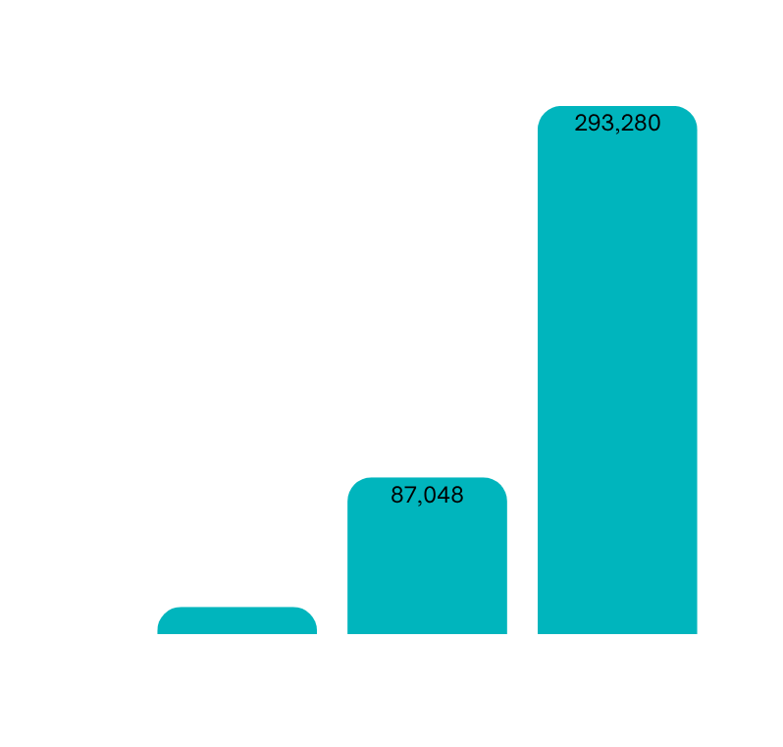
Financials
Campus forecast · Year 3 revenue breakdown
SUBSCRIPTIONS
HK$249.5K
ADD PASSES
HK$47.4K
LESS CREDITS
HK$3.6K
NET REVENUE
HK$293.3K
ASSUMPTIONS · Y1 / Y2 / Y3
NET REVENUE (HKD)
YEAR 3 SUMMARY
Registered learners | 300 / 1,200 / 3,000
Subscriber rate | 8% / 10% / 12%
Paid months | 5 / 6 / 7
Student price | HK$99 / month
Project uptake | 15% / 18% / 20%
HK$293.3K
Net revenue
HK$83.3K
Operating result
360
Paying subscribers
HK$210K
Assumed operating costs
~8.0%
Year 3 subscriber break-even
30% of passes redeem HK$20
Notes:
8:40–9:15 | Our Year 3 campus forecast is HK$293,280 in net revenue after HK$3,600 in completion credits. With HK$210,000 in estimated costs for development, AI usage and campus pilots, the projected operating result is HK$83,280. At seven paid months and the projected pass sales, about 8% of registered learners need to subscribe to break even, versus our 12% target.
Q&A calculations
• Subscriptions: 3,000 learners × 12% × 7 months × HK$99 = HK$249,480.
• Project Passes: 3,000 × 20% × HK$79 = HK$47,400. We model one pass per buyer.
• Credits: 600 passes × 30% redemption × HK$20 = HK$3,600. We assume 30% of passes lead to a credit redeemed within the year in each forecast year. This is a pilot assumption.
• The forecast uses the student subscription price and counts subscription and pass sales. School contracts are outside the campus revenue forecast.
• Downside: At 3,000 learners but Year 1 rates (8% subscribe, 5 paid months, 15% pass uptake), net revenue is HK$151,650 and the operating loss is HK$58,350 at the same cost base.

Slide 15

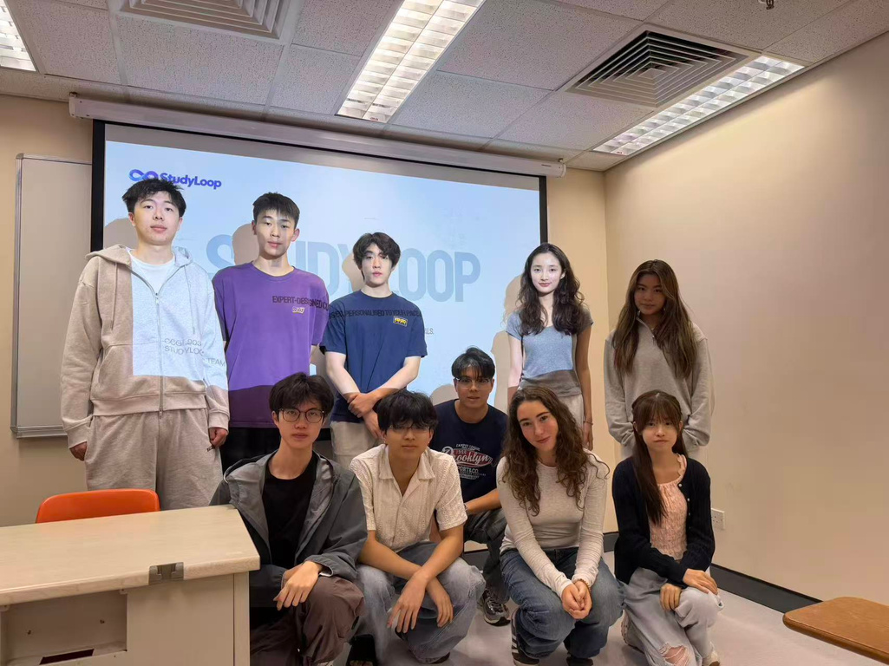
Our Team
Luo Tianqing
Product Strategy Lead
Chan Chin Ting
Learning Diagnostics Lead
Chan Sum Yau
Project-Based Learning Lead
Chan Ka Man
AI & Personalization Lead
Lu Yineng
Platform Engineering Lead
Lopez Sanchez Paz
UX & Design Lead
Fu Wai
Learner Research Lead
Cheng Yujia
Growth & Community Lead
Sun Yicheng
University Partnerships Lead
Wang Yiu
Finance & Operations Lead
Host our first Build-It pilot/Seed Fund
We’re looking for one Hong Kong university class
HK$100,000 in seed funding
Notes:
7:20–7:40 | Introduce Tim’s work on prerequisite diagnosis and William’s work on project progression. Explain how both ideas come together in the pilot.

