Slide 1

Winning in nba
Justin Tung
1
Notes:
Welcome to my project presentation, my name is Justin and I will be presenting the analysis on the winning factors in the National basketball association. The reason that I pick this topic is because I am interested in understanding how analytics can help with business operations and I am interested in the sports industry.

Slide 2

Project Process
Data gathering
Obtain data from source websites and combine
(https://www.basketball-reference.com/, Kaggle)
Data cleaning and exploration
Clean data and explore columns to better understand dataset
Data Visualization
Visualize dataset in Tableau to demonstrate the relationship between different stats and wins
Notes:
Here is the project process, first I gather team data from websites like basketball reference.com and Kaggle. Then I import them into a python environment to combine, clean and explore data. Last but not least is to visualize the data to demonstrate the relationship between different stats and winning.

Slide 3

Github
Project code
Final dataframe
https://github.com/yichengtung919/Capstone_Project.git
Notes:
If you are interested in looking at my project code and the data gathered. Here is a link to my github.

Slide 4
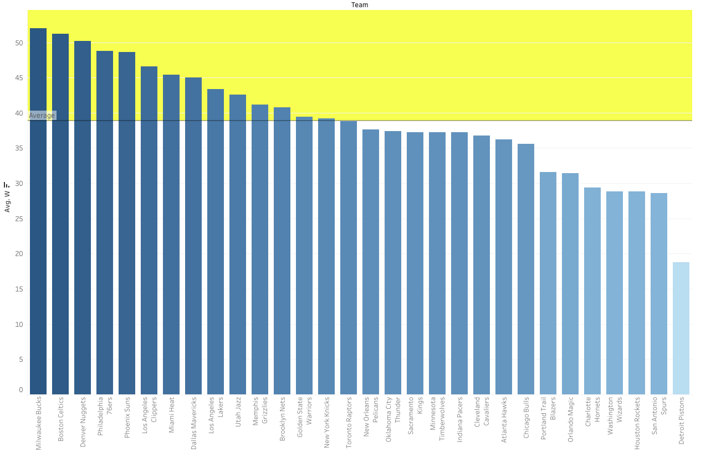
Who wins?
2019-2023 Season Averages
30 teams in total top 16 goes to playoffs
Average 38.86 Wins
4
Notes:
Now let’s get into the analysis. The first question that we want to know is who is on the winning side of the NBA? The graph shows the average wins per season by each team in the nba. the yellow highlighted area represents the top half the league and below represents the bottom half. There are a total of 30 teams in the nba and generally only the top 16 teams can make it to the playoffs. So in order to make it to the playoffs a team would have win approximately 38 games per season as show in the average.

Slide 5
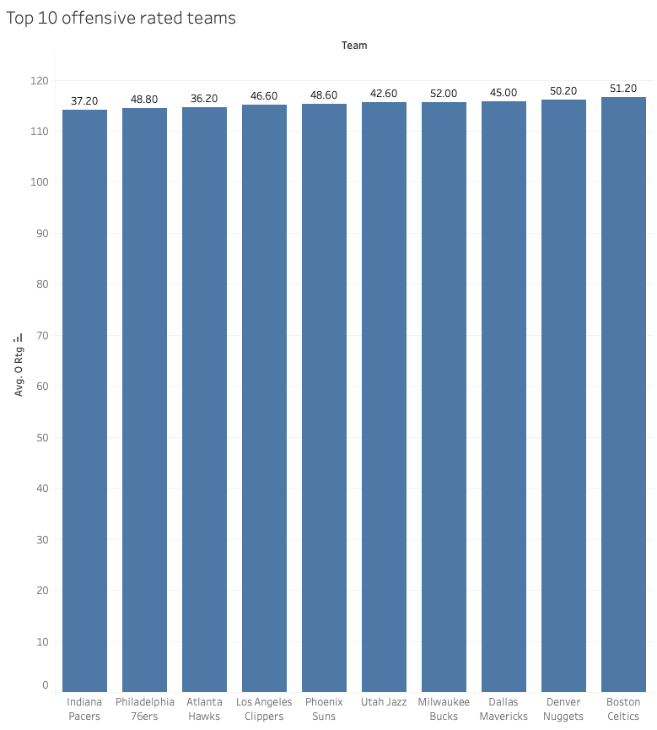
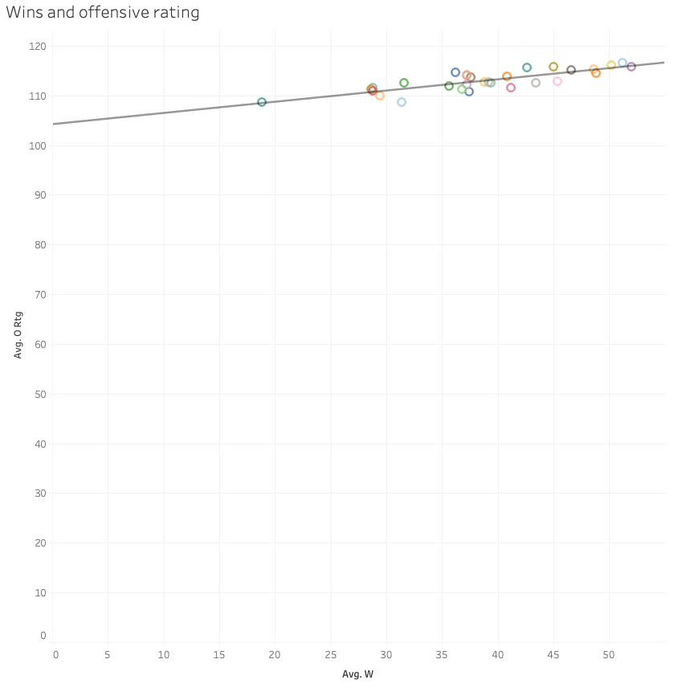
Top 10 offensive
Celtics at the top for 116 points per 100 possession
Positive relationship between offensive rating and wins
R-square 0.68
5
Notes:
Next lets dive into what contributes to a winning record. There are two side of the game, offense and defense. Offense means the number of scores on our side and defense means the points allowed to the opponent. Here we have the top 10 offensive rated teams in the league and their records. On the left we can see the Celtics is at the top of the league at 116 points scored for every 100 possession. On the right here we can see a positive relationship between offensive rating and the number of wins with an r-square of .68 which means the line can account for close to 70% of the data. So statistically it can be said to be positively related.

Slide 6
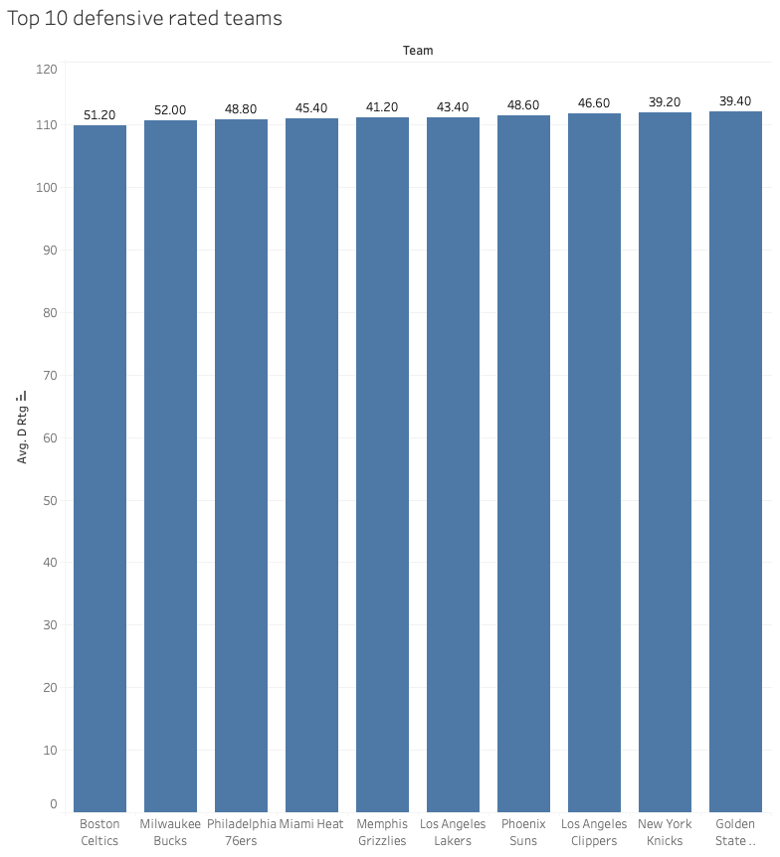
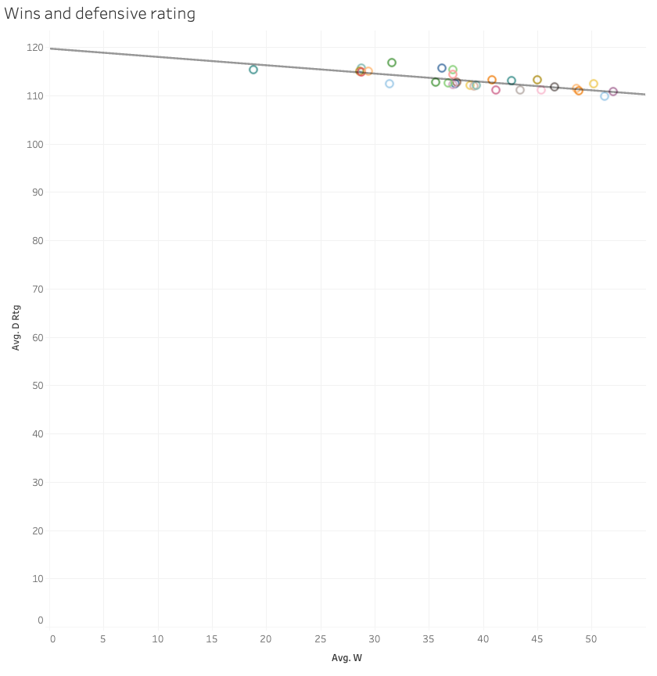
Top 10 defensive
Celtics at the top for 109 points per 100 possession
Negative relationship between defensive rating and wins
R-square 0.58
6
Notes:
Next is the other side of the game which is the defense. The top defensive team here is the Celtics again for 109 points allowed per 100 possession. As can be seen on the right hand side here there is a negative relationship between defensive rating and wins. Which means a team would aim to have a low defensive rating so there is a higher chance of winning. The r-square here shows 0.58 slightly lower than offense rating but also statically significant.

Slide 7
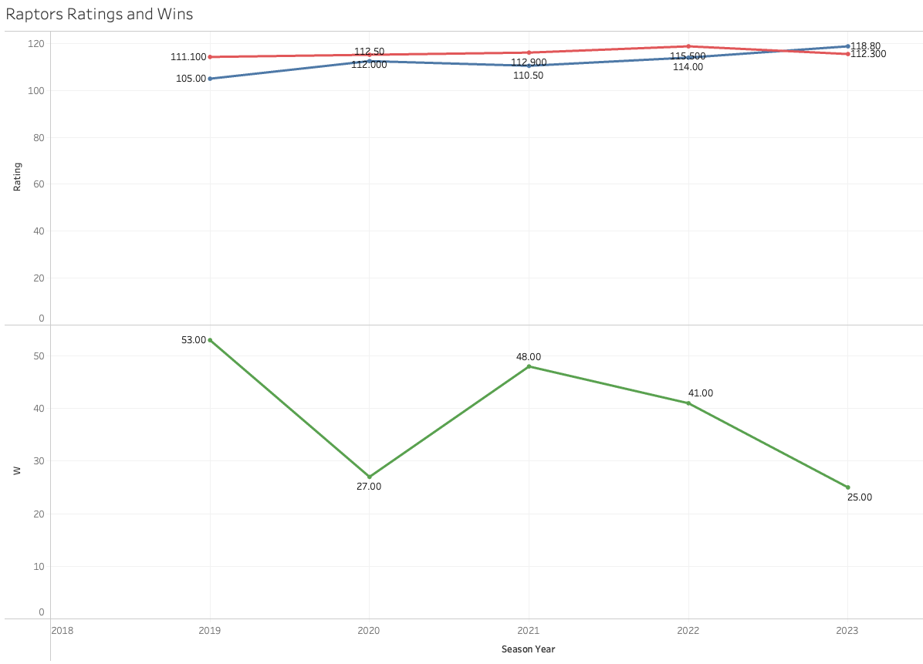

Home town hero
Red line-Offensive rating
Blue line- Defensive rating
Green line- Wins
Gap between off and def contributes to wins
2023 season at negative rating and lowest win record
Notes:
Now lets take a look at how the only Canadian team right now in the NBA, the Toronto raptors are doing. The red line represents offensive rating, blue lines represents defensive rating. The larger the gap between them means a higer chance of winning. Which can be seen in the green line at the bottom, it stands for the wins for each season. This past season 2023 shows a defense rating higher than the offense, which means the raptors are scoring less than what they allow the opponents on average. And the record suffers as a result at just 25 wins and missed playoffs.

Slide 8
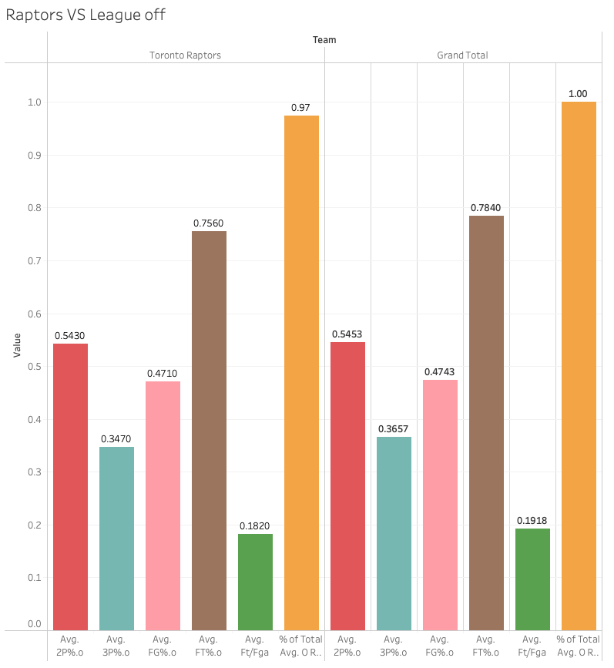
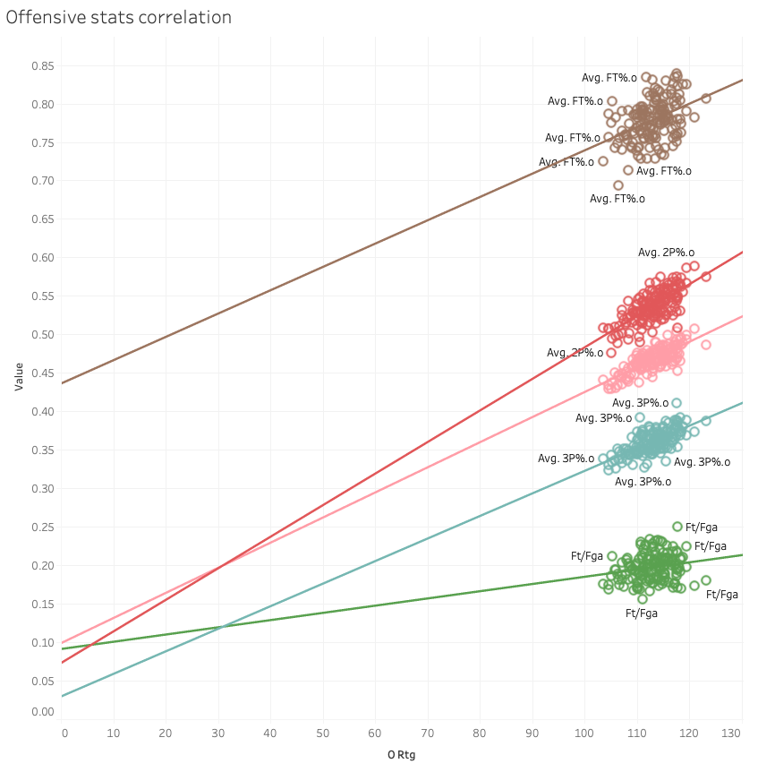
Home town hero
Offensive stats are below average
Offensive rating below average for 2023
Notes:
Now lets look at what they are doing offensively in 2023. We can see in the chart on the left here, all of the offensive stats are below average and so the rating is also below average.

Slide 9
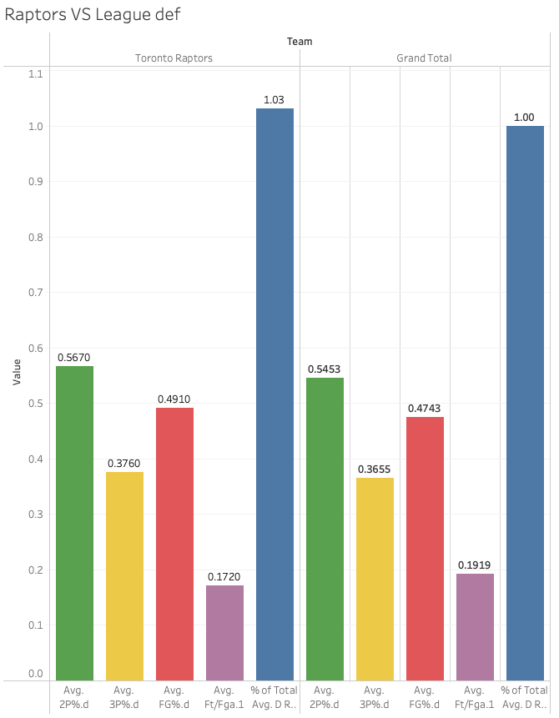
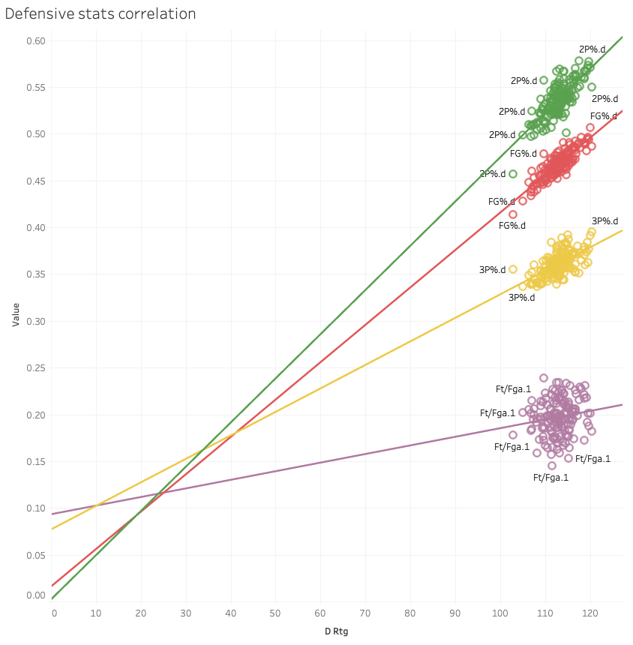
Home town hero
Defensive stats are higher than average
Defensive rating above average for 2023
Notes:
Similar to the offense. The defensive stats in 2023 also shows a subpar performance. Almost all of the stats that are contributing to the defensive rating are above average which means more scores allowed per game.

Slide 10

Summary
Winning is not determined by one single stat
Offense is contributing to winning but defense is
also very important to create the net rating gap
Further analysis can be done on a player level
Raptors offseason has a lot of work to be done!
Notes:
After going through the process of this project. I found that there is not a single stat that determines winning in the league. Instead, it is all the stats on both offense and defense that contribute to a teams success. This analysis focus more on the larger scale of the stats that helps with winning but further analysis can be done on a team and player level to explore more ways to increase chance of winning. And lastly , there is a lot of work to be done by the raptors this offseason to turn things around.

Slide 11
THANK YOU

