Slide 1
Lab5 5-stage Pipeline Processor

Slide 2
If you have any problems about the specification,
Please contact TA as soon as possible
Contact:
何承澤 djjjimmyyy@gmail.com
Notes:
https://docs.google.com/spreadsheets/d/1ZUCVMoT-TsYwq-XjuQmA8R_mjxXebLykivcohCnJsTE/edit?usp=sharing

Slide 3
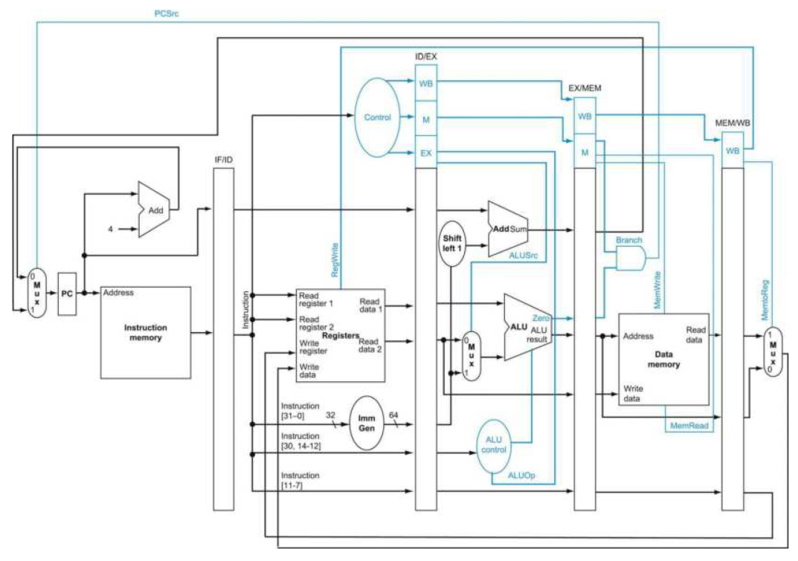
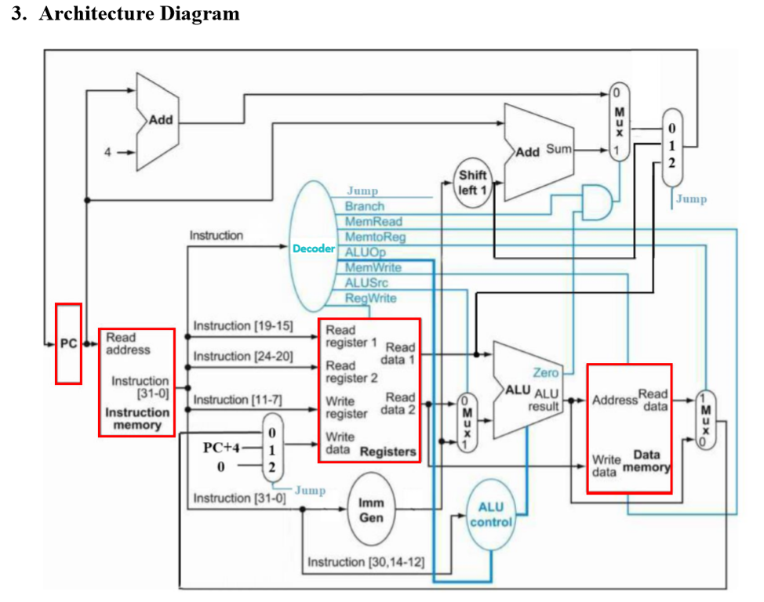
Architecture Diagram for Lab 5
Please modify your Single Cycle CPU design from Lab4 and implement a 5-stage Pipeline Processor.
Clock Positive edge triggered:
always@(posedge clk_i) begin
.
. // Code HERE
.
end
IF
ID
EX
MEM
WB

Slide 4
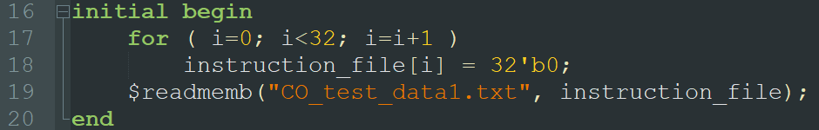
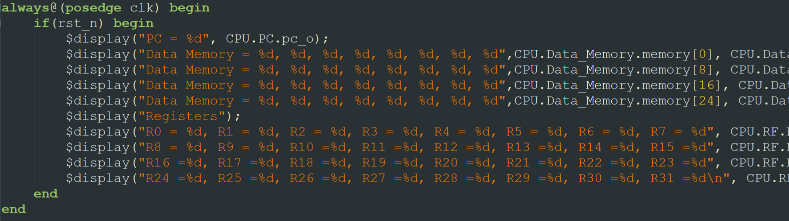
Testbench
13 test cases (CO_test_data1.txt ~ CO_test_data13.txt.)
Need to manual change by yourself
Edit line 19 in the file “Instr_Memory.v”
Notes:
目前作業有什麼問題？

Slide 5
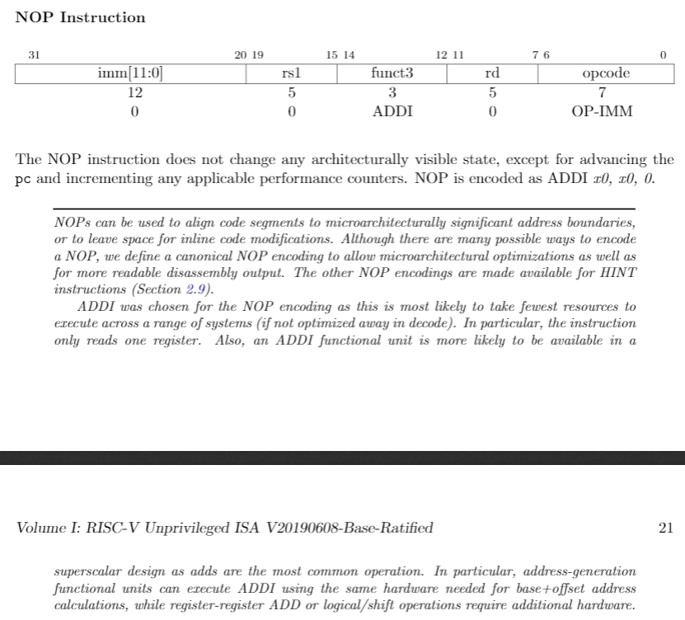
Nop instruction
Used to implement Stall

Slide 6
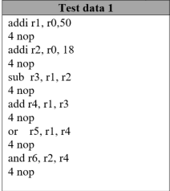
Test data (with data dependency)
IF
ID
EXE
MEM
WB
IF
ID
EXE
MEM
WB

Slide 7
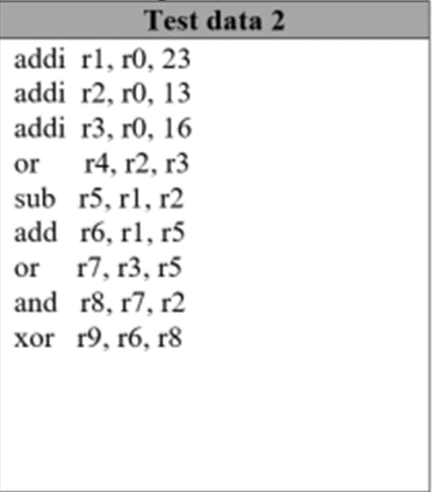

Test data (with data dependency)
IF
ID
EXE
MEM
WB
IF
ID
EXE
MEM
WB
IF
ID
EXE
MEM
WB
IF
ID
EXE
MEM
WB
IF
ID
EXE
MEM
WB

Slide 8
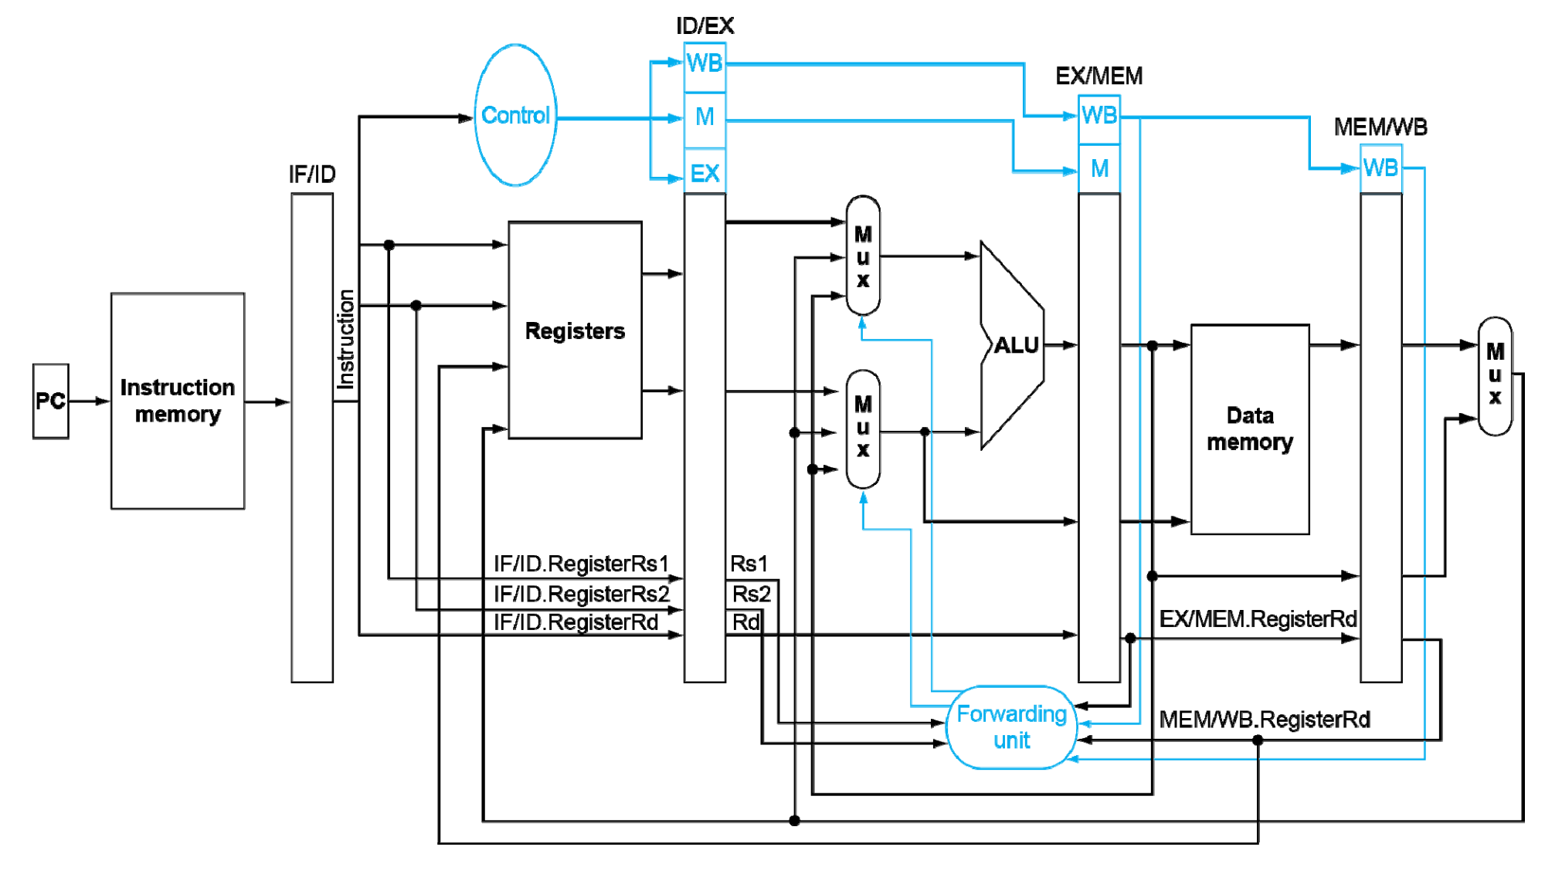
Data Dependecy
Need a ForwardingUnit.v to handle data forwarding:

Slide 9
bonus
In this part, there are some modules and wires not showed in the code we gave you, you can modify/create modules and add wires if you need.
(Bonus 1): consider instructions which have R-type follow right after LW
Tips:you need to implement the hazard detection unit
(Bonus 2): implement beq and jal (the add operation of beq is in ID stage)

Slide 10
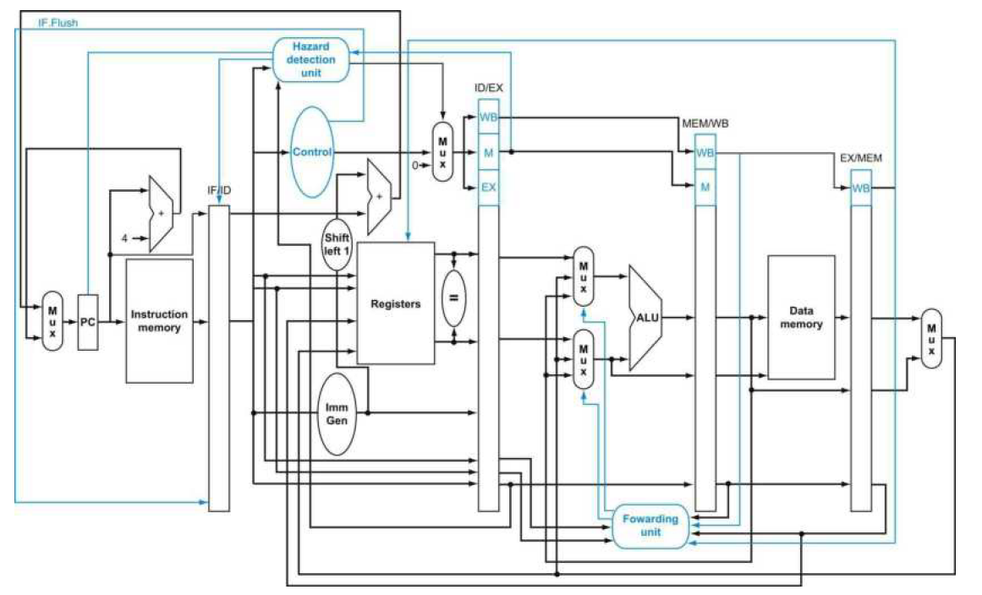
Reference Datapath (forwarding, flush, hazard detection)

Slide 11
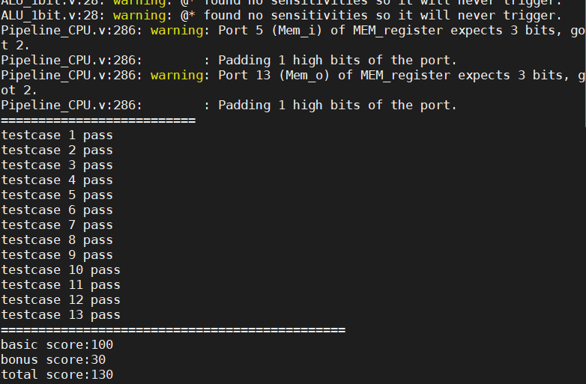
Testing
Important: we will test your code on ubuntu18.04 by running lab5TestScript.sh
Testing command:
Bash lab5TestScript.sh

Slide 12
Submit format
GroupID_ID1_ID2.zip
GroupID_ID1_ID2/
Your .v files, CO_Report.pdf

Slide 13
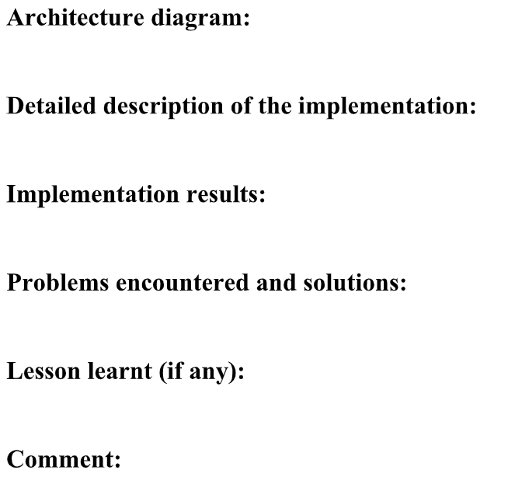
Report format
Can combine
Notes:
https://

