Slide 1
Two-Stage Low-Noise Amplifier Project

Slide 2
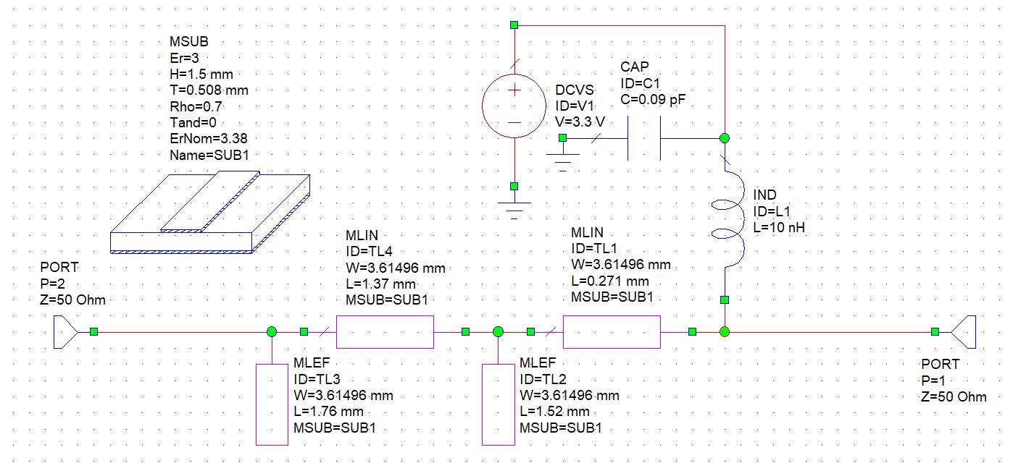
Input Matching Network

Slide 3
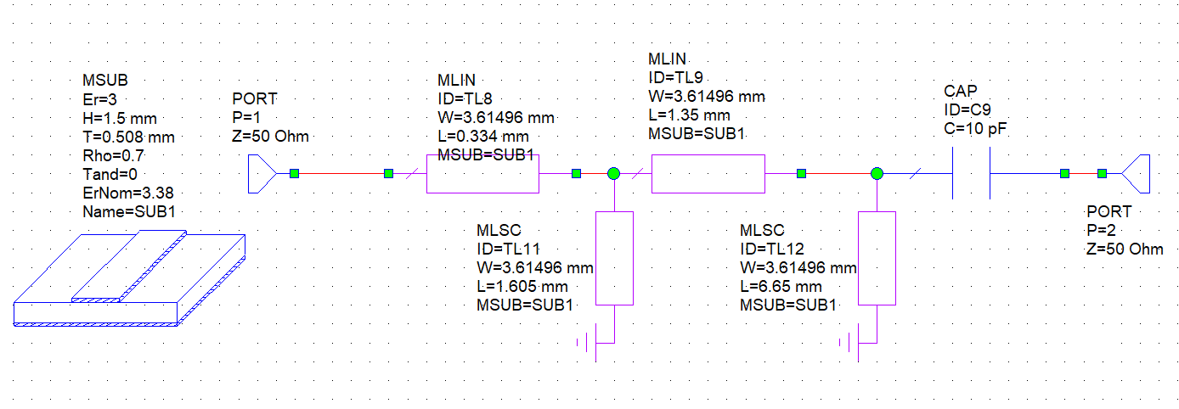
Output Matching Network

Slide 4
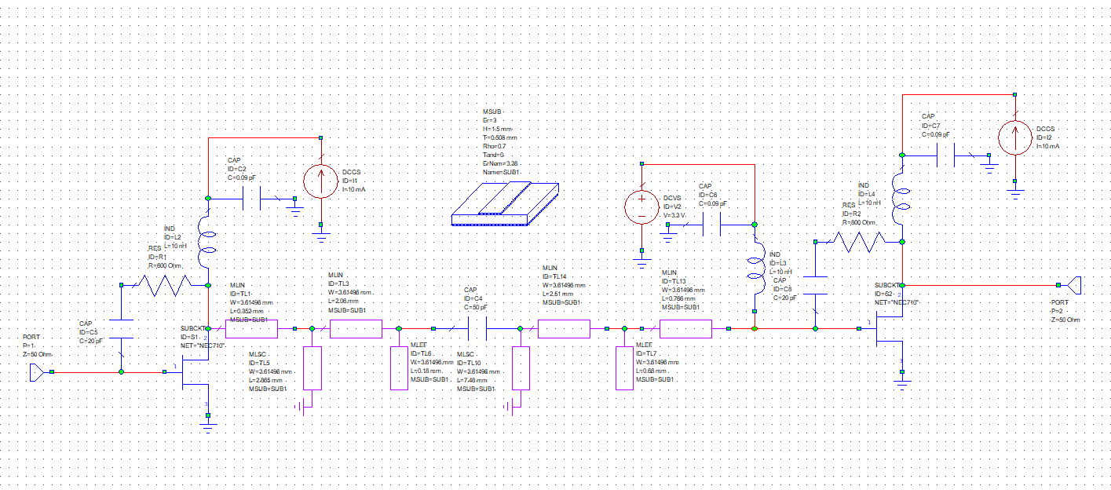
Interstage Matching Network

Slide 5
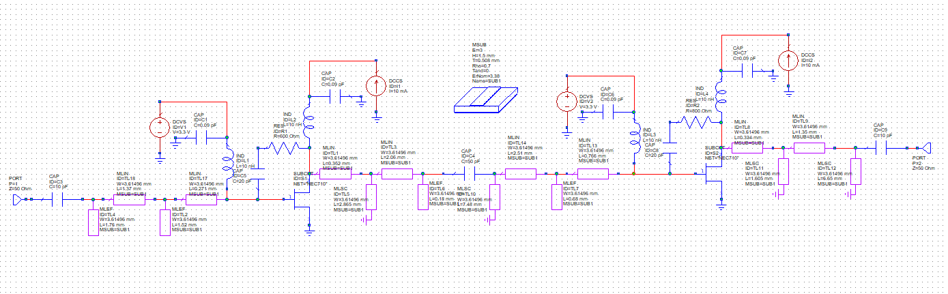
Full LNA

Slide 6
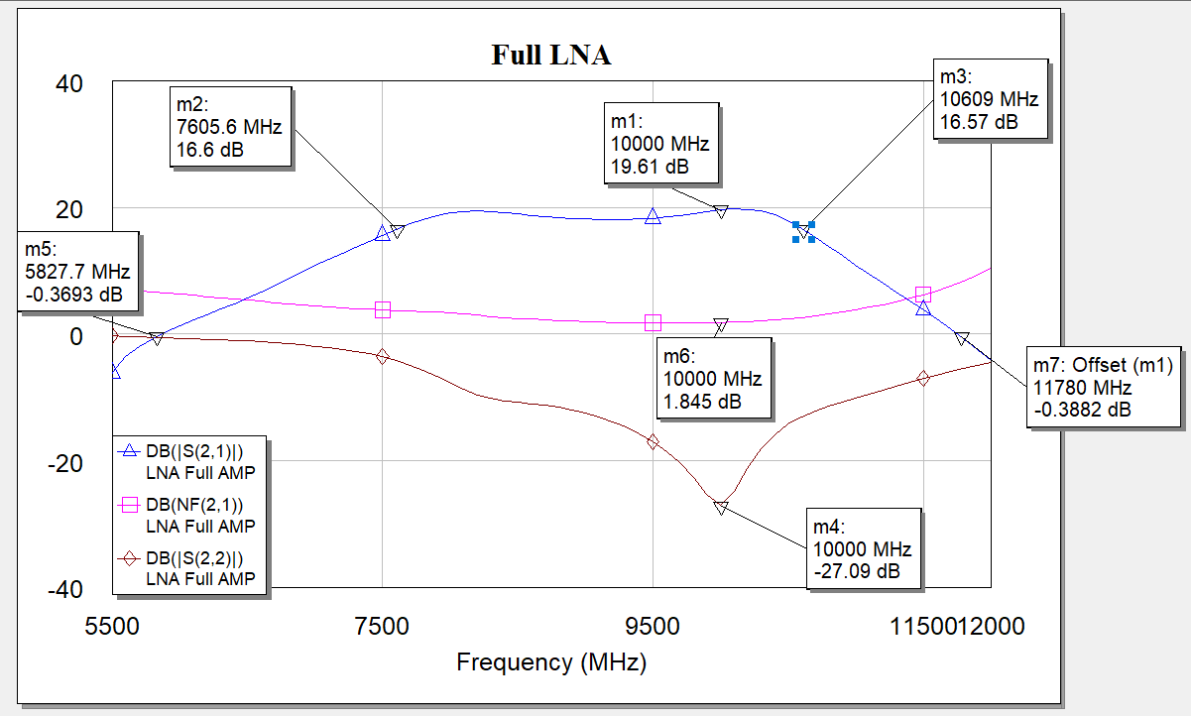
Full LNA

Slide 7
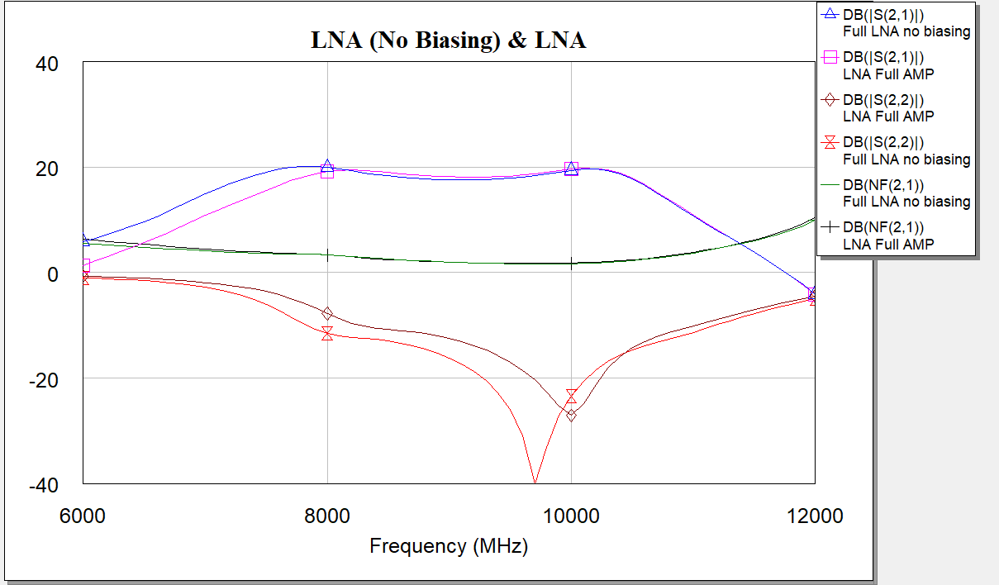
Full LNA (no biasing)

Slide 8
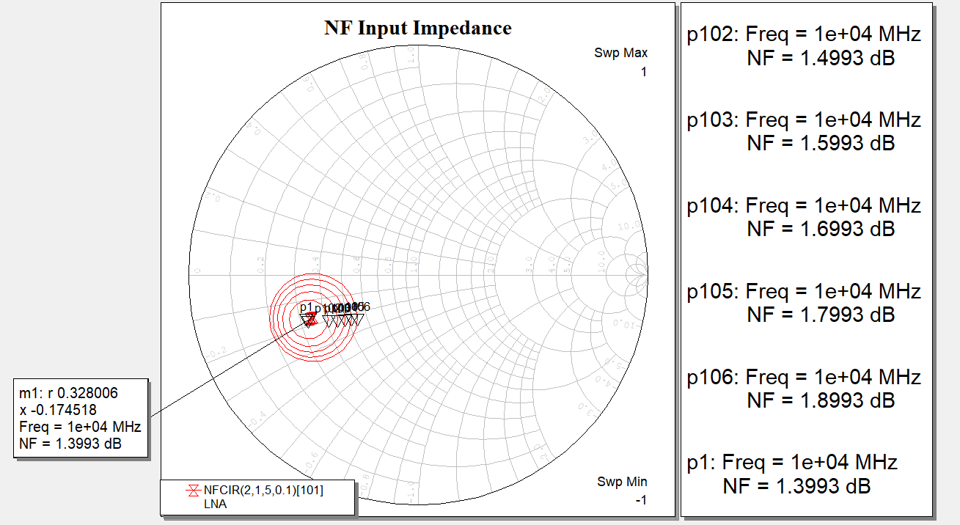
NF Circle

Slide 9
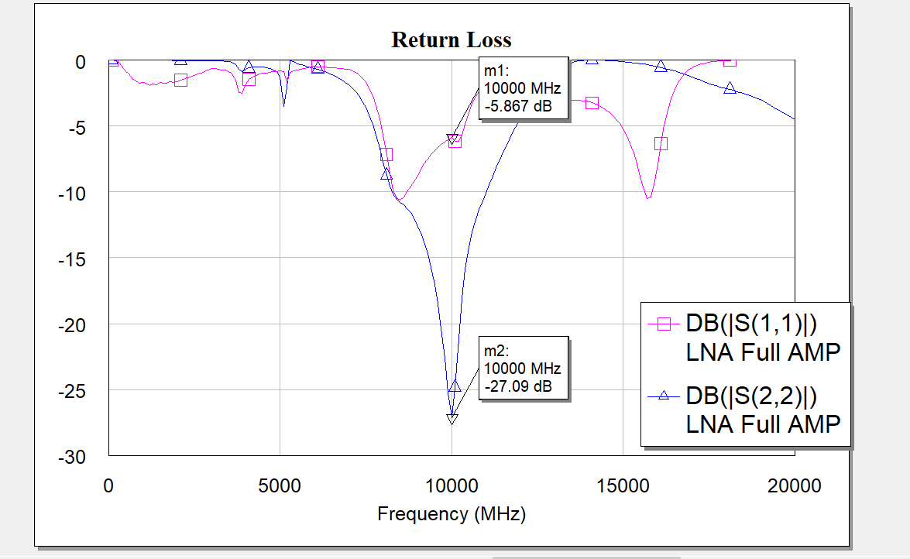
Return Loss

Slide 10
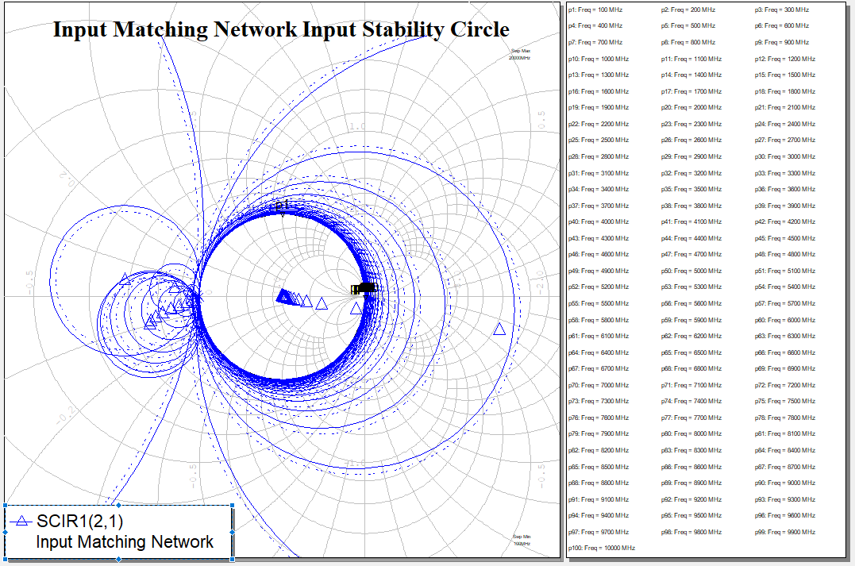
Input Matching Network Input Stability Circle

Slide 11
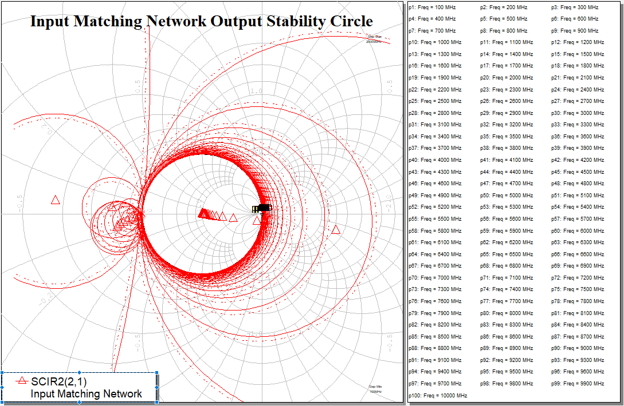
Input Matching Network Output Stability Circle

Slide 12
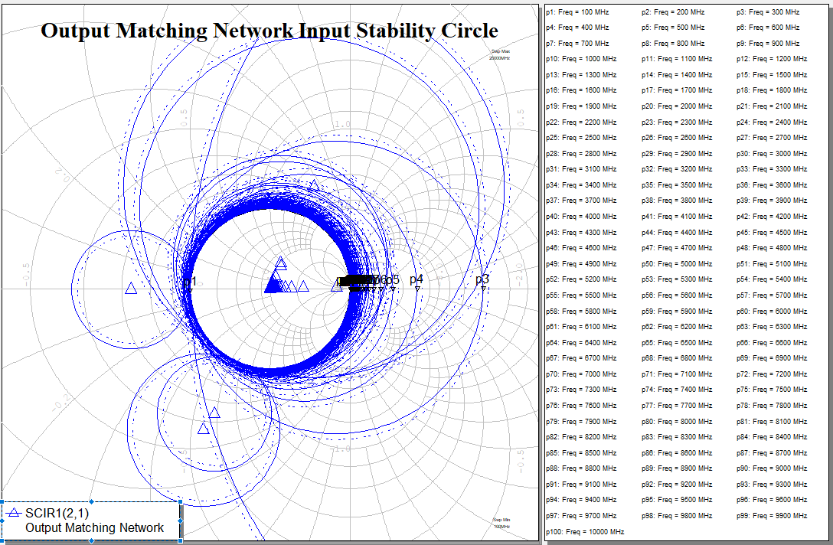
Output Matching Network Input Stability Circle

Slide 13
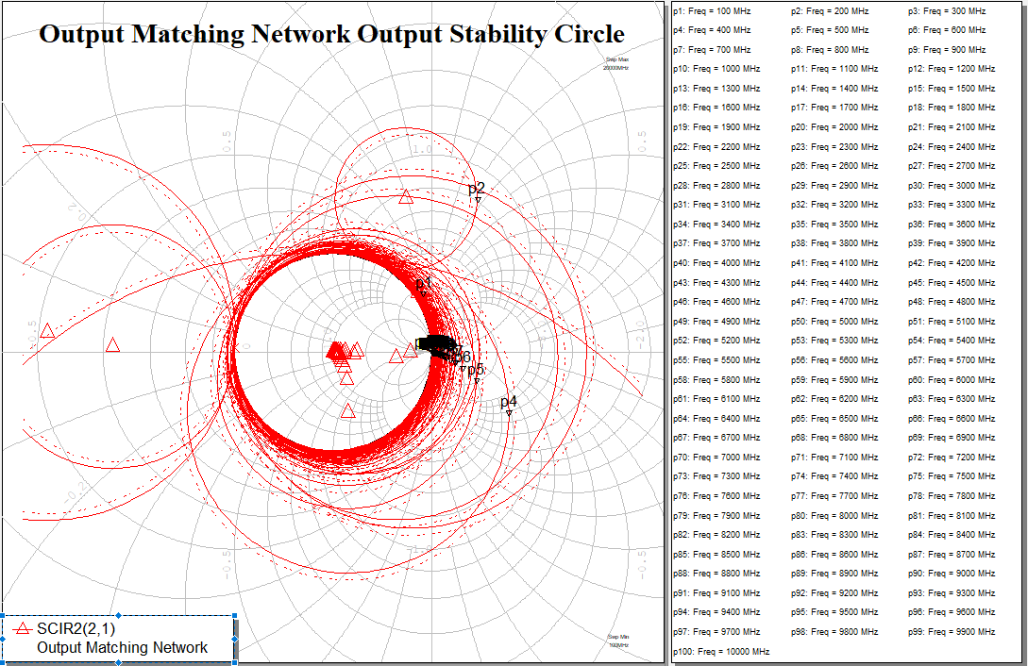
Output Matching Network Output Stability Circle

Slide 14
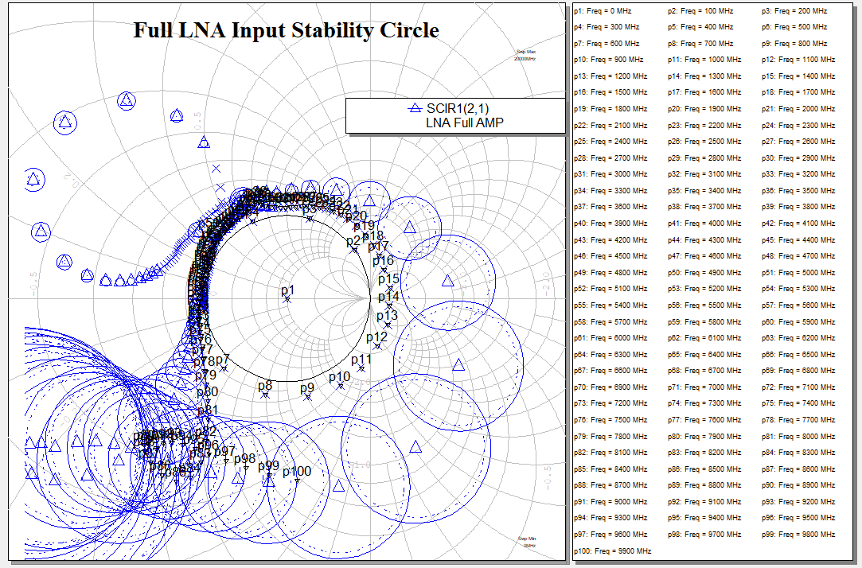
Full LNA Input Stability Circle

Slide 15
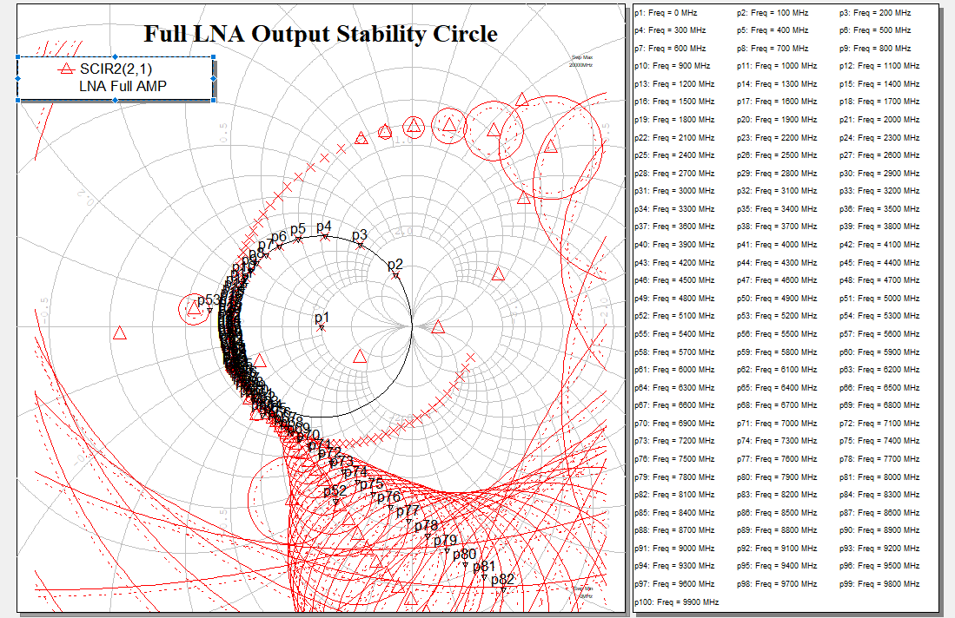
Full LNA Network Input Stability Circle

Slide 16
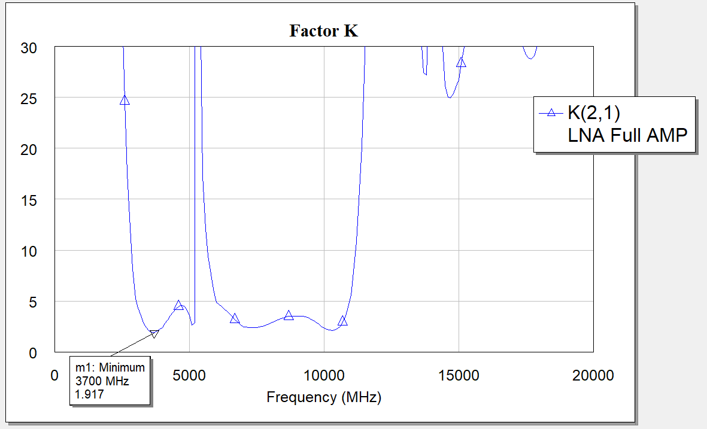
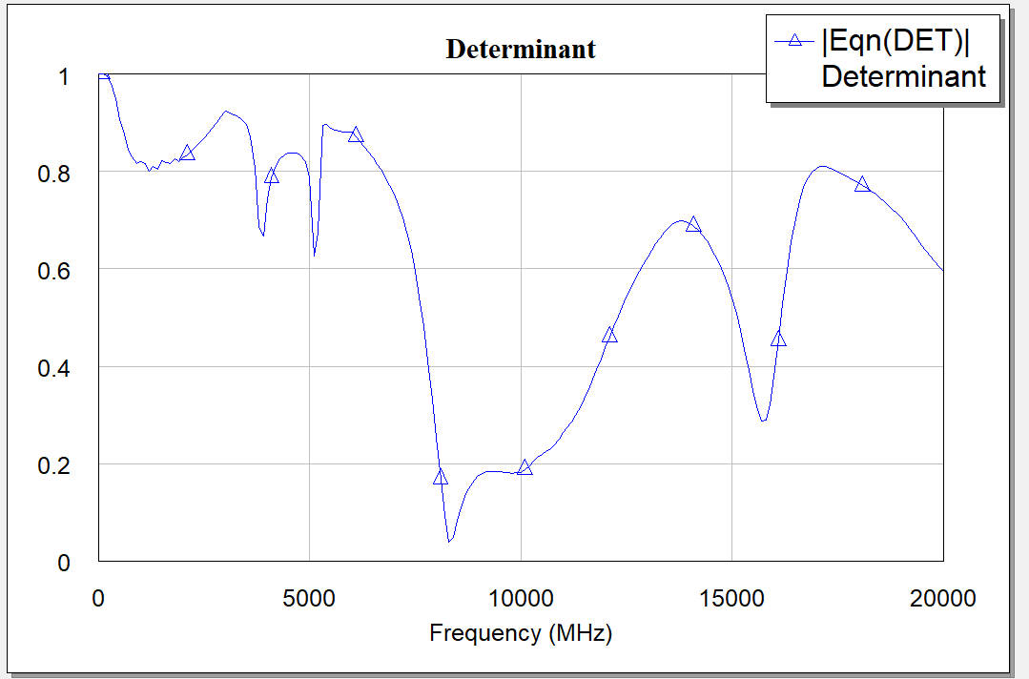
K and Determinant

