Slide 1
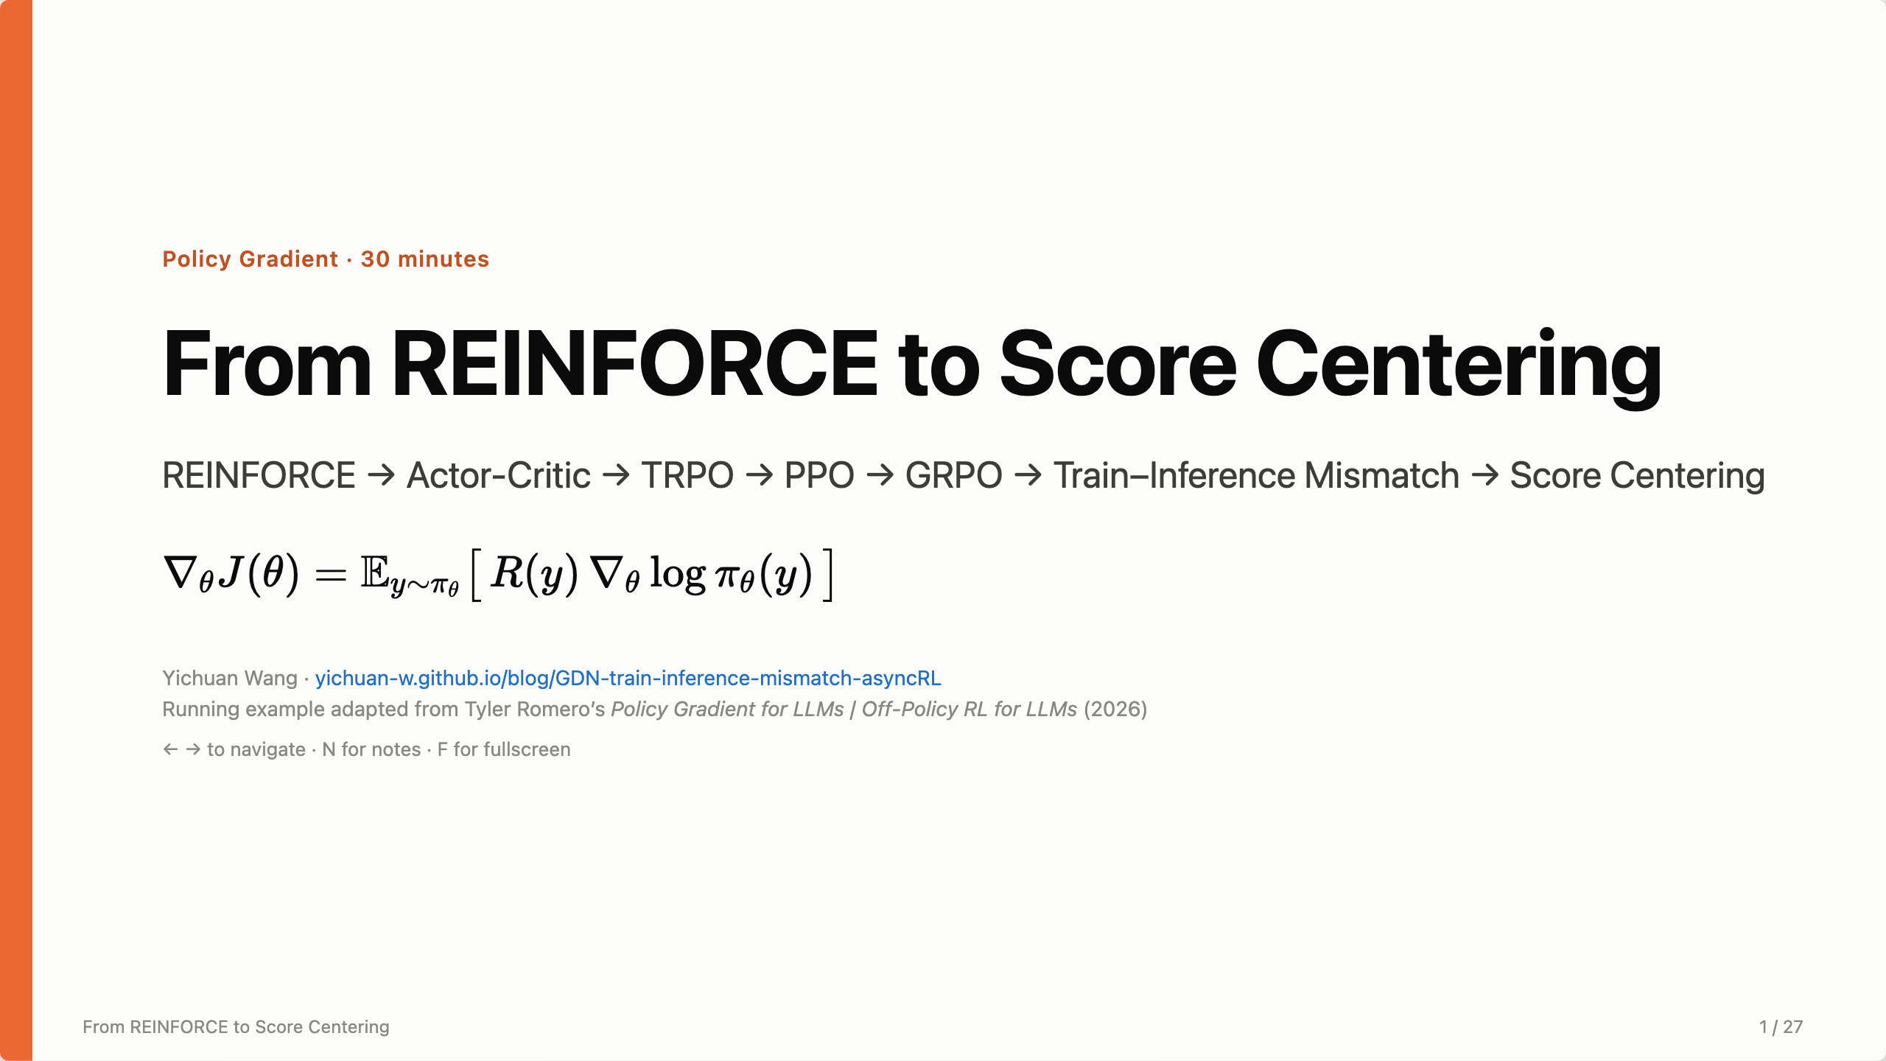
Notes:
Opening: every algorithm today is the same formula — the REINFORCE gradient on screen — plus a patch. The second half is about a problem I spent a lot of time on: the trainer and the inference engine disagree on log-probs even with the same weights, and what we can do about it at the systems level and at the algorithm level.

Slide 2
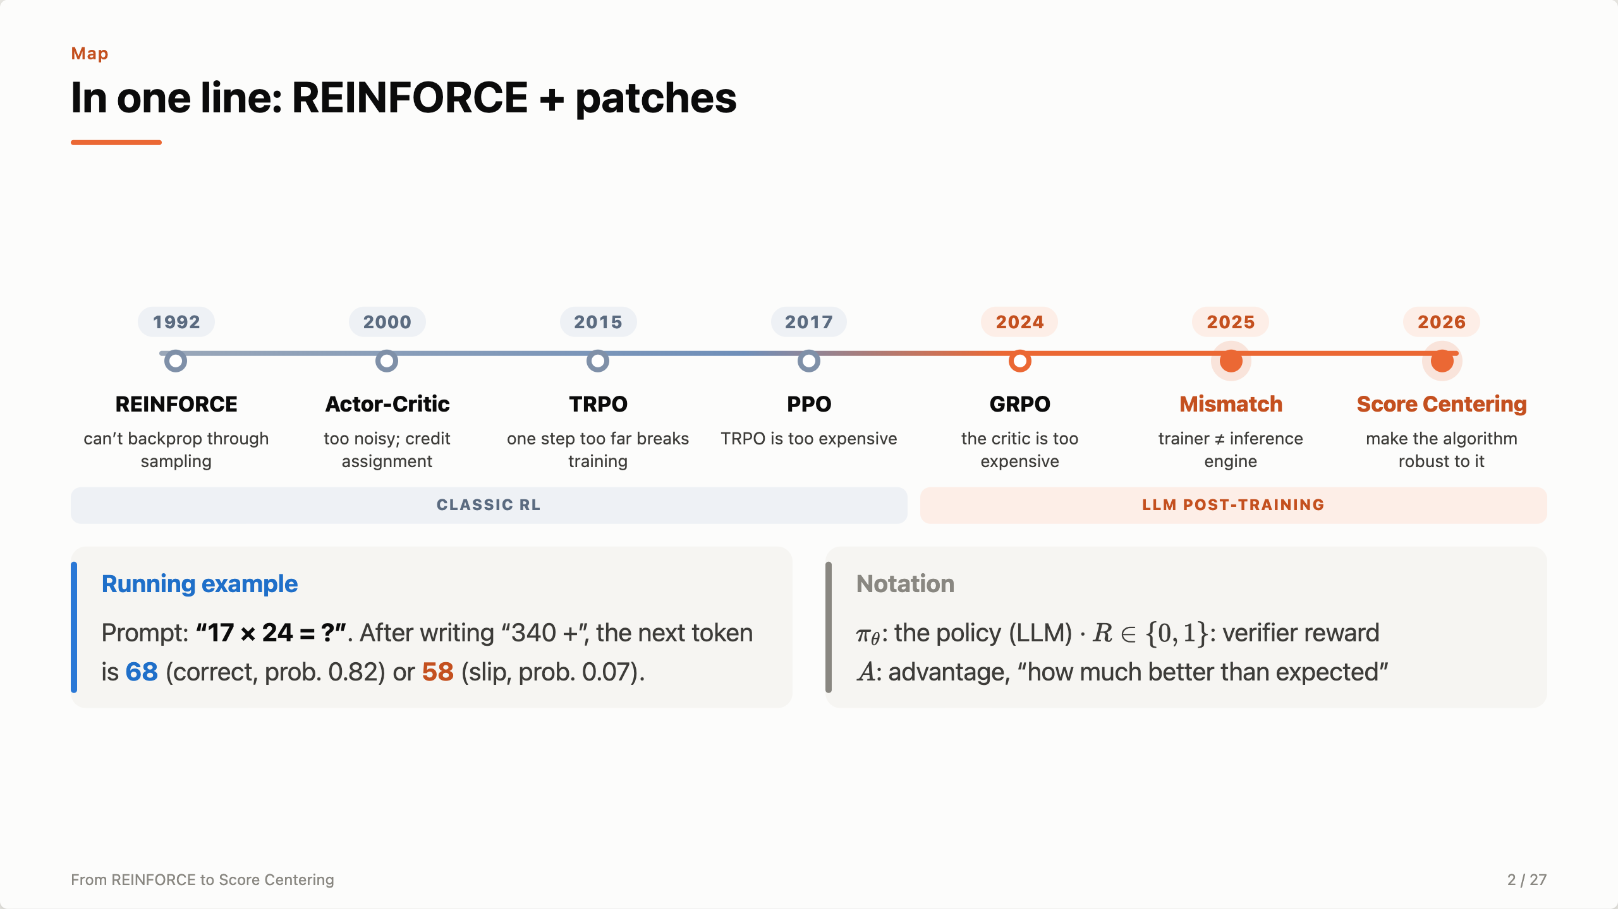
Notes:
Here is the map. Each method answers a problem left by the previous one. The last two are the systems problem and the algorithmic answer to it. Running example: 17×24; at “340 +”, 68 is right and 58 is the common slip.

Slide 3
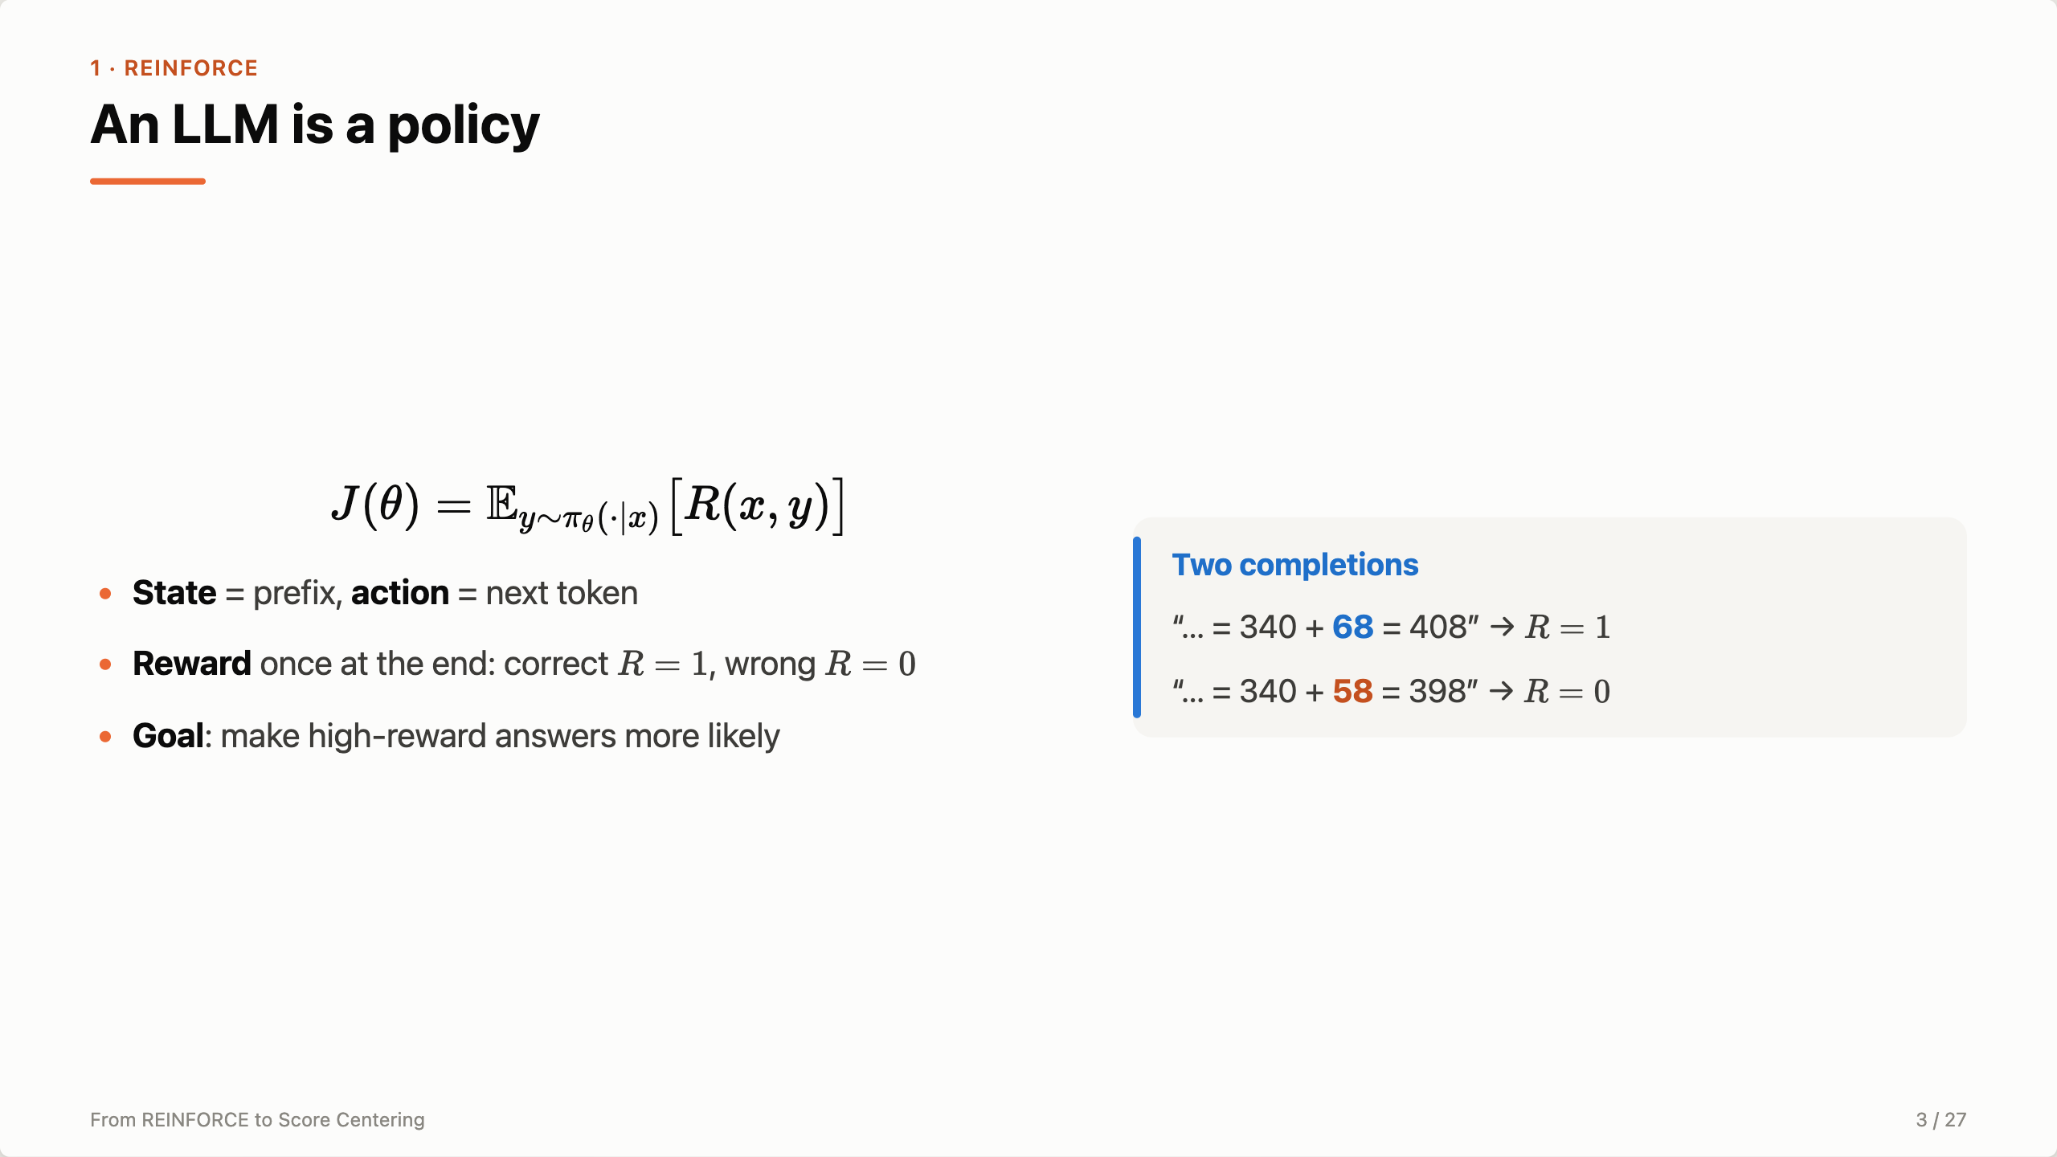
Notes:
Generation is RL: each token is an action, the prefix is the state, and the reward only comes at the end. J is the expected reward. θ only appears in the probability, not in the reward — that’s the difficulty on the next slide.

Slide 4
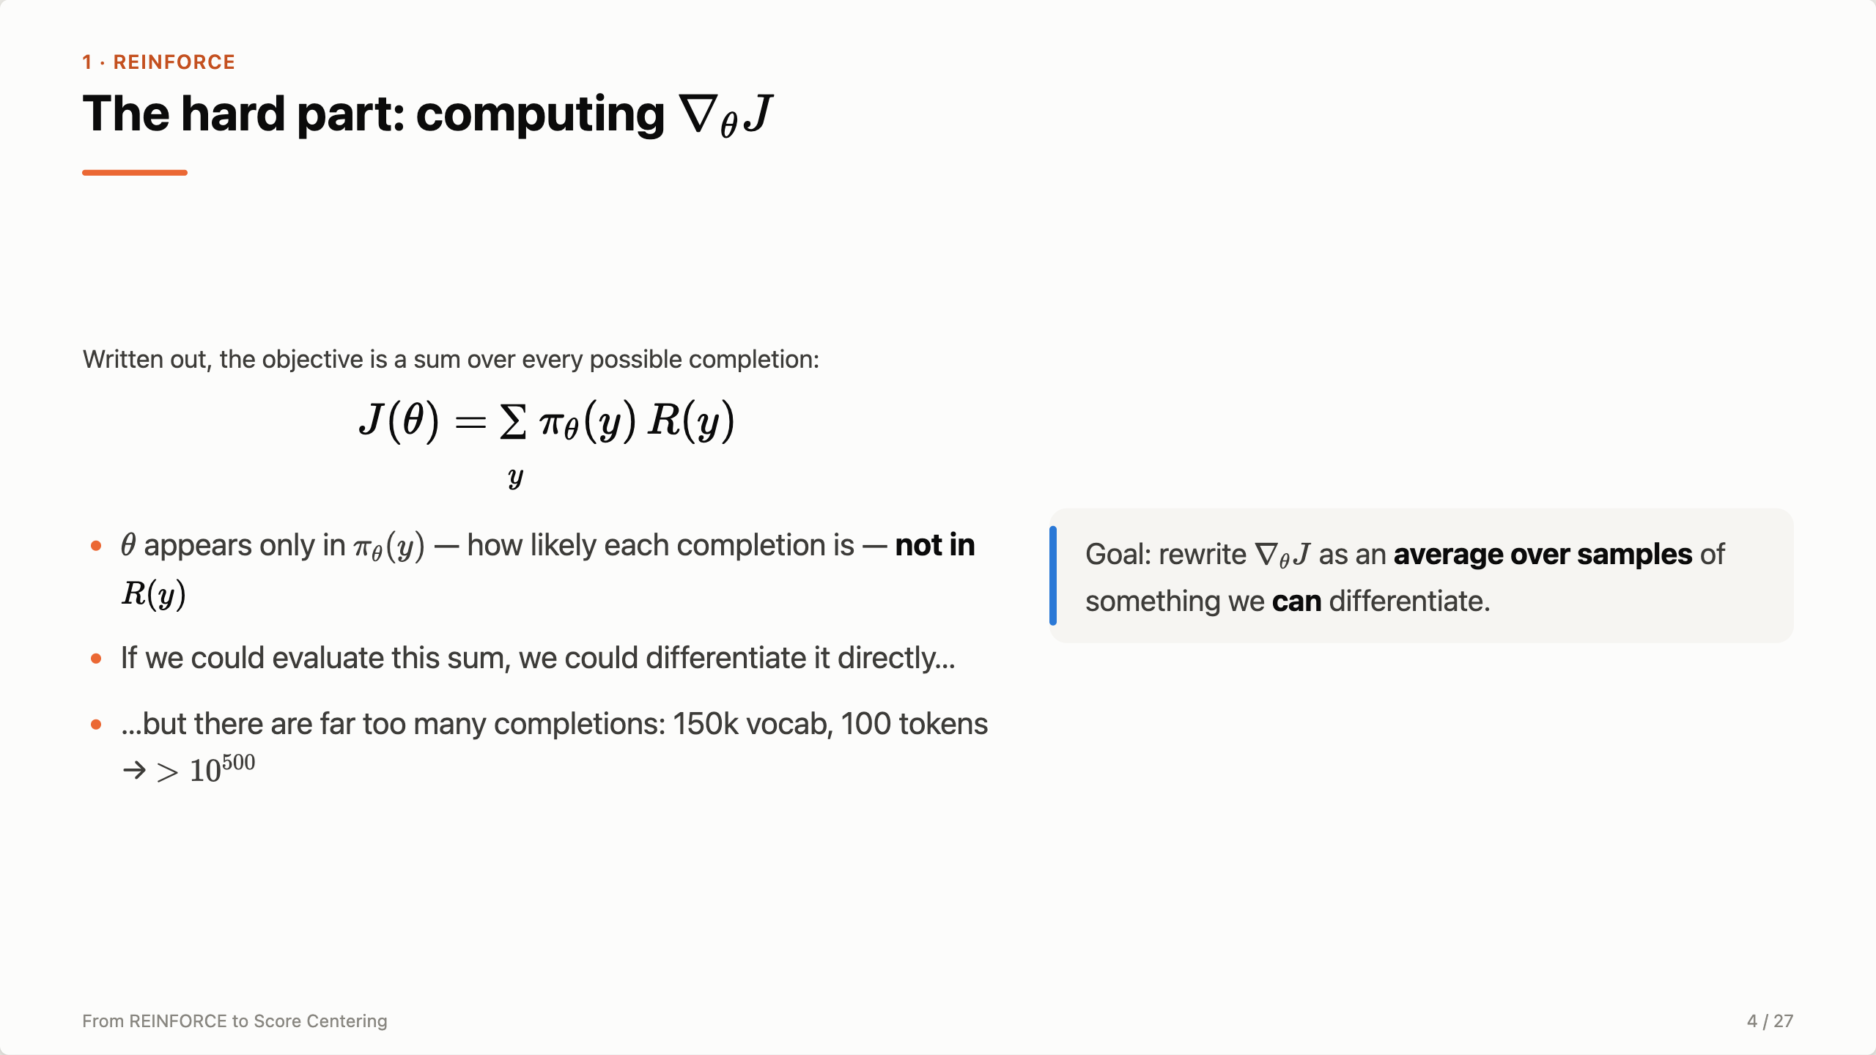
Notes:
To improve the model we want the gradient of J. The hard part is computing it. Written out, J is a sum over every possible completion of its probability times its reward. θ appears only in the probability, not in the reward. If we could evaluate this sum we’d just differentiate it, but with a 150k vocabulary even a 100-token answer has more than 10^500 possibilities. So what we need is a way to write the gradient itself as an average over samples — something we can estimate by sampling and differentiate.

Slide 5
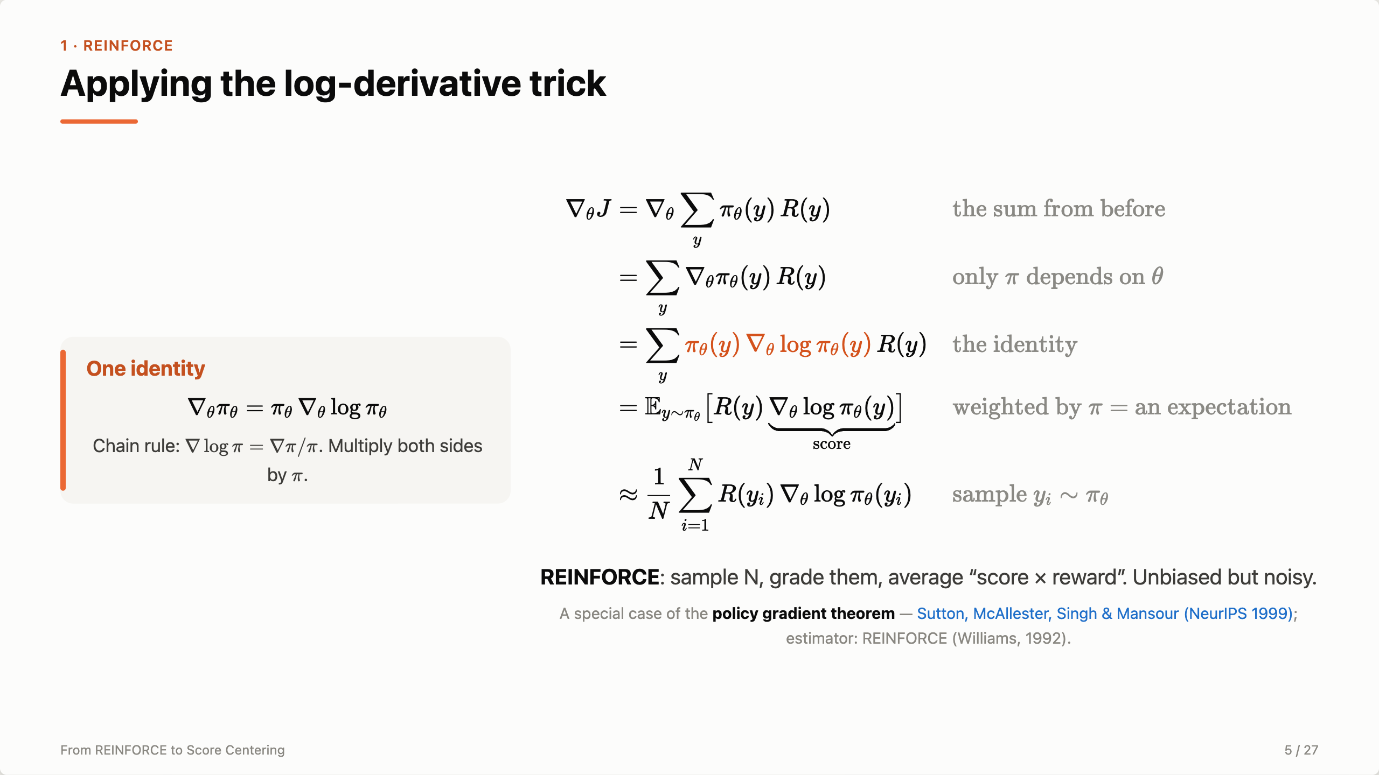
Notes:
The workaround is a one-line identity: the gradient of π equals π times the gradient of log π — that’s just the chain rule, multiplied through by π. Now apply it. Start from the sum. Only π depends on θ, so the gradient goes onto π. Replace ∇π with π ∇log π — highlighted. Now there’s a π in front of every term, and a sum weighted by π is exactly an expectation under π. So we can estimate it by sampling: N rollouts, each contributes its score times its reward. The score is the direction that makes that answer more likely; the reward decides how much that direction counts. That’s REINFORCE — and this derivation is a special case of the policy gradient theorem from Sutton and colleagues, 1999.

Slide 6
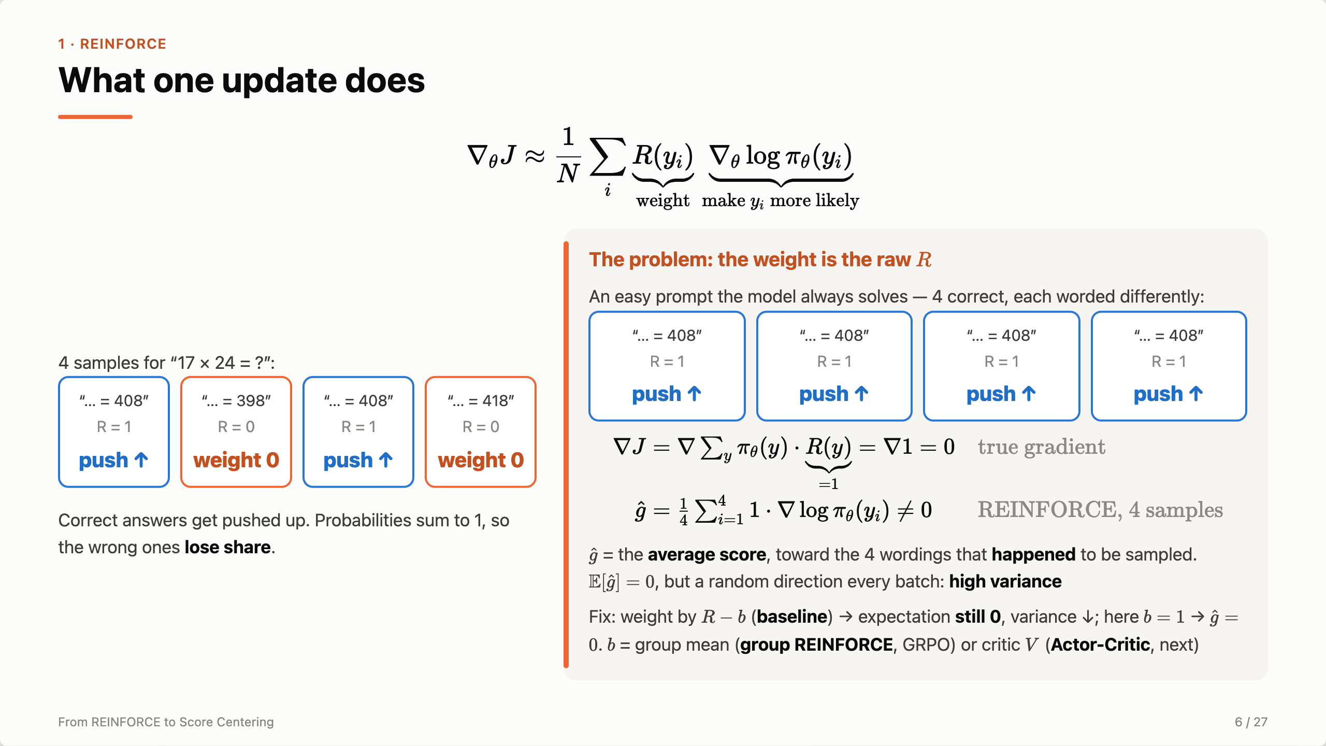
Notes:
Read the estimator as weight times direction. The score says make this answer more likely; the reward says how much. Four samples: two correct get pushed up, the two wrong ones get weight zero — they’re not pushed down directly, but since probabilities sum to one, they lose share. The problem is that the weight is the raw reward, not how much better than expected. To see why that hurts, take an easy prompt the model always solves. All four samples are correct, just worded differently. Look at the gradient. Every weight is 1, so the estimate is just the average of the four scores — the average of “make this exact text more likely”. The true gradient is zero: the reward is 1 no matter what θ is, so there’s nothing to improve. But the four-sample average isn’t zero: it points toward the four wordings the model happened to sample. The next batch samples four other wordings and moves somewhere else. On average these pushes cancel, but each single step is a random kick. So the expectation is still zero — the estimator is unbiased — the problem is variance. The fix is a baseline: weight each sample by R minus b instead of R. Subtracting b doesn’t change the expectation, it’s still zero, but it removes that noise term; here b equals 1 and the estimate is exactly zero every batch. Where does b come from? Either the mean reward of a group of samples for the same prompt — group REINFORCE, which is what GRPO does — or a learned critic V: actor-critic, next slide.

Slide 7
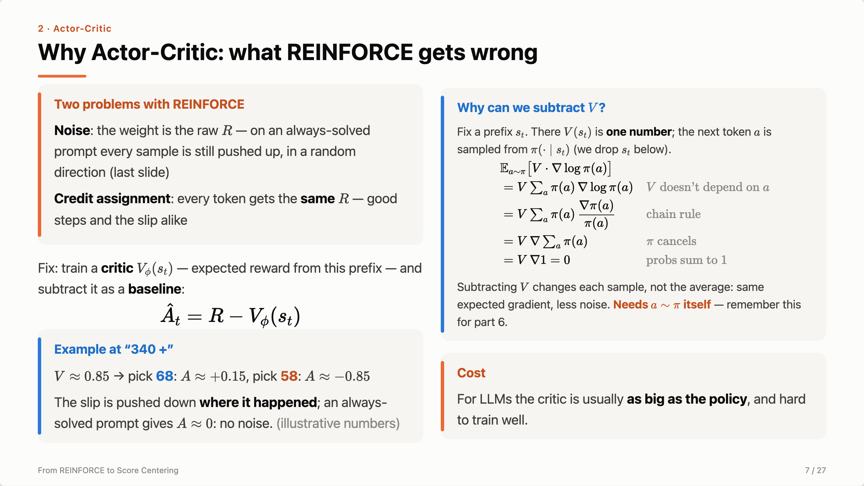
Notes:
So what’s wrong with REINFORCE? Two things. First, the noise from the last slide: the weight is the raw reward, not how much better than expected, so on a prompt the model always solves, every sample is still pushed up — toward whatever it happened to sample. Second, credit assignment: every token in a rollout gets the same R — the correct steps and the slip at “340 +” alike — so it can’t tell which token mattered. Actor-critic fixes both with one idea: train a second network, the critic, to predict the expected reward from each prefix, and subtract it as a baseline — R − V is a per-token advantage. At “340 +”, V is about 0.85: picking 68 gives +0.15, picking 58 gives −0.85, so the slip is pushed down right where it happened. On a prompt it always solves, V is about 1 and A is about 0: no noise. Why can we subtract V? Fix the prefix. There V is just a number — it doesn’t depend on which token gets sampled. And the score, averaged over the next token drawn from π, is zero: the probabilities sum to one, so making 68 more likely must make the other tokens less likely by the same total. So V times the score averages to V times zero, which is zero: subtracting it leaves the expected gradient unchanged and only removes noise. It’s the same reason the random pushes on the last slide average out. One condition: the token must be sampled from π itself; part 6 is about what happens when they don’t. In practice people use GAE to trade bias and variance, but the idea is just this. The cost: a second model as big as the policy — exactly what GRPO removes.

Slide 8
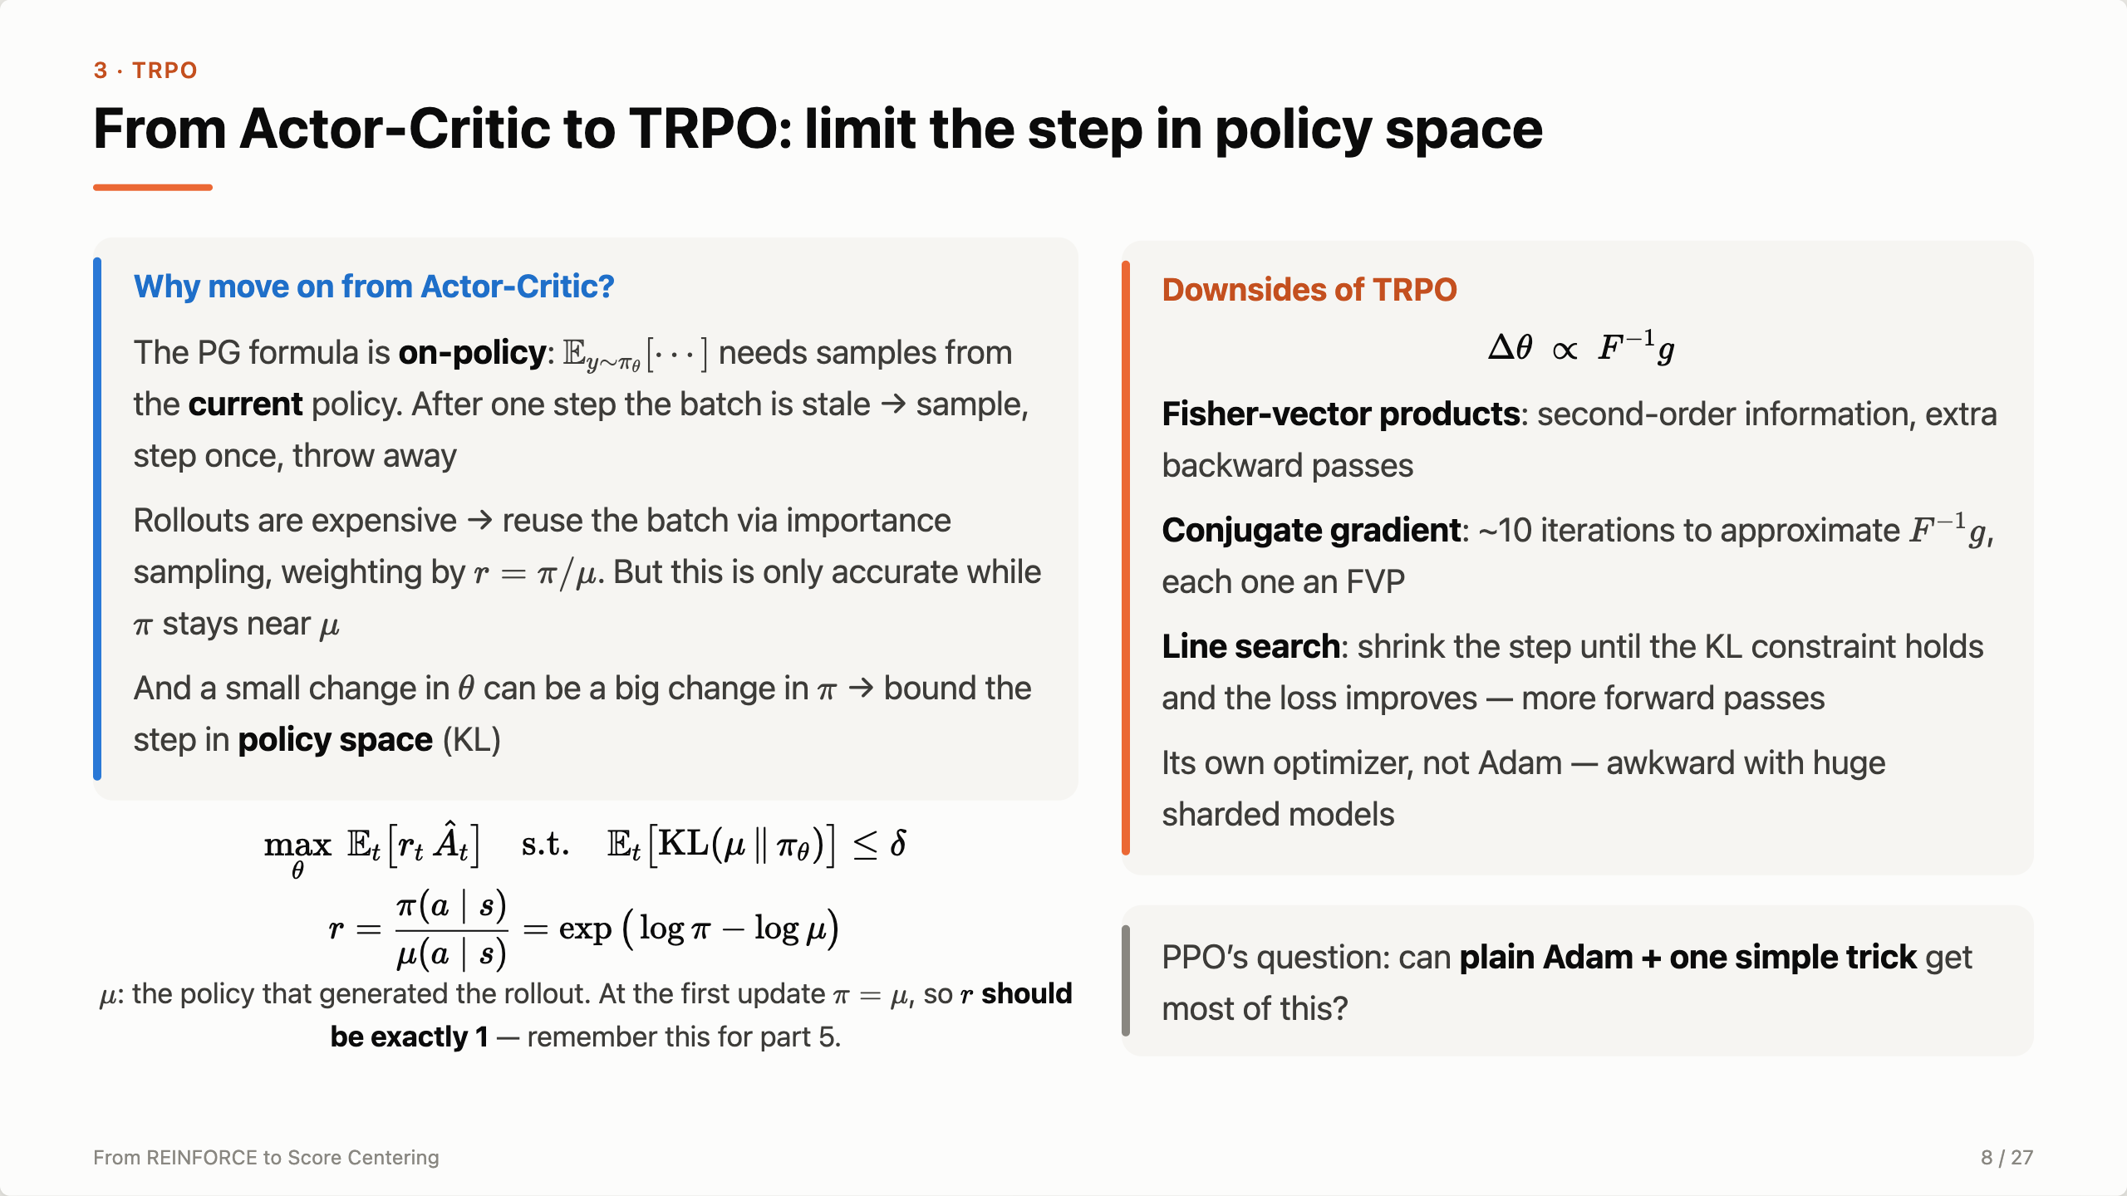
Notes:
Why isn’t actor-critic the end? The policy-gradient formula is on-policy: the expectation is under the current π_θ, so after one update the batch came from an old policy and the same formula would be biased. Plain actor-critic therefore samples, takes one step, and throws the batch away — expensive when rollouts are long generations. To reuse the batch we importance-weight by r = π/μ; the gradient of E_μ[r·A] equals the policy gradient at μ. But that surrogate is only accurate near μ: the ratio’s variance grows, and it only corrects the token choice, not the prefix distribution or the advantages. And a small change in parameters can be a big change in the policy. TRPO’s answer: measure the step in policy space, with KL, not in parameter space. Maximize the surrogate r times A subject to a KL budget δ. r is the importance ratio — and at the first update it should be exactly 1; remember that for part 5. The downsides are all about cost: solving the constrained problem needs the natural gradient F inverse g. That means Fisher-vector products, about ten conjugate-gradient iterations each needing one, then a line search that shrinks the step until KL and improvement both hold. It’s its own optimizer, not Adam, and painful at LLM scale. So PPO asks: can plain Adam plus one trick get most of this?

Slide 9
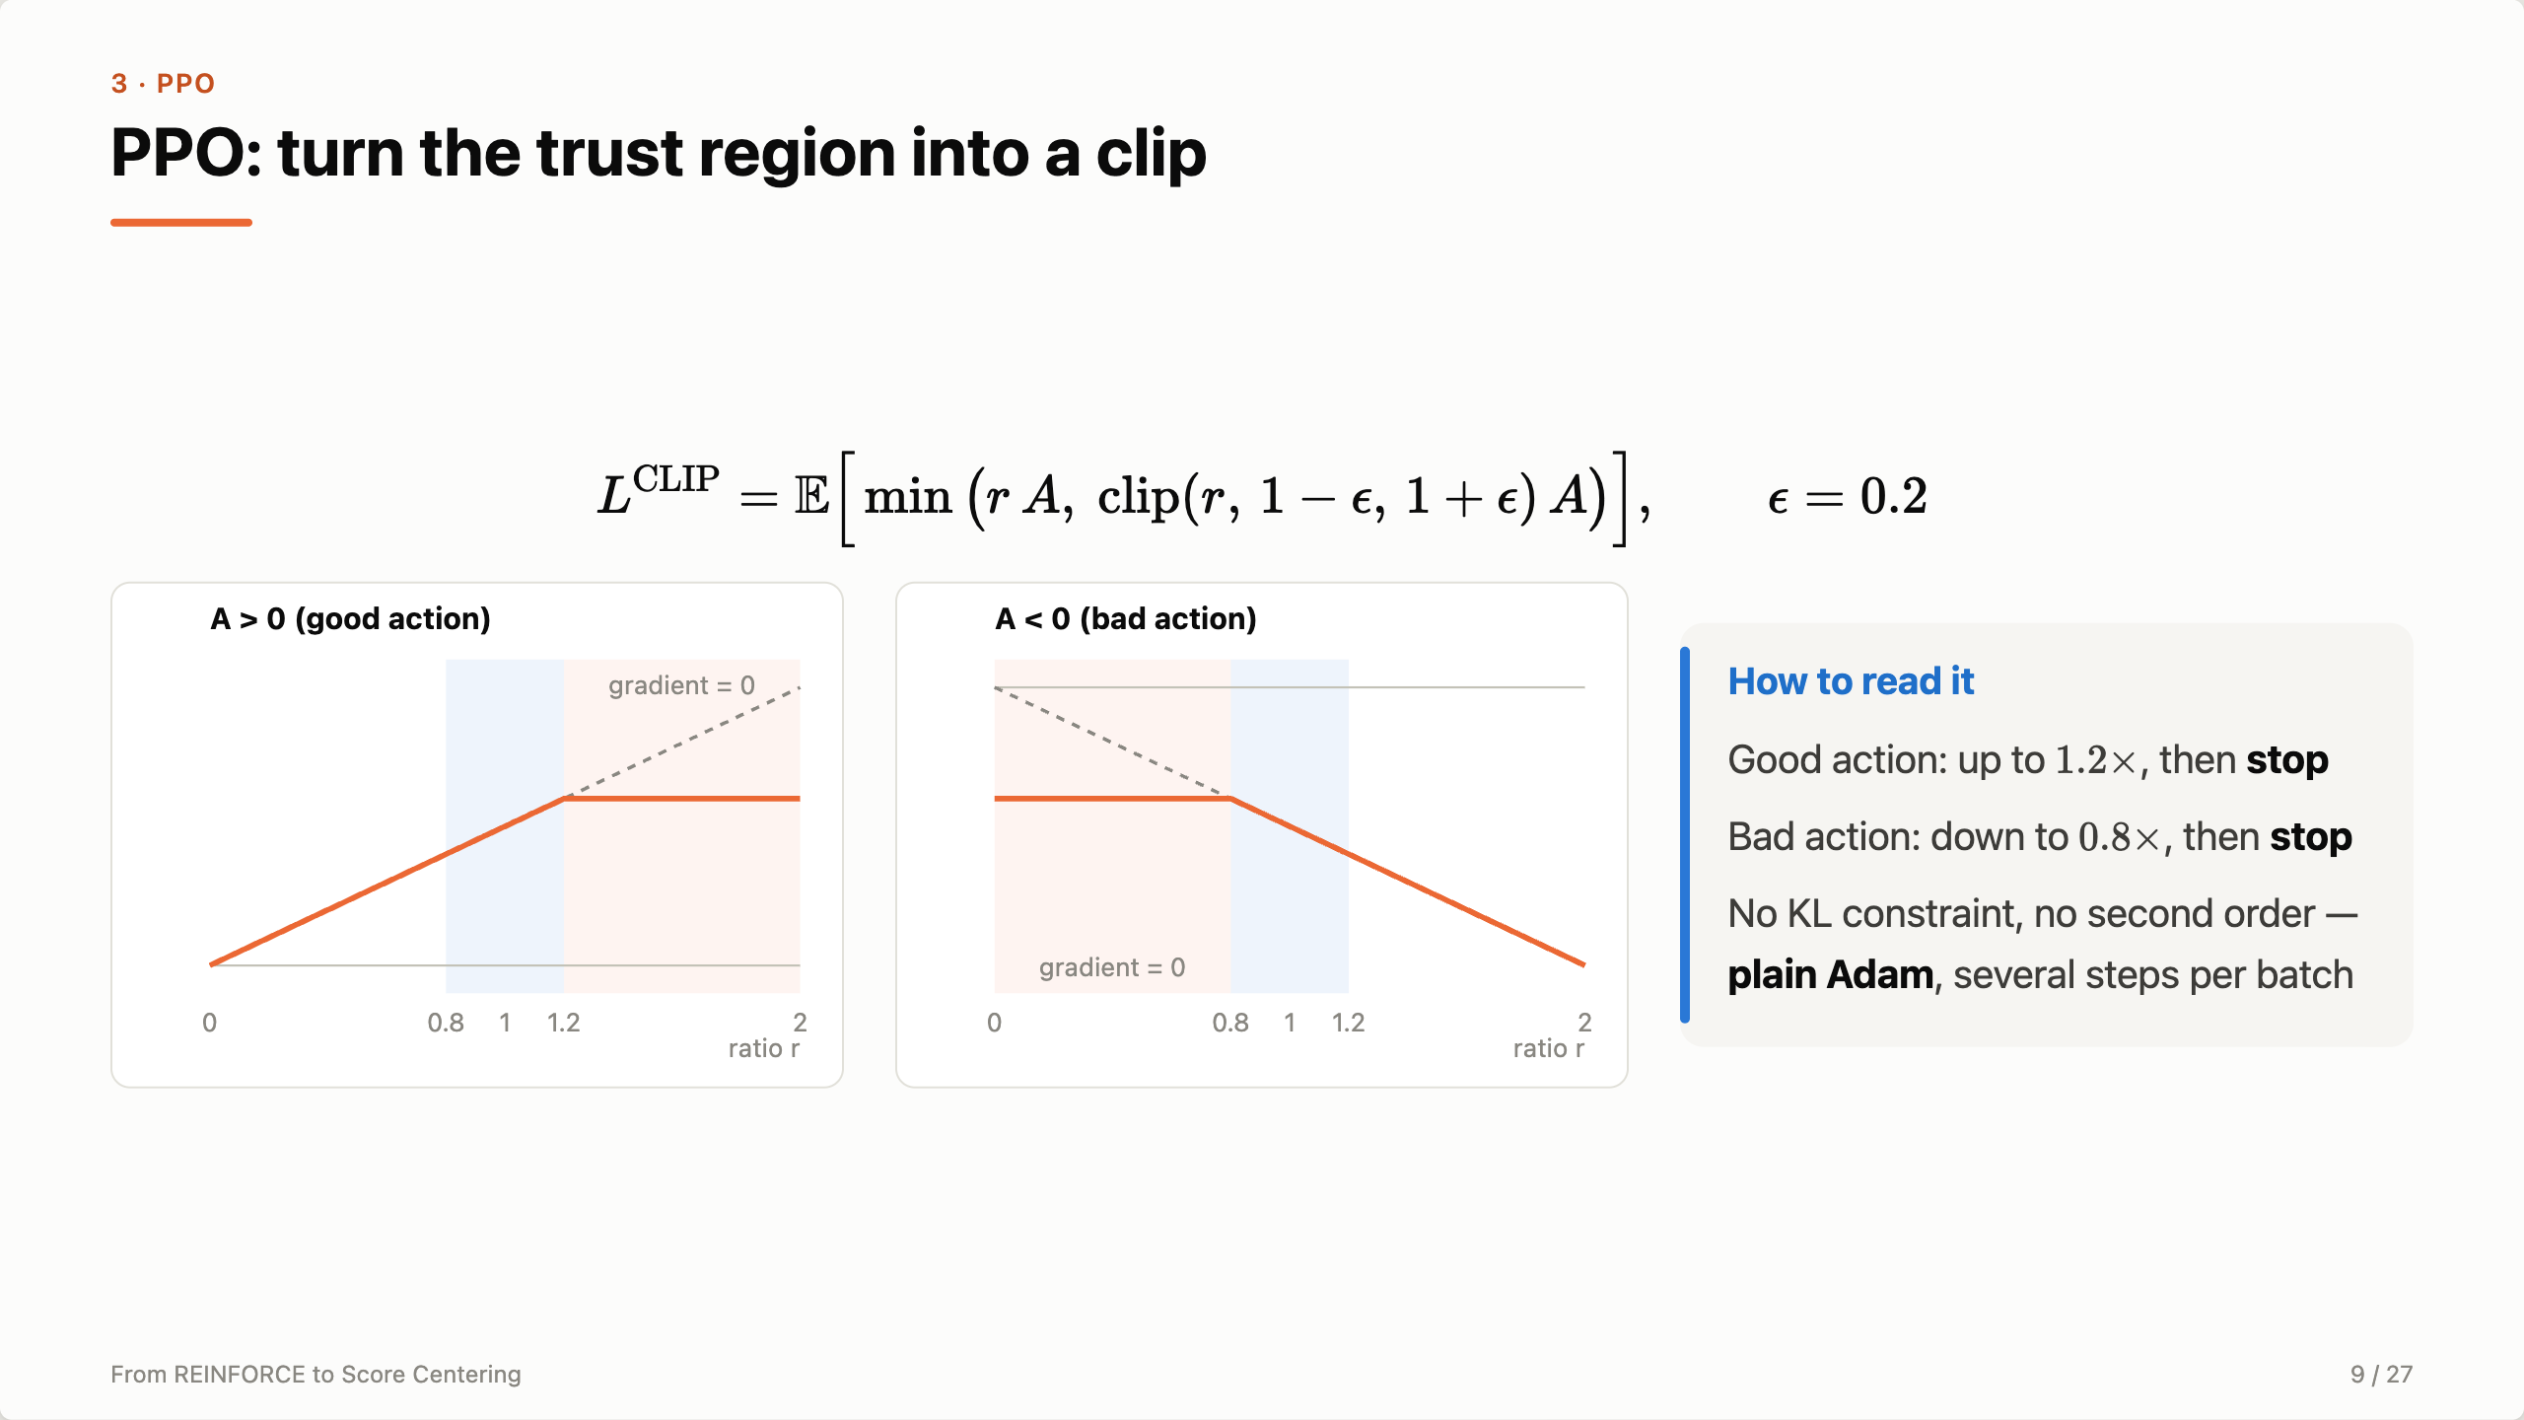
Notes:
PPO keeps TRPO’s idea but replaces the constraint with a clip. For a good action the objective goes flat once the ratio passes 1.2, so the gradient is zero — it’s gone up enough. For a bad action it goes flat below 0.8. A cheap trust region you can optimize with Adam. Note the clip range is only ±0.2 — remember that number.

Slide 10
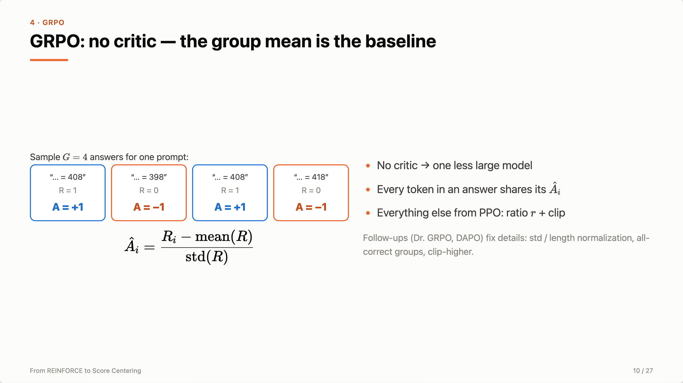
Notes:
GRPO from DeepSeekMath: sample a group per prompt, use the group mean as the baseline and divide by std. Two right, two wrong gives ±1. No critic. Everything else is PPO, including the ratio r. So r is at the heart of every algorithm we use today — and that brings us to the problem.

Slide 11
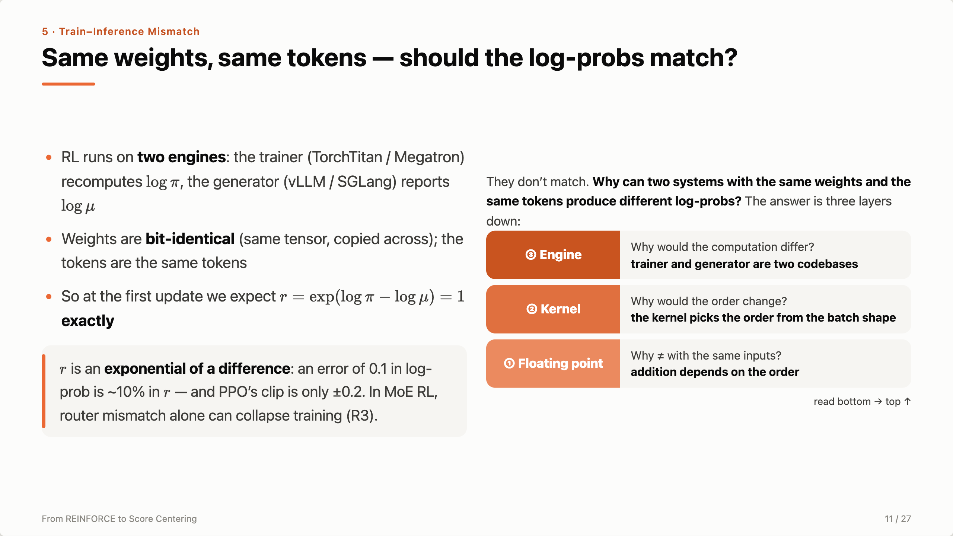
Notes:
Here’s the question that drives the second half. RL runs on two engines: the trainer recomputes log π, the generator reports log μ. The weights are bit-identical — the same tensor copied across — and the tokens are the same. So at the first update r should be exactly 1. And r is an exponential of a difference: an absolute error of 0.1 in the log-prob is a 10% error in r, while PPO’s clip is only 0.2. This is not academic — the R3 paper shows MoE routing mismatch alone collapsing training. Yet the log-probs differ. Why? The answer isn’t in RL at all. We go down to how a computer adds two numbers, then climb back up: floating point, kernels, engines.

Slide 12
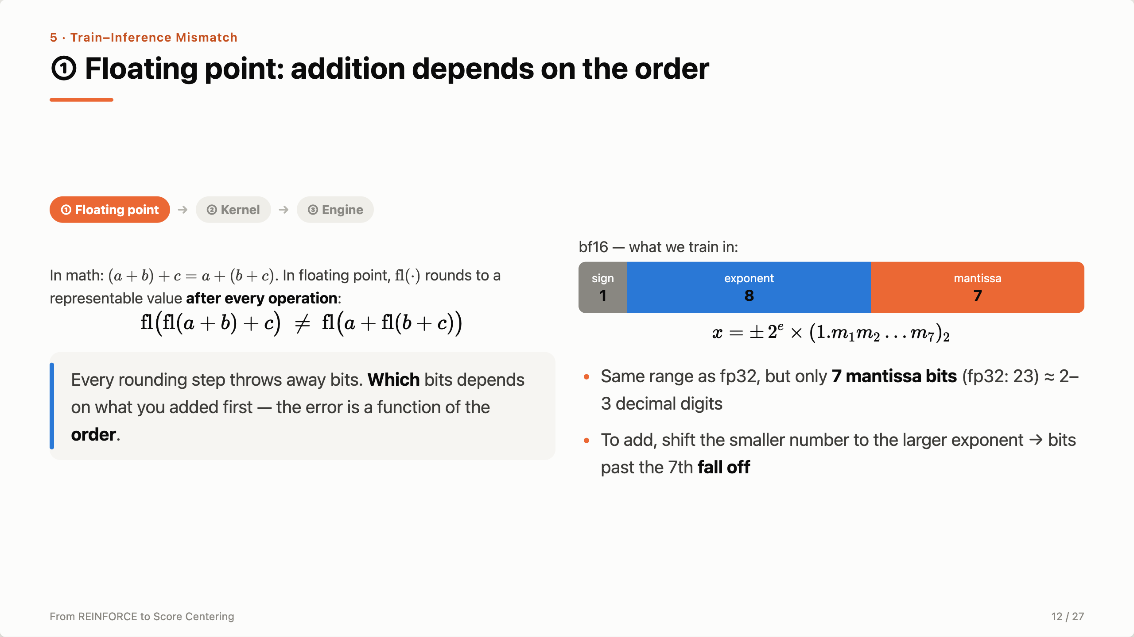
Notes:
Layer one, the bottom of the stack. In real numbers addition is associative. In floating point we round after every single operation, and rounding is where information is destroyed — so the result depends on the order. bf16 keeps fp32’s 8 exponent bits, so the same range, but only 7 mantissa bits: every number is 2 to some power times 1-point-seven-bits. To add two numbers, the hardware shifts the smaller one to the larger exponent, and whatever falls past the 7th bit is lost. Let me show you on a concrete example.

Slide 13
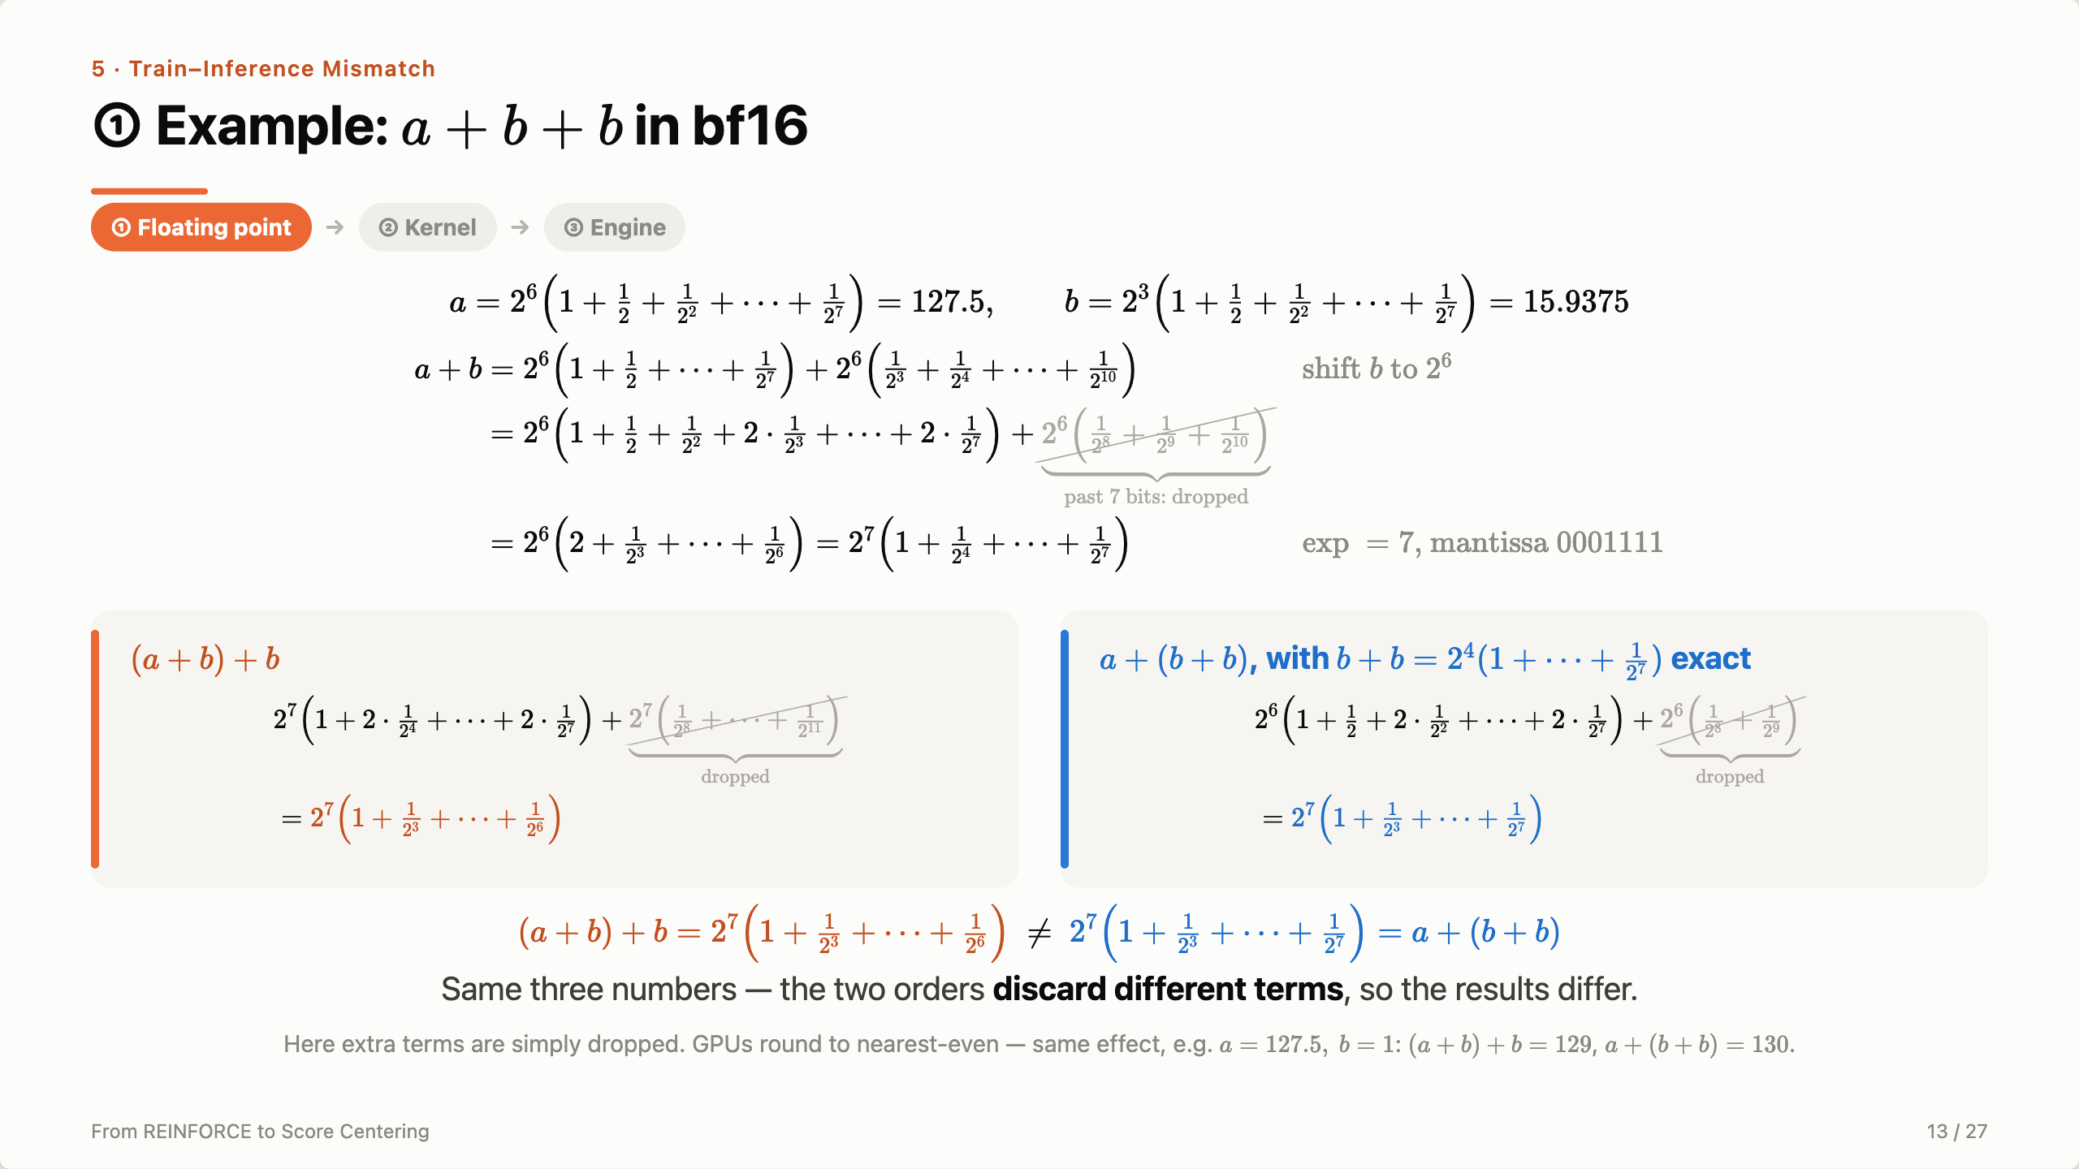
Notes:
[Top] Two bf16 numbers with the largest mantissa, seven ones: a is 2 to the 6 times 1 plus a half plus … plus 1 over 2 to the 7 — that’s 127.5. b is the same mantissa times 2 cubed — 15.9375. [Line 1] To add them, write b at a’s exponent: pull out 2 to the 6, and b’s terms become 1 over 2 cubed up to 1 over 2 to the 10. [Line 2] Add term by term: from 1 over 2 cubed to 1 over 2 to the 7 we get two copies. But the mantissa only has 7 bits, so the terms 1 over 2 to the 8, 9 and 10 have nowhere to go — they’re dropped. [Line 3] Collect: the two copies carry upward and give 2 to the 6 times 2 plus …, which is 2 to the 7 times 1 plus 1 over 2 to the 4 up to 1 over 2 to the 7 — exponent 7, mantissa 0001111. [Left card] Now add b again: write b at exponent 7 — this time four terms fall off. [Right card] Other order: b plus b first. That’s exact — it just bumps the exponent to 4. Adding it to a at exponent 6, only two terms fall off. [Bottom] Compare the two results: one ends at 1 over 2 to the 6, the other at 1 over 2 to the 7 — they differ. Same numbers, but each order discards different terms. Small print: I just dropped the extra terms; real GPUs round to nearest-even, and the same thing happens — for example 127.5 plus 1 plus 1 gives 129 one way and 130 the other. So who decides the order? The kernel.

Slide 14
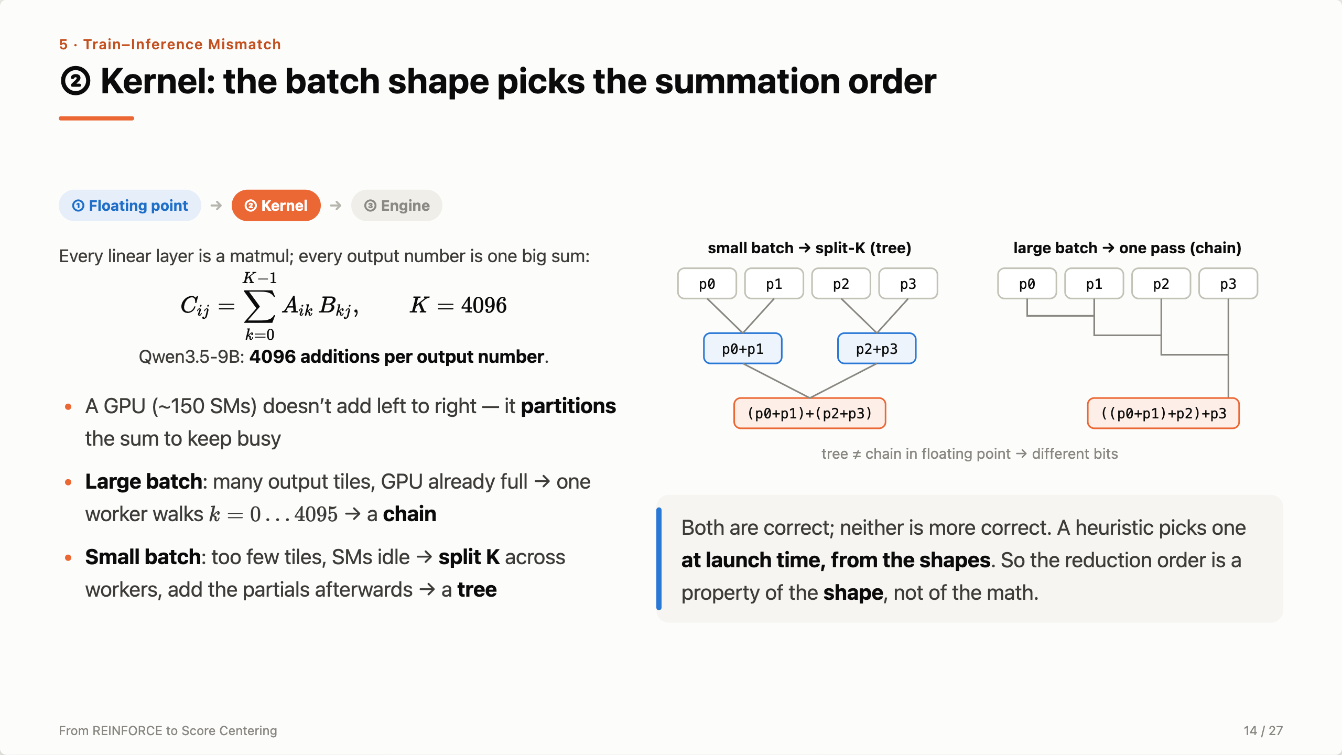
Notes:
Layer two. Nobody writes these sums by hand. Every linear layer is a matmul, and every output element is a 4096-term sum for this model — so every number in every activation is already a long reduction, and every long reduction has an order. A GPU has around 150 SMs to keep busy, so it partitions the sum. With a big batch there’s plenty of independent work: each output tile gets one worker that adds its 4096 terms in order — a chain. With a small batch there isn’t enough work, so the kernel chops K across several workers and adds their partial sums at the end — a tree. That’s split-K, purely a load-balancing optimization, and it silently changes the arithmetic. Tree versus chain is exactly (a+b)+c versus a+(b+c). The sentence to remember: the reduction order is a property of the shape, not of the math.

Slide 15
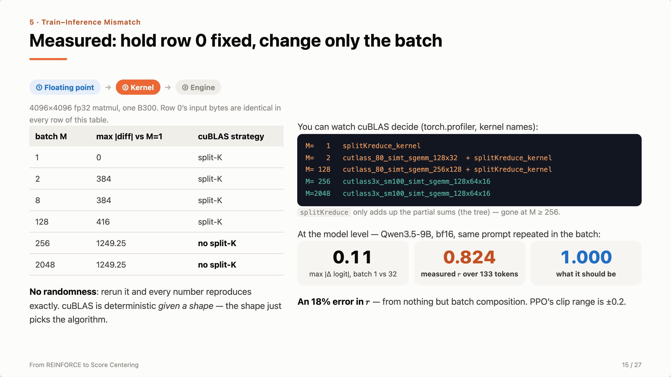
Notes:
A live-reproducible measurement on one B300. Row 0’s input never changes; only how many other rows share the batch. Below M = 256 the profiler shows a second kernel, splitKreduce, whose only job is to add up the partial sums — the tree. At 256 it disappears: enough tiles, no split, a chain — and row 0’s answer jumps. This is not nondeterminism: every number reproduces exactly. Now at the model level: one forward at batch 1 vs 32 moves a logit by 0.11. Over a 133-token sequence those deltas accumulate in the exponent and r lands at 0.824 instead of 1 — an 18% error from batch composition alone, the same order as PPO’s clip range.

Slide 16
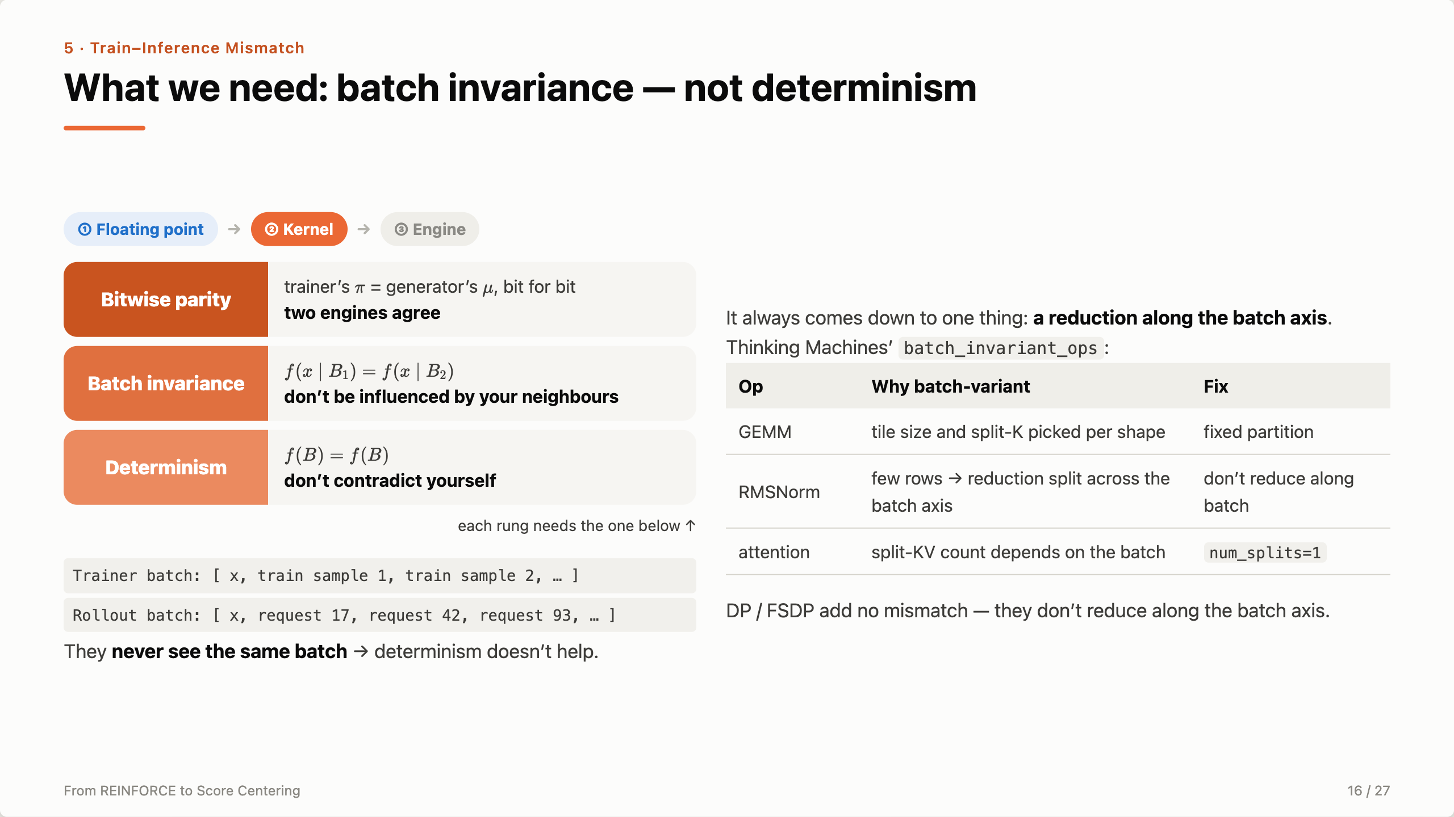
Notes:
Name the property precisely, because the obvious name is the wrong one. Three rungs. Determinism: the same batch gives the same result — don’t contradict yourself. Batch invariance: a sample’s result doesn’t depend on who else is in its batch — don’t be influenced by your neighbours. Bitwise parity: the two engines agree. Each rung needs the one below. Determinism is what people reach for, and it doesn’t help: in the trainer x sits next to training samples, in the generator it sits next to whatever requests happened to arrive. They never see the same batch. And every batch-variant op comes down to one thing — a reduction along the batch axis. Thinking Machines’ batch_invariant_ops fixes the three that matter: GEMM with a fixed partition, RMSNorm without batch-axis reduction, attention with one split. Useful fact: data parallelism is fine — it’s a within-kernel problem, not a cross-GPU one.

Slide 17
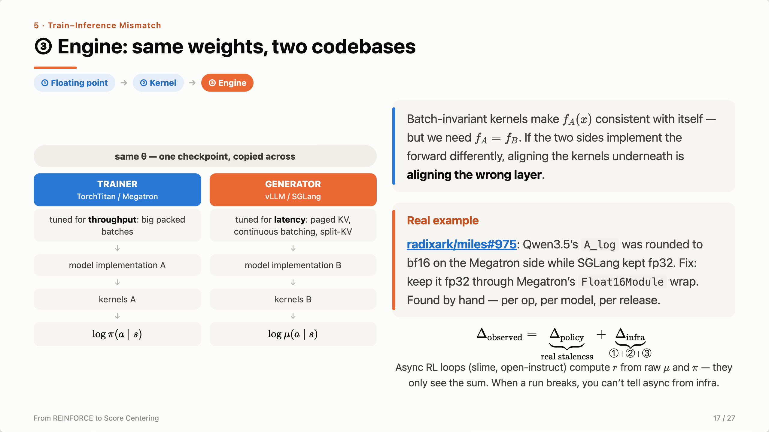
Notes:
Layer three, the top. Everything so far assumed both sides run the same model code with different kernels underneath. That’s false. The weights are shared — one checkpoint — but everything else is two codebases by two teams, optimized for opposite goals: the trainer saturates tensor cores on big packed batches, the generator returns tokens fast on a batch rebuilt every iteration. So there are two independent levels of mismatch. Perfect batch-invariant kernels give you f_A computed identically twice — but you wanted f_A equal to f_B. A real example: miles PR 975 — one tensor, A_log, bf16 on one side and fp32 on the other; someone had to find it by hand. Put together: we observe one number, the log-prob gap. It’s real staleness plus all three infra layers, and the popular async loops compute r straight from μ and π, so when a run degrades you can’t tell which part caused it.

Slide 18
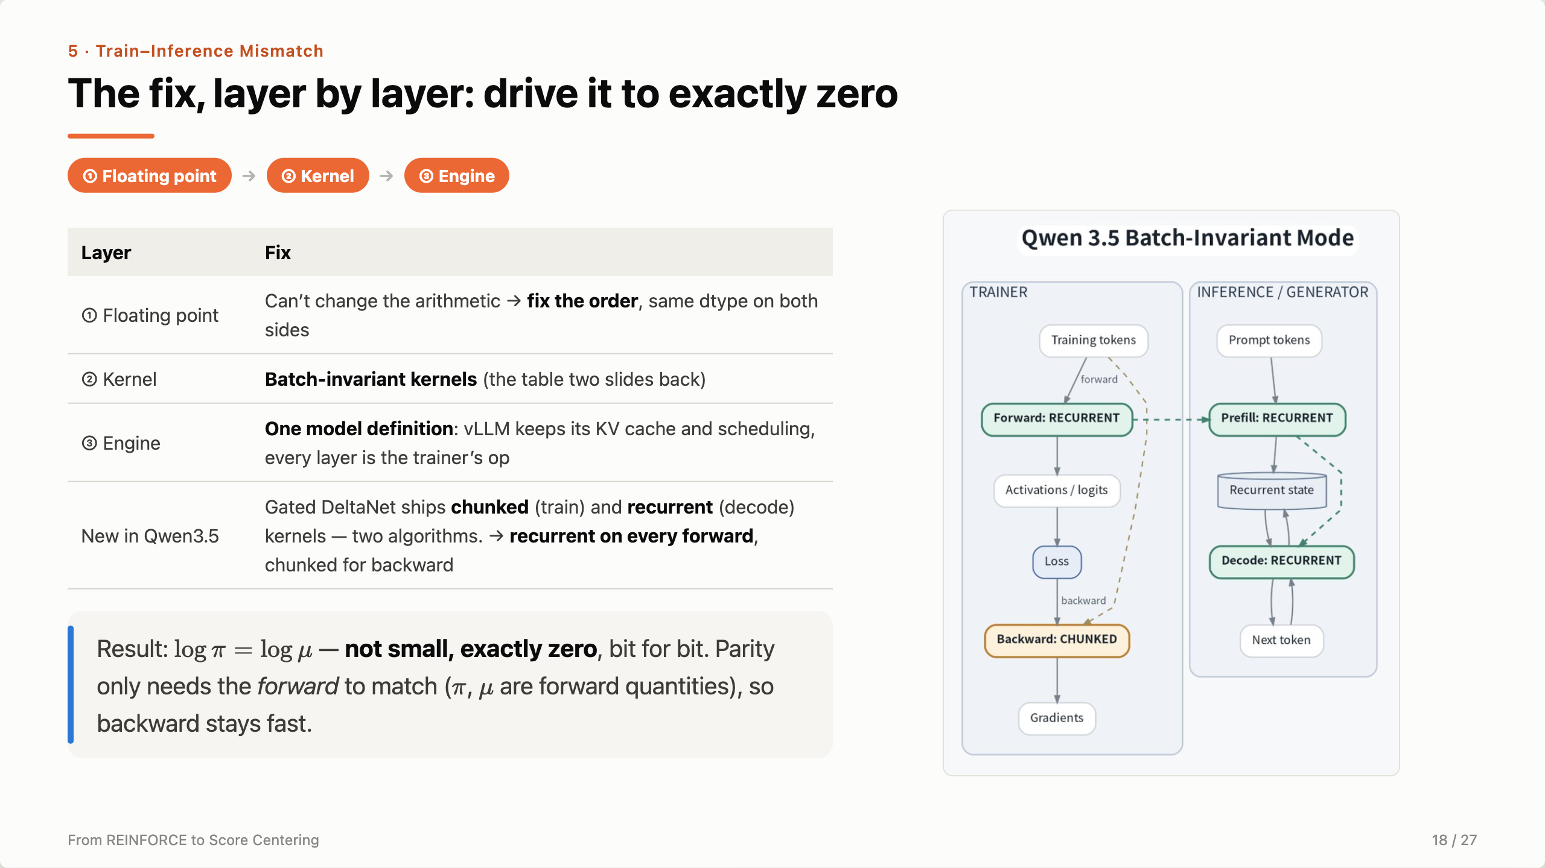
Notes:
The fix mirrors the layers. Floating point we can’t change, so we fix the order and match dtypes. Kernels: the batch-invariant ops from two slides back. Engine: one shared model definition — vLLM keeps paged attention, prefix caching and scheduling, but every layer runs the trainer’s code. That alone costs nothing. Then a genuinely new problem: Gated DeltaNet in Qwen3.5. FLA ships a chunked kernel for training and a recurrent one for decode — not the same algorithm scheduled differently, but two different algorithms. Parity is a property of the forward pass only, because μ and π are both forward quantities, so we use recurrent on every forward and keep the fast chunked kernel for backward. With everything on, the gap is exactly zero.

Slide 19
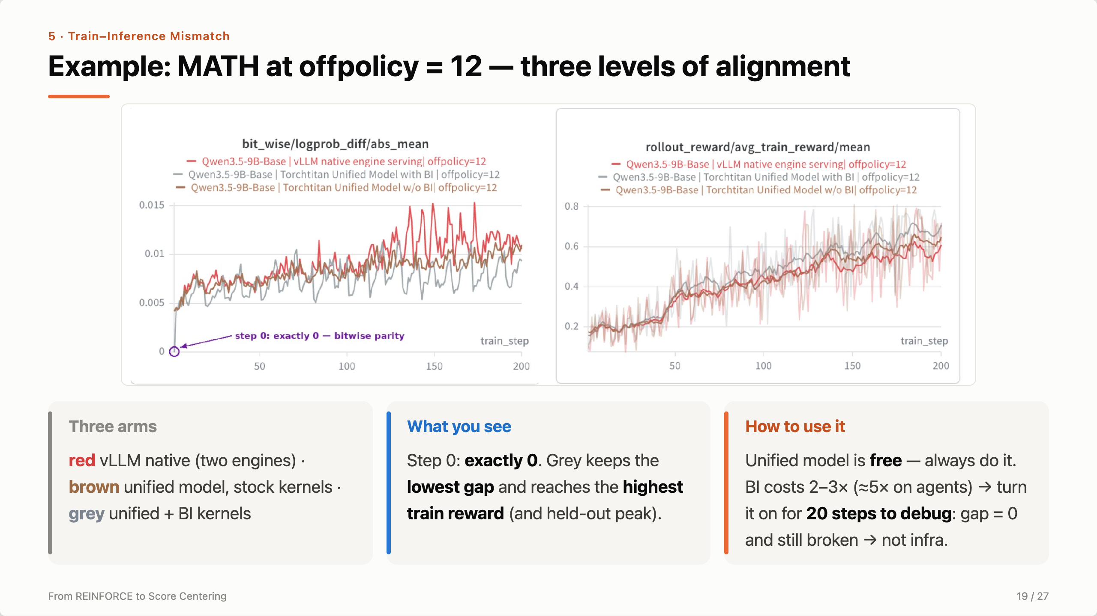
Notes:
A concrete example where it pays. MATH, Qwen3.5-9B, off-policy window 12, three arms forming a ladder. Red is what most open-source stacks do: two engines. Brown shares one model definition but keeps stock kernels. Grey adds batch-invariant kernels. Left: grey starts at exactly zero and stays lowest. Right: grey reaches the highest training reward, and in the blog it also has the highest held-out peak. Caveats, honestly: one seed, and on other windows and on search the reward moves within noise. Practical advice: the unified model is free, always do it. BI costs 2–3×, so use it as a debugging switch — 20 on-policy steps; if the gap is zero and the run is still broken, the infra is exonerated. One war story from the terminal agent: BI is ~5× slower, so scale the agent timeouts too, or slow rollouts get killed, score 0, and it looks like a reward regression.

Slide 20
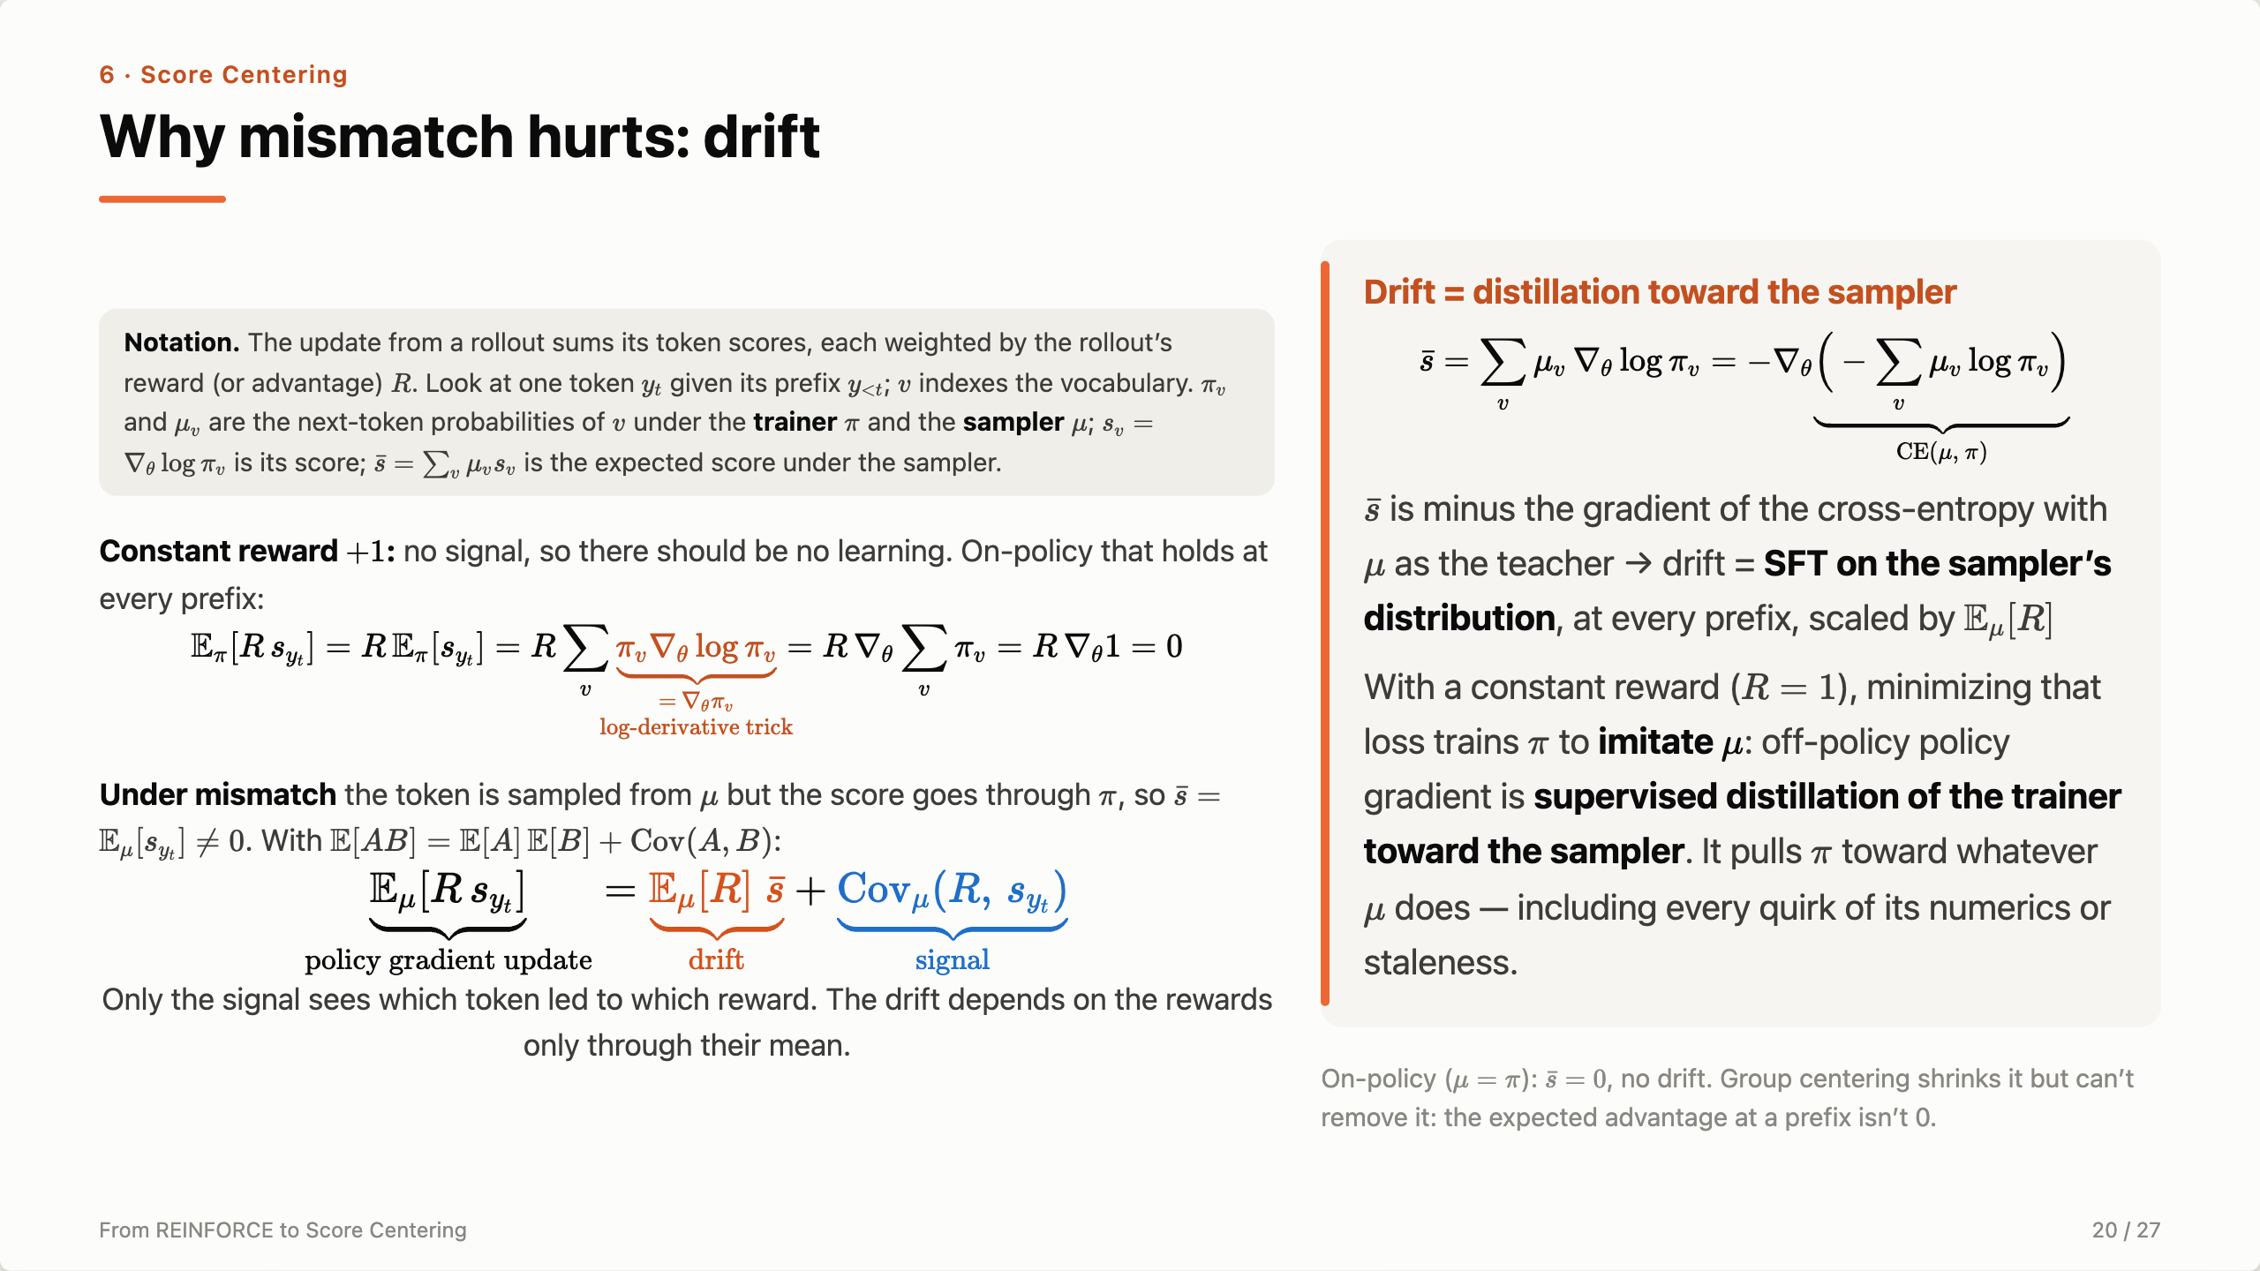
Notes:
[Notation box] Everything here is about a single token. Fix a prefix; y_t is the token that was actually sampled, and v runs over the vocabulary. π_v is the trainer’s probability of v, μ_v is the sampler’s. The score s_v is the gradient of the trainer’s log-prob — always the trainer, because that’s where we backprop. s̄ is the average score when tokens are drawn from the sampler. [First equation] Thought experiment: every rollout gets reward +1. There is no information, so a correct algorithm shouldn’t move. On-policy it doesn’t: the expected score is a π-weighted average of ∇log π_v. Since ∇log π_v = ∇π_v / π_v, the weights cancel and we get Σ ∇π_v — the gradient of the total probability, the gradient of 1 — zero. [Second paragraph] With mismatch the token is drawn from μ, but we still differentiate π. Now the weights are μ_v, not π_v; nothing cancels, and the expected score s̄ is nonzero. For a general reward, use E[AB] = E[A]E[B] + Cov(A,B) with A = R and B = the score. The update splits in two. The signal, the covariance of reward and score, is the only part that knows which token earned the reward. The drift, mean reward times s̄, knows nothing about which answer was right. [Right card] So what does s̄ do? Σ μ_v ∇log π_v is minus the gradient of the cross-entropy −Σ μ_v log π_v. Following it is exactly SFT with the sampler as the teacher: drift distills the trainer toward the sampler at every prefix, with strength E[R]. So with a constant reward, minimizing that loss trains π to imitate μ: off-policy policy gradient is supervised distillation of the trainer toward the sampler. It pulls π toward whatever μ does — including every quirk of its numerics or staleness. [Transition] If the problem is s̄, the fix is obvious: subtract it.

Slide 21
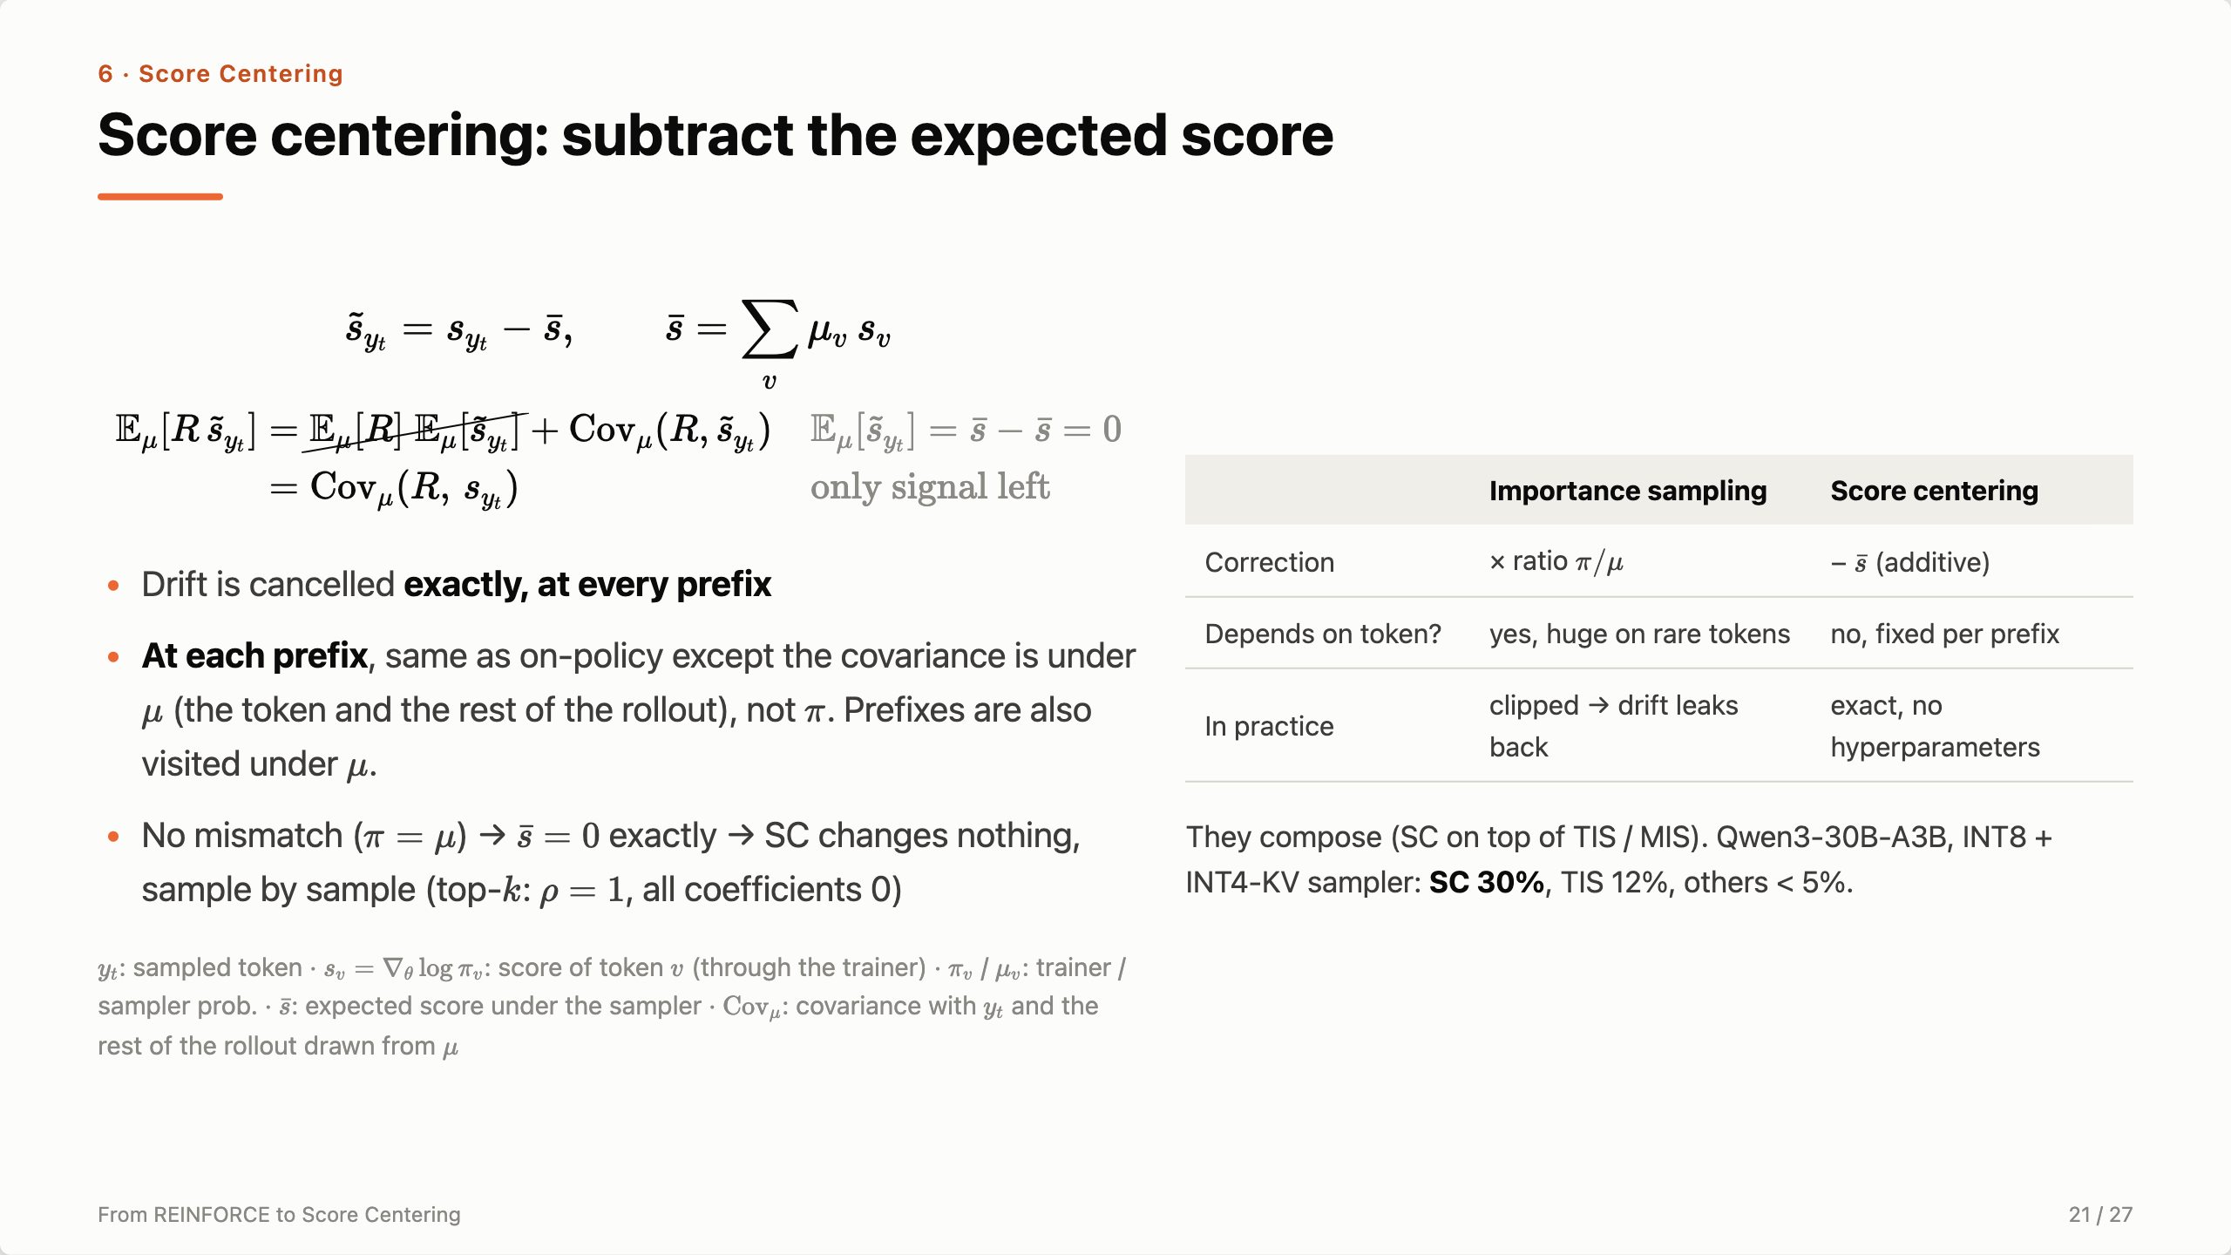
Notes:
[Top equation] Score centering replaces each token’s score s_{y_t} with s_{y_t} minus s̄. Note s̄ doesn’t depend on which token was sampled — it’s one fixed vector per prefix, computed from the sampler’s probabilities. [Second equation] Take the expected update again with the same covariance identity. In the first term, E_μ[s̃] = s̄ − s̄ = 0, so it’s crossed out: drift is gone, exactly, at every prefix. In the second term, subtracting a constant doesn’t change a covariance, so Cov(R, s̃) = Cov(R, s). Only the signal is left. [Bullets] Compare with on-policy, where the expected update is Cov_π(R, s) — that’s the actor-critic slide. At each prefix, the only difference is that the covariance is measured under μ — the sampled token and the rest of the rollout — instead of π. Summed over prefixes there’s one more difference SC doesn’t touch: the prefixes themselves are visited under μ. For a small numerical mismatch that difference is tiny; under real staleness it isn’t — that’s the future-work slide. And with no mismatch s̄ is exactly zero, so score centering changes nothing, sample by sample — in the top-k version ρ is 1 and every coefficient is 0. [Table] Why not importance sampling? Exact IS also cancels drift, but it multiplies by a random ratio that depends on the sampled token. On rare tokens the ratio explodes, so everyone clips it, and clipping lets drift back in. Score centering is additive, deterministic given the prefix, has no hyperparameters — and it composes with IS. [Result] Qwen3-30B-A3B with an INT8 sampler and INT4 KV cache: score centering 30%, TIS 12%, everything else below 5%.

Slide 22
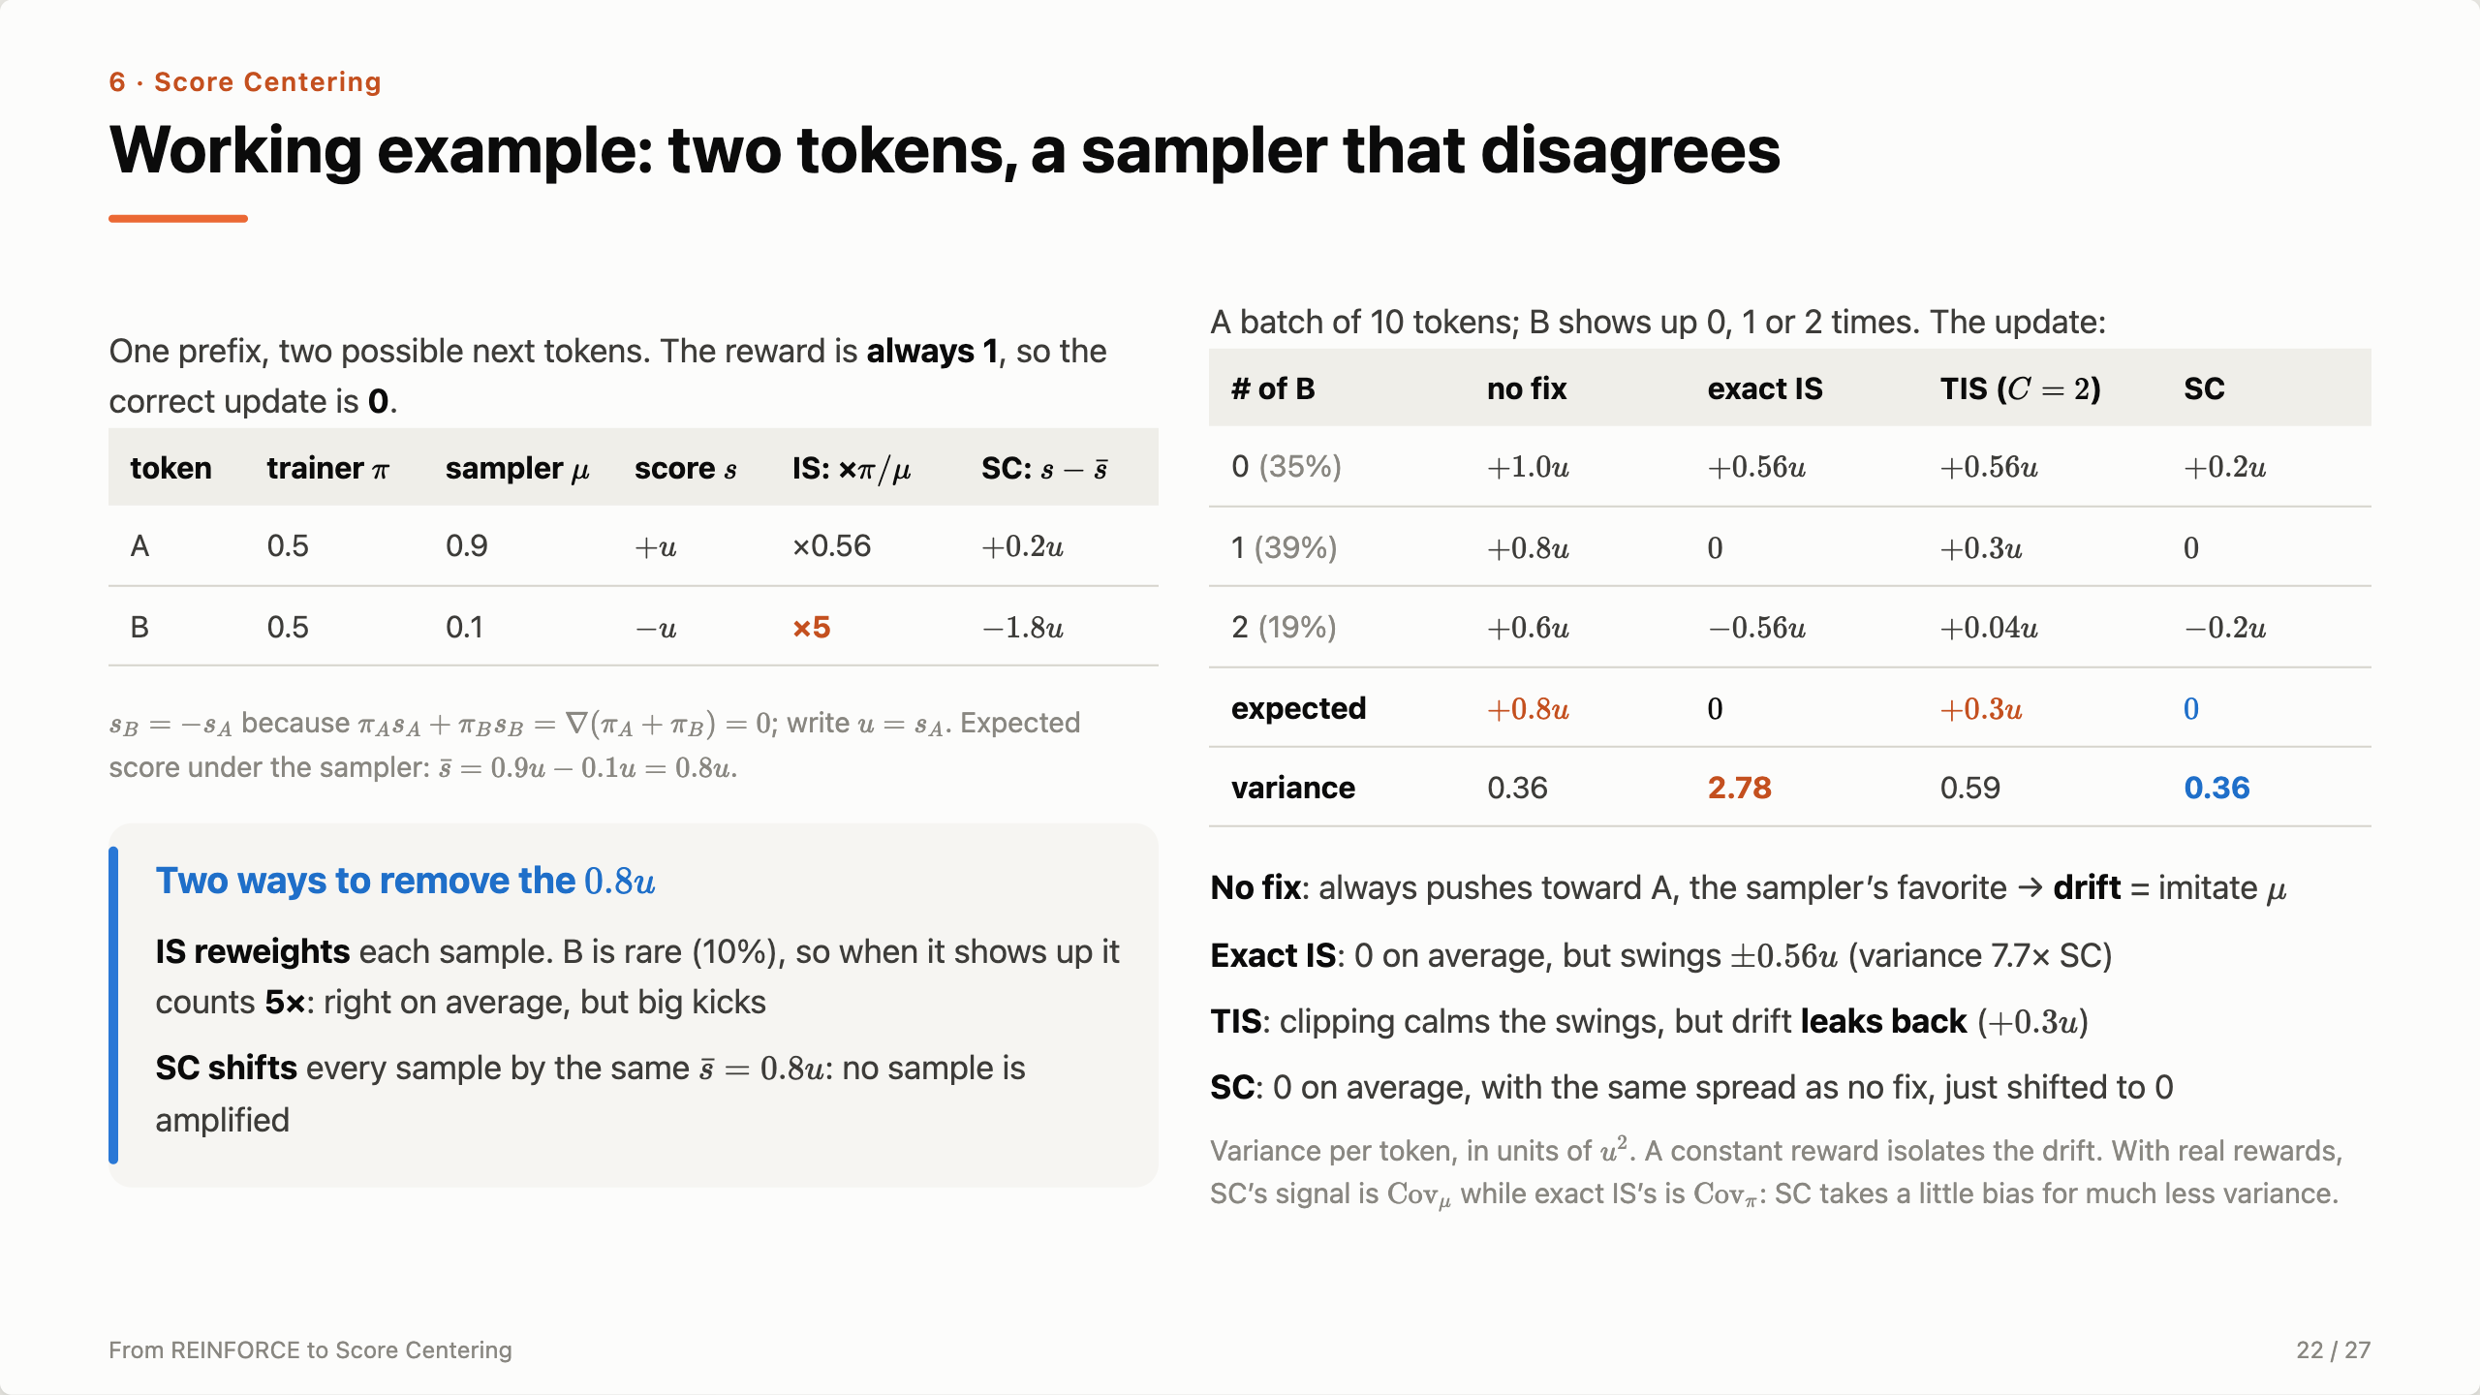
Notes:
[Setup] Let’s make this concrete with the smallest possible case. One prefix, two possible next tokens, A and B. The trainer thinks they’re 50/50; the sampler, because of numerics or staleness, picks A 90% of the time. Every rollout gets reward 1, so the right answer is: don’t move. The scores: because the trainer’s probabilities sum to one, the score of B is exactly minus the score of A — call it u. The expected score under the sampler is 0.9u minus 0.1u, 0.8u. That’s the drift. [Two fixes] Importance sampling reweights each sample by π over μ: A gets 0.56, B gets 5. Score centering subtracts the same 0.8u from every sample: A becomes +0.2u, B becomes −1.8u. [Batch table] Now take a batch of 10 tokens. Usually B shows up once, sometimes zero or two times. With no fix, the update is always positive: it always pushes toward A, the sampler’s favorite — that’s the drift, imitating μ. Exact IS is zero on average, but it swings between +0.56u and −0.56u depending on whether the rare B showed up — every time B appears it counts five times. Truncated IS with C equal 2 calms the swings, but now the expectation is +0.3u: the drift leaks back. Score centering is zero on average, and its swings are the smallest — the same spread as no correction at all, because it just shifts every sample by the same vector. [Caveat] A constant reward isolates the drift. With real rewards there’s a trade-off: exact IS recovers the covariance under π, SC gives the covariance under μ. SC accepts that small bias in exchange for much lower variance — and the two compose.

Slide 23
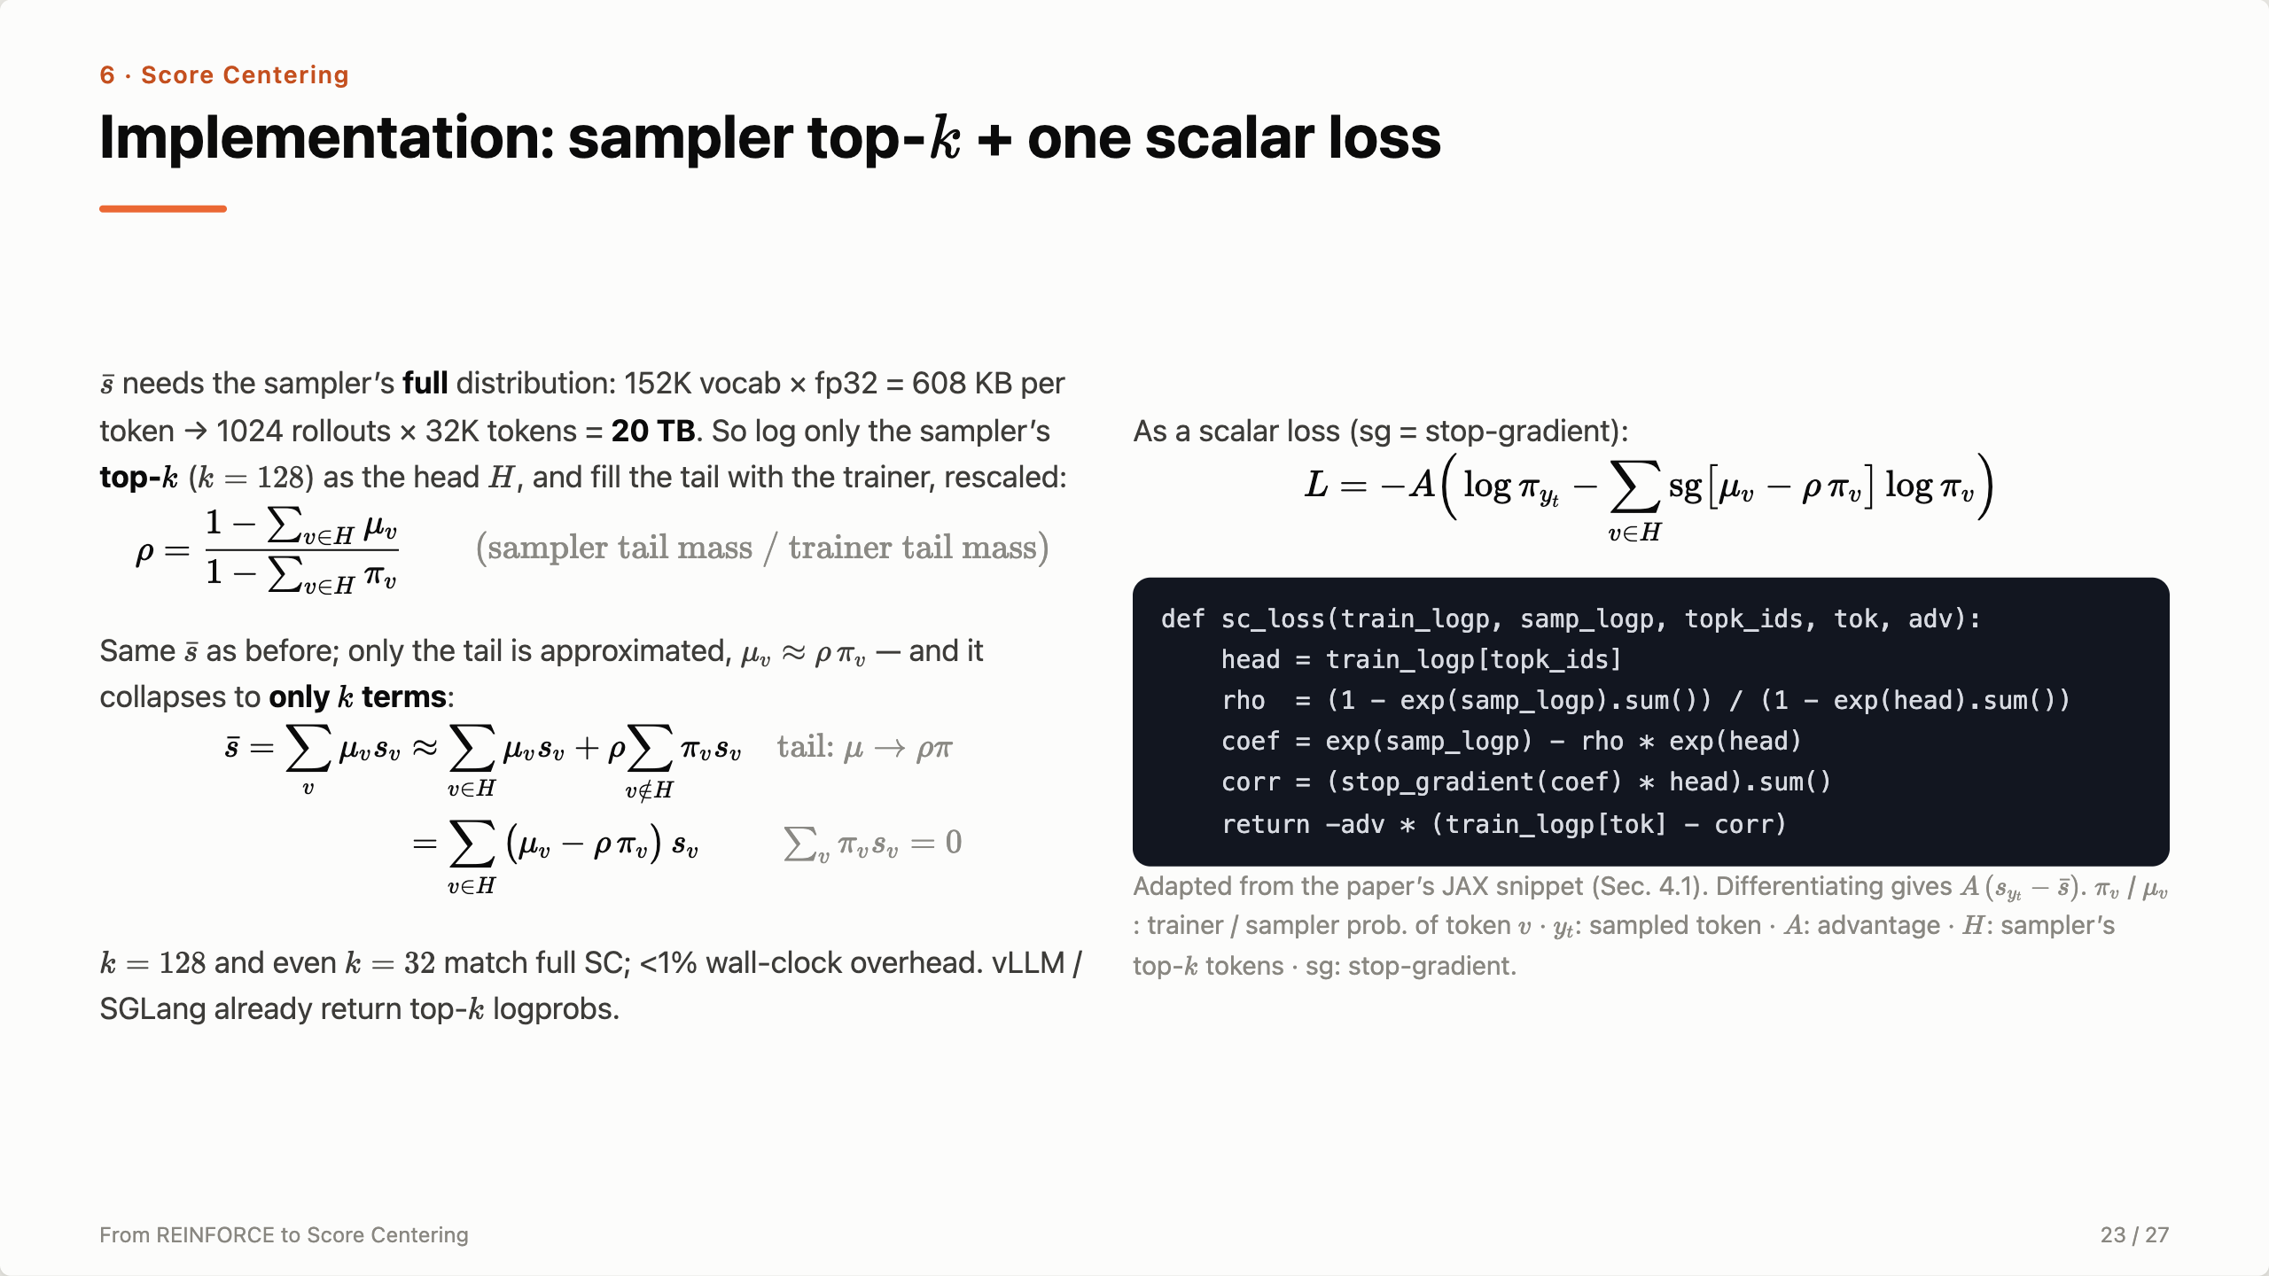
Notes:
[Left, top] To compute s̄ exactly we need the sampler’s full next-token distribution at every position: 152K vocabulary times 4 bytes is 608 KB per token — 20 terabytes for a batch of 1024 rollouts of 32K tokens. Not possible. [ρ formula] So log only the sampler’s top-k, k = 128 — call that set the head H. For the tail, borrow the trainer’s probabilities, scaled by ρ = sampler tail mass over trainer tail mass, so the whole thing still sums to one. [Head-only formula] Now the trick. Under the trainer, Σ over the full vocabulary of π_v s_v is zero — the identity from two slides back. So the tail part, ρ times Σ over the tail of π_v s_v, equals minus ρ times the same sum over the head. Everything collapses to k terms: Σ over the head of (μ_v − ρ π_v) s_v. We never touch the 152K-token tail. [Loss] In autograd, write it as a loss. The normal policy-gradient loss is −A log π of the sampled token. Subtract a correction: the trainer’s head log-probs weighted by detached coefficients μ_v − ρ π_v. Because the coefficients are stop-gradient, the gradient of the correction is exactly Σ (μ_v − ρ π_v) ∇log π_v, which is s̄. So minus the gradient of L is A times (s_{y_t} − s̄): the centered score. [Code] Five lines: gather the trainer’s log-probs at the sampler’s top-k ids, compute ρ, the coefficients, the detached correction, and the loss. [Bottom] k = 128, even k = 32, matches full score centering, with under 1% overhead, and vLLM and SGLang already return top-k logprobs.

Slide 24
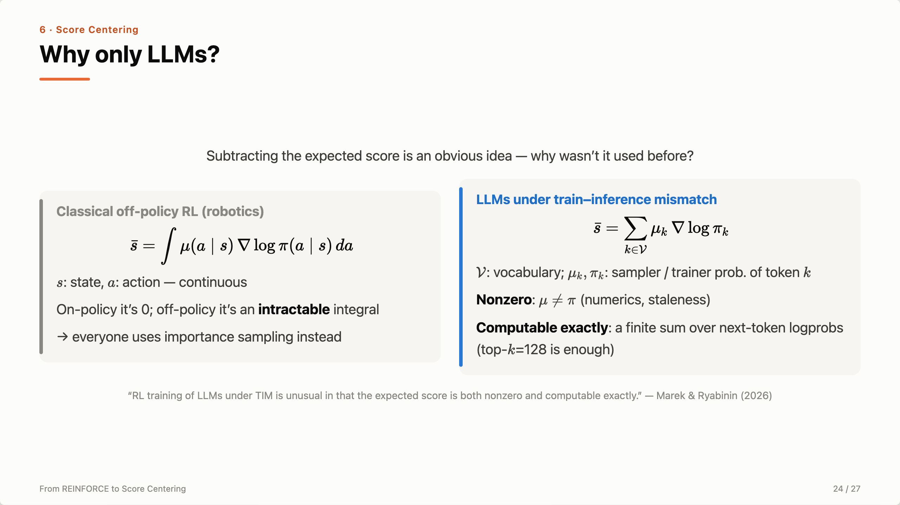
Notes:
Why is this an LLM thing? Subtracting the expected score is an obvious idea. But in classical off-policy RL — robotics, continuous control — the expected score is an integral over a continuous action space. On-policy it’s zero; off-policy you can’t compute it, so the field has always used importance sampling instead. LLM training under train–inference mismatch is unusual: the expected score is nonzero, because μ differs from π, and it’s computable exactly, because the action space is a finite vocabulary — just a sum over the next token’s logprobs, and the top 128 are enough. That’s why this idea only shows up now.

Slide 25
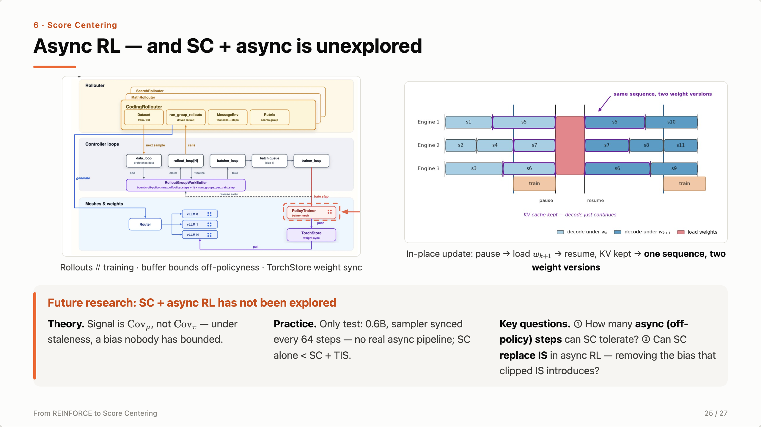
Notes:
[Left figure] This is what async RL looks like in practice — our stack. Rollouters for coding, math and search generate in parallel with training; controller loops feed a work buffer, and that buffer bounds how off-policy a training batch can be — max off-policy steps plus one, times groups per step. The trainer pushes weights through TorchStore and the vLLM engines pull them. [Right figure] And weights are updated in place: engines pause, load the new weights, and resume — the KV cache is kept, so decoding just continues. That means a single sequence, like s5 here, is decoded partly under w_k and partly under w_{k+1}. [Bottom card] This is exactly where score centering hasn’t been explored. Theory: SC removes drift but measures the signal under μ; under real staleness μ is an older policy, and nobody has bounded that bias. Practice: the paper’s only staleness test is a 0.6B model on Countdown with the sampler synced every 64 steps — nothing like this pipeline — and even there SC alone loses to SC plus TIS. The two questions I care most about: first, how many async off-policy steps can score centering tolerate before the μ-versus-π covariance bias hurts? Second, can SC replace importance sampling in async RL altogether? Everyone clips IS ratios, and clipping is biased; SC is exact for drift, so if SC alone held up under real async training we could drop IS and its bias. The paper’s one staleness run says not yet — SC plus TIS won — but that was periodic sync on a tiny model, not a pipeline like this.

Slide 26
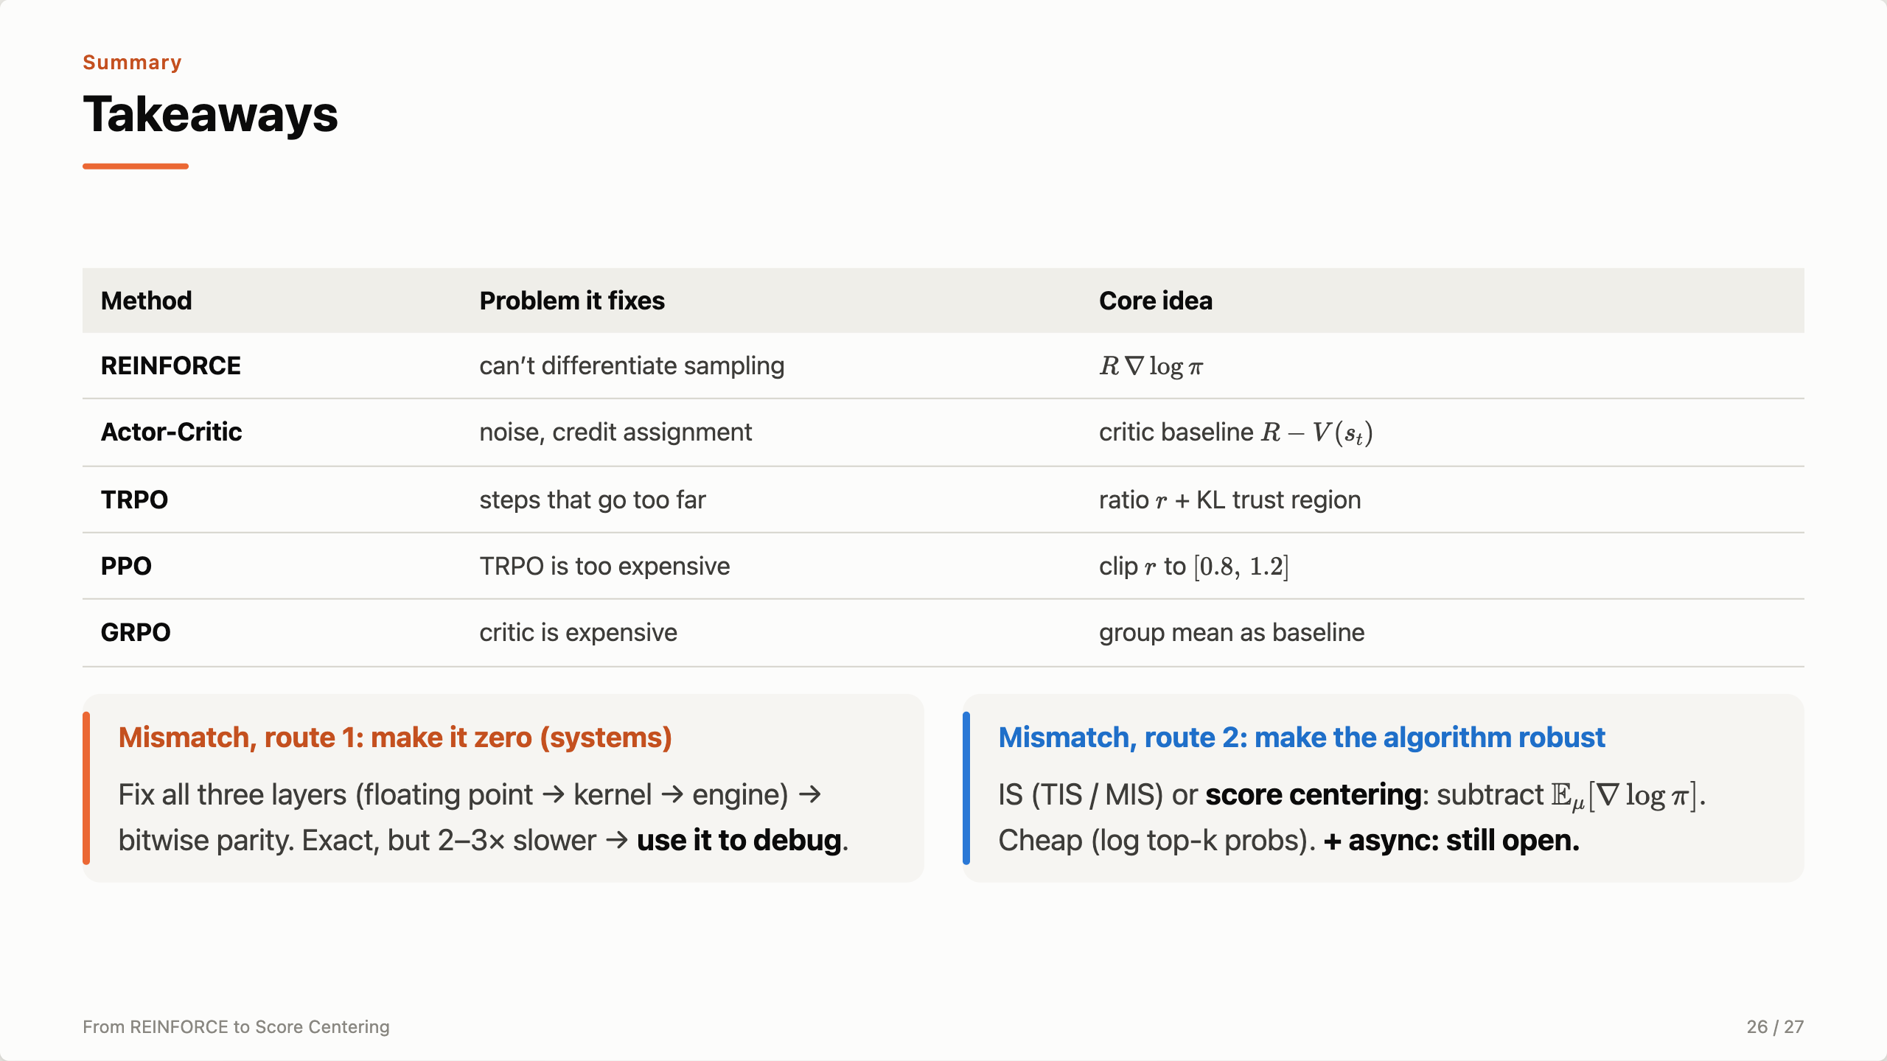
Notes:
Close with the table, one sentence per row. Then the two routes for mismatch: make it exactly zero at the systems level — exact, but 2–3× slower, so use it to debug — or make the algorithm robust to it with IS or score centering, which is cheap. The thread through the whole talk: the score has zero mean only under the policy that generated the data.

Slide 27

Notes:
Leave time for questions.

