Slide 1

Electricity Load Diagrams 2011-2014
Analysis
By Group 6:
Shumin Song
Qifan Jiang
Frank Li

Slide 2




Introduction
Our team will analyze a Time-Series data about electricity consumption of 370 clients from 2011 to 2014. The ultimate goal for this project is to predict electricity consumption with Models including ARIMA and SARIMAX.

Slide 3

Agenda
Value Creation
Project Milestones and Timeline
Data Extraction
Data Preprocessing
Variable Analysis
Stationarity Analysis
Model Training & Prediction Accuracy Analysis
Challenges and Future Steps
Visualizations on the raw dataset
Verification of correctness of ARIMA and SARIMAX model
Prediction of Electricity consumption in 2015

Slide 4
Timeline
Data extraction from the provided source website
Analyze Target Variable and Predictive Variables. Perform clients classification. Division of train, validation and test set
Prediction of Electricity consumption in 2015 with the two models
Data Extraction
Data Preprocessing
Variable Analysis
Stationarity Analysis
Model Prediction
Data Analysis. Create daily and monthly time window for Time-Series structured data.
Building Time-Series models (ARIMA and SARIMAX) and analyze for stationarity.

Slide 5
Data Extraction
Original Data source from UCI Machine learning repository:
https://archive.ics.uci.edu/ml/datasets/ElectricityLoadDiagrams20112014#
Artur Trindade, artur.trindade '@' elergone.pt, Elergone, NORTE-07-0202-FEDER-038564
Number of Instances (records in your data set):370
Number of Attributes (fields within each record):140256
First column present date and time as a string with the following format 'yyyy-mm-dd hh:mm:ss'
Other columns present float values with consumption in kW
Each column represent one client. Values are in kW of each 15 min.

Slide 6
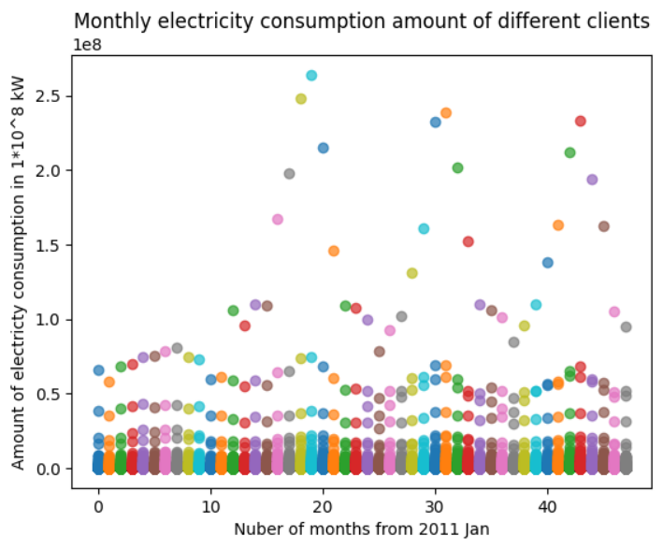
Data Analysis
Our first step is resampling the time window, since electricity consumption given in dataset is in every 15 mins, we combined the data into daily and monthly consumption by taking the average for appropriate model input.
From given dataset, we notice a significant difference in electricity consumption among clients. In order to predict more accurately and for future analysis, we decide to perform group classification with respect to their monthly electricity consumption value.
Monthly electricity consumption amount from 2011 to 2014 are accumulated to show the distribution of all clients.

Slide 7

Variable Analysis
Target Variables
Only one focused target variable: amount of electricity consumption in kW units
Represents monthly electricity consumption of a particular type of client.
Predictive Variables
The target variable is predicted by several variables in algorithmic solutions.
Primary method used is the SARIMAX with different time interval basis.
R
Model applied to both the general average consumption analysis and average consumption of each type of client.

Slide 8
Data Preprocessing
Since we want to predict consumption in 2015, the record of 2015-01-01 is discarded in our processing.
We noticed that approximately 210 clients don’t have electricity consumption in 2011, since the data for year 2011 contains many 0. We dropped the data from year 2011.
There’s a small group of clients have multiple months of 0 usage, which will affect the time series data, so we dropped those clients.
Most clients have an average monthly usage below 2.8 * 10^6 Kwh, but there are outliers which show a significant gap regarding the limit. So we dropped them.
After cleaning, there are 275 clients remain, which is about 75% of the original dataset.

Slide 9
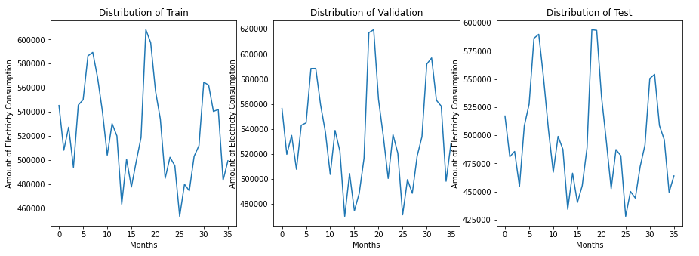
Data Preprocessing
Training, validation and testing set split
275 clients satisfied major group conditions as mentioned in previous slide
Randomly divide 275 clients in to development and test set with ratio (4 : 1), then split the development set to train and validation set with ratio (4 : 1):
development : test = train : validation = 4 : 1

Slide 10
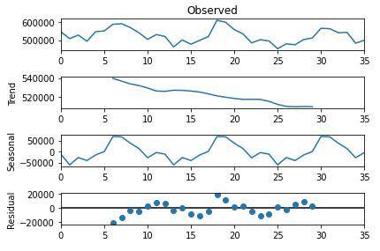
Stationarity Analysis
The trend line obviously shows an approximately constantly decreasing trend
The seasonal plot obviously shows a strong seasonality with period of approximately 12 months
The residuals spreads out regarding to the 0 line, which also reveal a non-stationarity

Slide 11

Stationarity Analysis
For monthly electricity consumption of major group of clients
The test method we chose is the Kwiatkowski–Phillips–Schmidt–Shin (KPSS) test.
The KPSS test has a null hypothesis of “An observed time series is stationary”. The result for the test is：
1
Since our test statistics is greater than the critical value of 1%, the null hypothesis is rejected at 1% level of significance. So we chose to apply the SARIMAX model.

Slide 12
Seasonal Auto-Regressive Integrated Moving Average with exogenous factors (SARIMAX) Prediction Model
Seasonal Auto-Regressive Integrated Moving Average with eXogenous factors, or SARIMAX, is an extension of the ARIMA class of models. Intuitively, ARIMA models compose 2 parts: the autoregressive term (AR) and the moving-average term (MA).
ARIMA only views the value at one time just as a weighted sum of past values. SARIMAX model that same value also as a weighted sum but of past residuals (confer. time series decomposition). There is also an integrated term (I) to difference the time series.

Slide 13
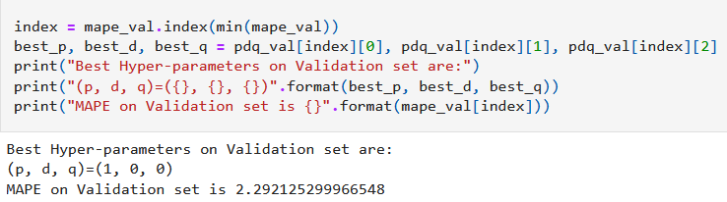
Hyper-parameter Tuning
SARIMAX model takes the parameter of the autoregressive, differences and moving average components, which is corresponding to “p”, “d” and “q”
For choosing the best combination of hyper parameters, we use hyper-parameter tuning on the interval of {0, 1, 2} for each of them, and evaluate their performance on the validation set
As a result, the best combination of hyper parameters is (p, d, q) = (1, 0, 0), which is AR(1)

Slide 14
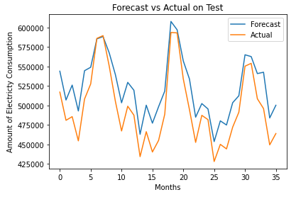
Model Training & Prediction Accuracy Analysis
Model for monthly electricity consumption of major group of clients
SARIMAX model with tuned hyperparameter values to the test set of clients in predicting their monthly electricity consumption. The plot on the left is a comparison between predicted monthly consumption for test set and the actual monthly consumption from 2012 Jan to 2014 Dec

Slide 15
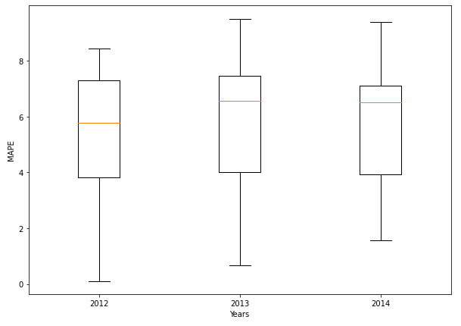
Model Training & Prediction Accuracy Analysis
The overall Mean Absolute Percentage Error(MAPE) result for model on the test set on last slide is 5.60%.
Test set is splited into three equal time periods each with a 12 months length for computing MAPE.
On the left is a box plot to show MAPE value in each time period in predicting the test set’s monthly consumption. As we can see the mean MAPE appears to be smallest in 2012.

Slide 16

Future Improvement
The forecasting done by SARIMAX on the average daily usage seems a bit different compared to the past time series. It follows the correct trend but has a smaller average value. Modifing the hyperparameters to see if a better result can be obtained.
In addtion, different models could be used for comparison.

