Slide 1
ISA formal

Slide 2
ISA formal verification flow we figure
RISC-V:
( official manual )
(L3)
Spec
Machine readable
ADL
SVA
Expected output
Manual
Manual
Auto
ARM:
( official manual )
( official manual )
( Sail )
Assembly program
Verification
result
RTL design
Actual output

Slide 3
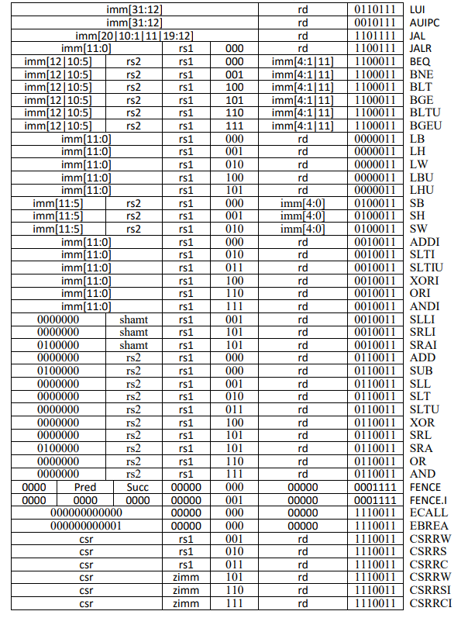
Risc-V version & Instruction
We will try to verify the version of RV32IM vscale processor first.
The open source code link
There are 47 instructions in RV32I version,
but we will research on how to
verify 37 of them in this year.

