Slide 1
The question of RISC-V

Slide 2
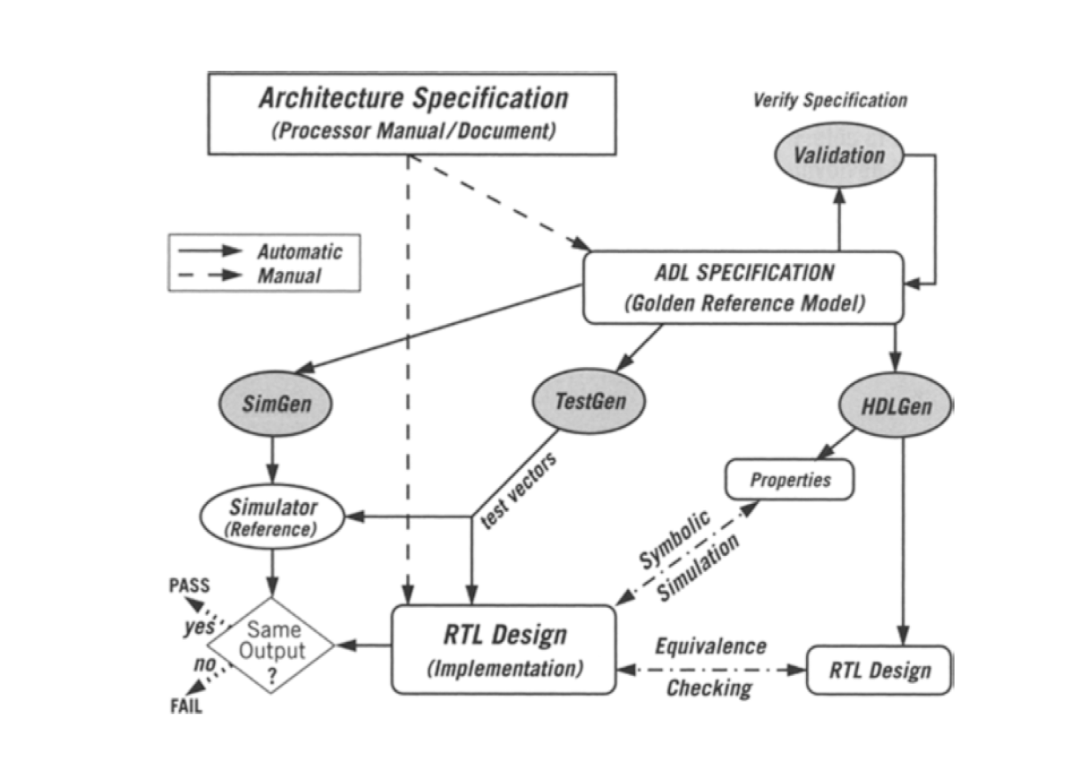
ASL
SPEC
ASL
Autogen Properties
input
RTL Design
SVA
Actual output
Expected output
Validation

Slide 3
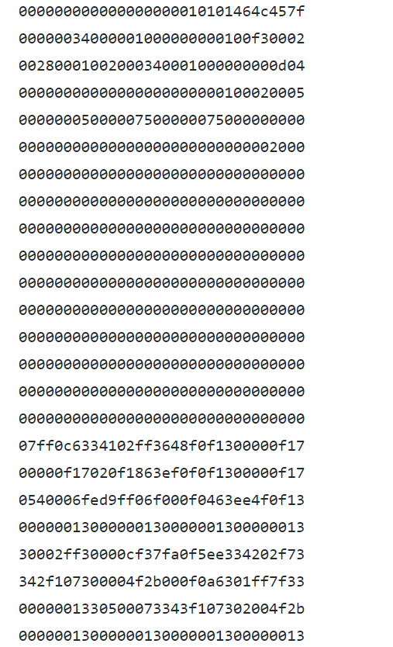
Test bench from RV32IM official website

Slide 4
RV32IM
Website:https://github.com/ucb-bar/vscale/blob/master/src/test/inputs/rv32ui-p-add.hex
RISC-V has many versions,
but the version of RV32IM is the closest to the project of VLSI which we are familiar with .

Slide 5
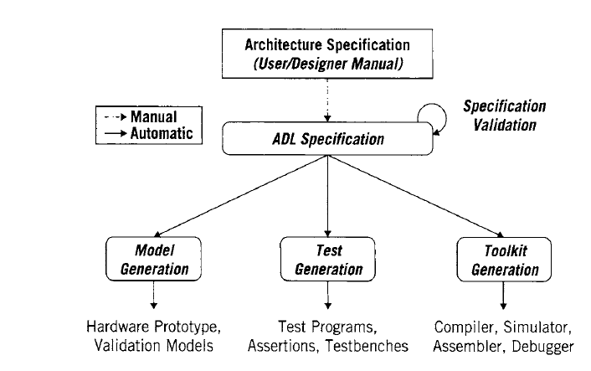
Maybe we can focus on “Specification Validataion”

Slide 6
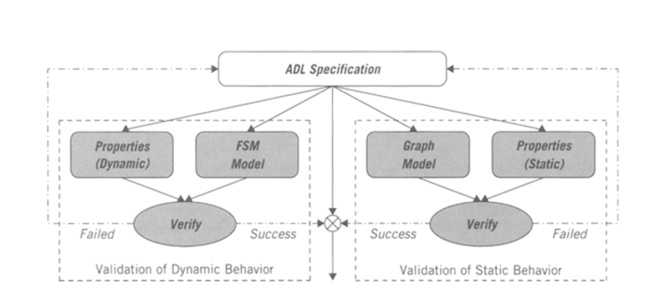
Specification Validataion

Slide 7
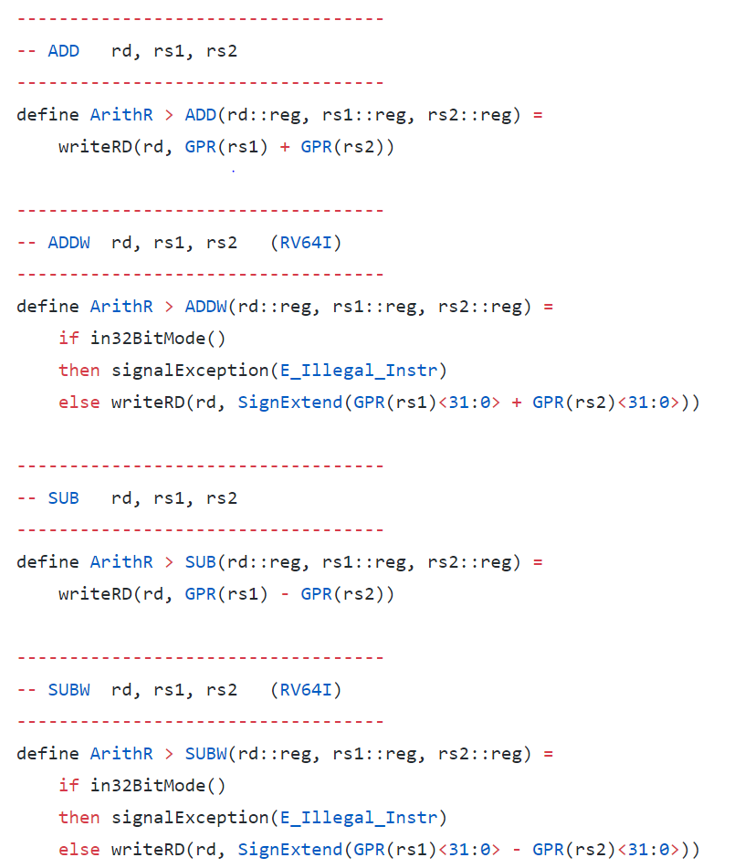
L3
Spec ➔ Machine readable txt file ➔ ASL ➔ SVA
This is not “Machine readable”

