Slide 1
Symbolic, Word-Level Hardware Verification
Randal E. Bryant
Carnegie Mellon University
http://www.cs.cmu.edu/~bryant
Contributions by graduate students:
Sanjit Seshia, Shuvendu Lahiri

Slide 2
Outline
Word-Level Abstraction of Hardware
  Abstract details of data
    While keeping detailed control and cycle-level timing
  Enables verification of entire system
Automated Formal Verification
  Provide capabilities similar to model checking
  Automate via automatic predicate abstraction

Slide 3
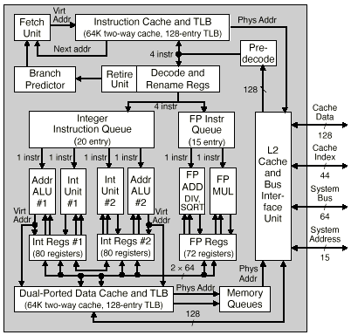
Challenge: System-Level Verification
Verification Task
  Does processor implement its ISA?
Why is it Hard?
  Lots of internal state
  Complex control logic
  Complex functionality
Alpha 21264 Microprocessor
Microprocessor Report, Oct. 28, 1996

Slide 4
Sources of Complexity
State
  ISA: registers, memory
  Microarchitectural: caches, buffers, reservation stations
  Conceptually finite state, but practically unbounded
Control
  Pipelines spread execution across multiple cycles
  Out-of-order execution modifies processing order
  Superscalar operation creates parallelism
  Control logic coordinates everything
    Resulting behavior matches that of sequential ISA model
Functionality
  Arithmetic functions, instruction decoding

Slide 5
Existing Verification Methods
  Simulators, equivalence checkers, model checkers, …
All Operate at Bit Level
  RTL model
    State encoded as words and arrays of words
    Comprised of bits
Most Operate at Cycle or Subcycle Level
  How each bit of state gets updated
System Modeling Languages
  Abstract time up to transaction level
  Still view state as collection of bits

Slide 6
Word-Level Abstraction
Control Logic
Data Path
Com.
Log.
1
Com.Log.
2
Data: Abstract details of form & functions
Control: Keep at bit level
Timing: Keep at cycle level

Slide 7
Data Abstraction #1: Bits → Integers
x₀
x₁
x₂
⇒
x
x_{n-1}
View Data as Symbolic Words
  Arbitrary integers
    No assumptions about size or encoding
    Classic model for reasoning about software
  Can store in memories & registers

Slide 8
Modeling Data Selection
If-Then-Else Operation
  Mulitplexor
  Allows control-dependent data flow
p
1
0
x
1
0
x
1
0
x
1
0
ITE(p, x, y)
x
y
y
y
y

Slide 9
Abstracting Data Bits
Control Logic
Data Path
Data Path
?
Com.
Log.
1
Com.
Log.
1
?
Com.Log.
2
Com.
Log.
1
What do we do about logic functions?

Slide 10
Abstraction #2:
Uninterpreted Functions
f
ALU
For any Block that Transforms or Evaluates Data:
  Replace with generic, unspecified function
  Only assumed property is functional consistency:
    a = x ∧ b = y ⇒ f (a, b) = f (x, y)

Slide 11
Abstracting Functions
Control Logic
Data Path
Com.
Log.
1
F₁
Com.
Log.
1
F₂
For Any Block that Transforms Data:
  Replace by uninterpreted function
  Ignore detailed functionality
  Conservative approximation of actual system

Slide 12
Modeling Data-Dependent Control
Branch?
Cond
Adata
p
Branch
Logic
Bdata
Model by Uninterpreted Predicate
  Yields arbitrary Boolean value for each control + data combination
  Produces same result when arguments match
    Pipeline & reference model will branch under same conditions

Slide 13
Abstraction #3: Modeling Memories as Mutable Functions
Memory M Modeled as Function
  M(a): Value at location a
Initially
  Arbitrary state
  Modeled by uninterpreted function m₀
M
a
M
a
m₀

Slide 14
Effect of Memory Write Operation
Writing Transforms Memory
  M′ = Write(M, wa, wd)
  Reading from updated memory:
    Address wa will get wd
    Otherwise get what’s already in M
Express with Lambda Notation
  Notation for defining functions
  M′ =
  λ a . ITE(a = wa, wd, M(a))
M′
wa
=
wd
a
1
0
M

Slide 15
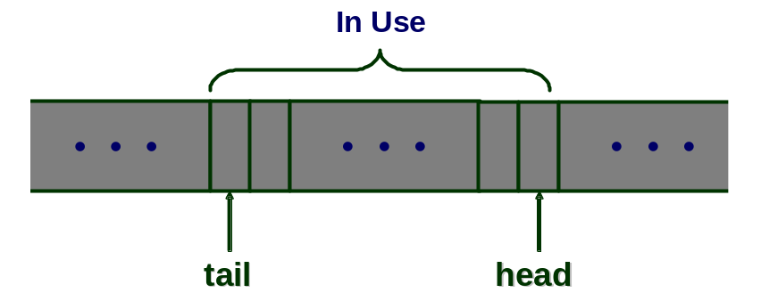
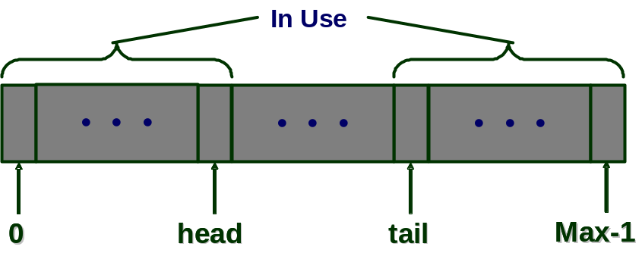
Systems with Buffers
Unbounded Buffer
Circular Queue
Modeling Method
  Mutable function to describe buffer contents
  Integers to represent head & tail pointers

Slide 16
Some History
Historically
  Standard model used for program verification
  Widely used with theorem-proving approaches to hardware verification
    E.g, Hunt ’85
Automated Approaches to Hardware Verification
  Burch & Dill, ’95
    Tool for verifying pipelined microprocessors
    Implemented by form of symbolic simulation
  Continued application to pipelined processor verification

Slide 17
UCLID
  Seshia, Lahiri, Bryant, CAV ‘02
Term-Level Verification System
  Language for describing systems
    Inspired by CMU SMV
  Symbolic simulator
    Generates integer expressions describing system state after sequence of steps
  Decision procedure
    Determines validity of formulas
  Support for multiple verification techniques
Available by Download
  http://www.cs.cmu.edu/~uclid

Slide 18
Challenge: Model Generation
  How to generate term-level model
  How to guarantee faithfulness to RTL description
Comparison of Models
  RTL
    Abstracts functional elements from gate-level model
    Synthesis allows automatic map to gate level
  Term level
    Abstracts bit-level data representations to words
    Abstracts memories to mutable functions
    No direct connection to synthesizable model

Slide 19
Generating Term-Level Model
Manually Generate from RTL
  How do we know it is a valid abstraction?
  Hard to keep consistent with changing RTL
Automatically Generate from RTL
  Andraus & Sakallah, DAC ‘04
  Must decide which signals to keep Boolean, which to abstract
    Confused by bit field extraction primitives of HDL
Synthesize RTL from Word-Level Model
  Difficult to make efficient

Slide 20
Underlying Logic
Existing Approaches to Formal Verification
  E.g., symbolic model checking
  State encoded as fixed set of bits
    Finite state system
    Amenable to Boolean methods (SAT, BDDs)
Our Task
  State encoded with unbounded data types
    Arbitrary integers
    Functions over integers
  Must use decision procedures
    Determine validity of formula in some subset of first-order logic
    Adapt methods historically used by automated theorem provers

Slide 21
EUF: Equality with Uninterp. Functs
  Decidable fragment of first order logic
Formulas (F ) Boolean Expressions
    ¬F, F₁ ∧ F₂, F₁ ∨ F₂ Boolean connectives
    T₁ = T₂ Equation
    P (T₁, …, T_{k}) Predicate application
Terms (T ) Integer Expressions
    ITE(F, T₁, T₂) If-then-else
    Fun (T₁, …, T_{k}) Function application
Functions (Fun) Integer → Integer
    f Uninterpreted function symbol
λ x₁, …, x_{k} . T Function lambda expression
Predicates (P) Integer → Boolean
    p Uninterpreted predicate symbol

Slide 22
EUF Decision Problem
Circuit Representation of Formula
  Truth Values
    Dashed Lines
    Logical connectives
    Equations
  Integer Values
    Solid lines
    Uninterpreted functions
    If-Then-Else operation
Task
  Determine whether formula F is universally valid
    True for all interpretations of variables and function symbols
      E.g., all values of integer x₀ & d₀, all Booleans e₀ and e₁, and all integer functions f
e
e
1
1
f
f
T
T
F
F
∧
∧
e
¬
e
¬
0
0
=
=
x
x
f
f
∨
0
0
T
T
∨
F
=
=
F
T
T
F
d
F
d
0
0

Slide 23
Finite Model Property for EUF
e
e
1
1
f
f
T
T
F
F
∧
∧
x₀
d₀
f (x₀)
f (d₀)
e
¬
e
¬
0
0
=
=
x
x
f
f
∨
0
0
T
T
∨
F
=
=
F
T
T
F
d
F
d
0
0
Observation
  Any formula has limited number of distinct expressions
  Only property that matters is whether or not different terms are equal

Slide 24
Boolean Encoding of Integer Values
Expression | Possible Values | Bit Encoding
x₀ | {0} | 0 | 0
d₀ | {0,1} | 0 | b₁₀
f (x₀) | {0,1,2} | b₂₁ | b₂₀
f (d₀) | {0,1,2,3} | b₃₁ | b₃₀
For Each Expression
  Either equal to or distinct from each preceding expression
Boolean Encoding
  Use Boolean values to encode integers over small range
  EUF formula can be translated into propositional logic
    Logic circuit with multiplexors, comparators, logic gates
    Tautology iff original formula valid

Slide 25
Some History of EUF Decision Procedures
  Ackermann, 1954
    Quantifier-free decision problem can be decided based on finite instantiations
  Burch & Dill, CAV ‘94
    Automatic decision procedure
      Davis-Putnam enumeration
      Congruence closure to enforce functional consistency
  Boolean approaches
    Goel, et al, CAV ‘98
      Attempted with BDDs, but didn’t get good results
    Bryant, German, Velev, CAV ‘99
      Could verify microprocessor using BDDs
    Velev & Bryant, DAC 2001
      Demonstrated power of modern SAT procedures

Slide 26
UCLID Operation
Symbolic
Simulation
file.ucl
UCLID
Formula
Model
+
Specification
Lambda
Expansion
λ-free
Formula
Function
&
Predicate
Elimination
Operation
  Series of transformations leading to propositional formula
  Except for lambda expansion, each has polynomial complexity
Term
Formula
Finite
Instantiation
Boolean
Formula
Boolean
Satisfiability

Slide 27
UCLID Example
Boolean state
DLX Pipeline
  Single-issue, 5-stage pipeline
Integer state
Function state
Pipeline
Write
Back
Fetch
Decode
Execute
Memory
pc
fd
de
em
mw
Branch
Arg1
Target
RF
Arg2
Value
Mem
Instr
Instr
Arg2
Type
Type
Instr
Data
pPC
PC
PC
Type
Dest
Valid
Valid
Valid
Valid

Slide 28
Writing & Reading Register File
Write
Back
Decode
fd
de
mw
Arg1
src1
RF
Arg2
Instr
src2
Data
Dest
Valid

Slide 29
Writing Register File
init[RF] := rf0; (* Uninterpreted Function *)
next[RF] := Lambda(a) .
case
mw_Valid & (a = mw_Dest) : mw_Data;
default : RF(a);
esac;
Write
Back
mw
RF
Data
Dest
Valid

Slide 30
Reading Register File
init[de_Arg1] := dea10; (* Initially arbitary *)
next[de_Arg1] := next[RF](src1(fd_Instr));
init[de_Arg2] := dea20; (* Initially arbitary *)
next[de_Arg2] := next[RF](src2(fd_Instr));
Decode
fd
de
Write-before-read semantics
Arg1
src1
RF
Arg2
Instr
src2

Slide 31
Verifying Safety Properties
Present
State
Next
State
Bad
States
δ
Reachable
States
Reset
States
Reset
Inputs
(Arbitrary)
State Machine Model
  State encoded as Booleans, integers, and functions
  Next state function expresses how updated on each step
Prove: System will never reach bad state

Slide 32
Bounded Model Checking
Reachable
Bad
States
R_{n}
• • •
R₂
R₁
Repeatedly Perform Image Computations
  Set of all states reachable by one more state transition
Easy to Implement
Underapproximation of Reachable State Set
  But, typically catch most bugs with 8–10 steps
Reset
States

Slide 33
True Model Checking
δ
Bad
States
R_{n}
• • •
R₂
R₁
Impractical for Term-Level Models
  Many systems never reach fixed point
    Can keep adding elements to buffer
  Convergence test undecidable
Reset
States
Reach Fixed-Point
  R_{n} = R_{n+1} = Reachable

Slide 34
Inductive Invariant Checking
δ
Bad
States
I
Reachable
States
Reset
States
Key Properties of System that Make it Operate Correctly
  Formulate as formula I
Prove Inductive
  Holds initially I(s₀)
  Preserved by all state changes I(s) ⇒ I(δ(i, s))

Slide 35
An Out-of-order Processor (OOO)
incr
D
E
C
O
D
E
valid tag val
dispatch
Program
memory
PC
valid
value
src1valid
src1val
src1tag
src2valid
src2val
src2tag
dest
op
result
Register
Rename Unit
1st
Operand
result bus
retire
ALU
2nd
Operand
execute
head
tail
Reorder
Buffer
Reorder Buffer
Fields
Data Dependencies Resolved by Register Renaming
  Map register ID to instruction in reorder buffer that will generate register value
Inorder Retirement Managed by Retirement Buffer
  FIFO buffer keeping pending instructions in program order

Slide 36
OOO Invariants
Split into Formulas I₁, …, I_{n}
  I_{j}(s₀) holds for any initial state s₀, for 1 ≤ j ≤ n
  I₁(s) ∧ I₂(s) ∧ … ∧ I_{n}(s) ⇒ I_{j}(s′ ) for any current state s and successor state s′ for 1 ≤ j ≤ n
Invariants for OOO (13)
  Refinement maps (2)
    Show relation between ISA and OOO models
  State consistency (8)
    Properties of OOO state that ensure proper operation
  Added state (3)
    Shadow values correctly predict OOO values
Overall Correctness
  Follows by induction on time

Slide 37
State Consistency Invariant Examples
Register Renaming invariants (2)
  Tag in a rename-unit should be in the ROB, and the destination register should match
    ∀r.¬reg.valid(r)⇒ (rob.head ≤ reg.tag(r) < rob.tail ∧ rob.dest(reg.tag(r)) = r )
  For any entry, the destination should have reg.valid as false and tag should contain this or later instruction
    ∀_{rob}t.(¬reg.valid(rob.dest(t)) ∧
      t ≤ reg.tag(rob.dest(t)) < rob.tail)

Slide 38
Extending the OOO Processor
  base
    Executes ALU instructions only
  exc
    Handles arithmetic exceptions
    Must flush reorder buffer
  exc/br
    Handles branches
    Predicts branch & speculatively executes along path
  exc/br/mem-simp
    Adds load & store instructions
    Store commits as instruction retires
  exc/br/mem
    Stores held in buffer
    Can commit later
    Loads must scan buffer for matching addresses

Slide 39
Comparative Verification Effort
 | base | exc | exc / br | exc / br / mem-simp | exc / br / mem
Total Invariants | 13 | 34 | 39 | 67 | 71
Manually instantiate | 0 | 0 | 0 | 4 | 8
UCLID time | 54 s | 236 s | 403 s | 1594 s | 2200 s
Person time | 2 days | 7 days | 9 days | 24 days | 34 days
(Person time shown cumulatively)

Slide 40
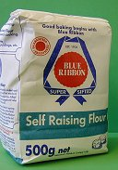
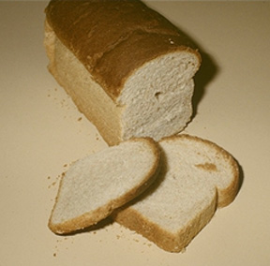
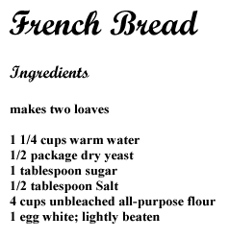

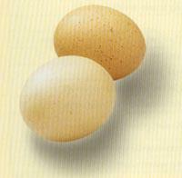
“I Just Want a Loaf of Bread”
Ingredients
Recipe
Result

Slide 41
Cooking with Invariants
Ingredients: Predicates
rob.head ≤ reg.tag(r)
Recipe: Invariants
∀r,t.¬reg.valid(r) ∧ reg.tag(r) = t
⇒
(rob.head ≤ reg.tag(r) < rob.tail
∧ rob.dest(t) = r )
reg.valid(r)
reg.tag(r) = t
Result: Correctness
rob.dest(t) = r

Slide 42
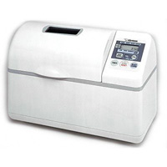
Automatic Recipe Generation
Ingredients
Recipe Creator
Result
Want Something More
  Given any set of ingredients
  Generate best recipe possible

Slide 43
Automatic Predicate Abstraction
  Graf & Saïdi, CAV ‘97
Idea
  Given set of predicates P₁(s), …, P_{k}(s)
    Boolean formulas describing properties of system state
  View as abstraction mapping: States → {0,1}^{k}
  Defines abstract FSM over state set {0,1}^{k}
    Form of abstract interpretation
    Do reachability analysis similar to symbolic model checking
Implementation
  Early ones had weak inference capabilities
    Call theorem prover or decision procedure to test each potential transition
  Recent ones make better use of symbolic encodings

Slide 44
Abstract State Space
Abstraction
Concretization
⟨P₁(s), …, P_{k}(s)⟩
Abstract
States
Abstract
States
Abstraction
Function
α
Concretization
Function
γ
Concrete
States
Concrete
States
s
t
s
t

Slide 45
Abstract State Machine
Abstract Transition
Abstract
System
Concretize
γ
Abstract
α
Concrete
System
Concrete Transition
s
s′
t
t′
  Transitions in abstract system mirror those in concrete

Slide 46
Generating Concrete Invariant
δ_{A}
R_{n}
Reach Fixed-Point on Abstract System
  Termination guaranteed, since finite state
Equivalent to Computing Invariant for Concrete System
  Strongest possible invariant that can be expressed by formula over these predicates
• • •
R₂
Abstract
System
R₁
Reset
States
Concretize
γ
δ_{C}
I
Concrete
System
Reset
States

Slide 47
Predicate Abstraction Example
State Space
  State variables: { x, y }
Initial State
  { (2, 1) }
Next State Behavior
  x → −x
  y → −y
Verification Task
  Prove all bad states unreachable
Initial
State
Bad
States

Slide 48
Precise Analysis
Reachable States
  { (2, 1), (−2, −1) }
Reachable
States
Bad
States

Slide 49
Predicates
c_{x:3}
c_{x:y}
c_{y:0}
L
L
E
G
E
E
G
G
L
  Use 3-valued predicates in this example

Slide 50
Abstract Initial State
c_{x:3}
c_{x:y}
c_{y:0}
L
G
G
Reached Set #0
{ LGG }

Slide 51
Step 1: Concretize Reached Set #0
Reached Set #0
{ LGG }
(Note loss of precision)
Concretize
Concretize
Concretize
γ
γ
γ
s
s
s
c_{x:3}
c_{x:y}
c_{y:0}
L
G
G

Slide 52
Compute Possible Successor States
  x → −x
  y → −y
Concretize
Concretize
Concretize
γ
γ
γ
Concrete Transition
Concrete Transition
Concrete Transition
′
′
s
′
s
s
s
s
s

Slide 53
Abstract Newly Reached States
c_{x:3}
c_{x:y}
c_{y:0}
L
L
L
0
0
0
Concretize
Reached Set #1
{ LLL, LGG }
Concretize
Concretize
Abstract
Abstract
γ
Abstract
γ
γ
α
α
α
Concrete Transition
Concrete Transition
Concrete Transition
′
′
s
′
s
s
s
s
s

Slide 54
Step 2: Concretize Reached Set #1
Reached Set #1
{ LLL, LGG }
(Note loss of precision)
Concretize
Concretize
Concretize
γ
γ
γ
s
s
s
c_{x:3}
c_{x:y}
c_{y:0}
L
L
L

Slide 55
Compute Possible Successor States
  x → −x
  y → −y
Concretize
Concretize
Concretize
γ
γ
γ
Concrete Transition
Concrete Transition
Concrete Transition
′
′
s
′
s
s
s
s
s

Slide 56
Abstract Newly Reached States
c_{x:3}
c_{x:y}
c_{y:0}
G
E
G
G
Concretize
Reached Set #2
{ LLL, LGG, EGG, GGG }
Concretize
Concretize
Abstract
Abstract
γ
Abstract
γ
γ
α
α
α
Concrete Transition
Concrete Transition
Concrete Transition
′
′
s
′
s
s
s
s
s

Slide 57
Final Reached State Set
EGG
LGG
GGG
LLL
Bad
States

Slide 58
Quantified Invariant Generation
  Lahiri, Bryant, VMCAI 2004
  User supplies predicates containing free variables
  Generate globally quantified invariant
Example
  Predicates
    p₁: reg.valid(r)
    p₂: rob.dest(t) = r
    p₃: reg.tag(r) = t
  Abstract state satisfying (p₁ ∨ p₂ ∨ ¬p₃) corresponds to concrete state satisfying
  ∀r,t[¬reg.valid(r) ∧ reg.tag(r) = t ⇒ rob.dest(t) = r]

Slide 59
Systems Verified with Predicate Abstraction
Model | Predicates | Iterations | CPU Time
Out-Of-Order Execution Unit | 25 | 9 | 1,207s
German’s Cache Protocol | 13 | 9 | 14s
German’s Protocol, unbounded channels | 24 | 17 | 427s
Bounded Retransmission Buffer | 22 | 9 | 11s
Lamport’s Bakery Algorithm | 33 | 18 | 471s
  Very general models
    Unbounded processes, buffers, cache lines, …
  Safety properties only

Slide 60
Predicate Abstraction Convergences
  Powerful method for generating & evaluating abstract model of system
  Applicable to variety of systems with different modeling levels
 | Hardware | Software
Word-Level | UCLID Seshia, Lahiri, Bryant, CAV ‘02 | SLAM Ball, Rajamani, SPIN ‘01
Bit-Level | Clarke, Talupar, Wang, SAT ‘03 | CBMC Kroening, Clarke, ICCAD ‘04

Slide 61
Ongoing Research Areas
Decision Procedures
  Expand class of logic
    Linear relations
  Improved encoding techniques
  Application to software & hardware verification
Predicate Abstraction
  Improving efficiency
    Increases rapidly with number of predicates
  Automatic generation of predicates
    Based on property to be verified & system model
Real-Life Application
  Closing gap with actual hardware models

