Slide 1
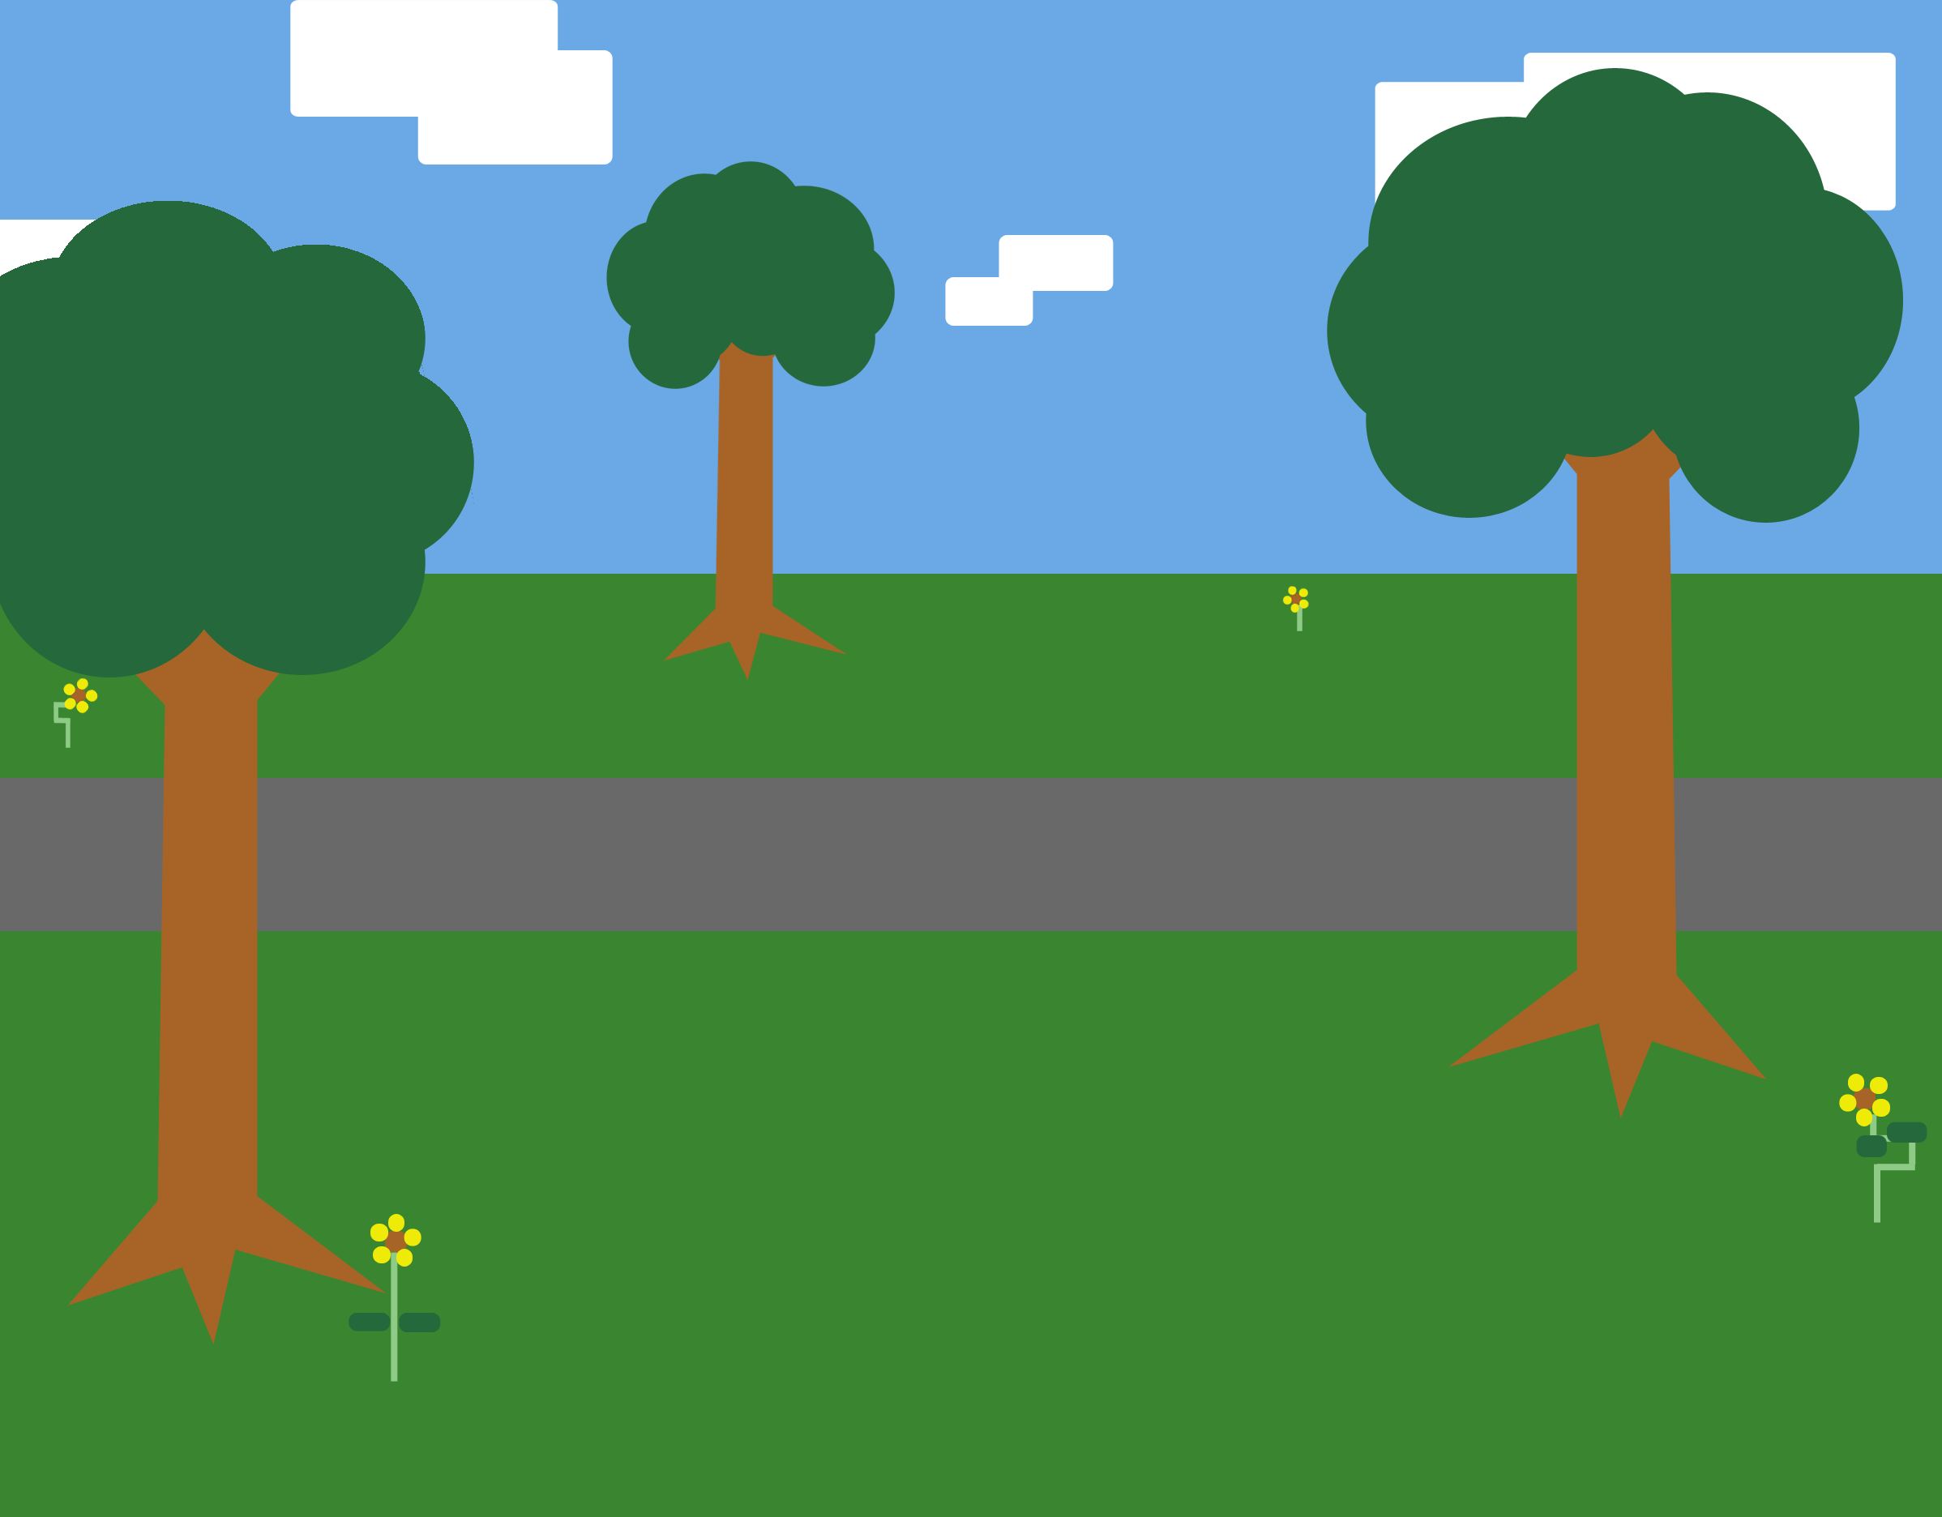
PitchIn With Us!
Group Members:
Deanna, Jenny, Steven
Sustainability & Social Impact

Slide 2
What is PitchIn?
PitchIn is an app that unites litter data and its users interactively!
Dataset: A sample of litter data provided by the City of Philadelphia
Maps compiled data and visualizes which parts of your cities are most litter prone with a heat map
Local users of their communities can contribute their efforts and "pitch in” to reduce scattered litter. Users are helping to clean up the community one piece of litter at a time.
This app incentivizes community clean up and brings people together in building a cleaner and sustainable environment

Slide 3
Why “Litter”?
Neighborhoods with more litter have lower real estate values and less pride
Potential safety and fire hazard
Harms plants & wildlife and degrades natural areas
Discourages economic development
Source: Pennsylvania DOT
http://www.penndot.gov/about-us/RoadsideBeautification/LitterFacts/Pages/Litter-Facts-and-Myths.aspx

Slide 4
Bettering Communities
A litter-free environment is a benefit for all
Community pride and improved quality of life
Inspiring contributors to further change (policy making, larger collaborative efforts, addressing public spending)

Slide 5
Everyone is affected by litter so let’s “PitchIn” our effort

Slide 6
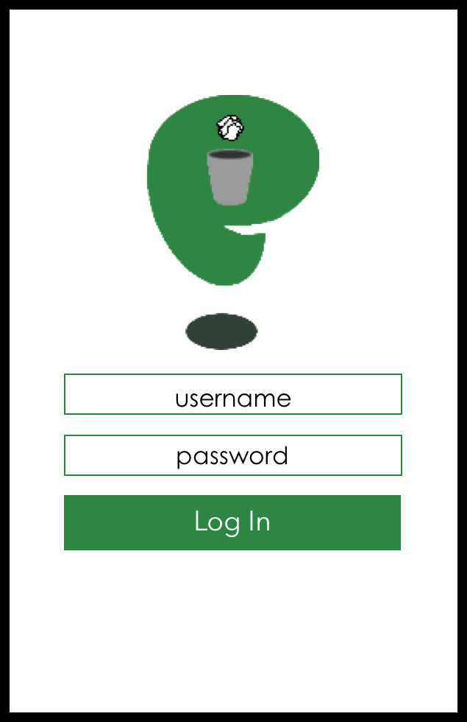
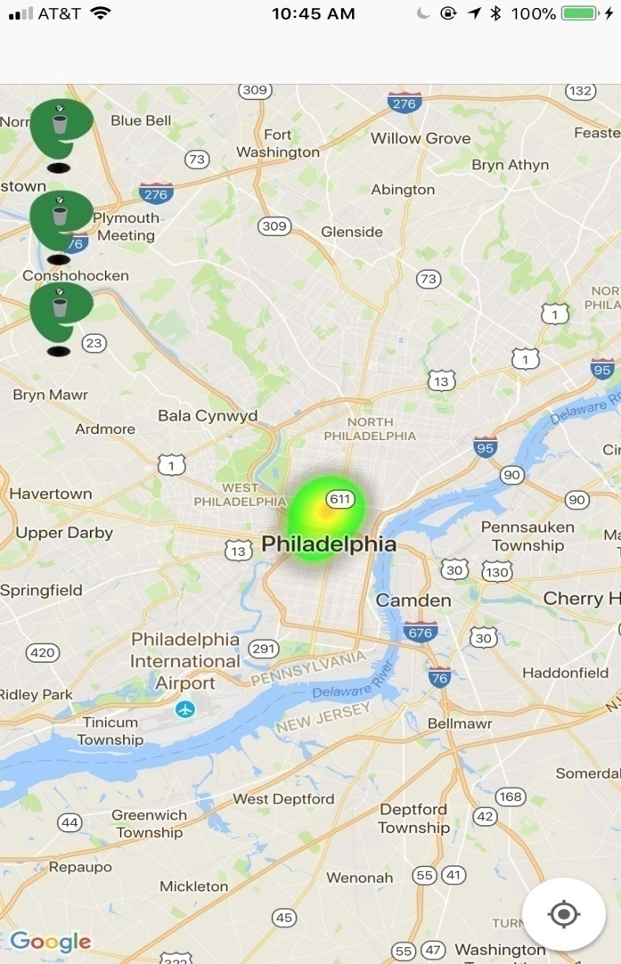
How to use the app?

Slide 7
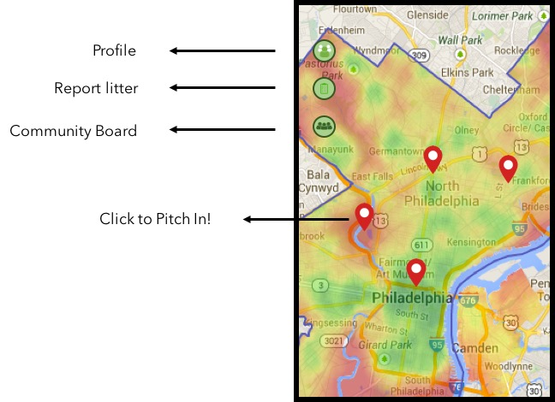
Main Page

Slide 8
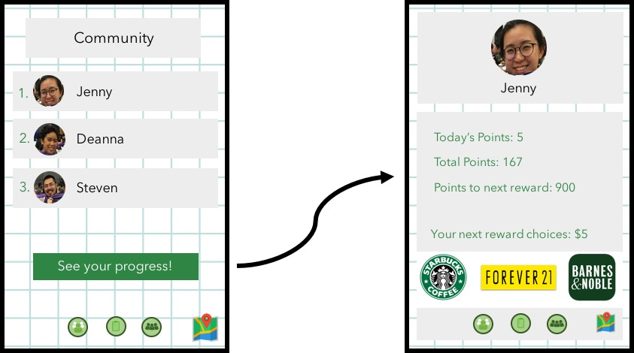
User Community
Your Profile

Slide 9
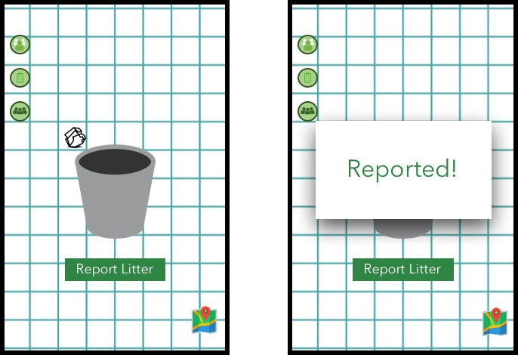
Reporting

Slide 10
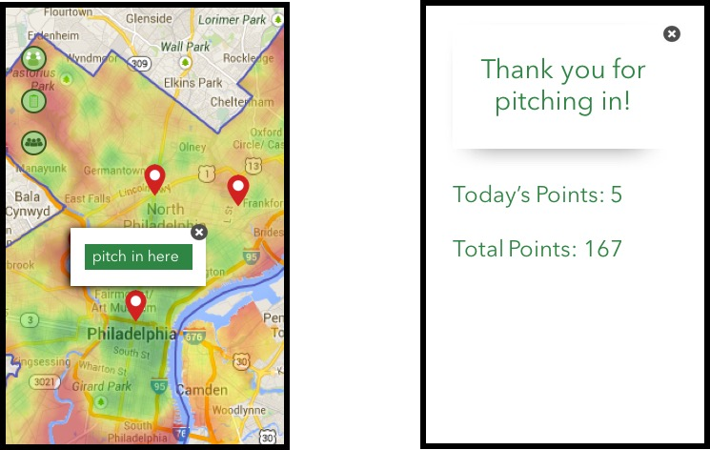
Pitching In

Slide 11
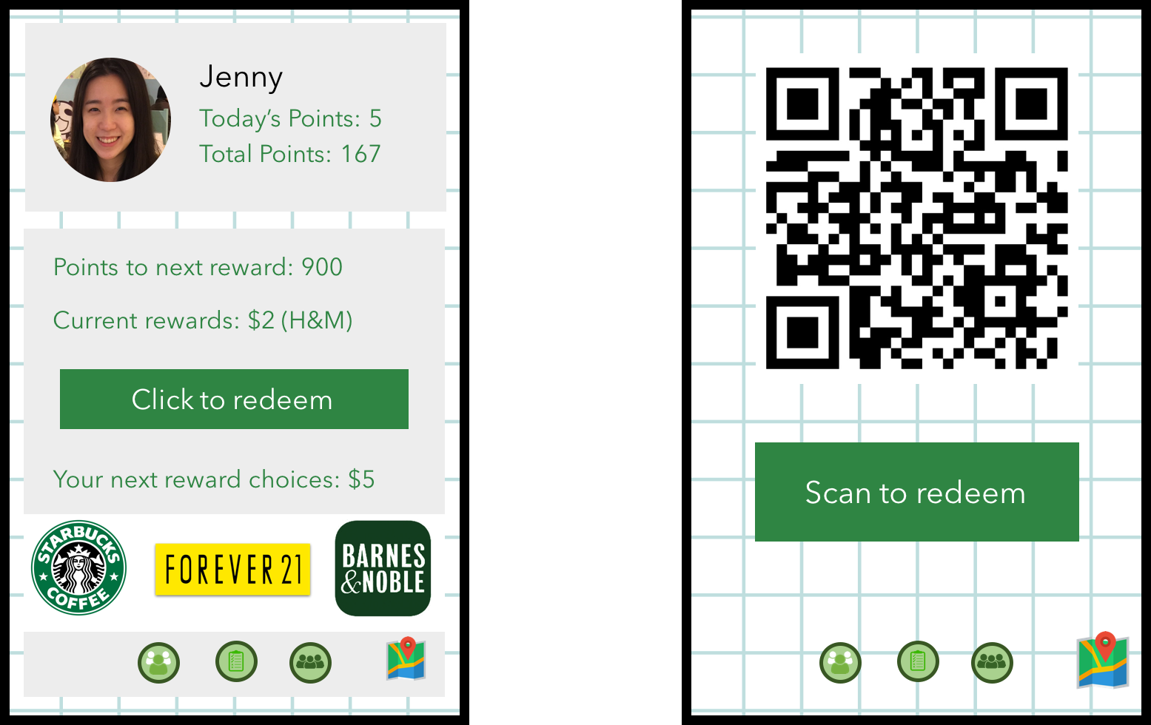
Rewards

Slide 12
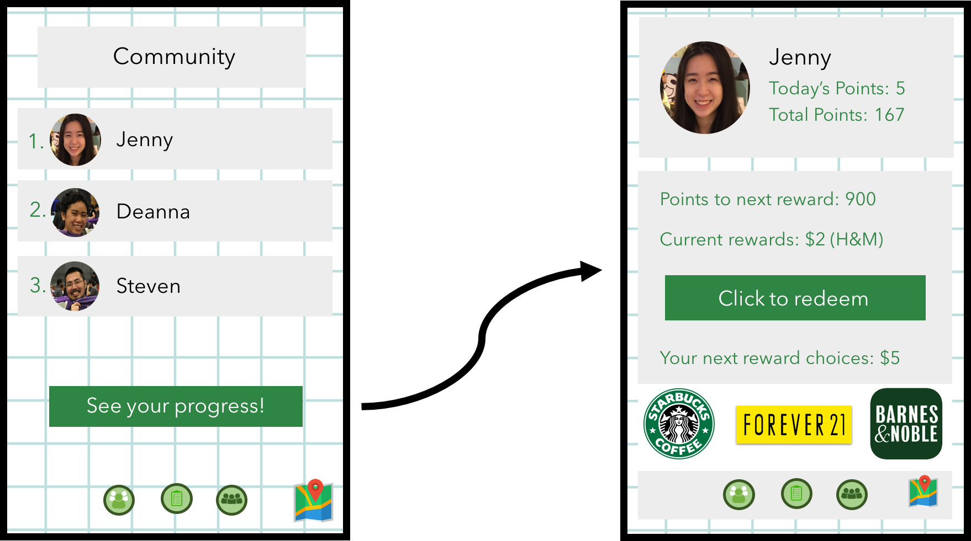
Your local community contributors

Slide 13
Scalability
Implementing AI :
Quickly assess the amount of litter in a photograph or live feed
Recognize and document the different categories of litter
Worldwide Applicability
Can be implemented anywhere especially cities

Slide 14
Scalability (cont’d)
Applicable to Other Datasets (i.e. Disaster Recovery)
Professionals assess environment damage and compile the data such as debris, mudslides, fallen trees, trash, etc.
Can use the compiled data to map and visualize what needs to be serviced/cleaned/removed
Volunteers and professionals can then use the app to keep the database updated
Connect the members of the community, especially volunteers and professionals
Data trends from the community crowd-funded data to visualize positive changes and contributions

Slide 15
A thank you to the sponsors and to the rest of the HackNYU community

