Slide 1
CS 61C: Great Ideas in Computer Architecture Intro to Assembly Language, MIPS Intro
Instructors:
Krste Asanovic & Vladimir Stojanovic
http://inst.eecs.Berkeley.edu/~cs61c/sp15

Slide 2
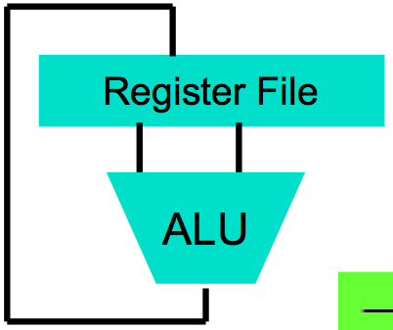
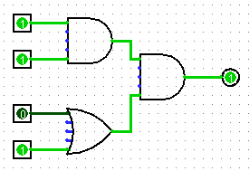
Levels of Representation/Interpretation
High Level Language Program (e.g., C)
temp = v[k];
v[k] = v[k+1];
v[k+1] = temp;
Compiler
Anything can be represented as a number, i.e., data or instructions
lw $t0, 0($2)
lw $t1, 4($2)
sw $t1, 0($2)
sw $t0, 4($2)
Assembly Language Program (e.g., MIPS)
Assembler
0000 1001 1100 0110 1010 1111 0101 1000
1010 1111 0101 1000 0000 1001 1100 0110
1100 0110 1010 1111 0101 1000 0000 1001
0101 1000 0000 1001 1100 0110 1010 1111
Machine Language Program (MIPS)
Machine Interpretation
Hardware Architecture Description (e.g., block diagrams)
Architecture Implementation
Logic Circuit Description (Circuit Schematic Diagrams)

Slide 3
From last lecture …
Computer words and vocabulary are called instructions and instruction set respectively
MIPS is example RISC instruction set used in CS61C
Rigid format: 1 operation, 2 source operands, 1 destination
add,sub,mul,div,and,or,sll,srl,sra
lw,sw,lb,sb to move data to/from registers from/to memory
beq, bne, j, slt, slti for decision/flow control
Simple mappings from arithmetic expressions, array access, in C to MIPS instructions

Slide 4
Review: Components of a Computer
Memory
Processor
Input
Enable?
Read/Write
Control
Program
Datapath
Address
Bytes
Program Counter
Registers
Write Data
Data
Arithmetic & Logic Unit
(ALU)
ReadData
Output
Processor-Memory Interface
I/O-Memory Interfaces

Slide 5
How Program is Stored
Memory
Program
Bytes
One MIPS Instruction = 32 bits
Data

Slide 6
How Program is Executed: Instruction Fetch
Memory
Processor
Read Instruction Bits
Control
Program
Datapath
Instruction
Address
Bytes
Program Counter
Registers
Data
Arithmetic & Logic Unit
(ALU)
The program counter (internal register inside processor) holds address of next instruction to be executed

Slide 7
Computer Decision Making
Based on computation, do something different
In programming languages: if-statement
MIPS: if-statement instruction is
beq register1,register2,L1
means: go to statement labeled L1 if (value in register1) == (value in register2)
….otherwise, go to next statement
beq stands for branch if equal
Other instruction: bne for branch if not equal

Slide 8
Types of Branches
Branch – change of control flow
Conditional Branch – change control flow depending on outcome of comparison
branch if equal (beq) or branch if not equal (bne)
Unconditional Branch – always branch
a MIPS instruction for this: jump (j)

Slide 9
Example if Statement
Assuming translations below, compile if block
f → $s0 g → $s1 h → $s2
i → $s3 j → $s4
if (i == j) bne $s3,$s4,Exit
f = g + h; add $s0,$s1,$s2
Exit:
May need to negate branch condition

Slide 10
Example if-else Statement
Assuming translations below, compile
f → $s0 g → $s1 h → $s2
i → $s3 j → $s4
if (i == j) bne $s3,$s4,Else
f = g + h; add $s0,$s1,$s2
else j Exit
f = g – h; Else: sub $s0,$s1,$s2
Exit:

Slide 11
Inequalities in MIPS
Until now, we’ve only tested equalities (== and != in C). General programs need to test < and > as well.
Introduce MIPS Inequality Instruction:
“Set on Less Than”
Syntax: slt reg1,reg2,reg3
Meaning: if (reg2 < reg3) reg1 = 1; else reg1 = 0;
“set” means “change to 1”, “reset” means “change to 0”.

Slide 12
Inequalities in MIPS Cont.
How do we use this? Compile by hand: if (g < h) goto Less; #g:$s0, h:$s1
Answer: compiled MIPS code…
slt $t0,$s0,$s1 # $t0 = 1 if g<h bne $t0,$zero,Less # if $t0!=0 goto Less
Register $zero always contains the value 0, so bne and beq often use it for comparison after an slt instruction
sltu treats registers as unsigned

Slide 13
Immediates in Inequalities
slti an immediate version of slt to test against constants
Loop: . . . slti $t0,$s0,1 # $t0 = 1 if # $s0<1 beq $t0,$zero,Loop # goto Loop # if $t0==0 # (if ($s0>=1))

Slide 14
Clickers/Peer Instruction
Label: sll $t1,$s3,2 addu $t1,$t1,$s5 lw $t1,0($t1)
add $s1,$s1,$t1 addu $s3,$s3,$s4 bne $s3,$s2,Label
What is the code above?
A: while loop
B: do … while loop
C: for loop
D: Not a loop
E: Dunno

Slide 15
Clickers/Peer Instruction
Simple loop in C; A[] is an array of ints
do { g = g + A[i]; i = i + j; } while (i != h);
Use this mapping: g, h, i, j, &A[0] $s1, $s2, $s3, $s4, $s5
Loop: sll $t1,$s3,2 # $t1= 4*i addu $t1,$t1,$s5 # $t1=addr A+4i lw $t1,0($t1) # $t1=A[i] add $s1,$s1,$t1 # g=g+A[i] addu $s3,$s3,$s4 # i=i+j bne $s3,$s2,Loop # goto Loop # if i!=h

Slide 16
Six Fundamental Steps in Calling a Function
Put parameters in a place where function can access them
Transfer control to function
Acquire (local) storage resources needed for function
Perform desired task of the function
Put result value in a place where calling program can access it and restore any registers you used
Return control to point of origin, since a function can be called from several points in a program

Slide 17
MIPS Function Call Conventions
Registers faster than memory, so use them
$a0–$a3: four argument registers to pass parameters
$v0–$v1: two value registers to return values
$ra: one return address register to return to the point of origin
Notes:
$at – assembler temporary register, used for pseudo instructions

Slide 18
Instruction Support for Functions (1/4)
... sum(a,b);... /* a,b:$s0,$s1 */ } int sum(int x, int y) { return x+y; }
address (shown in decimal) 1000 1004 1008 1012 1016 … 2000 2004
C
M I P S
In MIPS, all instructions are 4 bytes, and stored in memory just like data. So here we show the addresses of where the programs are stored.

Slide 19
Instruction Support for Functions (2/4)
... sum(a,b);... /* a,b:$s0,$s1 */ } int sum(int x, int y) { return x+y; }
address (shown in decimal) 1000 add $a0,$s0,$zero # x = a 1004 add $a1,$s1,$zero # y = b 1008 addi $ra,$zero,1016 #$ra=1016 1012 j sum #jump to sum 1016 … # next instruction … 2000 sum: add $v0,$a0,$a1 2004 jr $ra # new instruction
C
M I P S

Slide 20
Instruction Support for Functions (3/4)
... sum(a,b);... /* a,b:$s0,$s1 */ } int sum(int x, int y) { return x+y; }
2000 sum: add $v0,$a0,$a1 2004 jr $ra # new instruction
C
Question: Why use jr here? Why not use j?
Answer: sum might be called by many places, so we can’t return to a fixed place. The calling proc to sum must be able to say “return here” somehow.
M I P S

Slide 21
Instruction Support for Functions (4/4)
Single instruction to jump and save return address: jump and link (jal)
Before: 1008 addi $ra,$zero,1016 #$ra=1016 1012 j sum #goto sum
After: 1008 jal sum # $ra=1012,goto sum
Why have a jal?
Make the common case fast: function calls very common.
Don’t have to know where code is in memory with jal!

Slide 22
MIPS Function Call Instructions
Invoke function: jump and link instruction (jal)
(really should be laj “link and jump”)
“link” means form an address or link that points to calling site to allow function to return to proper address
Jumps to address and simultaneously saves the address of the following instruction in register $ra
jal FunctionLabel
Return from function: jump register instruction (jr)
Unconditional jump to address specified in register
jr $ra

Slide 23
Notes on Functions
Calling program (caller) puts parameters into registers $a0-$a3 and uses jal X to invoke (callee) at address X
Must have register in computer with address of currently executing instruction
Instead of Instruction Address Register (better name), historically called Program Counter (PC)
It’s a program’s counter; it doesn’t count programs!
What value does jal X place into $ra? ????
jr $ra puts address inside $ra back into PC
Notes:
PC+4

Slide 24
Where Are Old Register Values Saved to Restore Them After Function Call?
Need a place to save old values before call function, restore them when return, and delete
Ideal is stack: last-in-first-out queue (e.g., stack of plates)
Push: placing data onto stack
Pop: removing data from stack
Stack in memory, so need register to point to it
$sp is the stack pointer in MIPS
Convention is grow from high to low addresses
Push decrements $sp, Pop increments $sp

Slide 25
Example
int leaf_example (int g, int h, int i, int j)
{
int f;
f = (g + h) – (i + j);
return f;
}
Parameter variables g, h, i, and j in argument registers $a0, $a1, $a2, and $a3, and f in $s0
Assume need one temporary register $t0

Slide 26
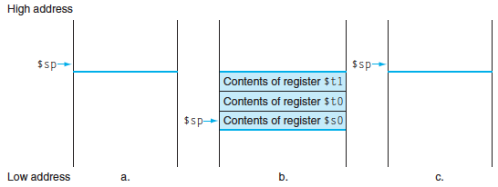
Stack Before, During, After Function
Need to save old values of $s0 and $t0
Contents of $t0
Contents of $s0

Slide 27
MIPS Code for leaf_example
Leaf_example
addi $sp,$sp,-8 # adjust stack for 2 items
sw $t0, 4($sp) # save $t0 for use afterwards
sw $s0, 0($sp) # save $s0 for use afterwards
add $s0,$a0,$a1 # f = g + h
add $t0,$a2,$a3 # t0 = i + j
sub $v0,$s0,$t0 # return value (g + h) – (i + j)
lw $s0, 0($sp) # restore register $s0 for caller
lw $t0, 4($sp) # restore register $t0 for caller
addi $sp,$sp,8 # adjust stack to delete 2 items
jr $ra # jump back to calling routine
Notes:
addi $sp,$sp,-8 # adjust stack for 2 items
sw $t0, 4($sp) # save $t0 for use afterwards
sw $s0, 0($sp) # save $s0 for use afterwards
add $s0,$a0,$a1 # f = g + h
add $t0,$a2,$a3 # t0 = i + j
sub $v0,$s0,$t0 # return value (g + h) – (i + j)
lw $s0, 0($sp) # restore register $s0 for caller
lw $t0, 4($sp) # restore register $t0 for caller
addi $sp,$sp,8 # adjust stack to delete 2 items
jr $ra # jump back to calling routine

Slide 28
What If a Function Calls a Function? Recursive Function Calls?
Would clobber values in $a0 to $a3 and $ra
What is the solution?
Notes:
Save $ra on the stack

Slide 29
Nested Procedures (1/2)
int sumSquare(int x, int y) { return mult(x,x)+ y; }
Something called sumSquare, now sumSquare is calling mult.
So there’s a value in $ra that sumSquare wants to jump back to, but this will be overwritten by the call to mult.
Need to save sumSquare return address before call to mult.

Slide 30
Nested Procedures (2/2)
In general, may need to save some other info in addition to $ra.
When a C program is run, there are 3 important memory areas allocated:
Static: Variables declared once per program, cease to exist only after execution completes - e.g., C globals
Heap: Variables declared dynamically via malloc
Stack: Space to be used by procedure during execution; this is where we can save register values

Slide 31
Optimized Function Convention
To reduce expensive loads and stores from spilling and restoring registers, MIPS divides registers into two categories:
Preserved across function call
Caller can rely on values being unchanged
$ra, $sp, $gp, $fp, “saved registers” $s0- $s7
Not preserved across function call
Caller cannot rely on values being unchanged
Return value registers $v0,$v1, Argument registers $a0-$a3, “temporary registers” $t0-$t9

Slide 32
Clickers/Peer Instruction
Which statement is FALSE?
A: MIPS uses jal to invoke a function and jr to return from a function
B: jal saves PC+1 in $ra
C: The callee can use temporary registers ($ti) without saving and restoring them
D: The caller can rely on the saved registers ($si) without fear of callee changing them
Notes:
B: Print It saves PC+4 …because ints in this system are 4-bytes long and the actual address increments by 4 even though it appears to only increment 1.

Slide 33
Clickers/Peer Instruction
Which statement is FALSE?
A: MIPS uses jal to invoke a function and jr to return from a function
B: jal saves PC+1 in $ra
C: The callee can use temporary registers ($ti) without saving and restoring them
D: The caller can rely on the saved registers ($si) without fear of callee changing them
Notes:
B: Print It saves PC+4 …because ints in this system are 4-bytes long and the actual address increments by 4 even though it appears to only increment 1.

Slide 34
Administrivia
Hopefully everyone turned-in HW0
HW1 due 11:59:59pm Sunday 2/8

Slide 35
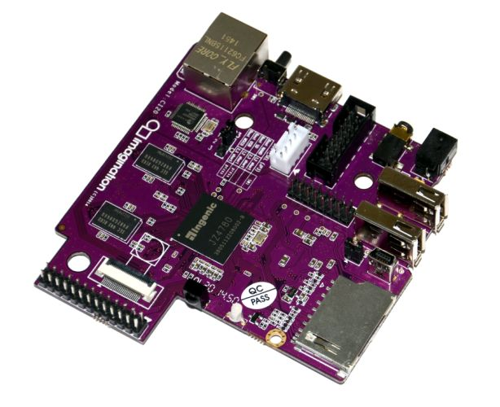
In the News MIPS for hobbyists
MIPS Creator CI20 dev board now available
A lot like Raspberry Pi but with MIPS CPU
Supports Linux and Android
1.2GHz 32-bit MIPS with integrated graphics
http://liliputing.com/2015/01/mips-creator-ci20-dev-board-now-available-for-65.html

Slide 36
Allocating Space on Stack
C has two storage classes: automatic and static
Automatic variables are local to function and discarded when function exits
Static variables exist across exits from and entries to procedures
Use stack for automatic (local) variables that don’t fit in registers
Procedure frame or activation record: segment of stack with saved registers and local variables
Some MIPS compilers use a frame pointer ($fp) to point to first word of frame

Slide 37
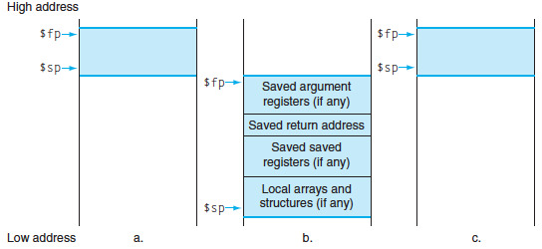
Stack Before, During, After Call

Slide 38
Using the Stack (1/2)
So we have a register $sp which always points to the last used space in the stack.
To use stack, we decrement this pointer by the amount of space we need and then fill it with info.
So, how do we compile this?
int sumSquare(int x, int y) { return mult(x,x)+ y; }

Slide 39
Using the Stack (2/2)
Hand-compile sumSquare: addi $sp,$sp,-8 # space on stack sw $ra, 4($sp) # save ret addr sw $a1, 0($sp) # save y add $a1,$a0,$zero # mult(x,x) jal mult # call mult lw $a1, 0($sp) # restore y add $v0,$v0,$a1 # mult()+y lw $ra, 4($sp) # get ret addr addi $sp,$sp,8 # restore stack jr $ra mult: ...
int sumSquare(int x, int y) { return mult(x,x)+ y; }
“push”
“pop”

Slide 40
Basic Structure of a Function
entry_label: addi $sp,$sp, -framesize sw $ra, framesize-4($sp) # save $ra save other regs if need be
...
restore other regs if need be lw $ra, framesize-4($sp) # restore $ra addi $sp,$sp, framesize jr $ra
Prologue
ra
Body (call other functions…)
memory
Epilogue

Slide 41
Where is the Stack in Memory?
MIPS convention
Stack starts in high memory and grows down
Hexadecimal (base 16) : 7fff fffc_{hex}
MIPS programs (text segment) in low end
0040 0000_{hex}
static data segment (constants and other static variables) above text for static variables
MIPS convention global pointer ($gp) points to static
Heap above static for data structures that grow and shrink ; grows up to high addresses

Slide 42
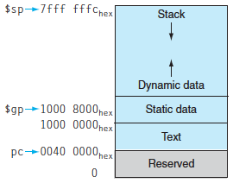
MIPS Memory Allocation

Slide 43
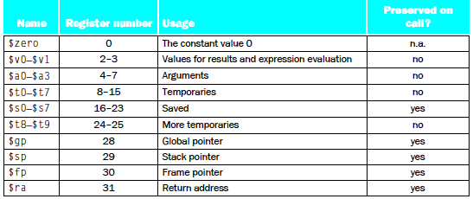
Register Allocation and Numbering

Slide 44
And in Conclusion…
Functions called with jal, return with jr $ra.
The stack is your friend: Use it to save anything you need. Just leave it the way you found it!
Instructions we know so far…
Arithmetic: add, addi, sub, addu, addiu, subu
Memory: lw, sw, lb, sb
Decision: beq, bne, slt, slti, sltu, sltiu
Unconditional Branches (Jumps): j, jal, jr
Registers we know so far
All of them!
$a0-$a3 for function arguments, $v0-$v1 for return values
$sp, stack pointer, $fp frame pointer, $ra return address

Slide 45
Bonus Slides

Slide 46
Recursive Function Factorial
int fact (int n)
{
if (n < 1) return (1);
else return (n * fact(n-1));
}

Slide 47
Recursive Function Factorial
Fact: # adjust stack for 2 items
addi $sp,$sp,-8
# save return address
sw $ra, 4($sp) # save argument n
sw $a0, 0($sp) # test for n < 1
slti $t0,$a0,1
# if n >= 1, go to L1
beq $t0,$zero,L1 # Then part (n==1) return 1
addi $v0,$zero,1 # pop 2 items off stack
addi $sp,$sp,8 # return to caller
jr $ra
L1:
# Else part (n >= 1) # arg. gets (n – 1)
addi $a0,$a0,-1 # call fact with (n – 1)
jal fact
# return from jal: restore n
lw $a0, 0($sp) # restore return address
lw $ra, 4($sp) # adjust sp to pop 2 items
addi $sp, $sp,8 # return n * fact (n – 1)
mul $v0,$a0,$v0 # return to the caller
jr $ra
mul is a pseudo instruction
Notes:
Slti: set dst to 1 if src is less than imm (signed immediate)

