Slide 1
CS 61C: Great Ideas in Computer Architecture Intro to Assembly Language, MIPS Intro
Instructors:
Krste Asanovic & Vladimir Stojanovic
http://inst.eecs.Berkeley.edu/~cs61c/sp15

Slide 2
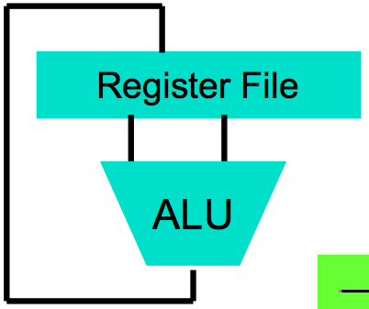
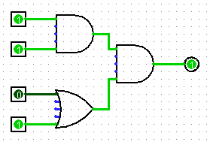
Levels of Representation/Interpretation
High Level Language Program (e.g., C)
temp = v[k];
v[k] = v[k+1];
v[k+1] = temp;
Compiler
Anything can be represented as a number, i.e., data or instructions
lw $t0, 0($2)
lw $t1, 4($2)
sw $t1, 0($2)
sw $t0, 4($2)
Assembly Language Program (e.g., MIPS)
Assembler
0000 1001 1100 0110 1010 1111 0101 1000
1010 1111 0101 1000 0000 1001 1100 0110
1100 0110 1010 1111 0101 1000 0000 1001
0101 1000 0000 1001 1100 0110 1010 1111
Machine Language Program (MIPS)
Machine Interpretation
Hardware Architecture Description (e.g., block diagrams)
Architecture Implementation
Logic Circuit Description (Circuit Schematic Diagrams)

Slide 3
Review: Allocating Space on Stack
C has two storage classes: automatic and static
Automatic variables are local to function and discarded when function exits
Static variables exist across exits from and entries to procedures
Use stack for automatic (local) variables that don’t fit in registers
Procedure frame or activation record: segment of stack with saved registers and local variables
Some MIPS compilers use a frame pointer ($fp) to point to first word of frame

Slide 4
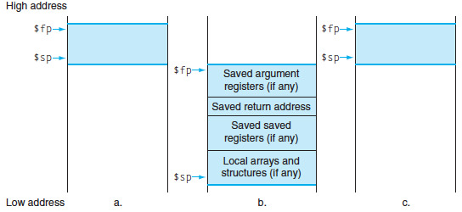
Stack Before, During, After Call

Slide 5
Using the Stack (1/2)
So we have a register $sp which always points to the last used space in the stack.
To use stack, we decrement this pointer by the amount of space we need and then fill it with info.
So, how do we compile this?
int sumSquare(int x, int y) { return mult(x,x)+ y; }

Slide 6
Using the Stack (2/2)
Hand-compile sumSquare: addi $sp,$sp,-8 # space on stack sw $ra, 4($sp) # save ret addr sw $a1, 0($sp) # save y add $a1,$a0,$zero # mult(x,x) jal mult # call mult lw $a1, 0($sp) # restore y add $v0,$v0,$a1 # mult()+y lw $ra, 4($sp) # get ret addr addi $sp,$sp,8 # restore stack jr $ra mult: ...
int sumSquare(int x, int y) { return mult(x,x)+ y; }
“push”
“pop”

Slide 7
Basic Structure of a Function
entry_label: addi $sp,$sp, -framesize sw $ra, framesize-4($sp) # save $ra save other regs if need be
...
restore other regs if need be lw $ra, framesize-4($sp) # restore $ra addi $sp,$sp, framesize jr $ra
Prologue
ra
Body (call other functions…)
memory
Epilogue

Slide 8
Where is the Stack in Memory?
MIPS convention
Stack starts in high memory and grows down
Hexadecimal (base 16) : 7fff fffc_{hex}
MIPS programs (text segment) in low end
0040 0000_{hex}
static data segment (constants and other static variables) above text for static variables
MIPS convention global pointer ($gp) points to static
Heap above static for data structures that grow and shrink ; grows up to high addresses

Slide 9
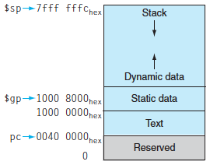
MIPS Memory Allocation

Slide 10
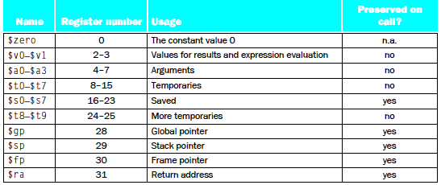
Register Allocation and Numbering
tans
tans

Slide 11
Administrivia
HW2 due Sunday 2/15
Can resubmit HW1’ given 80% weight, and clobber HW1 score
Autograder results only available after HW2 deadline

Slide 12
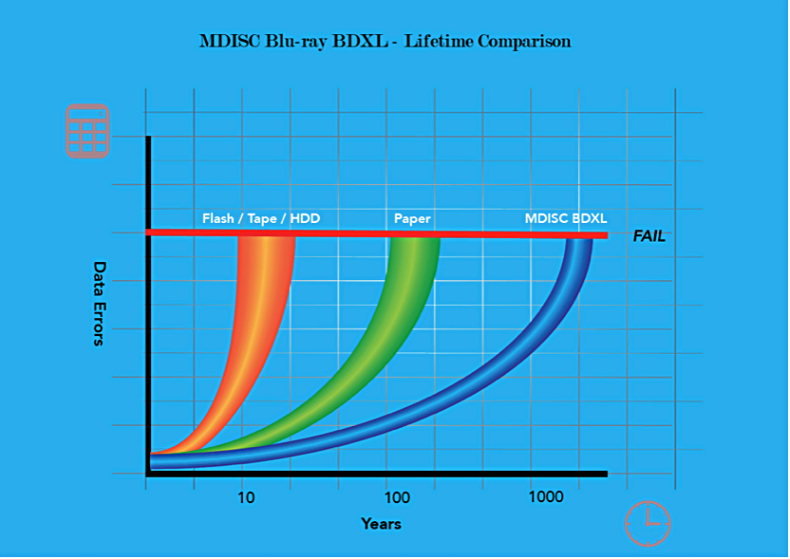

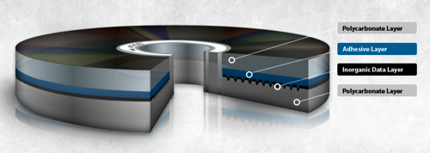
In the News: 1,000 year life Blu-Ray Discs
Verbatim and Milleniata launch MDISC 100GB Blu-ray optical media with >1,000 year lifetime
“average lifetime of significantly more than 2,000 years with no more than one failure per 100,000 discs expected, after more than 1,000 years at 250C (770F) and 50 per cent relative humidity.”

Slide 13
Levels of Representation/Interpretation
High Level Language Program (e.g., C)
temp = v[k];
v[k] = v[k+1];
v[k+1] = temp;
Compiler
Anything can be represented as a number, i.e., data or instructions
lw $t0, 0($2)
lw $t1, 4($2)
sw $t1, 0($2)
sw $t0, 4($2)
Assembly Language Program (e.g., MIPS)
Assembler
0000 1001 1100 0110 1010 1111 0101 1000
1010 1111 0101 1000 0000 1001 1100 0110
1100 0110 1010 1111 0101 1000 0000 1001
0101 1000 0000 1001 1100 0110 1010 1111
Machine Language Program (MIPS)
Machine Interpretation
Hardware Architecture Description (e.g., block diagrams)
Architecture Implementation
Logic Circuit Description (Circuit Schematic Diagrams)

Slide 14
Big Idea: Stored-Program Computer
First Draft of a Report on the EDVAC
^{by}
^{John von Neumann}
^{Contract No. W–670–ORD–4926}
^{Between the}
United States Army Ordnance Department and the
^{University of Pennsylvania}
Moore School of Electrical Engineering
^{University of Pennsylvania}
^{June 30, 1945}
Instructions are represented as bit patterns - can think of these as numbers.
Therefore, entire programs can be stored in memory to be read or written just like data.
Can reprogram quickly (seconds), don’t have to rewire computer (days)
Known as the “von Neumann” computers after widely distributed tech report on EDVAC project

Slide 15
Consequence #1: Everything Addressed
Since all instructions and data are stored in memory, everything has a memory address: instructions, data words
both branches and jumps use these
C pointers are just memory addresses: they can point to anything in memory
Unconstrained use of addresses can lead to nasty bugs; up to you in C; limited in Java by language design
One register keeps address of instruction being executed: “Program Counter” (PC)
Basically a pointer to memory: Intel calls it Instruction Pointer (a better name)

Slide 16
Consequence #2: Binary Compatibility
Programs are distributed in binary form
Programs bound to specific instruction set
Different version for Macintoshes and PCs
New machines want to run old programs (“binaries”) as well as programs compiled to new instructions
Leads to “backward-compatible” instruction set evolving over time
Selection of Intel 8086 in 1981 for 1st IBM PC is major reason latest PCs still use 80x86 instruction set (Pentium 4); could still run program from 1981 PC today

Slide 17
Instructions as Numbers (1/2)
Currently all data we work with is in words (32-bit chunks):
Each register is a word.
lw and sw both access memory one word at a time.
So how do we represent instructions?
Remember: Computer only understands 1s and 0s, so “add $t0,$0,$0” is meaningless.
MIPS/RISC seeks simplicity: since data is in words, make instructions be fixed-size 32-bit words also

Slide 18
Instructions as Numbers (2/2)
One word is 32 bits, so divide instruction word into “fields”.
Each field tells processor something about instruction.
We could define different fields for each instruction, but MIPS seeks simplicity, so define 3 basic types of instruction formats:
R-format
I-format
J-format

Slide 19
Instruction Formats
I-format: used for instructions with immediates, lw and sw (since offset counts as an immediate), and branches (beq and bne),
(but not the shift instructions; later)
J-format: used for j and jal
R-format: used for all other instructions
It will soon become clear why the instructions have been partitioned in this way.

Slide 20
R-Format Instructions (1/5)
Define “fields” of the following number of bits each: 6 + 5 + 5 + 5 + 5 + 6 = 32
For simplicity, each field has a name:
Important: On these slides and in book, each field is viewed as a 5- or 6-bit unsigned integer, not as part of a 32-bit integer.
Consequence: 5-bit fields can represent any number 0-31, while 6-bit fields can represent any number 0-63.
6
5
5
5
5
6
opcode
rs
rt
rd
shamt
funct

Slide 21
R-Format Instructions (2/5)
What do these field integer values tell us?
opcode: partially specifies what instruction it is
Note: This number is equal to 0 for all R-Format instructions.
funct: combined with opcode, this number exactly specifies the instruction
Question: Why aren’t opcode and funct a single 12-bit field?
We’ll answer this later.

Slide 22
R-Format Instructions (3/5)
More fields:
rs (Source Register): usually used to specify register containing first operand
rt (Target Register): usually used to specify register containing second operand (note that name is misleading)
rd (Destination Register): usually used to specify register which will receive result of computation

Slide 23
R-Format Instructions (4/5)
Notes about register fields:
Each register field is exactly 5 bits, which means that it can specify any unsigned integer in the range 0-31. Each of these fields specifies one of the 32 registers by number.
The word “usually” was used because there are exceptions that we’ll see later. E.g.,
mult and div have nothing important in the rd field since the dest registers are hi and lo
mfhi and mflo have nothing important in the rs and rt fields since the source is determined by the instruction (see COD)

Slide 24
R-Format Instructions (5/5)
Final field:
shamt: This field contains the amount a shift instruction will shift by. Shifting a 32-bit word by more than 31 is useless, so this field is only 5 bits (so it can represent the numbers 0-31).
This field is set to 0 in all but the shift instructions.
For a detailed description of field usage for each instruction, see green insert in COD (You can bring with you to all exams)

Slide 25
R-Format Example (1/2)
MIPS Instruction:
add $8,$9,$10
opcode = 0 (look up in table in book)
funct = 32 (look up in table in book)
rd = 8 (destination)
rs = 9 (first operand)
rt = 10 (second operand)
shamt = 0 (not a shift)

Slide 26
R-Format Example (2/2)
MIPS Instruction:
add $8,$9,$10
Decimal number per field representation:
Binary number per field representation:
hex representation: 012A 4020_{hex}
decimal representation: 19,546,144_{ten}
Called a Machine Language Instruction
0
9
10
8
0
32
000000
01001
01010
01000
00000
100000
_{hex}

Slide 27
I-Format Instructions (1/4)
What about instructions with immediates?
5-bit field only represents numbers up to the value 31: immediates may be much larger than this
Ideally, MIPS would have only one instruction format (for simplicity): unfortunately, we need to compromise
Define new instruction format that is partially consistent with R-format:
First notice that, if instruction has immediate, then it uses at most 2 registers.

Slide 28
I-Format Instructions (2/4)
Define “fields” of the following number of bits each: 6 + 5 + 5 + 16 = 32 bits
Again, each field has a name:
Key Concept: Only one field is inconsistent with R-format. Most importantly, opcode is still in same location.
6
5
5
16
opcode
rs
rt
immediate

Slide 29
I-Format Instructions (3/4)
What do these fields mean?
opcode: same as before except that, since there’s no funct field, opcode uniquely specifies an instruction in I-format
This also answers question of why R-format has two 6-bit fields to identify instruction instead of a single 12-bit field: in order to be consistent as possible with other formats while leaving as much space as possible for immediate field.
rs: specifies a register operand (if there is one)
rt: specifies register which will receive result of computation (this is why it’s called the target register “rt”) or other operand for some instructions.

Slide 30
I-Format Instructions (4/4)
The Immediate Field:
addi, slti, sltiu, the immediate is sign-extended to 32 bits. Thus, it’s treated as a signed integer.
16 bits ➔ can be used to represent immediate up to 2¹⁶ different values
This is large enough to handle the offset in a typical lw or sw, plus a vast majority of values that will be used in the slti instruction.
Later, we’ll see what to do when a value is too big for 16 bits

Slide 31
I-Format Example (1/2)
MIPS Instruction:
addi $21,$22,-50
opcode = 8 (look up in table in book)
rs = 22 (register containing operand)
rt = 21 (target register)
immediate = -50 (by default, this is decimal in assembly code)

Slide 32
I-Format Example (2/2)
MIPS Instruction:
addi $21,$22,-50
Decimal/field representation:
8
22
21
-50
Binary/field representation:
001000
10110
10101
1111111111001110
hexadecimal representation: 22D5 FFCE_{hex}
decimal representation: 584,449,998_{ten}

Slide 33
Clicker/Peer Instruction
Which instruction has same representation as integer 35_{ten}?
a) add $0, $0, $0
b) subu $s0,$s0,$s0
c) lw $0, 0($0)
d) addi $0, $0, 35
e) subu $0, $0, $0
Registers numbers and names: 0: $0, .. 8: $t0, 9:$t1, ..15: $t7, 16: $s0, 17: $s1, .. 23: $s7
Opcodes and function fields (if necessary)
add: opcode = 0, funct = 32
subu: opcode = 0, funct = 35
addi: opcode = 8
lw: opcode = 35
opcode
rs
rt
rd
shamt
funct
opcode
rs
rt
rd
shamt
funct
opcode
rs
rt
offset
opcode
rs
rt
immediate
opcode
rs
rt
rd
shamt
funct

Slide 34
Dealing With Large Immediates
How do we deal with 32-bit immediates?
Sometimes want to use immediates > ± 2¹⁵ with addi, lw, sw and slti
Bitwise logic operations with 32-bit immediates
Solution: Don’t mess with instruction formats, just add a new instruction
Load Upper Immediate (lui)
lui reg,imm
Moves 16-bit imm into upper half (bits 16-31) of reg and zeros the lower half (bits 0-15)

Slide 35
lui Example
Want: addiu $t0,$t0,0xABABCDCD
This is a pseudo-instruction!
Translates into:
lui $at,0xABAB # upper 16 ori $at,$at,0xCDCD # lower 16 addu $t0,$t0,$at # move
Now we can handle everything with a 16-bit immediate!
Only the assembler gets to use $at

Slide 36
Branching Instructions
beq and bne
Need to specify a target address if branch taken
Also specify two registers to compare
Use I-Format:
opcode specifies beq (4) vs. bne (5)
rs and rt specify registers
How to best use immediate to specify addresses?
31
0
opcode
rs
rt
immediate

Slide 37
Branching Instruction Usage
Branches typically used for loops (if-else, while, for)
Loops are generally small (< 50 instructions)
Function calls and unconditional jumps handled with jump instructions (J-Format)
Recall: Instructions stored in a localized area of memory (Code/Text)
Largest branch distance limited by size of code
Address of current instruction stored in the program counter (PC)

Slide 38
PC-Relative Addressing
PC-Relative Addressing: Use the immediate field as a two’s complement offset to PC
Branches generally change the PC by a small amount
Can specify ± 2¹⁵ addresses from the PC
So just how much of memory can we reach?

Slide 39
Branching Reach
Recall: MIPS uses 32-bit addresses
Memory is byte-addressed
Instructions are word-aligned
Address is always multiple of 4 (in bytes), meaning it ends with 0b00 in binary
Number of bytes to add to the PC will always be a multiple of 4
Immediate specifies words instead of bytes
Can now branch ± 2¹⁵ words
We can reach 2¹⁶ instructions = 2¹⁸ bytes around PC

Slide 40
Branch Calculation
If we don’t take the branch:
PC = PC + 4 = next instruction
If we do take the branch:
PC = (PC+4) + (immediate*4)
Observations:
immediate is number of instructions to jump (remember, specifies words) either forward (+) or backwards (–)
Branch from PC+4 for hardware reasons; will be clear why later in the course

Slide 41
Branch Example (1/2)
Start counting from instruction AFTER the branch
MIPS Code:
Loop: beq $9,$0,End addu $8,$8,$10 addiu $9,$9,-1 j Loop End:
I-Format fields:
opcode = 4 (look up on Green Sheet)
rs = 9 (first operand)
rt = 0 (second operand)
immediate = ???
1
2
3
3

Slide 42
Branch Example (2/2)
MIPS Code:
Loop: beq $9,$0,End addu $8,$8,$10 addiu $9,$9,-1 j Loop End:
Field representation (decimal):
Field representation (binary):
31
0
4
9
0
3
31
0
000100
01001
00000
0000000000000011

Slide 43
Questions on PC-addressing
Does the value in branch immediate field change if we move the code?
If moving individual lines of code, then yes
If moving all of code, then no
What do we do if destination is > 2¹⁵ instructions away from branch?
Other instructions save us
beq $s0,$0,far bne $s0,$0,next # next instr → j far next: # next instr
Notes:
As we will see, jumping instructions can reach farther than branching

Slide 44
J-Format Instructions (1/4)
For branches, we assumed that we won’t want to branch too far, so we can specify a change in the PC
For general jumps (j and jal), we may jump to anywhere in memory
Ideally, we would specify a 32-bit memory address to jump to
Unfortunately, we can’t fit both a 6-bit opcode and a 32-bit address into a single 32-bit word

Slide 45
J-Format Instructions (2/4)
Define two “fields” of these bit widths:
As usual, each field has a name:
Key Concepts:
Keep opcode field identical to R-Format and I-Format for consistency
Collapse all other fields to make room for large target address
31
0
6
26
31
0
opcode
target address

Slide 46
J-Format Instructions (3/4)
We can specify 2²⁶ addresses
Still going to word-aligned instructions, so add 0b00 as last two bits (multiply by 4)
This brings us to 28 bits of a 32-bit address
Take the 4 highest order bits from the PC
Cannot reach everywhere, but adequate almost all of the time, since programs aren’t that long
Only problematic if code straddles a 256MB boundary
If necessary, use 2 jumps or jr (R-Format) instead

Slide 47
J-Format Instructions (4/4)
Jump instruction:
New PC = { (PC+4)[31..28], target address, 00 }
Notes:
{ , , } means concatenation { 4 bits , 26 bits , 2 bits } = 32 bit address
Book uses || instead
Array indexing: [31..28] means highest 4 bits
For hardware reasons, use PC+4 instead of PC

Slide 48
Assembler Pseudo-Instructions
Certain C statements are implemented unintuitively in MIPS
e.g. assignment (a=b) via add zero
MIPS has a set of “pseudo-instructions” to make programming easier
More intuitive to read, but get translated into actual instructions later
Example:
move dst,src translated into addi dst,src,0

Slide 49
Assembler Pseudo-Instructions
List of pseudo-instructions: http://en.wikipedia.org/wiki/MIPS_architecture#Pseudo_instructions
List also includes instruction translation
Load Address (la)
la dst,label
Loads address of specified label into dst
Load Immediate (li)
li dst,imm
Loads 32-bit immediate into dst
MARS has additional pseudo-instructions
See Help (F1) for full list

Slide 50
Assembler Register
Problem:
When breaking up a pseudo-instruction, the assembler may need to use an extra register
If it uses a regular register, it’ll overwrite whatever the program has put into it
Solution:
Reserve a register ($1 or $at for “assembler temporary”) that assembler will use to break up pseudo-instructions
Since the assembler may use this at any time, it’s not safe to code with it

Slide 51
MAL vs. TAL
True Assembly Language (TAL)
The instructions a computer understands and executes
MIPS Assembly Language (MAL)
Instructions the assembly programmer can use (includes pseudo-instructions)
Each MAL instruction becomes 1 or more TAL instruction
TAL ⊂ MAL

Slide 52
Summary
I-Format: instructions with immediates, lw/sw (offset is immediate), and beq/bne
But not the shift instructions
Branches use PC-relative addressing
J-Format: j and jal (but not jr)
Jumps use absolute addressing
R-Format: all other instructions
I:
opcode
rs
rt
immediate
J:
opcode
target address
R:
opcode
rs
rt
rd
shamt
funct

