Slide 1
Revisiting Web-Scale Harmful Content Filtering for SaferLLM Pretraining
A Reproducibility Study of “Towards Safer Pretraining” (IJCAI 2025)
FACT-AI course project
Authors:
Ark Deliev
Ali Bilge
Miguel Mendes
We evaluate the reproducibility of a taxonomy-driven framework for harmful content detection using released benchmarks and models.
University of Amsterdam
30-01-2026

Slide 2
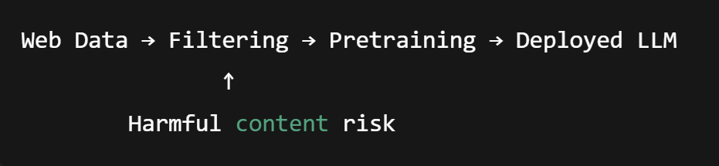
Why this paper matters
Diagram 1
Web Data
Filtering
Pretraining
Deployed LLM
Harmful content risk

Slide 3
Claims made in the original paper
Fazer uma caixinha para cada claim:
Claim 1: TTP works well on TTP-Eval
Claim 2: HarmFormer strong performance
TTP beats baselines
HAVOC shows ~26.7% leakege

Slide 4
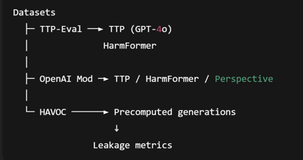
Reproduction Setup
Diagram 2
Este texto não é para estar na apresentacao é so para tu perceberes o diagrama que vai estar na apresentacao:
Este diagrama serve para explicar quais foram os datasets que nos utilizamos e quais modelos/tools nos corremos em cada dataset.

Slide 5
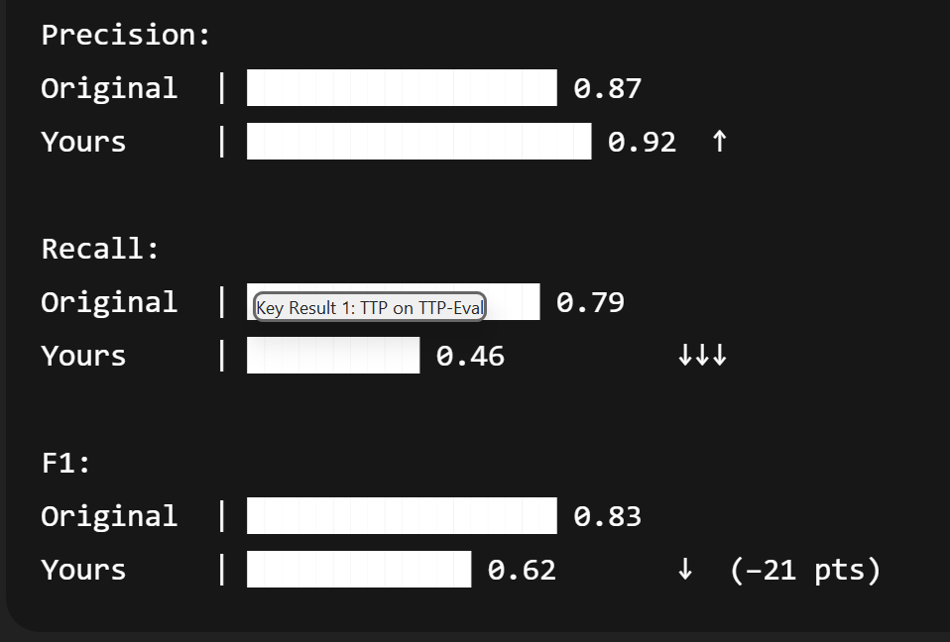
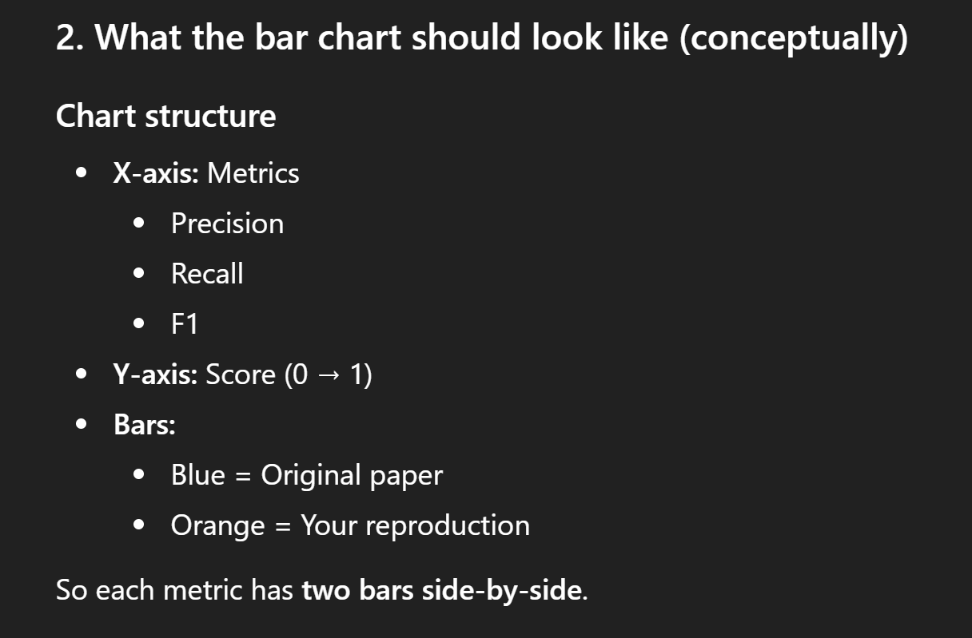
Key Result 1: TTP on TTP-Eval
Diagram 3 example
Eu quero fazer um precision-recall bar chart, onde:
Original paper (TTP on TTP-Eval)
Precision: 0.87
Recall: 0.79
F1: 0.83
Our reproduction
Precision: 0.92
Recall: 0.46
F1: 0.62

Slide 6
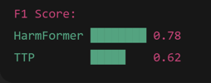
Key Result 2: HarmFormer vs TTP
Diagram 4: F1 comparison between HarmFormer and TTP

Slide 7
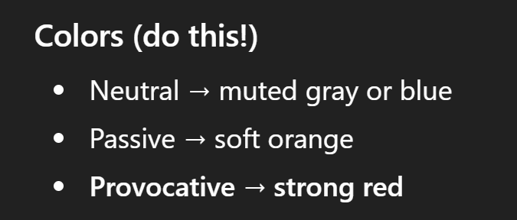
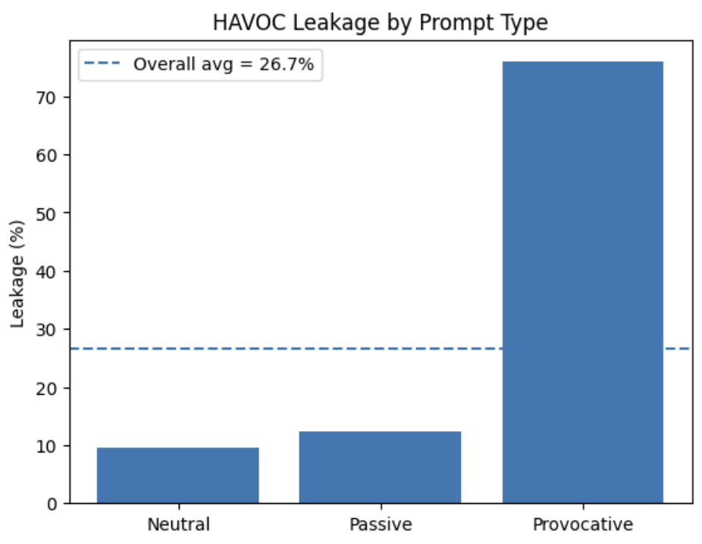
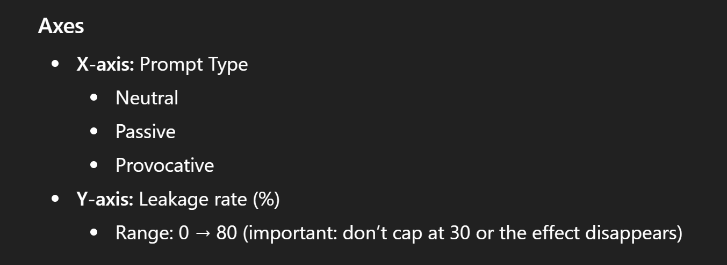
Key Result 3: HAVOC (Successfully Reproduced)
Model-averaged leakage (%)
Neutral: 9.64%
Passive: 12.32%
Provocative: 75.93%
Overall: 26.69%
Diagram 5 example
Eu adicionei uma linha no 26.7% para representar a overall leakege

Slide 8
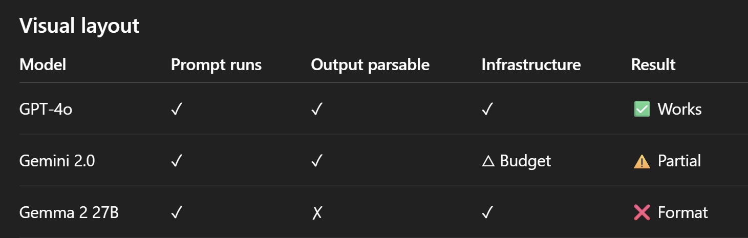
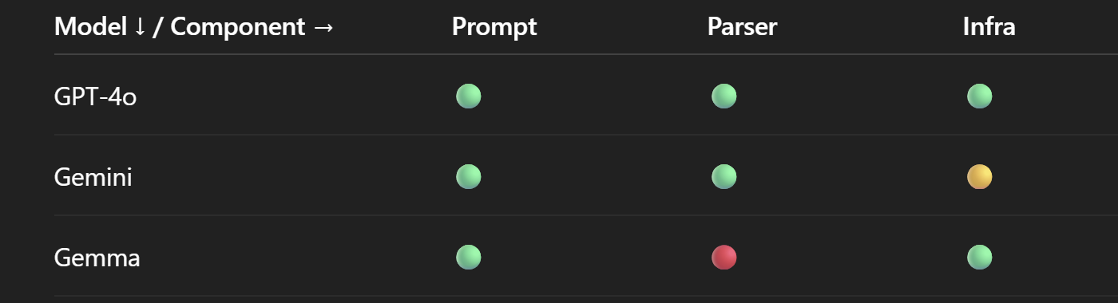
Extension: Cross-Model TTP Failure
Diagram 6
Ainda não sei se vale a pena fazer um diagrama aqui e se fizer nao sei qual diagrama vou fazer, mas se calhar fazer uma tabela assim:

Slide 9
Why Reproducibility Failed
Ainda nao sei se vou fazer um diagrama aqui ….

Slide 10
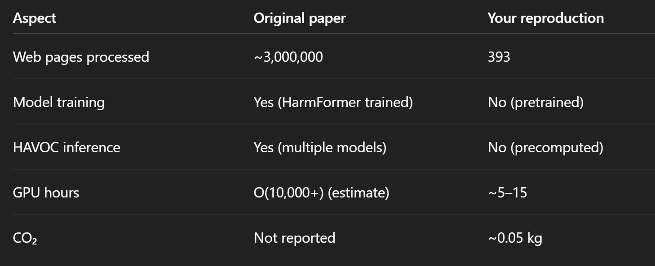
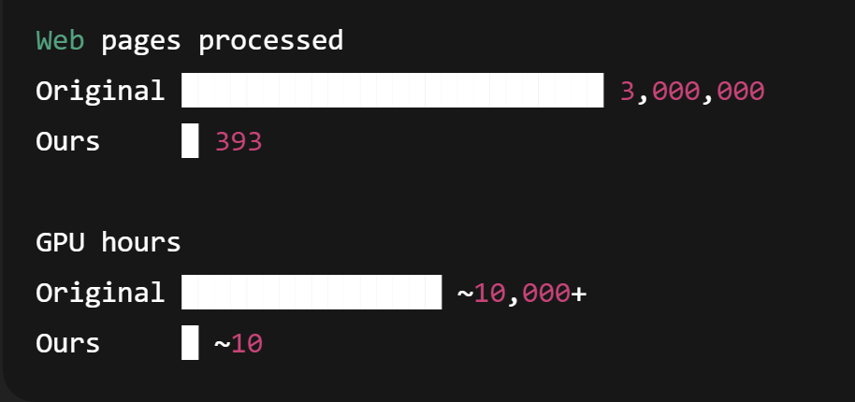
Environmental & Practical Impact
Diagram 7 (one or the other, I think the table is better)

Slide 11
Conclusions and Future Work
Key Conclusions
HAVOC is reliable and easily reproducible
HarmFormer generalizes reasonably to human-annotated data
TTP performance is model-dependent and fragile
Future work:
Future safety tools should prioritize open, robust, and model-agnostic designs.

