Slide 1
Roadmap to Value Creation
Team 18

Slide 2
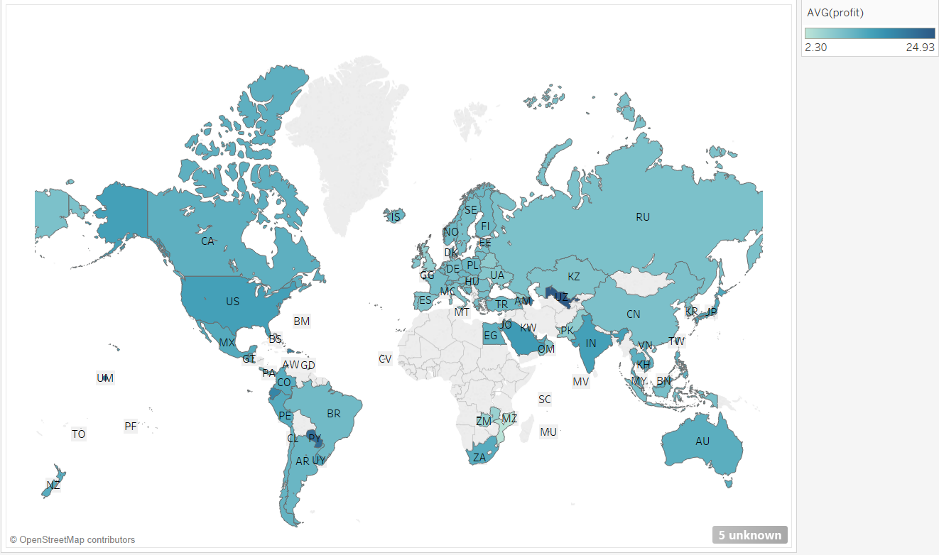
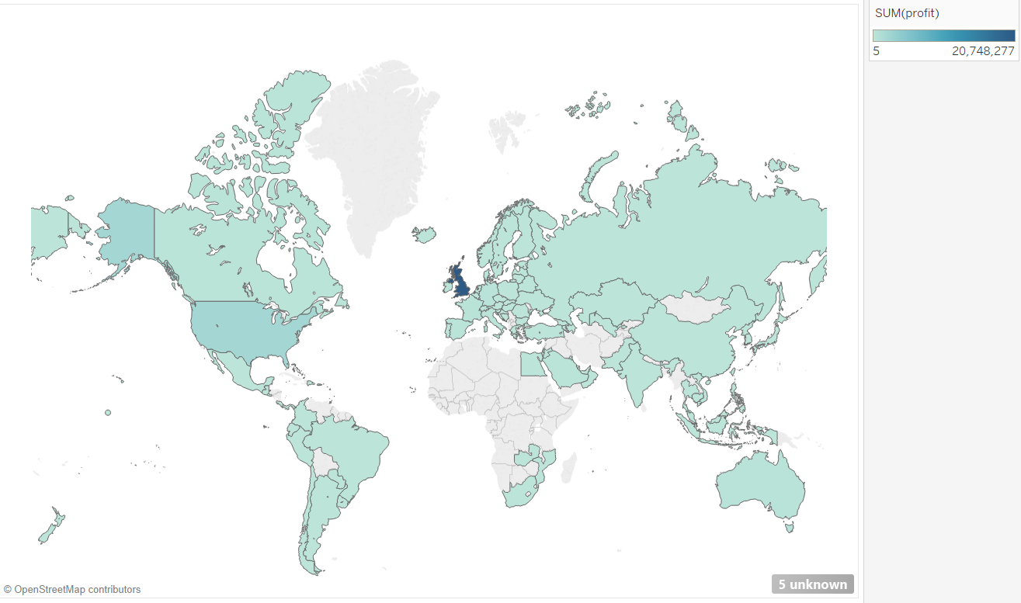
From the data...
UK
Uzbekistan
Notes:
UZ: Uzbekistan

Slide 3
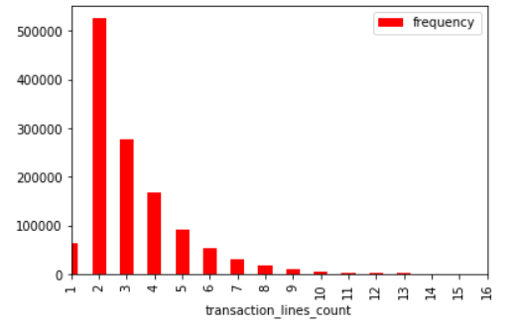
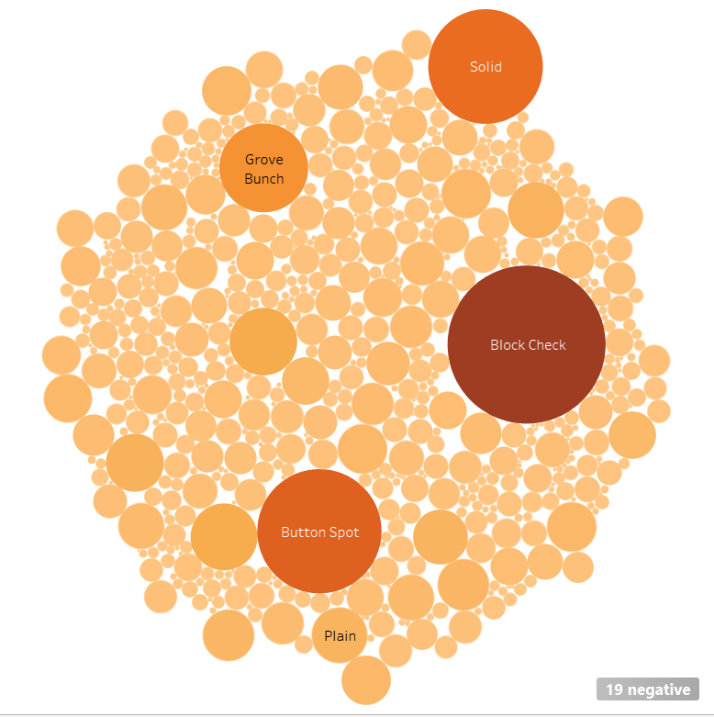
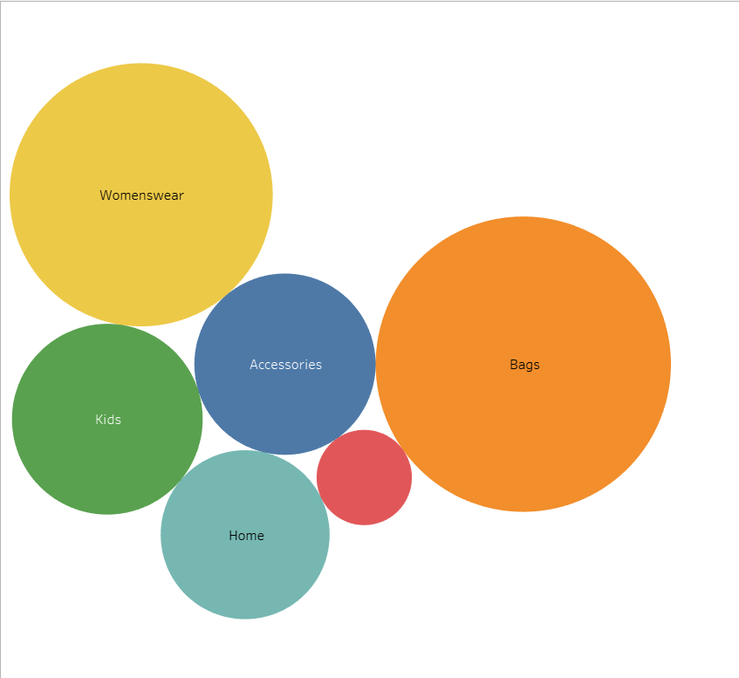
From the data...
Notes:
average revenue: red dot - consumables

Slide 4
How to sell MORE?
What to sell?
How to sell?

Slide 5
Part 1: What to Sell?

Slide 6
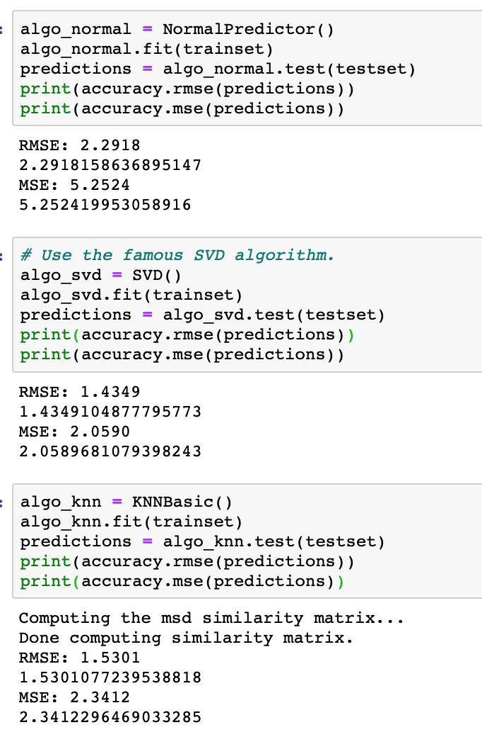
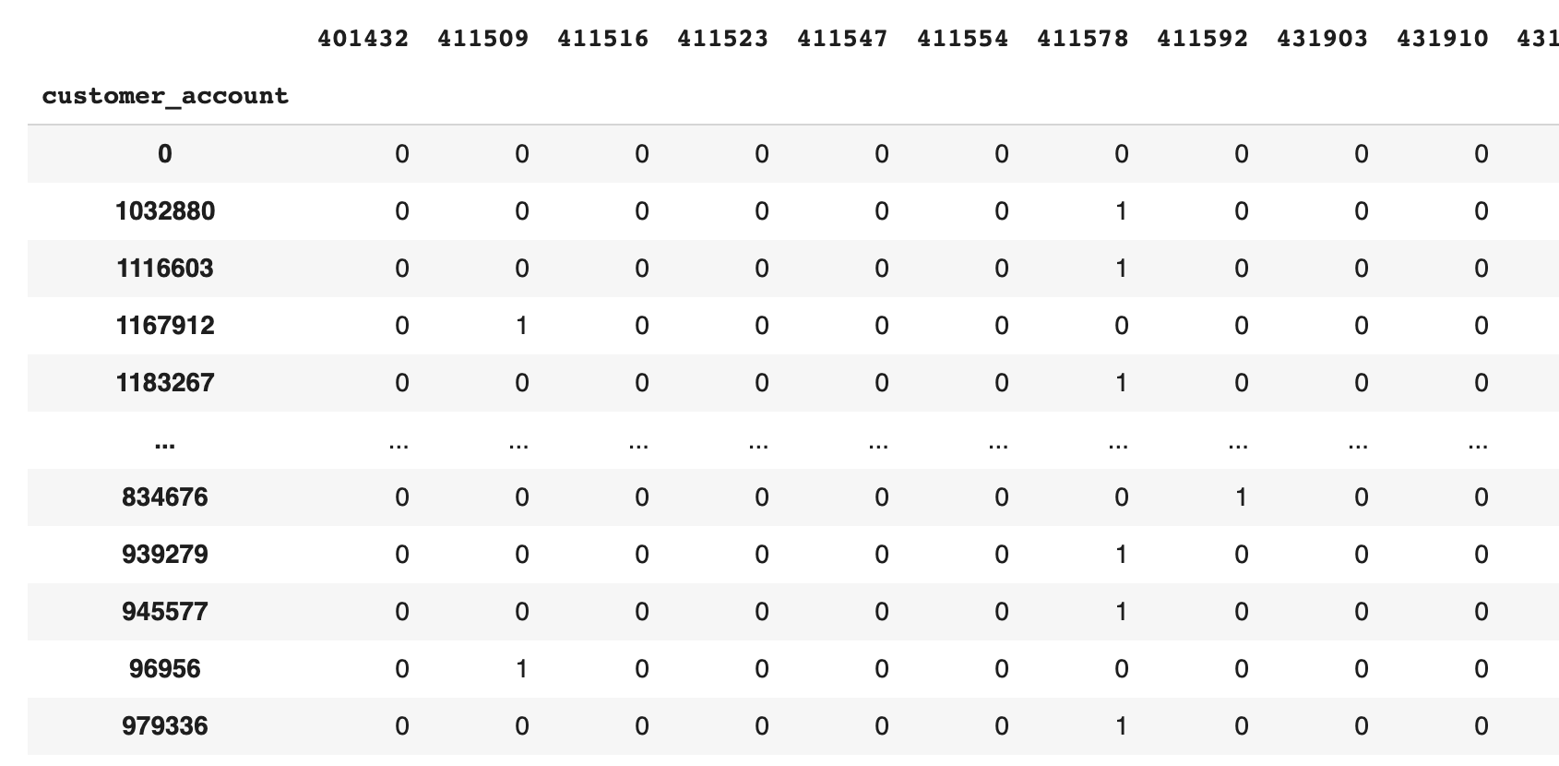
Model Selection in Collaborative Filtering
Models:
Random normal distribution (baseline)
Singular Value Decomposition ！！！
K-Nearest Neighbor

Slide 7
Part 2: How
to Sell?

Slide 8
Part 2: How to Sell?
“what discount method generates the most profit?”
-segmented customers based on country code and gender (customer title)
-computed profit as (sales net) - (net cost), take the average profit of each discount method

Slide 9
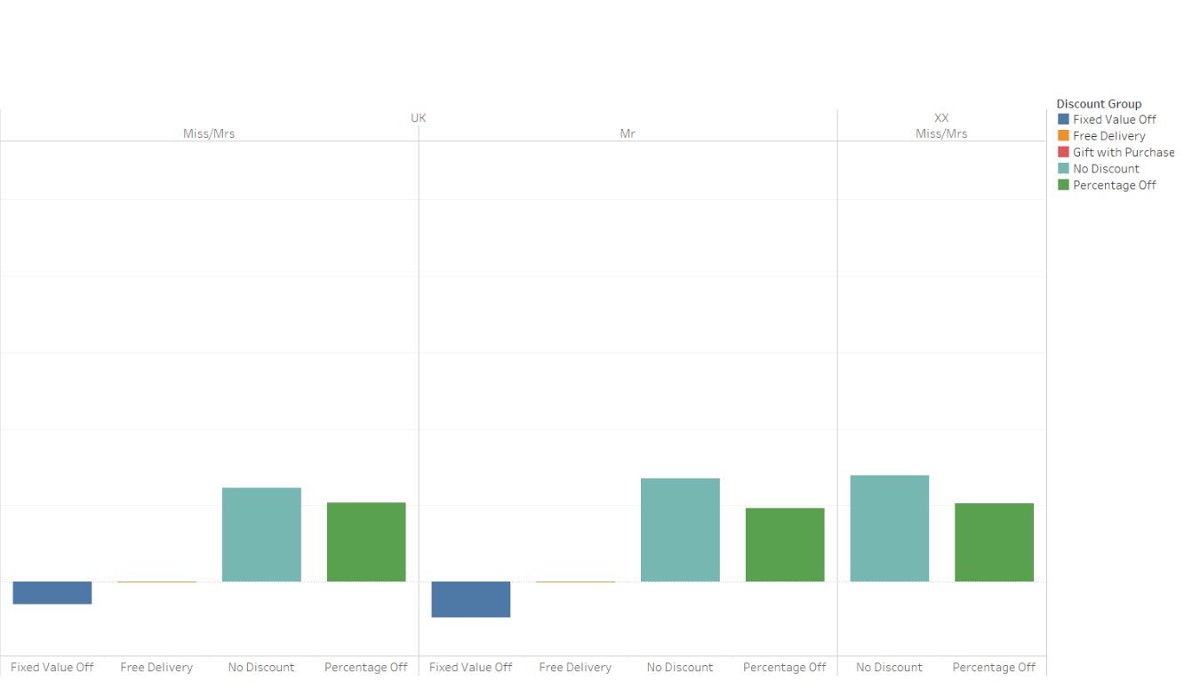
Part 2: How to Sell?
UK: No Discount generates the most profit, regardless of gender

Slide 10
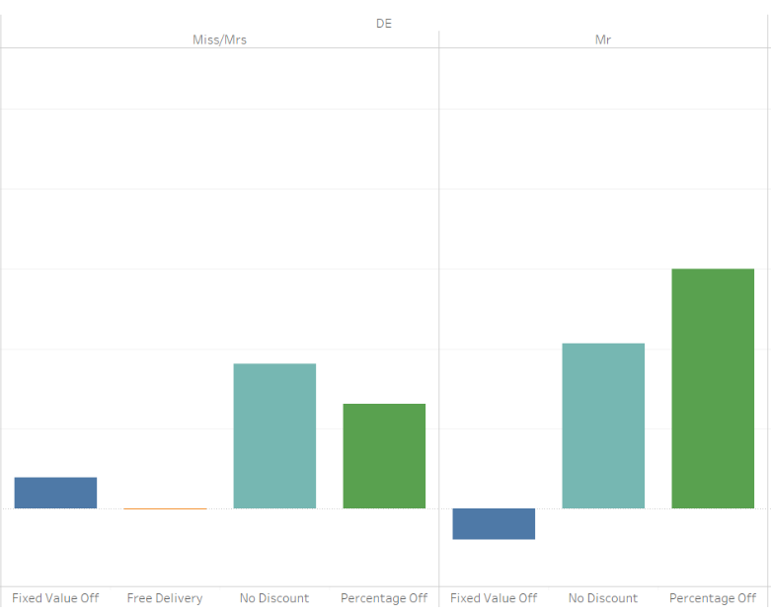
Part 2: How to Sell?
Germany: percentage off more effective for male

Slide 11
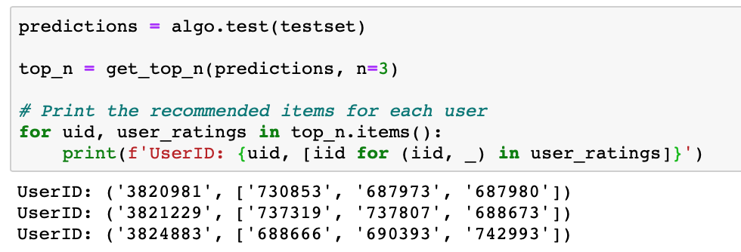



Method
Make a Purchase

Slide 12
Evaluation Metrics
Next Steps
-Profit growth
-Conversion Rate in recommendation
-The amount of transactions
1 - Use more accurate customer portrait to develop more customized discount strategy
2 - Use CNN to make recommendation based on picture of item
3 - Get user feedback on the rating of the purchase to get rid of some assumptions

Slide 13
Thank you!

