Slide 1
Stock Price Prediction
Yidi Zhang
Mentor: David Yakobovitch

Slide 2
Problems
I made a fantastic one year return from trading oxy, Occidental Petroleum. I am interested to find out whether I can do better by trading short term movement of oxy by using prediction models. Are there some stock price models that can make a good prediction?
Suppose a model is good enough, how do you use this to make profit?

Slide 3
I picked oxy, occidental petroleum, as the stock symbol for model prediction less votatile, less sentiment impact (less financial news) largely depend on wti crude oil price

Slide 4
Data Preprocessing
Data are downloaded from yahoo finance
All historical data, since Dec. 30, 1981
Two csv files, oxy and wti-crude oil price
7 features, open, high, low, close, adj close, volume, wti-crude
9895 rows

Slide 5
Exploratory Data Analysis
Clean data, ie, remove all nulls, merge all features, check data types
Check distribution of data
Data visualization
Merge two tables by dates

Slide 6
Comparison of three stock price models
LSTM (Long short term memory network)
GBM (Geometric Brownian Motion)
ARIMA (Auto-regression Integrated Moving Average)

Slide 7
LSTM-Long short term memory
a kind of neural network
Capable of learning long term dependency
Well suited for time series data
Allow multiple features as input
Features contains previous 30 day's stock price data
Using previous 100 day’s causes over-fit

Slide 8
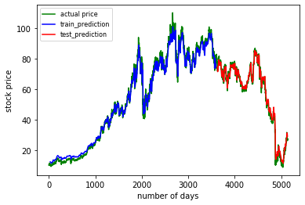
Model performance
MSE (Mean Square Error)
Train error 2.1916
Test error 2.4815
Slow to run
Can only predict next day stock price (one -step-ahead)
Prediction results are not unique

Slide 9
Geometric Brownian Motion
drift and diffusion are assumed to be constant
Can be improved by modelling drift and diffusion as functions of time
Only independent variable is historical stock price
Stochastic model- the randomness of stock fluctuation is simulated
Supported by well developed mathematical theories.

Slide 10
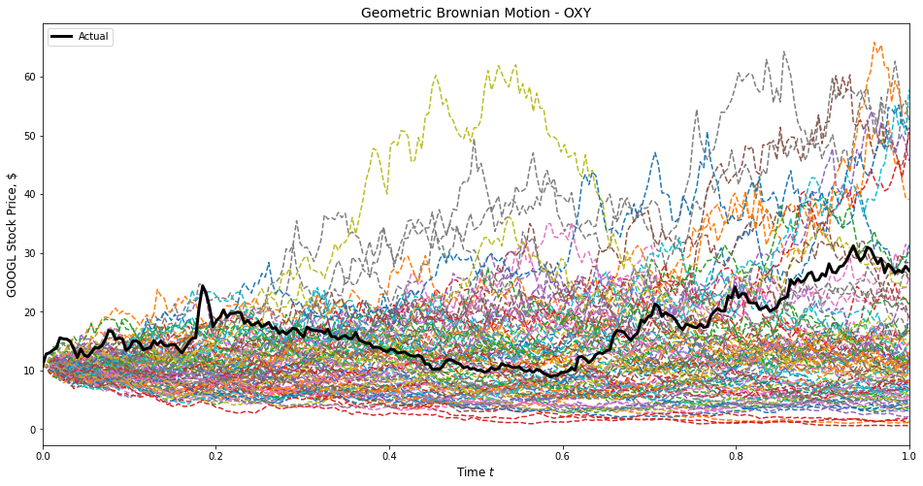
Model performance
Simulation of randomness
Stock price is the only feature
Prediction can be given by some range
Prediction power improves when combine with other important features
Non-linear(stochastic) model
Monte Carlo with 100 simulations
Normal distribution (95% confidence interval)

Slide 11
ARIMA model
Linear model
Checked stationality and choose best parameters
Log return transformation does not yield better p-value
Order of auto-regression term p
Order of differencing d
Order of moving average q

Slide 12
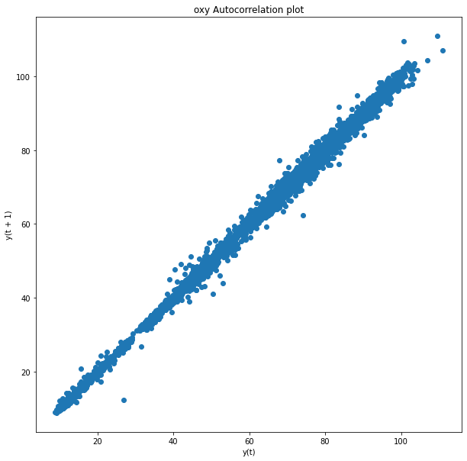
Auto-correlation
Strong correlation between the stock price for one day and next day
Linear relation
A good fit for ARIMA model

Slide 13
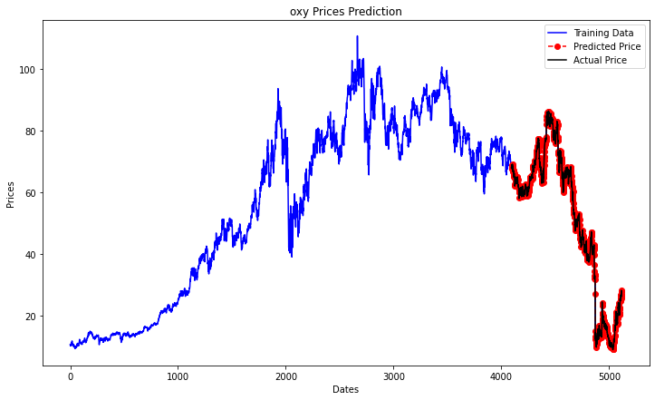
Model performance
MSE (mean square error)
Test error 1.196
Better than LSTM
Slow to build

Slide 14
 | LSM | GBM | ARIMA
features | Open,high, low, close, adj-close, volume, crude-oil price | Only daily stock price | Daily stock price and crude-oil price
Training errors | 2.1916 | Relied on the sound math theory | none
Test errors | 2.4815 | Relied on the sound math theory | 1.196
Actual predictions | poor | good | poor
Interpretability | Hard, black-box | Well-developed math theory | Hyper-parameters Can be tuned

Slide 15
Why these models are not effective?
Stock price are mainly driven by market sentiment
Market sentiment is hard to quantify and adopt for modeling
If stock price is predictable, then it violates the principle of efficiency market hypothesis-"neither fundamental analysis nor technical analysis can provide an advantage for an investor and that new information is instantly priced in to securities."

Slide 16
These models are still helpful
A combination of model predictions and wti crude oil price could give great insight for next day stock movement
Provides a range of stock price predictions, not exact
Provide good framework for further research

Slide 17
Trading Strategies
Buy and sell at target price if models predict a higher price movement while wti oil price moves higher
Short sell if models predict a lower price movement while wti oil price moves lower
Do not trade for other scenarios, for example, models predict a higher price movement but wti oil price moves lower

Slide 18
Future work
Calculate the mathematical relation of wti crude oil price and oxy stock price, ie, what is the change of oxy stock price per one dollar increase of wti crude oil price?
Geometric Brownian Motion model can be improved by considering drift and diffusion to be function of time.

Slide 19
Thank you!

