Slide 1
My Chatbot for Lost Package Tracking
Yiduo Ke for eGain

Slide 2
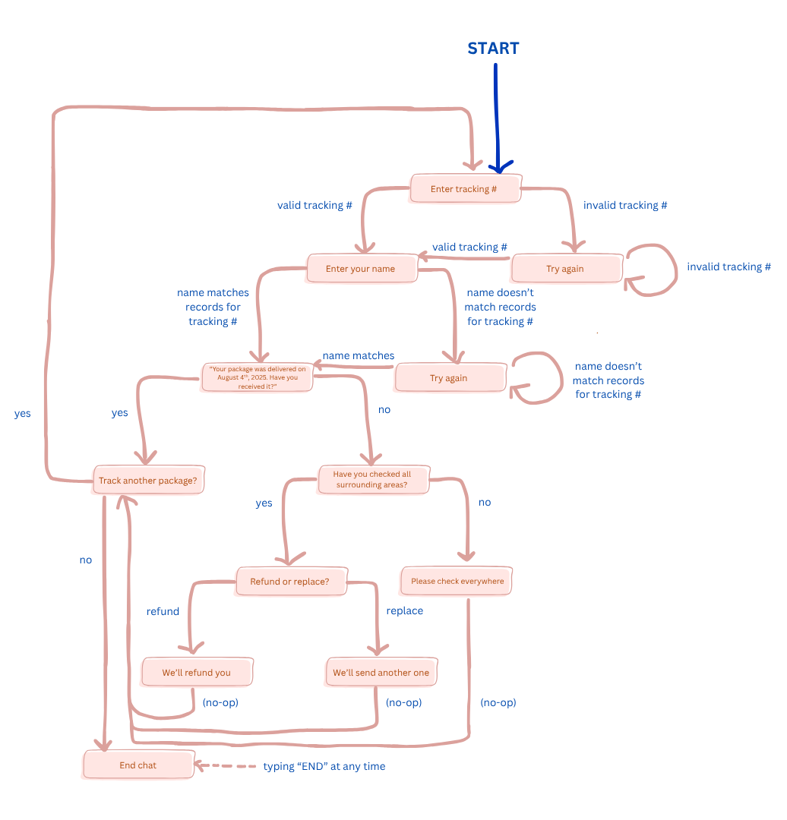
My design choices
For each question the chatbot asks, the possible input choices are listed. Below are some questions the chatbot asks:
'Bot: Would you like a refund or a replacement? (refund/replace)’
'Bot: I am sorry to hear that! Have you checked around your delivery area and asked your neighbors? (yes/no)’
'Bot: Would you like to track another package? (yes/no)'
Finite state automaton / flowchart detailing the chatbot logic

Slide 3
Error handling
When the user gives an invalid tracking number
When the user gave a valid tracking number, but gives a name that does not match the records for that tracking number
When the user gives an invalid input (writing anything other than “yes” or “no” when those are the only two valid inputs, or writing anything other than “refund” or “replace” when those are the only two valid inputs)

Slide 4
Technical implementation and challenges
The chatbot is a Python CLI (use Python3).
You fire it up by entering python chatbot.py into your terminal
The biggest challenge was not the programming portion, as that was straightforward, but rather designing the logic flow, especially in the levels near the bottom of the flowchart, when many states can flow into the “track another package?” state
Implementation: I maintain a state variable for the chatbot that keeps track of whether we are in the “awaiting tracking number input” state, or the “awaiting user response for wanting a refund or replacement” state, or the “awaiting whether user wants to track another package” state, and so on and so forth
User inputs are parsed, and the bot responds according to it and which state it is in, and then updates the state
This continues until the user either types ‘END’ or answers ‘no’ to the bot asking “Would you like to track another package? (yes/no)”
There are two valid predefined tracking numbers and their respective owner names. Tracking # ‘12345678’ belongs to yiduo, and ‘88888888’ belongs to cameron.
valid_records = {
'12345678': 'yiduo',
'88888888': 'cameron'
}

Slide 5
How I would improve the chatbot over time
Incorporate AI / LLM
Right now, the chatbot is basically an automated phone menu (IVR) in text form. It’s super inflexible with respect to user input recognition -- it only recognizes two valid inputs, but a non-tech savvy user or senior citizen may write something like “I want my money back!”, which it currently does not recognize. So, having natural language recognition would be a big step up
Offer an option for the user to log in so that they don’t have to manually type in their tracking number, but rather list to them all their active tracking numbers
Make a GUI for it so it’s more visually appealing

Slide 6
Thank you!!

