Slide 1
Gossip
JirongQiu | PingCAP

Slide 2
About me
Jirong Qiu
DBA
IBG Outbound

Slide 3
Chapters
Introduce
Theory
Code
Example

Slide 4
Intro
Protocol | Paxos | Raft | ZAB | Gossip
Software | OB | ETCD TiDB (multi) | Zookeeper | redis consul
Consistency | Strong | Strong | Strong | Week / Eventually
Heartbeat | To-Leader | To-Leader | To-Leader | Symmetric
State Change | boardcast | boardcast | boardcast | Dissemination

Slide 5
Intro
Docker
Swarm
Consul
Serf
memberlist
(gossip)
Notes:
Swarm is docker’s orginal orchestrate tool like Kubernetes.
Swarm use consul for service discovery by default, it is pluggable and can switch to etcd.
Consul is based on Serf. Serf is used to do failure detection via gossip protocol and make the whole cluster network coordinates
Serf is based on memberlist, it is a go project implements the Gossip protocol.

Slide 6
Theory
SWIM: Scalable Weakly-consistent Infection-style Process Group Membership Protocol
Notes:
paper: https://www.cs.cornell.edu/projects/Quicksilver/public_pdfs/SWIM.pdf

Slide 7
Theory
Problem in To-Leader heartbeat
every follower send heartbeat to leader, leader become hotspot.
Problem in state change boardcast
N msgs is boardcast from node (leader) at the same meantime, the network traffic will grow extremely heavy with a very large cluster scale N

Slide 8
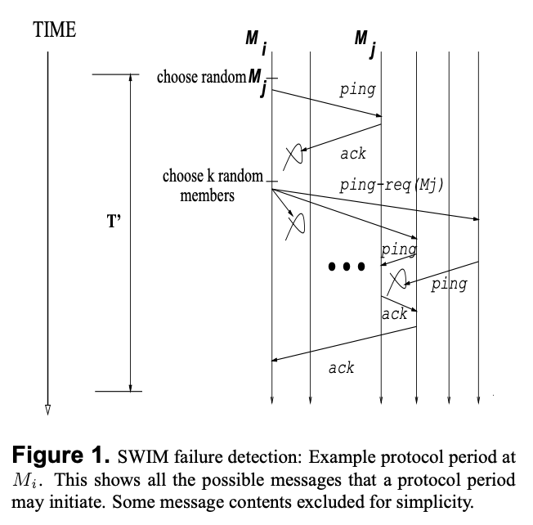
Theory
Notes:
During each protocol period of time T, a random member is selected from Mi's memberlist (called Mj), Mi send a ping message to Mj, and wait for ack.
If time-out, Mi select K random non-faulty members and send each a ping-req(Mj) message.
Each of selected member receive this message, ping Mj and forward the ack from Mj (if received) back to Mi.
At the end of T, Mi check if it has received any acks directly from Mj or indirectly from Mj.
If they all fail, Mi declare Mj as failed in its local memberlist, and spread dead-Mj msg to the cluster.
There are 2 problem in this figure.
After period of time T, Mi immediately declare the death of Mj. It is possible that Mj need process the ping request for a small duration of time, for e.g. Mj works on an overloaded host. This might cause Mj miss the opportunity to send timely replies, and be mistakenly declared as dead.
so we add a Suspicion mechanism.
After T time, Mj is not immediately declared as “dead”, Instead it is declared as “suspect”, and spread in cluster.
After another configurable timeout, Mj will finally be declared as “dead”
Mj may happen failure, for example Mj is down. But using random selection, in the extreme case, Mi may never choose Mj as probe target, so Mj’s failure may lead a large recover delay.

Slide 9

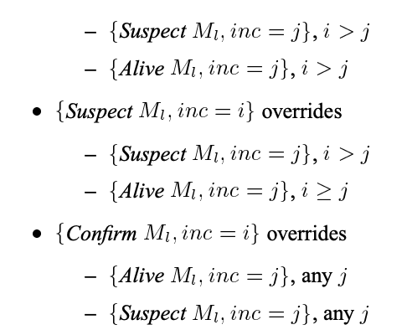
Theory
Notes:
inc is Incarnation number like raft term or log position.
Mi’s incarnation number is initialized to 0 when it join the cluster, and Incarnation number can be incremented only by Mi itself.
When Mi receive suspect-Mi in current incarnation, Mi will send Alive-Mi with an incremented incarnation number, and spread it in the cluster.

Slide 10
Theory
Round-Robin Probe Target Selection: Providing Time-Bounded Strong Completeness
Mi’s memberlist
Round-Robin and rearranges
Ma
random insert
Mb
Mj
Mc
...
M?
With Round-Robin selection, every member can be chosen at most 2n-1 protocol periods.
Notes:
With Round-Robin selection, every member can be chosen at most 2n-1 protocol periods.

Slide 11
Code
Action
Join
Leave
Shutdown
UpdateNode
Interface
delegate
State
Alive
Suspect
Dead
Left
Notes:
implement:
Join
One member can take an existing memberlist and attempt to join a cluster, it will contact all the given members and perform a state sync.
Initially, its Memberlist only contains it self, do the join will cause remote members to become aware of the existence of this member.
Join only need at least 1 successful contact. For e.g. one member want to join a 10 members cluster, and give it 5 members list to contact, assume it only contact 1 member successfully, and contact other 4 members failed, the join action is successful.
Leave
One member can Leave the cluster, it will declare its deadth, and spread it in cluster.
Even this member leave, it still can listen and handle Gossip msg.
Shutdown
Shutdown do not declare and spread its deadth in the cluster, it will immediately close all background listeneer and handler process, so the cluster being left will have to detect this member's shutdown by themselves. So if wish to more gracefully exit the cluster, call Leave first then Shutdown.
UpdateNode
UpdateNode will spread a new alive msg with high-level updated meta data, it will notify high-level delegate.
delegate
high-level register callback

Slide 12
Code
Func
tcpListen & Handle
userMsg
pushPullMsg
pingMsg
udpListen & Handle
compoundMsg
compressMsg
pingMsg
indirectPingMsg
ackRespMsg
suspectMsg
aliveMsg
deadMsg
userMsg
schedule
probe
pushpull
gossip
Notes:
when a member is created, it will only do 3 Funcs in its life cycle, each Func will run in a long running goroutine.
tcpListen & Handle
userMsg: notify high-level
pushPullMsg: readRemoteState & sendLocalState & mergeState & notify high-level
pingMsg: handle high-level tcp ping, reply ack
udpListen & Handle
compoundMsg: decompound msg and handle each
compressMsg: decompress msg and handle it
pingMsg: reply ack
indirectPingMsg: do indirect ping and reply ack
ackRespMsg: notify high-level
suspectMsg: follow suppect rules. If it's for self we need refute (spread a new Alive msg), otherwise spread suspect msg
aliveMsg (high priority): follow alive rules. If never seen before, it's a new member and store it in memberlist. If it's not for self, spread it. also notify high-level
deadMsg: follow dead rules. Delete this member in memberlist. notify high-level
userMsg: notify high-level
schedule
LAN / WAN
1. ProbeInterval: 1 * time.Second / 5 * time.Second
IndirectChecks: 3
probe: via udp network, basic failure detection logic, first directly send ping msg to member, if failed indirectly (IndirectChecks 3) send ping msg. If all failed, finally do suspect.
2. PushPullInterval: 30 * time.Second / 60 * time.Second
pushpull: via tcp network, choose a random member, perform a complete state exchange. receive remoteState & mergeState & notify high-level
3. GossipInterval: 200 * time.Millisecond / 500 * time.Millisecond
GossipNodes: 3 / 4
gossip: via udp network, fetch local broadcast queue msgs, gossip the message
if no message, do nothing
if 1 message, gossip it
if 2 or more messages, compound the Msgs, and gossip it

Slide 13
Thanks!

