Slide 1
Chapter 2: Image processing and computer vision
Camera models and parameters
Notes:
In this chapter we will learn the mathematical model of a computer and how to use the parameters involved.

Slide 2
Learn these in this chapter
Mathematical model of a camera
Intrinsic (static) parameters of a camera (Mint_{3x3})
Focal length (f) for fixed focal length, non-zoomed cameras
Image center (Ox,Oy)
Pixel width/height (Sx,Sy)
Extrinsic (dynamic) parameters of a camera (Mext_{3x4})
Rotation (R) and Translation (T) of a camera
Characteristics of R and T
Image formation and projection matrix P_{3x4}

Slide 3
Motivations
Digital cameras are everywhere.
Develop applications for cameras.
Help to choose a good camera.
Notes:
Before we learn how to use a camera for various applications we need to know the parameters and their characteristics.

Slide 4
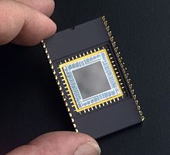
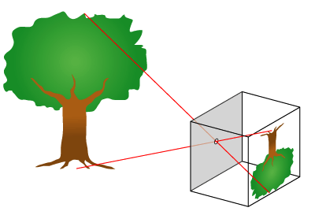

3D to 2D projection
http://upload.wikimedia.org/wikipedia/en/8/81/Pinhole-camera.png
Pinhole
Camera
Perspective model
u=F*X/Z
v=F*Y/Z
Virtual
Screen
or CCD
https://en.wikipedia.org/wiki/Charge-coupled_device
sensor
World
center
Y
v
v
F
Z
F
Real
Screen
Or
CCD
sensor
Thin lens
or a pin hole
Notes:
From your secondary school physics, you probably have learn this mode, if you place a lens in front of a screen you get the inverted image. A pin hoe camera and a thin lens camera are similar. The image is a 2D projection of the 3D world.

Slide 5
Perspective Projective
World Coordinates
Z_{w}
Y_{w}
X_{w}
Model M at t=1
O_{W}=(0,0,0)
(World center)
v-axis
image
(X,Y,Z)
R_{c},
T_{c}
Yc-axis
Camera
Coordinates.
(u,v)
Zc-axis
Principal axis
O_{c}=(0,0,0)
(Camera center)
c (Image center, o_{x},o_{y})
u-axis
F=focal length
Xc-axis
Notes:
There are many useful parameters that you need to know.
The most important parameters are:
Focal length
Camera center
Other useful parameters are:
Principal axis
Image center

Slide 6
Inspection exercise
Explain what are these variables.
F =(focal length)
C=(ox,oy)
Zc = principal axis
Ow =Camera center
(u,v) image 2-D axes
(Xc,Yc,Zc) 3-D axes
Focal length is the length between the lens and the image (screen)
Camera center is the origin of the camera coordinate system
Principal axis is the vector perpendicular to the image and intersects with the camera center
Image Center is the center the 2D image , or the point that the principal axis intersects with the image

Slide 7
The most important concept for a camera is the image formation process
3D Object points (X_{w},Y_{w},Z_{w}): world coordinates
Step1:
Motion of camera (R_{cam}=R_{c}⁻¹,T_{cam})
Camera Coordinates
result → X_{c},Y_{c},Z_{c}
Step2:
Projection of camera (F)
Result → image (x,y)

Slide 8
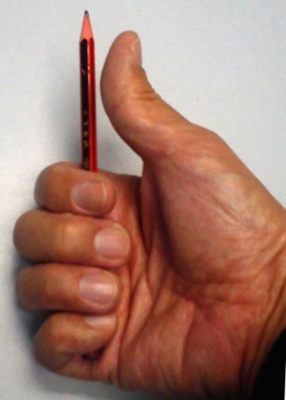
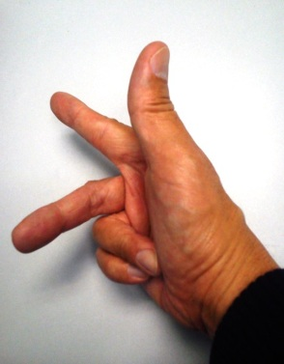
Step1
Motion of camera (R_{cam},T_{cam}) Camera Coordinates
result → Xc,Yc,Zc
Positive rotation angle about an axis: The thumb is pointing to the axis direction, a positive rotation angle is the same direction as the other fingers.
Y_{c}
Camera coordinates
R_{cam}=(R_{c})⁻¹, and T_{cam}=T_{c}
Thumb pointing Axis direction
X_{c}
Y_{w}
Z_{w}
Z_{c}
θ_{y}
θ_{z}
Right-hand coordinates
(world coordinates)
X_{w}
θ_{x}
Notes:
We have two coordinate systems,
(i) Camera coordinate system and (ii) world coordinate system.
The realtion between these two systems is Rc and Tc as shown

Slide 9
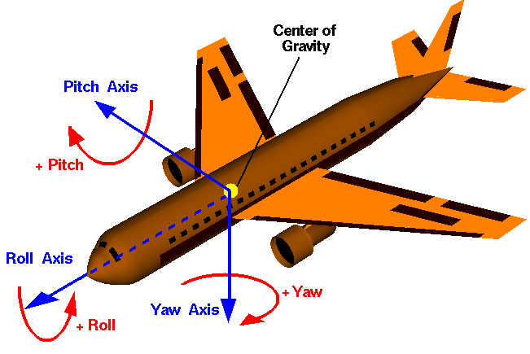
Rotation notations: Roll pitch yaw in aviation systems They are the same system– (you will see it if you turn the plane up side down). It is called the Right hand system.
http://www.grc.nasa.gov/WWW/k-12/airplane/rotations.html
Xw (Pitch angle)
Y_{w}
Z_{w}
θ_{y}
Zw (Roll angle)
θ_{z}
Right-hand coordinates
Yw (Yaw angle)
X_{w}
θ_{x}

Slide 10
A revision of basic matrix operations in case you forgot them
%matlab
A=[1 3 8
6 2 -9
10 7 5]
B=[2 1 0
7 -2 -1
3 4 6]
A’
A*B
A+B
Answer:>>
A’=
1 6 10
3 2 7
8 -9 5
A*B=
47 27 45
-1 -34 -56
84 16 23
A+B=
3 4 8
13 0 -10
13 11 11

Slide 11
Relate world 3D to camera 3D coordinates
P_{w}=World 3D coordinates=[X_{w},Y_{w},Z_{w}]^{T}
P_{c}= Camera 3D coordinates =[X_{c},Y_{c},Z_{c}] ^{T}
R_{cam}=rotate of the camera in world coord.
T_{cam}=T_{c}=translation of the camera in world coord.
We will show later why R_{c} is more convenient to be used

Slide 12
Step1:Motion of camera from world to camera coordinates
Camera motion (rotation=R_{cam}=R_{c}⁻¹, translation=T_{c}) will cause change of pixel position (x,y), See p156[1]
Y_{c}
Camera center
R_{cam},Tc
X_{c}
Y_{w}
Z_{w}
θ_{y}
Z_{c}
θ_{z}
X_{w}
World center
θ_{x}
Cameras v.3d

Slide 13
To learn more about : Rotation and Translation

Slide 14
Step2
Projection of camera (F)
Result → image (x,y)

Slide 15
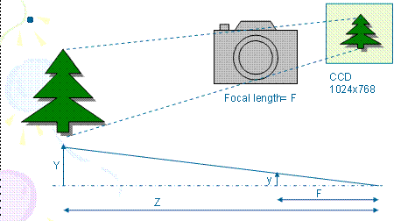
Step2: Camera coordinates to image plane (Perspective projection of camera in meters)
x=F*X_{c} /Z_{c}---(1)
y=F*Y_{c} /Z_{c}---(2)
F=focal length in meters
A Point in 3D space (camera reference space) is [X_{c},Y_{c},Z_{c}]^{T} in meters
The 2D image point is [x,y]^{T} in meters
Notes:
Step2 is about projection.

Slide 16
Worksheet 2.1
F=5mm
Z=1 meter
A tree is 2 meters high,0.5 meters wide. What is the size of the tree appears in the image?
Sketch the diagram.
Answer:___________

Slide 17
Picture element (Pixel) based image
[x,y]^{T} is in meters, []^{T} is transposition in matrix
[u,v]^{T} in pixels which is easy to be measured by the camera
Each pixel is Sx wide and Sy high
Typically Sx = Sy =5.46um (1um=1x10^-6m=1 micron)
Image=
1024x768
pixles
1 pixel
Sx =5.46um
Sy=5.46um
CCD Charge-coupled device
Sensor: http://en.wikipedia.org/wiki/Charge-coupled_device
Notes:
Of course we can measure everything in meters, but it would be easier if we measure them in picture elements (pixels), because pictures are turns into pixels in picture files.
I.e. a jpg file is 1024x768 , meaning 1024 pixels horizontally and 768 pixels vertically.
Each pixel is a point on the image CCD sensor, it responses to the light received at that picture element pixel position.

Slide 18
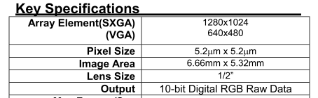
Worksheet 2.2
For an image of 1280x1024 Sx = Sy =5.2um.
What is the size of the image (CMOS or CCD sensor)?
Find the pixel size of your favorite camera.
Answer:________________
Image
(CMOS
sensor)
Hint:
www.ovt.com
OVT CameraChip OV9620/9120 webcam camera chip
Notes:
You can check with www.ovt.com
To see the specifications of various cameras.

Slide 19
Image center
In picture files, usually no negative pixel is used because the origin is at one of the corners (e.g. the right bottom (1,1))
Center of CCD is placed at C= (Ox,Oy)
v (pixels)
CCD
768
(O_{x},O_{y})=
(512,384) in pixels
x
u (pixels)
1024
1,1
Notes:
The image center is at the mid-point of the CCD, so if the CCD is 1024x768, image center is (1024/2,768/2)=(512,384)
But it is not always true because, placing the center of the CCD at the center of the projected image precisely is difficult if the cameras are mass produced. We will deal with this problem later in this chapter.

Slide 20
CCD Pixel (u,v) based Perspective Projection
(o_{x},o_{y}) in pixels is the image center
Equ. (1), (2) is divided by s_{x} ,s_{y,} resp.
Recall x=F*X_{c} /Z_{c}---(1)
y=F*Y_{c} /Z_{c}---(2)
u=(F/s_{x})*(X_{c}/Z_{c}) + o_{x} -------(3),F is in meter, F/Sx is in pixels
v=(F/s_{y})*(Y_{c}/Z_{c}) + o_{y} -------(4), F/Sx is in pixels
u=x/s_{x} + o_{x} , v=y/ s_{x}+ o_{y} (in pixels)
A Point in 3D space is [X_{c},Y_{c},Z_{c}]^{T} in meters (or pixels , still ok, because X_{c}/Z_{c} and Y_{c}/Z_{c} are ratios.
The 2D image point is [u,v]^{T} in pixels

Slide 21
Examples, center of CCD is at image center (right hand coordinate system with ideal CCD)
Z
y
v (pixels)
CCD
768
x
(O_{x},O_{y})=
(512,384) in pixels
u (pixels)
1024
1,1

Slide 22
A summary
The focal length can be expressed in pixels, f=F/Sx (assume Sx=Sy)
A 3D feature point is at P=(Xc,Yc,Zc)
The center of the CCD sensor is placed at Ox,Oy in pixels of the image.
The projected image point of P=(Xc,Yc,Zc) is at (u,v)
We can use Intrinsic parameters to represent all these.

Slide 23
Camera parameters
Intrinsic parameters
Focal length (F) in meters,
pixel width, height are s_{x} s_{y} in meters, resp.
image (or principal) center (o_{x},o_{y}) in pixels
lens-distortion (K) (assign no distortion , ignored here).
Extrinsic parameters
Position of the camera such as
(Rc -- rotation, Tc -- translation)

Slide 24
Intrinsic parameters from camera coordinates to image coordinates
M_{int} ( a 3x3 matrix)
(Current discussion assumes
center of camera=center of world)
Notes:
We now summarize all parameters that concerns the static part of the camera and call them intrinsic parameters.
They are called intrinsic parameters because they describe the internal parts of the camera after it is produced, they are fixed if the camera is a fixed focal length camera.
But for a zoomed camera (not fixed focal length camera) the focal length may change dynamically by the user during operations.

Slide 25
Typical webcam Intrinsic parameters
Fixed: by manufacturer
E.g. s_{x} =s_{y} ≈ 5.46um (1um=1x10^-6 m=1 micron)
For a CCD of 1024x768 , the image center or principal center is at (o_{x},o_{y})=(512x384)
lens-distortion (K) for fixed lens. (ignore to make life easier)
Variable :
focal length (e.g. f ≈ 5mm) , may be varied (zoom lens),
lens-distortion (K) may follow f.
Notes:
lens-distortion is not considered for this course, assume your camera is close to a pin hole camera and lens are of very good quality.

Slide 26
Intrinsic parameters M_{int} (an upper-triangular matrix)
_{3D=Xc,Yc,Zc in meters}
_{Image=u,v in pixels}
_{s= arbitrary rating factor}
_{Exercise:}
Show equations (3) (4) are the same as this matrix form eq(5).
Recall:
u=(F/s_{x})*(X_{c}/Z_{c}) + o_{x} --(3)
v=(F/s_{y})*(Y_{c}/Z_{c}) + o_{y} --(4)
Answer: from (5) use matrix multiplication
s*u=(F/s_{x})*(X_{c}) + o_{x} *Z_{c}--(i)
s*v=(F/s_{y})*(Y_{c}) + o_{y} *Z_{c}--(ii)
s= Z_{c}-------------------------(iii)
(i)/(iii), hence u=(F/s_{x})*(X_{c}/Z_{c}) + o_{x} , same as (3)
(ii)/(iii), hence v=(F/s_{y})*(Y_{c}/Z_{c}) + o_{y} , same as (4) (proved!)
Notes:
Equation 3 and 4 have been shown before, we can convert them into a matrix form in equation 5, you may try to show the conversion as an exercise.
Equation 5 has an advantage over formula 3 and 4, equation 5 is a linear system, in computer science we love linear systems because you can find a lot of math tools to solve linear problems.
Equation 3,4 are non-linear, because they involve division terms (1/Z) and make them difficult to solve.
But there is a hitch, (u,v) are what we want to find but the left hand side of the equation is a 3x1 vector [s*u,s*v,s]’ =[su,sv,s]’ , when you want to get u,v you need to do
u=su/s=first element of [su,sv,s]’ / last element of [su,sv,s]’
v=sv/s=second element of [su,sv,s]’ / last element of [su,sv,s]’
In fact we just delay the non-linear operation (the division operation) at the end. But we can use linear system math-tools to handle the more difficult stages and find u,v at the final step.
We call (u,v) as homogenous coordinates, remember that the actual pixel coordinates is (u,v) not su and sv.

Slide 27
Simplified Intrinsic parameters M_{int} in pixels Sx=Sy and F/sx= f in pixels
_{3D=Xc,Yc,Zc in meters}
_{Image=u,v in pixels}
_{s= arbitrary rating factor}

Slide 28
Examples, center of CCD is at image center (right hand coordinate system with ideal CCD)
y
Z
v (pixels)
CCD
768
x
(Ox,Oy)=
(512,384) in pixels
u (pixels)
1024
1,1

Slide 29
Worksheet 2.3
The camera CCD has 1024 x 768 pixels and the size of the CCD is 5mm x 3.75mm
What are Sx,Sy (pixel size)?
Ans:____________

Slide 30
Exercise 2.4, 3D projection on image (Ch1_e1.m )
s_{x}=s_{y}=5.4um
(o_{x},o_{y})=(512,384) in pixels
f=4.3mm/5.4um=800 pixels
[X_{c},Y_{c},Z_{c}]^{T} =[0.02,0.05,1.2]^{T}meters
[u v]’=??
Answer: ___________
Write a pseudo code (or matlab) program to calculate the projected point [u v] ^{T from} [X_{c},Y_{c},Z_{c}]T based on the above camera intrinsic parameters.

Slide 31
CCD is glued to the back of a camera
W2 begins
Ideally the CCD center is at ([512, 384]= image center) of a 1024x768 resolution camera.
Because of manufacturing fault the CCD center may not be at the image center.
Examples: 2 cameras of the same model (e.g. G11).
CCD
sensor
CCD
sensor
Camera 2: The sensor slight shifted to leftward and upward
Camera 1
Notes:
We mentioned this problem before, now here is the solution.

Slide 32
Worksheet 2.5 Because of manufacturing fault the CCD center may not be at image center, see(Ch1_e2.m )
X,Y,Z are in 3D
u,v are in 2D
Sx=sy=5.4um
(Ox,oy)=(600,400) in pixels
f=4.3mm/5.4um=800 pixels
[X_{c},Y_{c},Z_{c}]^{T}=[0.02,0.05,1.2]^{T} meters
[u v]^{T}=??
^{Answer:} [u v]^{T =____________________}
Conclusion: A 3D object point can have different image positions for different cameras (different M_{int}) placed at the same position.
Y
v
Z
u=400
Y=384 X
(1,1)
X=512
v=600
o_{x},o_{y}=600, 400
(Image center is shifted to o_{x},o_{y})

Slide 33
Worksheet 2.6: Discussion
Two canon G11 cameras are taking pictures of a static object from the same position (using the same tripod), why the pictures are not the same.
What are the differences and why?

Slide 34
Extrinsic parameters
(Week2)
M_{ext} ( a 3x4 matrix)
(Enable camera center moves away from world center)

Slide 35
Extrinsic parameters M_{ext}
External camera parameters
Move the camera to a new position

Slide 36
The camera moves to a new position : Rotate of the camera Rcam, and translate (T_{C}) to a new position
P_{w}
Z_{w}
Y_{w}
Camera
coordinates
Y_{c}
Z_{c}
R_{c}
X_{c}
T_{Cam}= T_{C} =camera translation
in the world coordinates
Rcam
Rotation
World center
Camera center
X_{w}
Convention used: In this chapter we rotate the camera theta_z (angle around z axis) first, then theta_y and finally theta_x.
World coordinates
(reference)
Notes:
The world coordinate system is always the reference. The camera is first placed at the world center and then translated to Tc (Tc is actual a vector in the world coordinate system).
Then it is rotated using a transformation Rc which can rotate a vector in the world coordinate system to the camera coordinate system.
What we want to know is what is a point Pw (in the world coordinate system) should be described (as Pc) in the camera coordinate system.
The answer is Pc=Rc(Pw-Tc), we are about to show it

Slide 37
Precise definition of Rc, Tc and Rcam
Rc: A vector Pw will appear as Pc in camera coordinates using Rc
Pc=Rc*Pw, where a vector Pw in world coordinates is the same vector Pc in camera coordinates . Pw does not change, it is only the coordinate system changes
R_{cam} is the rotational matrix that rotates the principal axis (Vz) of the camera position to a new position in the world coordinates. R_{cam} will change Vz, but it is always in the world coord. Sys. before and after the change.
So R_{cam} rotates the camera but R_{c} is the transformation to bring a vector in the world corrd. sys to the camera corrd sys.
R_{cam} = (R_{c}) ⁻¹ (Note R⁻¹=R^{T} for rotation matrices)
T_{cam}=T_{c} is the translation of the camera center in the world coordinate system.
(-Tc) takes the camera center back to the world center in the world coordinate system.
Notes:
We learned that a vector P in the world coordinates is described as Pc= Rc*P=Rx*Ry*Rz*P
if the coordinate system is rotated Rz in the z-axis, Ry in the y-axis and Rx-in the x-axis.

Slide 38
Study the rotation matrix Rc Relate world 3D to camera 3D coordinates
We study pure camera rotation first
Assume Translation (Tc) =0 (from world center to camera center)
P_{w}=a stationary vector in World 3D coordinates P_{w}=[X_{w},Y_{w},Z_{w}]^{T}
Pc=a point in camera 3D coordinates =[X_{c},Y_{c},Z_{c}] ^{T}
Rotation of camera is R_{cam} ,
We introduce a transform R_{c} , such that R_{c} =(R_{cam})⁻¹
Pc=Rc*Pw where a vector Pw in world coordinates is the same vector Pc in camera coordinates
That means a vector Pw in the world coordinate system will appear as Pc=Rc*Pw in the camera coordinate system
Rotation and Translation can be treated independently
We will study Rc in the following slides
P_{w}
Y_{w}
Z_{w}
R_{cam}
=Rc⁻¹
X_{w}
World coordinates
(reference)
Camera rotated R_{cam}

Slide 39
Camera coordinates rotated θ_{z} about Z-axis relative to the world coordinates
A vector Pw=[Xw,Yw,Zw]’ is in the world coordinates (blue/solid_axes) is the same vector [Xc,Yc,Zc]’ in the camera coordinates (red/dash_axes)
Z-axis is facing you
Concentrate on Yc
Y_{c}= -X_{w}sin(θ_{z})+Y_{w}cos(θ_{z})
Y_{c}
Concentrate on Xc
θ_{z}
Y_{w}
θ_{z}
Y_{w}
θ_{z}
θ_{z}
X_{w}cos(θ_{z})
X_{w}
X_{w}
X_{w}sin(θ_{z})
θ_{z}
Pw
θ_{z}
Pw
X_{c}
X_{c}=X_{w}cos(θ_{z})+Y_{w}sin(θ_{z})
Y_{w}sin(θ_{z})
Y_{w}cos(θ_{z})

Slide 40
Explanation for the previous slide
Assume the camera coordinate system is rotated by θ_{z} relative to the world coordinate system. A vector in the world coordinates (large blue) is (Xw,Yw) . We are not interested in Zw , because it will not be changed by rotation in the Z-axis.
Note: The large blue vector Pw is not changed, the only change here is the camera coordinate system (rotated θ_{z} against the z-axis). And the same (large blue) Pw vector as observed in the camera coordinate system is (Xc,Yc)
The left-hand diagram shows that the relation between Xc and (Xw,Yw, and θ_{z}), which is X_{c}=X_{w}cos(θ_{z})+Y_{w}sin(θ_{z})
The right-hand diagram shows that Y_{c}= -X_{w}sin(θ_{z})+Y_{w}cos(θ_{z})
And Zw = Zc , because there is no change of value in the z-axis.
So it generates the matrix formula at the top
Copied here for your reference:
That means a vector Pw in the world coordinate system will appear as Pc=Rc*Pw in the camera coordinate system.
Or it means [Xc,Yc,Zc]’=Rz*[Xw,Yw,Zw]’ in the camera coordinate system refers to the same vector as [Xw,Yw,Zw]’ in the world coordinate system.
Remember that Pc=[Xc,Yc,Zc]’ is a vector in the camera coordinate system and Pw=[Xw,Yw,Zw]’ is a vector in the world coordinate system.

Slide 41
Given rotation angles of a camera find Rc=RxRyRz A point in World Pw=[Xw,Yw,Zw]’ is the same as Pc=[Xc,Yc,Zc]’ in the camera coordinates by these transformations
Proved in the previous slide
You may prove the other 2 cases as an exercise
http://ccar.colorado.edu/ASEN5070/handouts/coordsys.htm
http://www.google.com.hk/url?sa=t&rct=j&q=&esrc=s&source=web&cd=1&ved=0CCwQFjAA&url=http%3A%2F%2Fwww.colorado.edu%2FASEN%2Fasen3200%2Fhandouts%2FCoordinateTransformations.doc&ei=nAfdUfTzBqWSiQeo-oCYDw&usg=AFQjCNGp5O37pYqGghl5Fft1skUmSXJ2-A&sig2=6q91UADC3ZZreVm_frd7rg&bvm=bv.48705608,d.aGc&cad=rja

Slide 42
Combine rotations in 3 axes: The camera has rotated (θx, θy, θz), Rc brings a vector in world coordinates to the camera coordinates
Convention used: In this chapter we rotate the camera an_z (angle around z axis) first, then an_y and finally an_x.
We use R_{c}=R_{c(xyz)} for this chapter and demo programs
Notes:
According the formula Rc=Rx*Ry*Rz, the camera rotations must be in this order: first rotate in z-axis , then y-axis , finally x-axis. See that Rz is closest to [Xw,Yw,Zw]’ , hence it is rotated first.
Make sure your camera is rotated in this way, then you can use the above formula.
You may use another camera rotation sequence but you must change the formula .
E.g. If first rotate in x-axis , then y-axis , finally z-axis you should use the formula Rc=Rz*Ry*Rx

Slide 43
Another rotation possibility: How about Rc=Rc_zyx? Here we use Rc_zyx (rotate x –axis first, then y the z) Here we show formulas of Rc_zyx, and Inverse(Rc_zyx)
If we need Rc_zyx (rotate against x-axis first…),the coord. change rotation matrix
and (Rc_zyx)⁻¹ the camera motion rotation matrix (proved in previous slides, around p39). (Note R⁻¹=R^{T} for rotation matrices R.)
This (Rc_zyx)⁻¹ is the rotation matrix used in P333 of Intro. Techno. For 3-D comp. vision by Trucco and verri.
Show R_{c(zyx)} this for your curiosity!
Notes:
According the formula Rc=Rx*Ry*Rz, the camera rotations must be in this order: first rotate in z-axis , then y-axis , finally x-axis. See that Rz is closest to [Xw,Yw,Zw]’ , hence it is rotated first.
Make sure your camera is rotated in this way, then you can use the above formula.
You may use another camera rotation sequence but you must change the formula .
E.g. If first rotate in x-axis , then y-axis , finally z-axis you should use the formula Rc=Rz*Ry*Rx

Slide 44
Matlab program for Rc Used the Matlab/symbolic processor to create the transformation matrix
% ---- matlab demo: camera position change ----------------------
%Init position of the camera
%A camera is normally at eye(3)(Identity matrix of 3x3), no rotate in world coord.sys,
%rotated vs 3 axes: an_x,an_y,an_z (an_z first, an_y second, an_x third here),to a new (camera) coord sys.
%Rc will bring a vector in world coord. to camera coord. Such that
%so Pc=Rc*Pw, Pw is a vector in world, Pc is the same vector in cam. sys.
syms an_x an_y an_z
Rz=[cos(an_z) sin(an_z) 0
-sin(an_z) cos(an_z) 0
0 0 1]
Ry=[cos(an_y) 0 -sin(an_y)
0 1 0
sin(an_y) 0 cos(an_y)]
Rx=[1 0 0
0 cos(an_x) sin(an_x)
0 -sin(an_x) cos(an_x)]
Rc = Rx*Ry*Rz
%Properties transpose(R)*R=I, inverse(R)*R=I, inverse(R)=transpose(R), det(R)=I .
% Rc =
% [ cos(an_y)*cos(an_z), cos(an_y)*sin(an_z), -sin(an_y)]
% [ cos(an_z)*sin(an_x)*sin(an_y) - cos(an_x)*sin(an_z), cos(an_x)*cos(an_z) + sin(an_x)*sin(an_y)*sin(an_z), cos(an_y)*sin(an_x)]
% [ sin(an_x)*sin(an_z) + cos(an_x)*cos(an_z)*sin(an_y), cos(an_x)*sin(an_y)*sin(an_z) - cos(an_z)*sin(an_x), cos(an_x)*cos(an_y)]

Slide 45
Study the rotation matrix Rc and Translation vector Tc M_{ext} (3x4)Matrix form When Tc is not Zero
P_{w}
Y_{w}
Camera
coordinates
Z_{c}
Y_{c}
X_{c}
Z_{w}
T_{C}= camera translation
R_{cam}=(R_{c})⁻¹
Camera center
X_{w}
World center
World coordinates
(reference)
Notes:
After studying the effect of pure camera rotation where Tc=0, we now study the problem when the camera has translation Tc.
From the diagram you should observe that , the vector from the camera (camera center) to the top of the Christmas tree is equal to Pw-Tc.
So now we have a vector (Pw-Tc, from the camera center to the Christmas tree top) in the world coordinates,
we want to know how the vector is described in the camera coordinate system, so Rc is no used.
We learned that a vector P in the world coordinates is described as Pc= Rc*P=Rx*Ry*Rz*P
if the coordinate system is rotated Rz in the z-axis, Ry in the y-axis and Rx-in the x-axis.
Hence the total transformation (combining translation and rotation) becomes Pc=Rc(Pw-Tc)
That means a point Pw in the world coordinates is the same point Pc in the camera coordinates if the camera is translated and rotated.

Slide 46
Combine Mint and Mext
Camera
Coord.
Xc
Yc
Zc
Camera
motion
R,T
M_{ext}=
Rc[I₃| -Tc]
World
Coord.
X_{w}
Y_{w}
Z_{w}
Image
u,v
Projection
M_{int}=

Slide 47
Take home exercise
Given the camera rotation angles are:
an_z is the rotation about the Z-axis.
an_y is the rotation about the Y-axis.
an_x is the rotation about the X-axis.
and the camera translation Tc=[tcx,tcy,tcz]’
Test using matlab to verify the Properties
R^{T}*R=I,R^{-1*}R=I, R⁻¹⁼R^{T}, det(R)=I are true
Write a matlab (or pseudo code) program to find [Xc,Yc,Zc]^{T} from [Xw,Yw,Zw]^{T}

Slide 48
Projection Combine Mint and Mext to become P

Slide 49
Conclusion
Studied camera model intrinsic parameters
Studied camera rotation matrix R
Studied camera translation matrix T
Studied camera projection matrix P
49

Slide 50
References
[1A] Hartley and Zisserman, Multiple geometry in computer vision, Cambridge, University Press. 2004 (2nd edition, paperback).
[1B] Hartley and Zisserman, Multiple geometry in computer vision, Cambridge, University Press. 1999 (1st edition, hardback).
[2] CVonline: http://homepages.inf.ed.ac.uk/rbf/CVonline
[3] On Skew Symmetric matrix http://mathworld.wolfram.com/SkewSymmetricMatrix.html
[4] On Skew Symmetric matrix http://www.ee.ic.ac.uk/hp/staff/dmb/matrix/special.html#Skew_Symmetric
[5]On RQ decomposition http://wwwcsif.cs.ucdavis.edu/~wangjj/gsvd/codes/rq5.m
[6] Camera calibration matlab toolbox http://www.vision.caltech.edu/bouguetj/calib_doc/index.html#examples
[7] OpenGL Angles to Axes: http://www.songho.ca/opengl/gl_anglestoaxes.html
[8] http://www.ewerksinc.com/refdocs/coordinate%20and%20unit%20vector.pdf
[9] coordinate systems http://www.colorado.edu/ASEN/asen3200/handouts/
[10]http://www.google.com.hk/url?sa=t&rct=j&q=&esrc=s&source=web&cd=1&ved=0CCwQFjAA&url=http%3A%2F%2Fwww.colorado.edu%2FASEN%2Fasen3200%2Fhandouts%2FCoordinateTransformations.doc&ei=nAfdUfTzBqWSiQeo-oCYDw&usg=AFQjCNGp5O37pYqGghl5Fft1skUmSXJ2-A&sig2=6q91UADC3ZZreVm_frd7rg&bvm=bv.48705608,d.aGc&cad=rja
50

Slide 51
End

Slide 52
Appendix 1
Some text like to use Rcam rather than Rc, we will see the difference.
Cameras v.3a
52

Slide 53
Precise definition of Rc, Tc and Rcam
Rc: A vector (V) Pw will appear as Pc in camera coordinates using Rc
Pc=Rc*Pw , where a vector Pw in world coordinates is the same vector Pc in camera coordinates . V does not change, it is only the coordinate system changes
R_{cam} is the rotational matrix that rotates the principal axis (Vz) of the camera position to a new position in the world coordinates. R_{cam} will change Vz, but it is always in the world coord. Sys. before and after the change.
So R_{cam} rotates the camera but R_{c} is the transform to bring a vector in the world corrd. sys to the camera corrd sys.
R_{cam} = (R_{c}) ⁻¹ (Note R⁻¹=R^{T} for rotation matrices)
T_{cam}=T_{c} is the translation of the camera center in the world coordinate system.
(-Tc) takes the camera center back to the world center in the world coordinate system.
Notes:
We learned that a vector P in the world coordinates is described as Pc= Rc*P=Rx*Ry*Rz*P
if the coordinate system is rotated Rz in the z-axis, Ry in the y-axis and Rx-in the x-axis.

Slide 54
To rotate a vector in 2D
The vector u_{x} [1,0]’ is rotated by the matrix R(θ) to become
x’=cos(θ), y’=sin(θ)
The vector u_{y} [0,1]’ is rotated by the matrix R(θ) to become
x’’= -sin(θ), y’’= cos(θ)
A general vector v is a combination of
x component (v_{x}) * u_{x} and
y component (v_{y}) * u_{y}
So, v is rotated to v’ by R(θ) to produce x’+x’’ in x and y’+ y’’ in y
-sin(θ)
u_{y}
cos(θ)
-θ
θ
sin(θ)
cos(θ)
u_{x}
Radius=1
http://reedbeta.wordpress.com/2011/09/18/rotations-and-infinitesimal-generators/

Slide 55
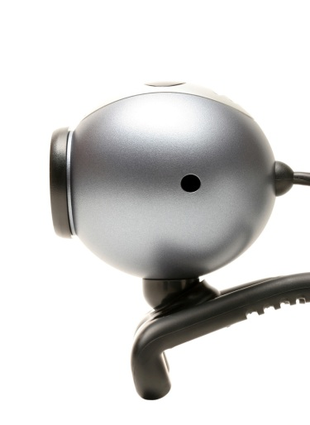
To show Rcam = Rc⁻¹
We can think of R_{cam}(θ_{Z})rotates the camera pointing to Yw in the world coordinate system to a new direction of Yc. Using the result of vector rotation described in the last slide we can show that R_{cam}(θ_{Z})=Rc(θ_{Z})⁻¹
(Note R⁻¹=R^{T} for rotation matrices R.)
Y_{c}
θ_{z}
Y_{w}
a=0.3 %matlab demo:
Rc_pos_a=[cos(a) sin(a) 0
-sin(a) cos(a) 0
0 0 1]
Rcam=[cos(a) -sin(a) 0
sin(a) cos(a) 0
0 0 1]
Rc_pos_a*Rcam %it is I3
θ_{z}
X_{c}
X_{w}

Slide 56
This slide is shown earlier combine rotations in 3 axes: The camera has rotated (θx, θy, θz), Rc brings a vector in world coordinates to the camera coordinates
Notes:
According the formula Rc=Rx*Ry*Rz, the camera rotations must be in this order: first rotate in z-axis , then y-axis , finally x-axis. See that Rz is closest to [Xw,Yw,Zw]’ , hence it is rotated first.
Make sure your camera is rotated in this way, then you can use the above formula.
You may use another camera rotation sequence but you must change the formula .
E.g. If first rotate in x-axis , then y-axis , finally z-axis you should use the formula Rc=Rz*Ry*Rx

Slide 57
Rc=Rc_xyz, Here we use Rc_zyx (rotate x –axis first, then y the z) Here we show Rc_zyx, and Inverse(Rc_zyx)
If we need Rc_zyx (rotate against x-axis first) which is the coordinate change rotation matrix
and (Rc_zyx)⁻¹ is the camera motion rotation matrix (proved in previous slides, around p39) (Note R⁻¹=R^{T} for rotation matrices R.)
This (Rc_zyx)⁻¹ is the rotation matrix used in P333 of Intro. Techno. For 3-D comp. vision by Trucco and verri.
(Note R⁻¹=R^{T} for rotation matrices R.)
Notes:
According the formula Rc=Rx*Ry*Rz, the camera rotations must be in this order: first rotate in z-axis , then y-axis , finally x-axis. See that Rz is closest to [Xw,Yw,Zw]’ , hence it is rotated first.
Make sure your camera is rotated in this way, then you can use the above formula.
You may use another camera rotation sequence but you must change the formula .
E.g. If first rotate in x-axis , then y-axis , finally z-axis you should use the formula Rc=Rz*Ry*Rx

Slide 58
syms an_x an_y an_z
%----------------------------------
Rz=[cos(an_z) sin(an_z) 0
-sin(an_z) cos(an_z) 0
0 0 1]
%---------------------------------------
Ry=[cos(an_y) 0 -sin(an_y)
0 1 0
sin(an_y) 0 cos(an_y)]
%-------------------------------------
Rx=[1 0 0
0 cos(an_x) sin(an_x)
0 -sin(an_x) cos(an_x)]
%-----------------------------------------
'This is to show the following 3 important results'
Rxyz=Rx*Ry*Rz
Rzyx=Rz*Ry*Rx
inv_Rzyx=inv(Rzyx)
%inv_Rzyx is used in P333 of Trucco
Result: -------------
Rxyz =
[ cos(an_y)*cos(an_z), cos(an_y)*sin(an_z), -sin(an_y)]
[ cos(an_z)*sin(an_x)*sin(an_y) - cos(an_x)*sin(an_z), cos(an_x)*cos(an_z) + sin(an_x)*sin(an_y)*sin(an_z), cos(an_y)*sin(an_x)]
[ sin(an_x)*sin(an_z) + cos(an_x)*cos(an_z)*sin(an_y), cos(an_x)*sin(an_y)*sin(an_z) - cos(an_z)*sin(an_x), cos(an_x)*cos(an_y)]
Rzyx =
[ cos(an_y)*cos(an_z), cos(an_x)*sin(an_z) + cos(an_z)*sin(an_x)*sin(an_y), sin(an_x)*sin(an_z) - cos(an_x)*cos(an_z)*sin(an_y)]
[ -cos(an_y)*sin(an_z), cos(an_x)*cos(an_z) - sin(an_x)*sin(an_y)*sin(an_z), cos(an_z)*sin(an_x) + cos(an_x)*sin(an_y)*sin(an_z)]
[ sin(an_y), -cos(an_y)*sin(an_x), cos(an_x)*cos(an_y)]
inv_Rzyx =
[ cos(an_y)*cos(an_z), -cos(an_y)*sin(an_z), sin(an_y)]
[ cos(an_x)*sin(an_z) + cos(an_z)*sin(an_x)*sin(an_y), cos(an_x)*cos(an_z) - sin(an_x)*sin(an_y)*sin(an_z), -cos(an_y)*sin(an_x)]
[ sin(an_x)*sin(an_z) - cos(an_x)*cos(an_z)*sin(an_y), cos(an_z)*sin(an_x) + cos(an_x)*sin(an_y)*sin(an_z), cos(an_x)*cos(an_y)]

Slide 59
%show transpose(Rc_pos_a)=Rc_neg_a and Rc_pos_a *transpose(Rc_pos_a) =I
% '----------results--------'
% a = 0.3000
%Rc_pos_a =
% 0.9553 0.2955 0
% -0.2955 0.9553 0
% 0 0 1.0000
% transpose (Rc_pos_a is)
% 0.9553 -0.2955 0
% 0.2955 0.9553 0
% 0 0 1.0000
% Rc_neg_a =
% 0.9553 -0.2955 0
% 0.2955 0.9553 0
% 0 0 1.0000
% shown: transpose(Rc_pos_a)=Rc_neg_a
% show that Rc_pos_a*transpose(Rc_pos_a)=I
% 1 0 0
% 0 1 0
% 0 0 1
a=0.3 %any angle a is ok
'Rc_pos_a is '
Rc_pos_a=[cos(a) sin(a) 0
-sin(a) cos(a) 0
0 0 1]
'transpose (Rc_pos_a is) '
Rc_pos_a'
'Rc_neg_a is '
Rc_neg_a=[cos(-a) sin(-a) 0
-sin(-a) cos(-a) 0
0 0 1]
‘shown: transpose(Rc_pos_a)=Rc_neg_a '
'------------------------------------------------'
'show that Rc_pos_a*transpose(Rc_pos_a)=I '
Rc_pos_a*Rc_pos_a'

Slide 60
Practical issue: center of CCD is at image center (right hand coordinate system with realistic CCD) **Image origin at left-top corner for .bmp .jpg etc. ‘-f’ instead of ‘f’
y
Z
1024
CCD
1,1
u (pixels)
(Ox,Oy)=
(512,384) in pixels
x
768
v (pixels)

Slide 61
Summary and meanings of notations used in this chapter
Pw=a vector in the world coordinate system.
Pc= the same vector (as Pw) but in the camera coordinate system.
Rcam, Tc : rotation, translation, resp., in the world coord. sys.
Rc : After the camera is rotated Rcam and translated Tc in the world coordinate system, Pc=Rc*(Pw-Tc)-----(i)
We proved that Rcam=Rc⁻¹, so equation (i) becomes
Pc=(Rcam)⁻¹*(Pw-Tc)----(ii), or
Pc=(Rcam)⁻¹*(Pw)+ (-(Rcam)⁻¹*Tc)----(ii), so we can make
Pc=R*Pw+T---(iii), if
R=(Rcam)⁻¹=Rc and
T=(-(Rcam)⁻¹*Tc) = -Rc*Tc
Equation (iii) is an expression used in many articles.

Slide 62
rot_syms.m : use the matlab symbolic processor to show varies possible arrangements of the Rotational matrix
% rot_syms.m
%show varies arrangement of the
%R rotation matrix, khw 140319
syms an_x an_y an_z real
Rz=[cos(an_z) sin(an_z) 0
-sin(an_z) cos(an_z) 0
0 0 1];
Ry=[cos(an_y) 0 -sin(an_y)
0 1 0
sin(an_y) 0 cos(an_y)];
Rx=[1 0 0
0 cos(an_x) sin(an_x)
0 -sin(an_x) cos(an_x)];
Rxyz= Rz*Ry*Rx %do x first then y, z
transpose_Rxyz= (Rz*Ry*Rx)'
inverse_Rxyz= inv(Rz*Ry*Rx)
Rzyx= Rx*Ry*Rz %do z first then y, x
transpose_Rzyx= (Rx*Ry*Rz)' %do z first, then z, and y
inverse_Rzyx= inv(Rx*Ry*Rz)%do z first, then z, and y
%ANOTHER SET , IN THIS SET r_x=Rx', r_y=Ry', r_z=Rz'
rz=Rz';
ry=Ry';
rx=Rx';
rxyz= rz*ry*rx %do x first then y, z
transpose_rxyz= (rz*ry*rx)'
inverse_rxyz= inv(rz*ry*rx)
rzyx= rx*ry*rz %do z first then y, x
transpose_rzyx= (rx*ry*rz)' %do z first, then z, and y
inverse_Rzyx= inv(rx*ry*rz)%do z first, then z, and y

Slide 63
Output of rot_syms.m (page1)
>> rot_syms
Rxyz =
[ cos(an_y)*cos(an_z), cos(an_x)*sin(an_z) + cos(an_z)*sin(an_x)*sin(an_y), sin(an_x)*sin(an_z) - cos(an_x)*cos(an_z)*sin(an_y)]
[ -cos(an_y)*sin(an_z), cos(an_x)*cos(an_z) - sin(an_x)*sin(an_y)*sin(an_z), cos(an_z)*sin(an_x) + cos(an_x)*sin(an_y)*sin(an_z)]
[ sin(an_y), -cos(an_y)*sin(an_x), cos(an_x)*cos(an_y)]
transpose_Rxyz =
[ cos(an_y)*cos(an_z), -cos(an_y)*sin(an_z), sin(an_y)]
[ cos(an_x)*sin(an_z) + cos(an_z)*sin(an_x)*sin(an_y), cos(an_x)*cos(an_z) - sin(an_x)*sin(an_y)*sin(an_z), -cos(an_y)*sin(an_x)]
[ sin(an_x)*sin(an_z) - cos(an_x)*cos(an_z)*sin(an_y), cos(an_z)*sin(an_x) + cos(an_x)*sin(an_y)*sin(an_z), cos(an_x)*cos(an_y)]
inverse_Rxyz =
[ cos(an_y)*cos(an_z), -cos(an_y)*sin(an_z), sin(an_y)]
[ cos(an_x)*sin(an_z) + cos(an_z)*sin(an_x)*sin(an_y), cos(an_x)*cos(an_z) - sin(an_x)*sin(an_y)*sin(an_z), -cos(an_y)*sin(an_x)]
[ sin(an_x)*sin(an_z) - cos(an_x)*cos(an_z)*sin(an_y), cos(an_z)*sin(an_x) + cos(an_x)*sin(an_y)*sin(an_z), cos(an_x)*cos(an_y)]
Rzyx =
[ cos(an_y)*cos(an_z), cos(an_y)*sin(an_z), -sin(an_y)]
[ cos(an_z)*sin(an_x)*sin(an_y) - cos(an_x)*sin(an_z), cos(an_x)*cos(an_z) + sin(an_x)*sin(an_y)*sin(an_z), cos(an_y)*sin(an_x)]
[ sin(an_x)*sin(an_z) + cos(an_x)*cos(an_z)*sin(an_y), cos(an_x)*sin(an_y)*sin(an_z) - cos(an_z)*sin(an_x), cos(an_x)*cos(an_y)]
transpose_Rzyx =
[ cos(an_y)*cos(an_z), cos(an_z)*sin(an_x)*sin(an_y) - cos(an_x)*sin(an_z), sin(an_x)*sin(an_z) + cos(an_x)*cos(an_z)*sin(an_y)]
[ cos(an_y)*sin(an_z), cos(an_x)*cos(an_z) + sin(an_x)*sin(an_y)*sin(an_z), cos(an_x)*sin(an_y)*sin(an_z) - cos(an_z)*sin(an_x)]
[ -sin(an_y), cos(an_y)*sin(an_x), cos(an_x)*cos(an_y)]
inverse_Rzyx =
[ cos(an_y)*cos(an_z), cos(an_z)*sin(an_x)*sin(an_y) - cos(an_x)*sin(an_z), sin(an_x)*sin(an_z) + cos(an_x)*cos(an_z)*sin(an_y)]
[ cos(an_y)*sin(an_z), cos(an_x)*cos(an_z) + sin(an_x)*sin(an_y)*sin(an_z), cos(an_x)*sin(an_y)*sin(an_z) - cos(an_z)*sin(an_x)]
[ -sin(an_y), cos(an_y)*sin(an_x), cos(an_x)*cos(an_y)]

Slide 64
Output of rot_syms.m (page2)
rxyz =
[ cos(an_y)*cos(an_z), cos(an_z)*sin(an_x)*sin(an_y) - cos(an_x)*sin(an_z), sin(an_x)*sin(an_z) + cos(an_x)*cos(an_z)*sin(an_y)]
[ cos(an_y)*sin(an_z), cos(an_x)*cos(an_z) + sin(an_x)*sin(an_y)*sin(an_z), cos(an_x)*sin(an_y)*sin(an_z) - cos(an_z)*sin(an_x)]
[ -sin(an_y), cos(an_y)*sin(an_x), cos(an_x)*cos(an_y)]
transpose_rxyz =
[ cos(an_y)*cos(an_z), cos(an_y)*sin(an_z), -sin(an_y)]
[ cos(an_z)*sin(an_x)*sin(an_y) - cos(an_x)*sin(an_z), cos(an_x)*cos(an_z) + sin(an_x)*sin(an_y)*sin(an_z), cos(an_y)*sin(an_x)]
[ sin(an_x)*sin(an_z) + cos(an_x)*cos(an_z)*sin(an_y), cos(an_x)*sin(an_y)*sin(an_z) - cos(an_z)*sin(an_x), cos(an_x)*cos(an_y)]
inverse_rxyz =
[ cos(an_y)*cos(an_z), cos(an_y)*sin(an_z), -sin(an_y)]
[ cos(an_z)*sin(an_x)*sin(an_y) - cos(an_x)*sin(an_z), cos(an_x)*cos(an_z) + sin(an_x)*sin(an_y)*sin(an_z), cos(an_y)*sin(an_x)]
[ sin(an_x)*sin(an_z) + cos(an_x)*cos(an_z)*sin(an_y), cos(an_x)*sin(an_y)*sin(an_z) - cos(an_z)*sin(an_x), cos(an_x)*cos(an_y)]
rzyx =
[ cos(an_y)*cos(an_z), -cos(an_y)*sin(an_z), sin(an_y)]
[ cos(an_x)*sin(an_z) + cos(an_z)*sin(an_x)*sin(an_y), cos(an_x)*cos(an_z) - sin(an_x)*sin(an_y)*sin(an_z), -cos(an_y)*sin(an_x)]
[ sin(an_x)*sin(an_z) - cos(an_x)*cos(an_z)*sin(an_y), cos(an_z)*sin(an_x) + cos(an_x)*sin(an_y)*sin(an_z), cos(an_x)*cos(an_y)]
transpose_rzyx =
[ cos(an_y)*cos(an_z), cos(an_x)*sin(an_z) + cos(an_z)*sin(an_x)*sin(an_y), sin(an_x)*sin(an_z) - cos(an_x)*cos(an_z)*sin(an_y)]
[ -cos(an_y)*sin(an_z), cos(an_x)*cos(an_z) - sin(an_x)*sin(an_y)*sin(an_z), cos(an_z)*sin(an_x) + cos(an_x)*sin(an_y)*sin(an_z)]
[ sin(an_y), -cos(an_y)*sin(an_x), cos(an_x)*cos(an_y)]
inverse_Rzyx =
[ cos(an_y)*cos(an_z), cos(an_x)*sin(an_z) + cos(an_z)*sin(an_x)*sin(an_y), sin(an_x)*sin(an_z) - cos(an_x)*cos(an_z)*sin(an_y)]
[ -cos(an_y)*sin(an_z), cos(an_x)*cos(an_z) - sin(an_x)*sin(an_y)*sin(an_z), cos(an_z)*sin(an_x) + cos(an_x)*sin(an_y)*sin(an_z)]
[ sin(an_y), -cos(an_y)*sin(an_x), cos(an_x)*cos(an_y)]

Slide 65
Rotation matrix

Slide 66
Answer for Worksheet2 Image processing and computer vision
Camera models and parameters
Answers

Slide 67
Answer: Worksheet 2.1
F=5mm
Z=1 meter
A tree is 2 meters high,0.5 meters wide. What is the size of the tree appears in the image?
Answer: using y=F*Y_{c} /Z_{c}
Tall=y=F*Y/Z=5x10⁻³x2 meters/1 meter=10mm
or 5*2*10^-3/1 =10mm
Wide=x=F*X/Z=5x10⁻³x0.5 meters/1 meter=0.0025 meter=2.5mm,
or =5*0.5*10^-3*1 =2.5mm

Slide 68
Answer: Worksheet 2.2
For an image of 1280x1024, Sx = Sy =5.2um.
What is the size of the image (CMOS or CCD sensor)?
1280*5.2um =1280*5.2*10^-6 = 0.00666m=6.66mm
1024X5.2um =1024*5.2*10^-6 = 0.00532m=5.32mm
Image
(CMOS sensor)
www.ovt.com
OVT CameraChip OV9620/9120 webcam camera chip

Slide 69
Answer Worksheet 2.3
The camera CCD has 1024x768 pixels and is 5mmx3.75mm
What are Sx,Sy (pixel size)?
Ans:
Sx=5mm/1024=4.88um
Sy=3.75mm/768=4.88um
Why Sx=Sy? Calculate the Sx , Sy of your favorite digital camera.

Slide 70
Answer: Worksheet 2.4, 3D projection on image (Ch1_e1.m )
%matlab
k=[800 0 512
0 8000 384
0 0 1]
x=[0.02 0.05 1.2]'
im=k*x
im(1)/im(3)
im(2)/im(3)
%answer:
im =
630.4000
860.8000
1.2000
u,v=
525.3333
717.3333
s_{x}=s_{y}=5.4um
(o_{x},o_{y})=(512,384) in pixels
f=4.3mm/5.4um=800 pixels
[X_{c},Y_{c},Z_{c}]^{T} =[0.02,0.05,1.2]^{T}meters
[u v]’=??
^{Answer: [525.3, 717.3]T}
Write a pseudo code (or matlab) program to calculate the projected point [u,v]’ from [Xc,Yc,Zc]’ based on the above camera intrinsic parameters.

Slide 71
Answer Worksheet 2.5 Because of manufacturing fault CCD center may not be at image center, example (Ch1_e2.m )
Sx=sy=5.4um
(Ox,oy)=(600,400) in pixels
f=4.3mm/5.4um=800 pixels
[X_{c},Y_{c},Z_{c}]^{T}=[0.02,0.05,1.2]^{T} meters
[u v]^{T}=[613.3, 733.3]^{T}
Conclusion: A 3D object point can have different image positions for different cameras (different M_{int}) placed at the same position.
X,Y,Z are in 3D
u,v are in 2D
Y
v
Z
u=400
Y=384 X
(1,1)
X=512
v=600
o_{x},o_{y}=600, 400
(Image center is shifted to o_{x},o_{y})

Slide 72
Answer: Worksheet 2.6 Discussion
Two canon G11 cameras are taking pictures of a static object from the same position (using the same tripod), why the pictures are not the same.
What are the differences and why?
CCD are not at the same position
Focal lengths are not the same (zooming)

Slide 73
Tutorial exercises
Cmsc5711 : ch2 camera models

Slide 74
CMSC5711: Tutorial 2.1 : Intrinsic parameters M_{int} (an upper-triangular matrix)
_{3D=Xc,Yc,Zc in meters}
_{Image=u,v in pixels}
_{s= arbitrary rating factor}
_{Exercise:}
Show equations (3) (4) are the same as this matrix form eq(5).
Recall:
u=(F/s_{x})*(X_{c}/Z_{c}) + o_{x} --(3)
v=(F/s_{y})*(Y_{c}/Z_{c}) + o_{y} --(4)
Notes:
Equation 3 and 4 have been shown before, we can convert them into a matrix form in equation 5, you may try to show the conversion as an exercise.
Equation 5 has an advantage over formula 3 and 4, equation 5 is a linear system, in computer science we love linear systems because you can find a lot of math tools to solve linear problems.
Equation 3,4 are non-linear, because they involve division terms (1/Z) and make them difficult to solve.
But there is a hitch, (u,v) are what we want to find but the left hand side of the equation is a 3x1 vector [s*u,s*v,s]’ =[su,sv,s]’ , when you want to get u,v you need to do
u=su/s=first element of [su,sv,s]’ / last element of [su,sv,s]’
v=sv/s=second element of [su,sv,s]’ / last element of [su,sv,s]’
In fact we just delay the non-linear operation (the division operation) at the end. But we can use linear system math-tools to handle the more difficult stages and find u,v at the final step.
We call (u,v) as homogenous coordinates, remember that the actual pixel coordinates is (u,v) not su and sv.

Slide 75
Answer: Tutorial 2.1 Intrinsic parameters M_{int} (an upper-triangular matrix)
_{3D=Xc,Yc,Zc in meters}
_{Image=u,v in pixels}
_{s= arbitrary rating factor}
_{Exercise:}
Show equations (3) (4) are the same as this matrix form eq(5).
Recall:
u=(F/s_{x})*(X_{c}/Z_{c}) + o_{x} --(3)
v=(F/s_{y})*(Y_{c}/Z_{c}) + o_{y} --(4)
Answer: from (5) use matrix multiplication
s*u=(F/s_{x})*(X_{c}) + o_{x} *Z_{c}--(i)
s*v=(F/s_{y})*(Y_{c}) + o_{y} *Z_{c}--(ii)
s= Z_{c}-------------------------(iii)
(i)/(iii), hence u=(F/s_{x})*(X_{c}/Z_{c}) + o_{x}
(i)/(iii), hence v=(F/s_{y})*(Y_{c}/Z_{c}) + o_{y} (proved!)
Notes:
Equation 3 and 4 have been shown before, we can convert them into a matrix form in equation 5, you may try to show the conversion as an exercise.
Equation 5 has an advantage over formula 3 and 4, equation 5 is a linear system, in computer science we love linear systems because you can find a lot of math tools to solve linear problems.
Equation 3,4 are non-linear, because they involve division terms (1/Z) and make them difficult to solve.
But there is a hitch, (u,v) are what we want to find but the left hand side of the equation is a 3x1 vector [s*u,s*v,s]’ =[su,sv,s]’ , when you want to get u,v you need to do
u=su/s=first element of [su,sv,s]’ / last element of [su,sv,s]’
v=sv/s=second element of [su,sv,s]’ / last element of [su,sv,s]’
In fact we just delay the non-linear operation (the division operation) at the end. But we can use linear system math-tools to handle the more difficult stages and find u,v at the final step.
We call (u,v) as homogenous coordinates, remember that the actual pixel coordinates is (u,v) not su and sv.

Slide 76
Tutorial 2.2 Given
X,Y,Z are in 3D
u,v are in 2D
Focal length is 3mm, sx=sy=3um
(ox,oy)=(620,410) in pixels
A 3D point is at X=0.015 meters, Y=0.02 meters and Z=2 meters away from the camera center.
Fill in the blanks (__?)
[u v]^{T}=??
^{Answer:} [u v]^{T =____________________?}
Y
v
Z
u=410
Y=384 X
(1,1)
X=512
v=620
o_{x},o_{y}=620, 410
(Image center is shifted to o_{x},o_{y})

Slide 77
Answer: Tutorial 2.2 Given
%matlab
m=[1000 0 620; 0 1000 410; 0 0 1]
p=[0.015 0.02 2]'
x=m*p
u=x(1)/x(3)
v=x(2)/x(3)
Answer :
u =627.5,v = 420
X,Y,Z are in 3D
u,v are in 2D
Focal length is 3mm, sx=sy=3um
(ox,oy)=(620,410) in pixels
A 3D point is at X=0.015 meters, Y=0.02 meters high and Z=2 meters away from the camera center.
Fill in the blanks (__?)
[u v]^{T}=??
^{Answer:} [u v]T =___627.5, 420_________________?
Y
v
Z
u=410
Y=384 X
(1,1)
X=512
v=620
o_{x},o_{y}=620, 410
(Image center is shifted to o_{x},o_{y})

Slide 78
Tutorial 2.3: Camera coordinates rotated θ_{y} about Y-axis relative to the world coordinates. A vector Pw=[Xw,Yw,Zw]’ is in the world coordinates (blue/solid_axes) is the same vector [Xc,Yc,Zc]’ in the camera coordinates (red/dash_axes)
Q1: Y-axis is facing in or out of the paper?
Q2: Fill in the blanks (__?)
Show:Z_{c}= -X_{w}sin(-θ_{y})+Z_{w}cos(-θ_{y})
__?
___?
Mark vector Pc on the paper
-θ_{y}
Z_{w}
-θ_{y}
Z_{w}
-θ_{y}
-θ_{y}
X_{w}cos(__?)
X_{w}
X_{w}
X_{w}___?(-θ_{y})
-θ_{y}
Pw
-θy
Pw
X_{y}
Show
X_{c}=Xwcos(-θ_{y}) +Zw_sin(-θ_{y})
___?sin(-θ_{y})
__?cos(-θ_{z})

Slide 79
ANSWER2.3: Camera coordinates rotated θ_{y} about Y-axis relative to the world coordinates. A vector Pw=[Xw,Yw,Zw]’ is in the world coordinates (blue/solid_axes) is the same vector [Xc,Yc,Zc]’ in the camera coordinates (red/dash_axes)
Q1: Y-axis is facing in or out of the paper?
Ans: in, Q2: Fill in the blanks (__?)
Show:Z_{c}= -X_{w}sin(-θ_{y})+Z_{w}cos(-θ_{y})
Zc_?
Mark vector Pc on the paper
Zc_?
-θ_{y}
Z_{w}
-θ_{y}
Z_{w}
-θ_{y}
-θ_{y}
X_{w}cos(-θ_{y}?)
X_{w}
X_{w}
X_{w}sin?(-θ_{y})
-θ_{y}
Pw
-θy
Pw
X_{y}
Show
X_{c}=Xwcos(-θ_{y}) +Zw_sin(-θ_{y})
Zw_?sin(-θ_{y})
Z_{w}?cos(-θ_{z})

Slide 80
Tutorial 2.4: Study the rotation matrix Rc and Translation vector Tc M_{ext} (3x4)Matrix form When Tc is not Zero
P_{w}
Y_{w}
Camera
coordinates
Z_{c}
Y_{c}
X_{c}
Z_{w}
T_{C}= camera translation
R_{cam}=(R_{c})⁻¹
Camera center
X_{w}
World center
World coordinates
(reference)
Tutorial 2.5:
Show the dimensions of the variables.
Notes:
After studying the effect of pure camera rotation where Tc=0, we now study the problem when the camera has translation Tc.
From the diagram you should observe that , the vector from the camera (camera center) to the top of the Christmas tree is equal to Pw-Tc.
So now we have a vector (Pw-Tc, from the camera center to the Christmas tree top) in the world coordinates,
we want to know how the vector is described in the camera coordinate system, so Rc is no used.
We learned that a vector P in the world coordinates is described as Pc= Rc*P=Rx*Ry*Rz*P
if the coordinate system is rotated Rz in the z-axis, Ry in the y-axis and Rx-in the x-axis.
Hence the total transformation (combining translation and rotation) becomes Pc=Rc(Pw-Tc)
That means a point Pw in the world coordinates is the same point Pc in the camera coordinates if the camera is translated and rotated.

Slide 81
ANSWER2.4: Study the rotation matrix Rc and Translation vector Tc M_{ext} (3x4)Matrix form When Tc is not Zero
P_{w}
Y_{w}
Camera
coordinates
Z_{c}
Y_{c}
X_{c}
Z_{w}
T_{C}= camera translation
R_{cam}=(R_{c})⁻¹
Camera center
X_{w}
World center
World coordinates
(reference)
Answer
Exercise 2.2:
Show the dimensions
of the variables.
Notes:
After studying the effect of pure camera rotation where Tc=0, we now study the problem when the camera has translation Tc.
From the diagram you should observe that , the vector from the camera (camera center) to the top of the Christmas tree is equal to Pw-Tc.
So now we have a vector (Pw-Tc, from the camera center to the Christmas tree top) in the world coordinates,
we want to know how the vector is described in the camera coordinate system, so Rc is no used.
We learned that a vector P in the world coordinates is described as Pc= Rc*P=Rx*Ry*Rz*P
if the coordinate system is rotated Rz in the z-axis, Ry in the y-axis and Rx-in the x-axis.
Hence the total transformation (combining translation and rotation) becomes Pc=Rc(Pw-Tc)
That means a point Pw in the world coordinates is the same point Pc in the camera coordinates if the camera is translated and rotated.

Slide 82
Tutorial 2.5
Write M_{exti=1,2,3; j=1,2,3,4} in terms of R_{i=1,2,3;j=1,2,3} and T_{c}=[t_{cx} ,t_{cy} ,t_{cz}]^{T}

Slide 83
Answer for Tutorial 2.5 (i)
%Matlab code
%Worksheet 2.7(i) Write Mi=1,2,3; %j=1,2,3,4 in terms of
%Ri=1,2,3;j=1,2,3 and %tc=[tcx;tcy;tcz]
clear
syms Mext Rc tcx tcy tcz r11 r12 r13 r21 r22 r23 r31 r32 r33
Rc=[ r11 r12 r13; r21 r22 r23; r31 r32 r33]
Tc=[tcx ;tcy ;tcz]
'%%% answer ws 2.7 (i) %%%%%%%%%%'
'now look at the answers for ws 2.7(i)'
Mext=Rc*[eye(3) -1*Tc]
'size of Mext is '
size(Mext)
'kit any key to continue'
pause
Answer:
Mext =
[ r11, r12, r13, - r11*tcx - r12*tcy - r13*tcz]
[ r21, r22, r23, - r21*tcx - r22*tcy - r23*tcz]
[ r31, r32, r33, - r31*tcx - r32*tcy - r33*tcz]

Slide 84
Tutorial 2.6
If the camera has moved T_{c}=[t_{cx} ,t_{cy} ,t_{cz}]^{T}
and rotates θz first , θy second and then θx in the world camera, discuss the procedures to find M_{exti=1,2,3; j=1,2,3,4}

Slide 85
Answer: Tutorial 2.6
If the camera has moved T_{c}=[t_{cx},t_{cy},t_{cz}]^{T}
and rotates θz first , θy second and then θz in the world camera, discuss how do you find Mext_{i=1,2,3; j=1,2,3,4}
Answer:
Find Rc first (see below), then find M_{ext} as in the previous exercise.

Slide 86
Answer for 2.6 (i)
Answer:
Mext =
[ r11, r12, r13, - r11*tcx - r12*tcy - r13*tcz]
[ r21, r22, r23, - r21*tcx - r22*tcy - r23*tcz]
[ r31, r32, r33, - r31*tcx - r32*tcy - r33*tcz]
%Matlab code
%Worksheet 2.7(i) Write Mi=1,2,3; %j=1,2,3,4 in terms of
%Ri=1,2,3;j=1,2,3 and %tc=[tcx;tcy;tcz]
clear
syms Mext Rc tcx tcy tcz r11 r12 r13 r21 r22 r23 r31 r32 r33
Rc=[ r11 r12 r13; r21 r22 r23; r31 r32 r33]
Tc=[tcx ;tcy ;tcz]
'%%% answer ws 2.7 (i) %%%%%%%%%%'
'now look at the answers for ws 2.7(i)'
Mext=Rc*[eye(3) -1*Tc]
'size of Mext is '
size(Mext)
'kit any key to continue'
pause

Slide 87
Answer for 2.6 (ii)
clear
%'Worksheet 2.7(ii) If the camera has moved
disp('Tt=1,2,3 and rotates an_x, an_y, anz in the world camera, ')
disp('find Mi=1,2,3; j=1,2,3,4')
syms P Mint Mext f ox oy tcx tcy tcz r11 r12 r13 r21 r22 r23 r31 r32 r33 an_x an_y an_z
Rz=[cos(an_z) sin(an_z) 0
-sin(an_z) cos(an_z) 0
0 0 1];
Ry=[cos(an_y) 0 -sin(an_y)
0 1 0
sin(an_y) 0 cos(an_y)];
Rx=[1 0 0
0 cos(an_x) sin(an_x)
0 -sin(an_x) cos(an_x)]
Tc=[tcx ;tcy ;tcz]
Rc=Rx*Ry*Rz
Mext=Rc*[eye(3) -1*Tc]
Mint=[-f 0 ox; 0 f oy; 0 0 1]
'%%%%% answer ws 2.7 (ii) %%%%%%%%%%%%%'
'now look at the answers for 2.7 (ii)'
P=Mint*Mext
'P(:,1)------- first column'
P(:,1)
'P(:,2)------- second column'
P(:,2)
'P(:,3)------- third column'
P(:,3)
'size of P is '
size(P)

Slide 88
Answer for 2.6 (ii)
%Answer:
P(:,1)------------first column----------------------------------
ans =
ox*(sin(an_x)*sin(an_z) + cos(an_x)*cos(an_z)*sin(an_y)) - f*cos(an_y)*cos(an_z)
oy*(sin(an_x)*sin(an_z) + cos(an_x)*cos(an_z)*sin(an_y)) - f*(cos(an_x)*sin(an_z) - cos(an_z)*sin(an_x)*sin(an_y))
sin(an_x)*sin(an_z) + cos(an_x)*cos(an_z)*sin(an_y)
P(:,2) -----------second column--------------------------------
ans =
- ox*(cos(an_z)*sin(an_x) - cos(an_x)*sin(an_y)*sin(an_z)) - f*cos(an_y)*sin(an_z)
f*(cos(an_x)*cos(an_z) + sin(an_x)*sin(an_y)*sin(an_z)) - oy*(cos(an_z)*sin(an_x) - cos(an_x)*sin(an_y)*sin(an_z))
cos(an_x)*sin(an_y)*sin(an_z) - cos(an_z)*sin(an_x)
P(:,3) ------------third column-----------------------------------
ans =
f*sin(an_y) + ox*cos(an_x)*cos(an_y)
oy*cos(an_x)*cos(an_y) + f*cos(an_y)*sin(an_x)
cos(an_x)*cos(an_y)

Slide 89
Tutorial 2.7 Write p_{i=1,2,3; j=1,2,3,4} in terms of M_{ext:i=1,2,3;j=1,2,3} and f

Slide 90
Answer: Tutorial 2.7
%Matlab code
clear
syms Mext f M11 M12 M13 M14 M21 M22 M23 M24 M31 M32 M33 M34
Mext=[M11 M12 M13 M14 ;M21 M22 M23 M24 ;M31 M32 M33 M34]
[f 0 0 ; 0 f 0 ; 0 0 1]*Mext
% answer %%%%%%%%%%%%%%%%%%%%%%%%%%
P =
[ M11*f, M12*f, M13*f, M14*f]
[ M21*f, M22*f, M23*f, M24*f]
[ M31, M32, M33, M34]

Slide 91
Answer for tut2.7, ref: http://www.colorado.edu/ASEN/asen3200/handouts a demo program to show the camera model (demo_cam_model6b.m)
% demo_cam_model6b.m
function demo_cam_model %
clear, xmax=1024 ,ymax=768 , xmin=1,ymin=1
anx=0,any=0,anz=0
command=0;%init
while(command ~= 'q')
command = input('Enter a command:a<, s>, w^, zv ,e(Z-axis: +ve),x(Z-axis: -ve),r(y-axis: +ve),c(y-axis: -ve),q=quit : ', 's');
switch command
case {'a'} ,any=any+5
case {'s'} ,any=any-5
case {'w'} ,anx=anx-5
case {'z'} ,anx=anx+5
case {'e'} ,anz=anz+5
case {'x'} ,anz=anz-5
case {'r'} ,any=any+5
case {'c'} ,any=any-5
otherwise ,disp('Unknown command'), end
[u,v]=rt(anx*pi/180,any*pi/180,anz*pi/180,xmax,xmin,ymax,ymin)
figure(1), clf, subplot(2,2,1),hold on
plot(xmin,ymin),plot(xmax,ymax)
plot([u],[v],'c-'),title('image point')
axis([xmin xmax ymin ymax])
set(gca,'XDir','reverse'); end
%%%%%%% rt function %%%%%
function [u,v]=rt(anx,any,anz,xmax,xmin,ymax,ymin)
%Find basic parameters----------------------------
pixel_width=5.4*10^-6 %5.4um (micron), assume square pixels
F=3*10^-3 %3mm foval length in meters
f=F/pixel_width %focal length in pixels
%assume the picture is 1024 x 768
ox=xmax/2, oy=ymax/2 %cam center is at middle
oy=ymax/2
Kint=[f 0 ox; 0 f oy; 0 0 1]
% ---- camera position change ----------------
%Init position of the camera
%A camera is normally at eye(3), no rotate io in world coord.sys,
%rotated about the 3 axes:an_x,an_y,an_z to the cam coord sys.
%Rc will bring a vector in world cood. to camera cood. Such that
%so vc=Rc*vw, vw is a vector in world, vc is same vector in cam. sys.
Rc=rot(anx,any,anz)
Tc=[0,0,0]'%camera translation

Slide 92
Continue(answer: tut2.7)
% a 3D point P
xx=300 %object width
yy=300 %object height
zz=1000 %object distance from the world origin
Pw1=[0 -yy*f zz*f 1]' %P_w is at a 3D position in world coorinates
Pw2=[0 yy*f zz*f 1]' %P_w is at a 3D position in world coorinates
Pw3=[-xx*f 300*f zz*f 1]' %P_w is at a 3D point in world coord.
Pw4=[xx*f 300*f zz*f 1]' %P_w is at a 3D point in world coord.
Pw=[Pw1 Pw2 Pw3 Pw4]
%Pcam=Rcw*(Pw-Tc) %P_c is at a 3D position in cam coord.
%%---- projection----------------------
%Kext=Rc*[eye(3), -1*Tc] %eye(n) is an identity matrix of size nxn
Kext=Rc*[eye(3), -1*Tc] %eye(n) is an identity matrix of size nxn
x=Kint*Kext*[Pw]
u=x(1,:)./x(3,:), v=x(2,:)./x(3,:)
%Properties transpose(R)*R=I, inverse(R)*R=I, inverse(R)=transpose(R), det(R)=I .
%%%%%%%% rot fucntion %%%%%%%%%%%
%matlab : usage e.g. Rc=rot(1*pi/180, 3*pi/180, 5*pi/180) % three angles 1,3,5
function Rc=rot(an_x,an_y,an_z) %in radians
%an_x=angle rotates about the x-axis(Yaw )
%an_y=angle rotates about the y-axis (Pitch)
%an_z= angle rotates about the z-axis (Roll)
Rz=[cos(an_z) sin(an_z) 0
-sin(an_z) cos(an_z) 0
0 0 1];
Ry=[cos(an_y) 0 -sin(an_y)
0 1 0
sin(an_y) 0 cos(an_y)];
Rx=[1 0 0
0 cos(an_x) sin(an_x)
0 -sin(an_x) cos(an_x)]
Rc = Rx*Ry*Rz;
%Properties transpose(R)*R=I, inverse(R)*R=I, inverse(R)=transpose(R), det(R)=I .

Slide 93
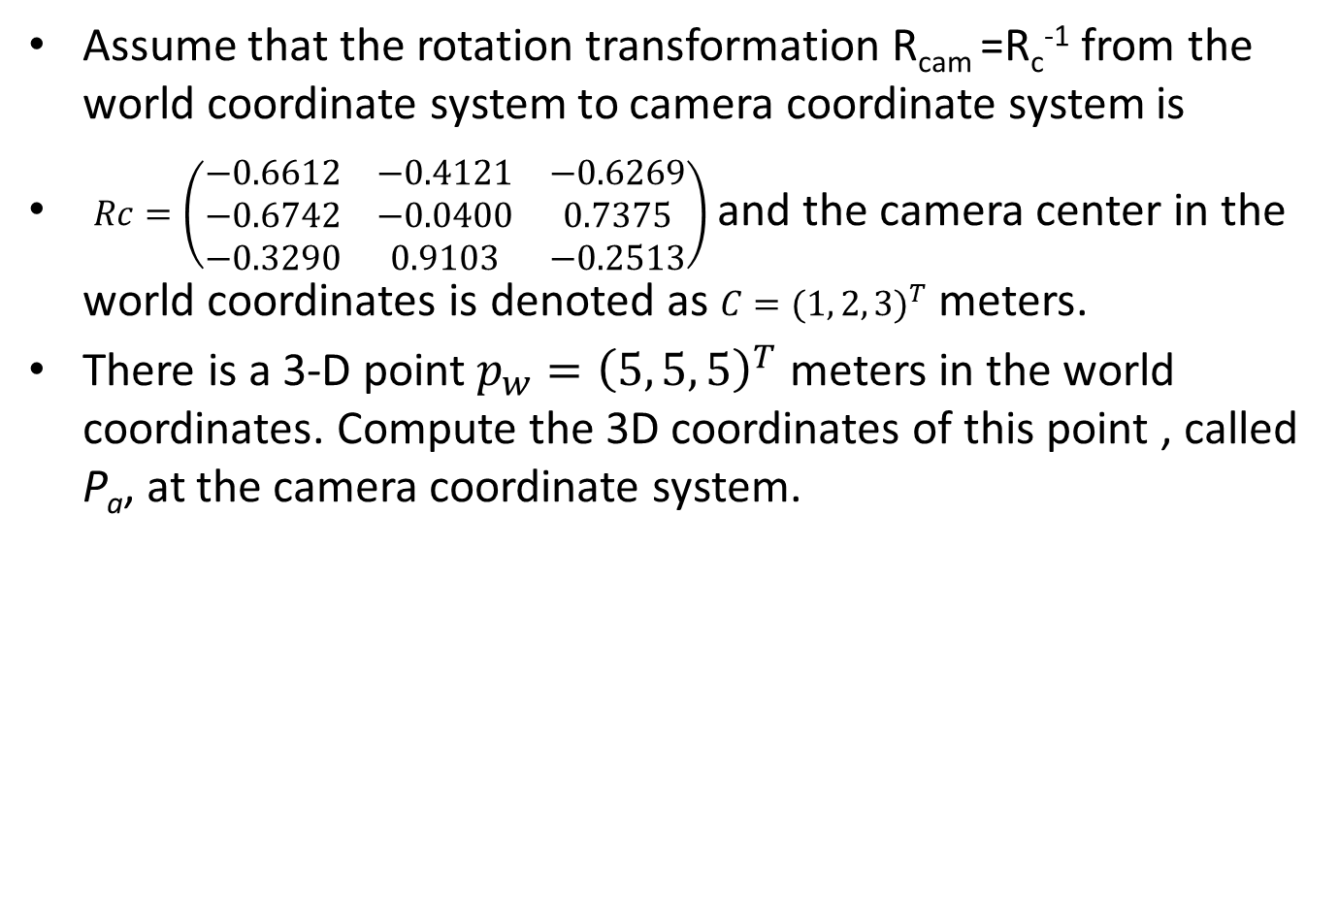
Tutorial 2.8
Assume that the rotation transformation R_{cam} =R_{c}⁻¹ from the world coordinate system to camera coordinate system is
$Rc=\left(\begin{matrix}−0.6612 & −0.4121 & −0.6269 \\ −0.6742 & −0.0400 & 0.7375 \\ −0.3290 & 0.9103 & −0.2513\end{matrix}\right)$ and the camera center in the world coordinates is denoted as $C={(1, 2, 3)}^{T}$ meters.
There is a 3-D point $p_{w}={\left(5, 5, 5\right)}^{T}$ meters in the world coordinates. Compute the 3D coordinates of this point , called P_{a}, at the camera coordinate system.

Slide 94
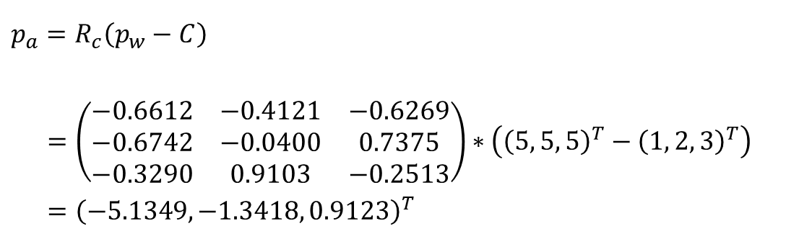
Answers tutorial 2.8
From the question, we can get that
$$p_{a}=R_{c}\left(p_{w}−C\right)$$ $=\left(\begin{matrix}−0.6612 & −0.4121 & −0.6269 \\ −0.6742 & −0.0400 & 0.7375 \\ −0.3290 & 0.9103 & −0.2513\end{matrix}\right)∗\left({\left(5, 5, 5\right)}^{T}−{\left(1, 2, 3\right)}^{T}\right)$ $={\left(−5.1349, −1.3418, 0.9123\right)}^{T}$
%matlab
rc=[-0.6612 -0.4121 -0.6269
-0.6742 -0.0400 0.7375
-0.3290 0.9103 -0.2513]
c=[1 2 3]'
pw=[5 5 5]'
pa=rc*(pw-c)
Answer: p_{a} =
-5.1349
-1.3418
0.9123

Slide 95
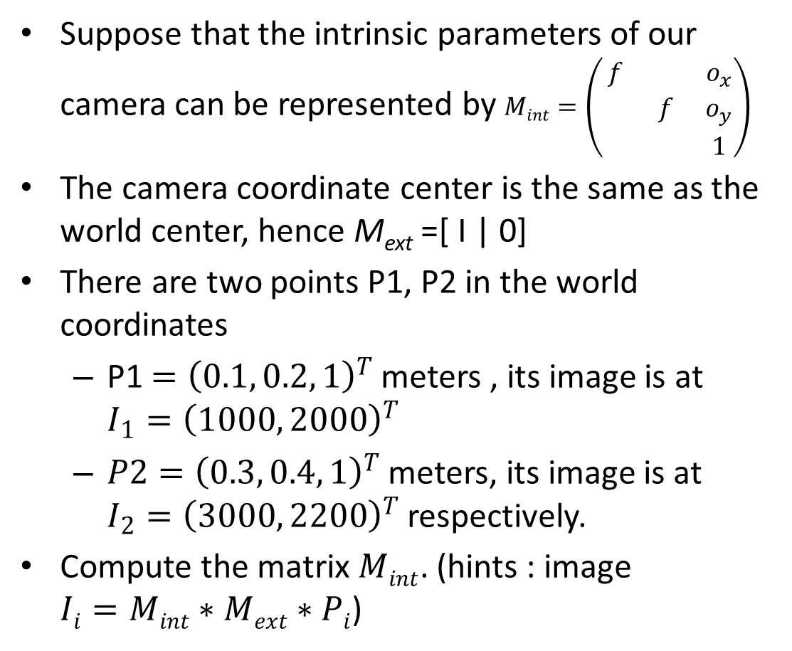
Tutorial 2.9
Suppose that the intrinsic parameters of our camera can be represented by $Mint=\left(\begin{matrix}f & & o_{x} \\ & f & o_{y} \\ & & 1\end{matrix}\right)$
The camera coordinate center is the same as the world center, hence M_{ext} =[ I | 0]
There are two points P1, P2 in the world coordinates
P1 $={\left(0.1, 0.2, 1\right)}^{T}$ meters , its image is at $I_{1}={\left(1000, 2000\right)}^{T}$
$P2={\left(0.3, 0.4, 1\right)}^{T}$ meters, its image is at $I_{2}={\left(3000, 2200\right)}^{T}$ respectively.
Compute the matrix $Mint$. (hints : image $Ii=Mint∗Mext∗Pi$)

Slide 96
Answers Tutorial 2.9

Slide 97
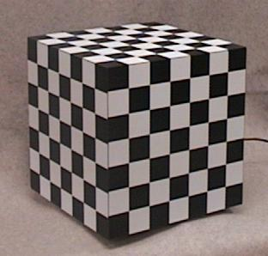
Use ex.2.9 to show how to achieve camera calibration : For a 3D object, assume the camera center is at [0 0 0] meters of the world coordinates. The cube is 1 meter away from the camera along the Z-axis. This model is easy to find if the size of squares are known, say 0.1m² for each checker element
u,v=1,1
u=4000
Zw
Set here as
Object orgin,
[0,0,1] meter
what is the 3D positions [Xw,Yw,Zw],[u,v] of this point in cm, pixels resp.?
Answer:
[0.1,0.2,1]meters
Estimate its [u,v] image position
Ans: estimated by inspection as [1000,2000]
Xw
what is the 3D/2D positions [Xw,Yw,Zw],[u,v] of this point in cm,pixels resp.?
Answer:
[0.3,0.4,1]meters
Estimate its [u,v] image position
Ans: estimated by inspection as [3000,2200?]
v=4000
Yw
Note: you may use this object to calibrate a camera using the method in this tutorial exercise. You can try it on your camera.

Slide 98
Exercise/answer 2.9 :Illustration of Camera calibration by a 3D object
[0.1, 0.2,1] meters
Set here as
World origin
[0,0,0]
Zw
[1000,2000]
Xw
[3000,2200]
[0 0 0]^{T}
Camera center
= world center
[0.3,0.4,1] meters
Image
Yw
Assume it is [ 0 0 0 1]^{T} meter away from the object

