Slide 1
Image processing and computer vision
Chapter 4: Feature extraction
and tracking
Week4 begins

Slide 2
You will learn
Edge features
Region features
Corner features
Tracking of corner features

Slide 3
Different types of features
Edges
Edge detection
Regions
region growing
Corner features
Corner feature detection and Tracking
Stereo correspondence

Slide 4
Edge detection
Tools: Use MATLAB edge detectors: edge.m
E.g. Template based: Sobel

Slide 5
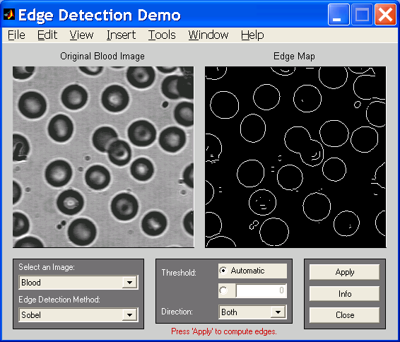
Example by Matlab from demo of Image processing toolbox: edge.m

Slide 6
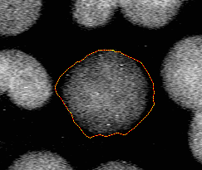
Region growing
Boundary detection
Snake – an energy minimization method for finding boundary
http://www.markschulze.net/snakes/
use mouse to select object,
press any key to start operation

Slide 7
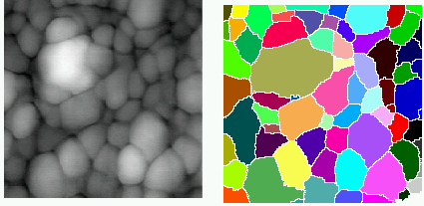
Region growing image processing toolbox
detecting object demo
Source image Output regions

Slide 8
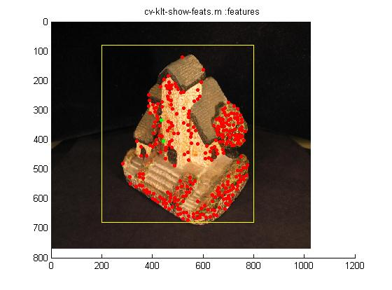
Corner features The correspondence problem and feature tracking problem
Applications
For 2 stereo images, identify 2D features corresponding to the same 3D feature .
For a sequence of images in a movie, identify 2D features corresponding to the same 3D feature .
Demo:
http://www.youtube.com/watch?v=RXpX9TJlpd0

Slide 9
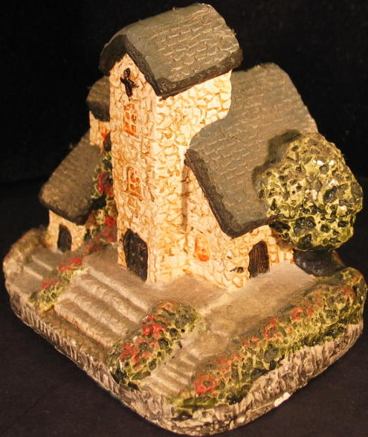
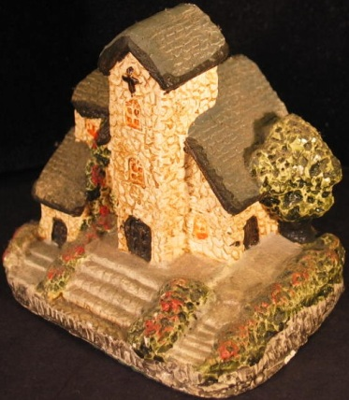
Camera moved, find correspondences for neighboring images
Neighborhood A
Image at t=t₀
(or left image)
Image at t=t₀+dt
(or right image)

Slide 10

Idea of a corner feature
This is a
corner feature, why?
The idea is to find pixels with high gradient at orthogonal directions
Example
?
This is a not
corner feature, why?

Slide 11
Harris Interest corner detector for feature tracking [1]
S1
2D
(x,y)
S2
For two images taken at T1 and T1+Δt, , we want to find how a patch of image (2D+2D) is moved.
Center of search window S1 (at T1) is moved from (x,y) to S2 (at T1+Δt ) with center at (x+u,y+v)
Image feature search criterion: Square pixel difference of S1 and S2 is minimum.
(x+u,y+v)
Reference : http://cmp.felk.cvut.cz/cmp/courses/dzo/resources/lecture_harris_urban.pdf

Slide 12
Harris Interest Operator Basic
S1
2D
(x,y)
S2
(x+u,y+v)

Slide 13
Continue
Discussion and conclusion:
So E(u,v) (image change or square pixel difference) depends on two independent factors: λ and (u,v)
Our target is to find a minimum E (u,v), but E(u,v) =0 is a trivial solution because a all-white window can match another all white windows anywhere. If we use E(u,v) as an indicator in the feature correspondence search algorithm (testing different u,v) , so E must be large enough to make the search effective.
Since (u,v) depends on the search algorithm, but λ depends on the image patch you select, so pick a large λ will benefit the search.
There are 2 λs (λmin, λmax) for A (a 2x2 matrix)
So λmin should not be too small.

Slide 14
Rules for finding the suitable feature patch window
Two Eigen values (λ_{max} , λ_{min} ) exist for A
λ_{min} must be big enough
λ_{max} ≈ λ_{min} is a good criterion for corner features.
See appendix for an eigen values tutorial

Slide 15
Harris corner detector procedures[1]
Harris Algorithm
Scan through all x,y in the image
For each pixel (x,y) find the neighborhood N(x,y) which is a (12x12) window.
Inside N(x,y) a 12x12 window, Find A
Find Eigen 2 values of A(x,y)=λ_{max}, λ_{min}
Sort all λ_{min} , discard pixel with small λ_{min}.
Discard pixels with large λ_{max}- λ_{min}..
Remaining are corner points
12pixels
12
pixels
Pixel(x,y)
N= Neighborhood
(12x12) window

Slide 16


Implementation of the Harris algorithm for feature extraction (step1)
% scan through the pixel
%For each pixel position (x,y),
% obtain its neighborhood image
%of size (12x12)
For (x=1,x<=x_max;x++)
{ For (y=1,y<=y_max;y++)
{
%Extract neighborhood
obtain a 12x12 N(x,y)
window centered at (x,y)}
}
(x=1,y=1)
(x=x_max,
y=y_max)
x-D,y-D
Neighbor-
hood A(x,y)
image
(x,y)
x+D,y+D
e.g. D=10

Slide 17
The Harris algorithm for feature extraction (step2)
%For each N(x,y)
%in the 12x12 neighborhood image N(x,y)
For (i=1, i<=12 i++)
{ For (j=1, j<=12 j++)
{ find
∂I(i,j)/∂x %convolve I(i,j) with x_edge mask
∂I(i,j) /∂y %convolve I(i,j) with y_edge mask
}
}
% then find a 2x2 matrix A(x,y) for N(x,y)
The 12x12 window
N(x,y)
(i=1,j=1)
(x,y)
i=12,j=12

Slide 18
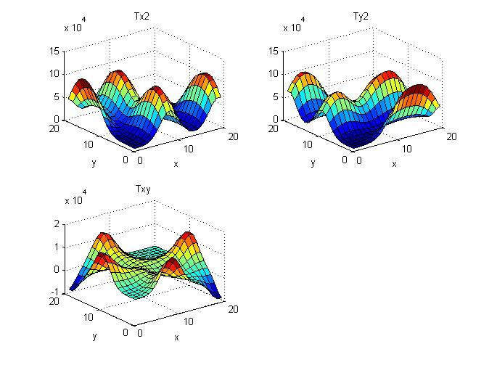
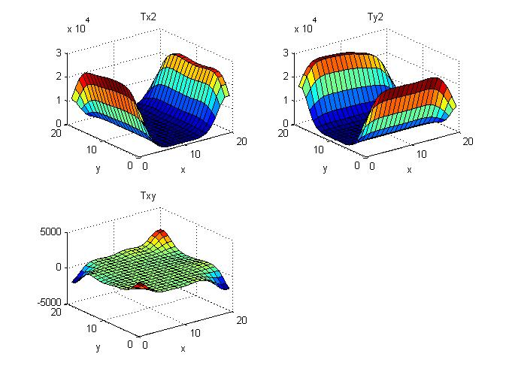
Example: Look at the data of a point with a corner feature
Iy2
Ix2
Ix2= (∂I(i,j)/∂x)^2;
Iy2= (∂I(i,j)/∂y)^2
Ixy= (∂I(i,j)/∂x)*(∂I(i,j)/∂y)
We see that variations in x,y directions are high
A(x,y)(a 2x2 matrix, representing the intensity variations in the neighborhood image {N(x,y)} is obtained from these data
Ixy
Example:
A neighborhood window N with
a corner feature
Ix2
Iy2
Ixy
Example:
A neighborhood window N without
corner feature

Slide 19
Reason
Bad: λ_{min} is too small: the image change is too flat, λ_{min} represents smallest intensity variation in the patch
Bad: λmax >> λmin: the image has horizontal or vertical edges
Good: λmax ≈ λmin and λmin is big enough

Slide 20
Eigen values and edges
Vertical
Edges
(λmax >>
λmin)
λmin
Corner area
(λmax ≈ λmin)
And they are large
enough
λmax, λmin
are small
Horizontal
Edges (λmax >> λmin)
λmax

Slide 21
A more efficient approach (Quick algorithm using R) [1]
Faster: no need to find Eigen values
Reponses function R=det(A)-k*trace(A)² , k≈0.04-0.06 by trial-and-error
Pick pixel with large R
This is the method used in the matlab file http://www.cse.cuhk.edu.hk/%7Ekhwong/www2/cmsc5711/demo_harris1.zip

Slide 22
The Harris algorithm for feature extraction (step3)
For each 2x2 matrix A(x,y) find the 2 Eigen values λ_{min}(x,y), λ_{max}(x,y)
Idea: Corner feature extraction rules:
λ_{min}(x,y) must be large enough
λ_{min}(x,y), λ_{max}(x,y), should both be large
Algorithm :
after all λ(x,y) are found :
Sort all λ_{min}(x,y) , discard pixels with small λ_{min}. (discard pixels with λ_{min} <min_threshold)
Discard pixels with large λ_{max}- λ_{min}.. (discard pixels with (λ_{max}- λ_{min} )>gap_threshold)
Remaining are corner features
(x,y)
N is a 12x12 neighborhood of I(x,y)
→a 2x2 matrix A(x,y)

Slide 23
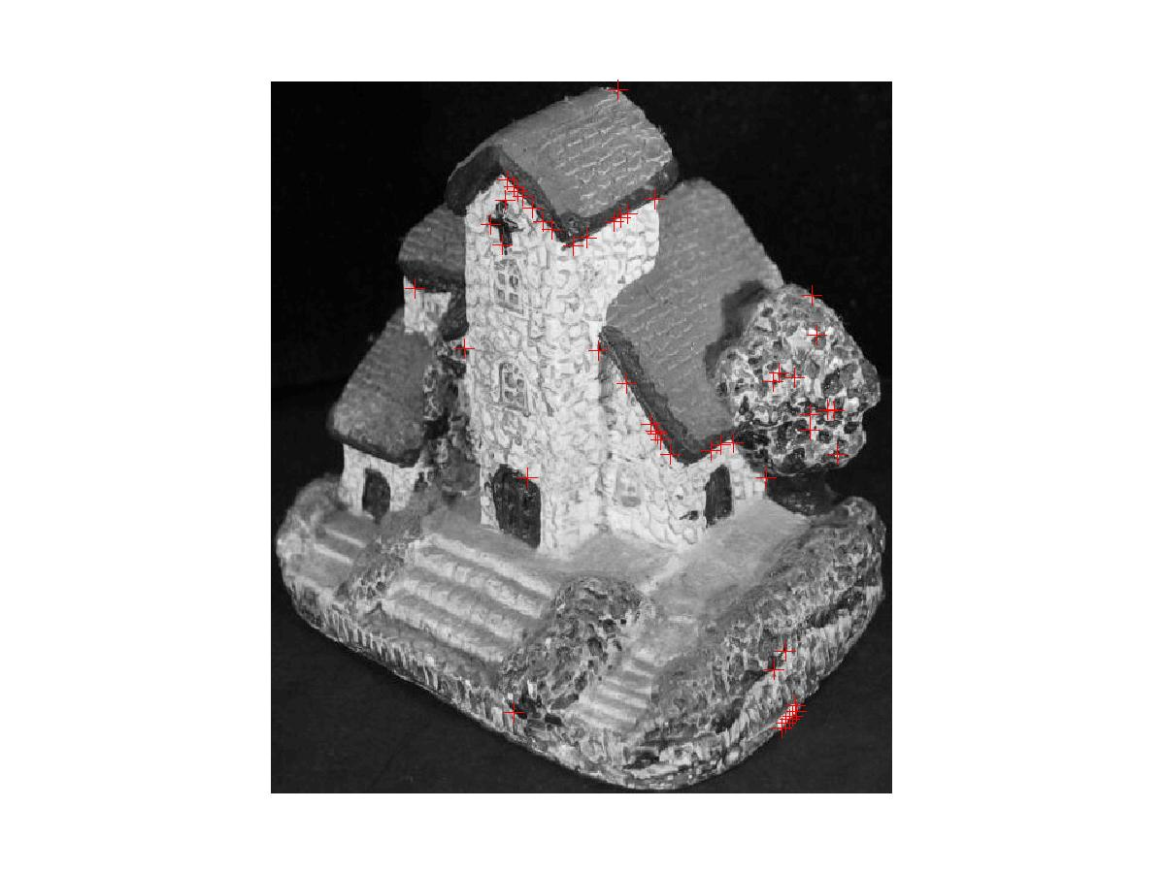
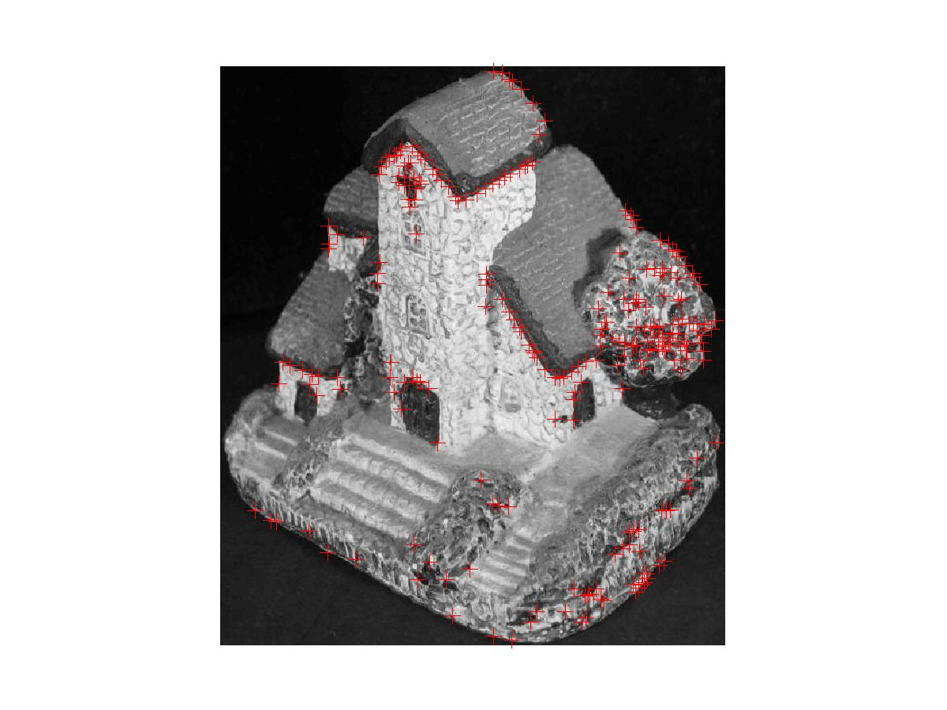
Examples of different threshold settings 50 corners, 250 corners

Slide 24
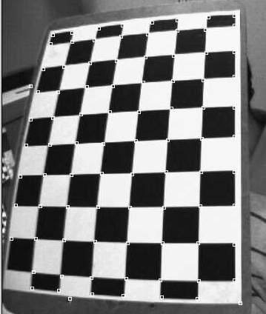
corner features are overlaid with white squares
The program can be found at
http://www.cse.cuhk.edu.hk/%7Ekhwong/www2/cmsc5711/demo_harris1.zip

Slide 25
Exercise 1A
Define
∂I/∂x=x_{i}-x_{i+1}
∂I/∂y=y_{i}-y_{i+1}
edge window is 2x2
dI/dx=-2, dI/dy=0
Image I
Unfilled cells are 0
Assume the edge window is 2x2
Sum of all (∂I/∂x)^2=
=______________________________?
Sum of all (∂I/∂y)^2=
=______________________________?
In side each 2x2 window, Define (∂I/∂x)*(∂I/∂y)=Σ(x_{i}-x_{i+1})* Σ(y_{i}-y_{i+1})
Sum of all (∂I/∂x)*(∂I/∂y)=
=______________________________?
Find the 2x2 matrix A
=______________________________?
Find 2 Eigen values
=______________________________?
IS it a good feature?
=______________________________?
edge window is 2x2, dI/dx=-1
dI/dy=-1
y
 |  |  |  | 1 | 1 | 1 | 1
 |  |  |  | 1 | 1 | 1 | 1
 |  |  |  | 1 | 1 | 1 | 1
 |  |  |  | 1 | 1 | 1 | 1
edge window is 2x2, dI/dx=0
dI/dy=2
x
(x,y)=(0,0)
Eigen calculator
http://www.arndt-bruenner.de/mathe/scripts/engl_eigenwert.htm

Slide 26
Exercise 1B: Find Eigen values and vectors
A=[ 13 1]
1 13]
Show the steps of finding Eigen values and vectors of A

Slide 27
Exercise 2
edge window is 2x2
dI/dx=-2, dI/dy=0
Image I
Unfilled cells are 0
Assume the edge window is 2x2
Sum of all (∂I/∂x)^2=
=______________________________?
Sum of all (∂I/∂y)^2=
=______________________________?
In side each 2x2 window, Define (∂I/∂x)*(∂I/∂y)=Σ(x_{i}-x_{i+1})* Σ(y_{i}-y_{i+1})
Sum of all (∂I/∂x)*(∂I/∂y)=
=______________________________?
Find the 2x2 matrix A
=______________________________?
Find 2 Eigen values
=______________________________?
IS it a good feature?
=______________________________?
y
 |  |  |  | 1 | 1 | 1 | 1
 |  |  |  | 1 | 1 | 1 | 1
 |  |  |  | 1 | 1 | 1 | 1
 |  |  |  | 1 | 1 | 1 | 1
 |  |  |  | 1 | 1 | 1 | 1
 |  |  |  | 1 | 1 | 1 | 1
 |  |  |  | 1 | 1 | 1 | 1
 |  |  |  | 1 | 1 | 1 | 1
x
(x,y)=(0,0)
Eigen calculator
http://www.arndt-bruenner.de/mathe/scripts/engl_eigenwert.htm

Slide 28
Exercise 3
edge window is 2x2
dI/dx=-1, dI/dy=-1
edge window is 2x2
dI/dx= -1, dI/dy= -1
Image I
Unfilled cells are 0
Assume the edge window is 2x2
Sum of all (∂I/∂x)^2=
=_____________________________?
Sum of all (∂I/∂x)^2=
=_____________________________?
Sum of all (∂I/∂x)*(∂I/∂y)=
=_____________________________?
Find the 2x2 matrix A
=_____________________________?
Find 2 Eigen values
=_____________________________________?
IS it a good feature?
=_yes, both eigen values are large
y
 |  |  |  | 1 | 1 | 1 | 1
 |  |  | 1 | 1 | 1 | 1 | 1
 |  | 1 | 1 | 1 | 1 | 1 | 1
 | 1 | 1 | 1 | 1 | 1 | 1 | 1
 |  | 1 | 1 | 1 | 1 | 1 | 1
 |  |  | 1 | 1 | 1 | 1 | 1
 |  |  |  | 1 | 1 | 1 | 1
 |  |  |  |  | 1 | 1 | 1
edge window is 2x2
dI/dx=-1, dI/dy=-1
x
(x,y)=(0,0)
Eigen calculator
http://www.arndt-bruenner.de/mathe/scripts/engl_eigenwert.htm

Slide 29
Exercise 4
3pixels
Eigen calculator
http://www.arndt-bruenner.de/mathe/scripts/engl_eigenwert.htm
3
pixels
Pixel(x,y)
∂I/∂x of N
For example, at (x,y)=(100,105)
Assume we have a 3x3 window N(x,y)
Find the 2x2 matrix A and its Eigen values
1 | 3 | 4
1 | -1 | 0
3 | 4 | 7
N= Neighborhood
(3x3) window
∂I/∂y of N
0 | 2 | 4
1 | -2 | 0
2 | 4 | -1

Slide 30
Tracking by Cross correlation
Find how a corner has moved between two image frames
Evaluate the likelihood between 2 image windows
A mathematical technical to track features

Slide 31
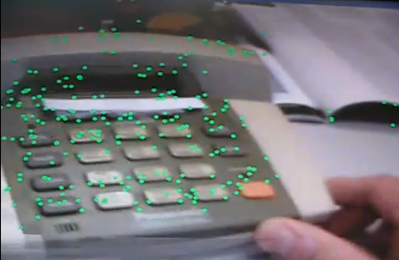
Demo: A more advanced version is feature tracking by the KLT (Kanade-Lucas-Tomasi) method It is more accurate by simple the cross-correlation method http://www.ces.clemson.edu/~stb/klt/
(Click picture to see movie)
Demo
http://www.youtube.com/watch?v=RXpX9TJlpd0
http://www.youtube.com/watch?v=9XknYOHKv-g

Slide 32
2D-2D Correspondence method using cross-correlation
Correlation or Cross correlation coefficient (r_{f,f’}) for 2 windows f and f’ in image frame t and frame t’, respectively. f and f’ have the same size s.
It is a measure of similarity(from -1 to +1): 1 = very similar, -1= very dissimilar.

Slide 34
Exercise 5
Use “Normalized cross correlation r (value from -1 to 1)” to measure similarity. S=all range

Slide 35
ANS:Ex5 steps A-G — Note: sum(sum(x)))=sum all elements in matrix x
E)sum(sum((f1-mean_f1).*(f2-mean_f2)))
=sum(sum(sf1.*sf2)) %sum all elements
=sum(sum([-2.3333 -0.3333 1.6667
-1.3333 2.6667 -1.3333
-0.3333 3.6667 -2.3333].* [
-2.2222 -0.2222 1.7778
-1.2222 2.7778 -2.2222
-1.2222 4.7778 -2.2222]))
=
-2.3333*-2.2222 + -0.3333*-0.2222 + 1.6667*1.7778 + -1.3333*-1.2222 + 2.6667*2.7778 + -1.3333*-2.2222 + -0.3333*-1.2222 + 3.6667*4.7778 + -2.3333*-2.2222
= 43.3333
A)mean_f1=mean2(f1) is
mean_f1 = 3.3333
B)mean_f2=mean2(f2) is
mean_f2 = 3.2222
C) sf1= f1-mean_f1 =
[1 3 5]
[2 6 2]- 3.33=sf1
[3 7 1]
sf1=[ -2.3333 -0.3333 1.6667
-1.3333 2.6667 -1.3333
-0.3333 3.6667 -2.3333]
D) sf2= f2-mean_f2 =
[ 1 3 5]
[ 2 6 1]-3.2222=sf2
[ 2 8 1]
sf2= [-2.2222 -0.2222 1.7778
-1.2222 2.7778 -2.2222
-1.2222 4.7778 -2.2222]

Slide 36
ANS:Ex5 steps A-G (continue)— note: sum(sum(x)))=sum all elements in matrix x
num=sum(sum((f1-mean_f1).*(f2-mean_f2)))
=43.3333
And
den=sqrt(sf1*sf2)
=sqrt(38 * 51.5556) =44.2619
Normalized_correlation_result=
num/den
= 43.3333/44.2619=0.9790
answer by Matlab function using
corr2(f1,f2)\\ (for verification)
ans = 0.9790 \\correct
'try corr2(f1,f3)'
corr2(f1,f3)
0.9480
Conclusion: by comparing correlation results, (f1 and f2) are more similar then (f1 and f3)
F)sf1=sum(sum((f1-mean_f1).^2))
sf1=sum(sum((sf1.*sf1))=
sum(sum([
(-2.3333)^2 -(0.3333)^2 (1.6667)^2
(-1.3333)^2 (2.6667)^2 (-1.3333)^2
(-0.3333)^2 (3.6667^2) (-2.3333)^2]))
sf1 = 37.7778 ≈38
G)sf2=sum(sum((f2-mean_f2).^2)) =
sum(sum([
(-2.2222)^2 (-0.2222)^2 (1.7778)^2
(-1.2222)^2 (2.7778)^2 (-2.2222)^2
(-1.2222)^2 (4.7778)^2 (-2.2222)^2]))
=51.5556

Slide 37
Demo Code
clear
f1=[1 3 5; 2 6 2; 3 7 1 ]
f2=[1 3 5; 2 6 1; 2 8 1 ]
f3=[1 3 5; 2 5 1; 2 9 1 ]
'A)mean_f1=mean2(f1) is '
mean_f1=mean2(f1)
'B)mean_f2=mean2(f2) is '
mean_f2=mean2(f2)
'C) f1-mean_f1 is '
f1-mean_f1
'D)f2-mean_f2 is '
f2-mean_f2
sf2=sum(sum((f2-mean_f2).^2))
'answer by direct calculation'
'E)num=sum(sum((f1-mean_f1).*(f2-mean_f2))) is '
num=sum(sum((f1-mean_f1).*(f2-mean_f2)))
'F)sf1=sum(sum((f1-mean_f1).^2)) is'
sf1=sum(sum((f1-mean_f1).^2))
'G)sf2=sum(sum((f2-mean_f2).^2)) is'
sf2=sum(sum((f2-mean_f2).^2))
den=sqrt((sf1*sf2))
'result of the 2D correlation formula: num/den is'
num/den
'answer by Matlab function corr2, (for verification)'
corr2(f1,f2)
'try corr2(f1,f3)'
corr2(f1,f3)
'end'

Slide 38
Exercise 6

Slide 39
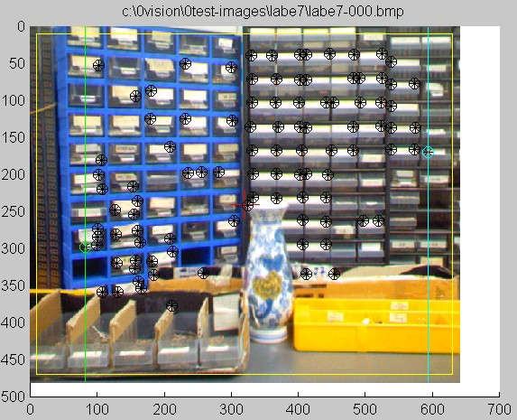
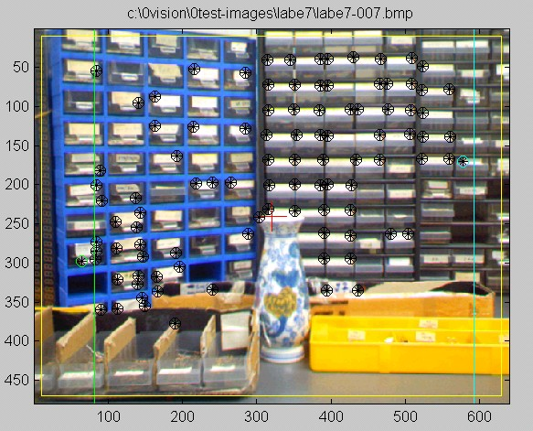
Feature extraction and tracking: for image 1(f) and image 2(g) find windows of corner features
Image1(f) (at Time=1) Image2(g) (at time=2)
Corner Features are shown by overlaid markers on images

Slide 40
Procedure
For( i=1;i<=enough features; i++)
{In image 1 search for corner features f_{i} and record its position (xi,yi)
In image 2 search around position (xi,yi) for possible corner windows: g_{i}(j), j=1…J. E.g. there are g_{i}(j=1), g_{i}(j=2), g_{i}(j=3),...
Use correlation to determine correspondence
r_{i}(j=1)=Correlation (f_{i},g_{i}(j=1))
r_{i}(j=2)=Correlation (f_{i}, g_{i}(j=2))
r_{i}(j=3)=Correlation (f_{i}, g_{i}(j=3))…
…j=4,j=5..………………..
Select j’ with the highest r, so f_{i} corresponds to g_{i}(j’)
}
i pairs of correspondences are found

Slide 41



In image 1, f_{i} is a window with a corner feature. In image 2, g_{i}(j=1),g_{i}(j=2),....are windows with corner features. Find correspondence between f₁ in Image2: choose between “f_{i} correspondence to g_{i}(j=1)”, or “f_{i} correspondence to g_{i}(j=2)”
Example
Image1 (at Time=1) Image2 (at time=2)
f_{i}:a small window
g_{i}(j=1)
g_{i}(j=2)
r_{i,j=1}= correlation(f_{i},g_{i}(j=1))
r_{i,j=2}= correlation(f_{i,}g_{i}(j=2))
Pick the window with a bigger ri(j)

Slide 42
Advanced technique for tracking of corner features :Kanade-Lucas-Tomasi (KLT) Feature Tracker
First locate corners by Harris detector
Use cross correlation to locate new window
Use affine deformation to check if the new window is correct.
See [2] for implementation
In opencv\Samples\lkdemo.exe

Slide 43
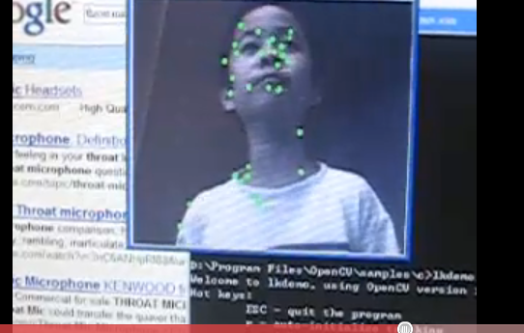
LKdemo (KLT :Kanade-Lucas-Tomasi) corner feature tracking) in opencv http://www.ces.clemson.edu/~stb/klt/
You can try it yourself, run opencv\Samples\lkdemo.exe
http://www.youtube.com/watch?v=WdvDcx1LqSo

Slide 44
Application of feature extraction and tracking: Stereo correspondence
Of corner features

Slide 45
A stereo system Assume cameras are aligned horizontally (No vertical disparity)
Left
Camera
Principle
axis
Right
Camera
Principle
axis
Object
Px(x,y,z)
A point in 3D (Px)
z
Left image
plane
Right image
plane
x_{L}
Left
Image
plane
Right
Image
plane
x_{L}
x_{L}
x_{R}
x_{R}
Focal
Length
f
Left
optical
Center
O(left)
(reference
point)
Right
optical
Center
O(right)
Stereo
Baseline (B)
B (Baseline)
Left camera center
(reference point)
Horizontal
Disparity=x_{L}-x_{R}

Slide 46

Example Assume cameras are aligned horizontally (No vertical disparity)
Left image Right image
White crosses are
overlaid on images
to show the positions
of features.
They are not
in the original pictures.
A corner feature is found
in a 10x10 window (w)
centered at the
left image (x_{L},y_{L})
(overlay a cross)
Horizontal search range=dx (around [x_{L},y_{L}])
For (x’=x_{R}-dx; x’<x_{R};x’=x’+1)
{ w’=a 10x10 window centered at (x’,yL)
c(x’)=Correlate (w,w’)
}
Find index of max {for all c(x’)}= x_{R}”.
then the corresponding window is centered at (x_{R}”,y_{L})
Horizontal disparity = (x_{L}-x_{R}”)

Slide 47
Summary
Studied popular types of features in computer vision
Studied feature extraction method: Harris detector
Studied feature tracking by correlation
Studied stereo correspondence by correlation

Slide 48
References
[1] C. Harris and Stephens, M.J. "A Combined Corner and Edge Detector“, 4th Alvey Conference, Manchester, U.K., August 1988 .
[2] KLT: An Implementation of the Kanade-Lucas-Tomasi Feature Tracker: http://www.ces.clemson.edu/~stb/klt/
[3] lecture note: cmp.felk.cvut.cz/cmp/courses/ dzo/resources/lecture_harris_urban.pdf
[4] S. Baker and I. Matthews, “Lucas-Kanade 20 Years On: A Unifying Framework: Part1” tech. report CMU-RI-TR-02-16, Robotics Institute, Carnegie Mellon University, July, 2002.

Slide 49
Appendix

Slide 50
Eigen value tutorial
A is an m x n matrix, Av=λv, where
v =[v1 v2….]^{T}is an nx1 vector ,
λ is a scalar (Eigen value)
By definition (A- λI)v=0,
So, det (A-λI)=0
Example 1, A is 2 x2, so v =[v1 v2]^{T}
A=[-3 -1 ]
[ 4 2 ],
Det[-3- λ , -1 ]
[ 4 , 2-λ ]=0
λ² + λ - 2=0
Solve for λ, Eigen values: λ₁=-2, λ₂=1
For λ₁=-2, (A- λ₁I)v=0,
A=[-3- λ₁ , -1 ][v1]
[4 , 2- λ₁ ]v2]=0
-v1-v2=0, and 4v1+4v2=0 (2 duplicated eqn.s)
V is a vector passing through 0,0, set v2=1,so
V1=-1, v2=1 is the direction of the vector v
The eignen vector for eigen value λ₁=-2 is [v1=-1,v2=1]
--------------------------------------
For λ₂=1, (A- λ₂I)v=0,
A=[-3- λ₂ , -1 ][v1]
[4 , 2- λ₂][v2]=0
-4v1-v2=0, and 4v1+v2=0, (2 duplicated eqn.s)
The eignen vector for eigen value λ₂=1 is v1=-1,v2=4
Ref:
http://www.math.hmc.edu/calculus/tutorials/eigenstuff/
http://www.arndt-bruenner.de/mathe/scripts/engl_eigenwert2.htm

Slide 51
Answer: Exercise 1A
Define
∂I/∂x=x_{i}-x_{i+1}
∂I/∂y=y_{i}-y_{i+1}
edge window is 2x2
dI/dx=-2, dI/dy=0
Image I
Unfilled cells are 0
Assume the edge window is 2x2
Sum of all (∂I/∂x)^2=
=(-2)^2+(-2)^2+(-2)^2+(-1)^2=13
Sum of all (∂I/∂y)^2=
=(-2)^2+(-2)^2+(-2)^2+(-1)^2=13
Sum of all (∂I/∂x)*(∂I/∂y)=
=(-2)*0+(-2)*0+2*0+(-1)*(-1)+0*2+0*2+0*2=1
Find the 2x2 matrix A
=[13 1; 1 13]
Find 2 Eigen values
=12,14
IS it a good feature?
=Yes , because both Eigen values are large, it has a corner
y
edge window is 2x2, dI/dx=-1
dI/dy=-1
 |  |  |  | 1 | 1 | 1 | 1
 |  |  |  | 1 | 1 | 1 | 1
 |  |  |  | 1 | 1 | 1 | 1
 |  |  |  | 1 | 1 | 1 | 1
edge window is 2x2, dI/dx=0
dI/dy=-2
x,y=(0,0)
x
Eigen calculator
http://www.arndt-bruenner.de/mathe/scripts/engl_eigenwert.htm

Slide 52
Answer 1B: Eigen value tutorial
Ref: Check the answer using
http://www.arndt-bruenner.de/mathe/scripts/engl_eigenwert2.htm
A=[ 13 1]
1 13]
Find Eigen values and vectors of A
Answer: Example 2, m=2, n=2
A=[13 1
1 13],
Det[13- λ , 1
1 , 13- λ ]=0
(13- λ)²-1²=0; so λ² -26λ+168=0
Solve for λ, solutions: λ₁=12, λ₂=14
for Eigenvalue 12:
Eigenvector: [ -1 ; 1 ]
for Eigenvalue 14:
Eigenvector: [ 1 ; 1 ]
For λ₁=12, (A- λ₁I)v=0,
A=[13-λ₁ , 1 ][v1]
[1 , 13- λ₁ ]v2]=0
A=[13-(12) , 1 ][v1]
[1 , 13-(12) ]v2]=0
v1+v2=0, and v1+v2=0 (2 duplicated eqn.s)
V is a vector passing through 0,0, set v2=1,so
V1=-1, v2=1 is the direction of the vector v
The eignen vector for eigen value λ₁=12 is [v1=-1,v2=1]
--------------------------------------
For λ₂=14, (A- λ₂I)v=0,
A=[13-λ₂ , 1 ][v1]
[1 , 13- λ₂][v2]=0
-v1+v2=0, and v1-v2=0, (2 duplicated eqn.s)
The eignen vector for eigen value λ₂=14 is v1=1,v2=1

Slide 53
Answer: Exercise 2
edge window is 2x2
dI/dx=-2, dI/dy=0
Image I
Unfilled cells are 0
Assume the edge window is 2x2
Sum of all (∂I/∂x)^2=
=___((-2)^2)*7=28
Sum of all (∂I/∂y)^2=
=___0
In side each 2x2 window, Define (∂I/∂x)*(∂I/∂y)=Σ(x_{i}-x_{i+1})* Σ(y_{i}-y_{i+1})
Sum of all (∂I/∂x)*(∂I/∂y)=
=___0
Find the 2x2 matrix A
=__[28 0 ; 0 0]
Find 2 Eigen values
=__________0,28
IS it a good feature?
=no, min eigen is 0, as you can see it has no corner
y
 |  |  |  | 1 | 1 | 1 | 1
 |  |  |  | 1 | 1 | 1 | 1
 |  |  |  | 1 | 1 | 1 | 1
 |  |  |  | 1 | 1 | 1 | 1
 |  |  |  | 1 | 1 | 1 | 1
 |  |  |  | 1 | 1 | 1 | 1
 |  |  |  | 1 | 1 | 1 | 1
 |  |  |  | 1 | 1 | 1 | 1
x
Eigen calculator
http://www.arndt-bruenner.de/mathe/scripts/engl_eigenwert.htm

Slide 54
Answer: Exercise 3(step1)
edge window is 2x2
Sum all X1-X2
edge window is 2x2
Horizontal edges
(∂I/∂x)^2=1
Each box has |(∂I/∂y)|²=1
edge window is 2x2
vertical edges
(∂I/∂y)^2=1
Each box has |(∂I/∂y)|²=1
y
y
 |  |  |  | 1 | 1 | 1 | 1
 |  |  | 1 | 1 | 1 | 1 | 1
 |  | 1 | 1 | 1 | 1 | 1 | 1
 | 1 | 1 | 1 | 1 | 1 | 1 | 1
 |  | 1 | 1 | 1 | 1 | 1 | 1
 |  |  | 1 | 1 | 1 | 1 | 1
 |  |  |  | 1 | 1 | 1 | 1
 |  |  |  |  | 1 | 1 | 1
 |  |  |  | 1 | 1 | 1 | 1
 |  |  | 1 | 1 | 1 | 1 | 1
 |  | 1 | 1 | 1 | 1 | 1 | 1
 | 1 | 1 | 1 | 1 | 1 | 1 | 1
 |  | 1 | 1 | 1 | 1 | 1 | 1
 |  |  | 1 | 1 | 1 | 1 | 1
 |  |  |  | 1 | 1 | 1 | 1
 |  |  |  |  | 1 | 1 | 1
x
x
Total sum |(∂I/∂y)| ²=14
Define
∂I/∂x=x_{i}-x_{i+1}
∂I/∂y=y_{i}-y_{i+1}
Total sum |(∂I/∂y)| ²=14

Slide 55
Answer: Exercise 3(step2)
In these boxes, each has (∂I/∂x)*(∂I/∂y) = -1
Total= -6
In these boxes, each has (∂I/∂x)*(∂I/∂y) =(-1)*(-1)= +1
Total= 8
(∂I/∂x)*(∂I/∂y) =
( -1)*(+1)= -1
y
y
-1
-1
 |  |  |  | 1 | 1 | 1 | 1
 |  |  | 1 | 1 | 1 | 1 | 1
 |  | 1 | 1 | 1 | 1 | 1 | 1
 | 1 | 1 | 1 | 1 | 1 | 1 | 1
 |  | 1 | 1 | 1 | 1 | 1 | 1
 |  |  | 1 | 1 | 1 | 1 | 1
 |  |  |  | 1 | 1 | 1 | 1
 |  |  |  |  | 1 | 1 | 1
(∂I/∂x)*
(∂I/∂y)=
 |  |  |  | 1 | 1 | 1 | 1
 |  |  | 1 | 1 | 1 | 1 | 1
 |  | 1 | 1 | 1 | 1 | 1 | 1
 | 1 | 1 | 1 | 1 | 1 | 1 | 1
 |  | 1 | 1 | 1 | 1 | 1 | 1
 |  |  | 1 | 1 | 1 | 1 | 1
 |  |  |  | 1 | 1 | 1 | 1
 |  |  |  |  | 1 | 1 | 1
-1
(∂I/∂x)*
(∂I/∂y)=
-1
-1
1
1
1
1
1
1
-1
x
In side each 2x2 window
Define (∂I/∂x)*(∂I/∂y)=
Σ(x_{i}-x_{i+1})* Σ(y_{i}-y_{i+1})
x
1 1
So the total sum {(∂I/∂x)*(∂I/∂y)}= 8-6=2

Slide 56
Answer: Exercise 3(step3)
Assume the edge window is 2x2
Sum of all (∂I/∂x)^2=
=14
Sum of all (∂I/∂y)^2=
=14
In side each 2x2 window, Define (∂I/∂x)*(∂I/∂y)=Σ(x_{i}-x_{i+1})* Σ(y_{i}-y_{i+1})
Sum of all (∂I/∂x)*(∂I/∂y)=
=2
Find the 2x2 matrix A
=[14 2; 2 14]_____________?
Find 2 Eigen values
= 12, 16 both are large
IS it a good feature?
=_yes, both eigen values are large ( it a sharp corer)
y
 |  |  |  | 1 | 1 | 1 | 1
 |  |  | 1 | 1 | 1 | 1 | 1
 |  | 1 | 1 | 1 | 1 | 1 | 1
 | 1 | 1 | 1 | 1 | 1 | 1 | 1
 |  | 1 | 1 | 1 | 1 | 1 | 1
 |  |  | 1 | 1 | 1 | 1 | 1
 |  |  |  | 1 | 1 | 1 | 1
 |  |  |  |  | 1 | 1 | 1
x
Eigen calculator
http://www.arndt-bruenner.de/mathe/scripts/engl_eigenwert.htm

Slide 57
Answer for Exercise 4
3pixels
3
pixels
Pixel(x,y)
Eigen calculator
http://www.arndt-bruenner.de/mathe/scripts/engl_eigenwert.htm
For example, at (x,y)=(100,105)
Assume we have a 3x3 window W_{A} (x,y)
Find E and its eigen values
Sum_all{(∂I/∂x)^2}=E(1,1)=1^2+3^2+4^2+1^2+ (-1)^2+0^2+3^2+4^2+7^2=102
Sum_all{(∂I/∂x)*(∂I/∂y)}=E(1,2)=E(2,1)=1*0+3*2+4*4+1*1+(-1)*(-2)+0*0+3*2+4*4+7*(-1)=40
Sum_all{(∂I/∂y)^2}=E(2,2)=0^2+2^2+4^2+1^2+(-2)^2+0^2+2^2+4^2+(-1)^2=46
Eig(E)=eig([102, 40;
40 46])
={ 25.17 ; 122.83 } are the 2 eigen values
∂I/∂x of N
N= Neighborhood
(3x3) window
1 | 3 | 4
1 | -1 | 0
3 | 4 | 7
∂I/∂y of N
0 | 2 | 4
1 | -2 | 0
2 | 4 | -1

Slide 58
Answer: Exercise 5
Use “Normalized cross correlation r (value from -1 to 1)” to measure similarity. S=all range
H)=E/sqrt(F*G)=43.33/sqrt(38*51.55)=0.979
I)0.948,
(J) so (f1,f2 ) is more similar to (f1,f3)

Slide 59
Matlab for 2D cross correlation
'answer by direct calculation'
'E)num=sum(sum((f1-mean_f1).*(f2-mean_f2))) is '
num=sum(sum((f1-mean_f1).*(f2-mean_f2)))
'F)sf1=sum(sum((f1-mean_f1).^2)) is'
sf1=sum(sum((f1-mean_f1).^2))
'G)sf2=sum(sum((f2-mean_f2).^2)) is'
sf2=sum(sum((f2-mean_f2).^2))
den=sqrt((sf1.*sf2))
‘result of the 2D correlation formula: num/den is'
num/den
'answer by Matlab function corr2, (for verification)’
corr2(f1,f2)
clear
f1=[1 3 5; 2 6 2; 3 7 1 ]
f2=[1 3 5; 2 6 1; 2 8 1 ]
%f3=[1 3 5; 2 5 1; 2 9 1 ]
'A)mean_f1=mean2(f1) is '
mean_f1=mean2(f1)
'B)mean_f2=mean2(f2) is '
mean_f2=mean2(f2)
'C) f1-mean_f1 is '
f1-mean_f1
'D)f2-mean_f2 is '
f2-mean_f2
sf2=sum(sum((f2-mean_f2).^2))

Slide 60
Result5a A-G
E)num=sum(sum((f1-mean_f1).*(f2-mean_f2))) is
num = 43.3333
F)sf1=sum(sum((f1-mean_f1).^2)) is sf1 = 38
G)sf2=sum(sum((f2-mean_f2).^2)) is 51.5556
den=sqrt(sf1*sf2)
den = 44.2618
‘result of the 2D correlation formula: num/den is
ans = 0.9790
answer by Matlab function corr2 (for verification)
ans = 0.9790
A)mean_f1=mean2(f1) is
mean_f1 = 3.3333
B)mean_f2=mean2(f2) is
mean_f2 = 3.2222
C) f1-mean_f1 is
ans =
-2.3333 -0.3333 1.6667
-1.3333 2.6667 -1.3333
-0.3333 3.6667 -2.3333
D)f2-mean_f2 is
ans =
-2.2222 -0.2222 1.7778
-1.2222 2.7778 -2.2222
-1.2222 4.7778 -2.2222
sf2 = 51.5556

Slide 61
Answer: Exercise 6
%Answer by matab
F1=[
1 4 6
3 2 3
1 1 2]
F2=[
2 4 6
3 7 3
6 1 2]
corr2(F1,F2)
corr2(F1,F3)
%ans =
% corr2(F1,F2)=0.3597
%ans =
% corr2(F1,F3)=0.7513

Slide 62
Tutorial

Slide 63
Tutorial 1A
Define
∂I/∂x=x_{i}-x_{i+1}
∂I/∂y=y_{i}-y_{i+1}
Assume the edge window is 2x2
Sum of all (∂I/∂x)^2=
=______________________________?
Sum of all (∂I/∂y)^2=
=______________________________?
In side each 2x2 window, Define (∂I/∂x)*(∂I/∂y)=Σ(x_{i}-x_{i+1})* Σ(y_{i}-y_{i+1})
Sum of all (∂I/∂x)*(∂I/∂y)=
=______________________________?
Find the 2x2 matrix A
=______________________________?
Find 2 Eigen values
=______________________________?
IS it a good feature?
=______________________________?
Image I
Unfilled cells are 0
y
 |  |  | 1 | 1 | 1 | 1 | 1
 |  |  | 1 | 1 | 1 | 1 | 1
 |  |  | 1 | 1 | 1 | 1 | 1
x
(x,y)=(0,0)
Eigen calculator
http://www.arndt-bruenner.de/mathe/scripts/engl_eigenwert.htm

Slide 64
Answer: Tutorial 1A
Define
∂I/∂x=x_{i}-x_{i+1}
∂I/∂y=y_{i}-y_{i+1}
edge window is 2x2
dI/dx=-2, dI/dy=0
Assume the edge window is 2x2
Sum of all (∂I/∂x)^2=
=(-2)^2+(-2)^2+(-1)^2=9
Sum of all (∂I/∂y)^2=
=(-2)^2+(-2)^2+(-2)^2+(-2)^2+(-1)^2=17
Sum of all (∂I/∂x)*(∂I/∂y)=
=(-2)*0+(-2)*0+2*0+(-1)*(-1)+0*(-2)+0*(-2)+0*(-2)+0*(-2)=1
Find the 2x2 matrix A
=[9 1; 1 17]
Find 2 Eigen values
=8.877,17.123
IS it a good feature?
=Yes , because both Eigen values are large, it has a corner
y
edge window is 2x2, dI/dx=-1
dI/dy=-1
 |  |  | 1 | 1 | 1 | 1 | 1
 |  |  | 1 | 1 | 1 | 1 | 1
 |  |  | 1 | 1 | 1 | 1 | 1
edge window is 2x2, dI/dx=0
dI/dy=-2
x,y=(0,0)
x
Eigen calculator
http://www.arndt-bruenner.de/mathe/scripts/engl_eigenwert.htm

Slide 65
Tutorial 2
Image I
Unfilled cells are 0
Assume the edge window is 2x2
Sum of all (∂I/∂x)^2=
=______________________________?
Sum of all (∂I/∂y)^2=
=______________________________?
In side each 2x2 window, Define (∂I/∂x)*(∂I/∂y)=Σ(x_{i}-x_{i+1})* Σ(y_{i}-y_{i+1})
Sum of all (∂I/∂x)*(∂I/∂y)=
=______________________________?
Find the 2x2 matrix A
=______________________________?
Find 2 Eigen values
=______________________________?
IS it a good feature?
=______________________________?
y
 |  |  | 1 | 1 | 1 | 1
 |  |  | 1 | 1 | 1 | 1
 |  |  | 1 | 1 | 1 | 1
 |  |  | 1 | 1 | 1 | 1
 |  |  | 1 | 1 | 1 | 1
 |  |  | 1 | 1 | 1 | 1
 |  |  | 1 | 1 | 1 | 1
 |  |  | 1 | 1 | 1 | 1
x
(x,y)=(0,0)
Eigen calculator
http://www.arndt-bruenner.de/mathe/scripts/engl_eigenwert.htm

Slide 66
Answer: Tutorial 2
Image I
Unfilled cells are 0
edge window is 2x2
dI/dx=-2, dI/dy=0
Assume the edge window is 2x2
Sum of all (∂I/∂x)^2=
=___((-2)^2)*7+(2^2)*7=56
Sum of all (∂I/∂y)^2=
=___0
In side each 2x2 window, Define (∂I/∂x)*(∂I/∂y)=Σ(x_{i}-x_{i+1})* Σ(y_{i}-y_{i+1})
Sum of all (∂I/∂x)*(∂I/∂y)=
=___0
Find the 2x2 matrix A
=__[56 0 ; 0 0]
Find 2 Eigen values
=__________0,56
IS it a good feature?
=no, min eigen is 0, as you can see it has no corner
y
 |  |  | 1 | 1 | 1 | 1
 |  |  | 1 | 1 | 1 | 1
 |  |  | 1 | 1 | 1 | 1
 |  |  | 1 | 1 | 1 | 1
 |  |  | 1 | 1 | 1 | 1
 |  |  | 1 | 1 | 1 | 1
 |  |  | 1 | 1 | 1 | 1
 |  |  | 1 | 1 | 1 | 1
edge window is 2x2
dI/dx=2, dI/dy=0
x
Eigen calculator
http://www.arndt-bruenner.de/mathe/scripts/engl_eigenwert.htm

Slide 67
Tutorial 3
Image I
Unfilled cells are 0
Assume the edge window is 2x2
Sum of all (∂I/∂x)^2=
=_____________________________?
Sum of all (∂I/∂x)^2=
=_____________________________?
Sum of all (∂I/∂x)*(∂I/∂y)=
=_____________________________?
Find the 2x2 matrix A
=_____________________________?
Find 2 Eigen values
=_____________________________________?
IS it a good feature?
=____________________________________?
y
 |  |  | 1 | 1 | 1 | 1 | 1
 |  | 1 | 1 | 1 | 1 | 1 | 1
 |  |  | 1 | 1 | 1 | 1 | 1
x
(x,y)=(0,0)
Eigen calculator
http://www.arndt-bruenner.de/mathe/scripts/engl_eigenwert.htm

Slide 68
Answer: Tutorial 3(step1)
edge window is 2x2
Sum all X1-X2
edge window is 2x2
vertical edges
(∂I/∂y)^2=1
Each is 1
edge window is 2x2
Horizontal edges
(∂I/∂x)^2=1
Each is 1
y
y
 |  |  | 1 | 1 | 1 | 1 | 1
 |  | 1 | 1 | 1 | 1 | 1 | 1
 |  |  | 1 | 1 | 1 | 1 | 1
 |  |  | 1 | 1 | 1 | 1 | 1
 |  | 1 | 1 | 1 | 1 | 1 | 1
 |  |  | 1 | 1 | 1 | 1 | 1
x
x
Total sum (∂I/∂y)²=4
Total sum (∂I/∂x)²=4
Define
∂I/∂x=x_{i}-x_{i+1}
∂I/∂y=y_{i}-y_{i+1}

Slide 69
Answer: Tutorial 3(step2)
These boxes have (∂I/∂x)*(∂I/∂y) = +1
Total= 2
These boxes have (∂I/∂x)*(∂I/∂y) = -1
Total= -2
y
-1
-1
y
 |  |  | 1 | 1 | 1 | 1 | 1
 |  | 1 | 1 | 1 | 1 | 1 | 1
 |  |  | 1 | 1 | 1 | 1 | 1
 |  |  | 1 | 1 | 1 | 1 | 1
 |  | 1 | 1 | 1 | 1 | 1 | 1
 |  |  | 1 | 1 | 1 | 1 | 1
1 1
x
x
In side each 2x2 window
Define (∂I/∂x)*(∂I/∂y)=
Σ(x_{i}-x_{i+1})* Σ(y_{i}-y_{i+1})
So the total sum {(∂I/∂x)*(∂I/∂y)}= 2-2=0

Slide 70
Answer: 3(step3)
Assume the edge window is 2x2
Sum of all (∂I/∂x)^2=
=4
Sum of all (∂I/∂y)^2=
=4
In side each 2x2 window, Define (∂I/∂x)*(∂I/∂y)=Σ(x_{i}-x_{i+1})* Σ(y_{i}-y_{i+1})
Sum of all (∂I/∂x)*(∂I/∂y)=
=0
Find the 2x2 matrix A
=[4 0; 0 4]_____________?
Find 2 Eigen values
= 4, 4 both are large
IS it a good feature?
=_yes, both eigen values are large ( it a sharp corer)
y
 |  |  | 1 | 1 | 1 | 1 | 1
 |  | 1 | 1 | 1 | 1 | 1 | 1
 |  |  | 1 | 1 | 1 | 1 | 1
x
Eigen calculator
http://www.arndt-bruenner.de/mathe/scripts/engl_eigenwert.htm

Slide 71
Tutorial 4
3pixels
Eigen calculator
http://www.arndt-bruenner.de/mathe/scripts/engl_eigenwert.htm
3
pixels
Pixel(x,y)
∂I/∂x of N
For example, at (x,y)=(100,105)
Assume we have a 3x3 window N(x,y)
Find the 2x2 matrix A and its Eigen values
6 | 2 | 1
2 | 5 | 4
3 | -1 | 1
N= Neighborhood
(3x3) window
∂I/∂y of N
-2 | 0 | 3
4 | -1 | 1
3 | -1 | 0

Slide 72
Answer for Tutorial 4
3pixels
3
pixels
Pixel(x,y)
Eigen calculator
http://www.arndt-bruenner.de/mathe/scripts/engl_eigenwert.htm
For example, at (x,y)=(100,105)
Assume we have a 3x3 window W_{A} (x,y)
Find E and its eigen values
Sum_all{(∂I/∂x)^2}=E(1,1)=6^2+2^2+1^2+2^2+ 5^2+4^2+3^2+(-1)^2+1^2=97
Sum_all{(∂I/∂x)*(∂I/∂y)}=E(1,2)=E(2,1)=6*(-2)+2*0+1*3+2*4+5*(-1) +4*1+3*3+(-1)*(-1)+1*0=8
Sum_all{(∂I/∂y)^2}=E(2,2)=(-2)^2+0^2+3^2+4^2+(-1)^2+1^2+3^2+(-1)^2+0^2=41
Eig(E)=eig([97, 8;
8 41])
={ -8.0083; 113.0083 } are the 2 eigen values
∂I/∂x of N
N= Neighborhood
(3x3) window
6 | 2 | 1
2 | 5 | 4
3 | -1 | 1
∂I/∂y of N
-2 | 0 | 3
4 | -1 | 1
3 | -1 | 0

Slide 73
Use “Normalized cross correlation r (value from -1 to 1)” to measure similarity. S=all range
Tutorial 5

Slide 74
Answer for Tutorial 5 (matlab)
clear
f1=[4 7 0; 7 0 1; 2 3 8]
f2=[4 1 5 ; 7 0 1 ; 2 8 4]
f3=[0 7 0 ; 1 4 1 ; 7 3 8]
mean_f1=mean2(f1)
mean_f2=mean2(f2)
ff1=f1-mean_f1
ff2=f2-mean_f2
num=sum(sum((f1-mean_f1).*(f2-mean_f2)))
sf1=sum(sum((f1-mean_f1).^2))
sf2=sum(sum((f2-mean_f2).^2))
den=sqrt((sf1*sf2))
corr_f1_f2= num/den %----------------------
mean_f3=mean2(f3)
ff3=f3-mean_f3
num=sum(sum((f1-mean_f1).*(f3-mean_f3)))
sf1=sum(sum((f1-mean_f1).^2))
sf3=sum(sum((f3-mean_f3).^2))
den=sqrt(sf1*sf3)
corr_f1_f3= num/den
mean_f1 =3.5556
mean_f2 =3.5556
ff1 =0.4444 3.4444 -3.5556
3.4444 -3.5556 -2.5556
-1.5556 -0.5556 4.4444
ff2 =0.4444 -2.5556 1.4444
3.4444 -3.5556 -2.5556
-1.5556 4.4444 0.4444
num = 19.2222
sf1 = 78.2222
sf2 = 62.2222
den = 69.7650
corr_f1_f2 = 0.2755
mean_f3 = 3.4444
ff3 =-3.4444 3.5556 -3.4444
-2.4444 0.5556 -2.4444
3.5556 -0.4444 4.5556
num = 33.7778
sf1 = 78.2222
sf3 = 82.2222
den = 80.1973
corr_f1_f3 = 0.4212

Slide 75
Tutorial 6

Slide 76
Answer: Tutorial 6
%Answer by matab
F1=[
7 3 2
0 1 2
7 0 3]
F2=[
7 3 2
0 2 1
0 7 3]
F2=[
3 7 2
0 1 2
10 7 3]
corr2(F1,F2)
corr2(F1,F3)
%ans =
% corr2(F1,F2)=0.1
%ans =
% corr2(F1,F3)=0.4664

