Slide 1
Image processing and computer vision
Chapter 6: Histogram equalization
and color models
Week 5

Slide 2
Overview
Week 6 begins
What is Histogram equalization?
Recalculate the picture gray levels to make the distribution more equalized
Used widely in image editing tools and computer vision algorithms
Can also be applied to color images
Ref: Intensity transformation :ch3 of Gonzalez ed.3 ch3.2 page 122.
Ref: Digital image processing, R.C. González, R.E. Woods edition3. ch3 of Gonzalez ed.3 ch3.2 page 120-128. It can be found at http://books.google.com/

Slide 3
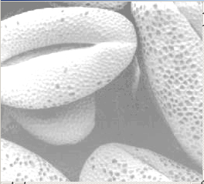
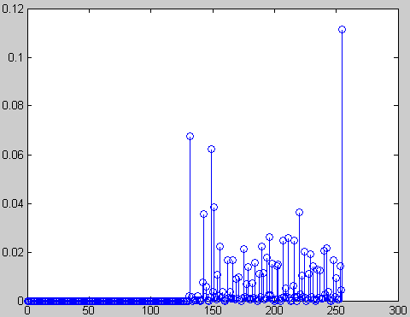
Why ? :Histogram equalization makes the picture look better.
Each pixel has
a gray level r_{k}
.
M rows
Eample:Histogram h(r_{k})=n_{k}
n_{k} = number of pixels in the image that have grade level r_{k.}
Since total number of pixels=M*N
K=0,1,2,..L-1 gray level (up to you, e.g. 8-bit→ 256 levels; 16-bit→ 65536 levels)
A normalized histogram
N
columns
P(r_{k})
Bright image
Normalized
Count
(value =0→1)
P(r_{k})=n_{k}/MN
Grad level(0-255) r_{k}

Slide 4
Example: Normalized histogram
0 | 250 | 250
100 | 100 | 100
55 | 55 | 10
An image of 9 pixels (M=3, N=3)
K=0,1,2,..,L-1=255.
L=256 levels
Normalized
Count
P(r_{k})=n_{k}/MN
Normalized histogram
level | count
0 | 1
10 | 1
55 | 2
100 | 3
250 | 2
3/9
2/9
1/9
0 10 55 100 250
Grade level(0-255) r_{k}

Slide 5
CMSC 5711- ch6 Histogram Exercise 1: Normalized histogram
7 | 100 | 200 | 45
2 | 100 | 7 | 120
100 | 100 | 7 | 120
200 | 100 | 45 | 100
200 | 200 | 45 | 45
An image of 5x4 pixels (M=?__, N=?___)
K=0,1,2,..,L-1=255.
L=256 levels
Sketch the histogram (??)
M
rows
Normalized
Count
P(r_{k})=n_{k}/MN
level | count
2 | ?
7 | ?
45 | ?
100 | ?
120 | ?
200 | ?
N columns
1
Normalized histogram (plot it)
0.5
0 100 200
Grad level(0-255) rk

Slide 6
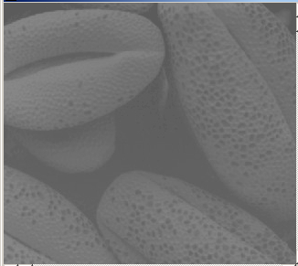
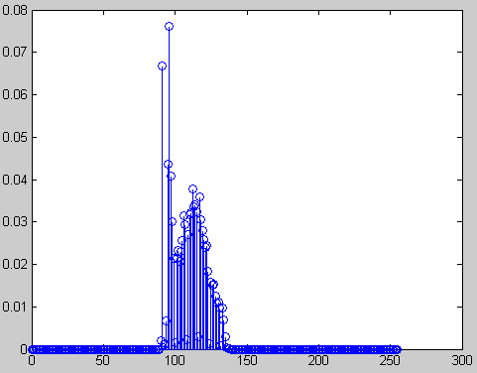
Exercise 2 : In each histogram (a) Identify the gray levels that have not been used. (b) Which gray level is the highest?
Histogram1
Bright image
Pixels are
concentrated
at too high
grade levels
Answer:?
Histogram2
Low contrast image
Pixels are
concentrated
at too low
grade levels,
Distribution is
too narrow.
Both images are not ideal: too bright or too dark. To fix it, use histogram equalization
0 50 100 150 200 250 300

Slide 7
Histogram equalization: Motivation
A mapping s=T(r) is needed, so that Probabilities of all pixel levels in the ‘s’ domain is a constant.
Change the scale from ‘r’ to ‘s’ domain using the mapping s=T(r).
Histogram quantization procedure: E.g. pixels of the gray level r_{k} (say r_{k}=0.75, for pixel levels are normalized from 0 to 1) in the original image may need to be changed to 0.82 in the normalized image.. etc.
So that Ps(s_{k}=0.1)=Ps(s_{k}=0.82)=Ps(s_{k}=0.95)...= Ps(s_{k}=all values)=a_constant. They are the same. But because of digitization, some errors may exit.
Output (normalized) gray values
s
1
s_{k}=T(r_{k})
S_{k}
r
0,0
r_{k}
1
Input gray values
(to be normalized)

Slide 8
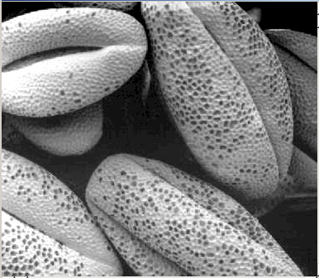
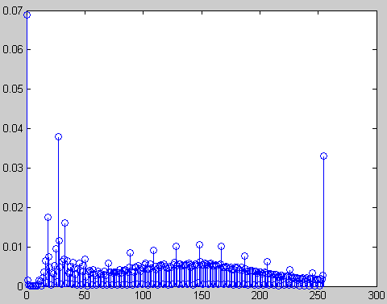
Effect of histogram equalization
Input: The picture is poorly shot. Most pixel gray levels are located in a small range.
Output: Use histogram transform to map the pixels in ‘r’ domain to ‘s’ domain . So in the ‘s’ domain, each s gray level has a similar number of pixels.
Input: Low contrast image
r domain
Output: High contrast image
S domain

Slide 9
Histogram equalization: The main problem is to choose a monotonic increasing relation T(r)
T(r)
A monotonic increasing
relation is needed
L-1=T(L-1)
T(r)
s_{k}=T(r_{k})
r
0
r_{k}
L-1

Slide 10
Objective of histogram equalization
We want to find T(r) so that Ps(s) is a flat line.
Objective:
To find the
Relation s=T(r)
T(r)
L-1
s_{k}
Input random distribution
The original image
r
0
r_{k}
L-1
Ps(s)=a constant
(flat horizontal line)
Pr(r)
s=T(r)
L-1
The probability of all levels are the same
In Ps(s)
r
L-1
s
The probability of these levels are lower)
L-1
The probability of these levels are higher
Equalized distribution

Slide 11
How to find S=T(s)?
Assume we know,
We want to prove that p_{s}(s) is a constant, if the above formula holds.
Later we will show:
if formula (1) is true, p_{s}(s) is a constant

Slide 12
Exercise 3
A numerical example, fill in the blanks

Slide 13
Exercise 4: Based on (1) we want to prove p_{s}(s)= constant
(2 slides back)
We want to show: if formula1 is true, P_{s}(S) is a constant

Slide 14
Discrete form for practical use
From the continuous form of formula (1) to its discrete form

Slide 15
How to do the mapping?
Look up table
T(r)
L-1
s_{k}
Having found the relationship
Transform the original image to obtain a equalized one by the Look-up table T(r).
For (x=0;x<N-1;x++) //For all pixels in the image
{For (y=0;y<M-1;y++) //
{ r_{k}=source_image (x,y);
newImage(x,y) = T(r_{k}); //use the lookup table
}
}
0
r_{k}
L-1
r

Slide 16
Exercise 5
(a) A numerical exercise, fill in the blanks
(b) when r_{k}=source_image(x,y)=4, newimage(x,y) will become ?__.
(c) What is the relation of the variables : Total , M,N and n_{k}?
(d) What is the “histogram back projection" of a pixel having pixel level 2?
(d) What is the “histogram back projection" of a pixel having pixel level 4?

Slide 17
Histogram equalization
Most pictures are in color, having multiple color channels.
We need to equalize color pictures
Then, how to represent color images?

Slide 18
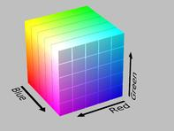
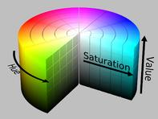
Color models
Cartesian-coordinate representation
RGB (Red , Green , Blue)
Cylindrical-coordinate representation
HSV (Hue, saturation, value)
HSL (Hue, saturation, Light)
etc
RGB
HSV
http://en.wikipedia.org/wiki/HSL_and_HSV#From_HSV

Slide 19
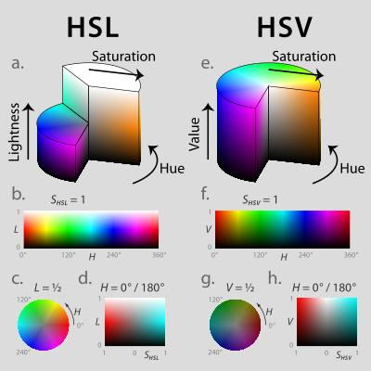
From RGB to HSV or HSL
RGB=red, green, blue (Cartesian-coordinate representation) not relevant to our perception)
So change RGB to cylindrical-coordinate representations , there are 3 choices:
HSV (Hue, saturation, value)
HSL (Hue, saturation, Light)
HSI (Hue, saturation, Intensity)

Slide 20

Hue色調
http://en.wikipedia.org/wiki/Hue
“the degree to which a stimulus can be described as similar to or different from stimuli that are described as red, green, blue, and yellow,”
The same numerical value for ‘Hue’ in HSV and HSL representations of the same picture
Encoded in degree
max=max_value(R,G,B)
min=min_value(R,G,B)
if R = max, H1 = (G-B)/(max-min)
if G = max, H1 = 2 + (B-R)/(max-min)
if B = max, H1 = 4 + (R-G)/(max-min)
H = H1 * 60
Hue

Slide 21
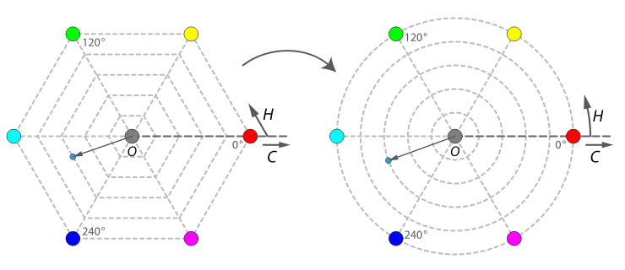
Cylindrical geometry of Hue (0-360º)
Mixing
Red/Green
Mixing
Green/Blue
Mixing
Blue/Red
0º
Red
Primary
120º
Green
Primary
240º
Blue
Primary
Wrap round
http://en.wikipedia.org/wiki/File:Hsv-hexagons-to-circles.svg

Slide 22
Lightness亮度: 3 different methods to encode brightness: Intensity (I), Value (V), Light (L)
Given RGB_{raw} (each channel 0-255 levels) pixels of a picture.
Normalize it first , e.g. each channel is 8-bit.
R=R_{raw}/255; G=G_{raw}/255; B=B_{raw}/255;

Slide 23
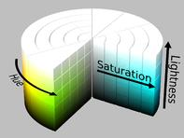
Saturation色彩飽和度
Saturation: “Saturation is the colorfulness of a color relative to its own brightness” from http://en.wikipedia.org/wiki/Colorfulness
Not the same numerical values for HSV and HSL representations of the same picture
HSV
HSL

Slide 24
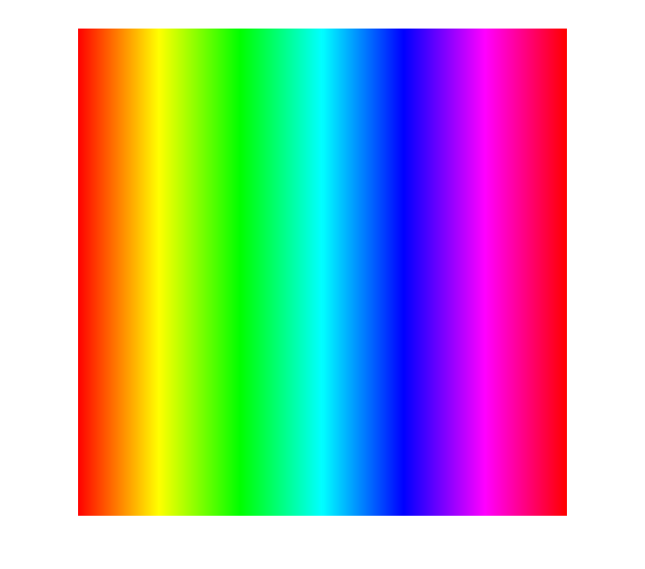
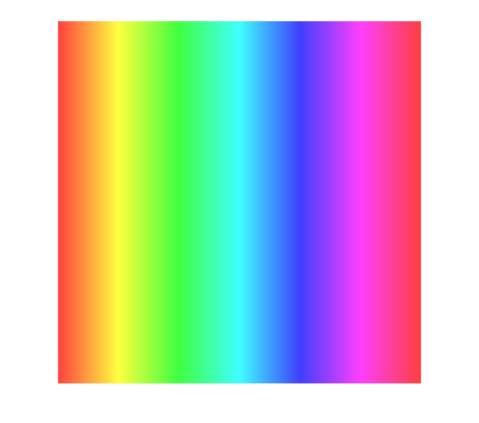


Different saturation (s) values (range 0-1)
S=1 =0.75 =0.5 =0.25
Less water
More water

Slide 25
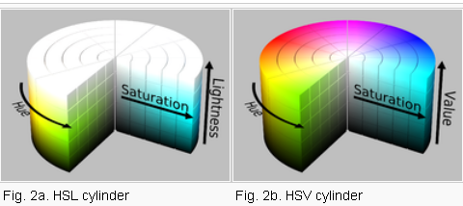
Saturation Calculation
HSL HSV
http://en.wikipedia.org/wiki/HSL_and_HSV

Slide 26
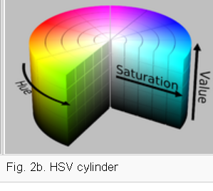
Exercise 6: From RGB (3x8-bit) to HSV
max= max_value(R,G,B) ------------------(1)
min=min_value(R,G,B) --------------------(2)
if R = max, H1 = (G-B)/(max-min) -------(3)
if G = max, H1 = 2 + (B-R)/(max-min)---(4)
if B = max, H1 = 4 + (R-G)/(max-min) ---(5)
H = H1 * 60------------------------------------(6)
V=max/255------------------------------------(7)
if H < 0, H = H + 360
s=(max-min)/max---------------------------(8)
Hue (0->
360º)

Slide 27
Exercise 7
RGB=(18,200,130)
What are the values in HSV,HSL,HSI?
Answer:

Slide 28
Color histogram equalization
Change the RGB representation to HSV
Do histogram equalization for the V channel.
The other two channels (H,S) remain unchanged.
Put back the equalized HSV image back to RGB

Slide 29
Programs and demos
Histogram in OpenCV:
Calculate Histogram: http://opencv.willowgarage.com/documentation/cpp/histograms.html?highlight=calchist#calcHist
Convert color space:
http://opencv.willowgarage.com/documentation/cpp/miscellaneous_image_transformations.html?highlight=cvtcolor#cvtColor
Histogram equalization
http://opencv.willowgarage.com/documentation/cpp/histograms.html?highlight=equalizehist#equalizeHist

Slide 30
Programming Exercise
A programming exercise with OpenCV to histogram equalize a color image
Given an RGB color image, convert it to HSV color space, compute its histogram on the V channel
Do histogram equalization for the V channel and generate the equalized RGB image.

Slide 31
Summary
Studied gray level histograms
Learned histogram equalization
Learned color models and equalization of color images

Slide 32
Reference
Digital image processing, R.C. González, R.E. Woods edition3. ch3 of Gonzalez ed.3 ch3.2 page 120-128. It can be found at http://books.google.com/
http://en.wikipedia.org/wiki/Histogram_equalization

Slide 33
Appendix

Slide 34
ANSWER1: Exercise 1: Normalized histogram
7 | 100 | 200 | 45
2 | 100 | 7 | 120
100 | 100 | 7 | 120
200 | 100 | 45 | 100
200 | 200 | 45 | 45
M
rows
An image of 5x4 pixels (M=?__5, N=?___4)
K=0,1,2,..,L-1=255.
L=256 levels
Sketch the histogram
Normalized
Count
P(r_{k})=n_{k}/MN
N columns
level | count
2 | 1
7 | 3
45 | 4
100 | 6
120 | 2
200 | 4
1
Normalized histogram(plot it)
0.5
0 100 200
Grad level(0-255) rk

Slide 35
Answer2: Exercise 2 : In each histogram (a) Identify the gray levels that have not been used. (b) Which gray level is the highest?
Histogram1
Bright image
Pixels are
concentrated
at too high
grade levels
Answer:
Histogram 1: 0->130
Histogram 2: 0->90, 140→255
(b) Histogram 1, around255. Histogram 2 around 100
Histogram2
Low contrast image
Pixels are
concentrated
at too low
grade levels,
Distribution is
too narrow.
Both images are not ideal: too bright or too dark. To fix it, use histogram equalization
0 50 100 150 200 250 300

Slide 36
Answer3a: Ex3
A numerical exercise
36

Slide 37
Answer 3b:Matlab : Exercise 4:
Ma
%ex3
%note index is shifted because matrix cannot have zero index
n(1)= 790
n(2)= 1023
n(3)= 850
n(4)= 656
n(5)= 329
n(6)= 245
n(7)= 122
n(8)= 81
M =64
N =64
L =8
for j=1:L
p(j)=n(j)
temp=0
for k=1:j
temp=n(k)+temp
end
s(j)=((L-1)/(M*N))*temp
end
n
s
Round(s)
s = 1.3501 3.0984 4.5510 5.6721 6.2344 6.6531 6.8616 7.0000
n = 790 1023 850 656 329 245
122 81
s = 1.3501 3.0984 4.5510 5.6721 6.2344 6.6531 6.8616 7.0000
Roudn s=
1 3 5 6 6 7 7 7

Slide 38
Answer4: Exercise 4: Based on (1) we want to prove p_{s}(s)= constant
The Second Fundamental Theorem of Calculus
http://www.ltcconline.net/greenl/courses/105/Antiderivatives/secfund.htm
Conclusion: if formula (1) is true, p_{s}(s) is a constant

Slide 39
Answer5: Ex 5
(a) A numerical exercise, fill in the blanks
(b) when r_{k}=source_image(x,y)=4, newimage(x,y) will become ?_6_.
(c) What is the relation of the variables : Total , M,N and n_{k}?
Answer: Total=M*N=Sum of all n_{k=0,1,..,Total}
Answer (d, e) In a certain image, the "histogram back projection of a gray level " means the probability of a pixel having that gray level. So "histogram back projection” is the same as pr (rk). Say, in this image the probability a pixel having pixel level rk=2 is 0.0078 or a pixel having pixel level rk=4 is 0.02393. That means in this image, the "histogram back projection" of a pixel having pixel level 2 is 0.0078 or the "histogram back projection" of a pixel having pixel level 2 is 0.02393.

Slide 40
Exercise 6: From RGB (3x8-bit) to HSV
max= max_value(R,G,B) ------------------(1)
min=min_value(R,G,B) --------------------(2)
if R = max, H1 = (G-B)/(max-min) -------(3)
if G = max, H1 = 2 + (B-R)/(max-min)---(4)
if B = max, H1 = 4 + (R-G)/(max-min) ---(5)
H = H1 * 60------------------------------------(6)
V=max/255------------------------------------(7)
if H < 0, H = H + 360
s=(max-min)/max---------------------------(8)
Ex6: Find R,G,B values and the color of
each of following cases:
when V=0.5,H=0º,S=1.
when V=0.2,H=120º,S=0.8
when V=0.6,H=260º,S=0.5.
when V=0,H=0º,S=1.
when V=0.5,H=0º,S=1.
H=0-120 120-240 240-260
H1=0-2 2-4 4-6

Slide 41
Answer 6a,b:Exercise 6: From RGB (3x8-bit) to HSV
6a) when V=0.5,H=0,S=1, the color is :
From (7) max=0.5*255=127.5
From (8) S=(max-min)/max=1,
max-min=max, hence min=0, Since H=0,
the only formula for H1 is (3), because
the other formulas will make H more than 0
From (3) H1 = (G-B)/(max-min)
(G-B)/127.5=0 , so G=B=0
The color is pure red.
----------------------------------------
6b) V=0.2,H=120,S=0.8
H=120 hence H1=2 by formula (6)
From (7) max=0.2*255=51
From (8) S=(max-min)/max=0.8,
max-min=0.8*max, hence min=0.2*max=10.2
Since H1=2, G max be max,
the only formula for H1 is (4), because the other
formulas will make H1 deviate too much from 2
From (4) H1 =2+ (B-R)/(max-min)
2+(B-R)/(51-10.2)=2 , so G=B=0 is the only solution
The color is pure green.
max=max_value(R,G,B) ------------------(1)
min=min_value(R,G,B) --------------------(2)
if R = max, H1 = (G-B)/(max-min) -------(3)
if G = max, H1 = 2 + (B-R)/(max-min)---(4)
if B = max, H1 = 4 + (R-G)/(max-min) ---(5)
H = H1 * 60------------------------------------(6)
V=max/255------------------------------------(7)
if H < 0, H = H + 360
s=(max-min)/max---------------------------(8)
H=0-120 120-240 240-260
H1=0-2 2-4 4-6

Slide 42
Answer 6c:Exercise 6: From RGB (3x8-bit) to HSV
6c) when V=0.6,H=260,S=0.5, the color is :
From (eq7) max=0.6*255=153
From (eq8) S=(max-min)/max=0.5,
max-min=0.5*max, hence min=0.5*max=76.5 Since H=260, from (eq6) H1=260/60=4.333,
the only formula for H1 is (eq5), because
the other formulas will make H1 outside 4 to 6
From (eq5) H1 = 4 + (R-G)/(max-min)
4 + (R-G)/(max-min) =4.333
R-G= 0.333*(153-76.5)=25.47
B=max=153,
R-G=25.47, hence R must be bigger than G, hence G=76.5, so R=G+min=76.5+25.47 =101.97
The color (R,G,B)=(153,101.97,76.6)
The color is purple.
----------------------------------------
max=max_value(R,G,B) ------------------(1)
min=min_value(R,G,B) --------------------(2)
if R = max, H1 = (G-B)/(max-min) -------(3)
if G = max, H1 = 2 + (B-R)/(max-min)---(4)
if B = max, H1 = 4 + (R-G)/(max-min) ---(5)
H = H1 * 60------------------------------------(6)
V=max/255------------------------------------(7)
if H < 0, H = H + 360
s=(max-min)/max---------------------------(8)
Hue 0->360º)
H=0-120 120-240 240-260
H1=0-2 2-4 4-6

Slide 43
Answer 6d,e:Exercise 6: From RGB (3x8-bit) to HSV
6d) when V=0,H=0,S=1,
From (eq7) max=V*255=0*255=0,
so min must be 0. (R,G,B)=(0,0,0)
The color is black.
----------------------------------
6e) when V=1,H=0,S=1,
From (eq7) max=V*255=1*255=255,
H=0, from (eq6) H1=0,
the only formula for H1 is (eq3), because
the other formulas will make H1 outside 0 to 2
From (eq3) H1 =(R-G)/(max-min)
(R-G)/(max-min) =
R-G= 0.333*(153-76.5)=25.47
B=max=153,
R-G=25.47, hence R must be bigger than G, hence G=76.5, so R=G+min=76.5+25.47 =101.97
The color (R,G,B)=(153,101.97,76.6)
The color is purple.
----------------------------------------
max=max_value(R,G,B) ------------------(1)
min=min_value(R,G,B) --------------------(2)
if R = max, H1 = (G-B)/(max-min) -------(3)
if G = max, H1 = 2 + (B-R)/(max-min)---(4)
if B = max, H1 = 4 + (R-G)/(max-min) ---(5)
H = H1 * 60------------------------------------(6)
V=max/255------------------------------------(7)
if H < 0, H = H + 360
s=(max-min)/max---------------------------(8)
Hue 0->360º)
H=0-120 120-240 240-260
H1=0-2 2-4 4-6

Slide 44
Answer 6:Exercise 6: From RGB (3x8-bit) to HSV
max=max_value(R,G,B) ------------------(1)
min=min_value(R,G,B) --------------------(2)
if R = max, H1 = (G-B)/(max-min) -------(3)
if G = max, H1 = 2 + (B-R)/(max-min)---(4)
if B = max, H1 = 4 + (R-G)/(max-min) ---(5)
H = H1 * 60------------------------------------(6)
V=max/255------------------------------------(7)
if H < 0, H = H + 360
s=(max-min)/max---------------------------(8)
Hue (0->
360º)

Slide 45
Answer7 for ex7
RGB=(18,200,130). Can normalize it first
RGB=(18,200,130)/255.
What are the values in HSV?
Answer:
(for HSV on R=18/255, G=200/255, B=130/255),
max=200/255, m=18/255, since green G=max
H1=2+(B-R)/(max-min), H1=
H1=2+(130-18)/(200-18)=2+(112/182)=2.615, need not to show 255 since they cancel each other in numerator and denominator
H=H1*60=156.9°
S=(max-min)/max=(200-18)/200=0.91
V=max/255=0.78
HSL, HSI , see formulas in note

