Slide 1
Image processing and computer vision
Chapter 7:
Mean-shift and Cam-shift
Ref
[1] Dorin Comaniciu, Peter Meer,"Mean Shift: A Robust Approach Toward Feature Space Analysis"Volume 24 , Issue 5 (May 2002),IEEE Transactions on Pattern Analysis and Machine Intelligence
[2] web.missouri.edu/~hantx/ECE8001/notes/Lect7_mean_shift.pdf
Week 6

Slide 2
What is Mean-shift?
Find the peak of a probability function by the change of the mean of the data
Applications:
  Non-rigid object tracking
  Segmentation

Slide 3
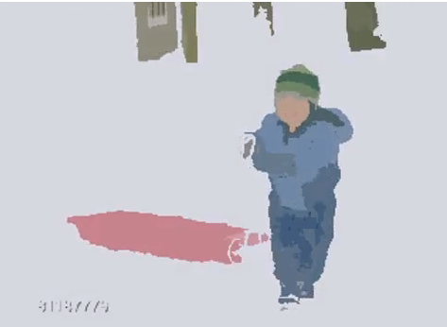
Applications: segmentation of regions of images in a movie
Use color to segment the image into logical regions for analysis.
If the regions are moving , mean-shift is useful.
http://www.youtube.com/watch?v=n1W0IwipRBQ&feature=related

Slide 4
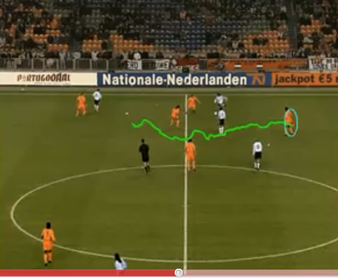
Application: tracking non-rigid object
Human tracking
http://www.youtube.com/watch?v=zLtjPfPP9HY

Slide 5
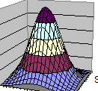
Intuition: find the mode by mean-shift
Target : Find the modes (peaks) in a set of sample data.
  The mode of a continuous probability distribution is the peak.
  There may be multiple peaks.
The method used is called mean-shift.
  By finding the shift of the mean, we can find the mode (peak)
It can be used to segment an image into logical regions. (e.g. within each region, the color is the same.)

Slide 6
First we need to understand the Probability Density Function PDF
We use
Kernel density estimation to find PDF
Obtain the probability function from samples

Slide 7
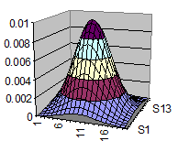
Motivation for Kernel density estimation to find PDF
The formula (parametric form) of the PDF (probability density function) is difficult to find.
Use sampling method to estimate the P.D.F.
That means: Gaussian ( a parametric form with mean , standard deviation etc., is easy to use), but it is too simple to model real life problems.
PDF(x)
Too simple
to model
real life problems
0
x
An irregular shape PDF, the distribution
Is difficult to model using parameters
--use non-parametric methods instead
Gaussian distribution

Slide 8
Example
Outbreak of flu in a year
How do you model this PDF?
CUHK Clinic
Patients
Number
Per day
100
3 6 9 12
month

Slide 9
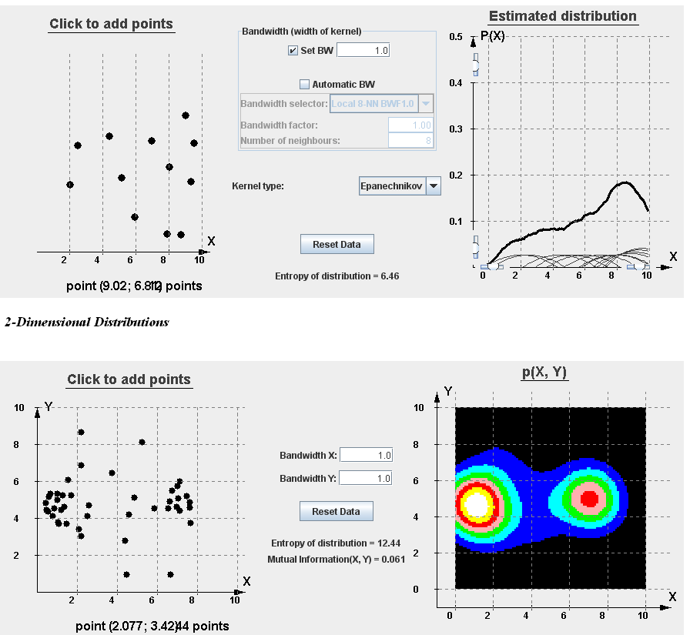
Kernel density estimation KDE Demo
http://parallel.vub.ac.be/research/causalModels/tutorial/kde.html
https://en.wikipedia.org/wiki/Kernel_density_estimation

Slide 10
kernel density distribution function
K is a function:
To be explained (see slide19)
The general form of a kernel density distribution function
The Kernel (K) has many choices
  Epanechnikov
  Uniform
  Normal (Gaussian)

Slide 11
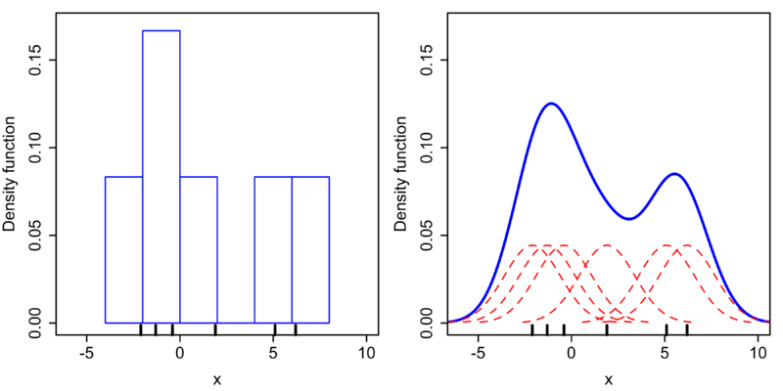
Non-parametric methods
--Histogram
--Kernel density estimation
(discuss here)
General form of a Kernel density function
Add kernel
functions
to become
the final P.D.F
Each one
is a kernel
function
K[(x-x_{i})/h)]
Histogram
Kernel (Gaussian) density
1-dimension example
http://en.wikipedia.org/wiki/Kernel_density_estimation

Slide 12
Example of a histogram and kernel density function
Kernel density estimates are closely related to histograms, but can be endowed with properties such as smoothness or continuity by using a suitable kernel. To see this, we compare the construction of histogram and kernel density estimators, using these 6 data points: x₁ = −2.1, x₂ = −1.3, x₃ = −0.4, x₄ = 1.9, x₅ = 5.1, x₆ = 6.2. For the histogram, first the horizontal axis is divided into sub-intervals or bins which cover the range of the data. In this case, we have 6 bins each of width 2. Whenever a data point falls inside this interval, we place a box of height 1/12. If more than one data point falls inside the same bin, we stack the boxes on top of each other.
From http://en.wikipedia.org/wiki/Kernel_density_estimation

Slide 13
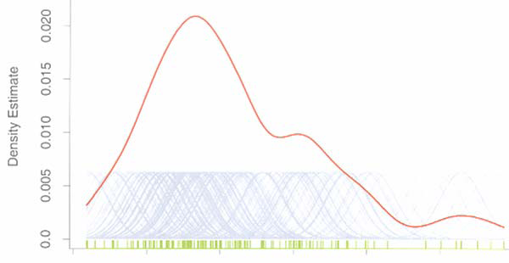
The concept:
General form of a Kernel density function (1-D example)
The area under each small Gaussian curve is 1. When n curves are summed together and divided by n, the total area under the curve of the summed_PDF is also 1
The summed_PDF = summation of many small Gaussian kernel functions
Kernel functions at
each sample point
The area under each Gaussian curve 1.
Modified from
http://www.cs.cornell.edu/courses/cs664/2005fa/Lectures/lecture3.pdf

Slide 14
Kernel density in 2D (x1,x2 as coordinates) example
E.g PDF of mosquitoes in CU.
At time t, if you can find one mosquito at a location x_{i} =(x1,x2)_{i}, mark it green in the diagram.
Assumption: at a position x, the probability f_{h}(x) of finding a mosquito is proportional to the number of mosquitos found in that circle.
It can be calculated by f_{h}(x), e.g. h=1 meter
x2
Each x has such a bandwidth h to contribute to the final probability f_{h} (x)
h
x
X_{i=1}
X_{i=2}
=
PDF of mosquitoes in CU
x1

Slide 15
Illustration of the mean-shift idea
You want to find the location of a circle (fixed radius) to enclose the biggest number of points. ➔ The more points, the bigger the PDF. E.g. you find the area where the biggest number of mosquitos are found.
The mean shift algorithm
Guess the peak is at x_{t=0}
  Draw a circle of radius h
  Find mean of points (mostquitos) inside the window=mean_loc(x_{t}) =‘*’ in the diagram
  Move the circle for x_{t+1} at mean_loc(x_{t})
  m(t)=mean_loc(x_{t})-x_{t}=mean-shift vector
  t=t+1
Repeat steps 1-5 , till m(t) is small enough
X is the result. (peak)
x2
Mean-shift-vector
m(t)
mean_loc(x_{t})
of the green
dots in the circle
Search
Radius
= Sr
‘*’
x_{t}
x1

Slide 16
Example 1
Show graphically of mean-shift
Starting from x and the circle shown
Find the peak of the PDF.
Repeat the task if your first selection is at x’
x2
Search
Radius
= Sr
x’
x
PDF of mosquitoes in CU
x1

Slide 17
Kernel choices
How about the kernels function “K” (內核 )?
Building blocks

Slide 18
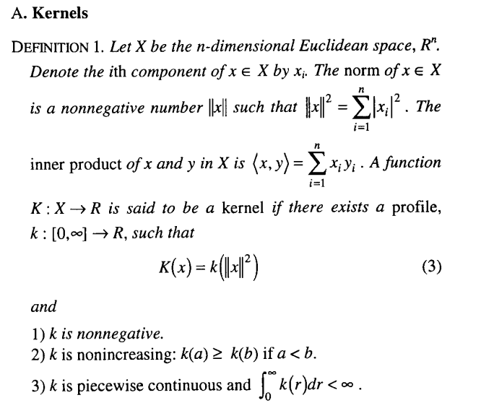
Define Kernel and Profile
Kernel
  The variable x of a kernel is a point in the n-dimensional space
Profile
  The variable for a profile is a 2-norm value (length of a vector in the n-dimensional space) ||x||²
From:Cheng, Yizong (August 1995). "Mean Shift, Mode Seeking, and Clustering". IEEE Transactions on Pattern Analysis and Machine Intelligence (IEEE) 17 (8): 790–799. doi:10.1109/34.400568.

Slide 19
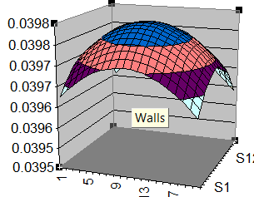
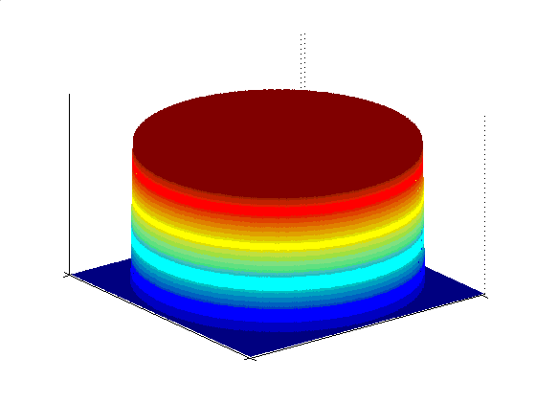
Kernel choices (內核)
Different radial symmetric kernel
Epanechnikov
Uniform
Normal
(Gaussian)

Slide 20
The use of the Epanechnikov (K_{E}) kernel function

Slide 21
CMSC5711 ,Ch7, Mean/cam-shift Exercise 1

Slide 22
CMSC5711 ,Ch7, Mean/cam-shift Exercise 2

Slide 23
Answer 2 : Exercise 2

Slide 24
Exercise 3
Use Epanechnikov kernel fuction
For K_{E}(w), c=3/4, h=1.5,
It is a 1-D problem
The window is centered at 0, hence x=0,with 3 samples:
x_{i=1}=0.3, x_{i=2}= -0.5, x_{i=3}=0.7,
Find P_{n,k}(x) in terms of C_{e}

Slide 25
Answer 3
Use Epanechnikov kernel fuction
For K_{E}(w), c=3/4, h=1.5,
It is 1-D problem
The window is centered at 0, hence x=0,with 3 samples:
x_{i=1}=0.3, x_{i=2}=-0.5, x_{i=3}=0.7,
Find P_{n,k}(x) in terms of C_{e}
Answer: P_{n,k}(x) =C_{e}{
(3/4)(1- ((0-0.3)/1.5)^2 ) +
(3/4)(1- ((0-(-0.5))/1.5)^2 ) +
(3/4)(1- ((0-0.7)/1.5)^2 ) }
= C_{e}* 1.9733
%Matlab code
clear
x=0, h=1.5, xi(1)=0.3, xi(2)=-0.5, xi(3)=0.7
tmp=0
for i=1:3
tmp=(3/4)*(1- ( (x-xi(i))/h )^2 )+tmp
end
'to verify'
(3/4)*(1- ((0-0.3)/1.5)^2 ) +...
(3/4)*(1- ((0-(-0.5))/1.5)^2 ) +...
(3/4)*(1- ((0-0.7)/1.5)^2 )

Slide 26
Probability Peak Finding
Go back to the PDF
Find the peak of PDF by finding x when ∇PDF(x)=0

Slide 27
Motivation:
Kernel Density (gradient) Estimation
The peak of a Probability distribution (PDF) P(x) is difficult to find,
so we find the gradient d{P(x)}/dx=∇P(x)
And when ∇P(x)=0 , it is at the peak of P(x)

Slide 28
If you have the PDF, you can find the peak (mode), how?
If you know the formula of the PDF, you can find the mode (peak). I.e. peak=max (pdf)
Usually the formula is not known, so max (pdf) is difficult to find. Solution: find gradient (pdf)=0 iteratively : so ∇(PDF)=0
peak
Until the peak is found when ∇(PDF)=0
Try this next
It is important to have the correct search direction, mean-shift can provide that
Try this first

Slide 29
Step1: Model the PDF
h
%matlab 1-D illustration,
% Epanechnikov
function v=prob_func(w)
c=3/4; %c=3/4 for epan
if abs(w) <=1
v=c*(1-w^2);
else
v=0;
end

Slide 30
The Kernel density function is using a Radial Symmetric Kernel Profile
because K(u)=K(u1)K(u2)..K(d)
, C_{k,d} is to normalize the dimension d used,
For each dimension K(u),the largest value=h, so this term is for normalization.
E.g. If dimension is 2, so d=2, h^{d=2} is used etc
n= number of samples used in this kernel density approximation, the bigger then the better.
Ref:http://sfb649.wiwi.hu-berlin.de/fedc_homepage/xplore/ebooks/html/spm/spmhtmlnode18.html

Slide 31
Derivation exercise
http://www.cse.psu.edu/~rcollins/CSE598G/moreMeanShift_6pp.pdf.
“the Shadow” is first defined in
Yizong Cheng, "Mean Shift, Mode Seeking, and Clustering ", IEEE PAMI, VOL. 17, NO. 8, AUG.1995

Slide 32
Exercise 4, fill in the blanks
k( ) is the shadow of g( )

Slide 33
Derivation steps

Slide 34
Continue

Slide 35
Continue

Slide 36
Exercise 5: Kernel Density (gradient) Estimation Fill in the blanks

Slide 37
Kernel Density (gradient) Estimation
Mean-shift-vector

Slide 38
Exercise 6 :Kernel Density (gradient) Estimation

Slide 39
Finding Mean-Shift-vector
mean of all
elements inside the
processing window
x=current position of the processing window
Always Positive
Mean shift
vector
The proof of convergence can be found in [1]

Slide 40
The gradient of PDF ∇ P(x) is proportional to the mean-shift vector m(x)
This is the mean of all
elements inside the
processing window
mean shift
vector m(x)

Slide 41
Mean-shift
Algorithm and procedure

Slide 42
P(a) points to the ascending direction of P(x). Since ∇P(x) ∝ m(x) so if we shift x_{t+1} =x_{t} + m(x_{t}), P(x) will increase. This is mean shift
Gradient of P(x)= ∇ P(x)
Mean shift vector = m(x)
∇ P(x) ∝ m(x) is shown before
At the left side of the peak (a < x)
  Assume x_{t} is at a.
  Slope at a is +ve, meaning ∇P(x_{t}=a) is +ve since ∇ P(x_{t}=a) ∝ m(x_{t}=a) , so m(x_{t}=a) is also +ve,
  In the mean_shift procedure , we do this: x_{t+1}=x_{t} + m(x_{t})
  This procedure brings x closer to the peak.
At the right side of the peak (a’ > x’_{t+1})
  Assume x’_{t} is at a’.
  slope at a’ is -ve, meaning ∇P(x’_{t}=a’) is -ve since ∇ P(x’_{t}=a’) ∝ m(x’_{t}=a’) , so m(x’_{t}=a’) is also -ve,
  In the mean_shift procedure , we do this: x’_{t+1}=x’_{t} + m(x’_{t})
  This procedure brings x closer to the peak.
P(x)
Peak
+ve slope at a
-ve slope at a’
a=x_{t}
x_{t+1}
x
x’_{t+1}
a’=x’_{t}
left side of peak
right side of peak

Slide 43
Procedures
To find the peak of PDF
For gradient of PDF =∇ P
  The first term is a PDF , it is positive.
  The second tern m(x_{t}) always points to the maximum PDF direction (proof in previous slides [1])
So the peak can be found by
  First guess at x(t=0)
  iterate followings until X_{t’+1}=x_{t’} (meaning m(x_{t}) too small)
    Find m(x_{t})
    X_{t+1}=x_{t} + m(x_{t})
    Increment t
  X_{peak} = x_{t’} (done)
Same as
x_{t+1}=x_{t} + ∇ P(x_{t})
Since ∇ P(x)∝ m(x_{t})
Gradient of PDF
+ve
P(x)
Peak
m(x_{t})
m(x_{t+1})
x_{t}
x_{t+1}
x_{t +2}
X_{peak(t=t’)}
x
[1] Dorin Comaniciu, Peter Meer,"Mean Shift: A Robust Approach Toward Feature Space Analysis"
Volume 24 , Issue 5 (May 2002),IEEE Transactions on Pattern Analysis and Machine Intelligence

Slide 44
Camshift
An implementation of mean-shift for object tracking
Reference s
Bradski, G.R., “Real time face and object tracking as a component of a perceptual user interface,” Applications of Computer Vision, 1998. WACV ‘98. Proceedings., Fourth IEEE Workshop on , vol., no., pp.214,219, 19-21 Oct 1998
http://docs.opencv.org/trunk/doc/py_tutorials/py_video/py_meanshift/py_meanshift.html

Slide 45
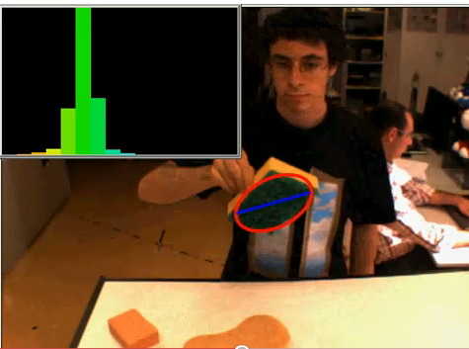
A target tracking tool using mean-shift: Cam-shift
Demo opencv video
http://www.youtube.com/watch?v=iBOlbs8i7Og

Slide 46
Motivation
For target tracking , mean shift can be used.
Implementing the full mean shift algorithm is too complex
It is found that the implementation can be found by zero-moment and first-moment
We will show how
Ref: Gary R. Bradski, “Computer Vision Face Tracking For Use in a Perceptual User”, Microcomputer Research Lab, Santa Clara, CA, Intel Corporation

Slide 47
Overview
Color features for tracking
Object tracking by cam-shift
  Step1: find object color model (histogram)
  Step2: use the model to track using mean-shift, use histogram-back-project to identify the object for tracking
Illustration of the cam-shift idea
Demonstration
Applications
  Face tracking
  Object tracking

Slide 48
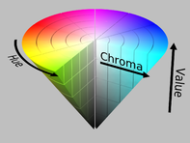

(1) Color features for tracking
Color processing
Recall, hue =色調
From 0 to 360 degrees
Encode values:0→1
0 0.5 1

Slide 49
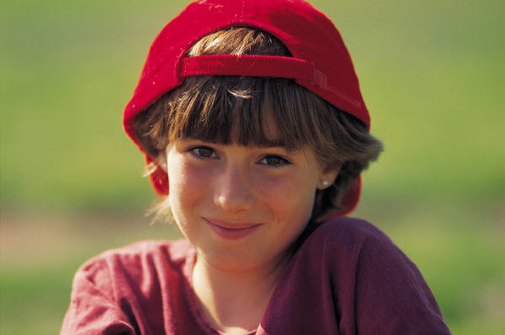
2) Object tracking
Step1
Procedure to find object color model histogram, example
Learn object color distribution e.g. face color, hue is enough to identify face
Circle face by hand, keep hue image only: Hue =0→7 levels
Find model face histogram of Hue color inside
E.g. 8 bins
I(x,y)=
probility_of_face_color(Hue of the pixel)
counts
Hue
Histogram

Slide 50

Example to find model and histogram back project
e.g.
Pixel at location(12,34), the hue image level
I(12,34) is 3
x2
64x64
Color histogram Model building
Image size M=64,N=64. Total=(MxN)
For the hue image, each pixel value r_{k} =0→7. (In practice, use 0→255)
The number of pixels having hue_value r_{k} is n_{k}
Use 8 bins (buckets). (In practice, use 32 bins)
Histogram back project P_{hist}[I(x,y)]
You have a pixel r_{k} =I(x1,x2) (with hue color r_{k}.)
P_{hist}[I(x1,x2)] is the probability this pixel belonging to a face
E.g. r_{k} =I(12,34)=3 (see next slide for the histogram)
Read up P_{hist}(r_{k} =3) from histogram ,
P_{hist}[3] =0.160
x1
I(r_{k})
Hue

Slide 51
Example
A numerical exercise
51

Slide 52
2) Object tracking step2: Recall: mean-shift procedures to find the peak of PDF
Gradient of PDF
For gradient of PDF =∇ P
  The first term is a PDF , it is positive.
  The second tern m(x_{t}) always points to the maximum PDF direction (proof in previous slides [1])
So the peak can be found by
  First guess at x(t=0)
  iterate followings until X_{t’+1}=x_{t’} (meaning m(x_{t}) too small)
    Find m(x_{t})
    X_{t+1}=x_{t} + m(x_{t})
    Increment t
  X_{peak} = x_{t’}
Same as
x(t+1)=x(t) + ∇ P(x)
Since ∇ P(x)∝ m(xt)
+ve
P(x)
Peak
m(x_{t})
m(x_{t+1})
x_{t}
x_{t+1}
x_{t +2}
X_{peak(t=t’)}
x
[1] Dorin Comaniciu, Peter Meer,"Mean Shift: A Robust Approach Toward Feature Space Analysis"
Volume 24 , Issue 5 (May 2002),IEEE Transactions on Pattern Analysis and Machine Intelligence

Slide 53
The Cam-shift trick:
Weighted kernel density for image tracking

Slide 54
Exercise 7: What is moment ?
In mechanics, it is moment=length * mass.
3Kg
2Kg
2 m
3 m
Position ‘o’
M1=First Moment on this side about position ‘o’
is 3x2 Kgm
M0=Zero moment is 3Kg, no length involved
M1=First Moment on this side about position ‘o’is ?(i)______Kgm
M0=Zero moment is ?(ii)_______, no length involved

Slide 55
Answer:7: What is moment ?
In mechanics, it is moment=length * mass.
3Kg
2Kg
2 m
3 m
Position ‘o’
M1=First Moment on this side about position ‘o’
is 3x2 Kgm
M0=Zero moment is 3Kg, no length involved
M1=First Moment on this side about position ‘o’is ?(i)2x3 Kg Kgm
M0=Zero moment is ?(ii) 2Kg, no length involved

Slide 56
In computer vision it is the pixel intensity * length
x2
I(x,y),
the probability of this
pixel has
the color of skin
is P_{hist}[I(x1,I2)]
x1
If only intensity is considered
In our application, we want to know the probability of a pixel that has the color of skin, use histogram back project P_{hist}[I(x1,I2)] instead of I(x1,I2)

Slide 57
Find first, zero moment in mean shift vector m(x)
Histogram_back_project :P_{hist}[I(x1,x2)]
First moment
Zero moment
m(x)=Mean-shift-vector
in the mean-shift algorithm

Slide 58
The Cam-shift algo.
[x_{t}=(x1,x2)_{t}]
Recall : m(x1,x2)=[(M10/M00), (M01/M00)]-[x1,x2]
---The camshift algorithm --
First guess at x_{(t=0)} =[x1,x2]_{t=0} .
Form a search window centered at x_{t=0}
  Calculate M10,M01,M00 of the search window
  Find mean_loc(x_{t})=[(M10/M00),(M01/M00)]_{t}
  Find mean-shift-vector m(x_{t})=mean_loc(x_{t})-[x1,x2]_{t}
  New search window will center at mean_loc(x_{t})
  t=t+1;
  Loop to 1 until m(x_{t}) < threshold
X_{peak} = [x1,x2]_{t}
Recall the mean-shift algo.
The peak can be found by
  First guess at x(t=0)
  iterate followings until X_{t’+1}=x_{t’} (meaning m(x_{t}) too small)
    Find m(x_{t})
    X_{t+1}=x_{t} + m(x_{t})
    Increment t
  X_{peak} = x_{t’}

Slide 59
(3) Illustration of the cam-shift (mean-shift) idea
You want to find the location of a circle (fixed radius) to enclose the biggest number of points. ➔ The more points, the bigger the PDF.
Guess the peak is at x_{t=0}
  Draw a circle of radius h
  Find mean of points inside window=mean_loc(x_{t})
  Move the circle for x_{t+1} at mean_loc(x_{t})
  m(t)=mean_loc(x_{t})-x_{t}=mean-shift vector
  t=t+1
Repeat 1-5 , till m(t) is small enough
X is the result. (peak)
x2
Mean-shift-vector
m(xt)
mean_loc(xt)
of the green
dots in the circle
h
x
x1

Slide 60
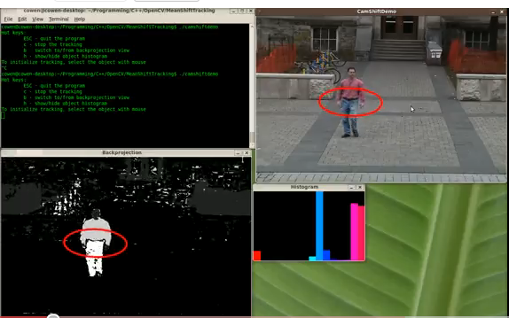
(4) Demonstration of result Animation of tracking
Demo
http://il.youtube.com/watch?v=Mfo_wE17bog&feature=related

Slide 61
Exercise 8
A tutorial to show the operation of the mean-shift algorithm
An object has pixels of gray level 1. The empty cells have gray level 0.
A mean shift algorithm is applied to find the position of the object of size around 5x5 with gray level 1 . That means you need to find the center of a 5x5 box covering the biggest number of pixels with gray level 1 in the image.
The initial window is given to be centered at (x,y)=(5,4)
1) Describe the procedure of finding the object by a mean-shift algorithm,
2) Find the location of the center of the 5x5 box at each step of the mean-shift algorithm. Round off values to integers during your calculations.
0 | 1 | 2 | 3 | 4 | 5 | 6 | 7 | 8 | 9 | 10 | 11 | 12 | 13 | 14
1
2
3
4
5 |  |  |  |  |  |  | 1
6 |  |  |  |  |  |  | 1 | 1 | 1
7 |  |  |  |  |  | 1 | 1 | 1 | 1
8 |  |  |  |  |  | 1 | 1 | 1 | 1
9 |  |  |  |  |  | 1 | 1 | 1 | 1
10 |  |  |  |  |  |  | 1 | 1
11
12
13
14
Figure 8a
Initially the 5x5 search window is
centered at (5,4)

Slide 62
Summary
Studied mean shift
Studied cam-shift for face tracking

Slide 63
Appendix

Slide 64
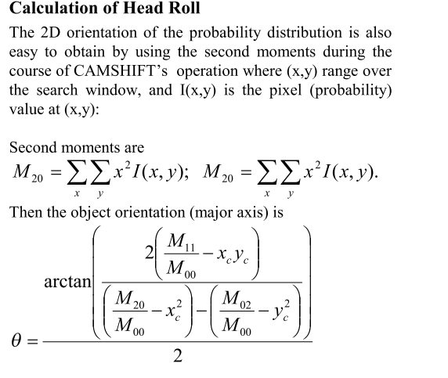
(5) Rotation tracking

Slide 65
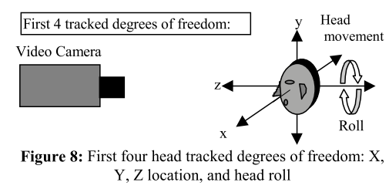
(7) Applications: Head motion tracking

Slide 66
Compare mean shift vector and zero, first moments
The general Mean shift algorithm
The peak is found by:
First guess at x(t=0)
  iterate until m(x_{t})=0
    Find m(x_{t})
    X_{t+1}=x_{t} + m(x_{t})
  X_{peak} = x_{t}
The new Cam shift (mean shift using zero-first-moment)
Recall in the previous slide
M(x,y)=[(M10/M00), (M01/M00)]-[x,y]
---The new camshift algorithm --
First guess at x(t=0)
Iterate until m(x_{t})=0
  Find m(x_{t})=[(M10/M00),(M10/M00)]_{t}-[x,y]_{t}
  [x,y]_{t+1}=[x,y]_{t} + m(x_{t})
  [x,y]_{t+1}=[x,y]_{t} + [(M10/M00),(M10/M00)]_{t}-[x,y]_{t}
  [x,y]_{t+1}=[(M10/M00),(M10/M00)]_{t}
X_{peak} = [x,y]_{t}
The centriod window is shifted by [xc,yc]_{t}= =[(M10/M00),(M10/M00)]_{t}
For Camshift
X→[x,y]

Slide 67
Use excel to plot an Epanechnikov distribution
(cut and paste to excel to view plot) each cell is
=(1/(2*3.1416*$A$25*$A$25))*(1-(1*( ($A2-$B$25)^2 + (B$1-$C$25)^2) / (1*($A$25)*($A$25) )))

Slide 68
Use excel to plot a Gaussian (or normal) distribution
(cut and paste to excel to view plot) each cell is
=(1/(2*3.1416*$A$25*$A$25))*EXP(-1*( ($A3-$B$25)^2 + (B$2-$C$25)^2) / (2*($A$25)*($A$25) ))

Slide 69
Answer 1 : Exercise 1

Slide 70
Answer 4: Exercise 4
Derivation

Slide 71
Answer5: Exercise 5
Kernel Density (gradient) Estimation

Slide 72
Answer 6: Exercise 6, Kernel Density (gradient) Estimation

Slide 73
ANS8: Step 1: In Figure 8a. find x-moment--
0_moment =sum all pixels in the box =2
The center of the window is (x=5,y=4), the horizontal distance of the top pixel with level 1 is (x=7,y=5) , so the horizontal distance (x_distance1) of this pixel to the center of the window is 7-5=2. Therefore 1st x_moment=x_distance1*pixel_value1=2*1=2. All pixels are of value ‘1’ in this image.
For the second non-zero pixel at (x=7,y=6), 1st_moment=x_distance2*pixel_value2=2*1=2. All pixels are of value ‘1’ in this image.
All x_mean=(sum all 1stx_moment of all pixels)/0_moment=(2+2)/2=2, x_mean=2.
-----Similarly---for the y-moment- ------
1st y_moment=1+2=3
All y_mean=(summation of all 1st y_moment of all pixels)/0_moment =3/2=1.5 (round to 2), y_mean=2.
Current window is centered at (5,4), so the next window is centered at (5+2,4+2)=(7,6)
So the new window is shown in Figure 8b.
0 | 1 | 2 | 3 | 4 | 5 | 6 | 7 | 8 | 9 | 10 | 11 | 12 | 13 | 14
1
2
3
4
5 |  |  |  |  |  |  | 1
6 |  |  |  |  |  |  | 1 | 1 | 1
7 |  |  |  |  |  | 1 | 1 | 1 | 1
8 |  |  |  |  |  | 1 | 1 | 1 | 1
9 |  |  |  |  |  | 1 | 1 | 1 | 1
10 |  |  |  |  |  |  | 1 | 1
11
12
13
14
Figure
8a
0 | 1 | 2 | 3 | 4 | 5 | 6 | 7 | 8 | 9 | 10 | 11 | 12 | 13 | 14
1
2
3
4
5 |  |  |  |  |  |  | 1
6 |  |  |  |  |  |  | 1 | 1 | 1
7 |  |  |  |  |  | 1 | 1 | 1 | 1
8 |  |  |  |  |  | 1 | 1 | 1 | 1
9 |  |  |  |  |  | 1 | 1 | 1 | 1
10 |  |  |  |  |  |  | 1 | 1
11
12
13
14
Figure
8b
The 5x5 search window is
centered at (7,6)

Slide 74
Ans:Ex8-step2
0 | 1 | 2 | 3 | 4 | 5 | 6 | 7 | 8 | 9 | 10 | 11 | 12 | 13 | 14
1
2
3
4
5 |  |  |  |  |  |  | 1
6 |  |  |  |  |  |  | 1 | 1 | 1
7 |  |  |  |  |  | 1 | 1 | 1 | 1
8 |  |  |  |  |  | 1 | 1 | 1 | 1
9 |  |  |  |  |  | 1 | 1 | 1 | 1
10 |  |  |  |  |  |  | 1 | 1
11
12
13
14
Referring to the Figure 8b
Step 2: 0_moment =12 (summation of all pixels values inside the window of Fig 8b-the last slide)
All 1st x_moment=
-1-1+0+0+0+0+1+1+1+2+2+2=7
x_mean=1st x_moment/0_moment=
7/12=0.583=round off to 1
All 1st y_moment=
-1+0+0+0+1+1+1+1+2+2+2+2=11
y_mean=all 1st x_moment/0 moment=11/12=0.96 (round off to 1)
Current window is centered at (7,6), so the next window is centered at (7+1,6+1)=(8,7)
So the new window is at :
Figure
8b
The 5x5 search window is
centered at (7,6)
74
0 | 1 | 2 | 3 | 4 | 5 | 6 | 7 | 8 | 9 | 10 | 11 | 12 | 13 | 14
1
2
3
4
5 |  |  |  |  |  |  | 1
6 |  |  |  |  |  |  | 1 | 1 | 1
7 |  |  |  |  |  | 1 | 1 | 1 | 1
8 |  |  |  |  |  | 1 | 1 | 1 | 1
9 |  |  |  |  |  | 1 | 1 | 1 | 1
10 |  |  |  |  |  |  | 1 | 1
11
12
13
14
Figure
8c
The 5x5 search window is
centered at (8,7)

Slide 75
Ans:Ex8-step3
Step 3: 0_moment =17
1st x_moment=-2-2-2-1-1-1-1-1+0+0+0+0+1+1+1+1= -11+4=-7
x_mean=1st x_moment/0 moment=-7/17=-0.417=round off to 0.
1st y_moment=-2-1-1-1+0+0+0+0+1+1+1+1+2+2+2+2= -5+12=-7
y_mean=1st y_moment/0 moment=-7/17=-0.41=round off to 0
The current window is centered at (8,7), so the next window is centered at (8-0,8-0)=(8,7).
Since the center has no change we will stop here and the final window is centered at (8,7).
0 | 1 | 2 | 3 | 4 | 5 | 6 | 7 | 8 | 9 | 10 | 11 | 12 | 13 | 14
1
2
3
4
5 |  |  |  |  |  |  | 1
6 |  |  |  |  |  |  | 1 | 1 | 1
7 |  |  |  |  |  | 1 | 1 | 1 | 1
8 |  |  |  |  |  | 1 | 1 | 1 | 1
9 |  |  |  |  |  | 1 | 1 | 1 | 1
10 |  |  |  |  |  |  | 1 | 1
11
12
13
14
Figure
8c
The 5x5 search window is
centered at (8,7)
75

