Slide 1
Image processing and computer vision
Chapter 8: Stereo vision
Week 7

Slide 2
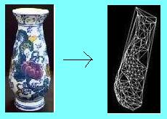
3-D computer vision, an overview
Find 3-D structure using 2-D images
One camera:
Possible but limited results, e.g. by identify vanishing lines
Two cameras:
Stereo: use Epipolar geometry (This chapter)
Three cameras:
Trifocal tensor method (very advanced not discussed here)
N cameras:
Factorization (Chapter 9), fast method, moderate accuracy
Bundle adjustment (chapter 11), slow but accurate.

Slide 3
In this chapter you will learn
Stereo camera setup
Essential matrix (E)for describing the geometry between two cameras of known intrinsic parameters
Fundamental matrix (F) for describing the geometry between two cameras of unknown intrinsic parameters
Epipolar geometry: parameters and characteristics
The Correspondent problem
3D Reconstruction using stereo vision

Slide 4
Part 1: A simple approach 3-D reconstruction from stereo images
Assumption : the cameras are parallel (2 principal axes are parallel) and the camera shift is only in the horizontal direction

Slide 5

Introduction to Stereo Vision
Objectives:
Basic idea of stereo vision
Stereo reconstruction by epipolar geometry
Stereo camera pair calibration (find Fundamental matrix F)
Construct the 3D (graphic) model from 2 images
Inside a computer
e.g. Graphic
model in a game
3-D object

Slide 6
A simple stereo system Assume cameras are aligned horizontally (No vertical disparity)
Left
Camera
Principle
axis
Right
Camera
Principle
axis
Object
Px(x,y,z)
A point in 3D (Px)
z
Left image
plane
Right image
plane
Left
Image
plane
Right
Image
plane
x_{L}
x_{R}
Focal
Length
f
Left
optical
Center
O(left)
(reference
point)
Stereo:
Baseline (B)
Right
optical
Center
O(right)
B (Baseline)
Left camera center
(reference point)
Horizontal
Disparity=x_{L}-x_{R}
Notes:
You may close your left eye and see an object in front of you, then close you right eye and see the same object. The object seems to be moved because both eyes are seeing things at a different angle and it gives us the clues for reconstruction of the 3-D model. The slight motion of the object in the images is called disparity.

Slide 7

Example Assume cameras are aligned horizontally(No vertical motion of camera= no vertical disparity)
Left image Right image
White crosses are
overlaid on images
to show the positions
of features.
They are not
in the original pictures.
A corner feature is found
in a 10x10 window (w)
centered at the
left image (x_{L},y_{L})
(overlay a cross)
Find the correspondence at (x_{R},y_{R})
Horizontal disparity=X_{L}-X_{R}
The stereo sequence video : http://www.youtube.com/watch?v=Ursyjokuils
Notes:
Here we show how features points of the two images are shifted . If the camera has not moved vertically, the features in the images should mainly be shifted horizontally.
The feature points can be obtained by the corner detectors in chapter 4 on feature extraction. Or the Sift detector in http://www.cs.ubc.ca/~lowe/keypoints/
Matching of the features of the left/right cameras can be done by cross-correlation also mentioned in that chapter 4.

Slide 8
Triangular calculation
Left
Camera
Principle
axis
Right
Camera
Principle
axis
Object
Px(x,y,z)
By similar triangle,
w.r.t left camera lens center
z
x
Left
Image
plane
Right
Image
plane
x’_{l}
x’_{r}
Focal
Length
f
b (Baseline)
By similar triangle,
w.r.t right camera lens center
Left camera center
(reference point)
Horizontal
Disparity=x_{L}-x_{R}
One major problem is to locate x’l and x’r The correspondence problem
Notes:
After the correspondences of corner features are obtained we can use the horizontal shifts (called horizontal disparities of these 2-D features) to find the 3D positions of the 3-D features (find the Z-value of each feature) using the triangulation method.

Slide 9
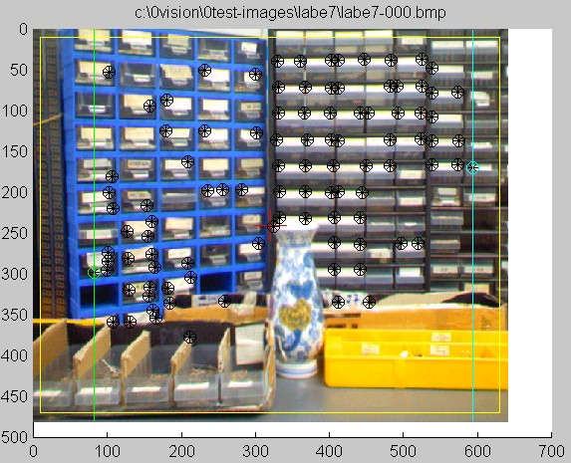
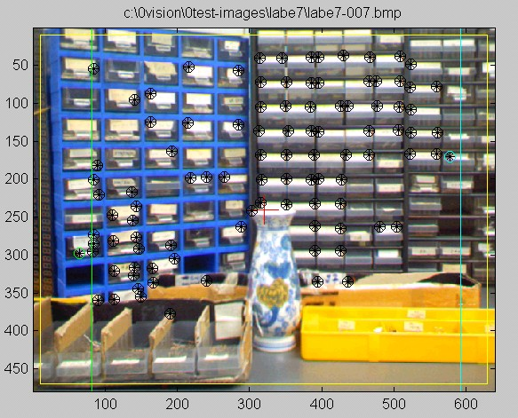
Stereo vision example: step1:feature extraction (e.g. Harris operator) : for the left and right image find features and locate their windows
Left image right image
Features are shown by overlaid markers on images

Slide 10



Stereo vision example: step2: Correspondence problem example: Find correspondence of f1 in the right image and determine which is the match (see chapter 4, features extraction and tracking)
Left image
Right image
f1:a small window
f2
f3
r_{1,2}=Cross correlate
f₁ with f₂
r_{1,3}=Cross correlate
f₁ with f₃

Slide 11
For stereo vision with horizontal camera motion only.
Matching in 2D space becomes 1D
For A, find r_{A,A’} r_{A,B’} r_{A,C’} and see which is the biggest and determine the correspondence
E.g. If r_{A,B’} is the biggest, A corresponds to B’, etc
A B C in 3D space
A B C
Left image scan line
A’ B’ C’
Right image scan line
Notes:
As we have mentioned, the movement of the camera is only in the horizontal axis, the features shown in the images should only be moved mainly in the horizontal direction.
For example, there are three features in the left image in one horizontal image scan line (shown in the slide) , the corresponding features should also be on the corresponding scan line on the right image.
Here, feature A on the left may match A’ , B’ or C’ , use cross-correlation to determine which is the correct match.

Slide 12
Part 2: Epipolar geometry approach of 3-D reconstruction from stereo images
Assumption : the cameras can be placed at any viewing angles as long both share enough common views.
Epipolar Approaches:
Essential matrix (known intrinsic parameters)
Fundamental matrix (unknown intrinsic parameters)

Slide 13
Stereo reconstruction by epipolar geometry
Stereo camera pair calibration : Find Fundamental matrix (F)
Find 2-D to 2-D feature correspondences by Cross-correlation
From correspondences find F
3D model reconstruction from stereo cameras after stereo calibration
Step 0: Rectification of stereo images (optional: it makes feature correspondences more efficient, but not entirely necessary)
Step 1: Find 2-D feature correspondences (by F, and rectification)
Step 2: 3-D Model reconstruction by triangulation

Slide 14
Essential matrix (E) for describing the geometry of a stereo camera pair
Find Essential matrix E

Slide 15
Notations: Tc of chapter 2 and T in this chapter
X
Y₂
Z₁
Y₁
Z₂
X₁
X₂
Cam1 center
(reference/world)
T_{C}
Cam2 center
(camera)
R,T are used in this chapter
X₂=R*X₁+T, R=Rc
where a vector X₁ in world coordinates is the same vector X₂ in camera coordinates . X₁ does not change, it is only the coordinate system that changes
Tc= a vector from cam1 center to cam2 center in cam1 coordinates
So –Tc is a vector from cam2 center to cam1 center in cam1 coordinates.
T=-Rc*Tc=-R*T_{c} = a vector from cam2 center to cam1 center in cam2 coordinates.
Notes:
Here we use the formula X2=R*X1+T, R here is the same Rc as in chapter 2, but T here is not the same as Tc in chapter 2, but T= -Rc*Tc

Slide 16
Recall in chapter 2: Combine rotations in 3 axes: The camera has rotated (θx, θy, θz), Rc brings a vector in world coordinates to the camera coordinates

Slide 17
Demo_stereo1
function demo_stereo
ppm=5*10^-6;%ppm=pixel_per_meter
Pw=[0,0,1/ppm]'
f=5*10^-3/ppm %f=focal length
%cam1 left(ref/world), cam2 right camera
tc1=-0.1/ppm %translation of from world center to cam2 center,(to -ve dir)
tc2=0/ppm; tc3=0/ppm
Tc=[tc1,tc2,tc3]';
Rc=rot(0,1,0)
Pc=Rc*(Pw-Tc) %this forumla is used in chapter 2 , camera model
%%%%%%%%%%%%%%%%%%%%%%%%%%%%%
P1=Pw %Pw (in ch2, world coord.);P1 is in world coord (in ch8)
T=-Rc*Tc %Tc is a vector from cam1 center to cam2 center (by defn)
%-Tc is the vector from cam2 center to cam1 center (in cam1 coord)
%by defn , Rc brings a vector in cam1 coord. to cam2 coord.
%T is the vector from cam2 center to cam1 center in the cam2 coords.
P2=Rc*P1+T %this is used in chapter 8 stereo
Pc %try to see the two formulas are same or not P2
'Tc is the vector from cam1 center to cam2 center (in cam1 coord)'
Tc
'%so T is the vector from cam2 center to cam1 center in the cam2 coords. '
T
function Rc =rot(an_x,an_y,an_z)
Rz=[cos(an_z) sin(an_z) 0; -sin(an_z) cos(an_z) 0; 0 0 1];
Ry=[cos(an_y) 0 -sin(an_y); 0 1 0; sin(an_y) 0 cos(an_y)];
Rx=[1 0 0;0 cos(an_x) sin(an_x); 0 -sin(an_x) cos(an_x)];
Rc = Rx*Ry*Rz;
P1 =
1.0e+005 *
0
0
2.0000
T =
1.0e+004 *
1.0806
0
1.6829
P2 =
1.0e+005 *
-1.5749
0
1.2489
Pc =
1.0e+005 *
-1.5749
0
1.2489
ans =
Tc is the vector from cam1
%center to cam2 center (in cam1 coord)
Tc =
1.0e+004 *
-2.0000
0
0
ans =
%so T is the vector from cam2 center
%to cam1 center in the cam2 coords.
T =
1.0e+004 *
1.0806
0
1.6829
>> demo_stereo2
Pw =
1.0e+005 *
0
0
2.0000
f =
1.0000e+003
tc1 =
-2.0000e+004
tc3 =
0
Rc =
0.5403 0 -0.8415
0 1.0000 0
0.8415 0 0.5403
Pc =
1.0e+005 *
-1.5749
0
1.2489

Slide 18
CMSC5711, Ch8 Stereo, Exercise1:X₁ is 3-D X in left camera (reference) system X₂ is 3-D X in right camera system (1a) Draw vectors T×X2 and T×X1 in the diagram Epipolar Geometry: Camera 1 at the reference world coordinates, camera 2 is at the camera coordinates, X₂=R*X₁+T
X
Plane-3 ∏₃
Perpendicular to
T×X₂ or T×X₁
(x₂,y₂)
Left image is the reference
Right epipolar line
Left epipolar line
(x₁,y₁)
left
Frame
Plane-1 ∏₁
right Frame
Plane-2 ∏₂
O₂
O₁
e₁
e₂
R
T (from O₂ to O₁ in cam2 coordinates)
Focal
length=f₁
Base line=||T||
Focal
length=f₂

Slide 19
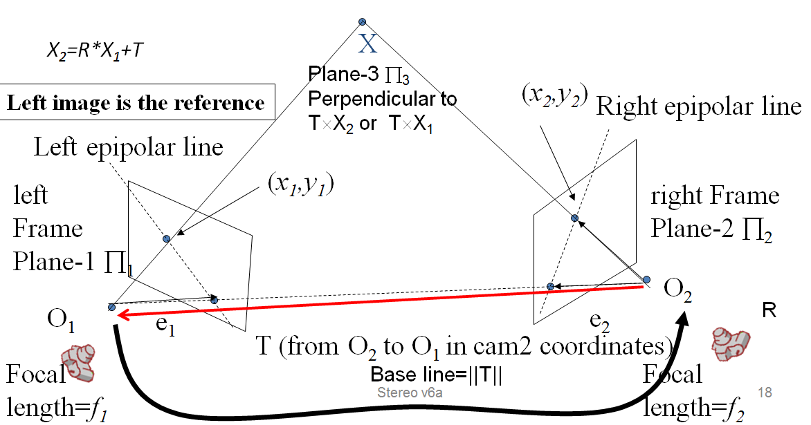
Essential matrix E (a 3x3 matrix) P.110[2] X₁ is 3-D X in left camera (reference) system X₂ is 3-D X in right camera system
Exercise 1b,1c
(1b) If T=[1 2 3]’, Write the matrix for [T]_{x}
(1c) Write the sizes of the matrices:
X1:___,X2:__, R:___,T:___, [T]_{x} :___,E:____
X₂
T

Slide 20
Essential Matrix (E)
Right_image_point^{T} * E * left_image_point=0
Focal lengths f₁ f₂ of both cameras should be known here

Slide 21
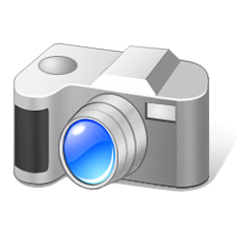
From E (Essential matrix) to F (Fundamental matrix)
Essential matrix + Camera intrinsic parameters becomes The Fundamental matrix
So we can use two un-calibrated cameras (unknown focal length , image centers etc) to make a stereo system
For Essential matrix you need to know the intrinsic parameters of the two cameras
For the Fundamental matrix F , it encapsulates all intrinsic parameters

Slide 22
Exercise2 : Fundamental matrix F (a 3x3 matrix) from E to prove: F= (M_{int_2}^{-T}*E*M_{int_1}⁻¹)
X₂^{T}*E*X₁=0 ------------(i)
If both camera intrinsic parameters are known
For each camera (R=I,T=0)the extrinsic matrix is K_{ext0}
Use normalized pixel coordinate u=[u ,v ,1]^{T} rather than x, where u=Mint*X, so X=(Mint)⁻¹*u ---------(ii)
Note in linear algebra: (a b)^{T=}b^{T} a^{T}
Given that F=(M_{int_2}^{-T}*E*M_{int_1}⁻¹)
Prove [u₂ ,v₂ ,1] *F* [u₁ ,v₁ ,1]^{T}=0---------------------------(iii)
?_
Advantage of F: No need to know Mint(s) for both cameras at all if you work on pixel coordinates

Slide 23
Exercise 3: Eight (n>=8) point algorithm for finding E or F n= number of corresponding point features left i-th image point=[u₁(i) v₁(i) 1]^{T}, right i-th image point=[u₂(i) v₂(i) 1]^{T}
For F, since M_{int}’s are not
required, for simplicity
we set both focal
lengths to 1

Slide 24
Eight Point algorithm (for n≥8) to solve the Fundamental matrix F equation , (p91[1A], 265[1B])
Find correspondences n=(8 or more) left-right image feature points
Normalize image points [u,v], this makes the algorithm more stable and accurate. Normalization means for each image
[u,v]_{All images points} should have zero mean
Average distance of [u,v] around the center [0,0] is 2^{1/2}
Rank of A is 8, at least 8 points are needed
From A(size is nx9) , left side [x,y,1] , right side =[x’,y’,1] image features, use the method of SVD to find f (f size is 9x1).
AF’=0, and [USV]=SVD(A), SVD=Singular Value Decomposition
Estimated F’=last column of V, from F’ find F.
Notes:
Eight Point algorithm is a very famous algorithm for solving the Funemntal matrix euqation.
Ref: Richard I. Hartley (June 1997). "In Defense of the Eight-Point Algorithm". IEEE Transaction on Pattern Recognition and Machine Intelligence 19 (6): 580–593. doi:10.1109/34.601246.

Slide 25
Matlab for finding the Fundamental matrix F (8-point algorithm)
%Normalized U,V first
norm_mat1 = get_normalization_matrix(x1)
norm_mat2 = get_normalization_matrix(x2)
x1n = norm_mat1 * x1
x2n = norm_mat2 * x2
u1=(x1n(1,:)./x1n(3,:))'
v1=(x1n(2,:)./x1n(3,:))'
u2=(x2n(1,:)./x2n(3,:))'
v2=(x2n(2,:)./x2n(3,:))'
%%%%% find F
A=[u2.*u1, u2.*v1, u2, v2.*u1, v2.*v1, v2, u1, v1, ones(N,1)]
[uu1,ss1,vv1]= svd(A)
F=(reshape(vv1(:,9),3,3))‘ % vv1(:,9) is 9x1 and F is 9x9

Slide 26
Epipolar geometry : Based on E or F, we have special relations between the two cameras in a stereo system, e.g.
(i) Epipolar lines
(ii) Epipoles

Slide 27
(i) Epipolar lines
u₂^{T}*(F*u₁)=0, (F*u₁ ) is a 3x1 vector, we can set it be L₂=F*u₁
So u₂^{T}*(L₂)=0, this shows the point u₂^{T} is on Line L₂
Meaning: A point u₁ in the left image (cam1)
Has a corresponding epipolar line L₂ in the right image (point / line relation)
[a b c]^{T}=(F*u₁)=L₂ is 3x1 vector
The epipolar line equation in the right image (cam2) is au₂+bv₂+c=0
The Line L₂ passes through [u₂, v₂ ,1]^{T} in the right image

Slide 28
Left-point governs the right epipolar line
[a b c]^{T}=(F*u₁)=L₂ is 3x1 vector
The epipolar line equation in the right image is au₂+bv₂+c=0
The Line L₂ passes through [u₂, v₂ ,1]^{T} in the right image
X
Left side is the reference
Right epipolar line L₂
(u₁,v₁)
Left
Frame
plane1 ∏₁
(u₂,v₂)
right Frame
plane1 ∏₂
O₂
O_{l}
Epipole e₂
Focal
length=f₁
Epipole e₁
F
Focal
length=f₂

Slide 29
Similarly: Right-point governs the left epipolar line
[a’ b’ c’]^{T}=(F^{T}*u₂)=L₁ is 3x1 vector
The epipolar line equation in the right image is a’u+b’v+c’=0
The Line L₁ passes through [u₁, v₁ ,1] ^{T}in the left image
X
Left side is the reference
(u₁,v₁)
Left epipolar line L₁
Left
Frame
plane1 ∏₁
(u₂,v₂)
Right Frame
plane1 ∏₂
O₂
O_{l}
e₁
e₂
Epipole e₂
Focal
length=f₁
Epipole e₁
Focal
length=f₂
F^{T}

Slide 30
(ii) Epipoles
Where epipolar lines meet in the image

Slide 31
Left-point governs right epipolar line
[a b c]^{T}=(F*u₁)=L₂ is a 3x1 vector
The epipolar line equation in the right image is au+bv+c=0
The Line L₂ passes through [u₂, v₂ ,1] in the right image
X
Left side is the reference
Right epipolar line L₂
(u₁,v₁)
Left
Frame
plane1 ∏₁
(u₂,v₂)
right Frame
plane1 ∏₂
O₂
O_{l}
Epipole e₂
Focal
length=f₁
Epipole e₁
F
Focal
length=f₂

Slide 32
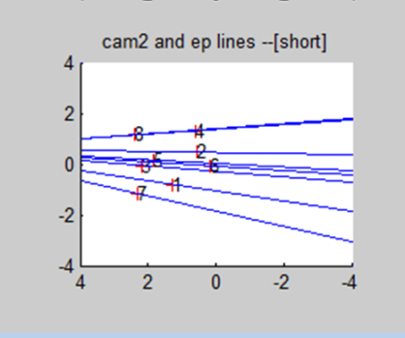
Epipoles
For simplicity, use the notation x=(s*u,s*v,s)^{T} as an image point
For any point x₁ in image1 (left image) , x₂^{T}*F*x₁=0 (proved)
In the right image: image2 ,
Epipolar line equation L₂=F*x₁----(i)
line L₂ contains x₂, so
x₂^{T}*{L₂}=0, from (i), so x₂^{T}*{F*x₁}=0
Or {x₂^{T}*F}*x₁=0 for all x₁, since not all x₁ are 0
So x₂^{T}*F=0, take transpose on both sides, note (ab)^{T}=b^{T}a^{T}
F^{T}*x₂=0, since F is fixed and not 0, there is only one solution (call it e₂) : x₂=e₂ for all x₁ , which is a fixed point in the right image.
The point e2 is called the epipole, and F^{T}*e₂=0
A point that all epipolar lines in the right image meet.
Similarly if you use the right image as the reference you will get
F*x₁=0, (F^{T} become F because the direction is reversed)
The epipole on the right image is e₁, and F*e₁=0
e₁(epipole)
Right side image

Slide 33
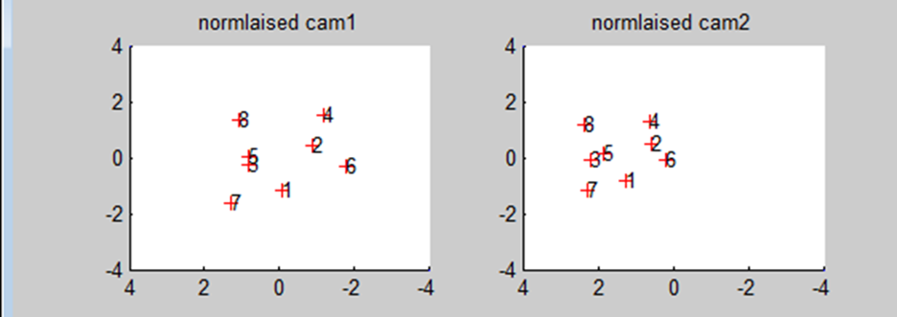

Output of demo_stereo5i_for_ex4.m, from http://www.cse.cuhk.edu.hk/%7Ekhwong/www2/cmsc5711/demo_stereo5i_for_ex4.zip
Cam1 (reference)
Epipolar lines and epipole at cam2

Slide 34
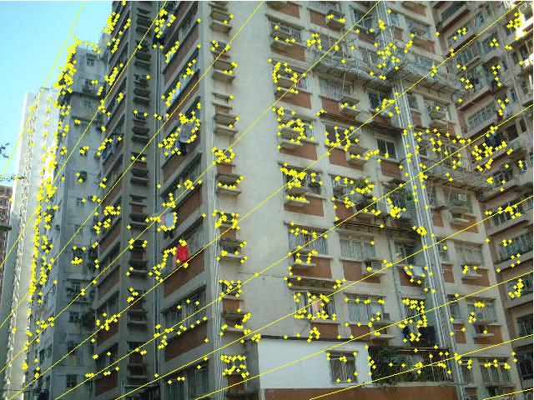
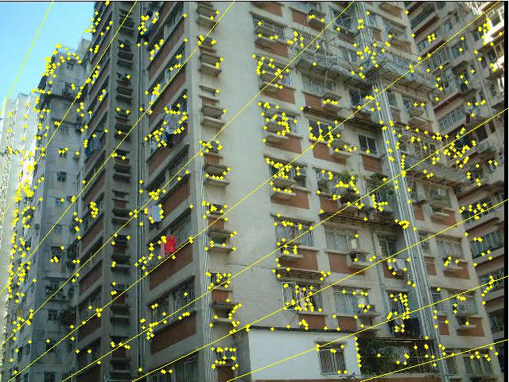
Example stereo images with epipolar lines The epipolar lines of each image will join at the epipole e (it may be outside the image frame)
Real image example
Left
Right
Exercise: Try to sketch the location of the epipoles.
http://homepages.inf.ed.ac.uk/rbf/CVDICT/CVFIG3/img85.png

Slide 35
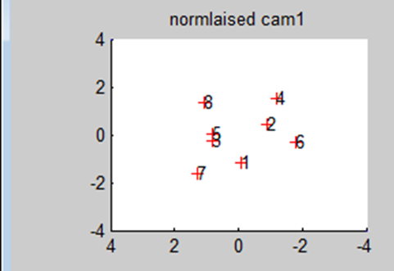
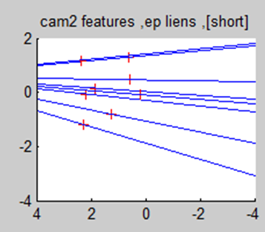
Exercise 4
(a) By inspection, point out the epipolar lines of feature 5 &7.
(b) Sketch the cam2 epipole (right-side) in the above image.
(c) Find epipoles (e_{2_x},e_{2_y}) , line formula is Ax+By-C=0 .
Since (F*u₁)=L₂ is a 3x1 vector for representing a line
Line 5 is [A1 B1 -C1]^{T}=[-0.0455,0.6520,-0.0114]^{T}:A1=-0.0455,B1= 0.6520,C1=0.0114
Line 7 is [A2 B2 -C2]^{T}=[-0.1835,0.6128,1.1484]^{T}:A2=-0.1835,B2=0.6128,C2=-1.1484
Find the epipole where line 5 and line7 meet
Hints: x= (B₂*C₁ – B₁*C₂) / det, y = (A₁*C₂ – A₂*C₁) / det , for det = A₁*B₂ – A₂*B_{1,}
Answer: ? e_{2_x},e_{2_y} =?_____ , _____
http://www.aishack.in/2010/04/solving-for-intersection-of-lines-efficiently/
Warning: In the above link the line is in Ax+By=C, in my slides , it is in Ax+By=C,
so we need to fix the sign of C
http://www.cse.cuhk.edu.hk/%7Ekhwong/www2/cmsc5711/demo_stereo5i_for_ex4.zip
Type command “a” after starting the above program will get the result of this slide

Slide 36
Epipoles: Matlab or octave program for testing the epioles
To solve F*e₁=0 use SVD, see appendix
[uu1,ss1,vv1]= svd(F)
e₁ is the last column of vv₁
//epipoles e1,e2 //matlab testing program
[uu1,ss1,vv1]= svd(F)
FT=F'
[uu2,ss2,vv2]= svd(FT)
e1=vv1(:,3) // epipole on the left image ---------------
e1_u=e1(1)/e1(3)
e1_v=e1(2)/e1(3)
e2=vv2(:,3) // epipole on the right image ---------------
e2_u=e2(1)/e2(3)
e2_v=e2(2)/e2(3)
//by definition e2’*F*e1=0 or e1’*FT*e2=0 ,
//because e1, e2 are on Image 1, image 2 resp.
(e2')*F*e1
(e1')*FT*e2

Slide 37
A small summary: x₂^{T}*E*x₁=0 (essential matrix, metric coordinates in meters)
F= (M_{int_2}^{-T}*E*M_{int_1}⁻¹), cameras 1, 2 can be different
u₂^{T}*(F*u₁)=0( Fundamental matrix in pixel coordinates)
set L₂=F*u₁ , so u₂^{T}*(L₂)=0, point line relation
//epipoles e1,e2
[uu1,ss1,vv1]= svd(F)
FT=F'
[uu2,ss2,vv2]= svd(FT)
e1=vv1(:,3) // epipole on the left image ---------------
e1_u=e1(1)/e1(3)
e1_v=e1(2)/e1(3)
e2=vv2(:,3) // epipole on the right image ---------------
e2_u=e2(1)/e2(3)
e2_v=e2(2)/e2(3)
//by definition e2’*F*e1=0 or e1’*FT*e2=0 ,
//because e1, e2 are on Image 1, image 2 resp.
(e2')*F*e1
(e1')*FT*e2

Slide 38
Exercise 5
Given 10 corresponding points, describe the procedure to find the fundamental matrix F
Answer: ?

Slide 39
Rank and Degree of freedom of the Fundamental matrix F
“F is a rank 2 homogeneous matrix with 7 degrees of freedom.” p.226 [1]
“The degrees of freedom of the fundamental matrix is 7, it can be counted as follows: 2 for e, 2 for e’, and 3 for the epipolar line homography which maps a line through e to a line through e’.” p.227 section 8.2.5 [1]

Slide 40
How to make the Fundamental Matrix found to be more accurate?
Data needed to be normalized to [-1,1] to make the solution more stable.
[u,v]_{All images points} should have zero mean
Average distance of [u,v] around the center [0,0] is 2^{1/2}
"RANdom SAmple Consensus" RANSAC to find a better F. http://en.wikipedia.org/wiki/RANSAC

Slide 41
Feature correspondence is essential in 3D model reconstruction
3D model reconstruction from stereo cameras after stereo calibration requires 3 steps:
Step 0: Rectification of stereo images
Step 1: Find 2-D feature correspondences (by F)
Step 2: 3-D Model reconstruction

Slide 42
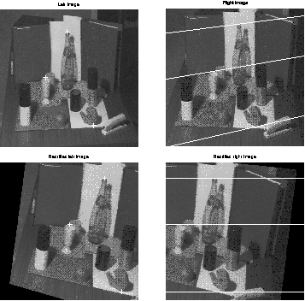
Exercise 6: Step 0 : Rectification (optional)
Un-recitfied image pair
(a) Given points (A,B) in the left image, point the correspondence point in the right image for the un-rectified image pair and the rectified image pair.
(b) Discuss why it is easier to find correspondences in rectified images
(The rectification algorithm can be found in the appendix)
Left Right
A
B
A’
B’
Rectified image pair

Slide 43
Step 1: 3-D Model reconstruction: Find 2-D feature correspondences
by cross correlation

Slide 44
Search for correspondences
Take left image as reference (I)
Find all (N) features in the left and rigth images.
For each feature in the reference image (I)
Find the corresponding epipolar line in the right image (I’)
Along the epipolar line (in image I’) search for the correct correspondence by cross-correlation.
Till all correspondences are found

Slide 45
Recall :each point in the reference (left) image has an epipolar line in the right image.
[a b c]T=(F*u1)=L2 is 3x1 vector
The epipolar line equation in the right image is au+bv+c=0
The Line L2 passes through [u2, v2 ,1] in the right
X
Left side is the reference
Right epipolar line
L₂
(u₁,v₁)
Left
Frame
plane1 ∏₁
(u₂,v₂)
right Frame
plane1 ∏₂
O₂
O_{l}
Epipole e₂
Focal
length=f₁
Epipole e₁
F
Focal
length=f₂

Slide 46
Search correspondences
From (x,y) in the left image
Search (x’,y’)_{i} in the right image along the epipolar line (with tolerance)
Use cross-correlation to measure the likelihood (see next slide for one example)
(x,y)₁
L’=E*[x1,y1,f1]_{T}
The gray area is
the search region
With certain tolerant level
(x,y)₂
(x’,y’)_{i}
(x,y)_{i}
Epipolar line L’i
of (x,y)_{i}
(x,y)_{N}
Left image (I)
Right image (I’)

Slide 47
Example: To find one pair of correspondence (enlarged)
W’j=3
Search region
Above L’1
Epipolar line L’1 of p1
p1
W’j=1
W’j=2
Search region
below L’1
Wi
A 5x5 window
containing
Feature
In the reference (left) image I
3 5x5 windows. each is a
candidate window containing a feature.
C_{j=1}=correlation (Wi,W’_{j=1})
C_{j=2}=correlation (Wi,W’_{j=2})
C_{j=3}=correlation (Wi,W’_{j=3})
Select the biggest Cj, the index j is j’,
Wi is corresponding to window Wj’.

Slide 48
Step 2 : 3-D Model reconstruction (by triangulation):
Recall:
3D model reconstruction from stereo cameras after stereo calibration requires 3 steps:
Step 0: Rectification of stereo images (optional)
Step 1: Find 2-D feature correspondences (by epipolar line to guide the search for correpsondences)
Step 2: 3-D Model reconstruction

Slide 49
Procedures for Stereo reconstruction of 3D model X
Week 8 begins
So far
The stereo camera pair is calibrated: Essential-matrix-E (Fundamental-matrix-F) is found.
All good 2-D correspondences are found
Will discuss here
Find Translation (T) and Rotation (R) between 2 Cameras from E (or F) .
From R,T calculate projection matrices P₁(left) and P₂ (right)
3D reconstruction: from P₁ and P₂ find 3D points X by triangulation

Slide 50
From F or E find Rotation (R), Translation (T) between 2 Cameras
If camera intrinsic parameters are known, E=(M_{int2})^{T}*F*(M_{int1})
E= [T]_{x} *R, (derived earlier)
[ ]_{x}=skew symmetric matrix
Decompose E using SVD, using the fact that R is an orthogonal matrix→ R^{T}=R^{-1,} or R^{T}R=RR^{T}=I
Procedures:
From corresponding features find F and E, (W_{3x3}, Z_{3x3}) are given “make up” matrices
[U,S,V]=SVD(E), then
[T]_{x}=UZU^{T}
R=U*W*V^{T} (note: using these “make up” W, Z matrices, R is orthogonal and E= [T]_{x} *R is satisfied)
Reference: (p.258[1]hartley-ed2,p 239[1B]) see http://isit.u-clermont1.fr/~ab/Classes/DIKU-3DCV2/Handouts/Lecture16.pdf

Slide 51
From R,T find projection matrices P₁ (left) and P₂ (right)(p.244[1A],p 224[1B])
From F or E find R₂ (3x3 rotation matrix) ,T₂(3x1 translation vector) of cam2 (previous slide)
Note: P₁ =projection of the reference camera(size 3x4) (reference is on the left, so R₁=I_{3x3}, T₁=[0,0,0]^{T}
P₁=Reference camera projection

Slide 52
Triangulation to find X
X_{i} is the point at a minimum
distance between two vectors
{O1, (x₁,y₁)_{i}} and {O2, (x₁,y₁)_{i}}
Projection P₁ of X onto frame1
(x₁,y₁)_{i}
X_{i}
Projection (P₂) of X onto frame2
(x₂,y₂)_{i}
Left epipolar line
Left
Frame
plane1 ∏₁
O₂
O_{l}
e₁
e₂
Epipole e₂
Focal
length=f₁
Epipole e₁
Focal
length=f₂
F

Slide 53
3D reconstruction: For each i-th feature
from projections: P₁ and P₂ (found earlier) find 3D points X_{i} by triangulation (p.312[1A],p297[1B])

Slide 54
Exercise 7
Reconstruction: Given some corresponding image points x₁ and x₂, show the procedures for finding 3D points.
Answer: ?___

Slide 55
Summary of reconstruction
From 2 images and correspondences, find Fundamental matrix F
From F find R,T
From R,T find P2. (P₁ on the left is known because it is the reference R=I₃, T=[0 0 0]^{T})
For every point correspondence left/right pair (x₁,y₁)_{i} (x₂,y₂)_{i} ,where i=1,,,N
Using camera projections: P₁, P₂ and (x₁,y₁)_{i} (x₂,y₂)_{i} we can find the 3D point Xi in the 3D space (reference of the camera center on left).
The result is all i=1,..,N 3D points are found

Slide 56
Summary
Learned
Stereo computer vision and epipolar geometry
Fundamental matrix, epipolar lines and epipoles
How to reconstruct 3D model points from 2 stereo views

Slide 57
References
[1A] Hartley and Zisserman, Multiple geometry in computer vision, Cambridge, University Press. 2004 (2nd edition, paperback).
[1B] Hartley and Zisserman, Multiple geometry in computer vision, Cambridge, University Press. 1999 (1st edition, hardback).
[2] CVonline on stereo http://homepages.inf.ed.ac.uk/rbf/CVonline/LOCAL_COPIES/EPSRC_SSAZ/node22.html
[3] On Skew Symmetric matrix http://mathworld.wolfram.com/SkewSymmetricMatrix.html
[4] On Skew Symmetric matrix http://www.ee.ic.ac.uk/hp/staff/dmb/matrix/special.html#Skew_Symmetric
[5]On RQ decomposition http://wwwcsif.cs.ucdavis.edu/~wangjj/gsvd/codes/rq5.m
[6] Camera calibration matlab toolbox http://www.vision.caltech.edu/bouguetj/calib_doc/index.html#examples

Slide 58
Useful software tools
[7] Blloyd , Fundamental Matrix computation ( http://www.cs.unc.edu/~blloyd/comp290-089/fmatrix/ )
[8] P.H.S. Torr, “A Structure and Motion Toolkit in Matlab: Interactive adventures in S and M” http://homepages.inf.ed.ac.uk/rbf/CVonline/LOCAL_COPIES/TORR1/index.html
[9] http://ai.stanford.edu/~mitul/cs223b/draw_epipolar.m

Slide 59
Appendix

Slide 60
Appendix 1 Refined SVD method for Af=0
In MATLAB, [U, S, V] = svd(A);
S is a diagonal matrix with descending values down the diagonal.
f= the last column of V;
[u,s,v]=svd(f)
Set the smallest singular value in s=0, so s becomes s
Approximate f=usv’.
More accurate iterative methods are in [1]

Slide 61
Appendix 2:See how to factorize E into [T]_{x} R
Given E=[T]_{x}R, E is rank2
USV^{T}=SVD(E), S=diag(1,1,0) because E is rank2 (by Definition)
=USV^{T}=U| 1 0 0 |V^{T}
| 0 1 0 |
| 0 0 0 |
We known S=ZW=[ 1 0 0
0 1 0
0 0 0]
E= U{S}V^{T}=U{ZW}V^{T}
={UZU^{T}}{UWV^{T}}
= [T]_{x} R
So both [T]_{x} R satisfy their own characteristics
Make up 2 matrices Z,W
Z=[0 1 0
-1 0 0
0 0 0]
W=[0 -1 0
1 0 0
0 0 1]
>> ZW=
1 0 0
0 1 0
0 0 0
http://www.ee.ic.ac.uk/hp/staff/dmb/matrix/special.html

Slide 62
Appendix 3 Solve Ax=0
To solve Ax=0, Homogeneous systems
One solution is x=0, but it is trivial and no use.
We need another method, SVD (Singular value decomposition)

Slide 63
Appendix 4: What is SVD?
A is mxn, decompose it into 3 matrces: U, S, V
U is mxm is an orthogonal matrix
S is mxn (diagonal matrix)
V is nxn is an orthogonal matrix
σ1, σ2, σn, are singular values
Columns of vectors of U=left singular vectors
Columns of vectors of V=right singular vectors

Slide 64
SVD (singular value decomposition)
Singular values
Left singular vectors
Right singular vectors
SVD
…

Slide 65
More properties

Slide 66
SVD for Homogeneous systems
To solve Ax=0,
(Homogeneous systems)
One solution is x=0, but it is trivial and no usage.
If we set ||x||2=1, the solution will make sense.
So we ask a different question: find min(||Ax||) and subject to ||x||2=1.
Note:||x||2 is 2-norm of x

Slide 67
Minimize ||Ax|| subject to ||x||2=1
(’)=transpose
To minimize the 2-norm of ||Ax||2, since A=USV’
||Ax||2=||USV’x||2= (USV’x)’ (USV’x) by definition 2-norm: ||Y||2=Y’Y
So ||Ax||2= (x’VS’U’)(USV’x) because (ABC)’=C’B’A’
so||Ax||2=(x’VS’SV’x), since U is orthogonal and U’U=1
Since x’VS’= (SV’x)’ put back to above. So ||Ax||2=(SV’x)’(SV’x) =||SV’x||2
To minimize ||Ax||2 subject to ||x||=1
Or minimize =||SV’x||2 subject to ||V’x||2
=1 (see ** on the right)
Set y=V’x
We now minimize ||Sy||2 subject to ||y||2=1
Note: S is diagonal with descending entries
The solution is y_{s}=[0, 0, ..,0, 1]’ (reason: ||y_{s}||2=1, and just ||Sy_{s}||=||S *[0 0 ..0 1]’ || is the smallest, the last element of s is the smallest σ_{n}
Since V’x=y, so x=(V’)⁻¹ y . V is orthogonal, (V’)⁻¹=V
X_{solution}=V[0 0 0.. 1]’=last column of V
** To show
||x||2=||V’x||2
Proof:
||V’x||2=(V’x)’ (V’x)
=x’V(V’x)
=x’x since VV’=I , (V is orthogonal)
=||x||2, done
To be continued

Slide 68
Appendix 5: Study the rotation matrix Rc and Translation vector Tc M_{ext} (3x4)Matrix form When Tc is not Zero
P_{w}
Y_{w}
Camera
coordinates
Z_{c}
Y_{c}
X_{c}
Z_{w}
T_{C}= camera translation
R_{C}
Camera center
X_{w}
World center
World coordinates
(reference)

Slide 69
Precise definition of Rc, Tc
Rc rotates a vector P in world coordinate system to the camera coordinate system, i.e. P_cam=Rc*P_world
Rotation of camera in world coordinates is actually (Rc)⁻¹
Tc is the translation of the camera center from the world center in the world coordinate system.
(-Tc) takes the camera center back to the world center in the world coordinate system.

Slide 70
Compare Rc and R Rc=R⁻¹ The stereo setup used here
Y’
y
Z’
z
α (yaw)
β pitch)
x
X’
Reference (world center)
γ (roll)
Right camera (R,T)
//A yaw is a counterclockwise rotation (α ) about the z-axis.
//A pitch is a counterclockwise rotation (β) about the y-axis.
//A roll is a counterclockwise rotation (γ ) about the x-axis.

Slide 71
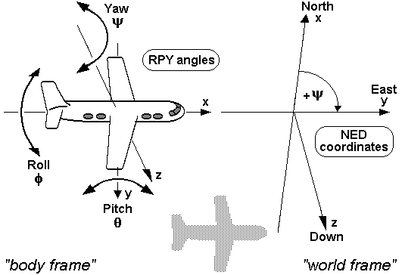
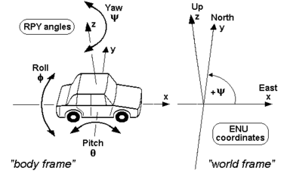
Yaw pitch roll
http://en.wikipedia.org/wiki/Yaw,_pitch,_and_roll

Slide 72
Test using scilab
//rotation angles, [0,5,1]
//pixel width 5umx5um
//focal length 6mm/5um=1200
//Translation 10cm , 10*1000*1000 /5um= 10*1000*1000/5
//a 3d point is at point is [0.01, 0.02 1]meters
//Translation
//t=[10*1000*1000/5 0 0]'
t=[-20*1000*1000/5 0 0]'
//a point in 3D space is
//
//xx=[0.01 0.02 1 ]*1000*1000*1000/5 //in ipxel
xx=[0 0 1 ]*1000*1000*1000/5 //in ipixel
x=[xx 1]'
//angs=([0,15,1]*3.1416/180)
angs=([0,0,0]*3.1416/180)

Slide 73
Matlab /scilab code: stereo_test.sce (http://www.scilab.org/)
cosAsinB = cosA .* sinB;
sinAsinB = sinA .* sinB;
R = [ cosA.*cosB cosAsinB.*sinC-sinA.*cosC cosAsinB.*cosC+sinA.*sinC ;
sinA.*cosB sinAsinB.*sinC+cosA.*cosC sinAsinB.*cosC-cosA.*sinC ;
-sinB cosB.*sinC cosB.*cosC ];
R
R'*R
mint =[1200 0 512
0 1200 384
0 0 1]
x1= mint*[1 0 0 0; 0 1 0 0; 0 0 1 1]*x
x1(1)/x1(3)
x1(2)/x1(3)
mext=R*[[1 0 0; 0 1 0 ; 0 0 1] -t]
x2= mint*mext*x
x2(1)/x2(3)
x2(2)/x2(3)
//rotation angles, [0,5,1]
//pixel width 5umx5um
//focal length 6mm/5um=1200
//Translation 10cm , 10*1000*1000 /5um= 10*1000*1000/5
//a 3d point is at point is [0.01, 0.02 1]meters
//Translation
//t=[10*1000*1000/5 0 0]'
t=[-20*1000*1000/5 0 0]'
//a point in 3D space is
//
//xx=[0.01 0.02 1 ]*1000*1000*1000/5 //in ipxel
xx=[0 0 1 ]*1000*1000*1000/5 //in ipixel
x=[xx 1]'
//angs=([0,15,1]*3.1416/180)
angs=([0,0,0]*3.1416/180)
cosA = cos (angs(3));
sinA = sin (angs(3));
cosB = cos (angs(2));
sinB = sin (angs(2));
cosC = cos (angs(1));
sinC = sin (angs(1));
Result
-7->x1(1)/x1(3)
512.
-7->x1(2)/x1(3)
384.
-7->x2(1)/x2(3)
ans =
536.
-7->x2(2)/x2(3)
ans = 384.

Slide 74
Further test of E,F
skew_t=[0 -t(3) t(2)
t(3) 0 -t(1)
-t(2) t(1) 0]
E=skew_t*R
F=inv(mint)*E*mint
L2_1=F*[100 200 1]'
[u s v]=svd(F)
//epipoles e1,e2
[uu1,ss1,vv1]= svd(F)
FT=F'
[uu2,ss2,vv2]= svd(FT)
e1=vv1(:,3) // epipole on the left image ---------------
e1_u=e1(1)/e1(3)
e1_v=e1(2)/e1(3)
e2=vv2(:,3) // epipole on the right image ---------------
e2_u=e2(1)/e2(3)
e2_v=e2(2)/e2(3)
//by definition e2’*F*e1=0 or e1’*FT*e2=0 ,
//because e1, e2 are on Image 1, image 2 resp.
(e2')*F*e1
(e1')*FT*e2

Slide 75
Result skew_t ..
skew_t =
0. 0. 0.
0. 0. 4000000.
0. - 4000000. 0.
E =
0. 0. 0.
- 1035278.5 0. 3863702.7
0. - 4000000. 0.
F =
0. 2.048D+09 6.554D+08
- 1035278.5 1.536D+09 4.911D+08
0. - 4.800D+09 - 1.536D+09
L2_1 =
1.0D+11 *
4.1025536
3.0758755
- 9.61536
vv1 =
- 0.0000512 - 0.9273836 0.3741117
0.9524304 0.1139676 0.2826440
0.3047561 - 0.3563299 - 0.8832626
ss1 =
5.712D+09 0. 0.
0. 1070927.1 0.
0. 0. 0.0000001
uu1 =
0.3764731 - 0.1107978 0.9197782
0.2823314 0.9593169 - 3.636D-14
- 0.8823588 0.2596823 0.3924387

Slide 76
Result e1,e2
e1 =
0.3741117
0.2826440
- 0.8832626
e1_u =
- 0.4235566
e1_v =
- 0.32
e2 =
0.9197782
- 3.282D-13
0.3924387
e2_u =
2.34375
e2_v =
- 8.362D-13
ans =
2.181D-08
ans =
- 1.956D-20
Execution done.
FT =
0. - 1035278.5 0.
2.048D+09 1.536D+09 - 4.800D+09
6.554D+08 4.911D+08 - 1.536D+09
vv2 =
- 0.3764731 0.1107978 0.9197782
- 0.2823314 - 0.9593169 - 3.282D-13
0.8823588 - 0.2596823 0.3924387
ss2 =
5.712D+09 0. 0.
0. 1070927.1 0.
0. 0. 0.0000001
uu2 =
0.0000512 0.9273836 - 0.3741117
- 0.9524304 - 0.1139676 - 0.2826440
- 0.3047561 0.3563299 0.8832626

Slide 77
Appendix 6: Stereo rectification algorithm (P.159 of the book “Introductory Techniques for 3_D computer vision by Trucco”)

Slide 78
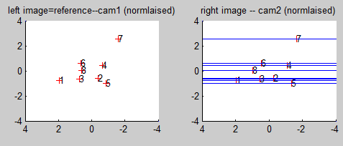
Step 1 of 3-D Model reconstruction: Rectification
The two images can be rectified (transformed) so that epipolar lines become horizontal.
Alternative , if the left camera has no rotation, all epipolar lines are parallel
So that corresponding points can be found more easily (1D search along horizontal epipolar lines).
More accurate corresponding points can be found for dense field reconstruction

Slide 79
Application of rectification
A point has the correspondence from a tiled epipolar line (difficult)
Original
pair
A point now has a horizontal epipolar line to search for correspondence (easier)
Rectified
pair

Slide 80
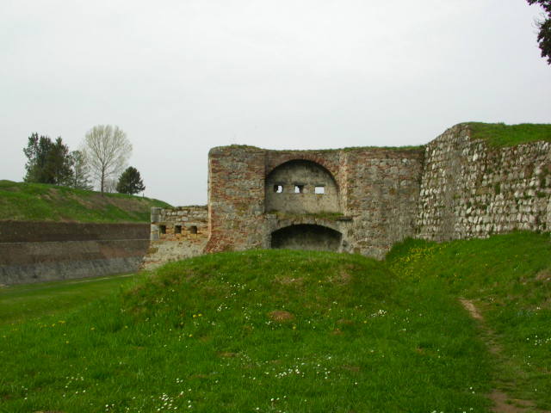
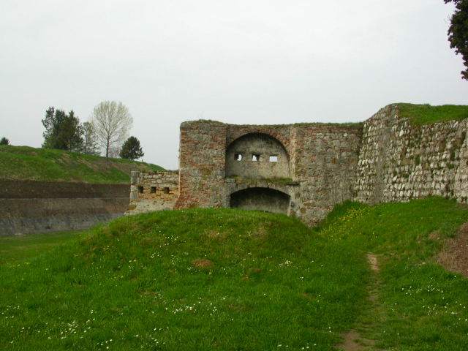
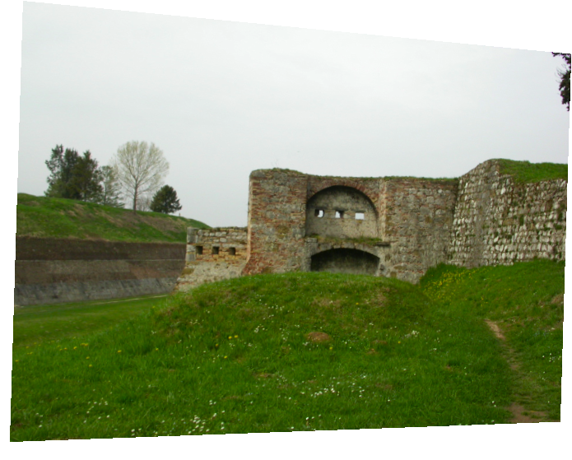
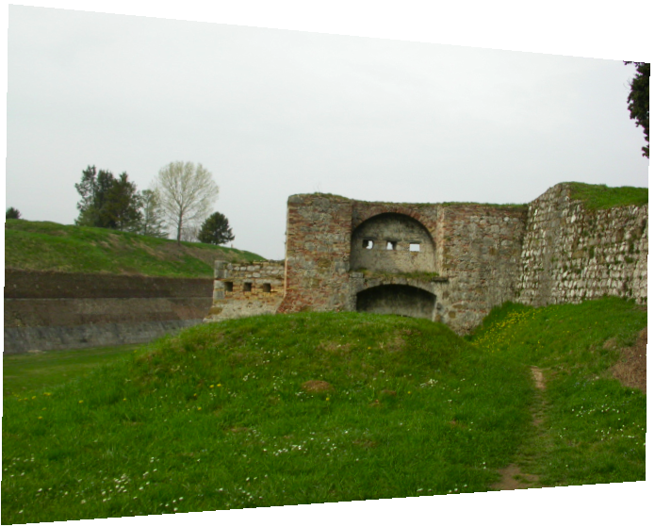
Example generated by the Matlab rectification (un-calibrated) tool kit from http://www.diegm.uniud.it/fusiello/demo/rect
Input files
Features moved in all directions
Rectified outputs: Features moved horizontally only.

Slide 81
Answers

Slide 82
Essential matrix E (a 3x3 matrix) P.110[2] X₁ is 3-D X in left camera (reference) system X₂ is 3-D X in right camera system
Answer1: Exercise1: (a) Draw vectors T×X2 or T×X1 in the diagram
They are perpendicular to the plane3 ( ∏₃ )
(b) If T=[1 2 3]’, Write the matrix for [T]x
Answer: [0 -3 2; 3 0 -1; -2 1 0]
(1c) X1:3x1,X2:3x1, R:3x3,T:3x1, [T]_{x} :3x3,E:3x3

Slide 83
ANSWER2:: Fundamental matrix F (a 3x3 matrix) from E to prove: F= (M_{int_2}^{-T}*E*M_{int_1}⁻¹)
x₂^{T}*E*x₁=0 ------------(i)
If both camera intrinsic parameters are known
Use pixel coordinate u=[u ,v ,1]^{T} rather than x, where u=Mint*x, so x=(Mint)⁻¹*u ---------(ii)
Note in linear algebra: (a b)^{T=}b^{T} a^{T}
From (i) & (ii) , ((Mint)⁻¹*u₂ )^{T}*E*(Mint)⁻¹*u₁
u₂^{T}*(M_{int_2}^{-T}*E*M_{int_1}⁻¹)*u₁=0
u₂^{T}*F*u₁=0----------------------------------(iii)
u₁=[u₁,v₁,1]^{T,} u₂=[u₂,v₂,1]^{T} are normalized correspondences points, on left, right images respectively. So (iii) becomes
[u₂ ,v₂ ,1] *F* [u₁ ,v₁ ,1]^{T}------------------------------(iv)
Since it is given that F= (M_{int_2}^{-T}*E*M_{int_1}⁻¹)
Advantage of F: No need to know Mints for both cameras at all if you work on pixel coordinates

Slide 84
Answer3: Exercise 3: Eight point algorithm for finding E or F (p279[1A], p263[1B]) left i-th image point=[u₁(i) v₁(i) 1]^{T}, right i-th image point=[u₂(i) v₂(i) 1]^{T}
For F, since M_{int}’s are not
required, for simplicity
we set both focal
lengths to 1

Slide 85
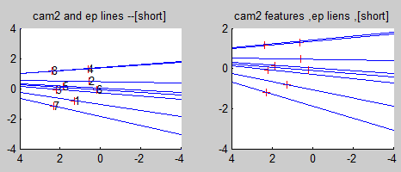
Answer4: Exercise 4
(a) By inspection, point out the epipolar lines of feature 5 &7.
(b)sketch the cam2 epipole (right-side) in the above image.
(c) Find epipoles (ep2_x,ep2_y) , line formula is Ax+By-C=0.
Line 5 is [A1 B1 -C1]^{T}=[-0.0455,0.6520,-0.0114]^{T}:A1=-0.0455,B1= 0.6520,C1=0.0114
Line 7 is [A2 B2 -C2]^{T}=[-0.1835,0.6128,1.1484]^{T}:A2=-0.1835,B2=0.6128,C2=-1.1484
Find the epipole where line 5 and line7 meets
Hints: x= (B2*C1 – B1*C2) / det, y = (A1*C2 – A2*C1) / det ,
for det = A1*B2 – A2*B1,
det=(-0.0455)*( 0.6128)-(-0.1835)*(0.6520)=0.0918
x= (B2*C1 - B1*C2) / det= ((0.6128)*(0.0114)-(0.6520)*(-1.1484) )/0.0918=8.2325
y= (A1*C2 - A2*C1) / det= ((-0.0455)*(-1.1484)-(-0.1835)*(-0.0114) )/0.0918=0.592
Answer: ? ep2_x,ep2_y =[ 8.2325,0.592]
http://www.aishack.in/2010/04/solving-for-intersection-of-lines-efficiently/
http://www.cse.cuhk.edu.hk/%7Ekhwong/www2/cmsc5711/demo_stereo5i_for_ex4.zip
Type command “a” after starting the above program will get the result of this slide

Slide 86
Answer 5: Exercise 5
Given 10 corresponding points, describe the procedure to find the fundamental matrix F
Answer:
Normalize image feature points
A matrix
Find [u,s,v]=svd(A)
Last columns of v is the solution for F’ (9x1) matrix
F=reshape F’(9x1) into 3x3

Slide 87
Answer6 :Exercise 6: Find correspondences
Answers
Un-rectified image pair
(a) Given points (A,B) in the left image, point the correspondence point in the right image for the un-rectified image pair and the rectified image pair.
(b) Discuss why it is easier to find correspondences in rectified images
Answer: searching for correspondences is along a horizontal lines
Left Right
A
B
A’
B’
Rectified image pair

Slide 88
Answer7: Exercise 7
Reconstruction: Given some corresponding image points x1 and x2, show the procedures for finding 3D points.
Answer:
Normalize corresponding points, find A, [u,s,v]=SVD, ;last column of v is F’, turn F’(9x1)→F(3x3)
Find projection matrices of the two cams:P1, P2
From P1, P2, correspondence image points (x1,x2) Use triangulation to find 3D points X1_3D of x1

Slide 89
Why F or E is rank2?
E= [T]_{x} *R, (derived earlier)
Since [T]_{x} is rank2 so E must be rank 2
Since
F= (M_{int_2}^{-T}*E*M_{int_1}⁻¹)
So rank of F is also 2
Proof [T]_{x} is rank2

