Slide 1
Image Processing and Computer Vision
Chapter 10: Pose estimation by the iterative method
(restart at week 9)

Slide 2
Overview
Define the terms
Define Structure From Motion SFM
Methods for SFM
Define pose estimation, and why we need to study it
Newton's method
Iterative algorithm for pose estimation

Slide 3
Define the terms
3D Model=X_{j} =[X,Y,Z]^{T}: where i=feature index =1,2…n features.
X can found by manual measurement
Pose θ _{t} is the Rotation (R) and Translation (T) of the object at a time t, where θ_{t}={R_{3x3},T_{3x1}} _{t}
q^{t}_{i} = [u;v]^{t}_{i} is the image point of the i^{th} 3D feature at time t
X_{i=2}=[92,126,209]^{T}
X_{i=1}=[102,18,23]^{T}
Y
X
Z
u= horizontal image position,
v=vertical image position

Slide 4
What is Structure From Motion SFM?
3D Model=X_{j} : where j=feature index =1,2…n features
t=1 t= 2 t=3 …
Γ
Time (t)

Slide 5
Methods of Structure From Motion SFM :3D reconstruction from N-frames
Factorization (linear, fast, not too accurate)
Bundle adjustment BA (slower but more accurate), can use factorization results as the first guess.
Non-linear iterative methods are more accurate than linear method, require first guess (e.g. From factorization).
Many different implementations, but the concept is the same.
Two-step Bundle Adjustment (a special form of Bundle adjustment BA)
Iterative pose estimation
Iterative structure reconstruction

Slide 6
Motivation
In order to understand bundle adjustment for 3-D model structure reconstruction from N-frames, we need to understand pose estimation first.
Pose estimation problem definition: There are N features in a known 3D object .
We take m pictures of the object at different views.
Input :
We know the n model points of the object
Image sequence I₁,I₂,…I_{m}.
Each image has n image feature points
Output (structure=model, and motion=pose)
Pose (R-rotation, T-translation) of the object in 3-D at each image.
Model of the object (X, Y, Z of each of the n feature points on the object)

Slide 7
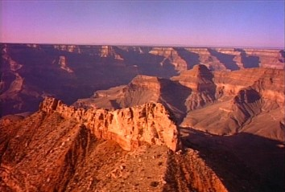
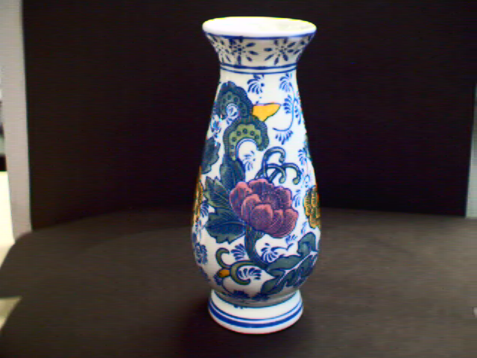
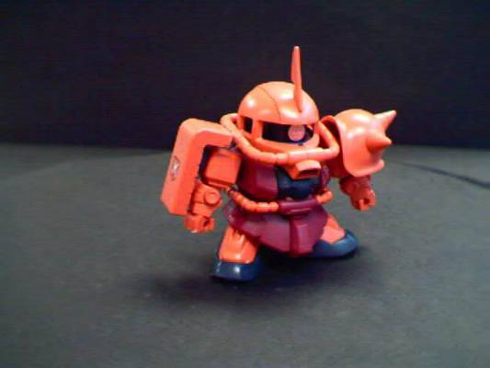
Example: Bundle adjustment 3D reconstruction (see also http://www.cse.cuhk.edu.hk/khwong/demo/index.html)
Grand Canyon Demo
Flask
Robot
http://www.youtube.com/watch?v=2KLFRILlOjc
http://www.youtube.com/watch?v=xgCnV--wf2k
http://www.youtube.com/watch?v=ONx4cyYYyrI
http://www.youtube.com/watch?v=4h1pN2DIs6g

Slide 8
The iterative SFM alternating (2-step)bundle adjustment
Break down the system into two phases: --SFM1: find pose phase --SFM2: find model phase
Initialize first guess of model
The first guess is a flat model perpendicular to the image and is Zinit away (e.g. Zinit = 0.5 meters or any reasonable guess)
Iterative while ( Err is not small )
{
SFM1: find pose phase
SFM2: find model phase
Measurement error(Err) or(model and pose stabilized)
}

Slide 9
Define SFM1: the pose estimation algorithm (assume the model is found or given)
Use KLT (FeatureDetector interface (or lkdemo.c) in opencv, or http://www.cs.ubc.ca/~lowe/keypoints/) to obtain features in [u,v]^{T}
There are t=1,2,…,Γ image frames,
So there are θ_{t=1}={R,T} _{t=1} , θ_{t=2}={R,T} _{t=2} , …., θ_{t=Γ}={R,T} _{t= Γ} poses.
Given: focal length f and one model M_{i}=[X,Y,Z]_{I},with i=1,..,N features
Initialize first guess of model
The first guess is a flat model perpendicular to the image and is Zinit away (e.g. Zinit = 0.5 meters or any reasonable guess)
For (t=1; t<Γ; t++)
{(for every time frame t, use all N features, run SFM1 once);
so SFM1 {SFM1: find pose : to find θ_{t} } runs Γ times here
}
After the above is run
θ_{t=1}={R,T} _{t=1} , θ_{t=2}={R,T} _{t=2} , …., θ_{t=Γ}={R,T} _{t= Γ} poses are found

Slide 10
Define SFM2: the structure estimation algorithm (assume poses are found or given) To be discussed in the next chapter : Bundle adjustment
Similar to pose estimation.
In pose estimation: model is known, pose is unknown.
Here (Model finding by the iterative method) Assume pose is known, model is unknown.
The ideas of the algorithms are similar.

Slide 11
SFM1 : find pose (R_{3x3},T_{3x1})_{t}
Pose estimation
One image (taken at time t) is enough for finding the pose at time t, if the model is known.

Slide 12
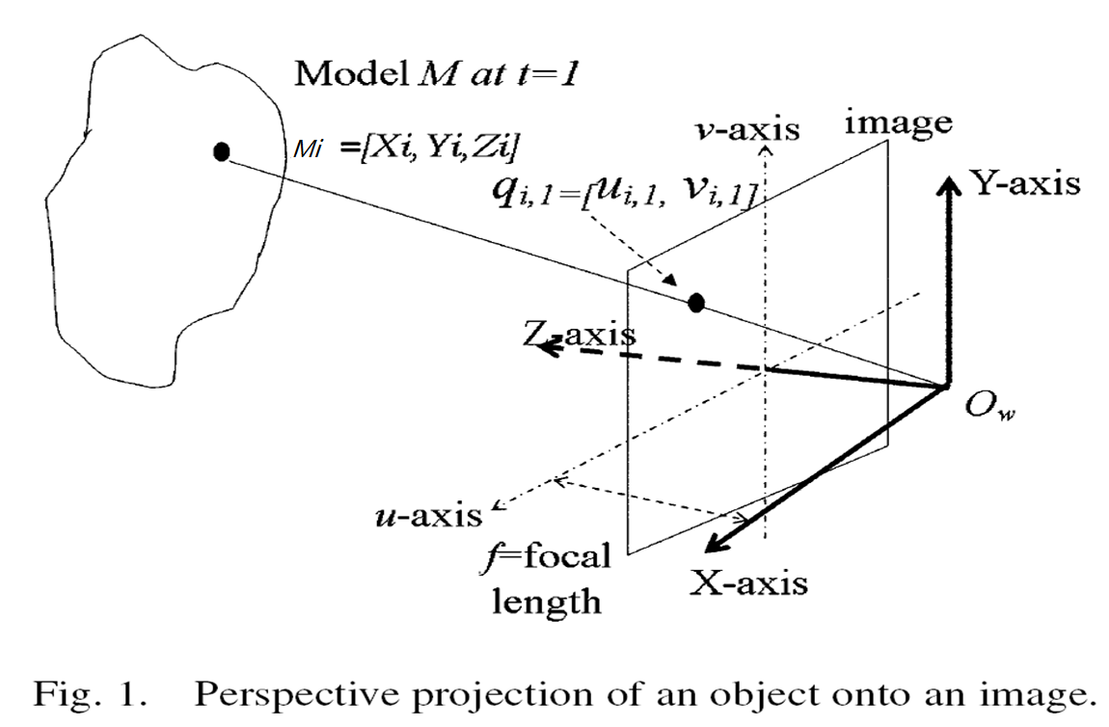
Problem setting

Slide 13
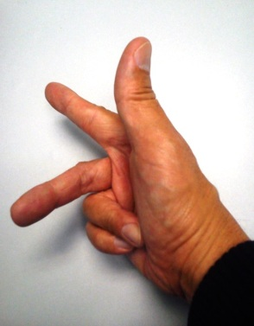


% matlab: object rotation: cam is stationary at world center; object and cam are all in world coord;
% object rotation center is the center of the object.
%see http://inside.mines.edu/fs_home/gmurray/ArbitraryAxisRotation/
%cos_x=cos(theta_x);cos_y=cos(theta_y);cos_z=cos(theta_z); theta_x = object rotate around x-axis etc.
%sin_x=sin(theta_x);sin_y=cos(theta_y);sin_z=cos(theta_z);
syms Rx Ry Rz cos_x cos_y cos_z sin_x sin_y sin_z
Rx=[ 1 0 0
0 cos_x -sin_x
0 sin_x cos_x];
Ry=[ cos_y 0 sin_y
0 1 0
-sin_y 0 cos_y];
Rz=[ cos_z -sin_z 0
sin_z cos_z 0
0 0 1];
‘R_object(rotates around x first, then y then z) =Rz*Ry*Rx='
Rz*Ry*Rx
>>Answer in matlab: R_object=Rz*Ry*Rx=
[ cos_y*cos_z, cos_z*sin_x*sin_y - cos_x*sin_z, sin_x*sin_z + cos_x*cos_z*sin_y]
[ cos_y*sin_z, cos_x*cos_z + sin_x*sin_y*sin_z, cos_x*sin_y*sin_z - cos_z*sin_x]
[ -sin_y, cos_y*sin_x, cos_x*cos_y]
Object rotation R_{object}:
rotates around x first, then y, then z
Y_{w}
Z_{w}
θ_{y}
θ_{z}
X_{w}
θ_{x}
Cam is at world center
World coord. sys.

Slide 14
Pose estimation problem definition (given model points and one image at t, find pose )
The definition of R,T can be found in the appendix of chapter2 (camera models and parameters)
There are N 3-D feature points on the model. The relative positions of the 3D features are known through measurements.
At time t (t=1,..m)there are N image features {q_{i=1..,N} }_{t}
Assume you know the correspondences for all i=1,…,N, That means:
(X,Y,Z)_{i=1,..N} ←→ {q_{i=1..,N} }_{t}
The target is to find R,T from {q_{i=1..,N} }_{t}
Only one image at t is need.
[X_{i=2},Y_{i=2},Z_{i=2}]^{T}
[X’_{i=2},Y’_{i=2},Z’_{i=2}]^{T}
i=1,…,N
Total
N-features
Model
R (rotation),
T (translation)
[X’_{i=1},Y’_{i=1},Z’_{i=1}]^{T}
[X_{i=1},Y_{i=1},Z_{i=1}]^{T}
World
coordinates

Slide 15
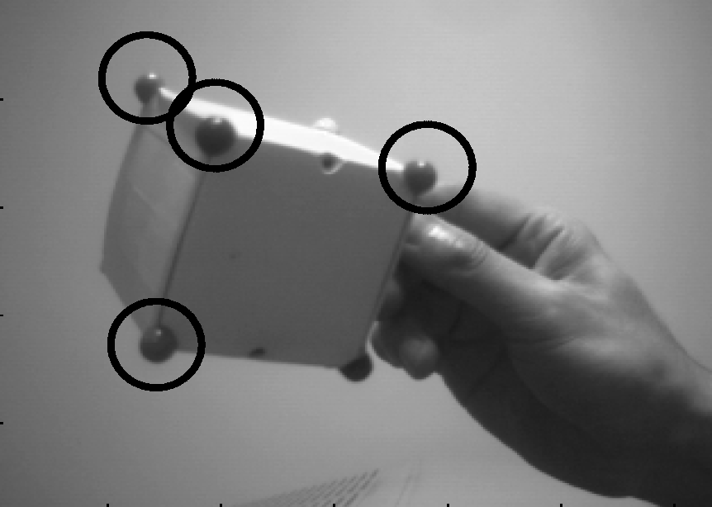
Example of pose estimation
We know the 3-D positions of the features on this box. (e.g. 4 points as shown, corners of a 10cm^3 cube)
In the image at time t, we know the correspondences of which corners appear in the image and their image positions. (image correspondences)
We can find R,T from this image at time t1.
q_{i=1,t=0}
q_{i=1,t=t1}
q_{i=2,t=0}
q_{i=2,t=t1}
R,T
Time t=0
Time t=t1

Slide 16
Exercise 0:Pose estimation & image correspondence
What are the input and output of a pose estimation algorithm?
How many images are enough for pose estimation?
Estimate the correspondences and Fill in the blanks
Image at
Time t=t₀
Image at
Time t=t1
V
5
4
3
2
1
0
q_{i=1,t=0}
q₃
q_{i=1,t=t1}
q₄
q_{i=2,t=0}
R,T
q_{i=2,t=t1}
u=0 1 2 3 4 5
u=0 1 2 3 4 5
Time t | q1 |  | q2 |  | q3 |  | q4
 | u | v | u | v | u | v | u | v
t=t₀ | 2 | 4 | 3 | 1 | 3 | 3 | 4 | 4
t=t1 | 2 | 3 | 2 | 0 | 3 | 2 | 4 | 2

Slide 17
Exercise 1: Newton’s method (An itervative method )
First guess, x₀=2.
f(x)=f(x₀)+ f’(x₀) *(x-x₀)≈0
0 ≈ f(x₀) + f’(x₀) *(x-x₀)
[0-f(x₀)]/f’(x₀) ≈ (x-x₀)
[0-(x₀²-5)]/2*x₀ = Δx ≈(x-x₀)
[0-(x₀²-5)]/2*x₀ = Δx
Take x₀=2, [0-(2²-5)]/2*2 = Δx
¼= Δx
Since Δx ≈(x-x₀),
x=new guess, x₀=old_guess
¼ ≈ x-2, x ≈ 2.25
That means the next guess is x ≈ x≈2.25.
Exercise: Complete the steps to find the solution.
For your reference: sqrt(5)=2.2360679 (by calculator)
An iterative method for finding the solution of a non-linear system
Exercise 1.Find sqrt(5), same as find the non-linear function.
f(x)=x²-5=0
Taylor series (by definition)
f(x)=f(x₀)+f’(x₀)*(x-x₀)=0
f’(x₀)=2*x₀, so
f(x)=f(x₀)+2*x₀*(x-x₀)=0
http://www.ugrad.math.ubc.ca/coursedoc/math100/notes/approx/newton.html

Slide 18
The main idea of Newton's method
We saw this formula before: f(x)=f(x₀)+f’(x₀)*(x-x₀)≈0 -----(i)
From f(x)=f(x₀)+f’(x₀)*(x-x₀)≈0
0 ≈ f(x₀)+f’(x₀)*(x-x₀)
0 - f(x₀)= f’(x₀)*(x-x₀)
[0 - f(x₀)]/ f’(x₀)=Δx=(x-x₀)
We can compute Δx=[0 - f(x₀)]/ f’(x₀), then
Since Δx=(x-x₀), so x=x₀+ Δx
That means: X_{new_guess}= x_{0(old_guess) +} Δx

Slide 19
Pose estimation in 3D
3D object at t₀
q_{i=1,t0}
Camera
center
q_{i=2,t0}
q_{i=1,t1}
q_{i=2,t1}
3D object at t=t₁

Slide 20
Exercise 2 From 3-D :P=[X,Y,Z]^{T} to 2-D :q=[u,v]^{T} image projection
Camera
center
q_{i=1,t}
q_{i=2,t}
image
3D object
Here you relate pose (R,T) and
model (X,Y,Z)_{i} with
image point (u,v)

Slide 21
Exercise 3

Slide 22
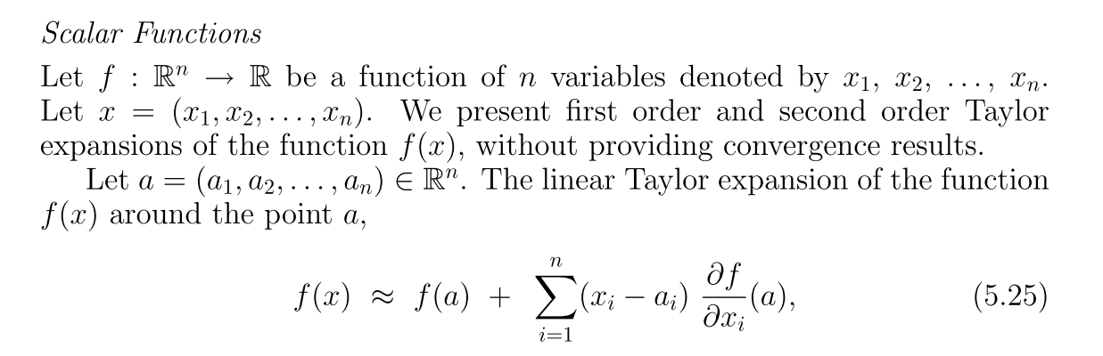
Using Taylor series
http://www.fepress.org/files/math_primer_fe_taylor.pdf

Slide 23
Exercise 4

Slide 24
Continue

Slide 25
Continue

Slide 26
Find partial derivatives

Slide 29
Similarly, so we have the results for v_{i} ,
Exercise 5: complete the proofs on the right hand side

Slide 30
Exercise 6

Slide 31
continue
Guessed :have hats ∼, when guessed poseθ is given, guessed u,v are found by equation 5(a),5(b)
Measured
Important idea
Calculated from
guessed(φ_{1,2,3},T_{1,2,3})
To be found (φ_{1,2,3},T_{1,2,3})
j_{2x6}

Slide 32
Exercise 7
(7b) Rewrite equation 7(b) if measured ui=132,vi=215,
Xi=100,Yi=200,Zi=300, focal length is 788 and guessed pose θ_{t} is [0.1,0.2, 0.3, 1111,2222,3333]^{T}. Angles are in radian.
After you put in the above values to equation 7(b) what are the unknowns left?
(7a) Referring to previous notes and write the answers

Slide 33
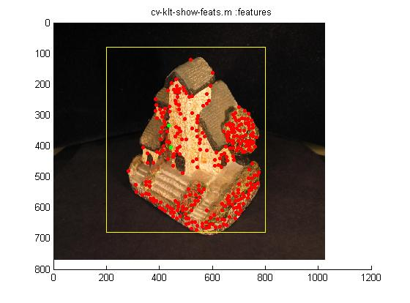
From Eq. 7b
The formulas apply to one frame at time t. There are 1=1,2,…N features.
each time t, θ_{t} is found.
SFM1 will run Γ times, each time is independent.
At time t, there are N features

Slide 34
The Jacobian (J) can also be written as follows (J can be found when guessed pose and model M are given)

Slide 35
Define terms for the iterative algorithm

Slide 36
Recall: The main idea of Newton's method
We saw this formula before: f(x)=f(x₀)+f’(x₀)*(x-x₀)≈0 -----(i)
From f(x)=f(x₀)+f’(x₀)*(x-x₀)≈0
0 - f(x₀)= f’(x₀)*(x-x₀)----------------------(ii)
[0 - f(x₀)]/ f’(x₀)=Δx=(x-x₀)
We can compute Δx=[0 - f(x₀)]/ f’(x₀), then
Since Δx=(x-x₀), so x=x₀+ Δx
That means: X_{new_guess}= x_{0(old_guess) +} Δx
In our pose estimation algo. X becomes θ
E=J*Δθ , J⁻¹*E=Δθ , this is similar to (ii) , J⁻¹→1/f’(x₀), E→ [0 - f(x₀)] , Δx →Δθ
E=[u_{measure}-u_{guess}]
J⁻¹*E=Δθ=θ_{(k+1 new_guess)}- θ_{(kth-old_guess)}
Use J⁻¹*E =Δθ to find Δθ
since Δθ=θ_{(k+1 new_guess)}- θ_{(kth-old_guess)}
θ_{(k+1_new_guess)=} θ_{(kth_old_guess)} +Δθ , see next slide

Slide 37
The iterative algorithm (SFM1)
SFM1: This algorithm is to find the pose θ
The formulas apply to one frame at time t. There are 1=1,2,…N features.
each time t, θ_{t} is found.
SFM1 will Γ times, each time is independent.
In the end, θ_{t=1}={R,T} _{t=1} , θ_{t=2}={R,T} _{t=2} , …., θ_{t=Γ}={R,T} _{t= Γ} poses are found

Slide 38
Summary
Studied the iterative algorithm for pose estimation

Slide 39
Appendix

Slide 40
Matlab for pose Jacobian matrix (full)
%********************feb 2013*** for extended lowe******************************
function TestJacobian
% Try to solve the differentiate equations without simplification
clc,clear;
disp('TestJacobian');
syms a b c; %yaw( around x axis), pitch(around y), roll(aroudn z) respectively
syms f X Y Z T1 T2 T3;
F = [
%u
f*((cos(b)*cos(c)*X - cos(b)*sin(c)*Y + sin(b)*Z+ T1)...
/((-cos(a)*sin(b)*cos(c) + sin(a)*sin(c))*X ...
+ (cos(a)*sin(b)*sin(c)+ sin(a)*cos(c))*Y + cos(a)*cos(b)*Z + T3));
%v
((sin(a)*sin(b)*cos(c)+ cos(a)*sin(c))*X ...
+ (-sin(a)*sin(b)*sin(c)+ cos(a)*cos(c))*Y - sin(a)*sin(b)*Z + T2)...
/((-cos(a)*sin(b)*cos(c) + sin(a)*sin(c))*X + (cos(a)*sin(b)*sin(c)...
+ sin(a)*cos(c))*Y + cos(a)*cos(b)*Z + T3)]
V = [a,b,c];
Fjaco = jacobian(F,V);
disp('Fjaco =');
disp(Fjaco);
size(Fjaco)
Fjaco(1,1)
%************************

Slide 41
Matlab for pose Jacobian matrix (approximation)
'===test jacobian for chang,wong ieee_mm 2 pass lowe= for lowe212.m======'
%use twist (small) angles approximation.
clear, clc;
syms R dR M TT XYZ ZZ x y z f u v a1 a2 a3 t1 t2 t3 aa1 aa2 aa3 tt1 tt2 tt3
R=[1 -aa3 aa2; aa3 1 -aa1; -aa2 aa1 1];
dR=[1 -a3 a2; a3 1 -a1; -a2 a1 1];
M=[x;y;z];
TT=[tt1;tt2;tt3];
dt=[t1;t2;t3]
XYZ=dR*R*M+TT+dt; % R is a matrix multiplication transform
u=f*XYZ(1)/XYZ(3);
v=f*XYZ(2)/XYZ(3);
ja=jacobian([u ;v],[a1 a2 a3])

Slide 42
Alternative form: jacobian for chang,wong ieee_mm 2 pass lowe
'==========test jacobian for chang,wong ieee_mm 2 pass, for lowe212.m===='
clear
% a1=yaw, a2=pitch, a3=roll,
% t1=translation in x, t2=translation in y, t3=translation in z,
syms R dR M TT XYZ ZZ x y z f u v a1 a2 a3 t1 t2 t3 aa1 aa2 aa3 tt1 tt2 tt3
R=[1 -aa3 aa2
aa3 1 -aa1
-aa2 aa1 1];
dR=[1 -a3 a2
a3 1 -a1
-a2 a1 1];
M=[x;y;z];
TT=[tt1;tt2;tt3];
dt=[t1;t2;t3]
% XX=(dR.*R)*M+TT; %not correct, becuase R is a matrix multiplication transform
XYZ=dR*R*M+TT+dt; %correct, becuase R is a matrix multiplication transform
% XX=(dR+R)*M+TT; %not correct becuase R is not an addition transform
u=f*XYZ(1)/XYZ(3);
v=f*XYZ(2)/XYZ(3);
%diff (u,a3)
%diff (v,a3)
ja=jacobian([u ;v],[a1 a2 a3])
jt=jacobian([u ;v],[t1 t2 t3])

Slide 43
%Appendix: rpymat(angs)
% Author: Rodrigo Carceroni
% Disclaimer: This code comes with no guarantee at all and its author
% is not liable for any damage that its utilization may cause.
%khw added 3.3002 , input angs is a 1x3 matrix,
% angs(1) is yaw angle about x-axis
% angs(2) is pitch angle about y-aixs
% angs(3) is roll angle about z-axis
%then X'=RX+T; X,T are 3X1 matrixes for [X,Y,Z]' 3D corrd. and translations.
function R = rpyMat (angs)
% Return the 3x3 rotation matrix described by a set of Roll, Pitch and Yaw
% angles.
cosA = cos (angs(3));
sinA = sin (angs(3));
cosB = cos (angs(2));
sinB = sin (angs(2));
cosC = cos (angs(1));
sinC = sin (angs(1));
cosAsinB = cosA .* sinB;
sinAsinB = sinA .* sinB;
R = [ cosA.*cosB cosAsinB.*sinC-sinA.*cosC cosAsinB.*cosC+sinA.*sinC ;
sinA.*cosB sinAsinB.*sinC+cosA.*cosC sinAsinB.*cosC-cosA.*sinC ;
-sinB cosB.*sinC cosB.*cosC ];

Slide 44
Appendix: Two rotation schemes
Scheme 1: stationary object, moving cam (Rcam in the world corrd. Sys.):
E.g. in robot navigation, the camera is carried by the robot, the environment is in the world corrd. sys and is static .
Use the formula described in ch2, i.e.
Pc=Rc*(Pw-Tc) -----(i) , Rc=(Rcam)⁻¹, Tc=Tcam=translation of the camera in the world corrd. sys.
Scheme 2:stationary camera (camera coord sys is the same as the world coord. sys), R_{cam}= (R_{c})⁻¹= R_{c} =eye(3), so T_{cam}=T_{c}=0. The object is rotated (R_{obj} ) around the center of the object, and translated by T_{obj} . The object is at Pw_{old} and is moved to Pw_{new} by R_{obj},T_{obj}.
E.g. in virtual reality applications, the user is holding an object Pw, you want to find the pose of the object after the motion of R_{obj},T_{obj}
Use the formulas in ch10, pose estimation, i.e. Pw_{new}=R_{obj}(Pw_{old})+T_{obj} ----(ii)
Relate scheme1 and 2:
You may put (ii) back to (i) with R_{c}=eye(3), Tc=[0 0 0 ]^{T}, hence Pc=Pw, so Pc=R_{obj}(Pw_{old})+T_{obj}
Other schemes may exist e.g. moving object and camera , but seldom used.

Slide 45
Answer0: Exercise 0:Pose estimation & image correspondence
What are the input and output of a pose estimation algorithm?
How many images are enough for pose estimation?
Estimate the correspondences and fill in the blanks
Image at
Time t=t₀
Image at
Time t=t1
V
5
4
3
2
1
0
q_{i=1,t=0}
q₃
q_{i=1,t=t1}
q₄
q_{i=2,t=0}
R,T
q_{i=2,t=t1}
u=0 1 2 3 4 5
u=0 1 2 3 4 5
Answer (a): Inputs: model of the object, (X,Y,Z)_{i} of all i feature points, i=1,..,n
Output: R_{3x3},T_{3x1} of the object at time t
Answer (b): One
Time t | q1 |  | q2 |  | q3 |  | q4
 | u | v | u | v | u | v | u | v
t=t₀ | 2 | 4 | 3 | 1 | 3 | 3 | 4 | 4
t=t1 | 2 | 3 | 2 | 0 | 3 | 2 | 4 | 2

Slide 46
Answer 1: Newton’s method
An iterative method for finding the solution of a non-linear system
Exercise 1.Find sqrt(5), same as find the non-linear function. sqrt(5)=2.2360679 (by calculator)
f(x)=x²-5=0
Taylor series (by definition)
f(x)=f(x0)+f’(x0)*(x-x0)=0
f’(x0)=2*x0, so
f(x)=f(x0)+2*x0*(x-x0)=0
Guess, x0=2.25
f(x)=f(x0)+2*x0*(x-x0)=0
f(x)=(x0²-5)+2*x0*(x-x0)=0
f(x)=(x0²-5)+2*x0*(x-x0)=0
(5.06-5)+2*2.25*(x-2.25)=0
0.06+4.5*(x-2.25)=0
X=((4.5*2.25)-0.06)/4.5
X=2.2366666 (temporally solution, but is good enough.
||Previous solution-current solution||2 =||2.25-2.2366666||2=0.013333 (small enough), continue if needed...
Otherwise the solution is
sqrt(5)=2.2366666.
http://www.ugrad.math.ubc.ca/coursedoc/math100/notes/approx/newton.html

Slide 47
Answer2 for exercise 2 Image Projection

Slide 48
Exercise 3

Slide 49
Answer3 for exercise 3

Slide 50
Answer4: Exercise 4

Slide 51
Similarly, so we have the results for v_{i} ,
??Answer5(left for student exercises):
Exercise 5: complete the proves for the right hand side

Slide 52
Answer 6: exercise 6

Slide 53
Answer7a: Exercise 7a
Check the previous notes and

Slide 54
Answer 7b

Slide 55
Answer8: exercise 8

