Slide 1
Image Processing and Computer Vision
Chapter 11: Bundle adjustment
Structure reconstruction SFM
from N-frames
Week 9/10

Slide 2
Reconstruction from N-frames
Factorization (linear, fast, not too accurate)
Bundle adjustment (slower but more accurate), can use factorization results as the first guess.
Non linear iterative methods are more accurate than linear method, require first guess (e.g. From factorization).
Many different implementations, but the concept is the same.

Slide 3
Problem definition
There are N features in the 3D object .
We take Γ pictures of the object at different views.
Input :
Image sequence I₁,I₂,…I _{Γ}.
Each image has n image feature points
Output (structure=model, and motion=pose)
3-D coordinates of all 3-D model points X₁,X₂,..,X_{N}.
Camera pose for each image taken [R(t),T(t)] t=1,… Γ

Slide 4
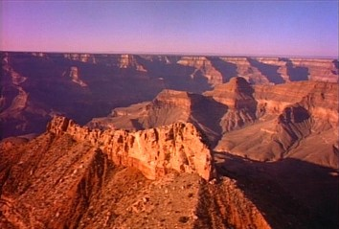
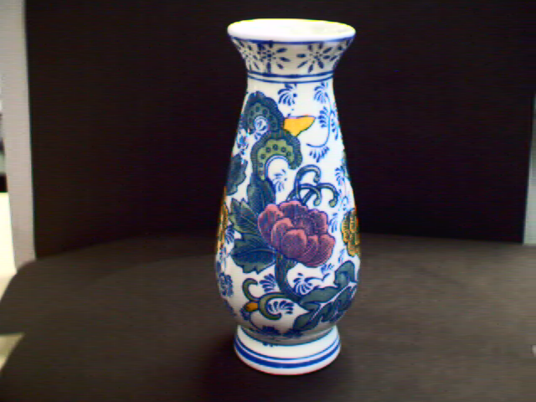
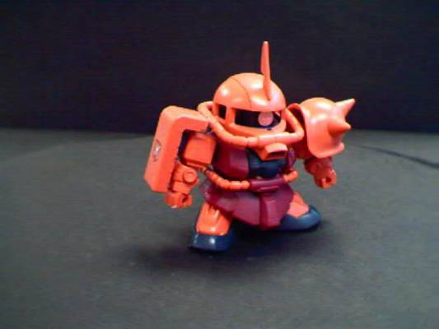
Example: Bundle adjustment 3D reconstruction (see also http://www.cse.cuhk.edu.hk/khwong/demo/index.html)
Grand Canyon Demo
Flask
Robot
http://www.youtube.com/watch?v=2KLFRILlOjc
http://www.youtube.com/watch?v=xgCnV--wf2k
http://www.youtube.com/watch?v=ONx4cyYYyrI
http://www.youtube.com/watch?v=4h1pN2DIs6g

Slide 5
The iterative SFM alternating bundle adjustment method
Break down the system into two phases: --SFM1: find pose phase --SFM2: find model phase
Initialize first guess of model
The first guess is a flat model perpendicular to the image and is Zinit away (e.g. Zinit = 0.5 meters or any reasonable guess)
Iterative while ( Err is not small )
{
SFM1: find pose phase
SFM2: find model phase
Measurement error(Err) or(model and pose stabilized)
}

Slide 6
SFM1 : find pose phase
Pose estimation
discussed in the last chapter

Slide 7
SFM2: Model finding by the iterative method
Similar to pose estimation.
In pose estimation: model is known, pose is unknown.
Here (Model finding by the iterative method) Assume pose is known, model is unknown.
The algorithms are similar.

Slide 8
Problem Formulation

Slide 9
Derivation for the model partial derivatives

Slide 10
CMSC5711: Exercise11.1:

Slide 11
Exercise11.2: proves all these partial derivatives

Slide 12
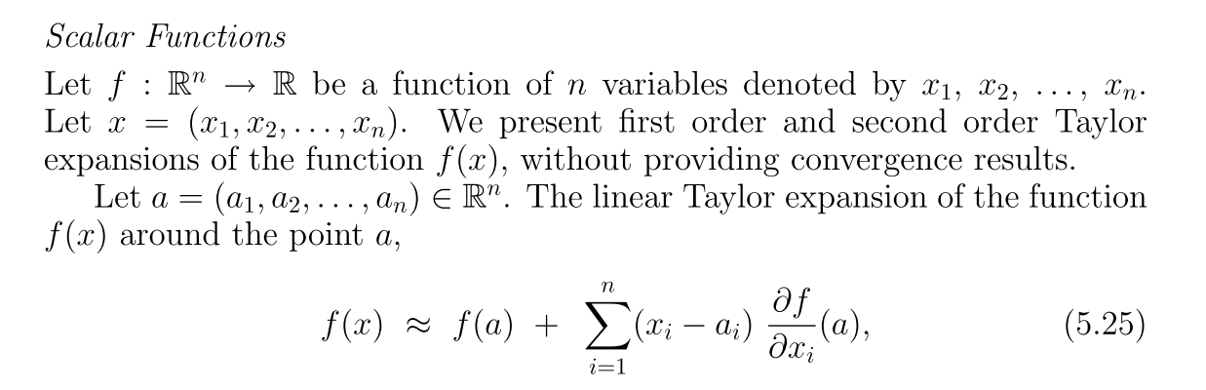
Recall

Slide 13

Continue

Slide 14
continue

Slide 15
SFM2: Iteration for finding the model point i: In this algorithm each point i (i=1,2,..N) is found independently , so the following algorithm will be run N times.
SFM2: This algorithm is to find the model M

Slide 16
The iterative SFM alternating bundle adjustment method
Break down the system into two phases: --SFM1: find pose phase --SFM2: find model phase (method (A) or (B))
Initialize first guess of model
The first guess is a flat model perpendicular to the image and is Zinit away (e.g. Zinit = 0.5 meters or any reasonable guess)
Iterative while ( Err is not small )
{
SFM1: find pose phase
SFM2: find model phase
Measurement error(Err) small or model and pose stabilized
}

Slide 17
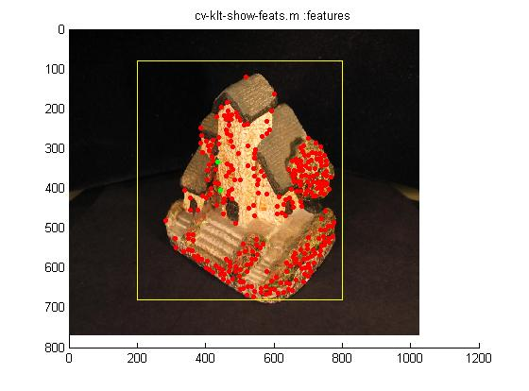
Overall processing revisit
Given: measurements
Images of N frames
Point feature tracked by KLT Kanade–Lucas–Tomasi_feature_tracker or SURF (Speeded Up Robust Features) methods
Examples, demo
http://www.youtube.com/watch?v=RXpX9TJlpd0
To find pose (Rotation R, translation T ) of every frame, and the model structure X

Slide 18
Putting it altogether
Repeat the explanations
SFM1 (find pose phase) and
SFM2 (find model phase) with implementation details.

Slide 19
Putting it altogether
Use KLT (or SIFT, Harris then correlation) to obtain features in [u,v]^{T}
There are t=1,2,…,Γ image frames,
So there are θ_{t=1}={R,T} _{t=1} , θ_{t=2}={R,T} _{t=2} , …., θ_{t=Γ}={R,T} _{t= Γ} poses.
There is only one model M_{i}=[X,Y,Z]_{I},with i=1,..,N features
Initialize first guess of model
The first guess is a flat model perpendicular to the image and is Zinit away (e.g. Zinit = 0.5 meters or any reasonable guess)
Iterative while ( Err is not small ){
/////////////// SFM1: Pose finding ////////////////////////////////////
//(for every time frame t, use all N features, run SFM1 once); so SFM1 runs Γ times here
For (t=1; t<Γ; t++)
{ Inputs: You have f(focal length), M_{i}=[X,Y,Z]_{i}
For each frame t, you have i=1,,,N, image feature points and measurements [u,v]^{T}_{i,t}
Output: pose θ_{t}
}
After the above is run
θ_{t=1}={R,T} _{t=1} , θ_{t=2}={R,T} _{t=2} , …., θ_{t=Γ}={R,T} _{t= Γ} poses are found
////////////////////// SFM2: model finding //////////////////////
(For i=1,i<N;i++) (for every feature, use all Γ frames, run SFM2 once; so SFM2 runs N times here)
{SFM2: find model phase}
Measurement error(Err) small or model and pose stabilized}

Slide 20
Recall: SFM1:Find Pose phase
//(for every time frame t, use all N features, run SFM1 once); so SFM1 runs Γ times here
For (t=1; t<Γ; t++)
{ Inputs: You have f(focal length), M_{i}=[X,Y,Z]_{i}
For each frame t, you have i=1,,,N, image
feature points and measurements [u,v]^{T}_{i,t}}
Output: pose θ_{t}
}
After the above is run
θ_{t=1}={R,T} _{t=1} , θ_{t=2}={R,T} _{t=2} , …., θ_{t=Γ}={R,T} _{t= Γ} poses are found

Slide 21
Recall in pose estimation SFM1: a slide in ch.iv10: pose estimation
The formulas apply to one frame at time t. There are i=1,2,…N features.
each time t, θ_{t} is found.
SFM1 will Γ times, each time is independent.
At time t, there are N features

Slide 22
Exercise
Exercise 11.3 : If the model is a checker board plane, each square is 1cm^{2.}. It is perpendicular to the camera principal axis and at Z=0.5 meters away from the camera center. Pixel width is 5um.
Find the 3D positions of X1,X2,X3 and X4 in pixels
X4
Y
1cm
1cm
x3=
[0,0]
X2
X1
X

Slide 23
How to get the first guess of the model?
We have an image with [u,v]_{i=1,2,..,N}
Camera focal length is f
In theory
u_{i}=f*X_{i}/Z_{i}
v_{i}=f*Y_{i}/Z_{i}
First guess of the model is all points on a plane
X’_{i}=u_{i}*Z_{guess}/f, Y’_{i}=v_{i}*Z_{guess}/f,
Z’_{i}=Z_{guess}=0.5 meters (for example)
So the guessed i-th 3D point is at [X’_{I,} Y’_{I,} Z’_{i}]
Image
Camera
center
_{Zguess}
f

Slide 24
Exercise 11.4 Revision for pose estimation SFM1: : Point out which are know variables and unknown variables in this page.
The formulas apply to one frame at time t. There are i=1,2,…N features.
each time t, θ_{t} is found.
SFM1 will Γ times, each time is independent.
At time t, there are N features

Slide 25
Exercise 11.5 Revision for pose estimation SFM1: : Explain why E is known here in the following formula.

Slide 26
Revision for pose estimation SFM1: Explain why J is known here. Answer: because guessed M, and guessed pose are known

Slide 27
Exercise 11.6 : Revision for pose estimation SFM1: Identify known variables and unknown variables when k=0 and k=5 in this iterative pose estimation algorithm
SFM1: This algorithm is to find the pose θ
The formulas apply to one frame at time t. There are i=1,2,…N features.
SFM1 will Γ times, each time is independent,

Slide 28
SFM2: Find model phase Similar to SFM1 but pose is known, find model here.
(for every feature, use all Γ frames, run SFM2 once; so SFM2 runs N times here)
For i=1,i<N;i++
{ SFM2: find model phase
}

Slide 29
Exercise11.7: Revision of SFM2: Identify which are known which are known here. Explain why J^{(m)} is known at this stage.
Measured
The formulas apply to one feature (i) for all time frames t=1,2,…Γ.
SFM2 will N times , each time is independent.
See next slide for the graphical illustration,
Result from the guessed model and given pose
Jacobian
New Guessed model
Current Guessed model

Slide 30
In SFM2, we handle a feature i, at one time.
The formulas in the pervious slide apply to one feature (i) for all time farmes t=1,2,…Γ
X
v1
[u,v]_{i,t=1}
v2
v3
[u,v] _{i,t=2}
vm
O_{t=1}
Image
t=1
[u,v] _{i,t=3}
[u,v] _{i,t=Γ}
…
θ_{t=1}={R,T} _{t=1}
…
Image
t=2
O_{t=2}
Image
t=3
Image
t=Γ
O_{t=Γ}
θ_{t=2}={R,T} _{t=2}
O_{t=3}
θ_{t=Γ}={R,T} _{t=Γ}
θ_{t=3}={R,T} _{t=3}
Camera motion
O_{t}=camera center at time t

Slide 31
Exercise11.8 : SFM2: Algo. to find the i-th model point (repeat this N times to get all N points) Identify which are known and unknown when K=0, K=5
SFM2: This algorithm is to find the model M
The formulas apply to one feature (i) for all time frames t=1,2,…Γ.
SFM2 will N times , each time is independent.
See next slide for the graphical illustration,

Slide 32
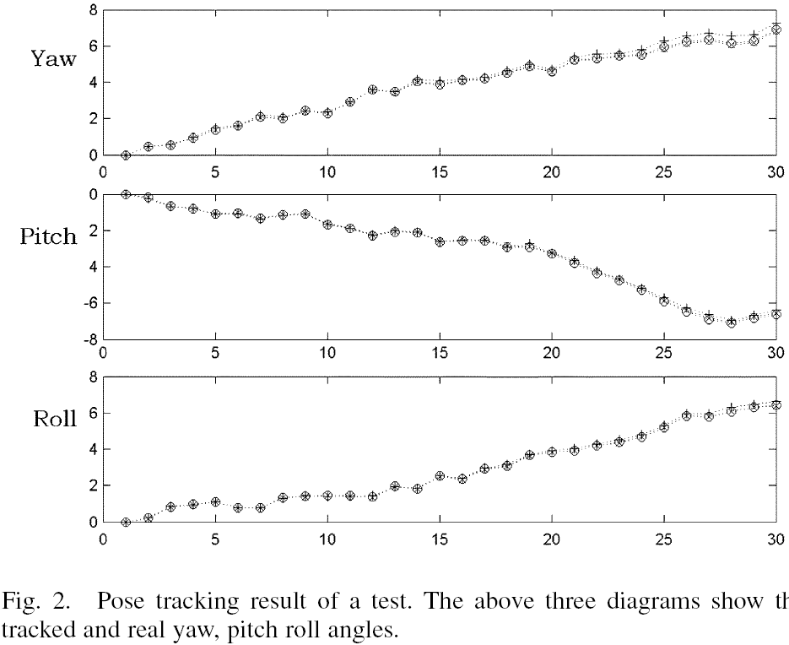
From [2] Result for rotation angles

Slide 33
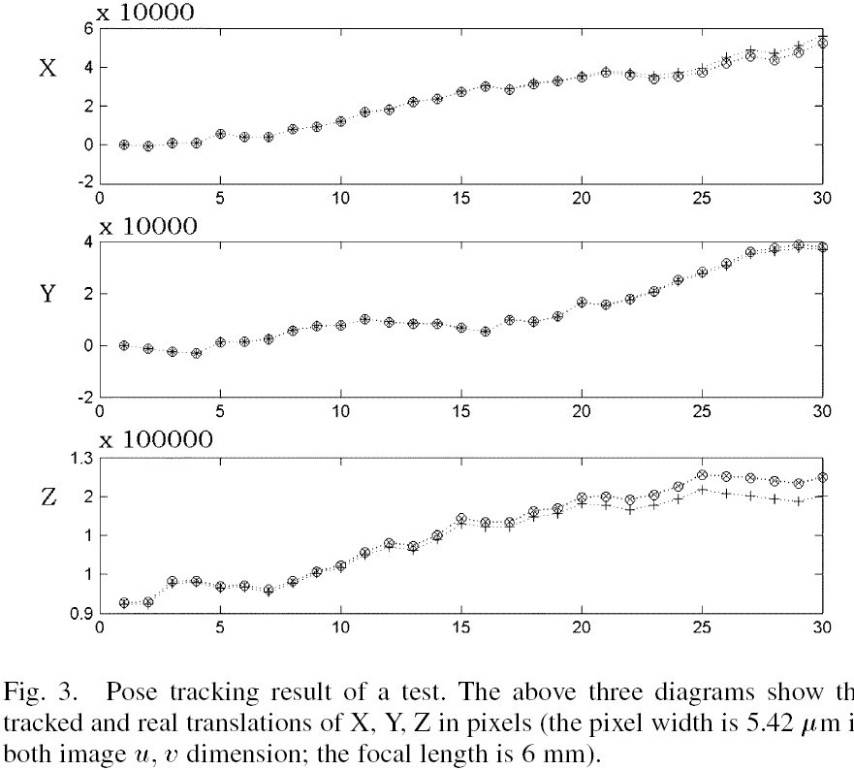
From [2] Result for translations

Slide 34
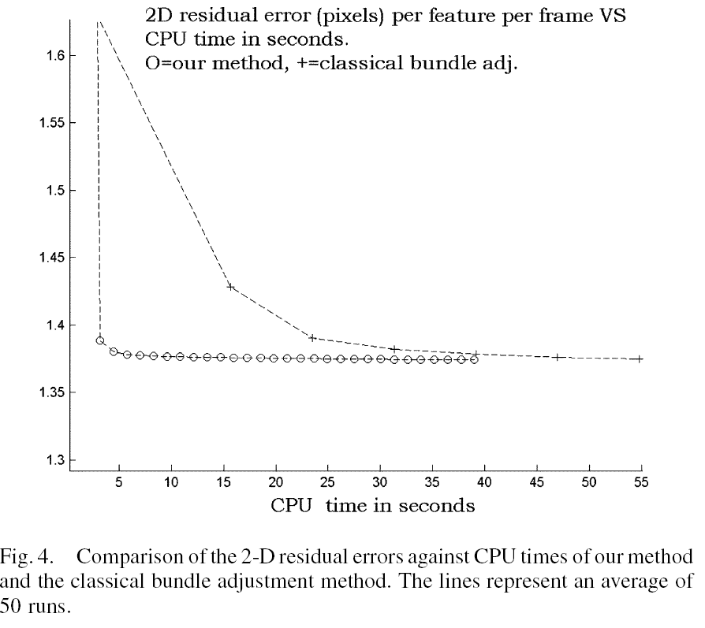
From [2] Result: compare full/classical(+) and 2-pass algorithm (o)

Slide 35
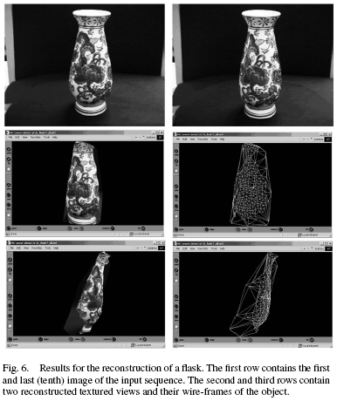
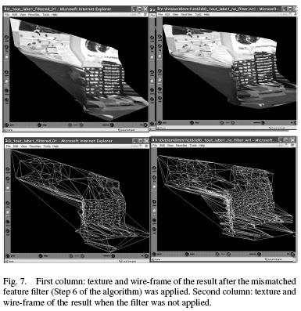
From [2] Results for real images

Slide 36
Conclusions
Bundle adjustment can be used for structure and motion SAM (model structure reconstruction and pose estimation).
Bundle adjustment is an accurate method for Structure from motion SFM.
It can made more efficient by using a two pass (pose finding step, model fining step) algorithm

Slide 37
Appendices

Slide 38
Demo Newton's method
function new_x=demo_newton1(x)
%This is to solve x^3-2x=3
%assume x is the guessed x
% 3= f(true_x)=f(x)+f'(x)(new_x-x)+ small_terms_ignored % Taylor series
% 3-f(x)/f'(x)=new_x-x, or
% new_x=x+((3-f(x))/f'(x))= new_x, until new_x not changed
% so that
% new_x=x+((3-f(x))/f'(x))
% new_x=x+((3-(x^3-2*x))/(3*x^2-2));
while (1)
new_x=x+((3-(x^3-2*x))/(3*x^2-2));
err=abs(x - new_x);
st=sprintf('new_x=%2.3f,err=%2.3f, err is still too big\n',new_x,err);
disp(st);
if (err < 0.01)
break;
end
%'err still big, hit key to continue'
pause
x=new_x;
end
'err is small new_x is the solution'
new_x
>> demo_newton1(1)
new_x=5.000,err=4.000, err is still too big
new_x=3.466,err=1.534, err is still too big
new_x=2.534,err=0.931, err is still too big
new_x=2.059,err=0.475, err is still too big
new_x=1.909,err=0.150, err is still too big
new_x=1.893,err=0.015, err is still too big
new_x=1.893,err=0.000,
ans =
err is small new_x is the solution
new_x =
1.8933
ans =
1.8933

Slide 39
Rotation matrix

Slide 40
Jacobian for model :JacobM
% Jacobian for model :JacobM %%%%%%%%
N = size(model,2); %model=3,N
if N~=1
error('JacobM: model size must be 4*1');
end
T = size(rt,3); %rt=3,4,T
J=zeros(2*T,3);
for t=1:T %index T vertical blocks
V = rt(:,:,t)*model;
X = V(1,:);
Y = V(2,:);
Z = V(3,:);
Z2 = Z.*Z;
XZ2 = X./Z2;
YZ2 = Y./Z2;
a11 = rt(1,1,t)./Z - rt(3,1,t).*XZ2;
a12 = rt(1,2,t)./Z - rt(3,2,t).*XZ2;
a13 = rt(1,3,t)./Z - rt(3,3,t).*XZ2;
a21 = rt(2,1,t)./Z - rt(3,1,t).*YZ2;
a22 = rt(2,2,t)./Z - rt(3,2,t).*YZ2;
a23 = rt(2,3,t)./Z - rt(3,3,t).*YZ2;
a1 = [a11' a12' a13'];
a2 = [a21' a22' a23'];
J(t,:) = a1;
J(T+t,:) = a2;
end
J = flen.*J;

Slide 41
Angles and R pose conversion

Slide 42
jacobian for chang,wong ieee_mm 2 pass lowe
'==========test jacobian for chang,wong ieee_mm 2 pass lowe=================='
clear
% a1=yaw, a2=pitch, a3=roll,
% t1=translation in x, t2=translation in y, t3=translation in z,
syms R dR M TT XYZ ZZ x y z f u v a1 a2 a3 t1 t2 t3 aa1 aa2 aa3 tt1 tt2 tt3
R=[1 -aa3 aa2
aa3 1 -aa1
-aa2 aa1 1];
dR=[1 -a3 a2
a3 1 -a1
-a2 a1 1];
M=[x;y;z];
TT=[tt1;tt2;tt3];
dt=[t1;t2;t3]
% XX=(dR.*R)*M+TT; %not correct, becuase R is a matrix multiplication transform
XYZ=dR*R*M+TT+dt; %correct, becuase R is a matrix multiplication transform
% XX=(dR+R)*M+TT; %not correct becuase R is not an addition transform
u=f*XYZ(1)/XYZ(3);
v=f*XYZ(2)/XYZ(3);
%diff (u,a3)
%diff (v,a3)
ja=jacobian([u ;v],[a1 a2 a3])
jt=jacobian([u ;v],[t1 t2 t3])

Slide 43
Delaunay algorithm for generation of VRML files
VRML specifications
Viewers
Cortona3d, Cosmoplayer, Vivaty
http://cic.nist.gov/vrml/vbdetect.html
Delaunay algorithm

Slide 44
Alternative method fro finding the model
To find model by triangulation (not iterative method )
It is faster but may be not very accurate.

Slide 45
Alternative method for SFM2 : find model phase
There are two methods:
(SFM2: method A) Direct triangulation
(SFM2: method B) Iterative method (in the main body of this power point)
Either (A) or (B) can be used

Slide 46
SFM2(method A): direct triangulation model finding procedure
Assume you have m views,
Using the first view and each of the other views we can (m-1)pairs of images.
Each pair gives one version of X (using the triangulation method in the chapter on stereo (chapter iv08 http://www.cse.cuhk.edu.hk/%7Ekhwong/www2/cmsc5711/iv08_stereo.ppt)
So you have m-1 models X1, X2,… Xm-1 (all referring to the first camera coordinate system as reference)
The solution X=Xmean is the mean of all these (X1, X2,… Xm-1 )
So a temporally model X is found at this stage.
Also measure the error:
Measurement error (Err)
Err=∑||(current model - previous model)||²

Slide 47
SFM2 (method B) :The iterative steps
Initialize first guess of model and pose
The first guess is a flat model perpendicular to the image and is Zinit away (e.g. Zinit = 0.5 meters or any reasonable guess)
Iterative while ( Err is small)
{
SFM1 find pose
SFM2 find model
Measurement error (Err)
Err= ∑ ||(current model - previous model)||²
//If the model is stabilized, the solution is final.
}

Slide 48
Pose estimation result
Recall of SFM1 (pose estimation)
Input :
Image sequence I1,I2,…Im.
There are N features in the 3D object .
Each image has n image feature points
Output: pose [R(t),T(t)] t=1,…m
At time t, each image feature will give you a vector v_{t} from the camera center O(t) to the 3D point in X passing the image point x_{i,t}
Xi in 3D
v_{t}
X_{i,t}=[u_{i},v_{i}]_{t}^{T}
Camera center
O(t)
Image

Slide 49
After pose is found in SFM1
We can use triangulation to find the model
Example fro an 3D feature X
After pose estimation SFM1, v1,v2,vm can be found
0t=camera centers at time t
R(t),T(t)=pose at time t
X
v1
[u,v]1
v2
[u,v]2
v3
vm
O1
Image
t=1
[u,v]3
R1,T1
…
[u,v]m
…
Image
t=2
O2
Image
t=3
Image
t=m
Om
Rm,Tm
R2,T2
O3
R3,T3
Camera motion

Slide 50
SFM2(method A): From vectors find the closes point
So you have v1,v2,..vm vectors in 3D
You want to find a point closes to this point
So hew to find the closest point between 2 vectors? Of the first sand second views
Recall: we learned this in stereo vision
We know
P1,P2 (projection matrices) of two cameras, (yes we know it here because we have guess solution R,T)
We know the 2D correspondences points (yes we know it here)
We can find the model point X in 3D .

Slide 51
SFM2(method A): Just concentrate on the first two views
Find X from 2 views
From RT found (SFM1 pose finding phase), we have P1,P2.
We also have 2D point correspondences: [u,v]1,[u,v]2
We can find X, see the next two slides
X
Projection matrix
P1
v1
[u,v]1
v2
[u,v]2
O1
Image
t=1
R1,T1
Image
t=2
O2
Projection matrix
P2
R2,T2

Slide 52
SFM2(method A): Recall: Triangulation to find X
X is the point at a minimum
distance between two vectors
{O1,(x1,y1)} and {O2,(x2,y2)}
(x₁,y₁)
Left epipolar line
Left
Frame
plane1 ∏₁
(x₂,y₂)
O₂
O_{l}
e₁
e₂
Epipole e₂
Focal
length=f₁
Epipole e₁
Focal
length=f₂
F

Slide 53
SFM2(method A): Recall: 3D reconstruction: from P₁ and P₂ find 3D points X by triangulation (p.312[1A],p297[1B])

Slide 54
References
D.G. Lowe, “Fitting Parameterized Three-Dimensional Models to Images”, IEEE Pattern Analysis and Machine Intelligence, Volume: 13 Issue: 5 , May 1991 Page(s): 441 -450
Michael Ming Yuen Chang and Kin Hong Wong, "Model reconstruction and pose acquisition using extended Lowe's method", IEEE Transactions on Multimedia, Volume: 7, Issue: 2, April 2005.

Slide 55
Answers

Slide 56
Answer11.1: Exercise11.1:

Slide 57
Answer11.2: Exercise11.2: proves all these partial derivatives: Left for students’ exercises

Slide 58
Exercise
Answer 11.3: Exercise 11.3 : If the model is a checker plane, each square is 1cm^{2.}. It is perpendicular to the camera principal axis and at Z=0.5 meters away from the camera center. Pixel width is 5um.
Find the 3D positions of X1,X2,X3 and X4 in pixels
Answer:
All Z are the same Z=0.5meters/5um=100,000
X1(-2cm, -2cm,0.5 meters)= [-4000,-4000,100,000]
X2(-2cm, -1cm,0.5 meters)=[-4000,-2000,100,000]
X3(0,0,0.5 m)=[0,0,100,000]
X4(2cm,2cm,0.5m)=[4000,4000,100,000]
X4
Y
1cm
1cm
x3=
[0,0]
X2
X1
X

Slide 59
Answer11.4: Revision for pose estimation SFM1: Exercise 11.4 : Point out which are know variables and unknown variables in this page.
At time t, there are N features

Slide 60
Answer 11.5 Revision for pose estimation SFM1: Exercise 11.5 : Explain why E is known here in the following formula.

Slide 61
Answer11.6 : Revision for pose estimation SFM1: Identify known variables and unknown variables when k=0 and k=5 in this iterative pose estimation algorithm Ans: K=0, we initialize (GUESS) θ _{k=0} then E,J, can be found. Then Δθ_{k=0} can be calculated, then the guessed θ_{k=1} =θ _{k=0}+Δθ_{k=0} is found, which will be used in the iteration k=1. When K=5, guessed θ _{k=5} is found during k=4 , then E,J, θ _{k=5}, are calculated, i.e. θ _{k=5} =θ_{k=4} + Δθ_{k=4} , when k=4. Then Δθ_{k=5} can be found and it will be used to find guessed θ _{k=6} =θ_{k=5} + Δθ_{k=5}
SFM1:
This algorithm is to find the pose θ

Slide 62
Exercise11.7: Answer11.7: At K=0:[X,Y,Z]_{i} are unknown. Others are known, because pose is found by SFM1, Model ∼M_{i} is guessed initially at k=0 (a plane) AT K=5: [X,Y,Z]_{i} is unknown.Others are known,because pose is found by SFM1, Model(∼M_{i}(xi,y,zi)) is (a better guess) found by the previous SFM2 phase J^{(m) depends on the guessed} model ∼M and current pose (current pose is found by SFM1)
Measured
The formulas apply to one feature (i) for all time frames t=1,2,…Γ.
SFM2 will N times , each time is independent.
See next slide for the graphical illustration,
Result from the guessed model and given pose
Jacobian
New Guessed model
Current Guessed model

Slide 63
SFM2: Algorithm to find the i-th model point (repeat this N time to get all points) Exercise11.8 : identify which are known and unknown when K=0, K=5 Answer11.8: k=0, Model [X,Y,Z]_{i} is a point in a plane, pose (by SFM1) is known and the algorithm can find a better model. Answer: k=5, Model [X,Y,Z]_{i}is the model found in the previous SFM2 and pose is found by SFM1, the algorithm can find a better Model.
SFM2: This algorithm is to find the model M

