Slide 1
Introduction to VRML for generating 3-D display
Chapter 12 Generate 3D display using VRML
KH Wong
Week 11

Slide 2
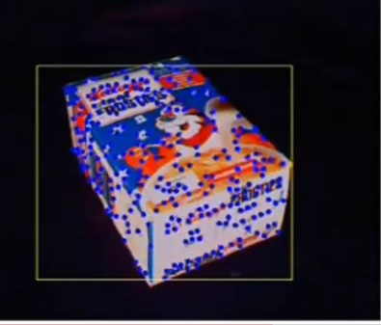
What is VRML?
Virtual Reality Modeling Language
A demo
A language for displaying a virtual reality 3D objects
Text based, can be read by most web browser with downloadable add-in.
Typical VRML Display viewers e.g.
  Cortona http://www.cortona3d.com/
  Cosmos player http://cosmo-player.en.softonic.com/

Slide 3
Basic concept
You can only see 2D pictures on a common 2-D screen
Based on the feature points, we divide the object into small triangles
When the object rotates, we display the shape and texture mapped images of the 2D triangles on screen.
The more triangles displayed, the more accurate the output is.
VRML is a rich language, but we only show how to display 3-D results of our Structure From Motion SFM algorithms here.

Slide 4
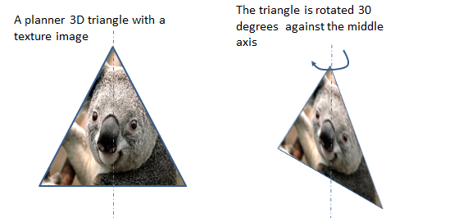
Example of a rotated triangle
It seems it has been rotated in 3D but you are just seeing the original picture but textured mapped to another triangle
Texture mapped

Slide 5
Input and data set of a VRML file for an object
Input:
  3-D Model points of the object
  One image of the object (called the texture)
Based on the input data we need to generate the following data set for the VRML file
  (i) 3-D Data points
  (ii) 3-D Triangles
If texture map is required
  (iii)2-D data points
  (iv) 2-D Triangles

Slide 6
2 faces of a cube: 2faces.wrl.
#VRML V2.0 utf8 (2faces.wrl)
Group {
children [
Shape {
appearance Appearance {
texture ImageTexture {
url "baboon.jpg"
} }
geometry IndexedFaceSet {
coord DEF COORD Coordinate {
point [
0 0 1,
1 0 1,
1 1 1,
0 1 1,
0 0 0,
1 0 0,
1 1 0,
0 1 0, ] }
coordIndex [
0 1 2 -1,
0 2 3 -1
3 2 6 -1,
3 6 7 -1, ]
texCoord DEF TEXCOORD TextureCoordinate {
point [
0 0,
1 0,
1 0.5,
0 0.5,
0.5 0.5, #not used here
0.5 1,#not used here
1 1,
0 1, ]}
texCoordIndex [
0 1 2 -1,
0 2 3 -1
3 2 6 -1,
3 6 7 -1,
] }}
]
}
Texture image
(III) 2D points
(I) 3-D points, see next page
(IV) 2-D triangles
(II) 3-D Triangles indexes

Slide 7
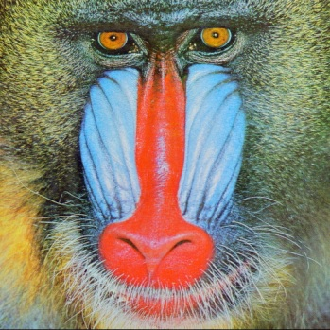
We need to prepare 4 tables for the VRML (.wrl) file, plus one texture image.
table
3-D points (format: x,y,z), e.g
  0 0 1, #point index 0, #=comment
  1 0 1, #point index 1
3-triangles (format: point_index_A, point_index_B, Point_index_C,-1), e.g
  0 1 2 -1, # point indexes 0, 1, 2 are vertices of the triangle, (-1= end)
  0 2 3 -1 # point indexes 0, 2, 3 are vertices of the triangle
2-D points (format: x,y) normalized image position , e.g
  0.5 0.3, #point index 0 , each value is from 0 to 1)
  0.2 1, #point index 1
2-D triangles (format: point_index A, point_index B, Point_index C,-1), e.g.
  0 1 2 -1, #usually the same as table (ii)
  0 2 3 -1
one texture image (e.g. baboon.jpg here)
table
table
table
(0,1)
(1,1)
(0,0)
(1,0)

Slide 8
3-D model of a cube
Show 2 faces :Front & Top )
Each face has 2 triangles
The model of a Cube :X (x,y,z) with indexes(#) and vertices
(Only front and top surfaces are displayed)
# is for comment
(see next slide)
2-D points (just skip Z of the 3-D points)
Normalized values of a picture)
0 0, #0 point 0
1 0, #1 point 1
1 0.5, #2 point 2
0 0.5, #3 point 3
0.5 0.5,#4 point 4 (not used)
0.5 1, #5 point 5 (not used)
1 1, #6 point 6
0 1, #7point 7
2-D Triangles
As same 3-D triangles
See (left side)
#7 (0 1 0)
#6 (1 1 0)
(table (i)) 3-D points
0 0 1, # point 0
1 0 1, # point 1
1 1 1, # point 2
0 1 1, # point 3
0 0 0, # point 4(Origin: not used)
1 0 0, # point 5 (Not used here)
1 1 0, # point 6
0 1 0, # point 7
(table (ii)) Triangles, same as table (iv))
0 1 2 -1, # triangle 1, using point 1 2 3
0 2 3 -1, # triangle 2, using point 0 2 3
3 2 6 -1, # triangle 3, using point 3 2 6
3 6 7 -1, # triangle 4, using point 3 6 7
#3
(0,1,1)
#2
(1 1 1)
#4(X=0, Y=0, Z=0)
#5 (1 0 0)
#0 (0 0 1)
#1 (1 0 1)

Slide 9
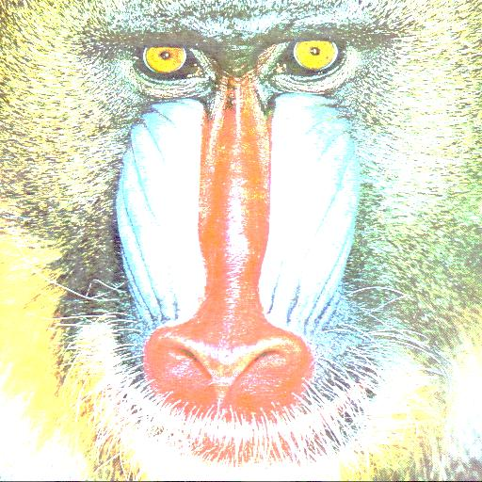
Texture map
A .jpg with normalized pixels values
Pixel x,y coordinates range from 0 to 1
#6 (1, 1)
#7 (0, 1)
(table iii) 2-D points (just skip Z of the 3-D points)
Normalized values of a picture)
0 0, #0 point 0
1 0, #1 point 1
1 0.5, #2 point 2
0 0.5, #3 point 3
0.5 0.5,#4 point 4 (not used)
0.5 1, #5 point 5 (not used)
1 1, #6 point 6
0 1, #7point 7
#2 (1, 0.5)
#3 (0, 0.5)
#0 (0, 0)
#1 (1, 0)
#(table iv) same as table (ii)
#Triangles, same as table (ii))
0 1 2 -1, # triangle 1, using point 1 2 3
0 2 3 -1, # triangle 2, using point 0 2 3
3 2 6 -1, # triangle 3, using point 3 2 6
3 6 7 -1, # triangle 4, using point 3 6 7
Exercise: point to the triangles 1,2,3,4 in the above diagram.

Slide 10
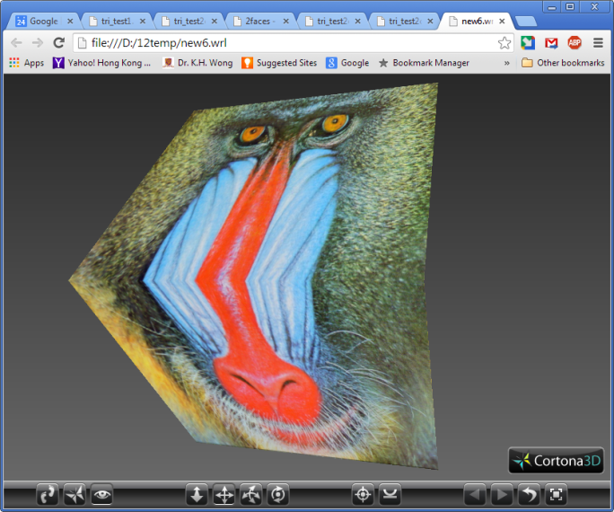
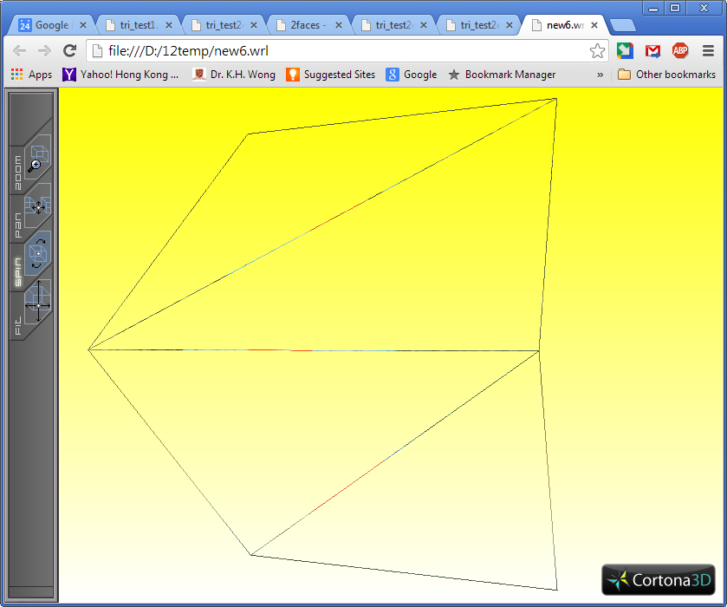
Exercise 1: (i) How many 2-D feature points are in Figure 1 below?
(ii) If (0 1 3) is a triangle, create at least 3 different combinations of how to triangulate these 2-D feature points.
The model of a Cube :X (x,y,z) with indexes# and vertices
#7(0,1,0)
#6(1,1,0)
#3(0,1,1)
#2(1,1,1)
Textured mapped 4 triangles c(rotated)
Demo of 2faces.wrl
#0(0,0,1)
#1(1,0,1)
Wireframes of 4-Triangles (rotated)
3-D points
0 0 1, #0
1 0 1, #1
1 1 1, #2
0 1 1, #3
0 0 0, #4
1 0 0, #5
1 1 0, #6
0 1 0, #7
Traingles
0 1 2 -1,
0 2 3 -1
3 2 6 -1,
3 6 7 -1,
#7
#6
The 2 faces of a cube is rotated
#2
#3
#0
#1
Demo
http://www.youtube.com/watch?v=qieuLWDMVx0&feature=youtu.be

Slide 11
Exercise 1: (i) How many 2-D feature points are in Figure 1 below?
(ii) If (0 1 3) is a triangle, create at least 3 different combinations of how to triangulate these 2-D feature points.
Answer:(i)8. (ii) (013)(123)(326)(367) or (013)(123)(267)(273) or (031)(163)(127)(267) etc..
The model of a Cube :X (x,y,z) with indexes# and vertices
#7(0,1,0)
#6(1,1,0)
#3(0,1,1)
#2(1,1,1)
Textured mapped 4 triangles c(rotated)
Demo of 2faces.wrl
#0(0,0,1)
#1(1,0,1)
Wireframes of 4-Triangles (rotated)
3-D points
0 0 1, #0
1 0 1, #1
1 1 1, #2
0 1 1, #3
0 0 0, #4
1 0 0, #5
1 1 0, #6
0 1 0, #7
Traingles
0 1 2 -1,
0 2 3 -1
3 2 6 -1,
3 6 7 -1,
#7
#6
The 2 faces of a cube is rotated
#2
#3
#0
#1
Demo
http://www.youtube.com/watch?v=qieuLWDMVx0&feature=youtu.be

Slide 12
VRML for displaying results of SFM (structure from motion)
How to find the 3-D model and 2-D feature points of the triangles
Take a sequence of images of an object: (Img_{t=1},Img_{t=2},Img_{t=3}),
From images, extract/track 2-D feature points (u,v)_{i=1,,N}(Harris plus cross correlation, or KLT - or SIFT trackers) and use Img_{t=1} as the texture map image
From 2-D (u,v) _{t=1,..Γ;i=1..N} run SFM
  Factorization
  or
  Bundle adjustment, to obtain the 3-D object model (X)_{i=1..N}
So we have 3-D (X)_{i=1..N} and 2-D (u,v) _{t=1,..Γ;i=1..N} points of the images.
Run Delaunay triangulation to obtain the triangles
Create the 4-tables for the VRML file, and use Img1 as the texture map.
KLT -- http://en.wikipedia.org/wiki/Kanade%E2%80%93Lucas%E2%80%93Tomasi_feature_tracker
SIFT -- http://en.wikipedia.org/wiki/Scale-invariant_feature_transform
Delaunay triangulation --http://en.wikipedia.org/wiki/Delaunay_triangulation

Slide 13


Graphical illustration: create a VRML file from SFM result
t=1 t= 2 t=3 …
Γ
Time (t)
(u,v)_{t=1; i=1}
img1
(2) From all 2-D features
(u,v)_{t=1,..Γ;} _{i=1,..,N}, run
SFM (structure from motion):
Factorization, bundle adjustment, etc
to object 3-D model points X (x,y,z)_{i=1,…N}
(1) From Img1 , obtain (u,v)_{t=1;} _{i=1,..,N}, which are used as the base to track all features in subsequence images using:
KLT, SIFT etc.
(3)Based on 2-D features (u,v)_{t=1;} _{i=1,..,N},
of img1 , run Delaunay to generate triangles
(u,v)_{t=1;} _{i=1,..,N},
of Img1
(4) Create 4 tables for the VRML file, use Img1 as texture

Slide 14
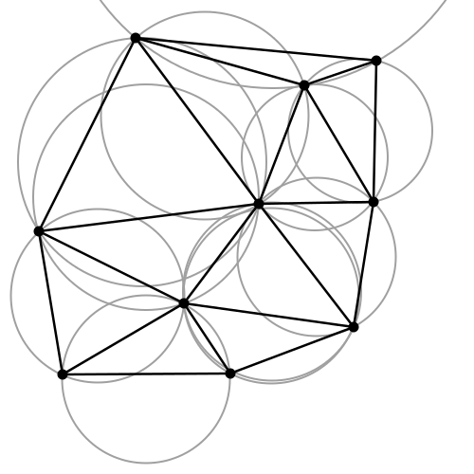
What is Delaunay triangulation?
In mathematics and computational geometry, a Delaunay triangulation for a set P of points in a plane is a triangulation DT(P) such that no point in P is inside the circumcircle of any triangle in DT(P). Delaunay triangulations maximize the minimum angle of all the angles of the triangles in the triangulation; they tend to avoid skinny triangles. The triangulation is named after Boris Delaunay for his work on this topic from 1934.^{[1]}
From http://en.wikipedia.org/wiki/Delaunay_triangulation
Correct triangulation by Delaunay
Incorrect triangulation:
The Delaunay algorithm will not generate such wrong result
This triangulation
has a cross, it is
not allowed, so this triangulation failed

Slide 15
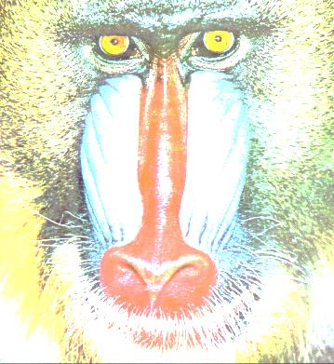

Texture map of triangles
The model of a Cube :X (x,y,z) with indexes# and vertices
In a 3-D display by texture map, you are actually seeing the first image at different texture mapped forms.
You can use the mouse in Cortona (VRML viewer) to control the viewing angle , the positions of the projected triangles are re-calculated and shown below.
#7(0,1,0)
#6(1,1,0)
#3(0,1,1)
#2(1,1,1)
#0(0,0,1)
#1(1,0,1)
The first image (Img1.jpg) as the texture map image
Each triangle (totally 4 here) is textured mapped to the new display window based on img1.jpg to create the 3-D viewing effect. You are always seeing the first image.
#7
#6
The 2 faces of a cube is rotated
Texture map
#2
#3
#0
#1

Slide 16
Summary
Studied a virtual reality display file format (the VRML format)
Studied how to display 3-D information using a 2-D display device.
Studied a triangulation method : Delaunay
Studied the method of texture map

