Slide 1
Math Tutorial
for computer vision

Slide 2
Overview
Basic geometry
2D
3D
Linear Algebra
Eigen values and vectors
Ax=b
Ax=b and SVD
Non-linear optimization
Jacobian

Slide 3
2D- Basic Geometry
2D homogeneous representation
A point x has x1,x2 components. To make it easier to operate, we use Homogenous representation.
Homogeneous points, lines are in the form of 3x1 vectors.
So a Point x=[x1,x2,1]’ , a line is L: [a,b,c]’
Properties of points and lines
If point x is on the line L2
x’*L=[x1,x2,1]*[a,b,c]’=0, see operation is a linear one, very easy.
We can get back to the line form we all recognize: ax1+bx2+c=0.
L1=[a,b,c]’ and L2=[e f g]’ intersects at Xc
Xc=(L1 X L2), intersection point = cross product of the 2 lines.
The line through two points a=[a1,a2,1]’, b=[b1,b2,1]’ is L=a X b
Plane

Slide 4
2D- Advanced topics : Points and lines at infinity
Point at infinity (ideal point) : Point of intersection of two parallel lines
L1=(a,b,c), L2=(a.b.c’), L1 L2 have the same gradient
Is [b,-a,0]’
Proof
Pintersect=L1×L2=
|x y z|
|a b c|
|a b c’|
Xbc’+acy+abz-abz-bcx-ac’y= xbc’–bcx+acy-ac’y=(c’-c)bx+(c’-c)(-a)y+0z
Pintersect=(c’-c)(b,-a,0)’,
Ignor the scale (c-c’), (b,-a,0)’ Is a point in infinity, the third element is 0, if we convert it back to inhomogeneous coordinates: [x=b/0= ∞, -a/0= ∞]
Line at infinity (L∞): L∞=[0 0 1]’.
A line passing through these infinity points is at infinity. It is called L∞ which satisfies L∞’ • x∞=0. We can see that L∞=[0 0 1]’, since L∞=[0 0 1]’• x∞ = [0 0 1] • [x1 x2 0]’=0. (*Note that if the dot product of the transpose of a point to a line is 0, the point is on that line.)

Slide 5
2D- Ideal points: (points at infinity)
Pideal (ideal point) = [a,-b,0]’ is the point where a line L1=[a,b,c]’ and the line at infinity L∞=[0 0 1]’ meets.
Proof
(Note : the point of intersection of lines L1, L2 = L1× L2.)
Pideal=L1 × L∞=
|x y z|
|a b c|=xb-ay+0z=a point at [b –a 0]
|0 0 1|
Hence Pideal=[ b –a 0], no c involved.
It doesn’t depend on c, so any lines parallel to L1 will meet L∞ at Pideal.

Slide 6
3D- homogeneous point
A homogeneous point in 3D is X=[x1,x2,x3,x4]’

Slide 7
3D- Homogenous representation of a plane
The homogenous representation of a plane π is represented by Ax1+Bx2+Cx3+Dx4=0 or π’x=0 where π’=[A,B,C,D] and x=[x1,x2,x3,x4]’ . And the inhomogeneous coordinates can be obtained by
X=x1/x4
Y=x2/x4
Z=x3/x4

Slide 8
3D- Normal and distance from the origin to a plane
The inhomogeneous representation of the plane can be written as [π1,π2,π3]•[X,Y,Z]’+d=0, where n=[π1,π2,π3]’ is a vector normal to the plane and is the distant from the origin to the plane along the normal. Comparing it with the homogeneous representation we can map the presentations as follows.
The normal to the plane is n=[π1, π2, π3]’
The distance from the origin to the plane is d=π4.

Slide 9
3D- Three points define a plane
Three homogeneous 3D points
A=[a1, a2, a3, a4]’
B=[b1, b2, b3, b4]’
C=[c1, c2, c3,c4]’
If they lie on a plane π=[π1,π2,π3,π4]’
[A’,B’,C’]’π=0

Slide 10
3D- 3 planes can meet at one point, if it exist, where is it?

Slide 11
Basic Matrix operation
(AB)T=B^{T} A^{T}

Slide 12
Rank of matrix http://en.wikipedia.org/wiki/Rank_(linear_algebra)
If A is of size m x n, Rank(A)<min{m,n}
Rank(AB)< min{rank(A), rank(B)}
Rank(A)= number of non zero singular values found using SVD.

Slide 13
Linear least square problems
Eigen values and vectors
Two major problems
Ax=b
Ax=0

Slide 14
Eigen value tutorial
For λ₁=-2, (A- λ₁I)v=0,
A=[-3- λ₁ , -1 ][v1]
[4 , 2- λ₁ ]v2]=0
-v1-v2=0, and 4v1+4v2=0 (2 duplicated eqn.s)
V is a vector passing through 0,0, set v2=1,so
V1=-1, v2=1 is the direction of the vector v
The eignen vector for eigen value λ₁=-2 is [v1=-1,v2=1]
--------------------------------------
For λ₂=1, (A- λ₂I)v=0,
A=[-3- λ₂ , -1 ][v1]
[4 , 2- λ₂][v2]=0
-4v1-v2=0, and 4v1+v2=0, (2 duplicated eqn.s)
The eignen vector for eigen value λ₂=1 is v1=-1,v2=4
A is an m x n matrix, Av=λv, where
v =[v1 v2….]^{T}is an nx1 vector ,
λ is a scalar (Eigen value)
By definition (A- λI)v=0,
So, det (A-λI)=0
Example 1, A is 2 x2, so v =[v1 v2]^{T}
A=[-3 -1 ]
[ 4 2 ],
Det[-3- λ , -1 ]
[ 4 , 2-λ ]=0
-6+ λ -2λ+ λ²-4(-1)=0 ➔λ² -λ-6=0
Solve for λ, Eigen values: λ₁=-2, λ₂=1
Ref:
http://www.math.hmc.edu/calculus/tutorials/eigenstuff/
http://www.arndt-bruenner.de/mathe/scripts/engl_eigenwert2.htm

Slide 15
Eigen value tutorial
Example 2, m=2, n=2
A=[1 13
13 1],
Det[1- λ , 13
13 , 1- λ ]=0
(1- λ)²-2(1- λ)+13²=0
Solve for λ, solutions: λ₁=-12, λ₂=14
for Eigenvalue -12:
Eigenvector: [ -1 ; 1 ]
for Eigenvalue 14:
Eigenvector: [ 1 ; 1 ]
Ref: Check the answer using
http://www.arndt-bruenner.de/mathe/scripts/engl_eigenwert2.htm

Slide 16
Ax=b problem Case1 :if A is a square matrix
Ax=b, given A and b find x
Multiple A⁻¹ on both sides: A⁻¹ Ax= A⁻¹ b
X= A⁻¹ b is the solution.

Slide 17
Ax=b problem Case2 :if A is not a square matrix
Ax=b, given A and b find x
Multiple A^{T} on both sides: A^{T} Ax= A^{T} b
(A^{T} A)⁻¹ (A^{T} A)x= (A^{T} A)⁻¹ A^{T} b
X=(A^{T} A)⁻¹ A^{T} b
is the solution

Slide 18
Ax=b problem Case2 :if A is not a square matrix Alternative proof
Numerical method and software by D Kahaner, Page 201
Ax=b, given A_{mxn} and b_{mx1} find x_{nx1}

Slide 19
Nonlinear leave square Jacobian

Slide 20
Solve Ax=0
To solve Ax=0, Homogeneous systems
One solution is x=0, but it is trivial and no use.
We need another method, SVD (Singular value decomposition)

Slide 21
What is SVD? Singular value decomposition
A is mxn, decompose it into 3 matrces: U, S, V
U is mxm is an orthogonal matrix
S is mxn (diagonal matrix)
V is nxn is an orthogonal matrix
σ1, σ2, σn, are singular values
Columns of vectors of U=left singular vectors
Columns of vectors of V=right singular vectors

Slide 22
SVD (singular value decomposition)
Singular values
Right singular vectors
Right singular vectors
SVD
…

Slide 23
More properties

Slide 24
SVD for Homogeneous systems
To solve Ax=0,
(Homogeneous systems)
One solution is x=0, but it is trivial and no usage.
If we set ||x||₂=1, the solution will make sense.
So we ask a different question: find min(||Ax||) and subject to ||x||₂=1.
Note:||x||₂ is 2-norm of x
http://en.wikipedia.org/wiki/Matrix_norm

Slide 25
Minimize ||Ax|| subject to ||x||₂=1
(’)=transpose
To minimize the 2-norm of ||Ax||₂, since A=USV’
||Ax||₂ =||USV’x||₂ = (USV’x)’ (USV’x) by definition 2-norm: ||Y||2=Y’Y
So ||Ax||₂ = (x’VS’U’)(USV’x) because (ABC)’=C’B’A’
so||Ax||₂ =(x’VS’SV’x), since U is orthogonal and U’U=1
Since x’VS’= (SV’x)’ put back to the above formula,
So ||Ax||₂ =(SV’x)’(SV’x) =||SV’x||₂
To minimize ||Ax|| subject to ||x||=1
Or minimize =||SV’x||₂ subject to ||V’x||₂
=1 (see ** on the right)
Set y=V’x
We now minimize ||Sy|| subject to ||y||=1
Since S is diagonal and with descending entries
The solution is y=[0 0 ..0 1]^{T} (reason: ||y||₂=1, and just ||Sy|| is the smallest
Since V’x=y, so x=(V’)⁻¹ y .
V is orthogonal, (V’)⁻¹=V
X_{solution}=V[0 0 0.. 1]’=last column of V
** To show
||x||₂=||V’x||₂
Proof:
||V’x||₂=(V’x)’ (V’x)
=x’V(V’x)
=x’x since VV’=I , (V is orthogonal)
=||x||₂, done
To be continued

Slide 26
Non-linear optimization
To be added

Slide 27
Some math background on statistics
Mean, Variance/ standard deviation
Covariance and Covariance matrix
Eigen value and Eigen vector

Slide 28
Mathematical methods in Statistics 1.
Mean, variance (var) and standard_deviation (std),

Slide 29
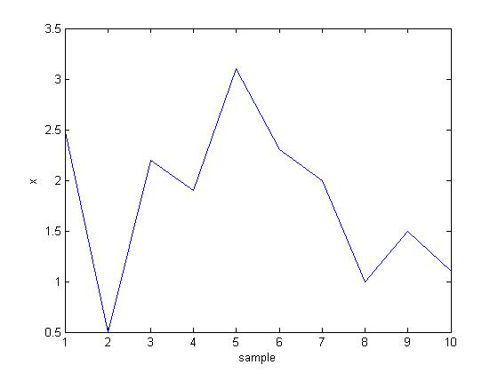
Revision of basic statistical methods: Mean, variance (var) and standard_deviation (std)
x =
2.5000
0.5000
2.2000
1.9000
3.1000
2.3000
2.0000
1.0000
1.5000
1.1000
mean_x = 1.8100
var_x = 0.6166
std_x = 0.7852
%matlab code
x=[2.5 0.5 2.2 1.9 3.1 2.3 2 1 1.5 1.1]'
mean_x=mean(x)
var_x=var(x)
std_x=std(x)
x
sample

Slide 30
n or n-1 as denominator?? see http://stackoverflow.com/questions/3256798/why-does-matlab-native-function-cov-covariance-matrix-computation-use-a-differe
“n-1 is the correct denominator to use in computation of variance. It is what's known as Bessel's correction” (http://en.wikipedia.org/wiki/Bessel%27s_correction) Simply put, 1/(n-1) produces a more accurate expected estimate of the variance than 1/n

Slide 31
Class exercise 1
By computer (Matlab)
By and
x=[1 3 5 10 12]'
mean(x)
var(x)
std(x)
Mean(x)
= 6.2000
Variance(x)= 21.7000
Stand deviation = 4.6583
x=[1 3 5 10 12]'
mean=
Variance=
Standard deviation=

Slide 32
Answer1:
By computer (Matlab)
By and
x=[1 3 5 10 12]'
mean(x)
var(x)
std(x)
Mean(x)
= 6.2000
Variance(x)= 21.7000
Stand deviation = 4.6583
x=[1 3 5 10 12]'
mean=(1+3+5+10+12)/5
=6.2
Variance=((1-6.2)^2+(3-6.2)^2+(5-6.2)^2+(10-6.2)^2+(12-6.2)^2)/(5-1)=21.7
Standard deviation= sqrt(21.7)= 4.6583

Slide 33
Mathematical methods in Statistics 2.
Covariance
Covariance (variance-covariance) matrix

Slide 34
Part 2a: Covariance [see wolfram mathworld] http://mathworld.wolfram.com/
“Covariance is a measure of the extent to which corresponding elements from two sets of ordered data move in the same direction.”
http://stattrek.com/matrix-algebra/variance.aspx

Slide 35
Part 2b: Covariance (Variance-Covariance) matrix ”Variance-Covariance Matrix: Variance and covariance are often displayed together in a variance-covariance matrix. The variances appear along the diagonal and covariances appear in the off-diagonal elements”, http://stattrek.com/matrix-algebra/variance.aspx
Note: x has N samples (rows) of C variables (columns), cov(x)=(1/n-1)(x’*x)
c=1 c=2 c=C
Xc
N

Slide 36
Find covariance matrix cov() of an input data set
Assume the measurements (x or y) have zero mean to simply the discussion
Different people make their preferred format of measurement matrices, but
If the measurement matrix (x_{(nxc)}) has N samples (rows) of C variables (columns) then
the covariance matrix of x is cov(x)_{(cxc)}=(1/n-1)(x’*x)
If the measurement matrix (y_{(cxn)}) has N samples (columns) of C variables (rows) then
the covariance matrix of y is cov(y)_{(cxc)} =(1/n-1)(y*y’)
This is to make sure the covariance matrix is a square matrix of size cxc=
number_of_variables x number_of_variables

Slide 37
Application of covariance matrix
You perform M sets of measurements, each measurement has n parameters (variables)
E.g. Four days of temperature, rain-fall (in mm), wind-speed (km per hour)
The data collected is placed in matrix A. E.g.
Rows: each row is a measurement of different variables
Columns: each column is a variable on different days
A_{(Mxn)} = [-1 1 2 ;
-2 3 1 ;
4 0 3 ;
1 2 0]_{(Mxn, or 4x3)}
Temperature is -1
on day1
Wind-speed is 3 on day3

Slide 38
Covariance matrix example1 A is 4x3
From Matlab >help cov
Consider
A = [-1 1 2 ;
-2 3 1 ;
4 0 3 ;
1 2 0]
To obtain a vector of variances for each column of A:
v = diag(cov(A))'
v =
7.0000 1.6667 1.6667
Compare vector v with covariance C=cov(A);
C=[7.0000 -2.6667 1.6667
-2.6667 1.6667 -1.3333
1.6667 -1.3333 1.6667]
Ie. Take the first column of A
a=[-1,-2,4,1]’
a2=a-mean(a)
a2=[-1,-2,4,1]’-0.5=[-1.5000,-2.5000, 3.5000, 0.5000]’
Cov([-1,-2,4,1]’)=7
Cov(a)=7
a2’*a2/(N-1)=
[-1.5000,-2.5000,3.5000,0.5000]*
[-1.5000,-2.5000,3.5000,0.5000]’/(4-1)
=7
Diagonals are variances of the columns
Covariance of first and second column
>> cov([-1,-2,4,1]',[1,3,0,2]')=
7.0000 -2.6667
-2.6667 1.6667
Also
>> cov([1,3,0,2]',[2,1,3,0]') =
1.6667 -1.3333
-1.3333 1.6667

Slide 39
Covariance matrix example2 A is 3x3
From Matlab >help cov
Consider
A = [-1 1 2 ;
-2 3 1 ;
4 0 3]. To obtain a vector of variances for each column of A:
v = diag(cov(A))'
v =
10.3333 2.3333 1.0000
Compare vector v with covariance matrix C:
C =
10.3333 -4.1667 3.0000
-4.1667 2.3333 -1.5000
3.0000 -1.5000 1.0000
Ie. Take the first column of A
a=[-1,-2,4]’
a2=a-mean(a)
a2=[-1,-2,4]’-0.333=[-1.3333 -2.3333 3.6667]’
Cov([-1,-2,4]’)=
Cov(a)=
a2’*a2/(N-1)=
[-1.3333 -2.3333 3.6667]’
*[-1.3333 -2.3333 3.6667]/(3-1)
=10.333
Diagonals are variances of the columns
Covariance of first and second column
>> cov([-1 -2 4]',[1 3 0]')=
10.3333 -4.1667
-4.1667 2.3333
Also
>> cov([1 3 0]',[2 1 3]') =
2.3333 -1.5000
-1.5000 1.0000

Slide 40
Covariance matrix example
Ie. Take the first column of A
a=[-1,-2,4]’
a2=a-mean(a)
a2=[-1,-2,4]’-0.333=[-1.3333 -2.3333 3.6667]’
b=[1 3 0]’
b2=[1 3 0]’-mean(b)=
b2= [-0.3333 , 1.6667, -1.3333]’
a2’*b2/(N-1)=[-1.3333 -2.3333 3.6667]*[-0.3333 , 1.6667, -1.3333]’
= -4.1667
------------------------------------------
C=[2 1 3]’
C2=[2 1 3]’-mean(c)
C2=[2 1 3]’-2=[0 -1 1]’
a2’*c2/(N-1)=[-1.3333 -2.3333 3.6667]*[0 -1 1]’/(3-1)=3
-----------------------------------
b2*b2’/(N-1)=[-0.3333 , 1.6667, -1.3333]*[-0.3333 , 1.6667, -1.3333]’/(3-1)=2.3333
b2*c2/(N-1)= [-0.3333 , 1.6667, -1.3333]*[0 -1 1]’/(3-1)=-1.5
From Matlab >help cov
Consider
A = [-1 1 2 ;
-2 3 1 ;
4 0 3]. To obtain a vector of variances for each column of A:
v = diag(cov(A))'
v =
10.3333 2.3333 1.0000
Compare vector v with covariance matrix C:
C =
10.3333 -4.1667 3.0000
-4.1667 2.3333 -1.5000
3.0000 -1.5000 1.0000
N=3, because A is 3x3

Slide 41
Mathematical methods in Statistics 3.
Eigen value and Eigen vector

Slide 42
Eigen vectors of a square matrix
Because A is
rank2 and is 2x2
cov_x * X= λ X,
so cov_x has
2 eigen values
and 2 vectors
In Matlab
[eigvec,eigval]
=eign(cov_x)
Square matrix
eigvect of cov_x =
[-0.7352 0.6779]
[ 0.6779 0.7352]
eigval of cov_x =
[0.0492 0]
[ 0 1.2840 ]
covariance_matrix of X =
cov_x=
[0.6166 0.6154]
[0.6154 0.7166]
So
eigen value λ₁= 0.49,
its eigen vector is [-0.7352
0.6779]
eigen value λ₂= 1.2840,
its eigen vector is [0.6779
0.7352]

Slide 43
To find eigen values

Slide 44
What is an Eigen vector?
AX=λX (by definition)
A=[a b
c d]
λ is the Eigen value and is a scalar.
X=[x1
x2]
The direction of Eigen vectors of A will not be changed by transformation A.
If A is 2 by 2, there are 2 Eigen values and 2 vectors.

Slide 45
Find eigen vectors from eigen values λ1=0.0492, λ2=1.2840, for λ1

Slide 46
Find eigen vectors from eigen values λ1=0.0492, λ2=1.2840, for λ2

Slide 47
Eigen vectors of a square matrix, example2
Example when A is 3x3
To be added, we should have 3 Eigen values and 3 Eigen vectors

Slide 48
Covariance matrix calculation
%cut and paste the followings to MATLAB and run
% MATLAB demo: this exercise has 10 measurements , each with 2 variables
x= [2.5000 2.4000
0.5000 0.7000
2.2000 2.9000
1.9000 2.2000
3.1000 3.0000
2.3000 2.7000
2.0000 1.6000
1.0000 1.1000
1.5000 1.6000
1.1000 0.9000]
cov(x)
% It is the same as
xx=x-repmat(mean(x),10,1) ;% subtract measurements by the mean of each variable.
cov_x= xx' *xx/(length(xx)-1) % using n-1 variance method ,
%you should see that cov_x is the same as cov(x), a 2x2 matrix, because the covariance matrix is of size = number_of_variables x number_of_variables
% Here, each measurement (totally 10 measurements) is a row of 2 variables. So we use cov_x= xx' *xx/(length(xx)-1)
%Note: some people make x by placing each measurement as a column in x, hence, you should use cov_x= xx*xx'/(length(xx)-1)

Slide 49
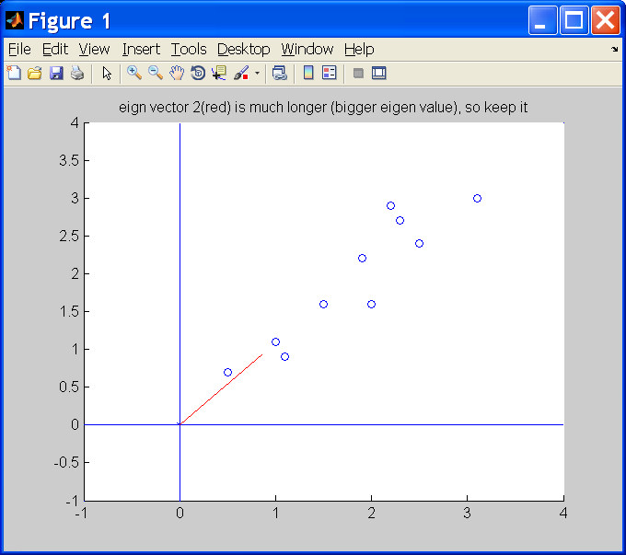
Cov numerical example (pca_test1.m, in appendix)
x2
x’1
Step2:
X_data_adj =
X=Xo-mean(Xo)=
=[x1 x2]=
[0.6900 0.4900
-1.3100 -1.2100
0.3900 0.9900
0.0900 0.2900
1.2900 1.0900
0.4900 0.7900
0.1900 -0.3100
-0.8100 -0.8100
-0.3100 -0.3100
-0.7100 -1.0100]
Mean is (0,0)
Step1:
Original data =
Xo=[ xo1 xo2]=
[2.5000 2.4000
0.5000 0.7000
2.2000 2.9000
1.9000 2.2000
3.1000 3.0000
2.3000 2.7000
2.0000 1.6000
1.0000 1.1000
1.5000 1.6000
1.1000 0.9000]
Mean 1.81 1.91(Not 0,0)
x’2
x1
Data is biased in this 2D space (not random) so PCA for data reduction will work. We will show X can be approximated in a 1-D space with small data lost.
Eigen vector with
small eigen value
Eigen vector with
Large eigen value
Step4:
eigvects of cov_x =
-0.7352 0.6779
0.6779 0.7352
eigval of cov_x =
0.0492 0
0 1.2840
Step3:
[eigvects, eigval)]=eig(cov(x))
Covariance_matrix of X =
cov_x=
0.6166 0.6154
0.6154 0.7166
Small eigen value
Large eigen value

Slide 50
Step 5:Choosing eigen vector (large feature component) with large eigen value for transformation to reduce data
Eigen vector with
small eigen value
Eigen vector with
Large eigen value
Covariance matrix of X
Cov(x) =
0.6166 0.6154
0.6154 0.7166
eigvects of cov(x) =
-0.7352 0.6779
0.6779 0.7352
eigvals of cov(x) =
0.0492 0
0 1.2840
Small eigen value
Large eigen value
Fully reconstruction case:
For comparison
only, no data lost
PCA algorithm
will select this
Approximate
Transform
P_approx_rec
For data reduction

Slide 51
X’_Fully_reconstructed
(use 2 eignen vectors)
X’_full=P_fully_rec_X
(two columns are filled)=
0.8280 -0.1751
-1.7776 0.1429
0.9922 0.3844
0.2742 0.1304
1.6758 -0.2095
0.9129 0.1753
-0.0991 -0.3498
-1.1446 0.0464
-0.4380 0.0178
-1.2238 -0.1627
{No data lost, for comparaison only}
X’_Approximate_reconstructed
(use 1 eignen vector)
X’_approx=P_approx_rec_X (the second column is 0) =
0.8280 0
-1.7776 0
0.9922 0
0.2742 0
1.6758 0
0.9129 0
-0.0991 0
-1.1446 0
-0.4380 0
-1.2238 0
{data reduction 2D → 1 D, data lost exist}

Slide 52
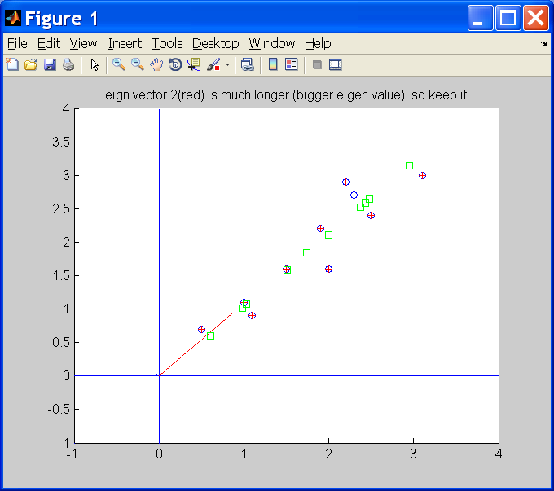
What is the meaning of reconstruction?
Squares=
Transformed values
X=T_approx*X’
x’1 x’2
0.8280 0
-1.7776 0
0.9922 0
0.2742 0
1.6758 0
0.9129 0
-0.0991 0
-1.1446 0
-0.4380 0
-1.2238 0
‘+’=Transformed values
X=T_approx*X’
x’1 x’2
0.8280 -0.1751
-1.7776 0.1429
0.9922 0.3844
0.2742 0.1304
1.6758 -0.2095
0.9129 0.1753
-0.0991 -0.3498
-1.1446 0.0464
-0.4380 0.0178
-1.2238 -0.1627
Reduced data
( 1 column)
Coordinates:
x’1,x’2
x2
x’1
X_data_adj =
X=Xo-mean(Xo)=
=[x1 x2]=
[0.6900 0.4900
-1.3100 -1.2100
0.3900 0.9900
0.0900 0.2900
1.2900 1.0900
0.4900 0.7900
0.1900 -0.3100
-0.8100 -0.8100
-0.3100 -0.3100
-0.7100 -1.0100]
Mean is (0,0)
x’2
Error
(small)
‘o’ are original
true values
‘o’ and + overlapped 100%
x1
Original data
2 columns
Coordinates: x1,x2

Slide 53
‘O’=Original data
‘’=Recovered using one eigen vector that has the biggest eigen value
(principal component)
Some lost of information
‘+’=Recovered using all Eigen vectors
➔ Same as original , so no lost of information
eigen vector with large eigen value (red)
eigen vector with small eigen value (blue, too small to be seen)

Slide 54
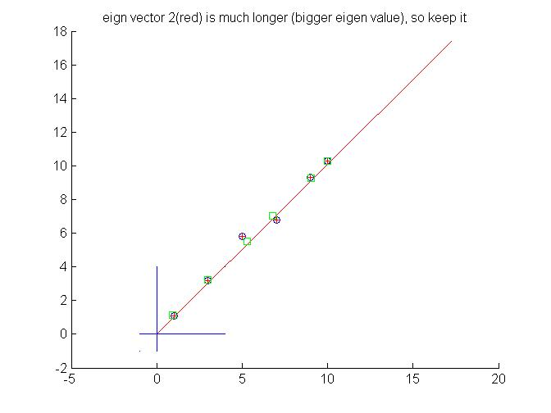
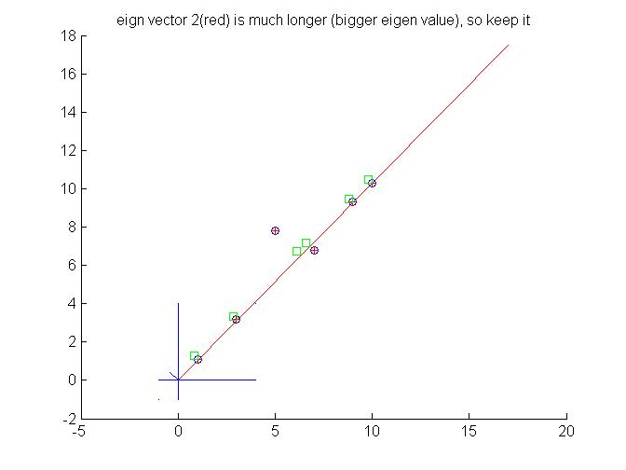
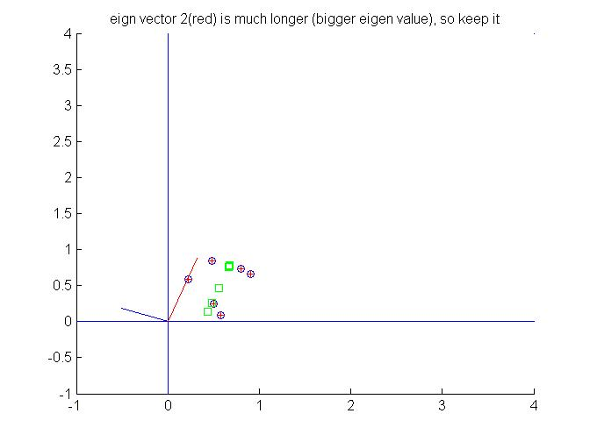
Some other test results using pca_test1.m (see appendix) Left) When x,y change together, first Eigen vector is larger than the second one. Right) Similar to the left case, however, a slight difference at (x=5.0, y=7.8) make the second Eigen vector a little bigger
x=[1.0 3.0 5.0 7.0 9.0 10.0]’
y=[1.1 3.2 5.8 6.8 9.3 10.3]'
x=[1.0 3.0 5.0 7.0 9.0 10.0]'
y=[1.1 3.2 7.8 6.8 9.3 10.3]'
x=rand(6,1);
y=rand(6,1);
Correlated data , one Eigen vector is much larger than the second one (the second one is too small to be seen)
Correlated data , with some noise: one Eigen vector is larger than the second one
y
y
y
Random data,
Two Eigen vectors have similar lengths
x
x
x

